Slide 1
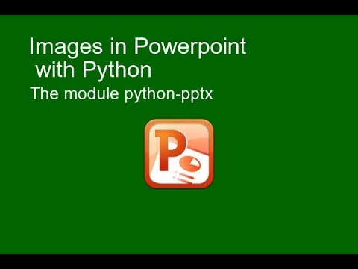
Notes:
These are the speaker notes for the first slide.

