Slide 1
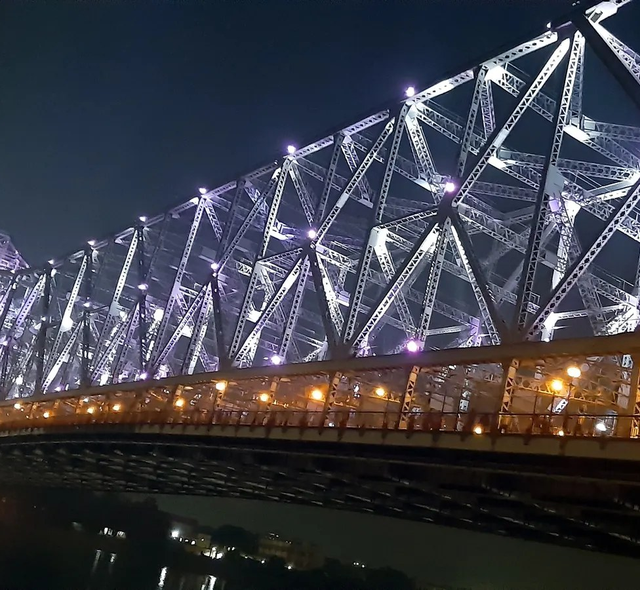

থামিয়ে নয়,
সামলে।
Keep Kolkata moving.
One live picture of Kolkata's roads, rain and crowds for the traffic police, KMC, disaster response and ambulance (108) crews. The AI proposes; a named officer decides.
Open source (MIT) · runs on one on-premises AI computer · github.com/shubro18202758/sahoshi
Reference photo · not live · Dr. Moumita Sahana · CC BY-SA 4.0 · Wikimedia Commons

Slide 2
THE PROBLEM
Kolkata loses its roads to the same few shocks, every year
251.6 mm
of rain in 24 h on 22–23 Sep 2025 — the heaviest in about four decades; roads went under within the hour, 8–12 people died, most by electrocution in waterlogged streets (IMD; Reuters/PTI).
High tide
closes the outfall gates on the Hooghly — the same rain waterlogs far faster when it meets a high tide.
10,000+
police a day on Durga Puja duty, about 30% on traffic, with ad-hoc one-ways and goods-vehicle bans (Kolkata Police, 2025).
≈ 1 lakh
vehicles a day on Howrah Bridge alone; one breakdown cascades across both banks.
15–45 min
corridor freezes for VIP movements between Nabanna, the city and the airport.
One picture missing
traffic police, KMC, WBSDMA, the power utility and ambulance (108) each hold a piece — coordination runs on phone and radio.
Sahoshi · সাহসী · Kolkata
2

Slide 3
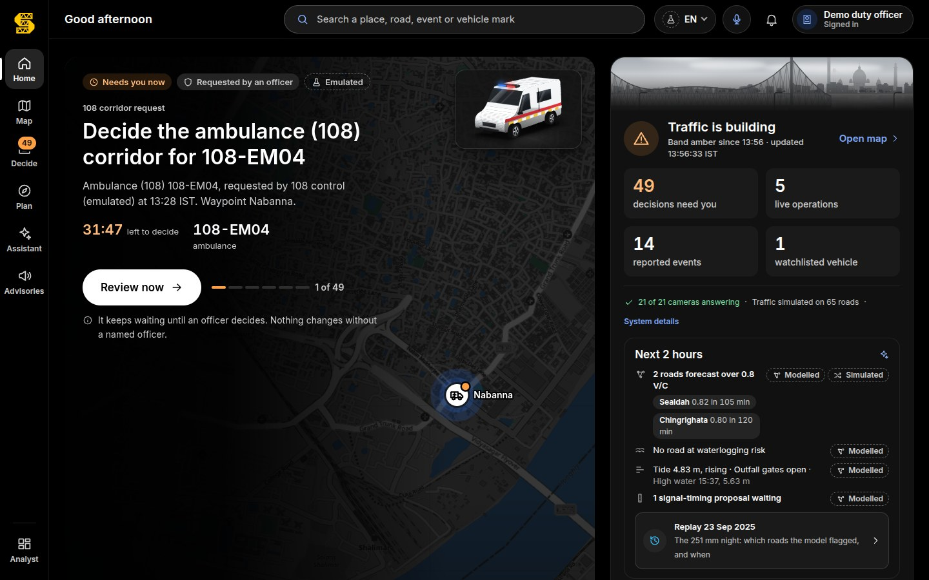
SAHOSHI
See · Decide · Act — one shared, Bengali-first picture
See
Roads, live traffic, rain, the Hooghly tide, pumps, IMD/NDMA alerts, Bengali and English news, field reports spoken in Bengali, camera road state — on one map.
Look ahead
Corridor congestion forecast 15–120 min ahead with uncertainty; a waterlogging nowcast ranks every road by risk with its lead time.
Decide
One proposal at a time with what changes if approved: a diversion, a signal-timing change tested in a traffic twin, a rolling hold instead of a freeze, an ambulance window, a live-wire hazard request.
Act
A named officer approves or rejects — nothing acts on its own; no answer, the plan holds. Advisories go out in বাংলা, English and हिंदी, read aloud.
Sahoshi · সাহসী · Kolkata
3

Slide 4
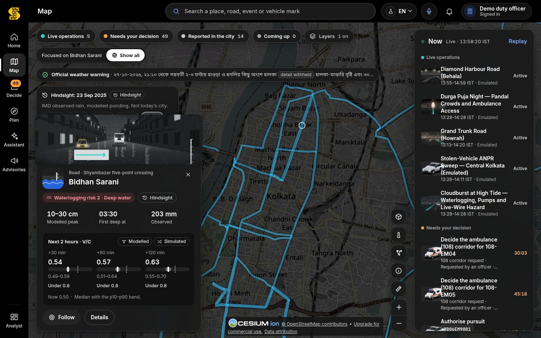
THE LIVE MAP
Waterlogging risk and the next two hours, on every road
Rain × tide × terrain × pumps
Rain: Open-Meteo, LIVE. Tide: Hooghly model at Garden Reach, MODELLED. Terrain: Copernicus 30 m DEM and OSM drains. Pumps: KMC FFEWS adapter, EMULATED until access.
Risk class 0–3 per road, depth band, lead time to deep water — and the drivers behind it, each labelled.
Forecast
Chronos-2 forecasts every corridor 15–120 min ahead with p10–p90 bands; crossings of 0.8 V/C become diversion proposals before the queue forms. SIMULATED traffic until Kolkata traffic is recorded.
Sahoshi · সাহসী · Kolkata
4

Slide 5
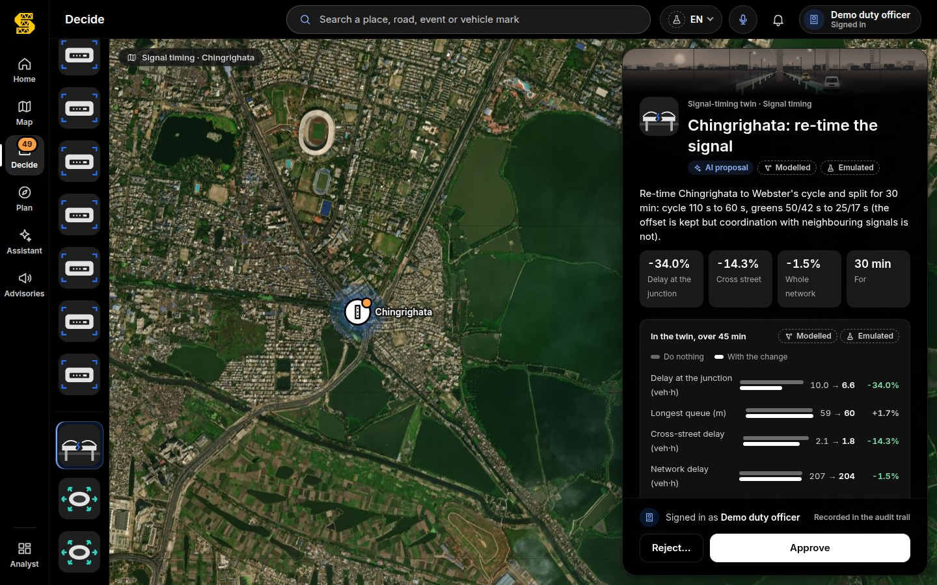
DECIDE
The AI proposes. A named officer decides.
Tested before it is shown
Every signal-timing proposal is simulated in a cell-transmission traffic twin of Kolkata against doing nothing: delay, queues, cross streets, the whole network. It is offered only if it helps without moving the jam.
Accountable
Evidence, what changes, confidence and assumptions on every card. Approve or reject is recorded with the officer's name. No answer: the current plan holds.
Explained in two languages
A local language model writes the rationale in English and Bengali; any number not in the twin's metrics is rejected.
Sahoshi · সাহসী · Kolkata
5

Slide 6
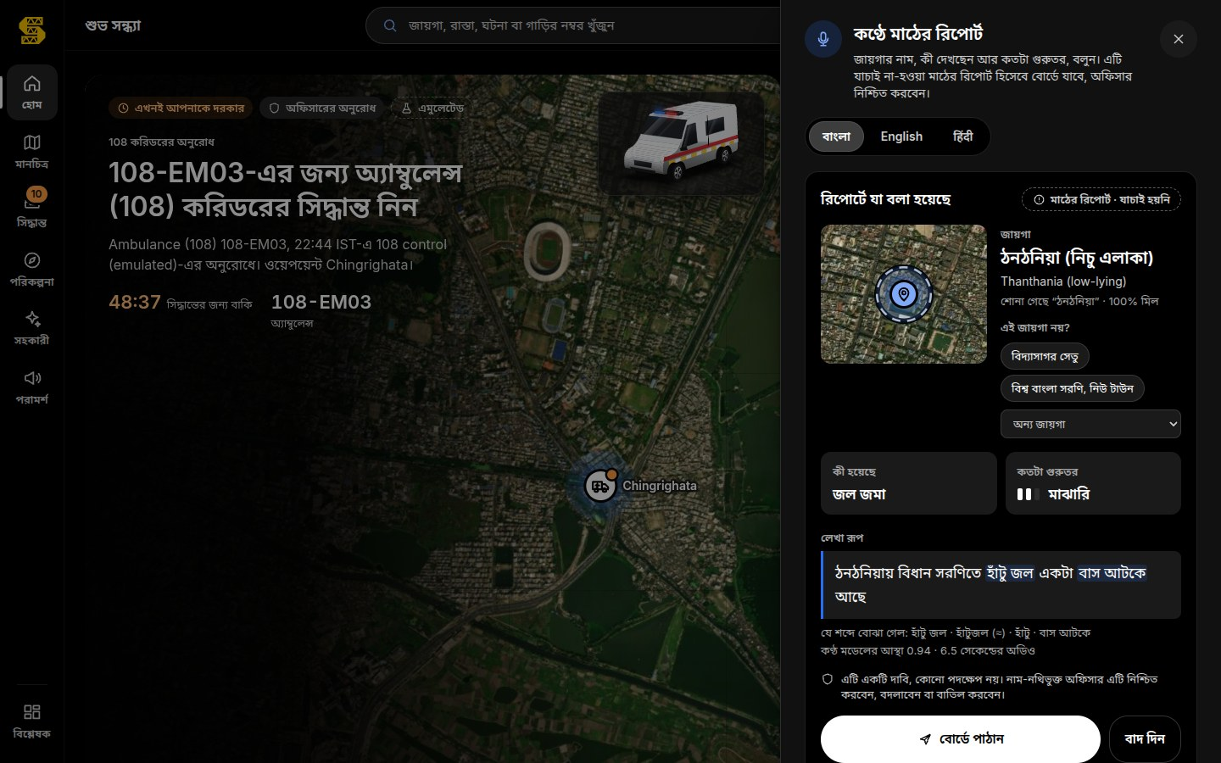
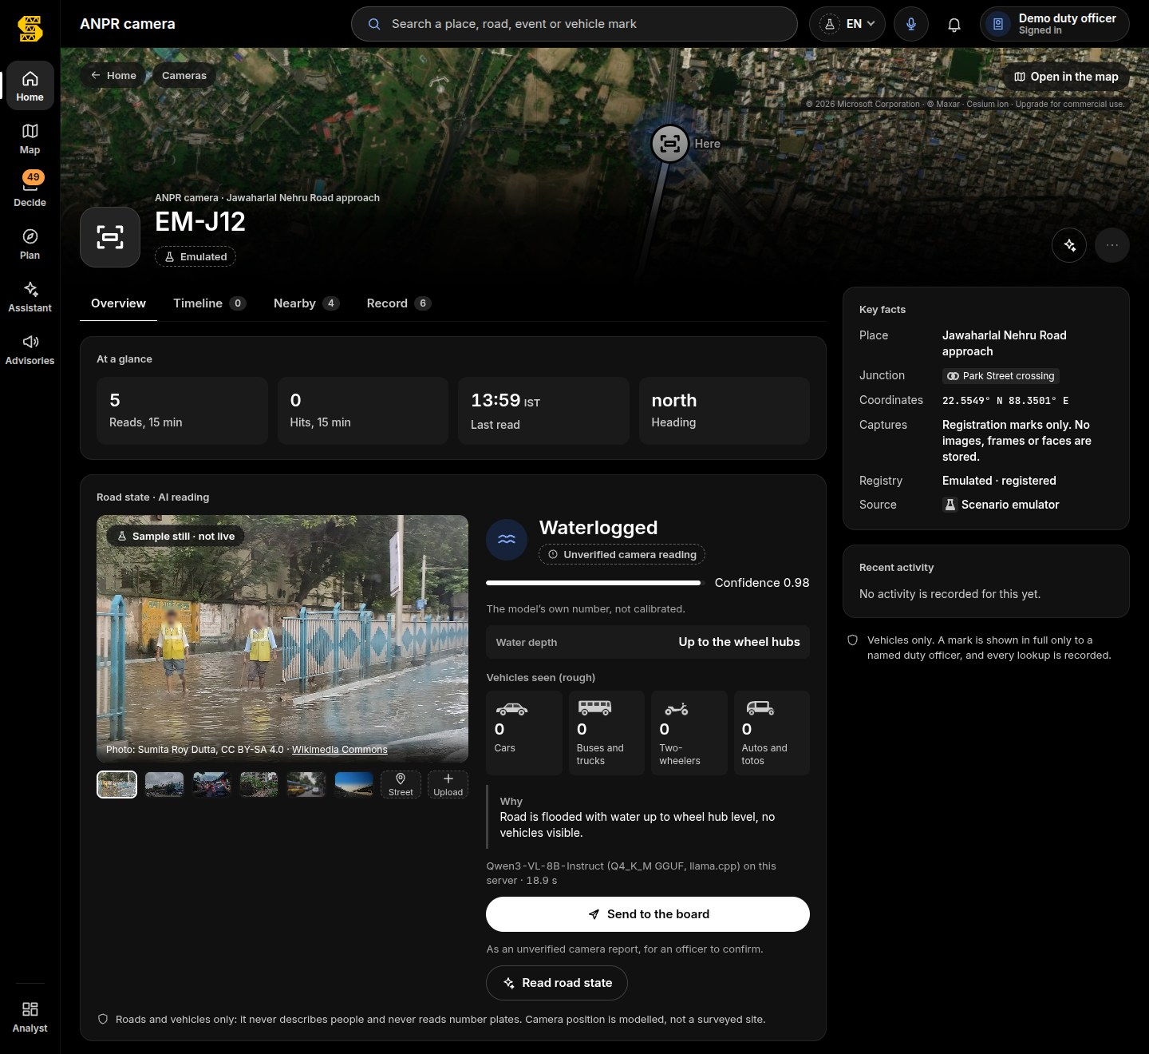
FROM THE FIELD
Bengali voice reports and camera road state
An officer speaks in Bengali; the on-premises speech model returns place · kind · severity with the transcript — an unverified field report for a named officer to confirm. Audio is not stored.
Qwen3-VL reads waterlogged / blocked / tree-fall / stalled bus / clear — roads and vehicles only. It refuses any question about people and never reads plates.
Sahoshi · সাহসী · Kolkata
6

Slide 7
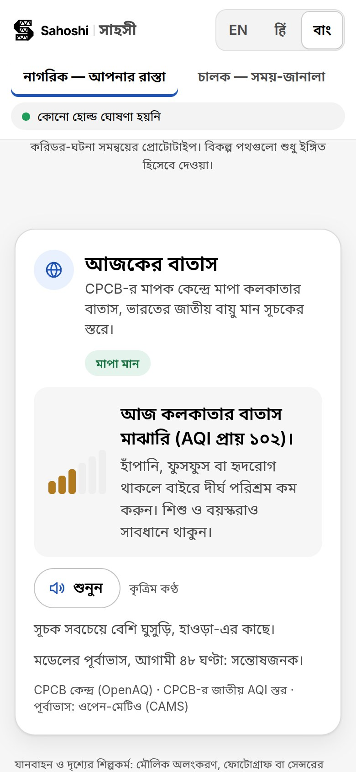
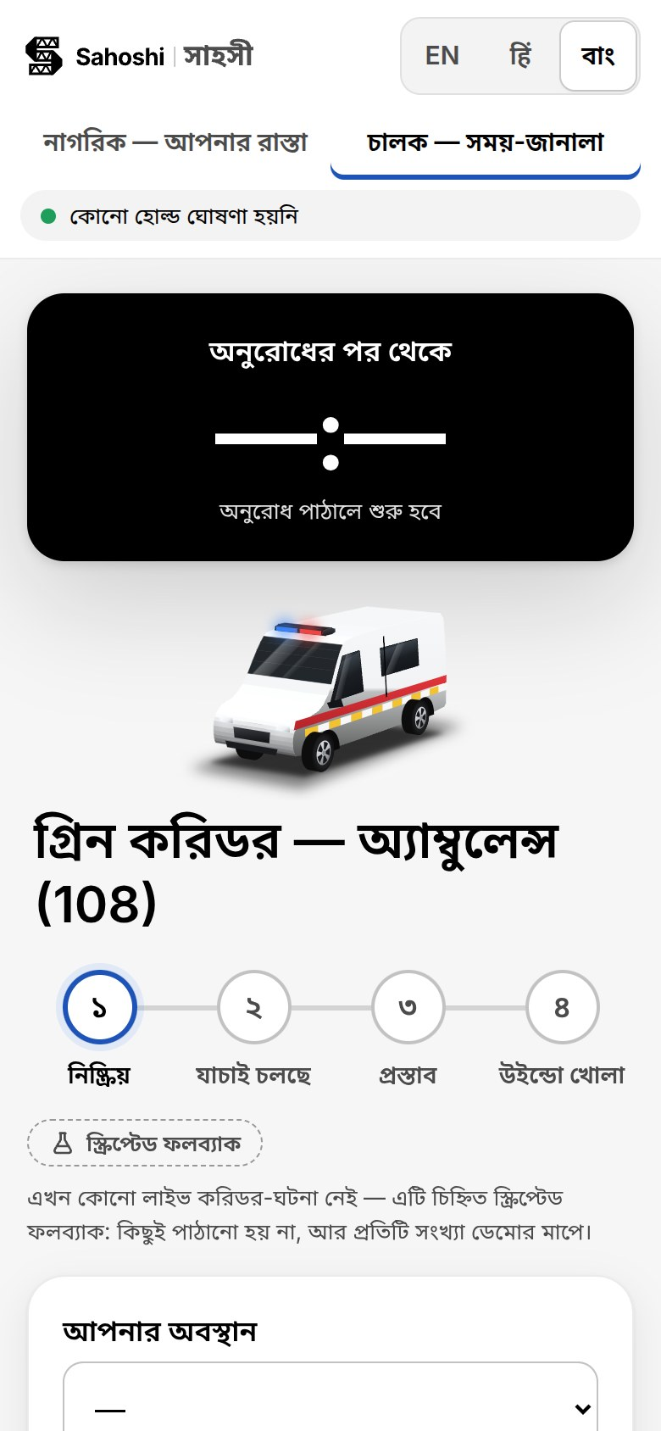
FOR CITIZENS
Check your road — in বাংলা, read aloud
Plain words, own language
Waterlogging on your road, the tide and the rain, holds and diversions — in বাংলা, English and हिंदी, with a Listen button (synthetic voice).
Honest by design
Anything simulated or emulated says so; an officer's unverified report never reaches the public page.
Ambulance (108) crews
A one-tap green-corridor request that a named duty officer approves.
Sahoshi · সাহসী · Kolkata
7

Slide 8
OPEN, ON-PREMISES AI
2025–26 open models on one control-room computer
Forecast
Chronos-2 (Apache-2.0)
Zero-shot corridor forecasts; error 55% below the seasonal baseline in backtest (SIMULATED history)
Waterlogging
Rain × tide × DEM × pumps
Replay of 22–23 Sep 2025 on IMD-observed rain: 13 of 13 reported places flagged
Signal twin
Cell-transmission model + Webster / max-pressure
Shockwave speed within 0.2% of theory; a 30-min city run in 0.12 s
Speech
Bengali Whisper + Indic Parler-TTS (Apache-2.0)
11.2% word error, place 55/60; voice: places 60/60 (round trip)
Vision
Qwen3-VL-8B (Apache-2.0)
11 of 12 road states right; 9 of 9 refusal probes refused
Decision
pplx-decider-v1.2 (27B) + Gemma 4
Typed answers in 1.0 s; 22 of 26 labelled Kolkata decisions; an officer approves every action
No data leaves the control room; it keeps working when the internet fails in a cyclone. No licence fees.
Sahoshi · সাহসী · Kolkata
8

Slide 9
EXPECTED IMPACT · MODELLED
Delay grows with the square of a freeze — so rolling holds change everything
100×
less junction-freeze delay (central case; range 25×–506×)
357,188 → 3,572
commuter-minutes per VIP movement on the Nabanna → airport corridor (13 junctions, 29 km)
≈ 33,000
golden-hour minutes a year returned to ambulance (108) trips
45–120 min
warning before a road goes under (2025 replay, IMD rain)
Model outputs on Kolkata's OpenStreetMap network under stated assumptions (IMPACT_REPORT.md) — not field measurements, and never a claim about lives saved.
Sahoshi · সাহসী · Kolkata
9

Slide 10
GUARDRAILS
Built to strengthen public institutions — safely
Vehicles only
No faces, no persons, no tracking of individuals. Number plates stay masked until a named duty officer is on duty.
Human in charge
The AI only proposes. A named officer approves every action; with no answer, the current plan holds. Every decision is audited.
Honest labels
LIVE, MODELLED, SIMULATED, EMULATED — on every number and every feed that is not yet connected.
Events, not people
News and social signals are aggregate, about places and situations; posters are never stored or scored.
Fair enforcement
No e-challan can be approved against a theft victim; penalties are recommendations a human reviews.
Data stays home
On-premises, retention limits, in the spirit of the DPDP Act 2023.
Sahoshi · সাহসী · Kolkata
10

Slide 11
IMPLEMENTATION
A 12-month pilot through one monsoon and one Durga Puja
Month 0–1
Read-only data MoU: Kolkata Traffic Police, KMC (FFEWS), WBSDMA, ambulance (108); nodal officers named.
Cost
Pilot, 12 months: ≈ ₹45–55 lakh
Two on-premises AI units ₹8–10 lakh · engineering ₹29 lakh · optional sensors ₹4 lakh · training ₹2 lakh · 15% contingency.
City-wide, two years: ≈ ₹2–2.5 crore
Running cost ≈ ₹40–60 lakh a year.
Software licences: ₹0
Open models, OpenStreetMap, Sahoshi under MIT — existing CCTV, control rooms and FFEWS sensors are reused.
Month 1–2
Install the on-premises unit; City Pack finalised for the pilot division; adapters switched from EMULATED to LIVE.
Month 2–4
Shadow mode: Sahoshi proposes, officers work as usual; weekly comparison.
Month 5–12
Live pilot (e.g. Esplanade – Park Street – Rashbehari – Gariahat) through the monsoon and Puja; officers approve.
Month 12
Independent review; city-wide roll-out over the next year.
Sahoshi · সাহসী · Kolkata
11

Slide 12
SCALABILITY
A city is a folder
The engine — live picture, forecasting, nowcast, voice, vision, decision loop, console — is the same everywhere. A City Pack holds what differs: the OpenStreetMap extract and corridors, gazetteer, agencies and emergency numbers, plate format, UI languages, local scenarios and impact parameters.
The prototype proves it: it was first built for another Indian city, and the same build tools now produce Kolkata; a test builds both.
Per district: about 1–2 weeks of local data work, local adapters (CCTV, signals, flood sensors) and local SOPs. The software, models and hardware stay the same.
Howrah · Bidhannagar
already inside the Kolkata pack
Siliguri
gateway to the North-East; NH10/NH31 choke-points
Asansol–Durgapur
industrial corridor
Patna · Ranchi
Bihar and Jharkhand; Hindi already first-class
Sahoshi · সাহসী · Kolkata
12

Slide 13
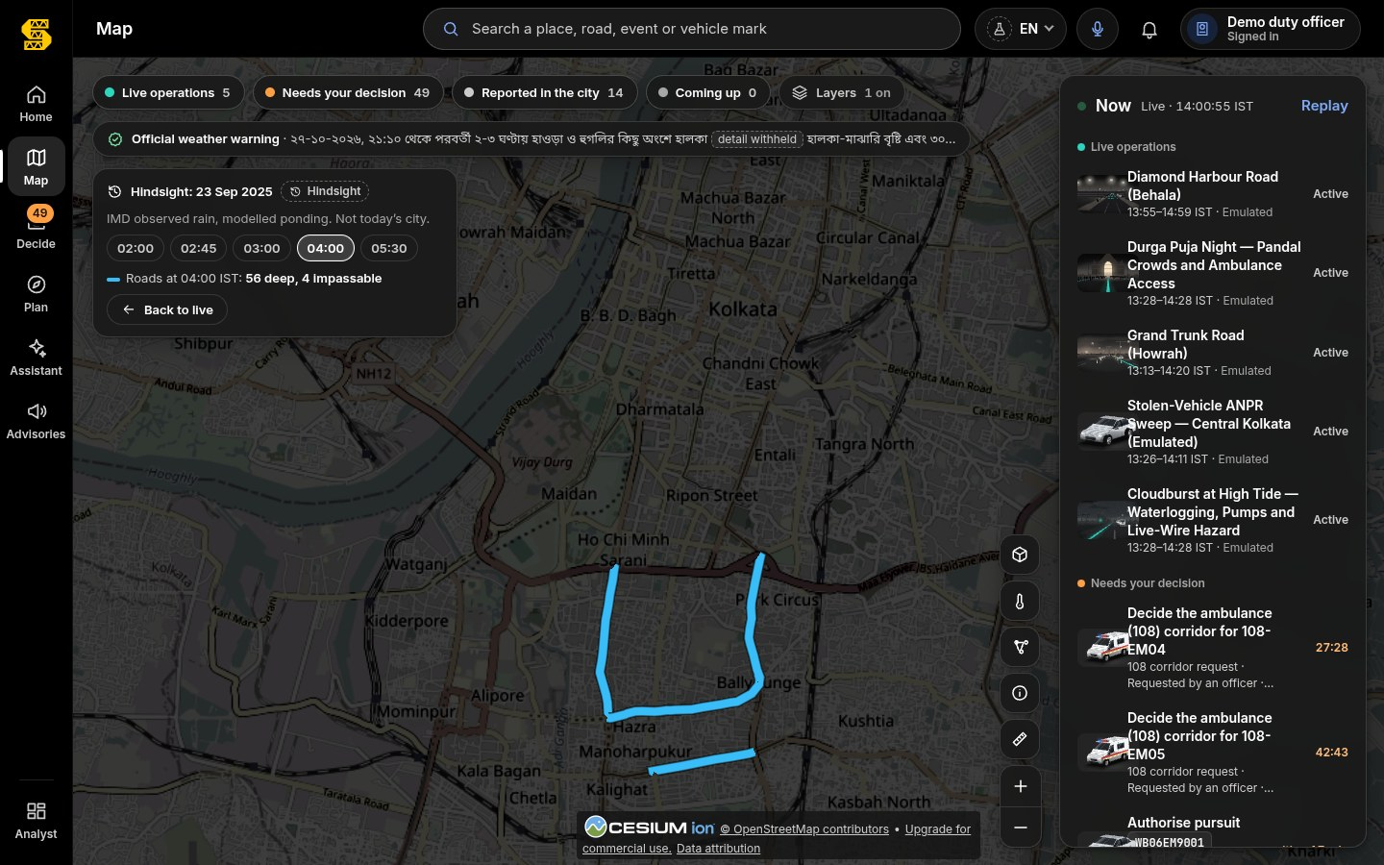
EVIDENCE
It runs today
Working prototype
Console, citizen and driver pages, five AI services and the traffic twin, on one on-premises unit.
Real Kolkata roads
49 junctions, 65 road segments, 125 km from OpenStreetMap; the Nabanna → airport route is 29 km.
Thousands of automated tests
Python suites, the console's unit and browser tests, contract replays and Rust tests — run on every change.
Open source
github.com/shubro18202758/sahoshi — setup, technical design, sample data and test cases.
Replay of 22–23 Sep 2025 on IMD-observed rain (OBSERVED rain, MODELLED ponding): every news-reported waterlogged place on the network was flagged — the night almost the whole city flooded.
Sahoshi · সাহসী · Kolkata
13

Slide 14
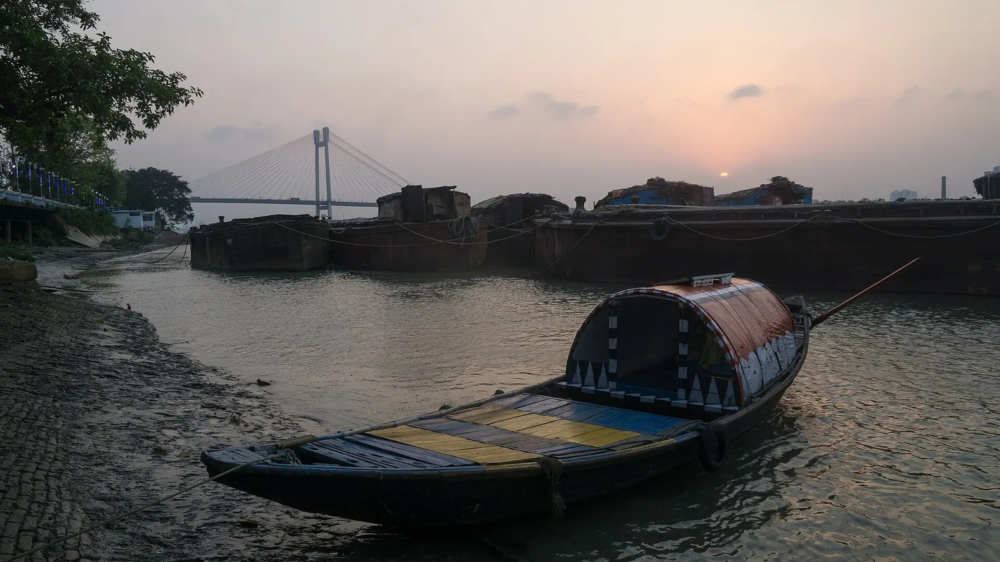

ধন্যবাদ
Thank you
github.com/shubro18202758/sahoshi
Reference photo · not live · Alexey Komarov · CC BY-SA 4.0 · Wikimedia Commons

