Slide 1
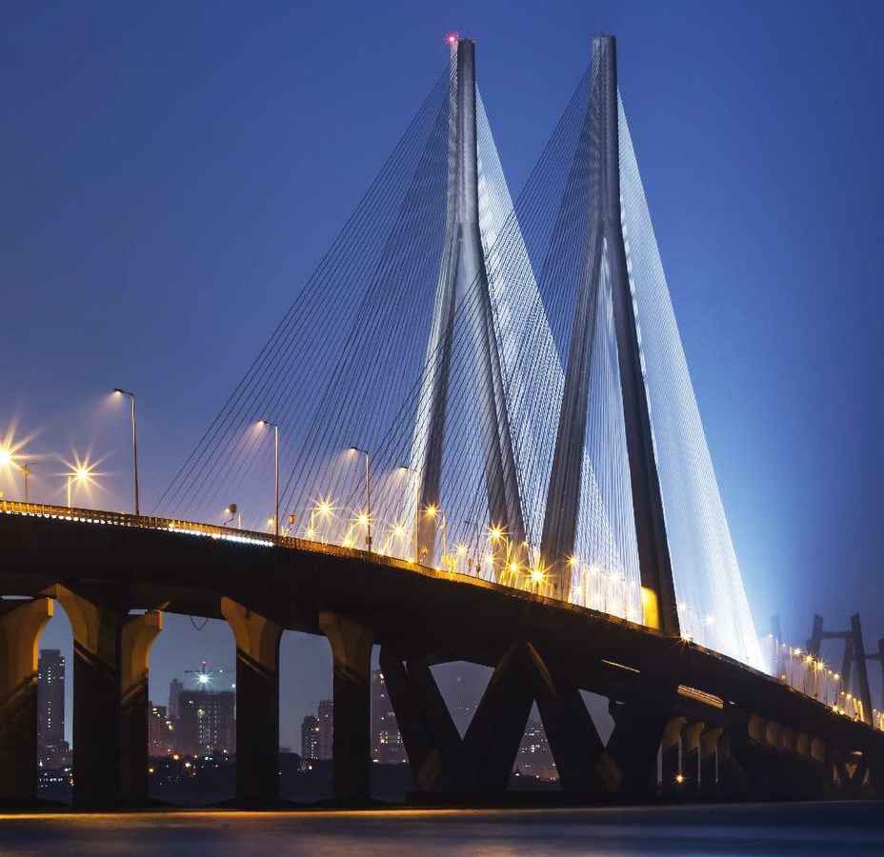

Not by stopping.
By steering.
For the city that never stops.
One live picture of Mumbai's roads, rain, tide and crowds for Mumbai Traffic Police, the BMC and its 1916 disaster control, ambulance (108) crews and BEST. The AI proposes; a named officer decides.
Sajag (सजग): Hindi and Marathi for “alert, watchful”.
Open source (MIT) · one on-premises AI computer · github.com/shubro18202758/sajag
Reference photo · not live · Bandra–Worli Sea Link at dusk · yatriksheth · CC BY-SA 4.0 · Wikimedia Commons

Slide 2
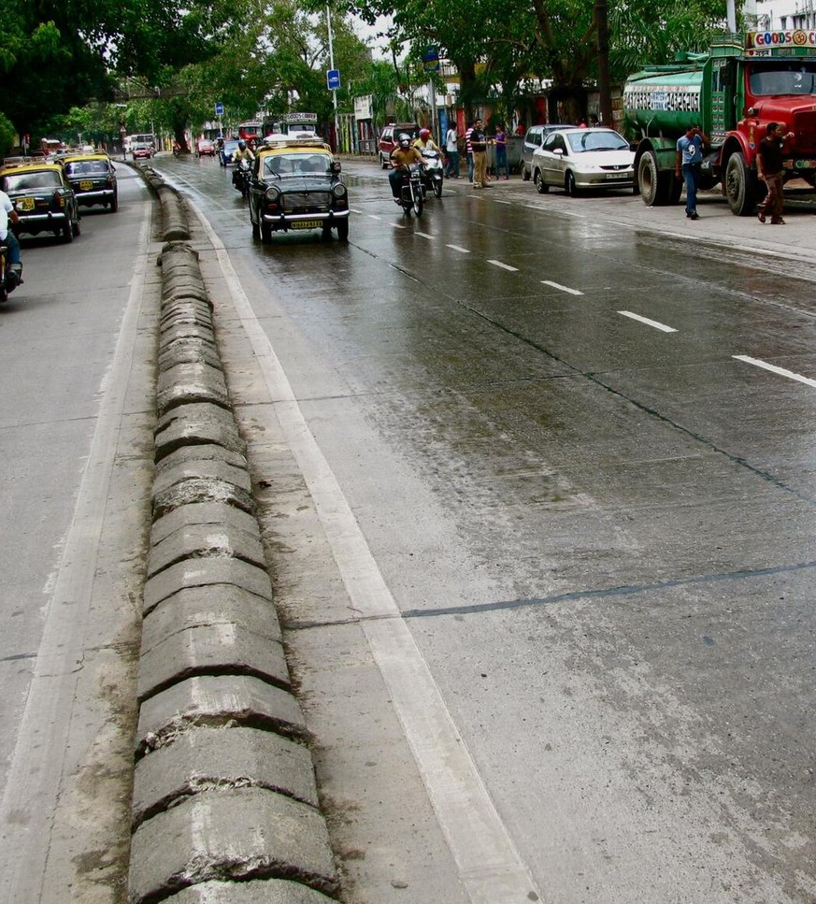
THE PROBLEM
Rain at high tide, and Mumbai stops
≈ 4.5 m tide
A heavy burst at a high tide of about 4.5 m closes the sea outfalls. The water has nowhere to go.¹
386–498 spots
Hundreds of known flooding spots, by year: Hindmata, King's Circle, Sion, Kurla, Parel, Andheri and Milan subways.²
26 May · 18–19 Aug 2025
The earliest onset in decades flooded a new Metro station; in August Santacruz logged ~207–238 mm in 24 h, the Mithi reached ~3.9 m against a 4 m danger mark and Andheri Subway shut.³
~68 lakh riders a day
ride the suburban locals. When tracks flood at Sion and Kurla, they pour onto roads and station forecourts.⁴
~126 hours
lost to peak-hour traffic in 2025; rush hour runs at ~17–21 km/h; 18th most congested city in the world.⁵
53 roads
under restrictions on a visarjan night, Lalbaug to Girgaon Chowpatty, while emergencies still need a way through.⁶
Reference photo · not live · Monsoon rain on Tulsi Pipe Road (Senapati Bapat Marg) · Satish Krishnamurthy from Bombay, India · CC BY 2.0 · Wikimedia Commons
Sources: ¹ BMC chief engineer via Free Press Journal (2025); India TV explainer (27 May 2025). ² BMC counts via Free Press Journal (386 chronic spots; 453 → 498 waterlogging spots in a later report). ³ IMD; Free Press Journal; The Statesman; HT (May and Aug 2025). ⁴ Central and Western Railway data via Free Press Journal (2025-26 average). ⁵ TomTom Traffic Index 2025. ⁶ The Statesman (2024).
Sajag · Mumbai · Not by stopping. By steering.
2

Slide 3
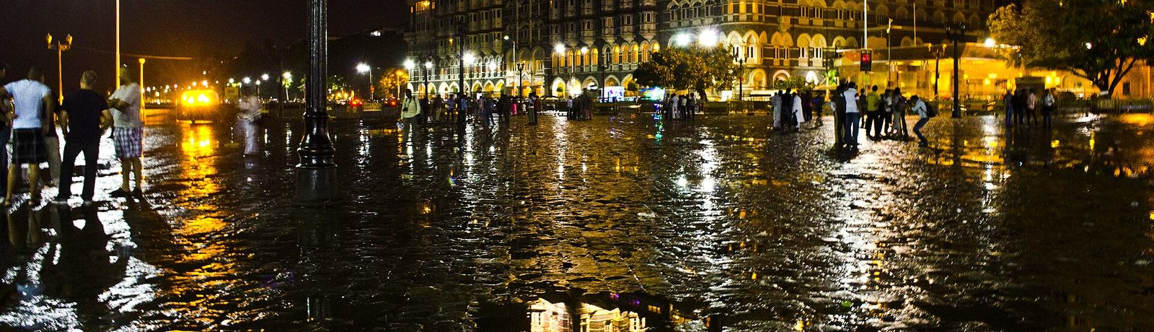
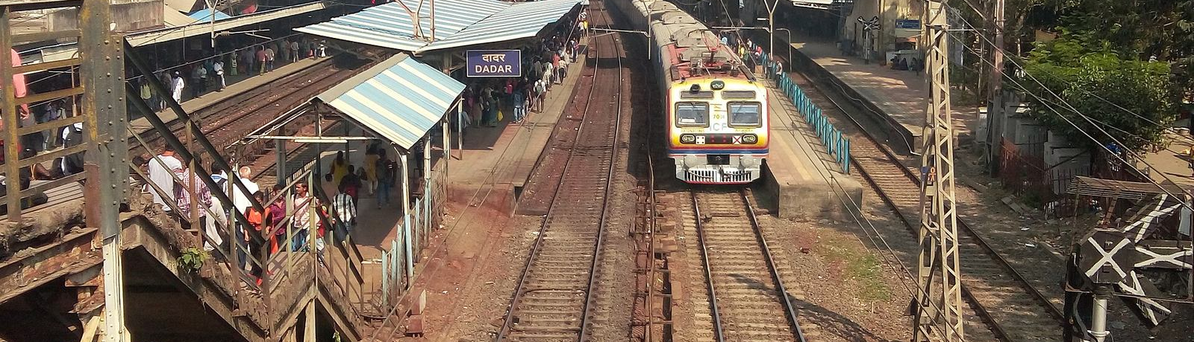
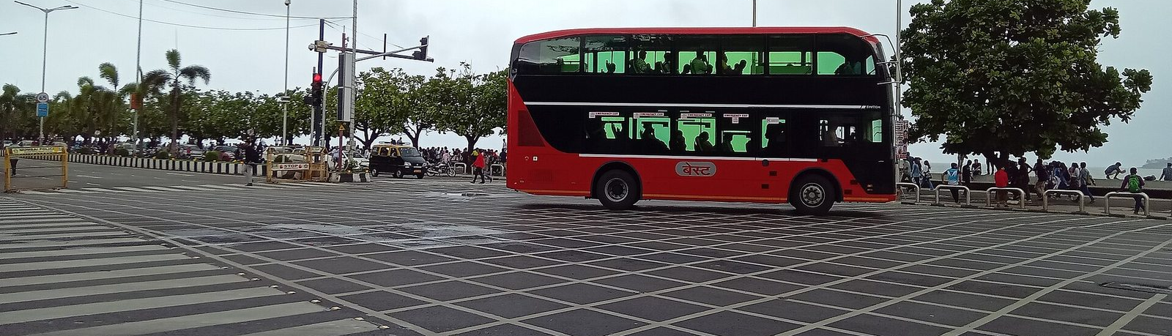
TODAY
Every agency sees one piece
Mumbai Traffic Police
Sees Roads, signals, junctions and cameras.
Acts Diversions, holds, closures.
BMC · 1916
Sees Drains, storm-water pumps, waterlogging and tree-fall calls.
Acts Pumps, crews, civic alerts.
Central and Western Railway
Sees Tracks and trains.
Acts Suspensions and platform announcements.
Ambulance (108)
Sees Its own vehicles and calls.
Acts Needs a clear road to KEM, Sion, JJ or Nair.
IMD Mumbai
Sees Rain at Santacruz and Colaba, radar, warnings.
Acts Nowcasts and colour-coded alerts.
Nobody holds one live picture that joins rain × tide × pumps × traffic × crowds and says what to do in the next 30–90 minutes.
The same gap shows on visarjan nights, at Wankhede egress, during protected movements and when a bridge or highway breaks down. Coordination runs on phone and radio.
Reference photo · not live · Rain on the road at Apollo Bunder · Debjyotiarr · CC BY-SA 3.0 · Wikimedia Commons
Reference photo · not live · A suburban local at Dadar · Tiven2240 · CC BY 3.0 · Wikimedia Commons
Reference photo · not live · A BEST double-decker on Marine Drive · Meghdhanu · CC BY-SA 4.0 · Wikimedia Commons
Sajag · Mumbai · Not by stopping. By steering.
3

Slide 4
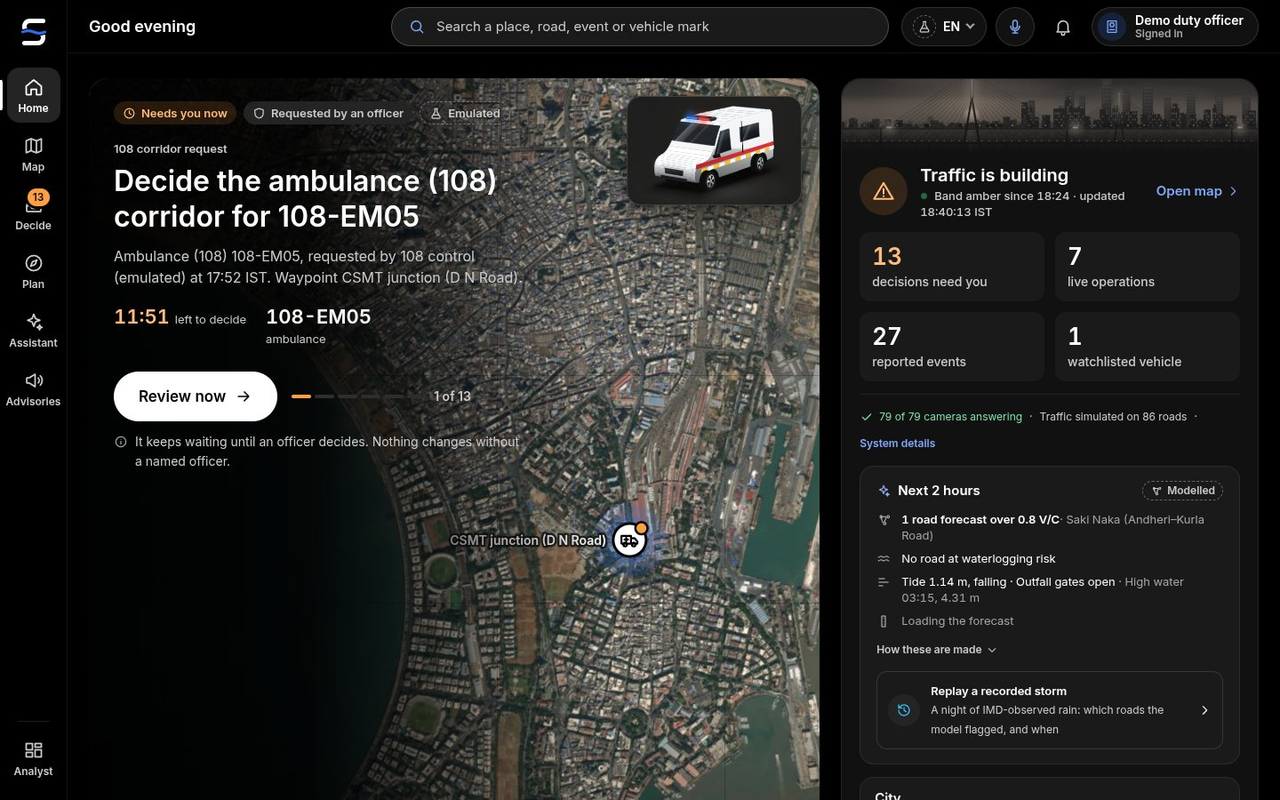
SAJAG
One live picture. One decision loop.
1 See
Roads and live traffic, rain, the Apollo Bunder tide, BMC pumps, IMD and NDMA alerts, Mumbai news (aggregate), field reports and camera road state, on one map.
2 Look ahead
Each corridor 15–120 min ahead with uncertainty bands; a waterlogging nowcast ranks every road and subway by risk and lead time.
3 Decide
One proposal at a time, with what changes if approved: a diversion, a signal plan tested in a traffic twin, a rolling hold, a green corridor, a request to BMC.
4 Act
A named officer approves or rejects; nothing acts on its own. No answer: the current plan holds. Advisories go out in English, Marathi and Hindi, read aloud.
The AI proposes. A named officer decides.
Every approval and rejection is recorded with the officer's name, the evidence and the time. If no one answers, nothing changes on the street.
Sajag · Mumbai · Not by stopping. By steering.
4

Slide 5
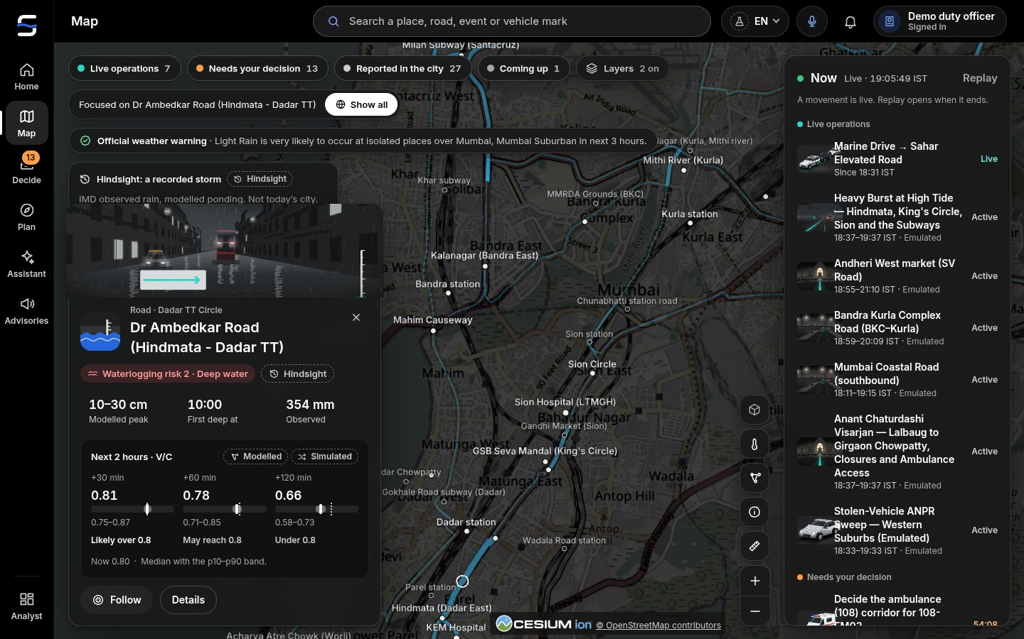
1 · RAIN × TIDE NOWCAST
Which road goes under next, 30–90 minutes ahead
Watched first
Hindmata, King's Circle, Sion, Kurla by the Mithi, Andheri Subway, Milan Subway, Parel.
The drivers, each labelled
Rain: Open-Meteo, LIVE (IMD where reachable). Tide: Apollo Bunder harmonic model, MODELLED. Terrain: Copernicus 30 m DEM and OSM drains. Pumps: BMC storm-water stations at Haji Ali, Irla, Love Grove, Cleveland Bunder, Britannia and Gazdarbandh, EMULATED until access.
Replayed on a real storm
18–19 August 2025: with the rain gauges' observed totals, the model flagged 9 of the 12 places reported flooded on its network (King's Circle, Andheri Subway, Gandhi Market, Byculla, Dadar TT, Vile Parle, Hindmata, Chembur, Kurla by the Mithi) and missed Sion, Khar and Goregaon. Its own flag came after the first news report at most places (median 51 minutes late: the bucket model fills slowly); with the observed rain as a perfect 2-hour nowcast (hindsight) it would have led the first report at 8 of the 9 (median 69 minutes). The Open-Meteo archive carried a third of the gauges' rain and flagged nothing, which is the case for a live rain-gauge feed. A second replay, 26 May 2025, flagged 5 of 15 reported places.
Sources: risk, depth and lead time are MODELLED from the drivers above; the replay uses observed rain for that date (IMD / Open-Meteo archive).
Sajag · Mumbai · Not by stopping. By steering.
5

Slide 6
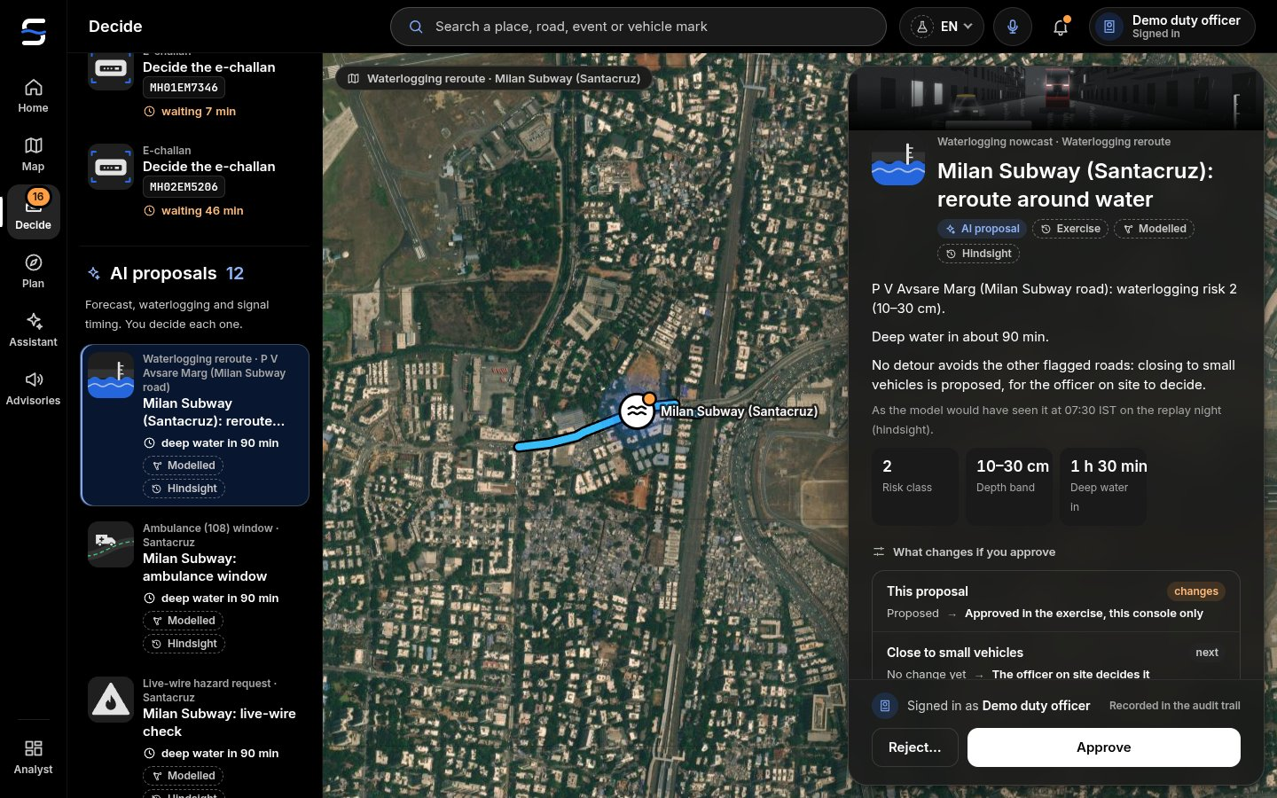
2 · DECIDE
One proposal at a time. A named officer decides.
Divert WEH traffic before Andheri Subway closes, onto routes the nowcast keeps dry.
Hold BEST routes that run through a flooding subway, with the diversion attached.
Green corridor for an ambulance (108) to KEM or Sion Hospital, junction by junction.
Ask BMC · 1916 for pumps at King's Circle when the station there is short.
Each card shows its evidence, what changes, confidence and assumptions. Approve or reject is logged with the officer's name.
Sajag · Mumbai · Not by stopping. By steering.
6

Slide 7
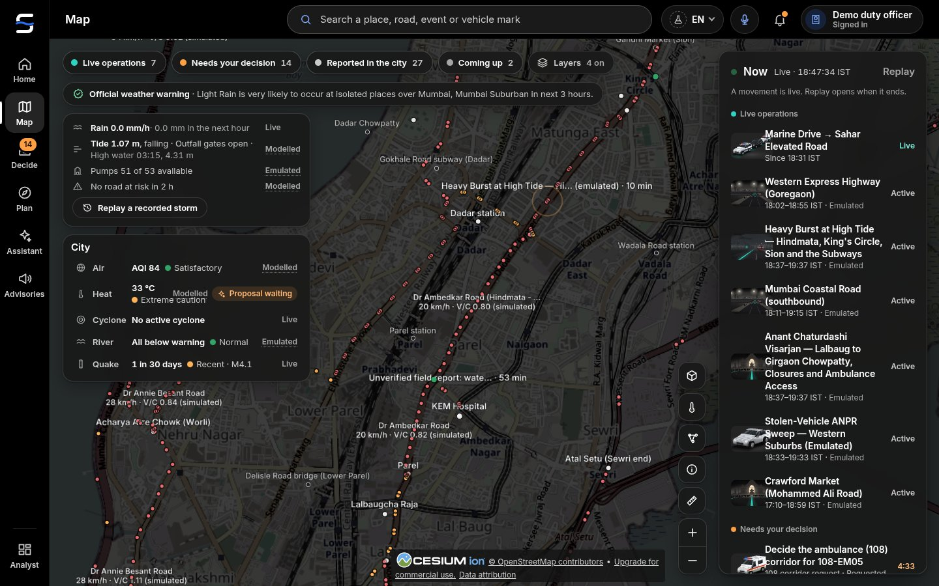
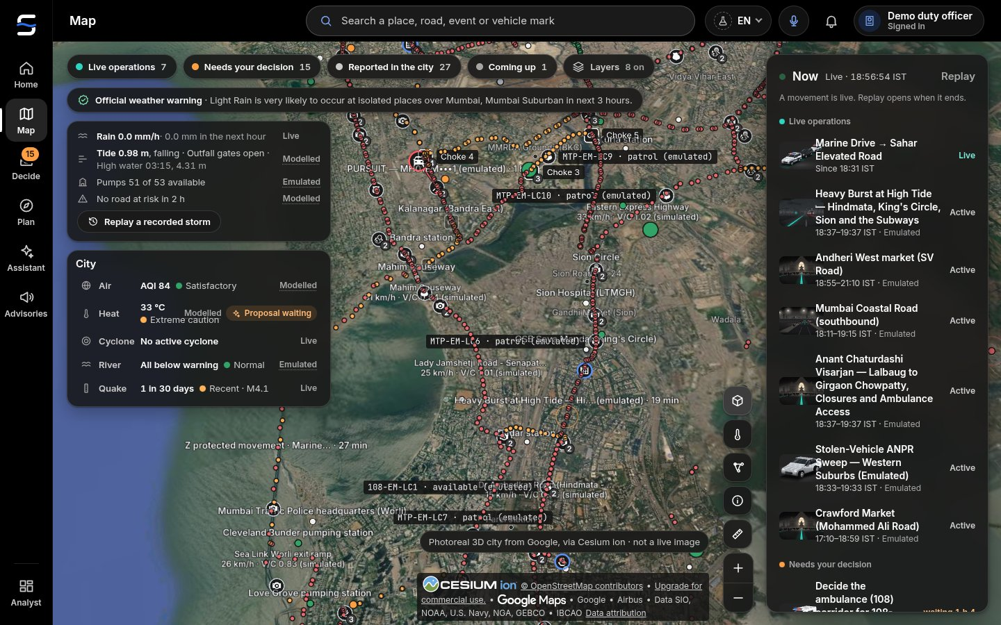
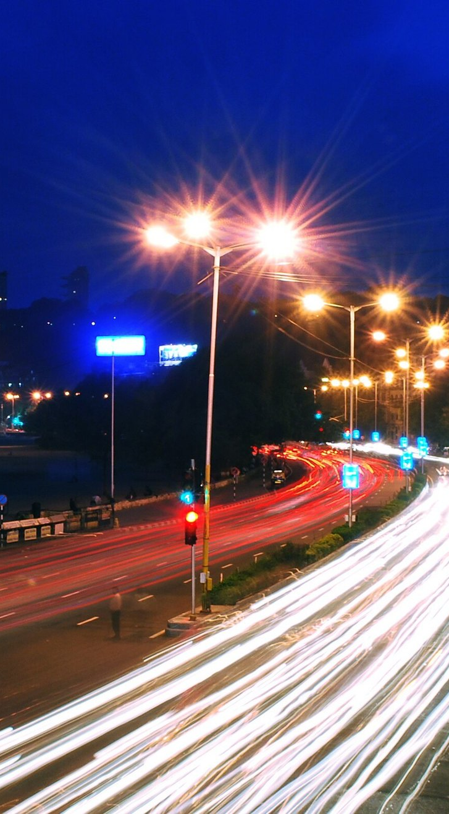
3 · TRAFFIC AHEAD · PROTECTED MOVEMENTS
The next two hours, and movements without a freeze
Two hours ahead, with bands
Chronos-2 forecasts every corridor 15–120 min ahead with p10–p90 bands. A signal change is tested in a traffic twin of Mumbai's roads first, and offered only if it helps without moving the jam. SIMULATED traffic until MTP detectors are connected.
Mantralaya → Mumbai Airport T2: rolling holds
Each junction is held for a couple of minutes just ahead of the convoy and released behind it, never a blanket freeze. On Sajag's network the route runs 27.6 km over 10 junctions.
Sources: route length and junction count from Sajag's OpenStreetMap network of Mumbai. Photo, right: Reference photo · not live · Evening traffic, South Mumbai · Abhijeet Rane from Bangalore, India · CC BY 2.0 · Wikimedia Commons.
Sajag · Mumbai · Not by stopping. By steering.
7

Slide 8
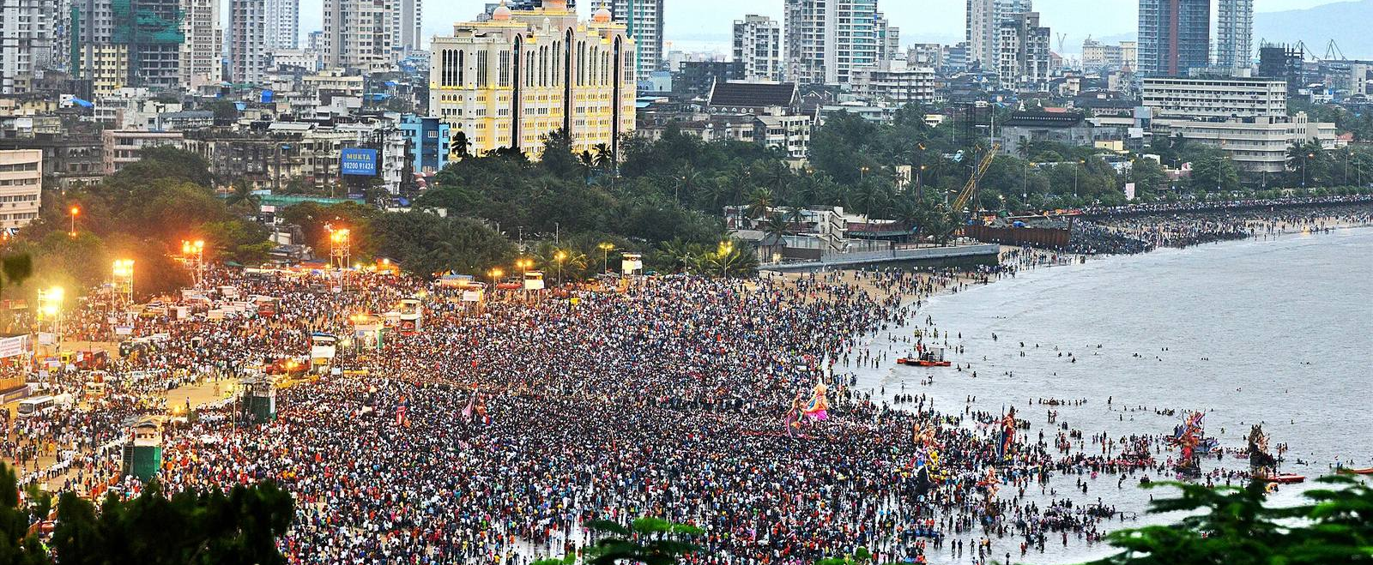
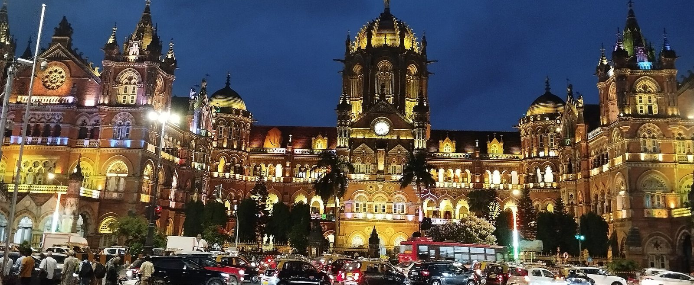
4 · CROWDS
Visarjan night and the station surge
Reference photo · not live · Visarjan crowd at Girgaon Chowpatty, 2019 · Swapnil Sakhare · CC BY-SA 4.0 · Wikimedia Commons
Reference photo · not live · CSMT and its forecourt at dusk · Dr. Raju Kasambe · CC BY-SA 4.0 · Wikimedia Commons
Lalbaug → Girgaon Chowpatty
Closures and one-ways on the procession roads, the crowd load at Girgaon Chowpatty, Juhu and Dadar Chowpatty, and an emergency corridor kept open through the night. Restrictions on 53 roads in 2024.¹ Crowd load is a SIMULATED scenario.
When the locals stop
Flooded tracks at Sion and Kurla push riders out at CSMT, Dadar, Kurla and Andheri. Sajag shows the forecourt load and proposes holds on turning traffic and extra BEST buses on the right roads. Rail running status is EMULATED.
Sources: ¹ The Statesman (2024 visarjan advisory).
Sajag · Mumbai · Not by stopping. By steering.
8

Slide 9
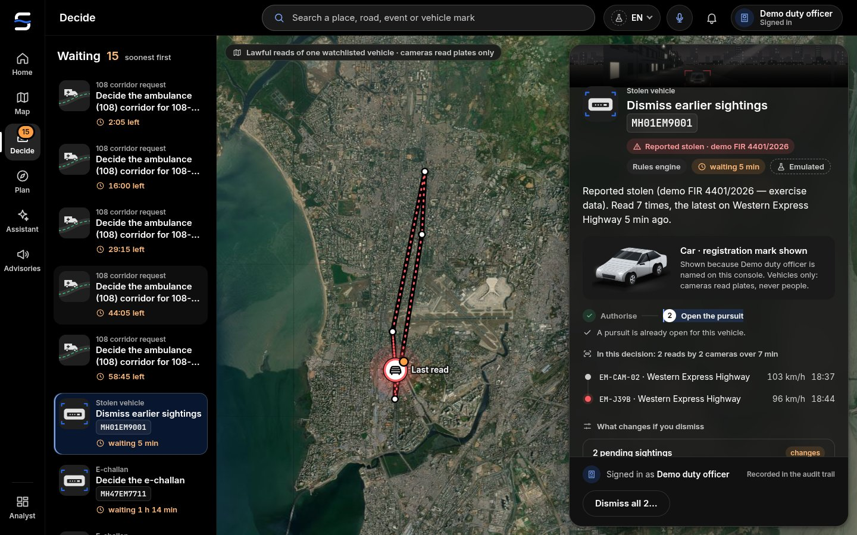
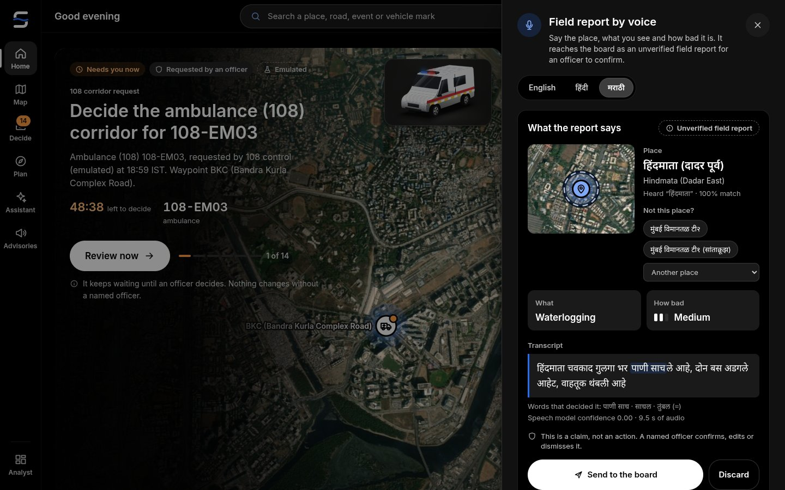
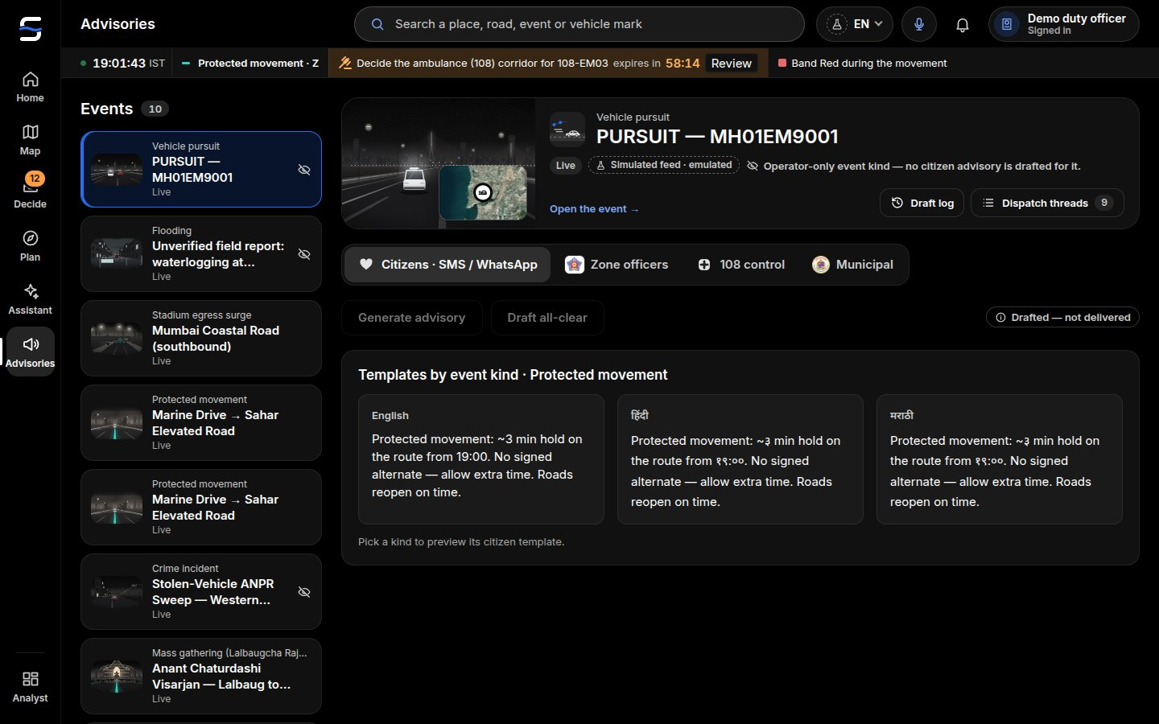
5 · VEHICLES · VOICE · ADVISORIES
A stolen car, a spoken report, an advisory in three languages
Stolen-vehicle chain
ANPR sightings (EMULATED) of a sample plate, MH 01 AB 1234, are linked into one chain for an officer. The plate stays masked until a named officer is on duty. No e-challan can be approved against a theft victim.
Voice field report
An officer speaks in Marathi, Hindi or English; the on-premises speech model returns place · kind · severity with the transcript, as an unverified report. Audio is not stored. Camera road state reads roads and vehicles only.
Advisories, read aloud
Plain words for citizens, in three languages, with a Listen button (synthetic voice):
Hindmata waterlogged; please use another route.
हिंदमाता येथे पाणी साचले आहे; कृपया पर्यायी मार्ग वापरा.
हिंदमाता में जलभराव है; कृपया वैकल्पिक मार्ग लें।
Sajag · Mumbai · Not by stopping. By steering.
9

Slide 10
TECHNOLOGY
Open models on one on-premises computer
Forecast
Chronos-2 (Apache-2.0)
Corridors 15–120 min ahead; error 55% below the seasonal baseline in backtest (SIMULATED history)
Waterlogging
Rain × tide × terrain × pumps
18–19 August 2025 replay: with the rain gauges' observed totals, the model flagged 9 of the 12 places reported flooded on its network (King's Circle, Andheri Subway, Gandhi Market, Byculla, Dadar TT, Vile Parle, Hindmata, Chembur, Kurla by the Mithi) and missed Sion, Khar and Goregaon. Its own flag came after the first news report at most places (median 51 minutes late: the bucket model fills slowly); with the observed rain as a perfect 2-hour nowcast (hindsight) it would have led the first report at 8 of the 9 (median 69 minutes). The Open-Meteo archive carried a third of the gauges' rain and flagged nothing, which is the case for a live rain-gauge feed. A second replay, 26 May 2025, flagged 5 of 15 reported places.
Signal twin
Cell-transmission model + Webster / max-pressure
Shockwave speed within 0.2% of theory; every signal proposal tested against doing nothing
Speech
IndicConformer 600M (Marathi, Hindi) · Whisper large-v3-turbo (English) · Indic Parler-TTS
Marathi WER 7.1 %, place right in 56 of 56; Hindi WER 14.0 %, 50 of 52 (IndicConformer, synthetic voices); English WER 10.2 % (Whisper turbo)
Vision
Qwen3-VL-8B (Apache-2.0)
11 of 12 stills right (10 taken in Mumbai); 11 of 11 person, plate and road probes passed
Decision
pplx-decider-v1.2 (27B) + Gemma 4
Typed answers in 1.0 s at p95; 22 of 26 labelled decisions on the Kolkata reference pack
No data leaves the control room; it keeps working when the internet fails in a cyclone. No licence fees.
It runs today: 69 gates green · 6,443 Python and 121 Rust tests · 46 console unit suites.
Sajag · Mumbai · Not by stopping. By steering.
10

Slide 11
HONEST BY DESIGN
Every number says what it is
LIVE
a real public feed: Open-Meteo rain, WAQI and OpenAQ air, NASA FIRMS, NDMA Sachet alerts for Maharashtra, IMD where reachable, Mumbai news (aggregate), OpenStreetMap.
Vehicles only
No faces, no persons, no tracking of individuals. Plates masked until a named officer is on duty.
EMULATED
a stand-in for an agency feed until access: BMC pumps and sensors, MTP signal controllers and detectors, ANPR, CCTV, 108 and fleet GPS, BEST and rail running status.
Human in charge
The AI proposes; a named officer approves every action; no answer, the plan holds; all audited.
SIMULATED
a scenario: traffic and crowds for an exercise or a demo.
Events, not people
News and social signals are aggregate and about places; posters are never stored or scored.
MODELLED
a computed estimate under stated assumptions: the tide, flood risk, impact.
Fair enforcement
No fine for a theft victim; penalties are recommendations a human reviews.
Reference photo · not live
a credited photo that shows a place, never the present.
Data stays home
On premises, with retention limits, in the spirit of the DPDP Act 2023.
Sajag · Mumbai · Not by stopping. By steering.
11

Slide 12
EXPECTED IMPACT · MODELLED
Delay grows with the square of a freeze
100× less
junction-freeze delay in the central case (range 25×–506×)
192,820 → 1,928
commuter-minutes per protected movement, Mantralaya → Mumbai Airport T2 (10 junctions, 27.6 km)
≈ 33,000 min a year
returned to ambulance (108) trips that cross a held corridor. Today: ~18.75 min to the patient in older Mumbai figures; 20–45 min at peak in Andheri, Kurla and South Mumbai.¹
median 69 minutes ahead of the first report with a perfect 2-hour nowcast (hindsight); median 51 minutes late on the bucket model alone
warning before a road goes under, in the 18–19 August 2025 replay
Sources: Model outputs on Sajag's Mumbai OpenStreetMap network (72 junctions, 86 segments, 202 km) under stated assumptions (IMPACT_REPORT.md): not field measurements, never a claim about lives saved. ¹ Context only: BW Healthcare World; The Bridge Chronicle (ranges as reported).
Sajag · Mumbai · Not by stopping. By steering.
12

Slide 13
PILOT
Twelve months, through one monsoon and one Ganeshotsav
Month 0–1
Read-only data MoU with Mumbai Traffic Police, the BMC (1916 disaster control, storm-water drains), Maharashtra SDMA and the ambulance (108) operator; nodal officers named.
Cost (planning estimates, not quotes)
Pilot, 12 months: ≈ ₹45–55 lakh
Two on-premises AI units ₹8–10 lakh · engineering ₹29 lakh · water-level sensors at subways and low spots without BMC gauges (optional, Mumbai estimate) ₹4 lakh · training ₹2 lakh · backup link ₹0.5 lakh · 15% contingency.
City-wide, two years: ≈ ₹2–2.5 crore
Mumbai estimate for 24 wards; running ≈ ₹40–60 lakh a year (estimate).
Software licences: ₹0
Open models, OpenStreetMap, Sajag under MIT; existing CCTV, control rooms and BMC sensors are reused.
Month 1–2
Install the on-premises unit in one control room; finish the Mumbai City Pack for the pilot zone; switch adapters from EMULATED to LIVE as access arrives.
Month 2–4
Shadow mode before the monsoon: Sajag proposes, officers work as usual; weekly comparison.
Month 5–12
Live pilot, e.g. Dr Ambedkar Road (Dadar TT – Hindmata – King's Circle – Sion) and the WEH at Andheri, through the monsoon and visarjan; officers approve every action.
Month 12
Independent review; a city-wide plan across the 24 wards.
Sajag · Mumbai · Not by stopping. By steering.
13

Slide 14
SCALE
A city is a folder
The engine (live picture, forecasting, nowcast, voice, vision, decision loop, console) is the same everywhere. A City Pack holds what differs: the OpenStreetMap extract and corridors, the gazetteer, agencies and emergency numbers, plate format, UI languages, local scenarios and impact parameters.
The prototype proves it: the same engine runs the Mumbai pack and the Kolkata reference pack.
Per city: about 1–2 weeks of local data work, local adapters (CCTV, signals, flood sensors) and local SOPs. The software, models and hardware stay the same.
Thane · Navi Mumbai
the same region, monsoon, tide and commuters
Pune
Mula–Mutha river floods and a Ganeshotsav of its own
Nagpur
the state's second capital; monsoon flash floods
Nashik
pilgrim crowds on the Godavari
Marathi and Hindi are already first-class in the console.
Sajag · Mumbai · Not by stopping. By steering.
14

Slide 15
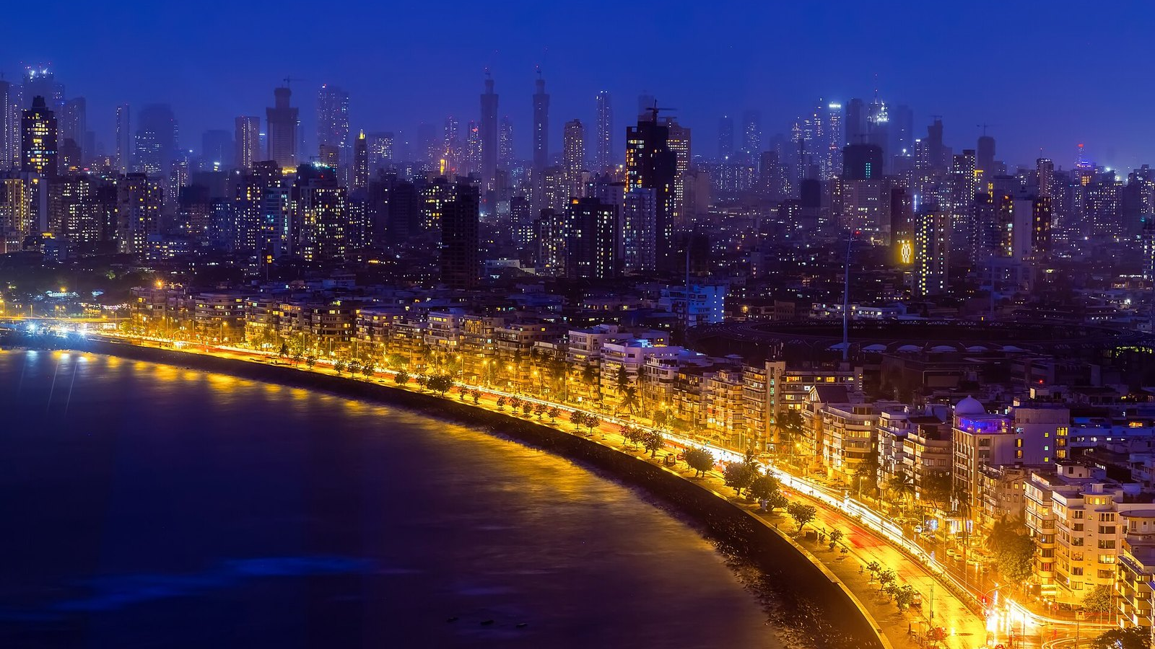

Not by stopping. By steering.
For the city that never stops.
github.com/shubro18202758/sajag
Reference photo · not live · Marine Drive at night · Dr Vikramjit Kakati · CC BY-SA 4.0 · Wikimedia Commons

