Slide 1
When a corridor closes, an Indian city holds its breath.
We built the intelligence that lets it exhale — corridors managed to the second, not frozen for half an hour. A city-scale platform on Ahmedabad's real roads, where VVIP routing is one component among many and a named officer decides every penalty, pursuit and route switch.
Today's default: a protected movement freezes corridors 15–45 minutes at every junction, coordinated by phone, radio and WhatsApp across five separate agencies.
The passage itself takes seconds per junction. The MHA Blue Book says traffic must be “regulated, not stopped” — the gap is tooling, not policy. Documented harm: ambulance held 5–10 min with siren running (Mumbai 2022); a death after a ~20-min hold (Kanchipuram 2018); another halt this February (Agartala 2026).
One failure mode, many costumes: the same freeze hits the Rath Yatra's 14 km old-city loop (148 annual editions), Kumbh-class perimeters (240→660 million visits, 2019→2025), a 24,000-runner marathon, Republic Day parade strips, ~130,000-person stadium egress, monsoon flood evacuation and metro work zones.
Our answer is a city-scale Corridor OS — the VVIP run is the base case, not the boundary (full library: VVIP/docs/USE_CASES.md) — and the same backbone carries everyday enforcement: a stolen-vehicle FIR traced from watchlist to interception plan, vehicles only, with a human in every penalty loop (VVIP/docs/GODS_EYE_INTEGRATION.md).
Gujarat · Veer · Hack for Social Cause · VBYLD 2027
Slide 1 / 7

Slide 2
PROBLEM STATEMENT
The gap, precisely — Gujarat (Ahmedabad–Gandhinagar)
Pilot geography: Ahmedabad's real road network, traced on OpenStreetMap — 49 segments, 34 junctions, ~192 km: Ashram Road, SG Highway, CG Road, SP Ring Road, the Gandhinagar Highway, the old-city bazaar belt (© OpenStreetMap contributors, ODbL 1.0).
  G1 No shared operational picture across the 5 agencies → 15–45-minute blanket holds
  G2 No prediction in the loop (fixed advance margins) → holds far longer than the convoy needs
  G3 No citizen advisory channel → the commuter discovers the closure at the barricade
  G4 No emergency-passage channel for 108 → golden-hour minutes burn; documented deaths
  G5 No measurement or accountability → nothing improves; over-caution every time
Beneficiaries, named: the commuter on Ashram Road; the cardiac patient in a 108 ambulance (Gujarat: ~585 EMRI ambulances, ~5 emergency trips each daily); the constable at the barricade; the duty officer with zero tooling — and, through the use-case library, the pilgrim, the runner, the spectator and the flood evacuee.
Gujarat · Veer · Hack for Social Cause · VBYLD 2027
Slide 2 / 7

Slide 3
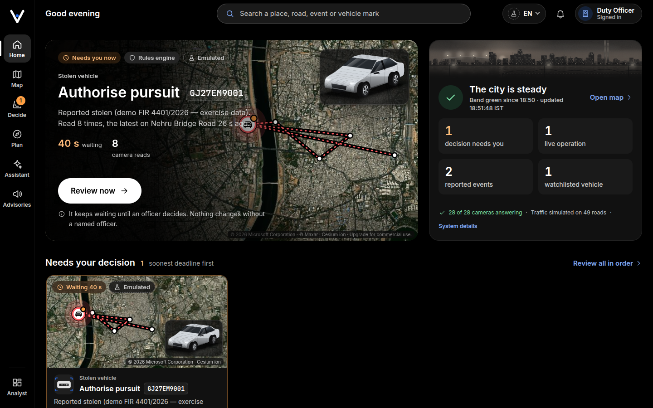
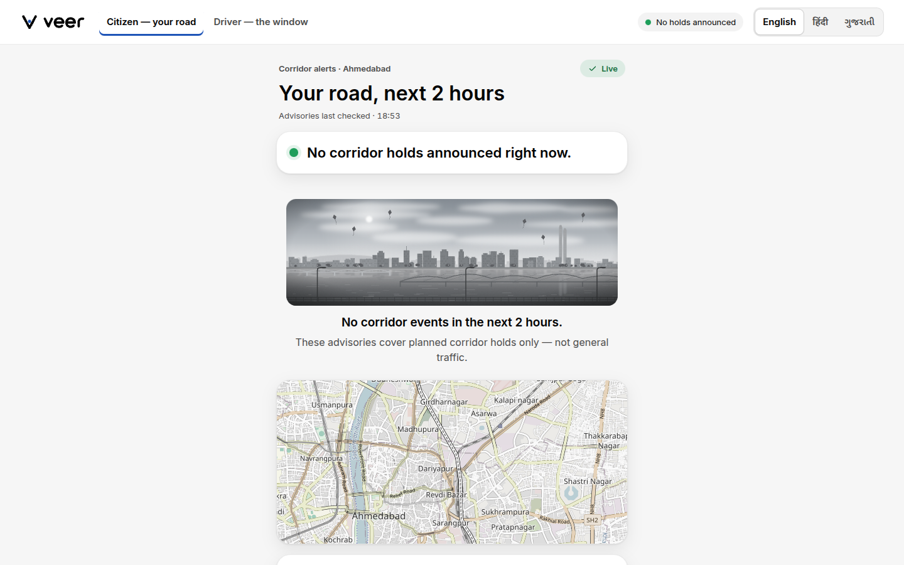
SOLUTION
The platform — a city-scale OS, the public's protagonist
Our Very Important Persons: the Voter on the bus, the Victim in the 108 ambulance, and the Vulnerable patient for whom ten minutes matter.
One interface, simple by default, deep on demand — 127.0.0.1:5273: Home (what needs you now), Map, Decide (one decision at a time, “what changes if you approve”), Plan, Assistant and Advisories on one rail; the full analyst workspace, situation wall and 3D city under Analyst; public /citizen + /driver in EN/HI/GU. Real place photos, agency marks and artwork; every approval carries a named officer.
The God's-eye — real 3D Ahmedabad: signed-in operators see Google Photorealistic 3D Tiles with the overlays draped on the city, none floating — the simulated congestion feed on the real roads, spines, the pursuit fan, units, cameras; public pages stay keyless. Eleven integrity-validated layers.
The officer approves every switch: during a live escort the AI only proposes a re-route, Plan B, a hold or closures; a named officer approves each — no answer in 90 s and the current plan holds. The AI never switches a route on its own.
Enforcement on the same rails: FIR → lawful-basis earmark → emulated ANPR reads → evidence-only sighting, never a fine on a stolen car's owner (409) → a named officer approves → pursuit (one approval, one pursuit) → pgRouting interception plan. Vehicles only — no faces, no persons; plates masked unless an officer is signed in.
Predictive rolling holds, two-tier AI, AMA: closures 60–180 s ahead, ~2–3-minute holds instead of 25-minute freezes; a 27B decider + Gemma 4 12B at the edge, every answer logged with its confidence; plans fail closed to protocol floors. In the flagship the engine chose signal hold at 45 s — “regulated, not stopped.”
Live stack, 2026-10-27 — Home · the public citizen page
Gujarat · Veer · Hack for Social Cause · VBYLD 2027
Slide 3 / 7

Slide 4
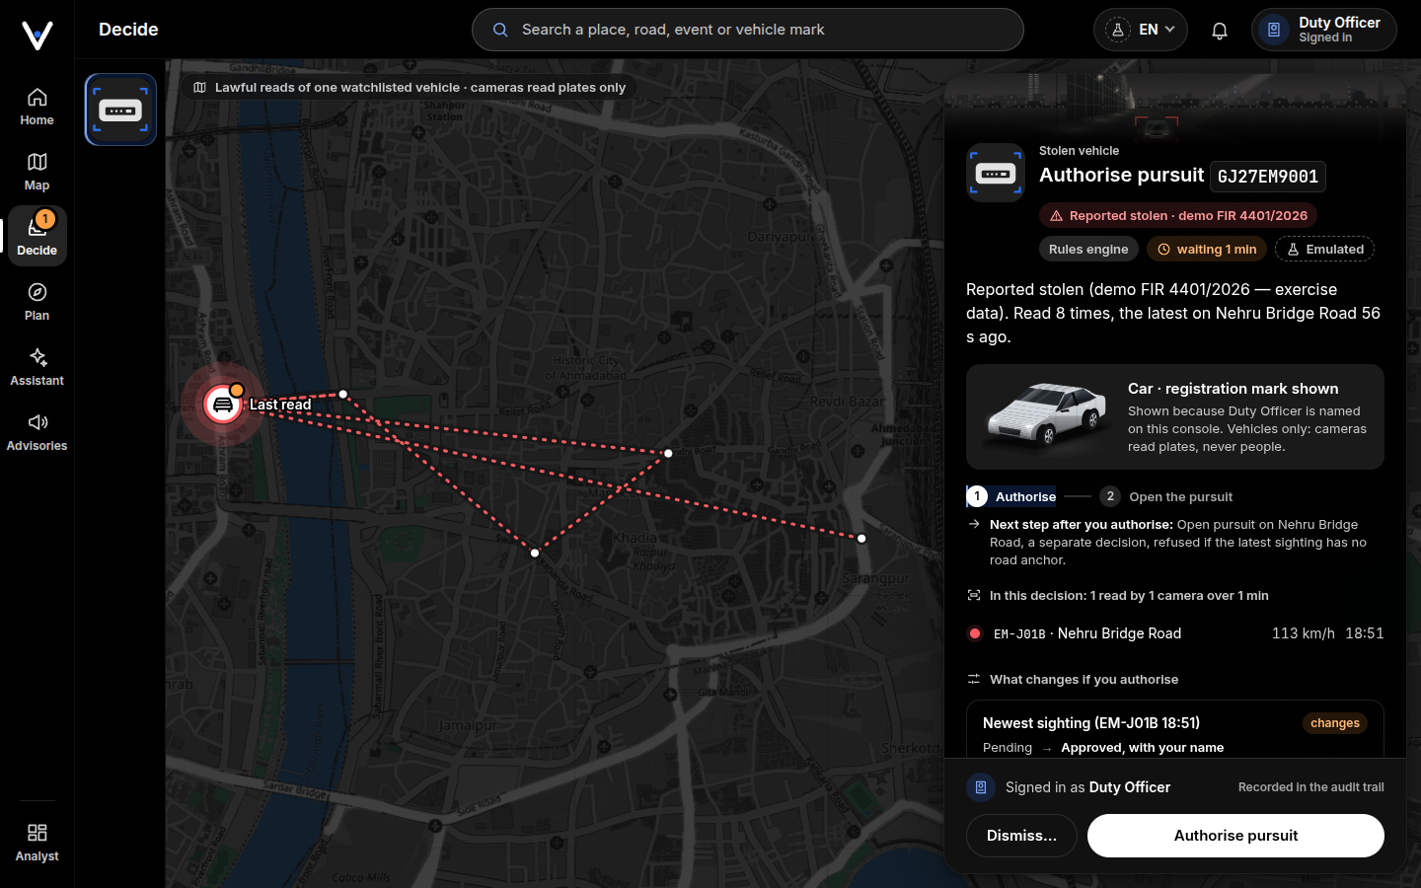
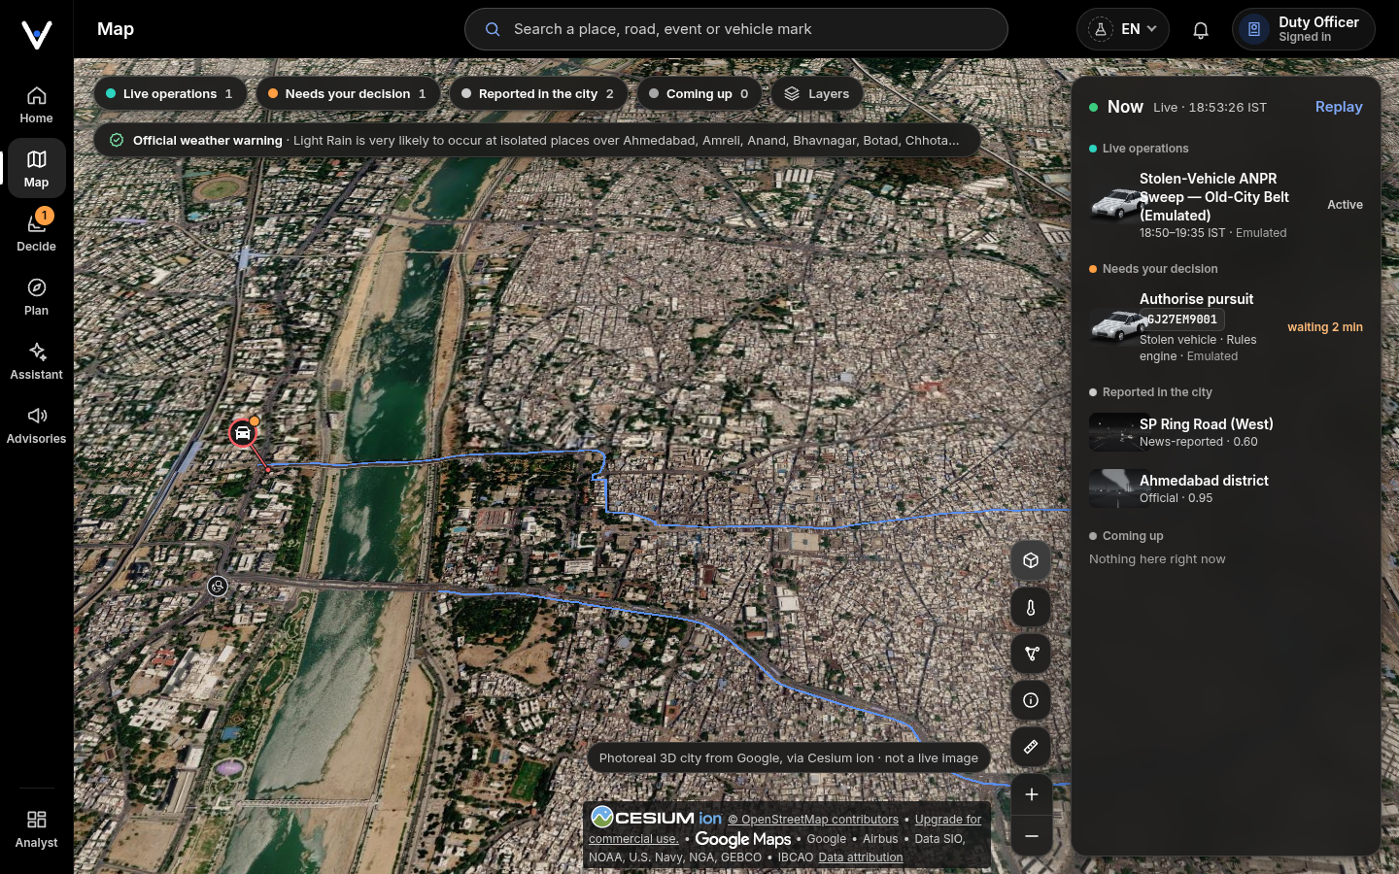
FUNCTIONALITY
Working now — one honest interface, live stack, measured
Live on the box: scripts/veer_up.sh brings the stack up and it starts itself at boot — real reboots came back READY in 4 min 25 s, no manual command. The V3 interface went live on 2026-10-27 (READY 12/12 with OSINT on, migrations 001–025, operator gate on): / is Home, Decide holds one decision at a time, Analyst keeps the workspace and the situation wall.
Deployed, then accepted live (2026-10-23/24): 19 of 22 acceptance steps passed first time; the tier-0 cache miss was fixed (route options named by their own segments, answers filed per movement), redeployed and re-run green — 1 hit in 3, 1825 ms saved; two canvas smokes' failed checks re-ran green once the reset cleared acceptance debris; the judge's journeys passed 92/92.
Flagship “God's Eye Morning” (SHOWCASE PASS three times that night; artifacts 2026-10-24 00:01 IST): Rath Yatra + monsoon + one 108 ambulance + a stolen-vehicle report, injected through the emulator into the live stack: 31 audited decisions; a 12-replication twin of the scenario's 4 scripted green-corridor windows (ambulance delay 231.92 s, model output); 6 emulated ANPR reads at 95–115 km/h → R_STOLEN_SIGHTING ×6, evidence only — e-challan withheld, an e-challan approval on the plate refused (409) → the sighting approved under the honest label “Scripted demo officer (showcase script)” (in the judged demo, a signed-in human) → 10 choke junctions ranked by pgRouting (top: junction 15, unsignalised, score 0.008683) + a live 12-position trace (its 24 h window also holds an earlier run's reads); the signal guard refused the uncalibrated commit (409 — no field observations).
Emulated/real split, plainly: the roads are real; the traffic feed, ANPR reads, camera sites and units are emulated or simulated and labelled so on every surface; every decision is the real stack's, every approval carries the officer's name — a signed-in human in the judged demo.
Measured: 5123 pytest tests collected on the deployed tree (5012 pass, 92 skip themselves) + 120 cargo tests; migrations 001–025. Bench: decider 455.78 tok/s (p99 1106.8 ms), Gemma 20.09 tok/s, embeddings 92.7 ms, 62.73 GiB resident; adversarial suite 19/19 (score 100; avg 29.19 s / max 57.38 s). Kept visible: tool coverage 0.684 / keyword coverage 0.561; one same-day 69.99 s scenario; DSTGAT ships as architecture only.
Live stack, 2026-10-27 — Decide · the Map on the 3D city
Gujarat · Veer · Hack for Social Cause · VBYLD 2027
Slide 4 / 7

Slide 5
SOCIAL CAUSE IMPACT
Impact for Viksit Bharat 2047 — from the impact run
Per movement (central case, modelled on the real-road network): commuter delay drops from 1,131,888 to 11,319 commuter-minutes when all 34 junctions of the 49-segment network are frozen — an upper-bound framing (per frozen junction ≈ 33,291 → ≈ 333); vehicles caught in holds fall from 60,367 to 6,037.
Reduction in junction-freeze commuter delay: 25× (conservative) — 100× (central) — 506× (optimistic), independent of the junction count: delay scales with hold duration squared.
Per year (250 movement-days, RTI-able): 4.67 million commuter-hours returned; 2.52 million litres of idle fuel and 6,303 tonnes of CO₂ avoided.
Emergency patients: ≈ 33,000 golden-hour minutes/year returned (12 intersecting trips/day × 11 min). We claim minutes returned, never “lives saved”.
Accountability (SDG 16): every AI decision logged with distribution + confidence; every penalty a recommendation until a named officer approves it, with an append-only audit trail; every escort route switch an officer's call; vehicles-only enforcement with lawful basis and capped retention — no person-tracking, no fine on a stolen car's owner. SDG 11 · 3 · 16 · 13.
One engine, eight corridor classes + the enforcement family: protected movements · the 148-edition Rath Yatra · Kumbh-class gatherings · marathons · the national ceremonial days · ~132,000-seat stadium egress · monsoon flood evacuation · metro work zones — plus the stolen-vehicle chain, each a runnable scenario on the real roads (VVIP/docs/USE_CASES.md).
Gujarat · Veer · Hack for Social Cause · VBYLD 2027
Slide 5 / 7

Slide 6
PRESENTATION & TEAMWORK
Team, adoption, sustainability
Team (≤3): <Name 1 — platform / ML> · <Name 2 — civic layer / outreach> · <Name 3 — operations / impact> — <institution>, <AISHE IDs>
Adoption: a Smart City SPV / city traffic police pilot on one corridor; bill of materials = one GB10-class edge box; it plugs into the state's ICCC / CCTV / ITMS cameras and 108/EMRI dispatch rather than replacing them.
Open source (MIT): any state can fork. Roadmap: T+1 month — register the city's ICCC / CCTV cameras and land the first live ANPR adapter · T+3 — pilot design with one city + 108 dispatch; real field traffic to calibrate the twin; lift the two open suite quality gaps (tool coverage 0.684, keyword coverage 0.561); first trained DSTGAT weights · T+6 — two more languages; event-corridor preset for a real gathering (Rath Yatra / match night) with the city.
Costs: the intelligence runs at the edge; marginal cost per movement ≈ zero; alerts ride existing SMS/WhatsApp rails.
Privacy principle: VVIP identity/destination never logged; decisions carry audit trails; enforcement is vehicles-only with lawful basis, capped retention and human-approved decisions.
Gujarat · Veer · Hack for Social Cause · VBYLD 2027
Slide 6 / 7

Slide 7
MANDATORY DISCLOSURE
Disclosure of AI-tool usage & references
AI tool usage: the base prototype and our enhancements were developed with the help of AI coding assistants — including agent sessions that built the model stack, the citizen advisory and 108 driver surfaces, the event emulator, the God's-eye canvas and its 3D draping, the real-road network generator, the command-deck interface, the enforcement/watchlist chain, escort authority, the impact harness and documentation.
Detection/decision tools are deterministic, team-reviewed code (optimizer, classifier, simulator, enforcement rules); the forecaster's live rung is a third-party zero-shot model with fixed weights (t0-alpha, Apache-2.0); the two-tier reasoning layer is logged answer-by-answer with probability and confidence; no AI output acts unreviewed — the AI proposes, a named officer decides every penalty, pursuit, dispatch and escort route switch.
The interface of record is the backend-wired command-deck at :5273 behind the operator sign-in (screenshots taken on it live, 2026-10-27: operator views, the public page keyless; reference photos are credited and labelled not live); the legacy React demo is the clearly-labelled offline fallback; the showcase injects emulator-generated causes into the real stack (reads labelled emulated_anpr, units labelled emulated). Every statistic comes from cited sources, the falsifiable assumptions ledger of IMPACT_REPORT.md, or the in-repo artifacts (scripts/bench_results.json, showcase/showcase_results.json, showcase/pursuit_chain.json, services/command-deck/tests/artifacts/screens/) — model outputs are labelled as modelled. Road geometry © OpenStreetMap contributors, ODbL 1.0.
  References: MHA Blue Book protocol summary · Free Press Journal (Mumbai ambulance hold, Sept 2022) · Kanchipuram 2018 · Agartala Feb 2026 · Times of India Ahmedabad (2009; riverfront-run diversions May 2024) · Vibes of India (2022 CM convoy) · GVK EMRI Gujarat fleet figures · NDTV + utsav.gov.in (148th Rath Yatra) · Wikipedia/UP govt (Kumbh 2019→2025) · ahmedabadmarathon.com / Olympics.com / ThePrint (2024 marathon) · Gujarat CMO (76th Republic Day) · Wikipedia + Ayen News (Motera / IPL 2026 final) · India Today (T20 WC 2026 final) · BBC / ReliefWeb (Gujarat floods 2024) · PIB + Indian Express (Metro Phase 2, Kankaria closure) · OpenStreetMap · MoRTH ITS / Smart Cities / Gati Shakti · MyBharat HSC 2027 brief.
  Full citation lists: PROBLEM_STATEMENT_GUJARAT.md §6 and VVIP/docs/USE_CASES.md (Sources). The demo runs live on the GB10 box; emulated sources are labelled on every screen.
Gujarat · Veer · Hack for Social Cause · VBYLD 2027
Slide 7 / 7

