Slide 1
AgriTech
Concept Squad

Slide 2
Problem Statement
Helping the farmers in terms of Crop suggestion, precautions based on the met department forecast of rain fall / weather, potential pest attacks etc.
Providing a platform for the farmers to buy the basic amenities like seeds, equipment etc.
System that provides details to farmers on fertilizers that could impact the soil, and possible pest attacks.

Slide 3
Approach
We will develop a web app for farmers which will be run by local authorities. The main motive for local authorities to run the website is the high illiteracy rate among the rural areas.
We provide the farmers with Crop yield prediction along with Fertilizers based on the type and health of the soil.
We also have a provision for directly buying the required seeds, fertilisers and equipment on the system itself via verified sellers make it convenient for the farmers.

Slide 4
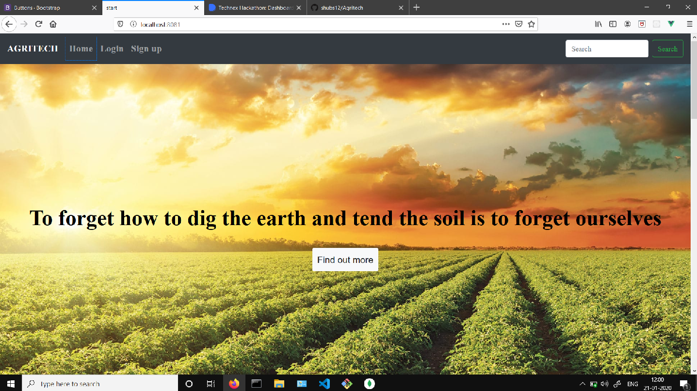
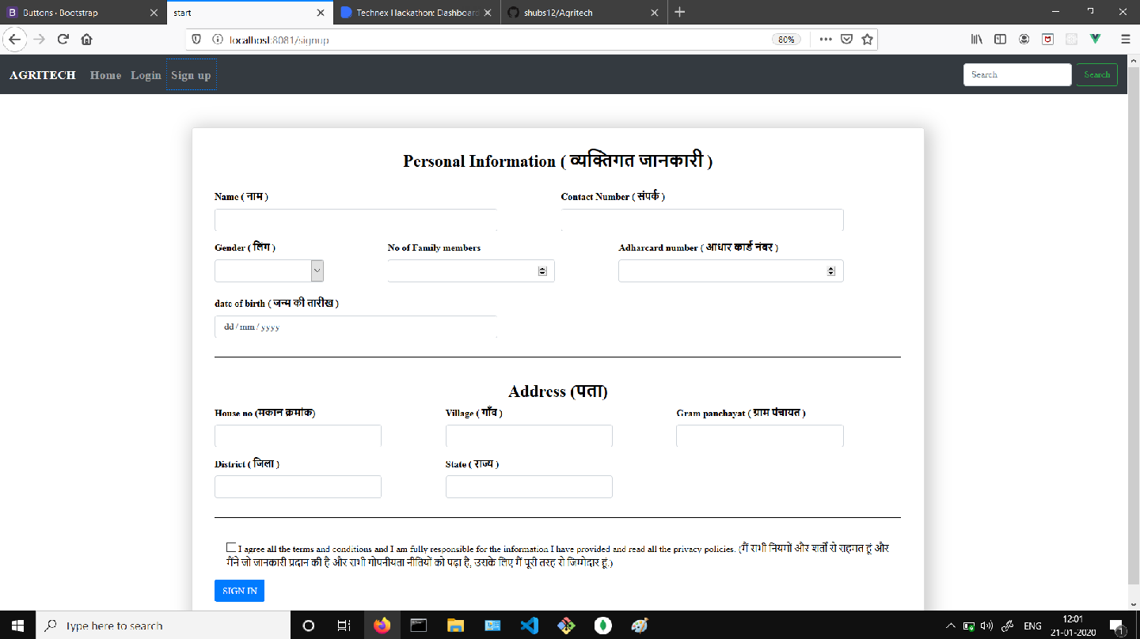

Slide 5
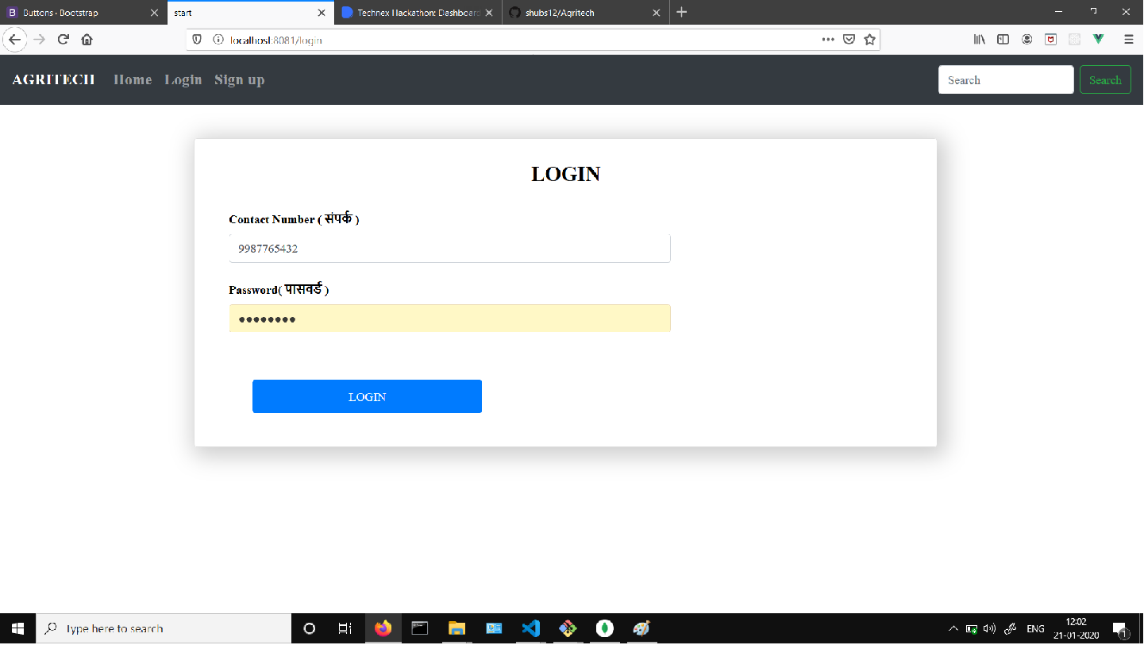
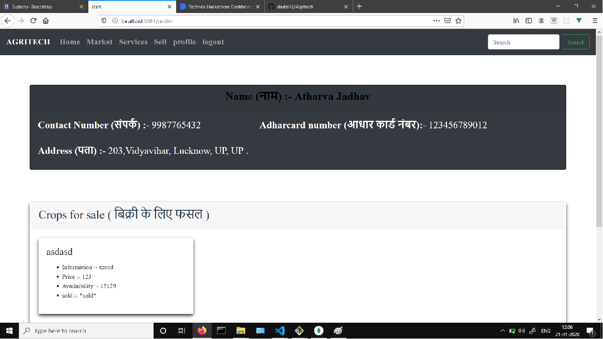

Slide 6
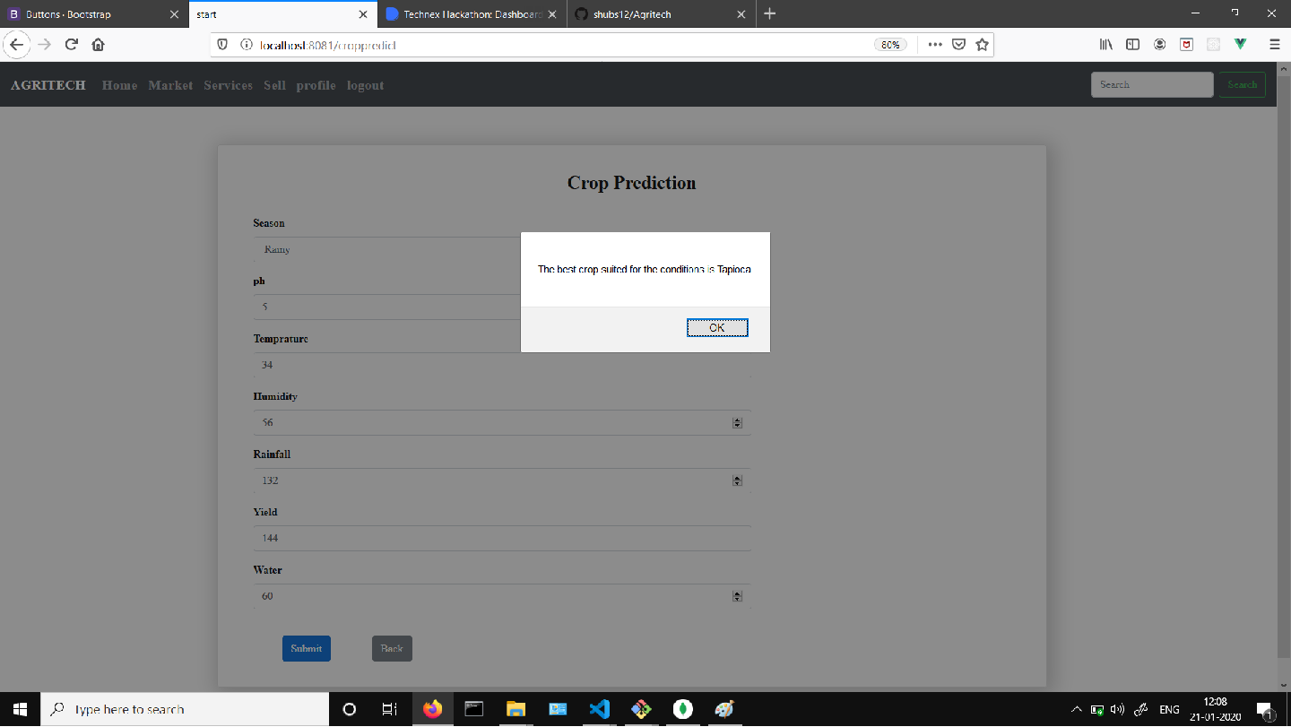

Slide 7
Technology Bucket
Use of the latest node.js framework Express.js for the higher security over the entire system.
SMS verification API.
VUE-VUEX is a more flexible, less opinionated solution that allows structuring of the app.
Python for applying the machine learning algorithms.

