Slide 1
FIVE-MINUTE DEMO
MetaboCausal
A Slack agent that traces evidence for metabolite-disease questions
One question in Slack. One checkable evidence card out.
Presented by Shucheng Cao and the MetaboCausal team
Say: We built a Slack agent that turns a science question into a checkable evidence card.
MetaboCausal · AI Tinkerers Montréal · 12 Sep 2026
01
Notes:
Hi everyone, we are the MetaboCausal team. In this hackathon, we built a Slack agent for metabolite-disease questions. The idea is simple: someone asks whether a molecule measured in blood may be related to a disease, and the agent returns a source-linked evidence card that the team can inspect together.

Slide 2
WHY THIS MATTERS
The Problem
Biology gives us signals. We still need evidence.
A molecule can be associated with disease without causing it.
Evidence is scattered across papers, genetics, targets and trials.
Manual review takes time; AI can sound confident without support.
Say: The hard part is not finding a signal. The hard part is checking what the signal means.
MetaboCausal · AI Tinkerers Montréal · 12 Sep 2026
02
Notes:
The problem starts before any model answer. Biology gives us many signals, but a signal is not automatically a causal explanation. A molecule can be associated with disease without causing it. The evidence is scattered across papers, genetic databases, target databases and clinical records. Manual review takes time, and AI summaries can sound confident even when support is weak.

Slide 3
SCIENTIFIC FRAMING
The Causal Gap
A blood marker, a gene target and a drug outcome are related, but they are not the same claim.
Molecule
Gene / target
Disease
Clinical outcome
MetaboCausal keeps these levels separate, so a useful signal does not become an unsupported target claim.
Say: This is the scientific boundary we tried to keep visible.
MetaboCausal · AI Tinkerers Montréal · 12 Sep 2026
03
Notes:
This is the scientific boundary we tried to keep visible. A metabolite is often a readout, while intervention may happen at a gene, protein, pathway or drug level. Moving a biomarker and helping a patient are different claims. MetaboCausal keeps these levels separate so a useful signal does not become an unsupported target claim.

Slide 4
A / B / C STATES
The Product Logic
A
B
C
Answered
Analysis-ready
Evidence gap
Existing genetic evidence retrieved and cited.
Required data appear available, but the estimate is not found yet.
The current sources do not support a result. The gap stays visible.
"Not found" never becomes "no effect."
Say: A gap should stay a gap. It should not be turned into a fake answer.
MetaboCausal · AI Tinkerers Montréal · 12 Sep 2026
04
Notes:
The core logic is the A/B/C state. State A means we retrieved existing genetic evidence. State B means the analysis appears feasible, but the exact estimate has not been found yet. State C means the required evidence was not retrieved from current sources. The key principle is simple: a gap should stay a gap. It should not become a fake answer.

Slide 5
EVIDENCE FIRST, MODEL SECOND
How It Works
Resolve names
Retrieve evidence
Classify A/B/C
Add context
Render card
The model can explain a run. It cannot rewrite the retrieved evidence.
This is how we reduce unsupported answers while still using LLMs for readable interpretation.
Say: The model explains the run. The retrieved evidence controls the answer.
MetaboCausal · AI Tinkerers Montréal · 12 Sep 2026
05
Notes:
The pipeline resolves molecule and disease names, retrieves genetic evidence, checks feasibility, adds gene and target context when available, and renders the result as an evidence card. The model can help explain the run, but it does not get to rewrite the evidence. If the evidence is missing or contradictory, the product should show that boundary.

Slide 6
SHOW THE LIVE WORKFLOW
Demo 1: Slack Answer
Switch to Slack now
Show the user question in the channel or thread.
Show the compact answer and evidence status.
Point to source links or attached evidence card.
Say: This is the part we want teams to actually use during discussion.
MetaboCausal · AI Tinkerers Montréal · 12 Sep 2026
06
Notes:
Now I will show the Slack demo. Here, a user asks a metabolite-disease question. The agent returns a compact answer in the same thread, with the evidence status and links back to sources. This matters because the discussion can happen where the team already works, while the underlying record remains inspectable.

Slide 7
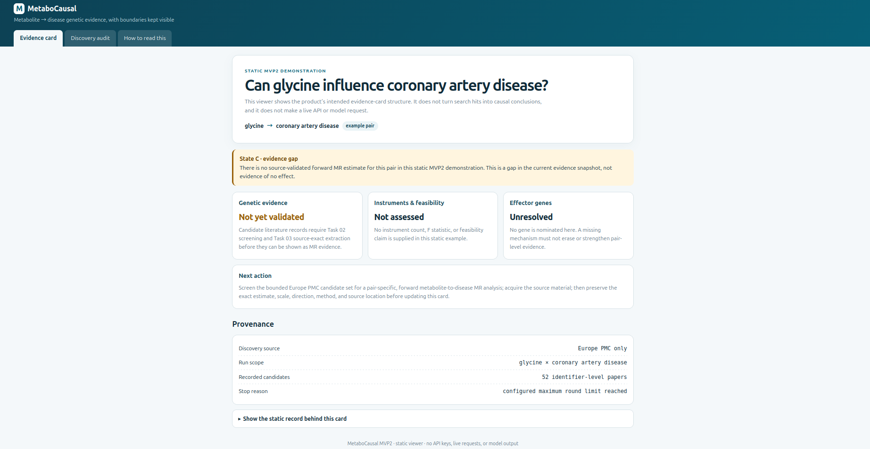
SHOW THE INSPECTABLE RECORD
Demo 2: HTML Evidence Card
HTML view keeps the gap visible
State C is shown as a gap, not as no effect.
Provenance records the source and run scope.
Next action tells the team what to check next.
Say: This is why the card matters: it shows the gap instead of hiding it.
MetaboCausal · AI Tinkerers Montréal · 12 Sep 2026
07
Notes:
For a deeper view, the same result can open as an HTML evidence card. This screenshot shows an important product behavior: the card says State C, evidence gap. It does not turn a missing validated MR estimate into no effect. It keeps provenance and tells the team what to check next. If I open the real HTML viewer, I will point to the gap, provenance and next action.

Slide 8
SHOW THE GUARDRAIL
Demo 3: Challenge Prompt
Switch back to Slack
Show the deliberately wrong prompt.
Show that the agent rejects unsupported evidence.
Say this is one safeguard test, not proof that hallucination is impossible.
Say: In this test, the agent refused an unsupported claim instead of making one up.
MetaboCausal · AI Tinkerers Montréal · 12 Sep 2026
08
Notes:
We also tested the system with a deliberately wrong prompt in Slack. In this test, the agent did not invent evidence for the false premise. It rejected the unsupported claim and kept the evidence boundary visible. We do not claim this means hallucination is impossible. We claim this is the kind of challenge test the product must pass.

Slide 9
CONTRIBUTION AND NEXT STEPS
What We Built
My lead contribution
Scientific framework, evidence states, model boundary and integration across team modules.
Current MVP
Slack workflow, source-linked evidence cards, OpenAI and Claude interpretation.
Next
Broader literature coverage and deeper gene / pathway context.
Say: We built a path from question to evidence, and we kept the uncertainty visible.
MetaboCausal · AI Tinkerers Montréal · 12 Sep 2026
09
Notes:
My main contribution was the scientific and product framework: turning a metabolite-disease question into a traceable causal-evidence workflow, separating retrieved evidence from model interpretation, and integrating the team modules into one product path. The current MVP includes the Slack workflow, source-linked evidence cards and model-based interpretation with OpenAI and Claude. Next, we expand literature coverage and add deeper gene and pathway context. MetaboCausal does not claim to prove that a drug will work. It helps teams see what is known, what is missing and what to test next.

