Slide 1
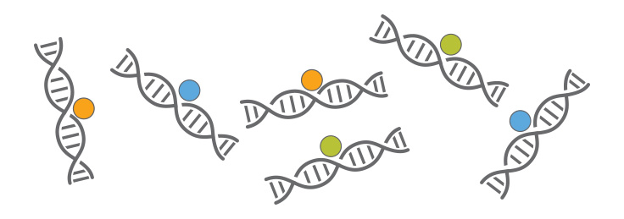
ChIP-seq introduction
Huitian Diao (Yolanda)
References:
ENCODE ChIP-seq pipeline: https://www.encodeproject.org/pipelines/ENCPL138KID/
Intro to ChIP-seq: https://github.com/hbctraining/Intro-to-ChIPseq

Slide 2

Using sticky notes for feedback
“I’ve got a good handle on things…”
“I think I understand but I’m still working through things…”
“I’m not understanding and I’m a little lost right now...”

Slide 3
Get course material
Github
Applied-Bioinformatics
Github
HW
git pull
git push
copy
My local:
Applied-Bioinformatics
My local:
My_name_HW
If you want to use packages you installed in “chip” environment, do:
source activate chip

Slide 4


Some tips
Google is man’s new best friend
Copy-pasting is not…
I just copy-pasted those codes …
What did
you say?

Slide 5
Q&A.3 How to debug my codes?
1. Common types of errors
Syntax errors (Grammar errors)
Typos
Missing or extra { [ ( ; , “
Structure problem
Runtime errors (Something computer is unable to do)
Use non-existing things
Logic errors (Something wrong with the design)
Adding when you should be subtracting
Using wrong file
…

Slide 6
Q&A.3 How to debug my codes?
2. Some of the most common mistakes
Typo
Directory error
Missing or extra { [ ( ; , “
Structure error (especially recursion)
Off-by-one errors
Names contain special characters

Slide 7
Q&A.3 How to debug my codes?
3. How to avoid bugs:
Practice, practice, practice
Use a good text editor that works for you (I use Sublime Text / Spyder / R Studio)
Syntax highlight
Autofill
Good coding style (Google style guide etc.)
Good readability is important to yourself and others
Comment codes well
Comment codes well when you update them
Consistent naming format
Simplicity: avoid using unnecessarily long and winding structures (simple and efficient is the best)
Modularity: separate code into self-contained, independent pieces
Test
Test by block when you write
Test before you use your scripts for batch analysis / big files
For R users: known that R studio save variables you created and silent error messages…
No need to re-invent the wheel when there’s something available and tested
Definitely read the documentations carefully

Slide 8
Practice 4.7 Read documentation!
Tips:
Questions:
1. MACS2 What is the flag you use to find narrowPeaks? What is the 8th column of gappedPeak file? What is the flag you use for supplying the control file in callpeaks function?
2. Bowtie1 and Bowtie2 For Bowtie2, what is the flag for using fastq input file for alignment? For Bowtie2, what is the flag you use for first and second end of pair-end sequencing result? Do Bowtie2 and Botie1 use same index format?
3. UCSC formats What is the difference between GTF format and GFF format? What is the use of bigwig format?

Slide 9
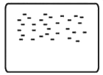
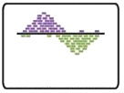

ChIP-seq analysis steps
0
1
2
√
0.0 | Acquire raw reads | fastq-dump
0.1 | Fastq quality control | fastqc
0.2 | Trimming | TrimGlore
Raw sequenced reads
√
Raw reads
√
Alignment
√
1.0 | Alignment | Bowtie2
1.1 | Convert, sort, filter | Samtools
1.2 | Filter blacklisted regions | bedtools
Aligned file
√
Aligned to
Genome
√
Peak Calling
√
2.0 | Peak calling | MACS2
2.1 | Peak visualization | UCSC genome browser
2.2 | ChIP quality control | ChIPQC
2.3 | Peak annotation | ChIP-seeker
Peak list
Identified Peak
Bardet, Anaïs F., et al. Nature protocols 7.1 (2012): 45.

Slide 10
Practice 4.8 Data visualization with UCSC genome browser
Tips:
Always: Google
Questions:
Sign up for Cyvrse and UCSC genomebrowser
Convert the treat_pileup.bdg file into bw format. Calculate the size of both files
Upload the bw file and visualize in UCSC genome browser
For the peak with highest signal you found in practice 4.6, take a genome browser screen shot with ~10,000bp in the window. What are the annotated features around the peak?

Slide 11
Homework 4.2
Tips:
Always: Google
Questions:
Record bugs / problems you found in your codes in a word document, with info: - Bug description Basic error type Occurred in what context Key error message that lead to finding the problem If you found solution on Google, include a link - Screen shot of the line of code with problem - Screen shot of error message The report should include: - At least 10 problems - Cover all the 3 basic types of errors
Reformat R codes Bar_charts.R according to Google style guide: - Group codes in blocks (e.g. all the library() should be put together) - Reformat variables so that they fit naming rules - Fix the spacing (e.g. “var.x <- value” instead “var.x<-value”) - Make the position of braces “{}” and “()” consistent - Add your name and date of modifying codes on top in comment

