Slide 1
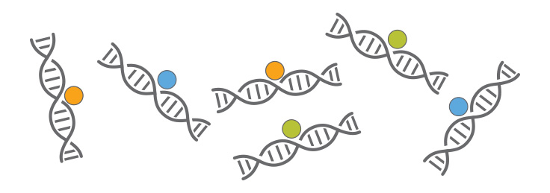
ChIP-seq introduction
Huitian Diao (Yolanda)
References:
ENCODE ChIP-seq pipeline: https://www.encodeproject.org/pipelines/ENCPL138KID/
Intro to ChIP-seq: https://github.com/hbctraining/Intro-to-ChIPseq

Slide 2

Using sticky notes for feedback
“I’ve got a good handle on things…”
“I think I understand but I’m still working through things…”
“I’m not understanding and I’m a little lost right now...”

Slide 3
Get course material
Github
Applied-Bioinformatics
Github
HW
git pull
git push
copy
My local:
Applied-Bioinformatics
My local:
My_name_HW
If you want to use packages you installed in “chip” environment, do:
source activate chip

Slide 4


Some tips
Google is man’s new best friend
Copy-pasting is not…
I just copy-pasted those codes …
What did
you say?

Slide 5
Some more prerequisites
Install Homer: http://homer.ucsd.edu/homer/introduction/install.html
Add Homer path to bash profile: nano ~/.bash_profile export PATH=”yourpathto/homer/bin:$PATH"
Notes:
Rpy2: Use R magic in Python notebook Install: https://anaconda.org/r/rpy2 Use: https://www.linkedin.com/pulse/interfacing-r-from-python-3-jupyter-notebook-jared-stufft/

Slide 6
Q&A.4 R problems & conflicts
If you want to use your local R instead of Ananconda’s R, uninstall Ananconda’s R: conda uninstall r-base
Check where is your R executable: which R
If you want to use Ananconda’s R (Do not recommend) and your R version is not up-to-date: conda uninstall r-base conda install -c r r=3.5.1
My Computer
Root
Conda
R
base
chip
X
X
R
R
Notes:
Rpy2: Use R magic in Python notebook Install: https://anaconda.org/r/rpy2 Use: https://www.linkedin.com/pulse/interfacing-r-from-python-3-jupyter-notebook-jared-stufft/

Slide 7
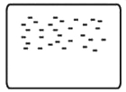
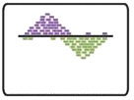

ChIP-seq analysis steps
0
1
2
√
0.0 | Acquire raw reads | fastq-dump
0.1 | Fastq quality control | fastqc
0.2 | Trimming | TrimGlore
Raw sequenced reads
√
Raw reads
√
Alignment
√
1.0 | Alignment | Bowtie2
1.1 | Convert, sort, filter | Samtools
1.2 | Filter blacklisted regions | bedtools
Aligned file
√
Aligned to
Genome
√
Peak Calling
√
2.0 | Peak calling | MACS2
2.1 | Peak visualization | UCSC genome browser
2.2 | ChIP quality control | ChIPQC
2.3 | TF motif enrichment | Homer
Peak list
√
Identified Peak
Bardet, Anaïs F., et al. Nature protocols 7.1 (2012): 45.

Slide 8
Practice 4.9 ChIPQC
Tips:
Always: Google
Questions:
Run ChIPQC for: SRR3001750_srt_dupr.chr12.srt.bam SRR3001751_srt_dupr.chr12.srt.bam
- Sort and index bam file - Run MACS2 - Create sample sheet - ChIPQC

Slide 9
ChIP-seq analysis steps
0
1
2
√
0.0 | Acquire raw reads | fastq-dump
0.1 | Fastq quality control | fastqc
0.2 | Trimming | TrimGlore
Raw sequenced reads
√
Raw reads
√
Alignment
√
1.0 | Alignment | Bowtie2
1.1 | Convert, sort, filter | Samtools
1.2 | Filter blacklisted regions | bedtools
Aligned file
√
Aligned to
Genome
√
Peak Calling
√
2.0 | Peak calling | MACS2
2.1 | Peak visualization | UCSC genome browser
2.2 | ChIP quality control | ChIPQC
2.3 | TF motif enrichment | Homer
Peak list
√
Identified Peak
√
Bardet, Anaïs F., et al. Nature protocols 7.1 (2012): 45.

Slide 10
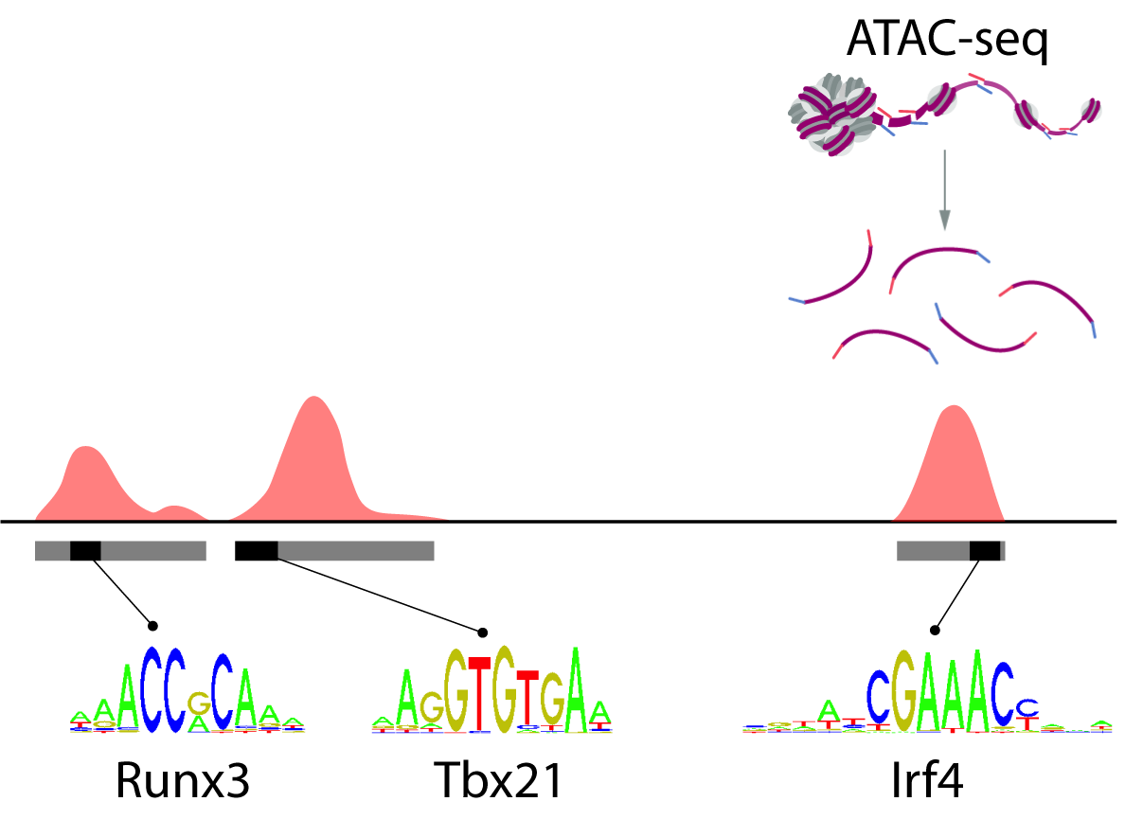

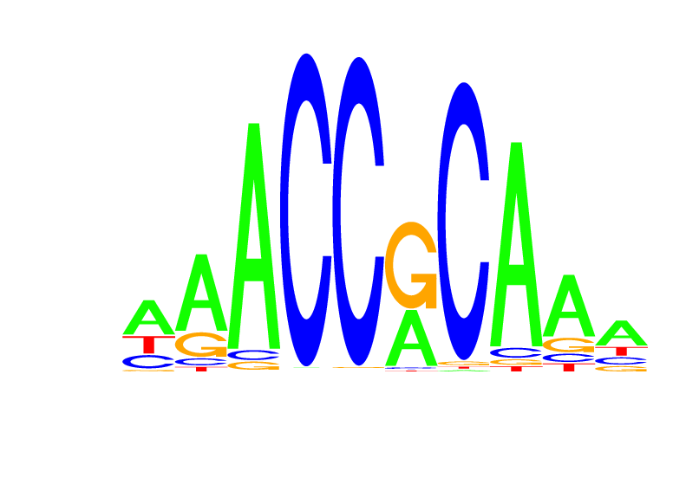
Transcription factor bind to consensus motif
ChIP-seq
Homer:
By searching for consensus motifs, we can look for putative TF binding sites
TF
Consensus motif
Notes:
Can we predict TF binding from open chromatin region?

Slide 11
ChIP-seq analysis steps
0
1
2
√
0.0 | Acquire raw reads | fastq-dump
0.1 | Fastq quality control | fastqc
0.2 | Trimming | TrimGlore
Raw sequenced reads
√
Raw reads
√
Alignment
√
1.0 | Alignment | Bowtie2
1.1 | Convert, sort, filter | Samtools
1.2 | Filter blacklisted regions | bedtools
Aligned file
√
Aligned to
Genome
√
Peak Calling
√
2.0 | Peak calling | MACS2
2.1 | Peak visualization | UCSC genome browser
2.2 | ChIP quality control | ChIPQC
2.3 | TF motif enrichment | Homer
Peak list
√
Identified Peak
√
√
Bardet, Anaïs F., et al. Nature protocols 7.1 (2012): 45.

Slide 12
Homework 4.3
Tips:
Always: Google
Questions:
1. Run ChIPQC for SRR3001750_srt_dupr.chr2.chr11.bam
- Sort and index bam file - Run MACS2 - Create sample sheet - ChIPQC
2. Use Homer to search for TF motifs in broadPeak file (from Q1)
- What are the top 5 knownResults? - What is the difference between knownResults and homerResults?

