Slide 1


QUIZ GAME PROJECT
PRESENTED BY:
➔ SHUCHISMITA BASU (25CS2011111)
➔ PRAPTI BANERJEE (25CS2011071)
➔ NILAY PAL (25CS2011066)
➔ SWATHI CHAKRABARTI (25CS2011131)
➔ DEEPAK KUMAR (25CS2011040)
PROGRAM NAME ➔ B.TECH CSE (CORE)
GUIDED BY ➔ DR.BIDISHA BHABANI
(ASSISTANT PROFESSOR)
01

Slide 2









CONTENTS
INTRODUCTION
GAP ANALYSIS
OBJECTIVES
METHODOLOGY
RESULT ANALYSIS
CONCLUSION
REFERENCES
02

Slide 3

INTRODUCTION
Quiz Games are one of the most interactive and mind blogging games of all time.
It is designed to improve knowledge retention.
It fascinates users from all age group.
Uses multiple-choice questions to test user understanding.
Developed using simple C-programming concepts.
03

Slide 4
GAP ANALYSIS
A quiz game in C involves comparing its current features with the ideal, desired features and identifying the steps needed to bridge that gap.
Our quiz game only shows :
Sequential questions which are rearranged after each round
Taking the user name although it doesn’t store it
Displaying the final score along with percentage
04

Slide 5




OBJECTIVES
User-friendly interface suitable for beginners.
Automatic score and percentage calculation and result display.
Supports multiple questions with options.
Enhances problem-solving skills.
05

Slide 6
METHODOLOGY
Steps included :-
The program loads a set of predefined questions.
The user reads each question and selects an option.
The program checks if the answer is correct.
Score increases with each right answer.
Final performance is displayed at the end.
06

Slide 7
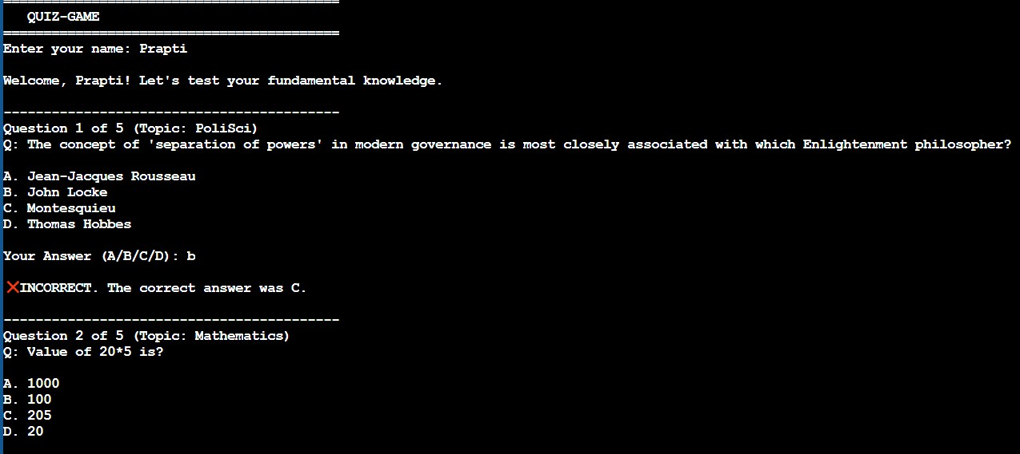

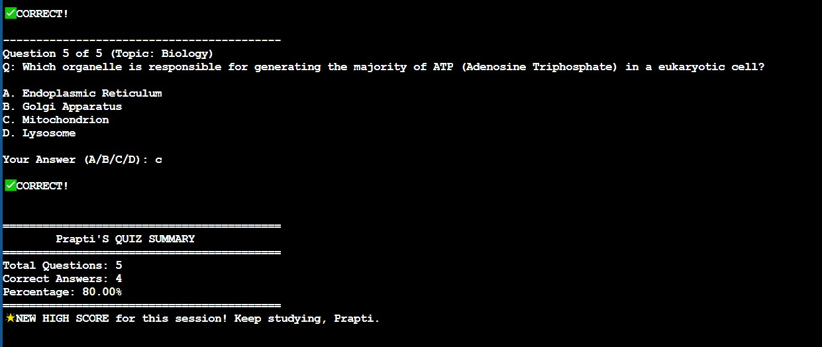
RESULT ANALYSIS
07

Slide 8
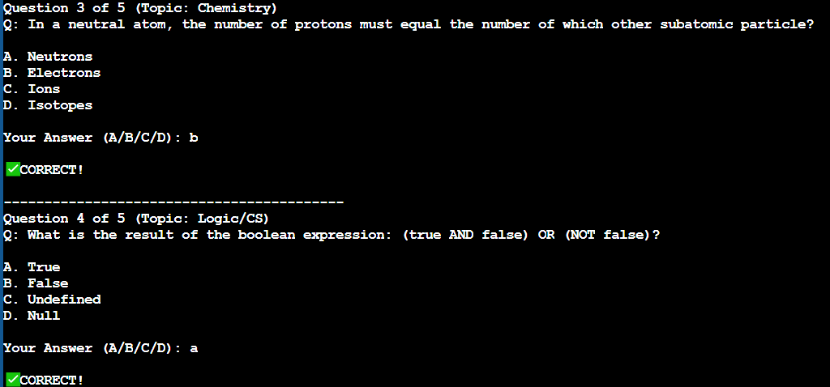
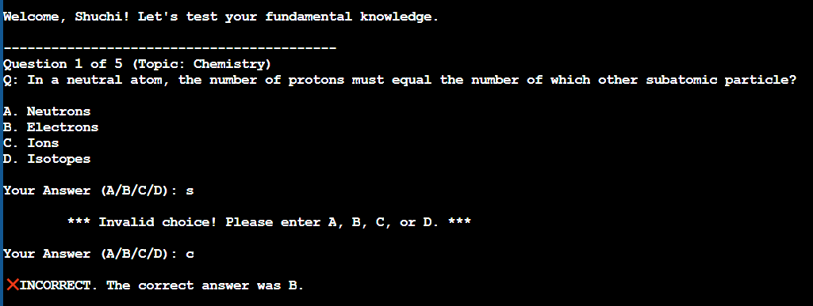
RESULT ANALYSIS
08

Slide 9



CONCLUSION
The quiz game is an effective learning tool.
Encourages quick thinking and topic revision.
Simple to develop and easy to present in
exams.
Demonstrates logic, loops, and decision- making in programming.
09

Slide 10


REFERENCES
We have taken help from various online resources as well as Youtube to get our project done.
Websites like cppreference.com or the C Standard Library documentation pages, guided us a lot.
10

