Slide 1

Telco Customer Churn
Shuchita mishra
001020146

Slide 2
Did you know that attracting a new customer costs five times as much as keeping an existing one?
The telecommunications business has an annual churn rate of 15-25 percent in this highly competitive market.
Corporations and businesses can forecast which customers are likely to leave ahead of time and focus on customer retention efforts.
As a result,
preserve their market position,
grow and thrive
lower the cost of initiation
larger the profit

Slide 3
DATA OVERVIEW
Each row represents a customer, each column contains customer’s attributes described on the column Metadata.
The data set includes information about:
Customers who left within the last month – the column is called Churn
Services that each customer has signed up for – phone, multiple lines, internet, online security, online backup, device protection, tech support, and streaming TV and movies
Customer account information – how long they’ve been a customer, contract, payment method, paperless billing, monthly charges, and total charges
Demographic info about customers – gender, age range, and if they have partners and dependents

Slide 4
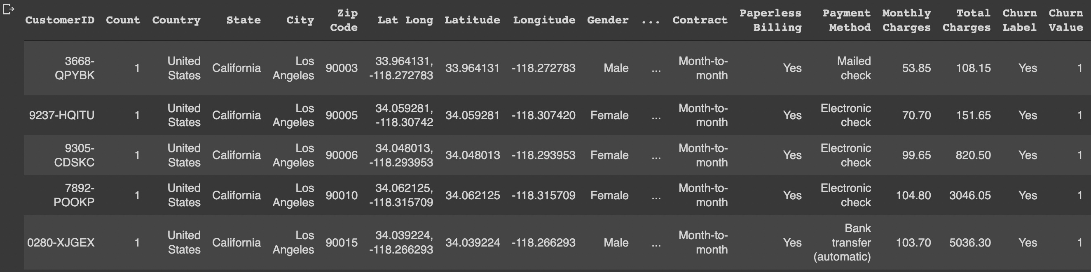
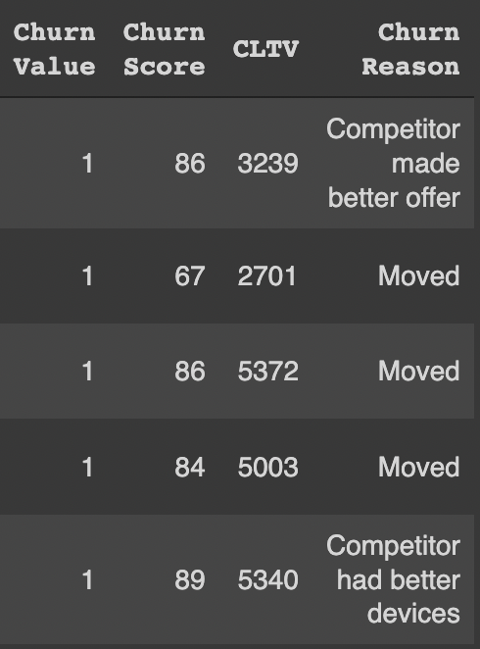

Slide 5
EXPLORATORY DATA ANALYSIS
Let’s explore the data and try to answer some questions

Slide 6
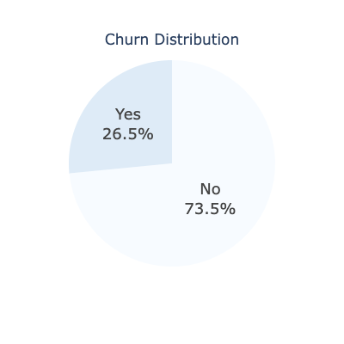
26.5 % of customers switched to another firm.

Slide 7
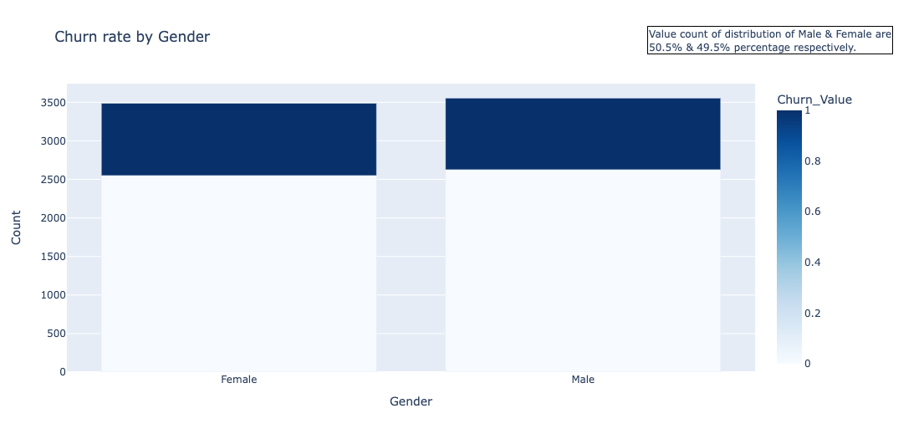
Both genders behaved in similar fashion when it comes to migrating to another service provider/firm

Slide 8
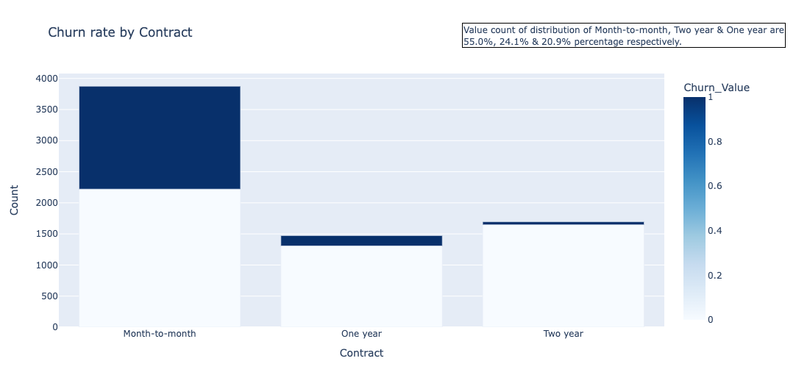
About 75% of customer with Month-to-Month Contract opted to move out as compared to 13% of customers with One Year Contract and 3% with Two Year Contract

Slide 9
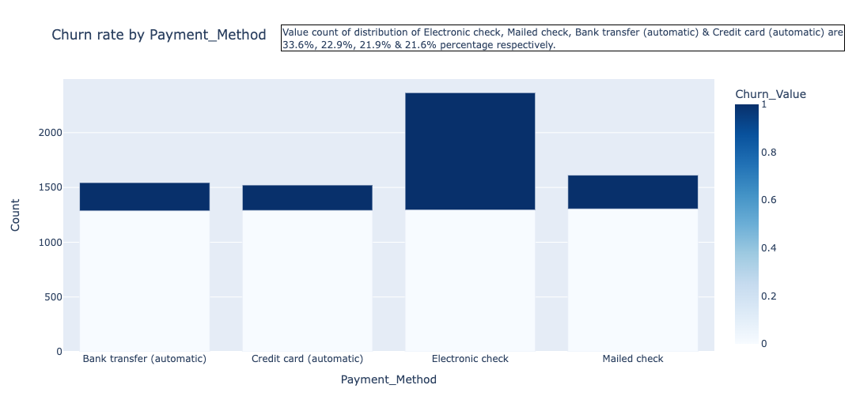
Major customers who moved out HAD AN Electronic Check as Payment Method ON FILE Customers who opted for Credit-Card automatic transfer or Bank Automatic Transfer and Mailed Check as Payment Method were less likely to move out

Slide 10
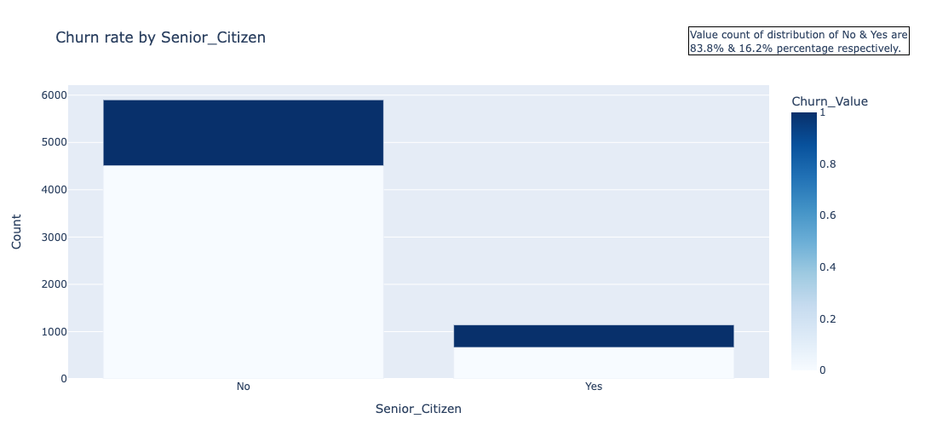
Most of the senior citizens churn

Slide 11
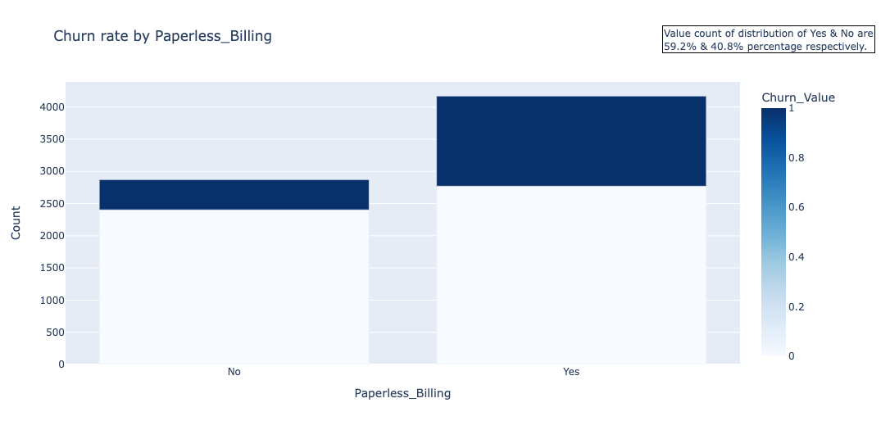
Customers with Paperless Billing are most likely to churn

Slide 12
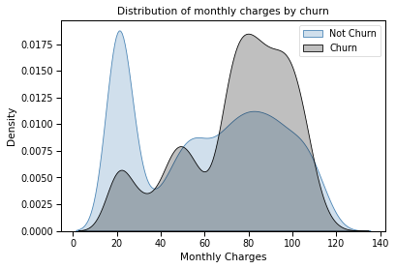
Customers with higher Monthly Charges are also more likely to churn

Slide 13
DATA PRE-PROCESSING AND CLEANING
Splitting the data into train and test sets
Standard scalar to scale numerical columns down to the same range
Manually categorizing the data in 0,1 form
One hot encoding the total charges column
Dropping the redundant columns such as country, state, count, latitude, longitude
Label encoding

Slide 14
ML MODEL EVALUATIONS AND PREDICTING
NOW THAT OUR DATA IS PROCESSED AND CLEANED, LET’S START PREDICTING THE CHURN STATUS

Slide 15
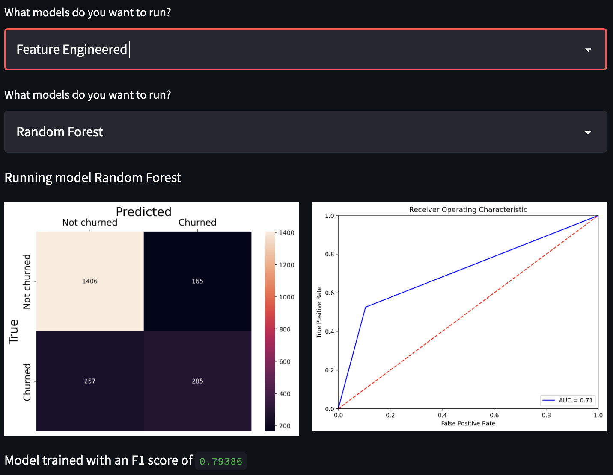
RANDOM FOREST CLASSIFIER GIVES BEST PREDICTION ON RAW UNSCALED DATA WITH F1 SCORE OF 79%

Slide 16
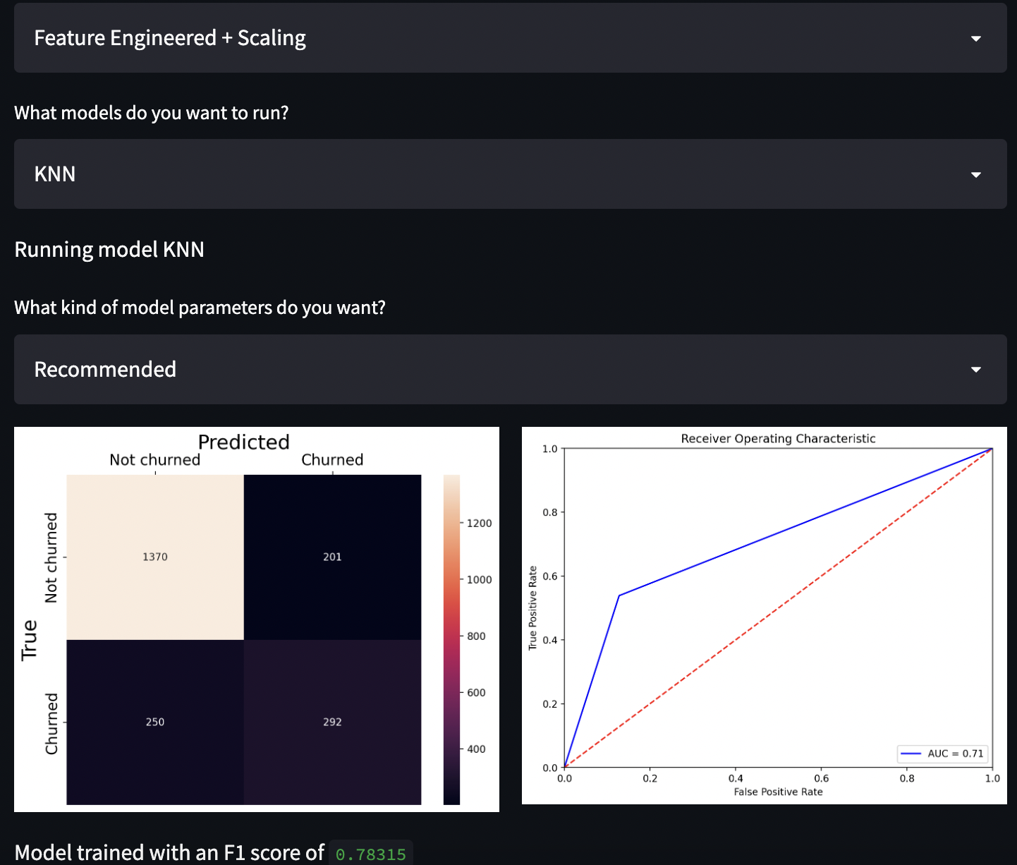
KNN CLASSIFIER GIVES A 78% F1 SCORE WITH SCALED DATA

Slide 17
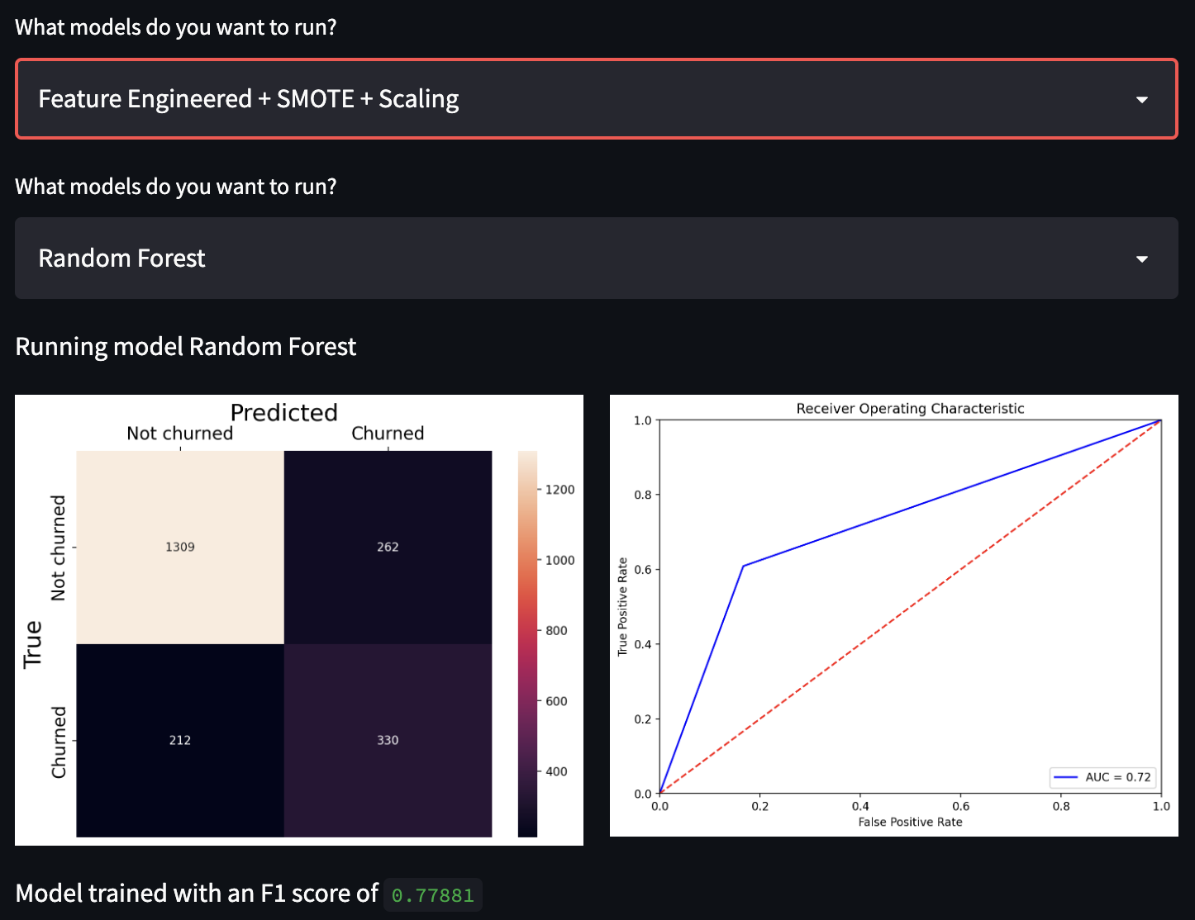
RANDOM FOREST CLASSIFIER GIVES 77% F1 SCORE WITH BALANCED, SCALED DATA

Slide 18
COMPARATIVE EVALUATIONS OF ALL ML MODELS USED
Logistic regression, SVM Classifier, Random Forest, KNN, XGBoost Classifier, LightGBM Classifier tuned with best/recommended parameters using cross-validation

Slide 19
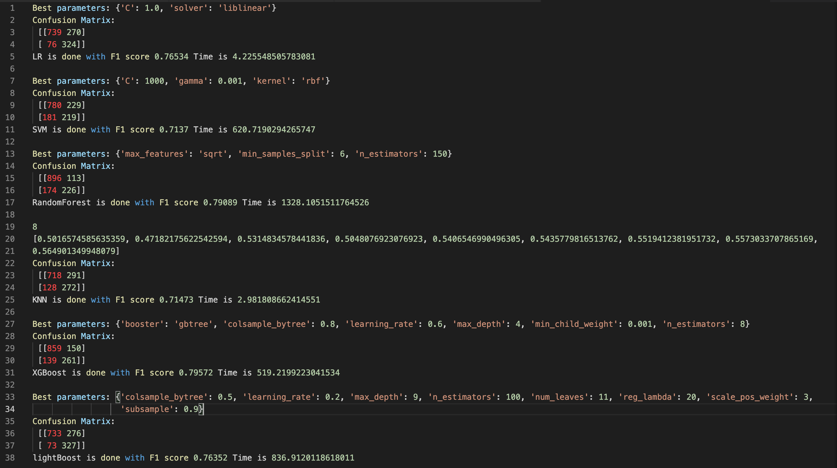

Slide 20
NEURAL NETWORKS GIVES THE BEST ACCURACY SCORE OF 86%
Last few optimal epochs and classification report

Slide 21
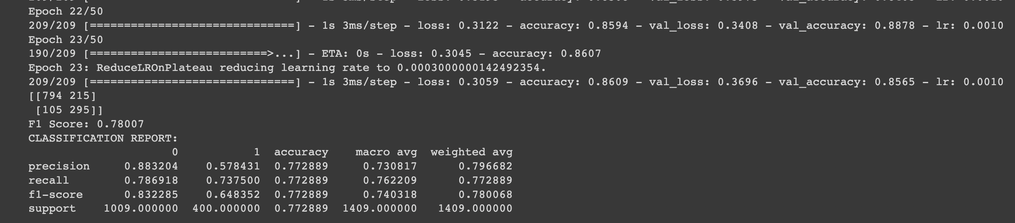

Slide 22
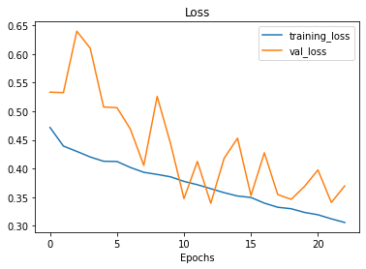
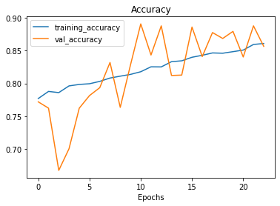
LOSS CURVES FOR TRAINING AND VALIDATION METRICS

Slide 23
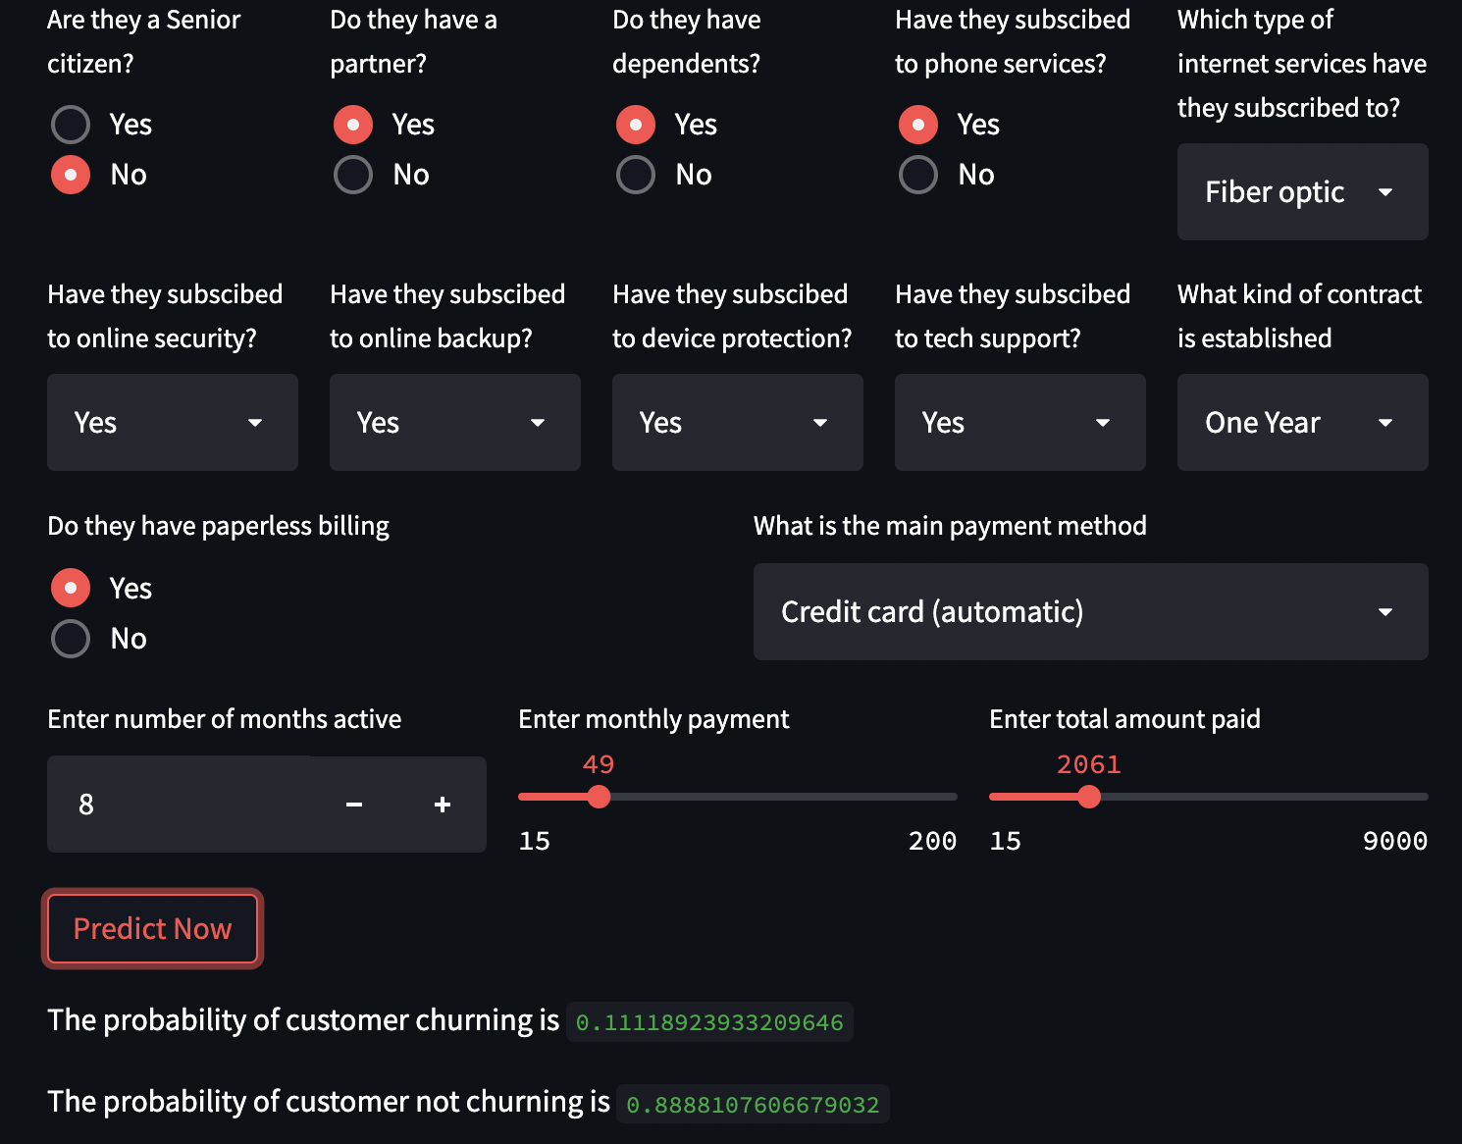
DEPLOYMENT USING STREAMLIT

Slide 24
CONCLUSION
The best way to avoid customer churn is to identify customers who are at risk of churning and working to improve their satisfaction.
The most important features that helped this models are ”Tenure” which had the biggest effect and then “TechSupport” and “TotalCharges”
Based on my project and results, Random Forests and Neural Network models predict the probability of “high risk” customers very effectively.
I decided to use ROC AUC as the evaluation metric
suitable to classification problems
robust to imbalance of the target classes compared to accuracy
The confusion matrix was used to check if I am avoiding both type I error and type II errors.

Slide 25
THANK YOU

