Slide 1



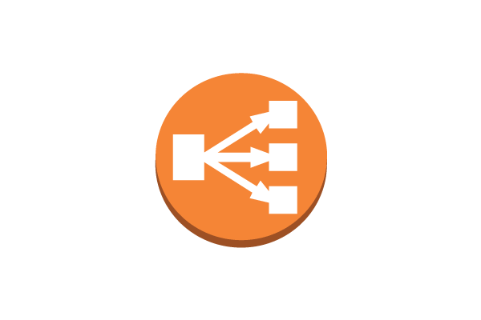



INTERNET
Route53
Web Servers in
Availability Zone A
Load Balancer
Web Servers in
Availability Zone B
Auto Scaling group
S3 Bucket

