Slide 1





Principles of Computational Thinking
Topic - Tea Stall
PCT- GROUP 12

Slide 2


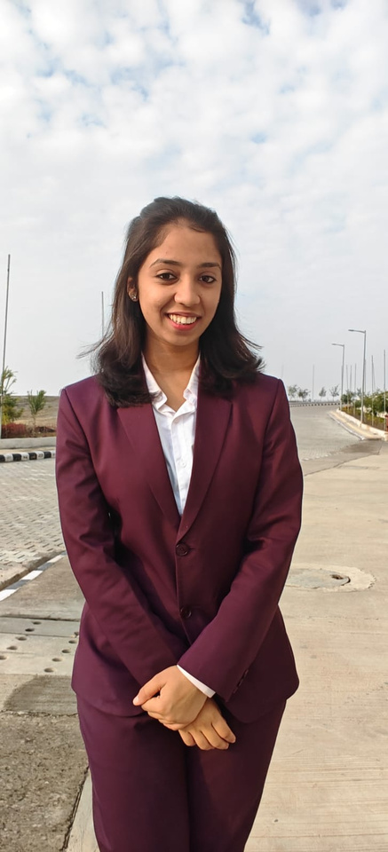


Our team
Priyanshu singh
IPM25104
Shudhanshu Jaiswal
IPM25125
Helly Vyas
IPM25059
Mishti Aggrawal
IPM25081
Anushka Jain
IPM25025

Slide 3
Objective of this simulation
• To create a model of a one server queue in real time by using arrival and service information.
• To study how customers flow through the system based on FIFO (First In-First Out) processing method.
•To obtain key performance measures, such as waiting time for service, service time, and total time in the system.
•Identify any delays, idle time, and bottlenecks present in the system.
•To analyze and improve the overall efficiency of the service.

Slide 4
Variables selected
•Inter-Arrival Time
•Service Time
•Waiting Time
•Idle Time/Serving time
•Dine-in / Leisure Time

Slide 5
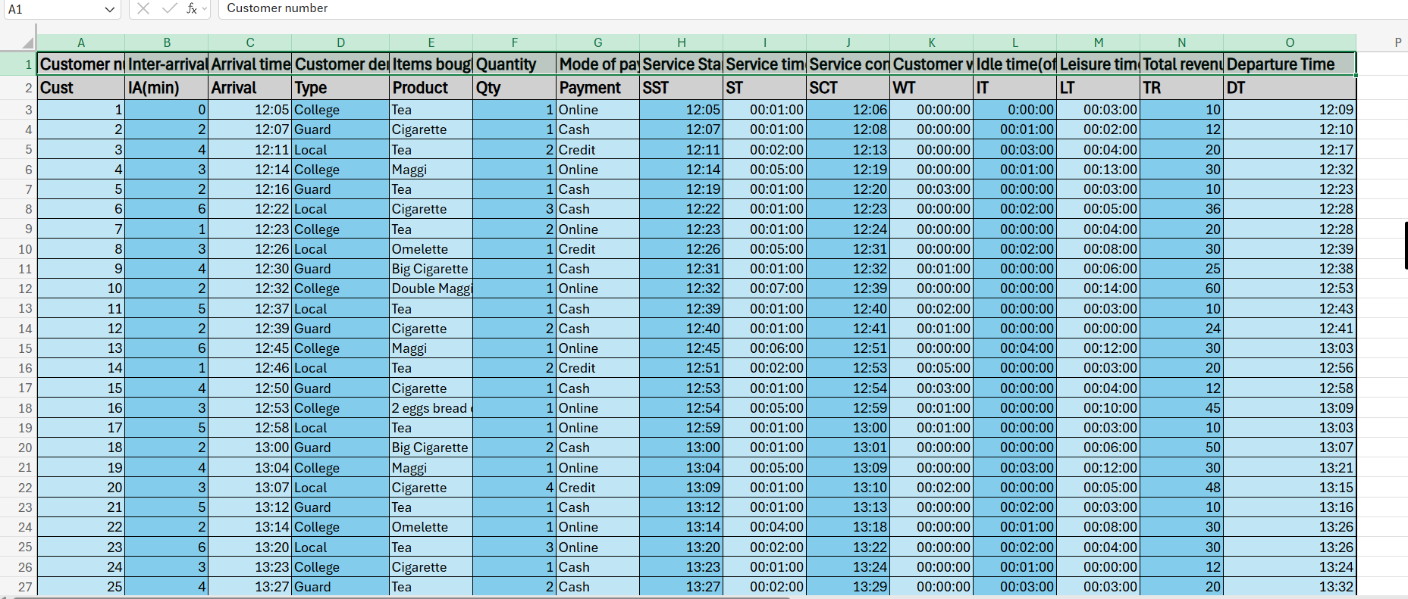
Data collection table

Slide 6
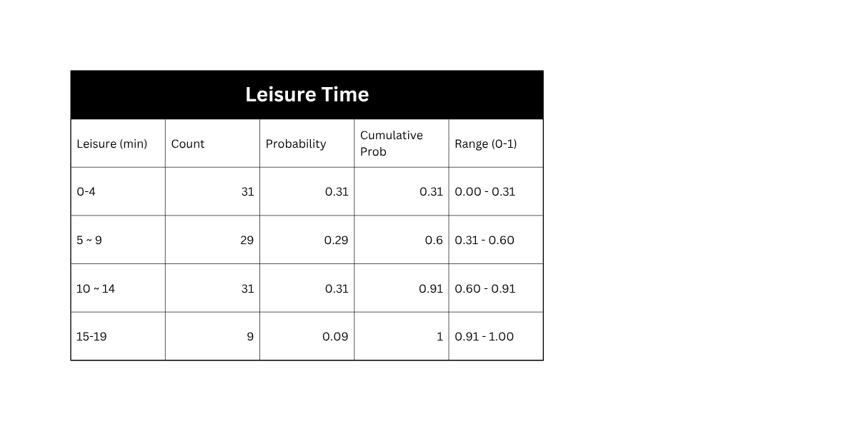
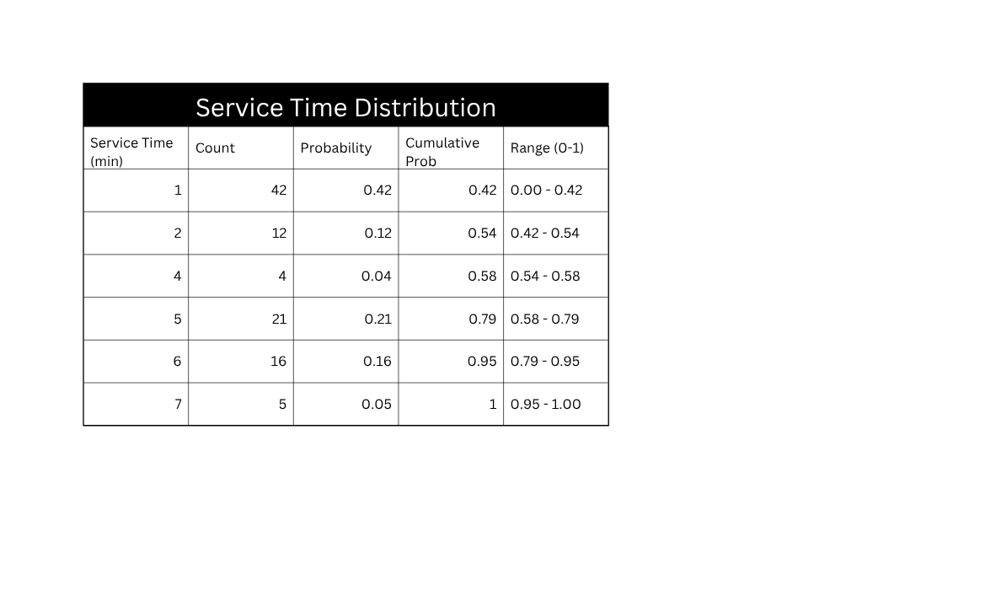
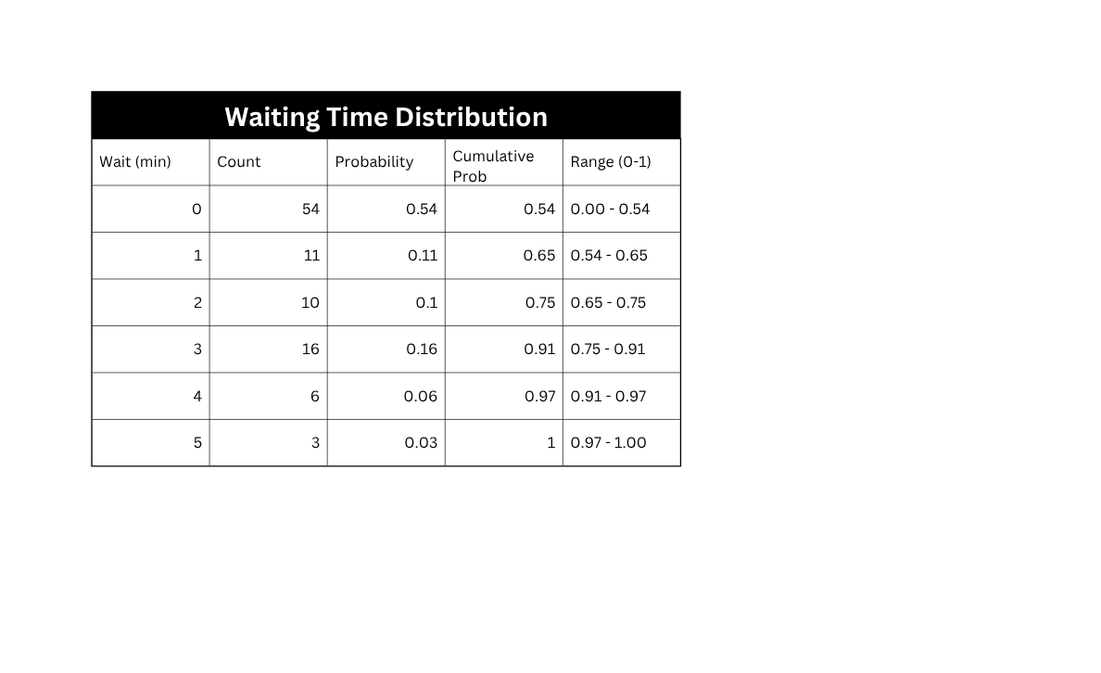
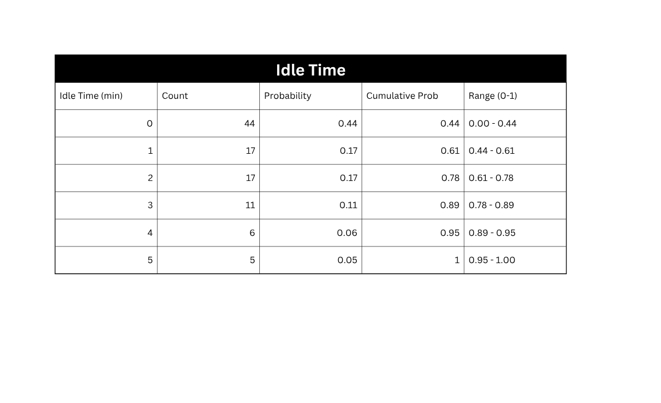
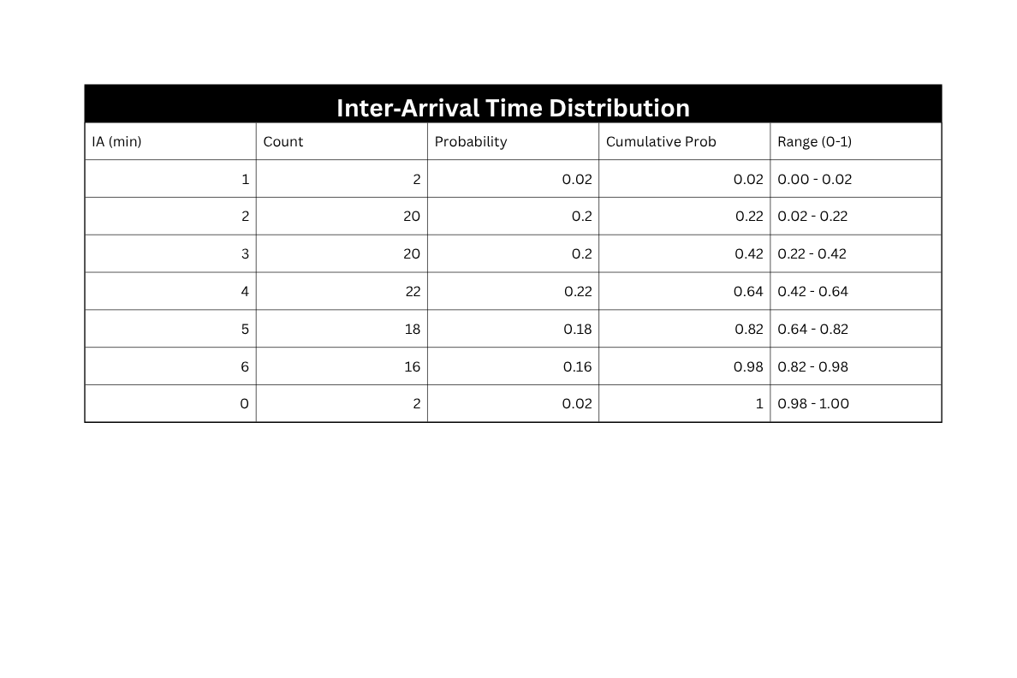
Range Tables for Each Variable

Slide 7
INFERENCES FROM SIMULATION
•More than half of all customers do not wait for their service because the server is able to meet demand effectively between peak hours.
•Service times are mostly between one and two minutes (54% of all cases) which reflects a very rapid, high volume service.
•In addition, 44% of the time, servers are idle, which indicates a near-constant demand on the system, with little downtime.
•Inter-arrival times are most often four minutes (22%), indicating that customer flow is moderate/steady throughout the business day.
•Leisure/dine-in times are spread out fairly evenly over all customers with 69% of all customers being on-site less than 14 minutes; resulting in most customers being there for a short duration.

Slide 8
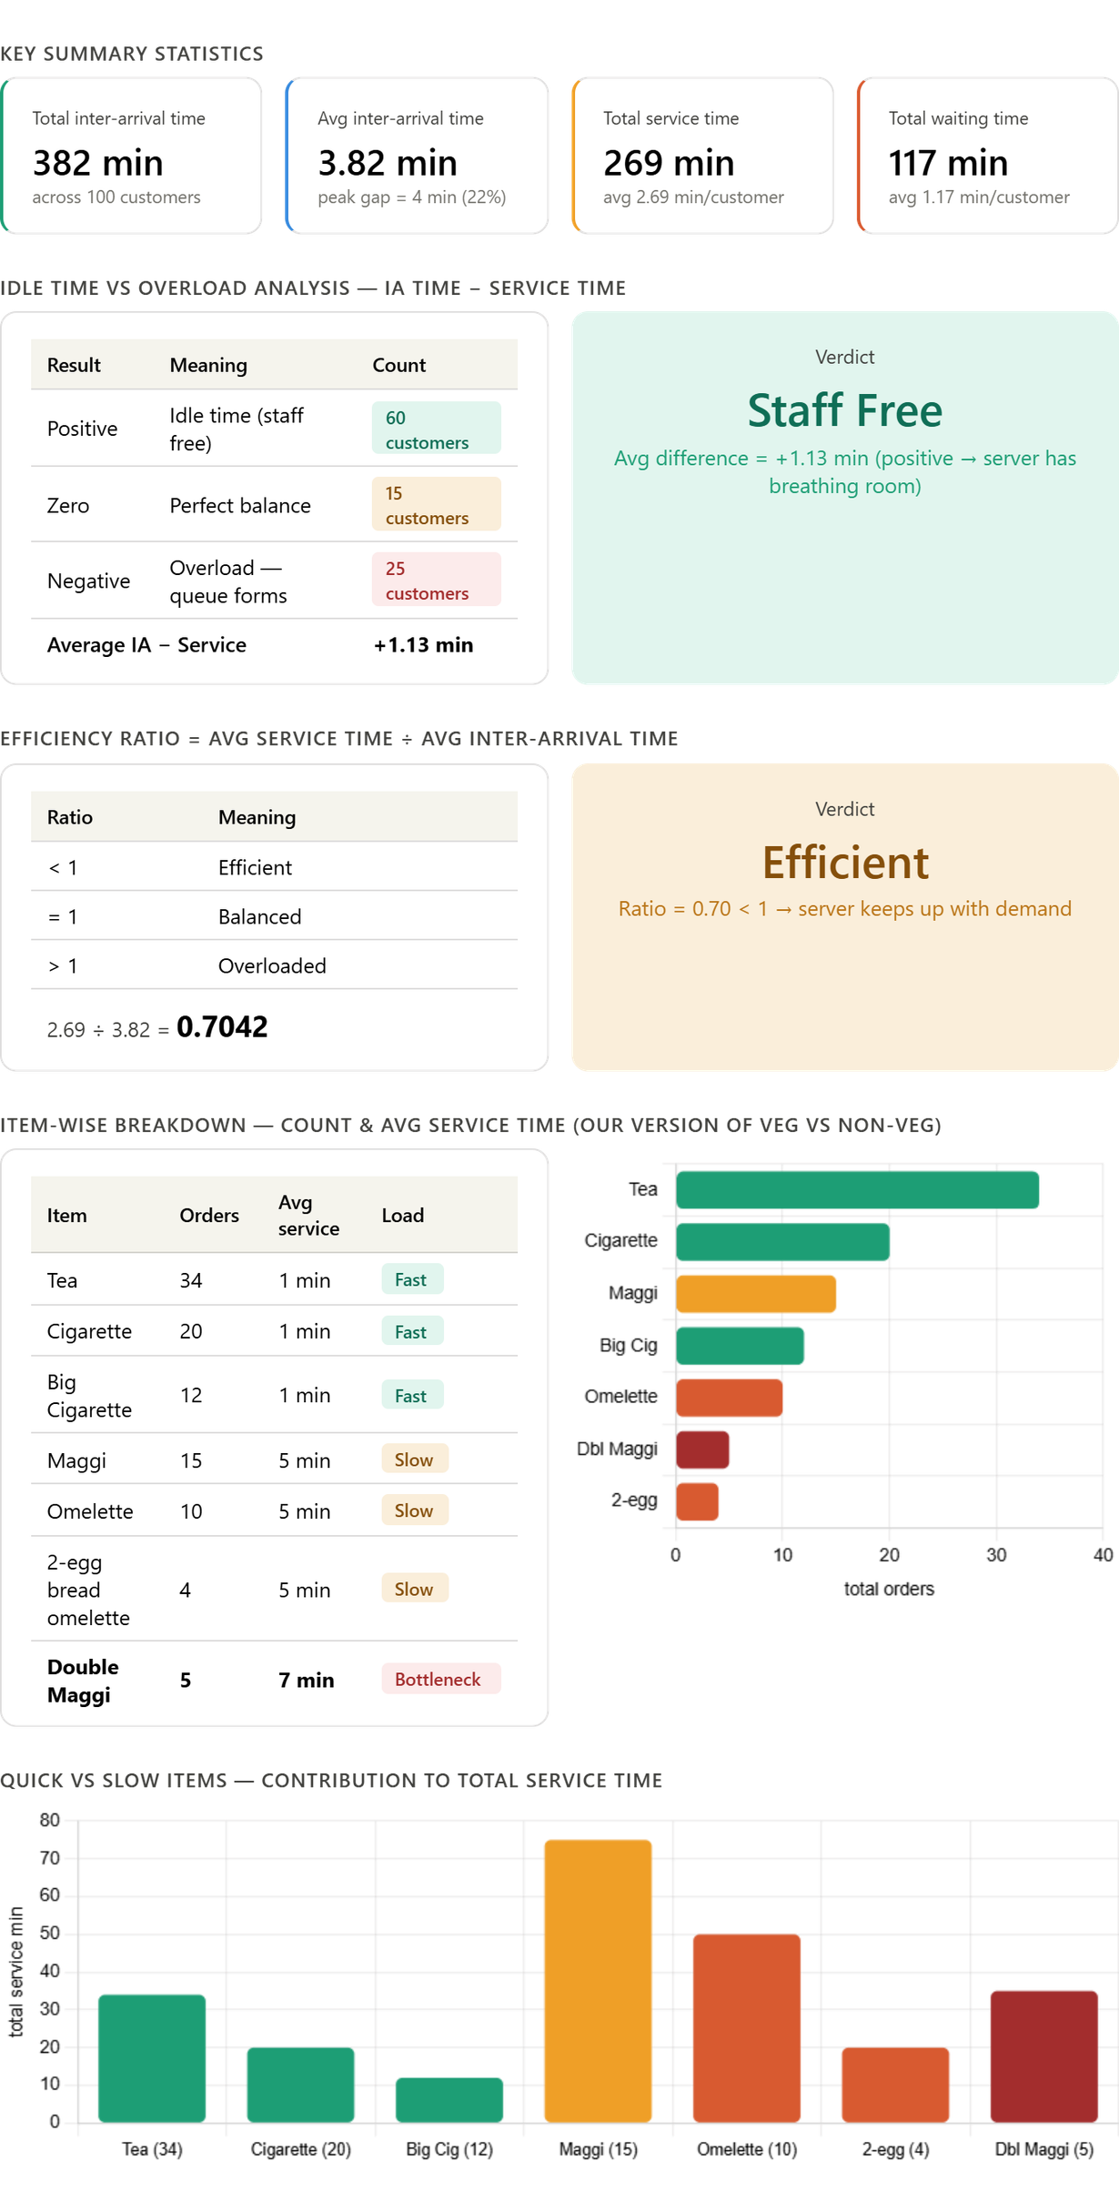
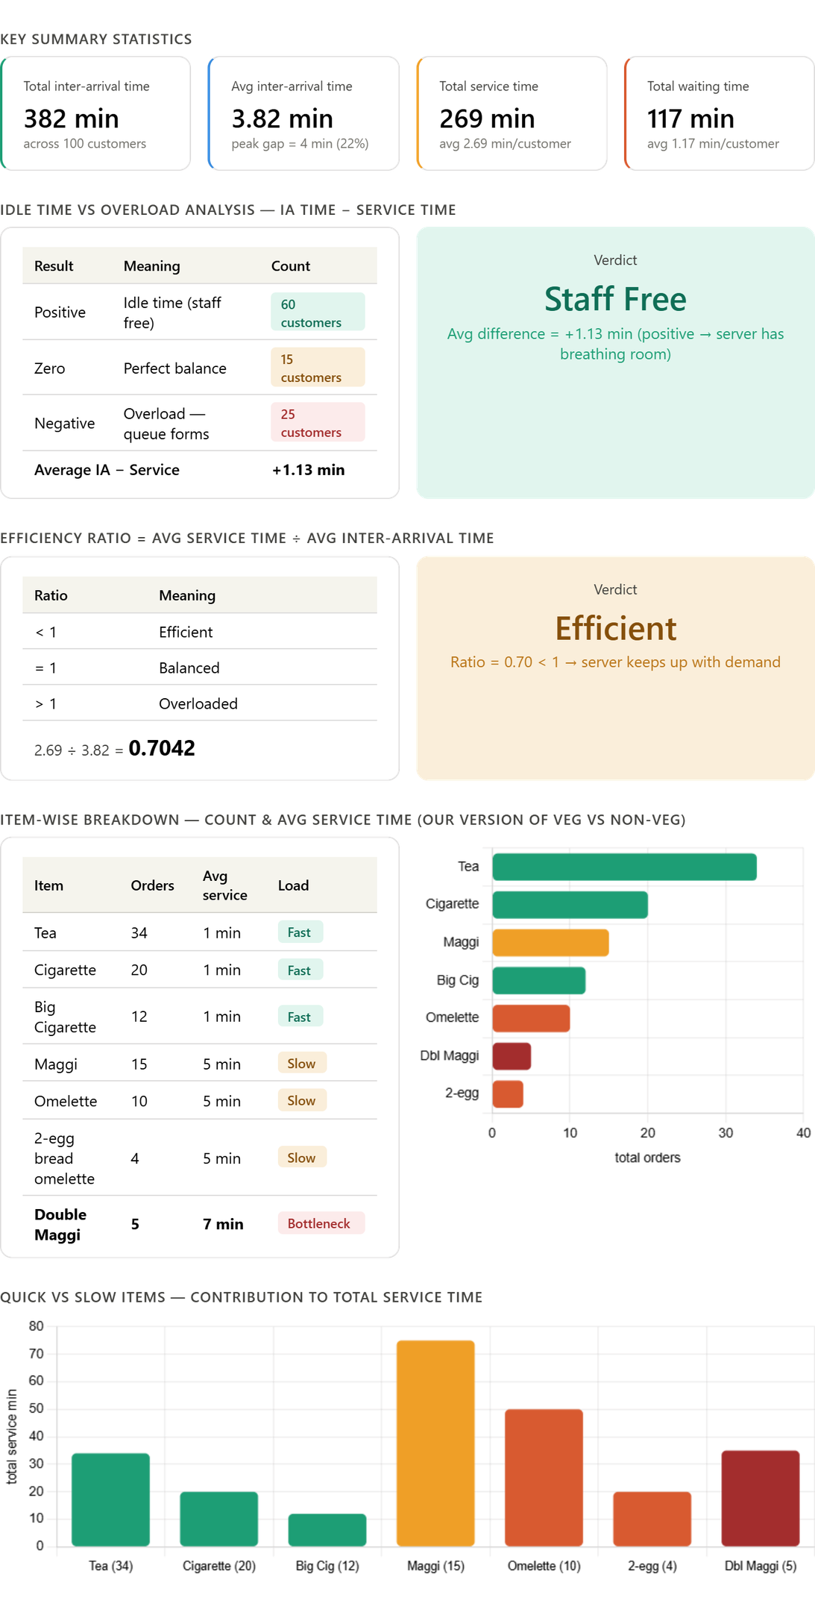
INFERENCES FROM SIMULATION

Slide 9
Conclusion
According to the Monte Carlo simulation, the canteen operates smoothly and serves the customers quickly, and waits are a rare occurrence (54% of customers do not encounter a wait). In fact, most customers finish their transactions between 1 and 2 minutes of ordering. However, during busy times, long lines form causing many customers to wait; and since there is only one server on duty, no time to recover from a long wait is available for the server to serve another customer immediately after the first customer has finished their transaction, resulting in longer than usual wait times. Adding one additional server during rush periods would dramatically reduce the time spent waiting in line and improve the overall experience of using the stall.

Slide 10
Contribution of each member
Anushka Jain
20%
Helly Vyas
20%
Mishti Aggrawal
20%
Priyanshu singh
20%
Shudhanshu Jaiswal
20%

Slide 11
Thank
You

