Slide 1
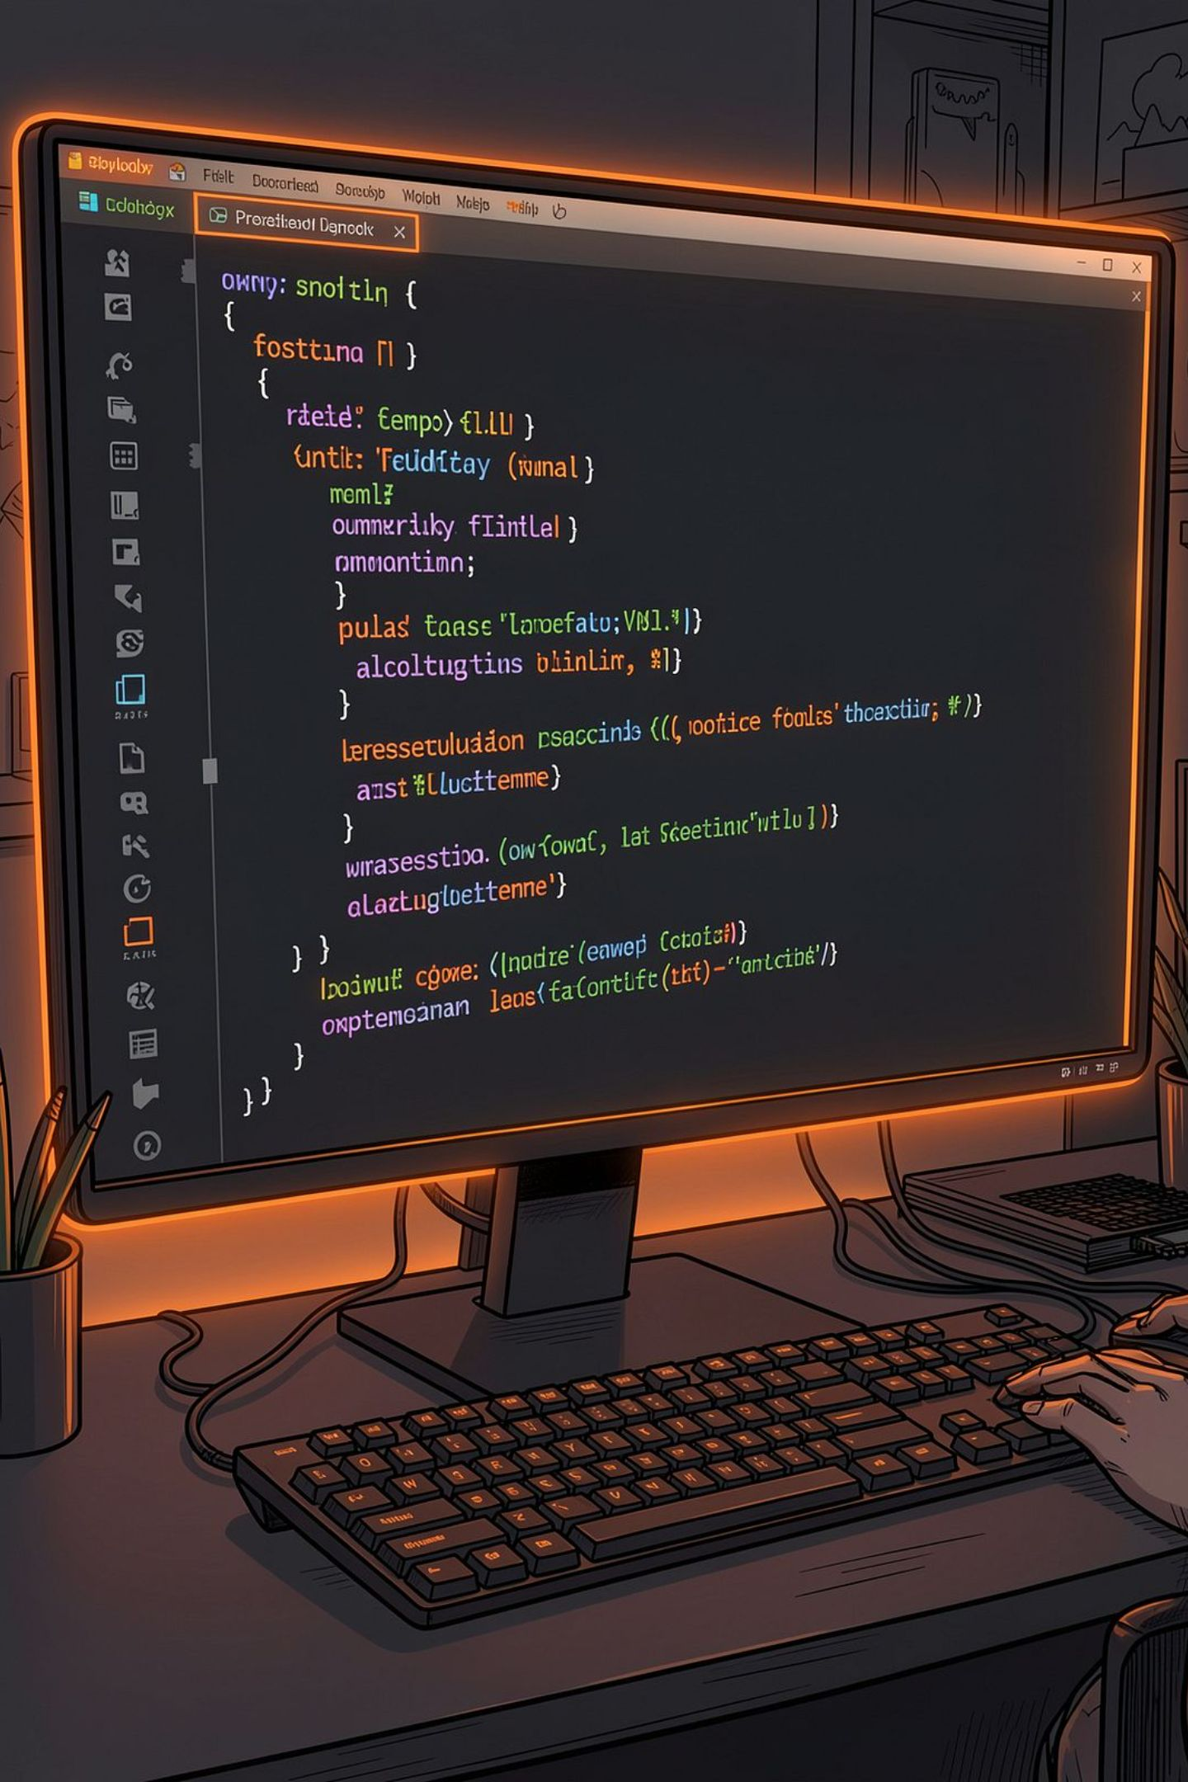
Python-Based Application Development and Automation
Internship Report · B.Tech CSE · School of Computer Science and Engineering, IILM University, Greater Noida
SUDHANSHU KUMAR · ROLL NO. 25SCS1003004635 · BATCH 2026–27

Slide 2
Declaration & Acknowledgement
Candidate's Declaration
Acknowledgement
I, Sudhanshu Kumar, declare this internship report is my original academic work, completed as Python Developer Intern at Codec Technologies Pvt. Ltd. (10/06/2026 – 10/07/2026). All references have been acknowledged.
Grateful to Codec Technologies for guidance and practical exposure to Python development. Thankful to IILM University for academic support, and to my parents, teachers, and friends for their continuous encouragement.

Slide 3
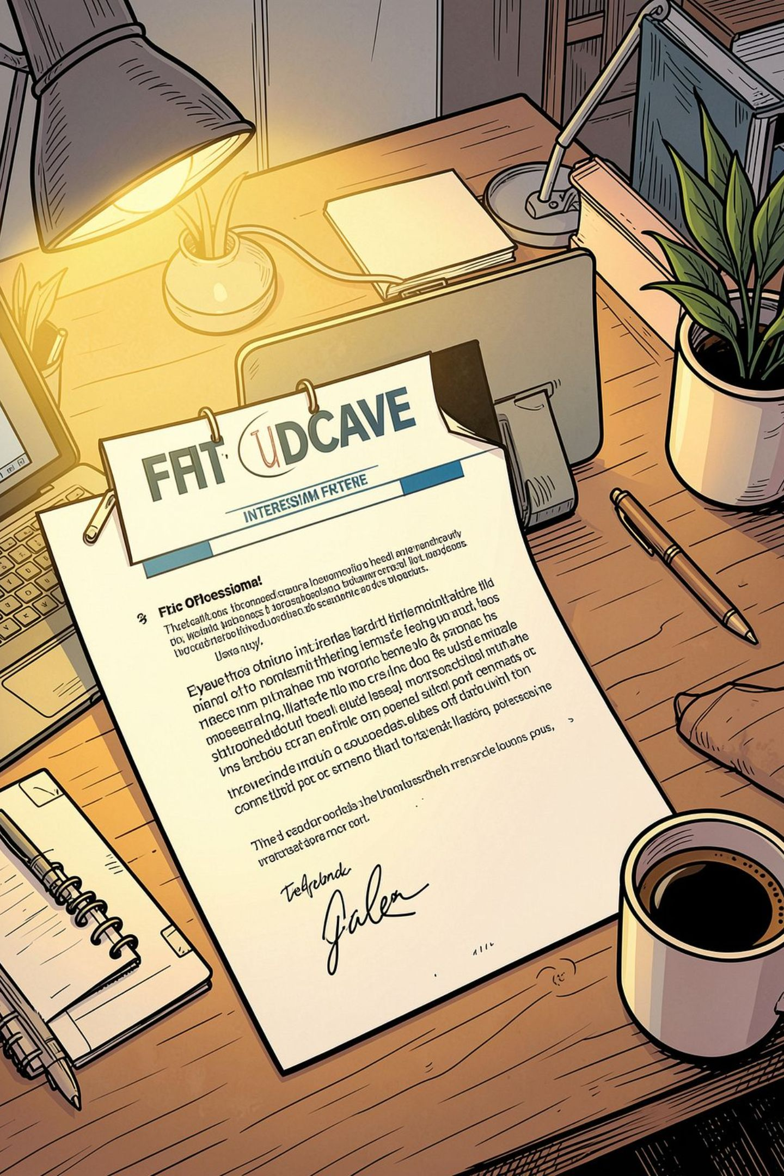
Internship Offer Letter
Designation
Python Developer Intern
Duration
10/06/2026 – 10/07/2026
Mode
Pan India, Hybrid
Reporting To
Assigned Project Head(s)
Codec Technologies is a global IT and business consultancy operating across 27+ countries, empowering learners and connecting diverse talent worldwide. Exceptional interns may qualify for a scholarship based on weekly performance reviews.

Slide 4
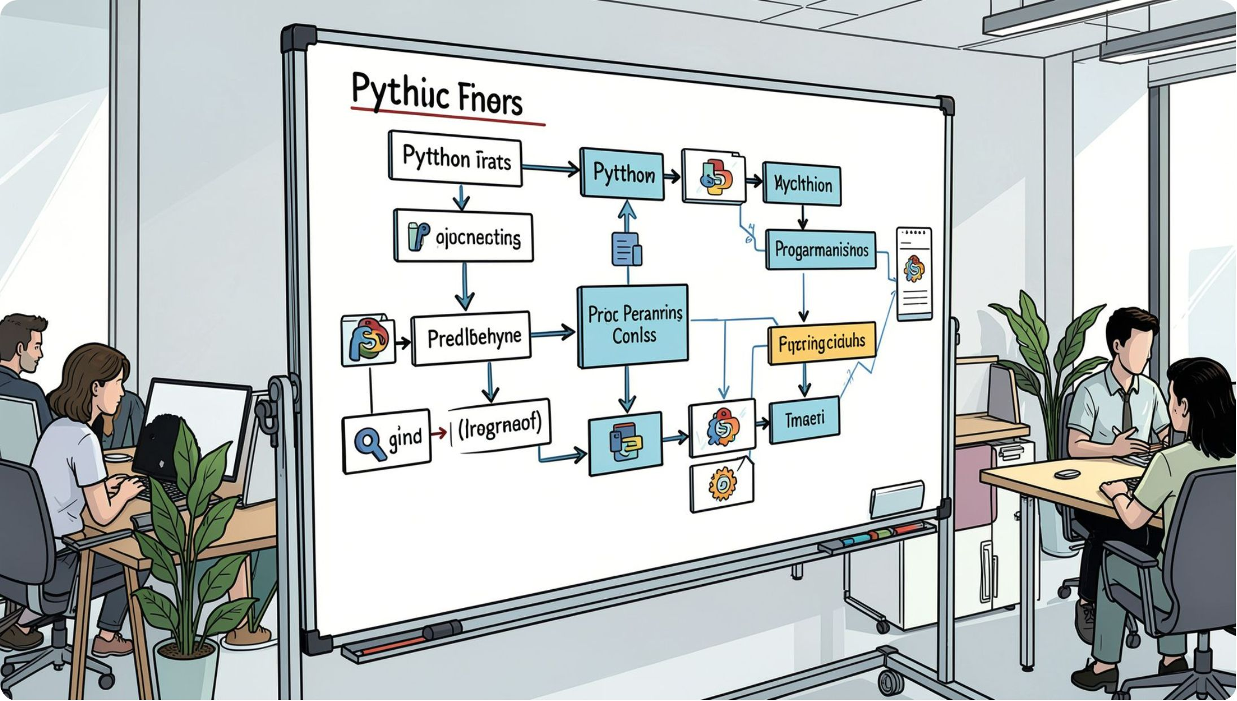

Introduction
Python is widely used for application development, task automation, data processing, and intelligent software solutions. This internship at Codec Technologies focused on practical Python development.
Core Focus
Skills Applied
Design of a Python-based workflow: input collection → processing → validation → output generation.
Functions, modules, data handling, error management, testing, and basic automation.

Slide 5
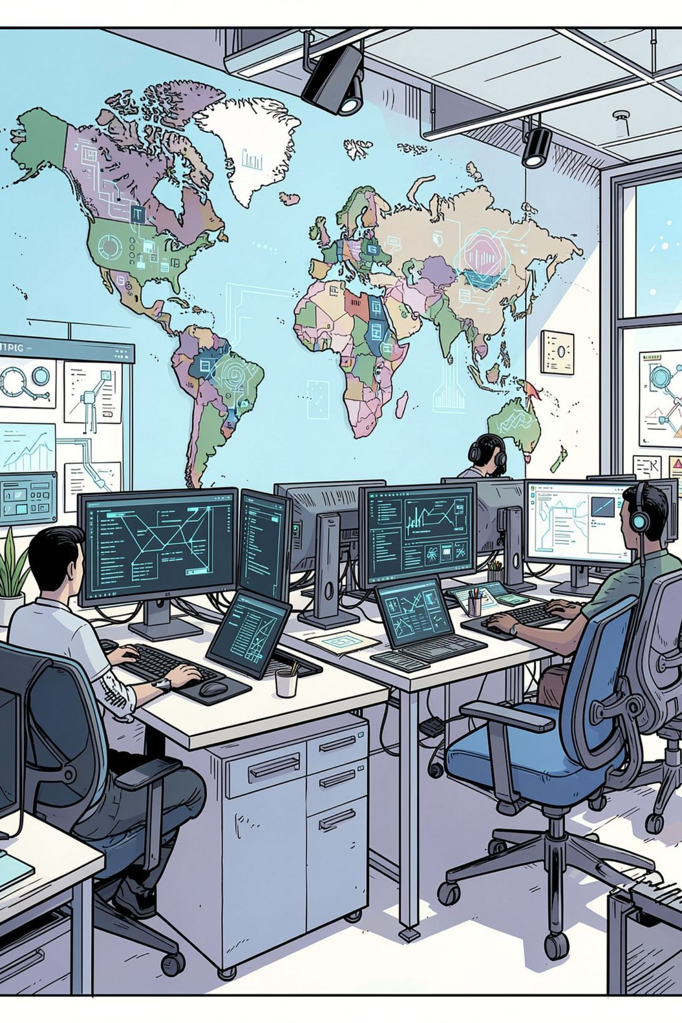



Organization Profile
Codec Technologies is an IT and business consultancy and technology-learning organisation. Its mission is to empower individuals and organisations through technology solutions and learning experiences.
Global Reach
Delivers IT and business consultancy services across 27+ countries, empowering global innovation and strategic growth.
Learning Programs
Provides internship and training programs, including Python Developer internships with hands-on exposure to industry tools.
Certified
ISO 9001:2015 certified and Google for Education Partner.

Slide 6

Problem Statement & Objectives
The Problem
Project Objectives
Repetitive tasks — data entry, validation, file handling — consume time and introduce errors when done manually. A Python-based solution can automate these with consistent program logic.
Strengthen practical Python skills through application-oriented work
Design a workflow for input, processing, validation, and output
Apply functions, modules, loops, and exception handling
Understand data handling, file processing, and professional practices

Slide 7
Scope & Technologies Used
Scope of the Project
Technologies & Tools
Covers Python programming, application logic, data processing, basic automation, testing, and documentation. Intended as a learning and prototype-level implementation. Future extensions may include a GUI, database integration, web APIs, and cloud deployment.
Python
IDE / CLI
Application logic & automation
Python-compatible editor & command-line tools
Git/GitHub
Standard Modules
Source-code management & project tracking
Python data structures & file-processing

Slide 8

System Architecture
The Python application follows a modular input → processing → output architecture, allowing individual components to be tested and improved independently.
Input
Python Processing
Validation
Output
Figure 4.1: System Architecture of the Python-Based Application

Slide 9

Methodology & Expected Outcomes
01
02
03
Orientation
Requirement Analysis
Design & Development
Understand internship program, Python workflow, and project requirements
Identify inputs, processing steps, validation rules, and expected outputs
Break application into functions/modules; implement using Python
04
05
Data Processing & Exception Handling
Testing & Documentation
Transform and validate sample data; handle invalid inputs gracefully
Run test cases, debug issues, and record project structure and learnings
Expected Outcomes: A functional prototype demonstrating Python-based input processing and automation; improved understanding of Python syntax, functions, modules, data handling, and exception handling; practical experience organizing a small software project; better debugging and testing skills; exposure to professional development practices including documentation and source-code management; increased confidence in using Python for future academic and software-development projects.

Slide 10
Certificate of Completion & References
Certificate of Internship
References
Awarded to Sudhanshu Kumar by Codec Technologies Pvt. Ltd. for completing the AICTE & ICAC approved 1-Month internship as Python Developer Intern (10/06/2026 – 10/07/2026).
Dr. Anurag Shrivastava, Program Manager
Codec Technologies — Official Website (organisation, internships, technology-learning programs). Accessed August 2026.
Codec Technologies — Placements/Internship information page (Python Developer opportunities). Accessed August 2026.
AICTE Internship Portal — Python Developer Internship program information. Accessed August 2026.
Internship Certificate, Codec Technologies Pvt. Ltd. (10/06/2026 – 10/07/2026).
Python Software Foundation — Python Documentation. Accessed August 2026.

