Slide 1
April Report
Sanjay Madria

Slide 2
UI design and architecture for battlefield DTN secure data sharing with ReVo-ABE
View model architecture.
Login page for security setup.
Main activity page for activity navigation and setting configuration.
Message page show all the receiving messages.

Slide 3
View model architecture
The view model architecture separate the data plane with the UI controller which is easy to debug.
The view model handle data operation in a non-block fashion thus reduce the UI delay.
The LiveData in the view model observe the data change and update the data value for the UI controller.
The view model stores important data when app stops and recover the view when the app restarts.
The view model communicates with the database and observes updated database value for its LiveData elements.

Slide 4
Design of Login page
The initial layout of the UI is the login page for security initialization.
The user needs to type in their username and password to login the demo APP.
If the user has a valid security key and a public key of ReVo-ABE, the APP will redirect the user to the main activity layout.
Otherwise, the user will be redirected to the security bootstrap layout to initialize the security and public key for a specific mission.

Slide 5
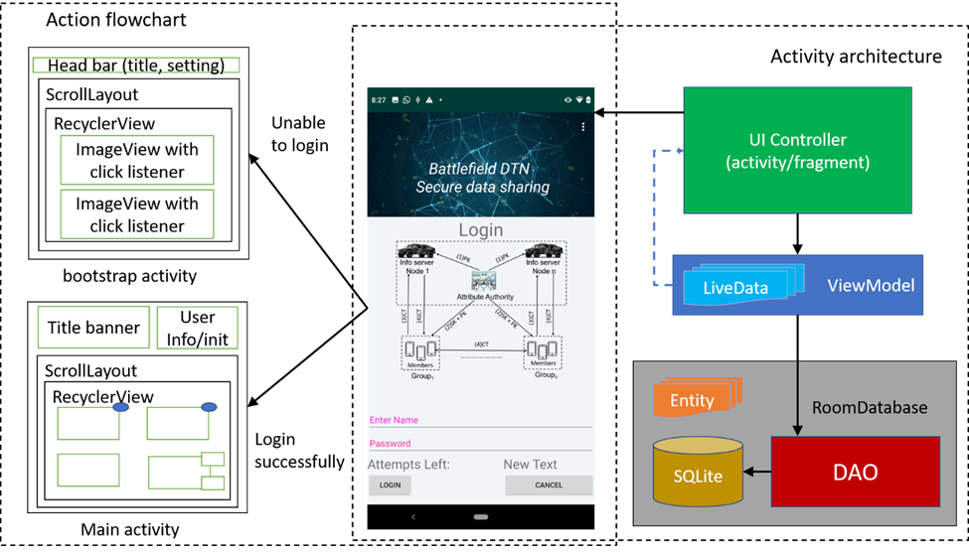
Design of Login page

Slide 6
Design of main activity page for activity navigation and setting configuration
The main activity layout is the key UI interface in this project.
It acts as a book index that lists most of the user actions in one page.
Its view model stores all the intermediate state of the running application in the live data parameters that prevent data losing after rotate, check out and check in.

Slide 7
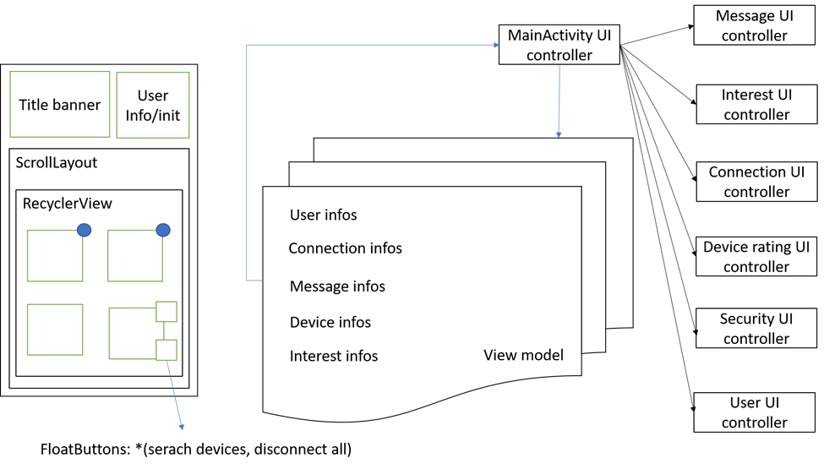
Design of main activity page for activity navigation and setting configuration

Slide 8
Design of the Message page
It shows all the in/out messages.
The message button, which may have red bubble that shows number of new messages, could direct the user to the message pages that contains all the received and sent messages with picture and text.
The use of Room database API simplifies the programming difficulty for database generation, updating, and data query.

Slide 9
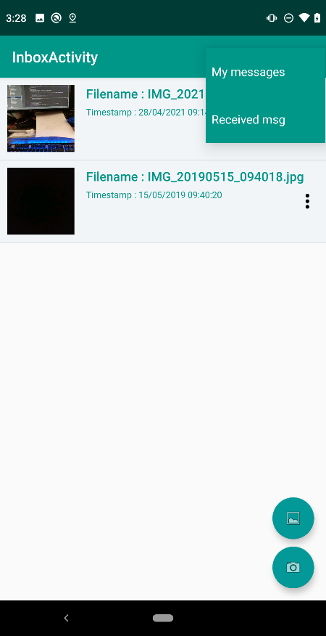
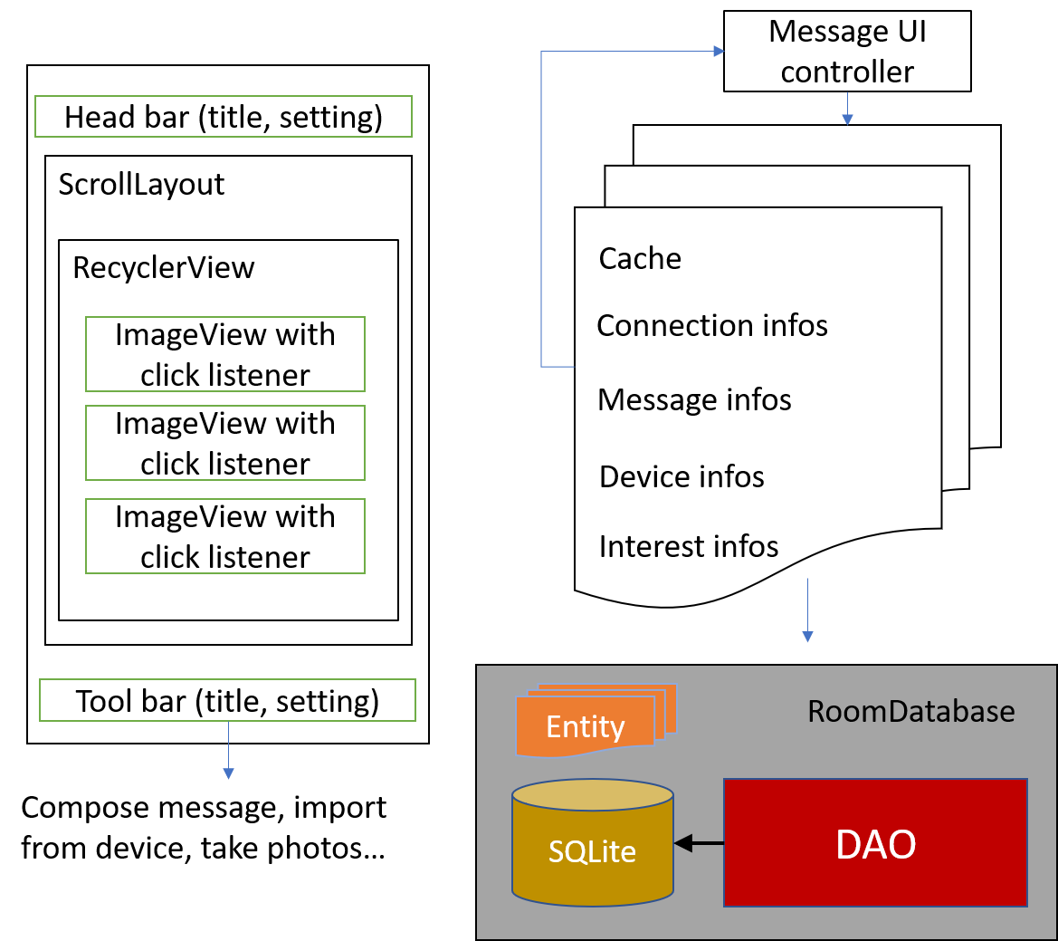
Design of the Message page

Slide 10
Content Caching for DTN network
Problem statement.
Object 1 and solutions.
Object 2 and solutions.
Object 3 and solutions.

Slide 11
Problem Statement
A message needs to be forwarded to a set of nodes who have higher interest similarity with this message. Besides, messages need to be forwarded to the CC also as many as possible.
While forwarding messages, congestion may occur to the nodes with high mobility and contacts.
Different events lead to different topic as trending or important. These need to be identified and quickly dispersed.
Due to limited bandwidth and intermittent connection among the node in a DTN, content transmission from further node causes long-transmission delay which can be handled by efficient cache management.
As nodes also move, their trajectories need to be analyzed in deciding what content to cache in which node.

Slide 12
Objective 1: Priority Content Delivery
Some content may have more priority due to an event and forwarding those content to the CC needs to be fast.
We propose to detect the content with higher priority and transfer them among the nodes as much as possible so that those content will be delivered to the CC and nodes quickly and everyone will be aware of the incident.
However, priority content may become less important after some time, and hence our approach can handle this issue by emphasizing more on content generated in recent time slots than previous time slots.

Slide 13
Trending topic detection
Message generation information is stored in the nodes by discretizing time in several time windows.
The trending topics can be identified by the “TF-IDF” (Term Frequency, Inverse Document Frequency) method by considering the topics of the generated messages in certain number of time windows.
Messages regarding trending topics are generated a lot in a short time span. Hence, we modify the “TF-IDF” by squaring the “TF” value of the topics.
However, messages for an event are generated in certain location. Hence, we consider the Standard Deviation (SD) of the location of the generated messages’ topics to find out how distributively they are being generated.

Slide 14
Trending topic detection formulation
We calculate the modified TF-IDF value of a topic t for a time window as follows:
TF(t)= $\frac{Count(t,{tw}_{cur})}{\sum_{t∈T}{Count(t,{tw}_{cur})}}$
IDF(t)=$\frac{∑t∈T\sum_{tw∈TW}{Count(t,tw)}}{\sum_{tw∈TW}{Count(t,tw)}}$
SD(t) =SD _{∀m ∈ M (t, tw_cur)} Location(m)
Where Count (t, tw) defines the number of times a topic t appeared in a time window tw. T is the set of all topics and TW is the set of all time windows. tw_{cur} is the current time window. M (t, tw_{cur}) is the set of messages containing topic t and generated in tw_{cur}.
Finally, we can calculate the modified TF-IDF as:
TF−IDF _{modified}(t) =TF(t)²∗ log [IDF(t)] / SD(t)
To calculate the priority of a message m, we take the average of all the associated topics’ (m_{t}) modified TF-IDF using the following equation.
Priority(m) = (∑ _{t ∈ m_t} TF−IDF _{modified} (t)) / |m_{t}|
Finally, we detect the trending messages by comparing their priority with the Trending Threshold θ as follows:
Is_Trending (m) =Priority(m) ≥ θ

Slide 15
Objective 2: Providing Content by Interest
Node’s storage, energy, and bandwidth is limited. So, a node cannot store and transmit/receive all the content.
We propose to forward content to a node based on its interest which is defined by its mission.
We measure the similarity of a content message with the interest of a node before forwarding so that it will fulfill the node’s interest.
For increased message delivery, we propose a RL based approach to adjust nodes interests so that they will be able to carry each other messages if frequently connected.

Slide 16
Congestion Handling
Data congestion in the nodes leads to more energy consumption due to transmission and more packet drops due to limited storage which can harm the overall performance of the network.
The congestion state of the nodes can vary based on the contact pattern and connection time with the other nodes.
Hence, we propose to learn the congestion nature of the nodes using RL and act accordingly so that nodes moving to the congested state will receive a reduced amount of data until they receive usual flow of content.

Slide 17
Finding better nodes to forward
Each node calculates the exponential moving average (EMA) of the Congestion Ratio (CR) which is the total transferred data vs total connection time.
The EMA of congestion is calculated based on the past few time intervals.
We consider multiagent Q-learning to forward information to the best node by considering the congestion status of the nodes.
Nodes apply different learning rates for different neighbors while learning based on the number of contact.
The reward r for learning is calculated as 1 / EMA of CR of the receiver node. This means if the receiver node is highly congested it will provide less reward.

Slide 18
Objective 3: Cache Management
Cache nodes can store huge content for other nodes and the content are always changing. This situation cannot be dealt with traditional Q-learning. Hence, we propose Asynchronous Advantage Actor-Critic (A3C) to handle the continuous state-action space.
In stationary scenario, transmission delay is considered as the key parameter while learning cache management. In our scenario, delay depends on the opportunity of nodes’ contact. Hence, transmission delay is measured with the time and hop needed to forward content to a node.
Nodes usually moves in a team for achieving same mission goal. A cache hit is considered when a team member receives the content for his other team member because they are supposed to be in closed vicinity.

Slide 19
Dependency Tree and Parse Tree Generation
Saving and Loading the model locally, saving the captions to database, tree edit distance.
Tree edit Distance.

Slide 20
Saving and loading the model locally
Trained the caption generation model on google collab database.
Saved the model on google drive and then downloaded all those required weights from the drive.
Tested all the code in local machines.

Slide 21
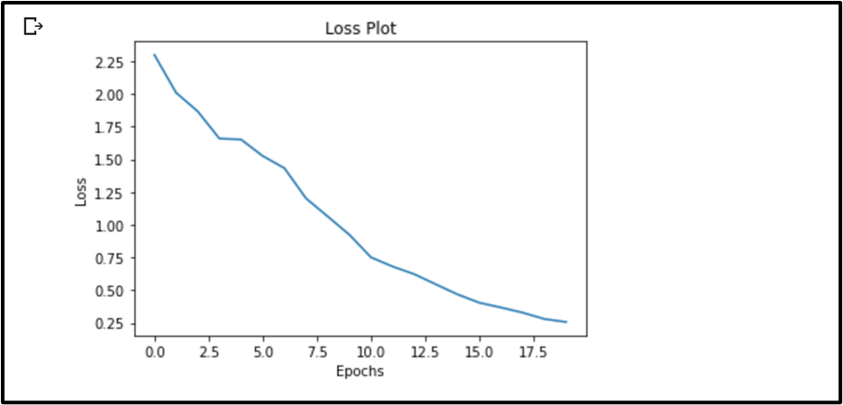
Loss plot after training the model for 20 epochs

Slide 22
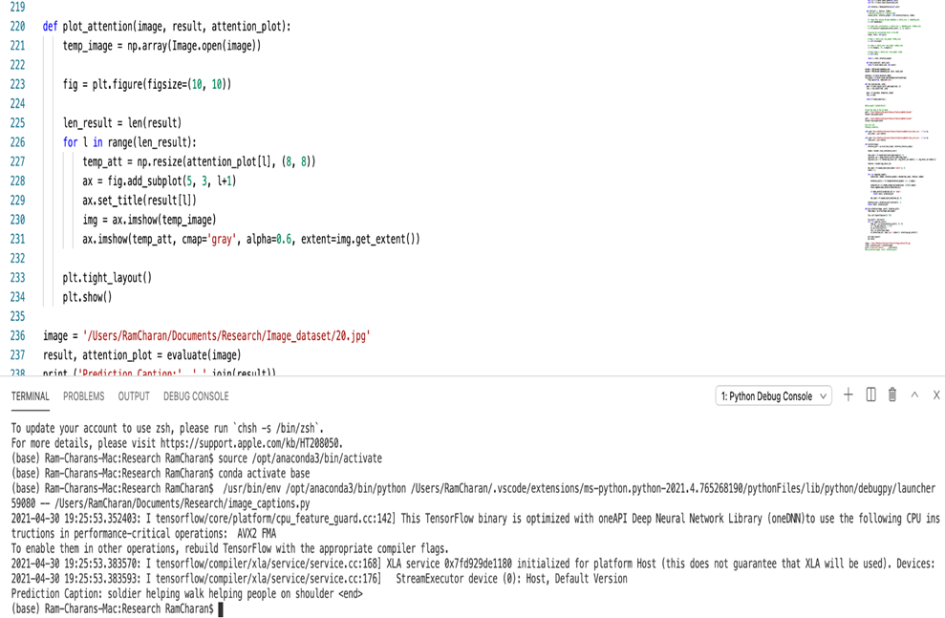
Example of prediction results of caption generation model in local machines

Slide 23
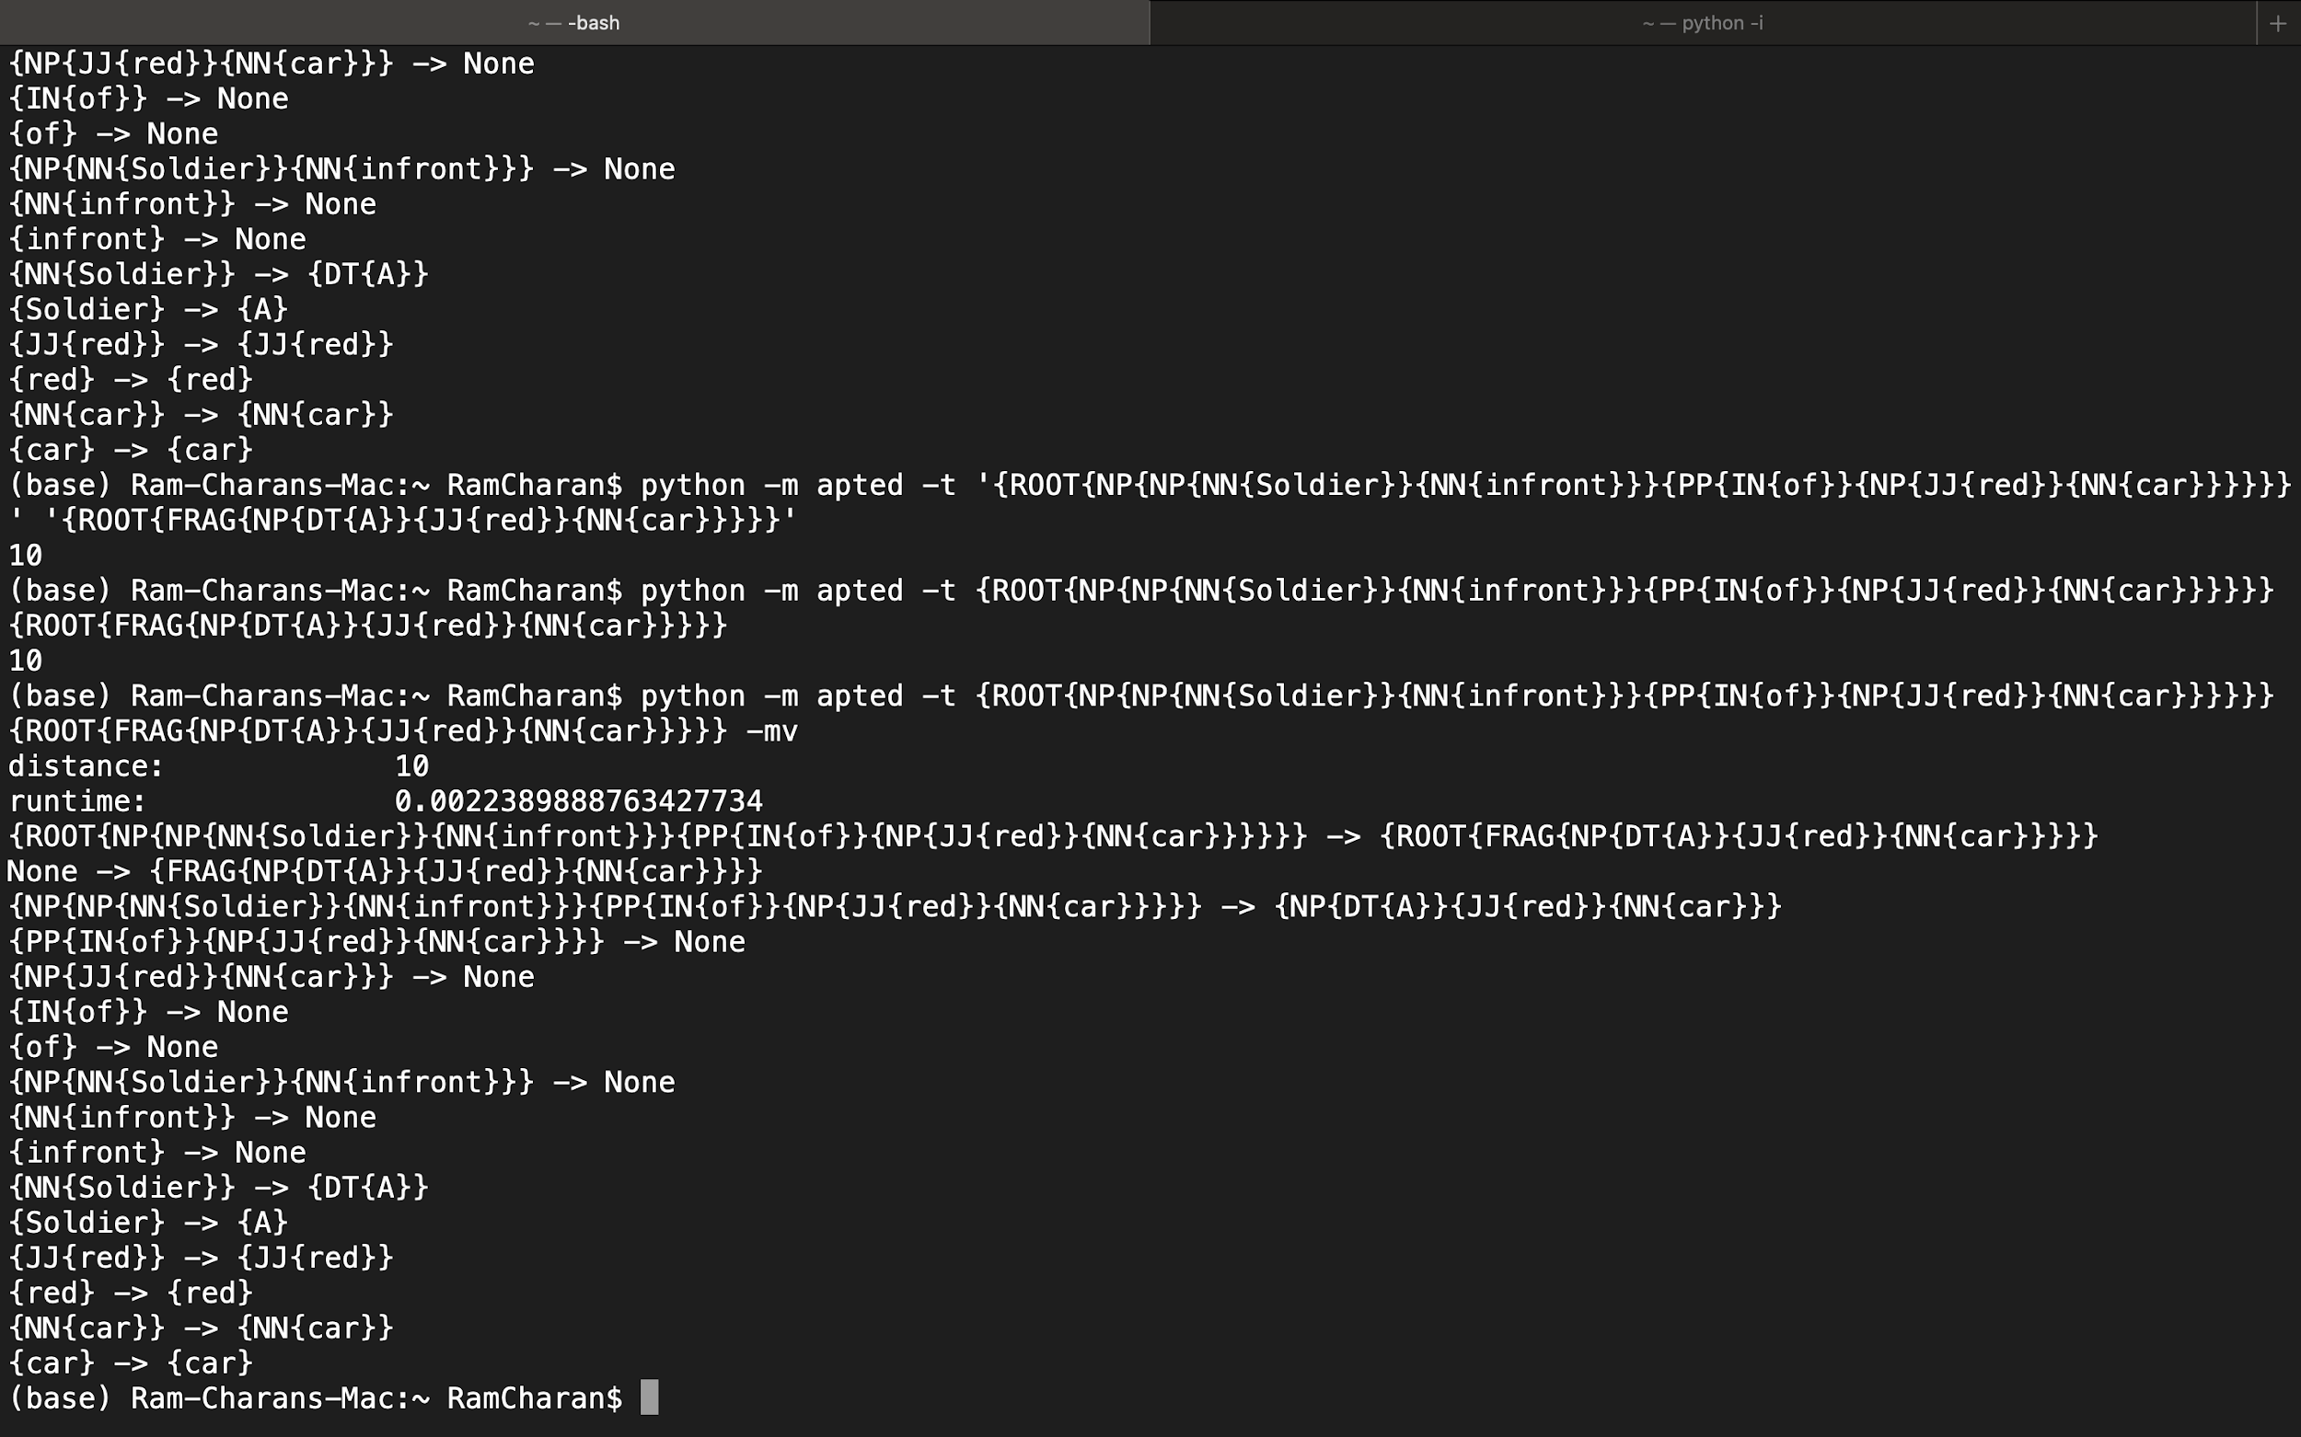
Tree edit distance
It is the minimum cost of transforming the source tree into the destination tree either by inserting, deleting or relabeling the nodes.
Apted Library helps us to compute the tree edit distance using it’s python implementation.
Below is an example to get the tree edit distance.

Slide 24
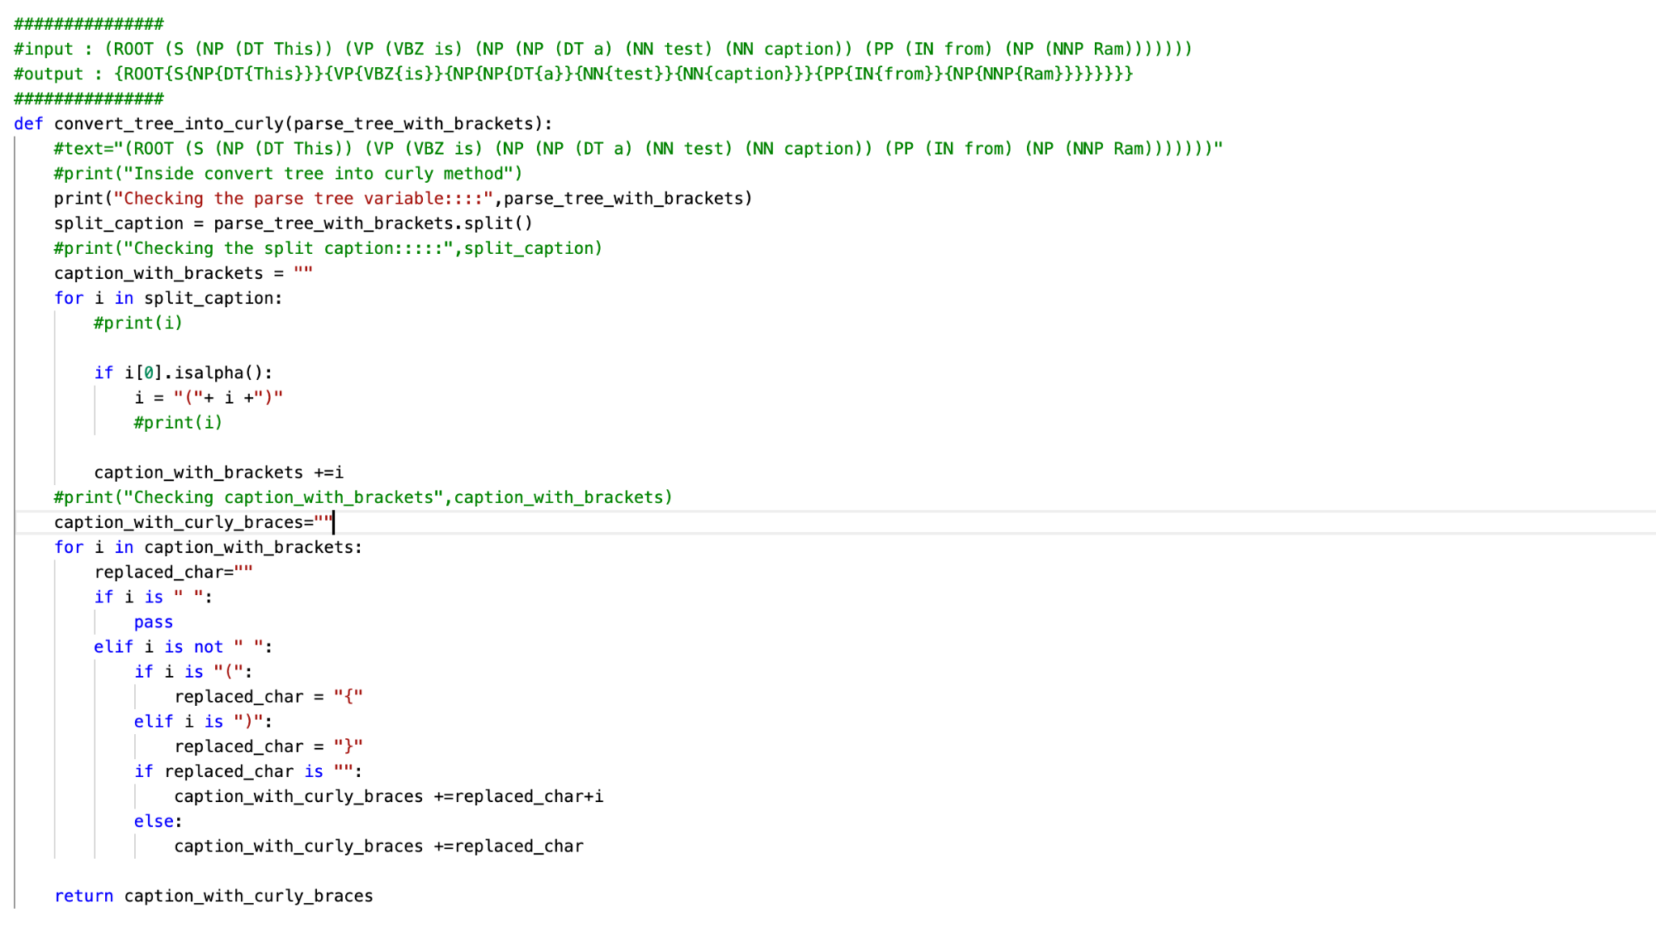
Code to convert the tree to the required format

