Slide 1
June Report
Sanjay Madria

Slide 2
Central Authority implementation
Mission information display.
User information display.
Create and delete mission.
Create and delete user.
Add user to the mission.
Generate barcode based on the mission code.

Slide 3
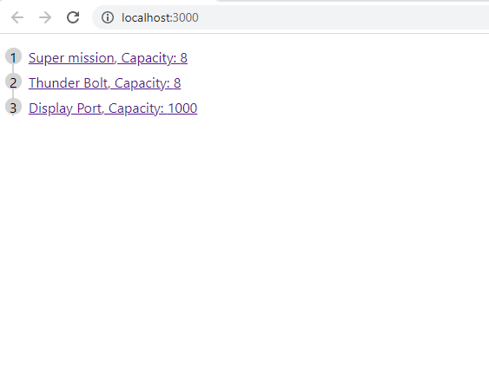
Mission information display
The initial version only shows the mission name and the mission capacity.
The purpose is to verify the backend returns the mission information successfully.
In the later development, we will add UI and more features for the central authority.

Slide 4
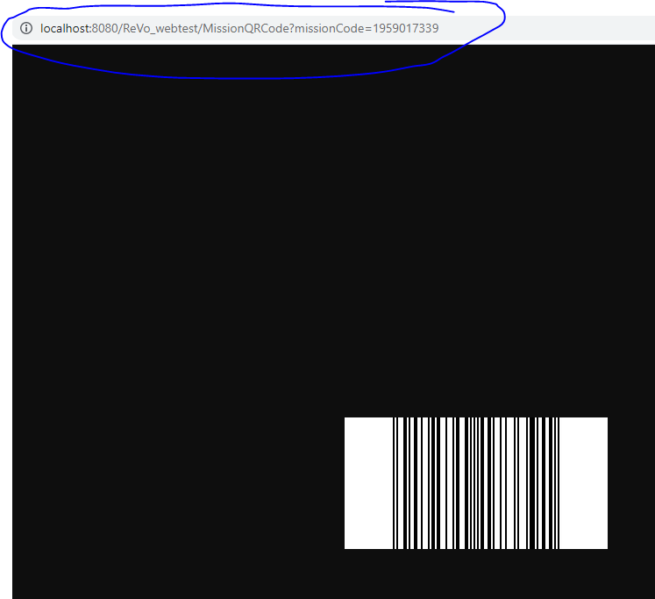
Barcode generation with ZXing java library
Click the mission will generate the mission code as the barcode.
In current version, we only generate the barcode to verify the Zxing library. In later version, we will use PDF417 code that easy to scan and recognize by android devices.
The barcode are generated at backend and will be transmit to the frontend through http response.

Slide 5
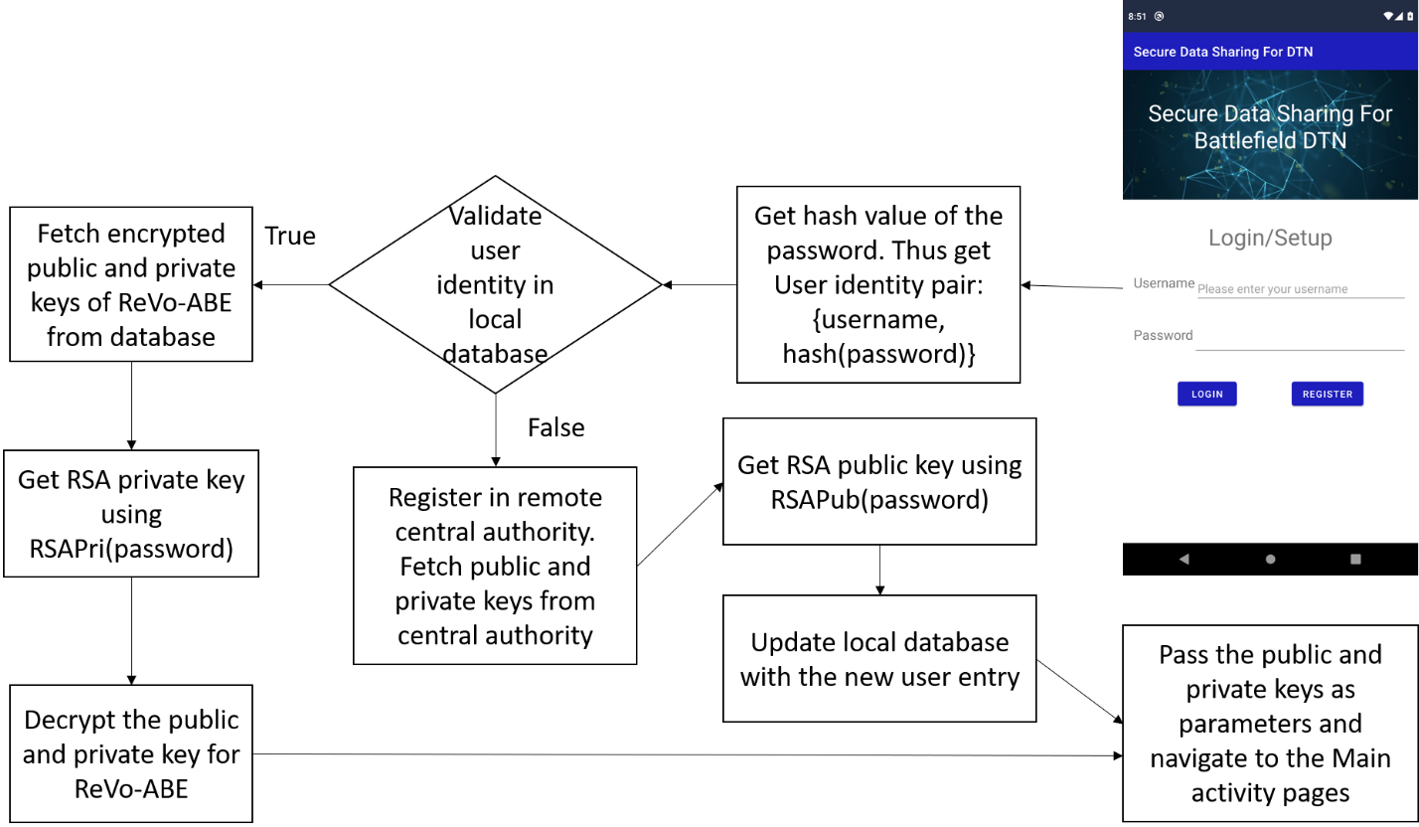
Flow chart of central authority

Slide 6
QR/Barcode scanner for android APP
When the user needs to setup their profile in the APP for secure data sharing, he/she have to enter the username and password (or bioidentification tokens such as finger print) that already been stored in the central authority. Also, he/she needs to have the mission code which he/she intends to join.
The mission code should be distributed in a secure way for example: a barcode/QR code printed in a paper.
The user then can scans the code with the APP and get the information without typing any numbers on the screen.

Slide 7
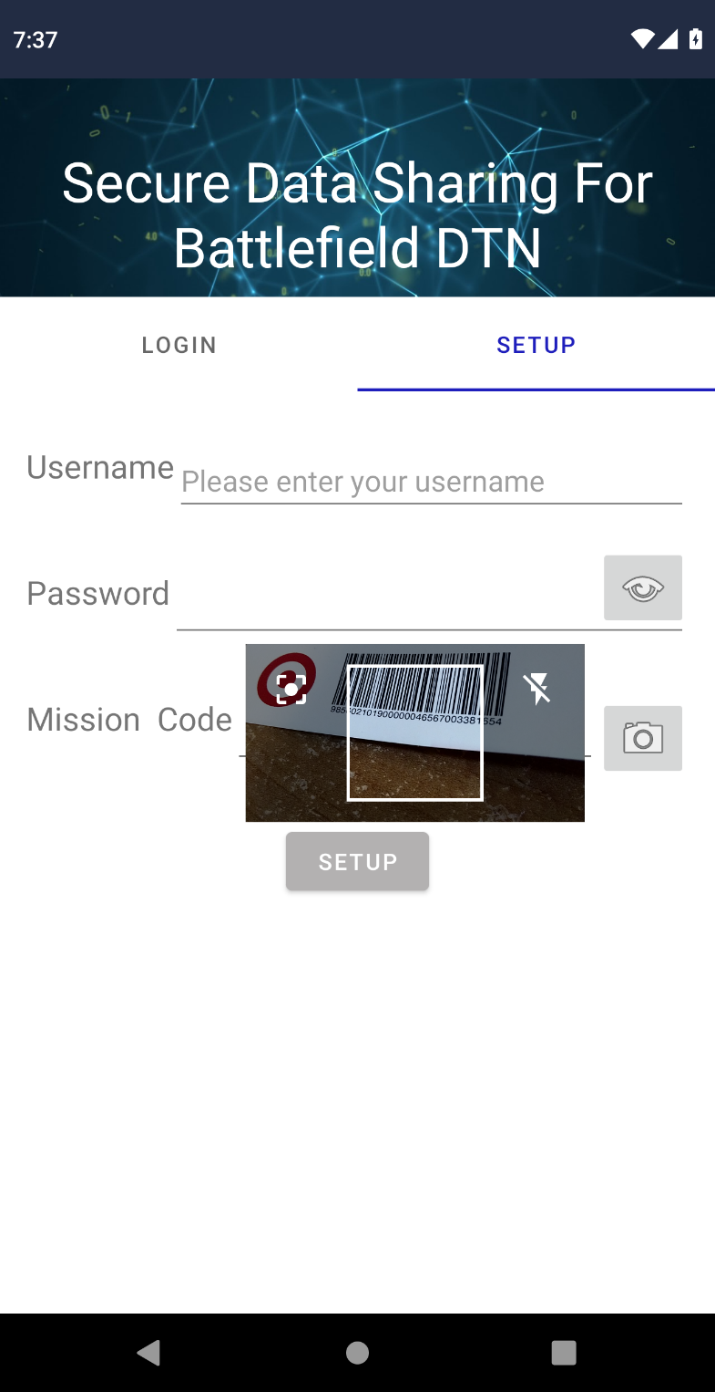
QR/Barcode scanner for android APP
Click SETUP to setup account through central authority
Type in the username and password that recorded in central authority
Click this button to view password
Type in the mission code in the editText field. Or click the camera button to use the QR/Barcode scanner to scan the code without leave any trace of typing.

Slide 8
ReVo-ABE object serialization - motivation
Serialization is a technique that transfer an object to a binary data stream.
In our case, we have to transmit the public and private keys of the ReVo-ABE from the central authority to the mobile APP.
However, in our design, the public and private keys are two objects which contains many JPBC paring elements which is not able to be serialized by themselves.
So we have to write our own serialization function to transfer the pairing object and element object to the android app and reconstruct the pairing and element objects of ReVo-ABE

Slide 9
ReVo-ABE object serialization - Solution
First, we override the toString function for all objects’ elements that outputs the byte array format of the pairing elements and the necessary information of the membership tree.
Second, to ensure the security while transmitting the keys, we have used the RSA to encrypt the public and private key’s binary Stream.
Third, we have implemented the decoding function in the mobile APP to reconstruct the pairing elements of the public and private keys from the byte array use the JPBC function “newElementFromBytes”.

Slide 10
Encryption and decryption functionality
Challenge: The origin code is writing in python using the Charm cryptography library.
In this month, we have implemented the encryption and decryption function with the JPBC library in java.

Slide 11
Conclusion
We have implemented the ReVo-ABE objects serialization and transmission.
We also added the QR/bar code scanning functionality for the user login/setup.
The central authority is implemented as a backend API that provide credential for the user who wants to setup for a new mission.
At last, we have implemented the encrypt and decrypt functionality of the ReVo-ABE algorithm.
In next month, we plan to integrate the security part with the caching part in the android demo and do some basic testing.

Slide 12
Content Caching for DTN network
Problem statement.
Object 1 and solutions.
Object 2 and solutions.
Object 3 and solutions.

Slide 13
Problem Statement
A message needs to be forwarded to a set of nodes who have higher interest similarity with this message. Besides, messages need to be forwarded to the CC also as many as possible.
While forwarding messages, congestion may occur to the nodes with high mobility and contacts.
Different events lead to different topic as trending or important. These need to be identified and quickly dispersed.
Due to limited bandwidth and intermittent connection among the node in a DTN, content transmission from further node causes long-transmission delay which can be handled by efficient cache management.
As nodes also move, their trajectories need to be analyzed in deciding what content to cache in which node.

Slide 14
Objective 1: Priority Content Delivery
Some content may have more priority due to an event and forwarding those content to the CC needs to be fast.
We propose to detect the content with higher priority and transfer them among the nodes as much as possible so that those content will be delivered to the CC and nodes quickly and everyone will be aware of the incident.
However, priority content may become less important after some time, and hence our approach can handle this issue by emphasizing more on content generated in recent time slots than previous time slots.

Slide 15
Trending topic detection
Message generation information is stored in the nodes by discretizing time in several time windows.
The trending topics can be identified by the “TF-IDF” (Term Frequency, Inverse Document Frequency) method by considering the topics of the generated messages in certain number of time windows.
Messages regarding trending topics are generated a lot in a short time span. Hence, we modify the “TF-IDF” by squaring the “TF” value of the topics.
However, messages for an event are generated in certain location. Hence, we consider the Standard Deviation (SD) of the location of the generated messages’ topics to find out how distributively they are being generated.

Slide 16
Trending topic detection formulation
We calculate the modified TF-IDF value of a topic t for a time window as follows:
TF(t)= $\frac{Count(t,{tw}_{cur})}{\sum_{t∈T}{Count(t,{tw}_{cur})}}$
IDF(t)=$\frac{∑t∈T\sum_{tw∈TW}{Count(t,tw)}}{\sum_{tw∈TW}{Count(t,tw)}}$
SD(t) =SD _{∀m ∈ M (t, tw_cur)} Location(m)
Where Count (t, tw) defines the number of times a topic t appeared in a time window tw. T is the set of all topics and TW is the set of all time windows. tw_{cur} is the current time window. M (t, tw_{cur}) is the set of messages containing topic t and generated in tw_{cur}.
Finally, we can calculate the modified TF-IDF as:
TF−IDF _{modified}(t) =TF(t)²∗ log [IDF(t)] / SD(t)
To calculate the priority of a message m, we take the average of all the associated topics’ (m_{t}) modified TF-IDF using the following equation.
Priority(m) = (∑ _{t ∈ m_t} TF−IDF _{modified} (t)) / |m_{t}|
Finally, we detect the trending messages by comparing their priority with the Trending Threshold θ as follows:
Is_Trending (m) =Priority(m) ≥ θ

Slide 17
Objective 2: Providing Content by Interest
Node’s storage, energy, and bandwidth is limited. So, a node cannot store and transmit/receive all the content.
We propose to forward content to a node based on its interest which is defined by its mission.
We measure the similarity of a content message with the interest of a node before forwarding so that it will fulfill the node’s interest.
For increased message delivery, we propose a RL based approach to adjust nodes interests so that they will be able to carry each other messages if frequently connected.

Slide 18
Congestion Handling
Data congestion in the nodes leads to more energy consumption due to transmission and more packet drops due to limited storage which can harm the overall performance of the network.
The congestion state of the nodes can vary based on the contact pattern and connection time with the other nodes.
Hence, we propose to learn the congestion nature of the nodes using RL and act accordingly so that nodes moving to the congested state will receive a reduced amount of data until they receive usual flow of content.

Slide 19
Finding better nodes to forward
Each node calculates the exponential moving average (EMA) of the Congestion Ratio (CR) which is the total transferred data vs total connection time.
The EMA of congestion is calculated based on the past few time intervals.
We consider multiagent Q-learning to forward information to the best node by considering the congestion status of the nodes.
Nodes apply different learning rates for different neighbors while learning based on the number of contact.
The reward r for learning is calculated as 1 / EMA of CR of the receiver node. This means if the receiver node is highly congested it will provide less reward.

Slide 20
Objective 3: Cache Management
Cache nodes can store huge content for other nodes and the content are always changing. This situation cannot be dealt with traditional Q-learning. Hence, we propose Asynchronous Advantage Actor-Critic (A3C) to handle the continuous state-action space.
In stationary scenario, transmission delay is considered as the key parameter while learning cache management. In our scenario, delay depends on the opportunity of nodes’ contact. Hence, transmission delay is measured with the time and hop needed to forward content to a node.
Nodes usually moves in a team for achieving same mission goal. A cache hit is considered when a team member receives the content for his other team member because they are supposed to be in closed vicinity.

Slide 21
Dependency Tree and Parse Tree Generation
Saving and Loading the model locally, saving the captions to database, tree edit distance.
Tree edit Distance.

Slide 22
Saving and loading the model locally
Trained the caption generation model on google collab database.
Saved the model on google drive and then downloaded all those required weights from the drive.
Tested all the code in local machines.

Slide 23
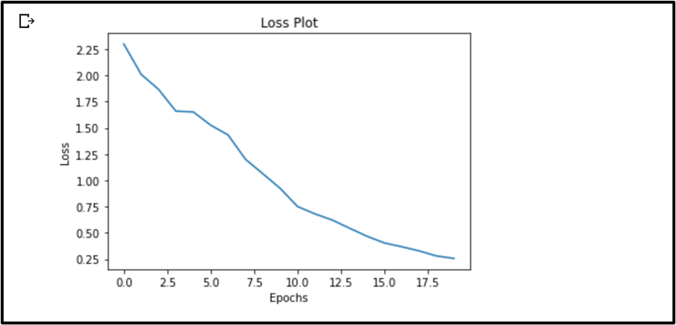
Loss plot after training the model for 20 epochs

Slide 24
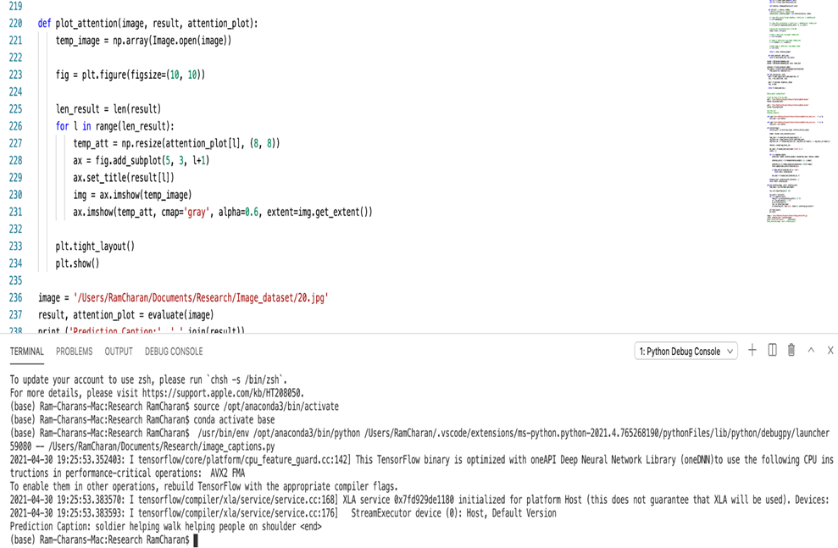
Example of prediction results of caption generation model in local machines

Slide 25
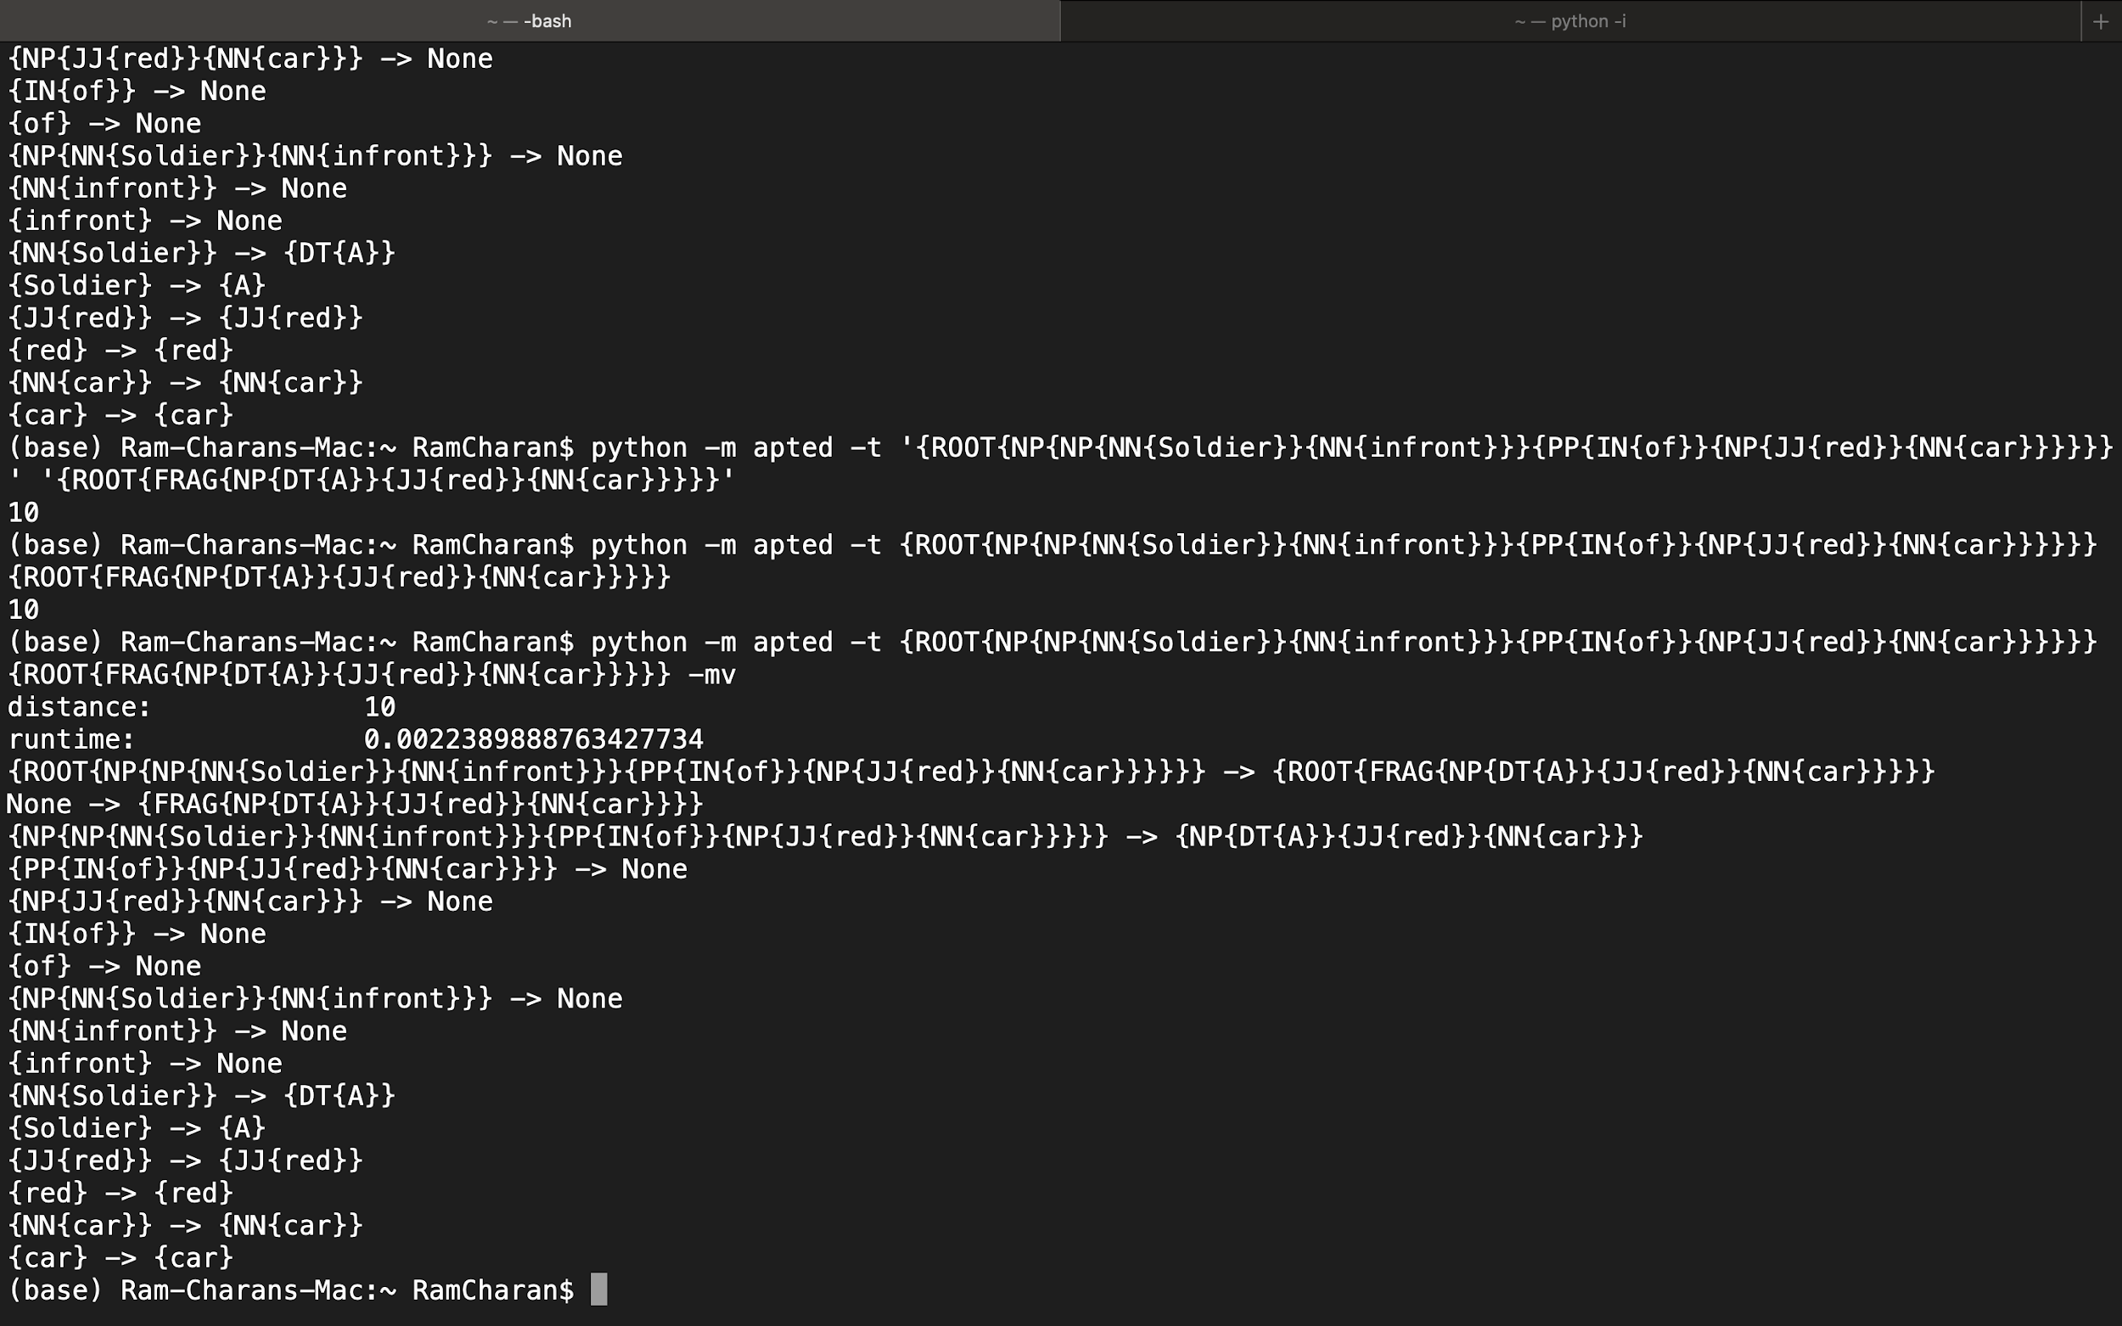
Tree edit distance
It is the minimum cost of transforming the source tree into the destination tree either by inserting, deleting or relabeling the nodes.
Apted Library helps us to compute the tree edit distance using it’s python implementation.
Below is an example to get the tree edit distance.

Slide 26
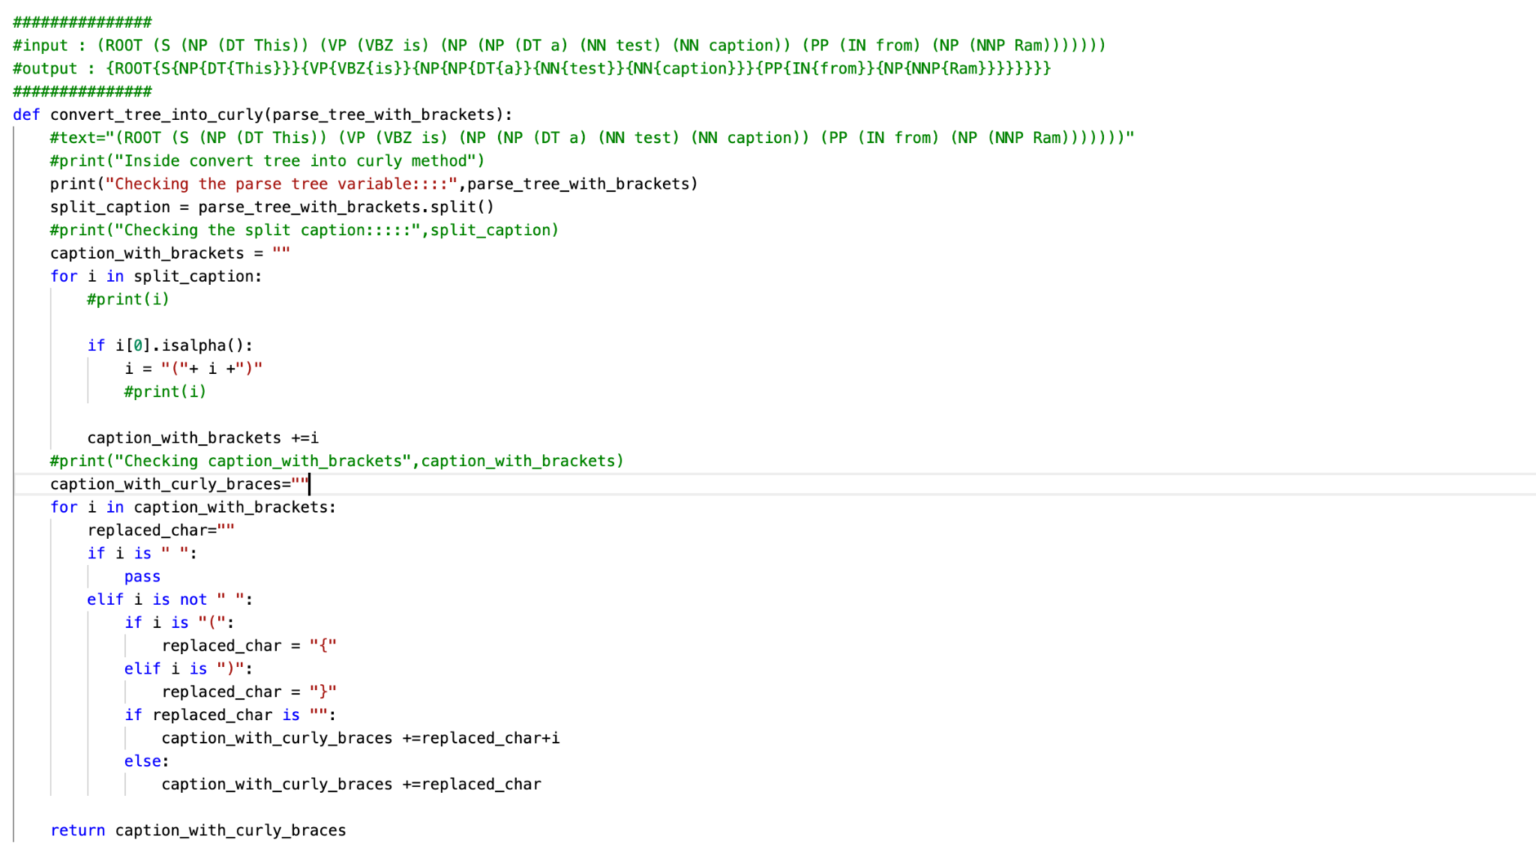
Code to convert the tree to the required format

Slide 27
New results

Slide 28
New results

Slide 29
New results

Slide 30
New results

