Slide 1
May Report
Sanjay Madria

Slide 2
Implementation of secure login
To prevent adversary of compromising the device used for secure communication. All users need to login before they can use the APP.
The secure login system verifies the user’s identity by comparing the username and password that the user typed in the screen with the database values stored in the local device.
To ensure the security of the user’s information, the password of the user is shown as “*” symbol when the user typing in.

Slide 3
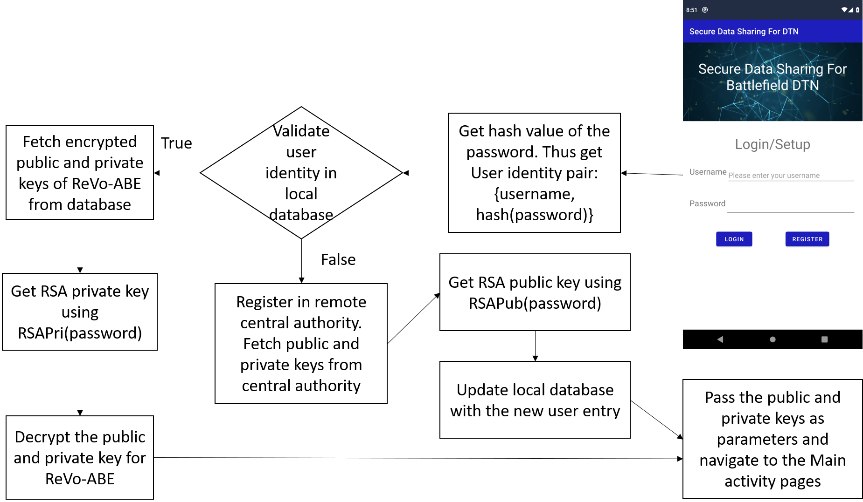
Architecture of secure login

Slide 4
Password hashing
When the user types in his password in the screen, the password will be hashed with SHA3-256 before comparing with the databased values.
Hash function is a one way function. So the adversary won’t be able to get the user’s password by eavesdropping the user’s communication.
The database will only store the hashed value of the password which makes the adversary hard to decipher the user’s password even they can compromise the user’s device.

Slide 5
Key encryption
To prevent the user’s public and private keys of ReVo-ABE be compromised. The APP will encrypt the keys using RSA encryption.
The RSA encryption is a symmetric encryption approach that only the person with public key can decrypt the data being encrypted with the private key.
The APP will generate the RSA keys using the password the user types in on the screen using a customized hash function. Thus, the adversary won’t be able to get the RSA keys to decrypt the public and private keys of ReVo-ABE.

Slide 6
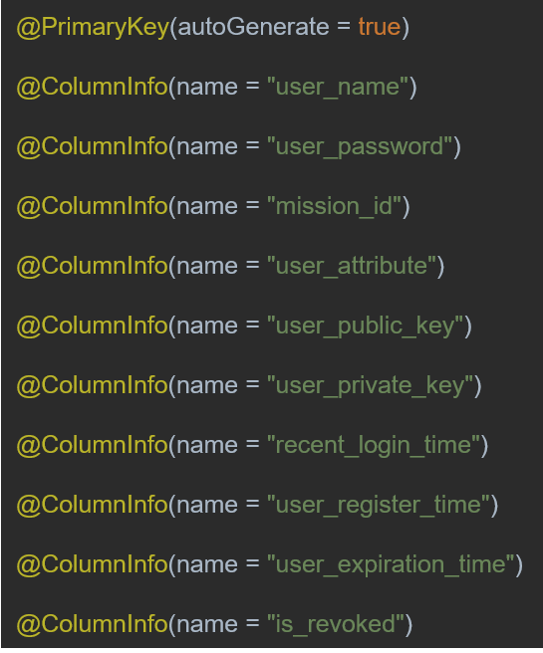
Data entity of local database
The database stores the following parameters:
User’s name
User’s password
Mission ID the user joins
The ReVo-ABE attributes the user has
ReVo-ABE public key
ReVo-ABE private key
Timestamps the user possesses
Is the user being revoked

Slide 7
Query the central authority
If the local databased won’t be able to verify the user’s identity. The user need to setup his account with the remote central authority.
The central authority stores both the user’s information and the mission information.
The database structure of the central authority is shown in next slide.

Slide 8
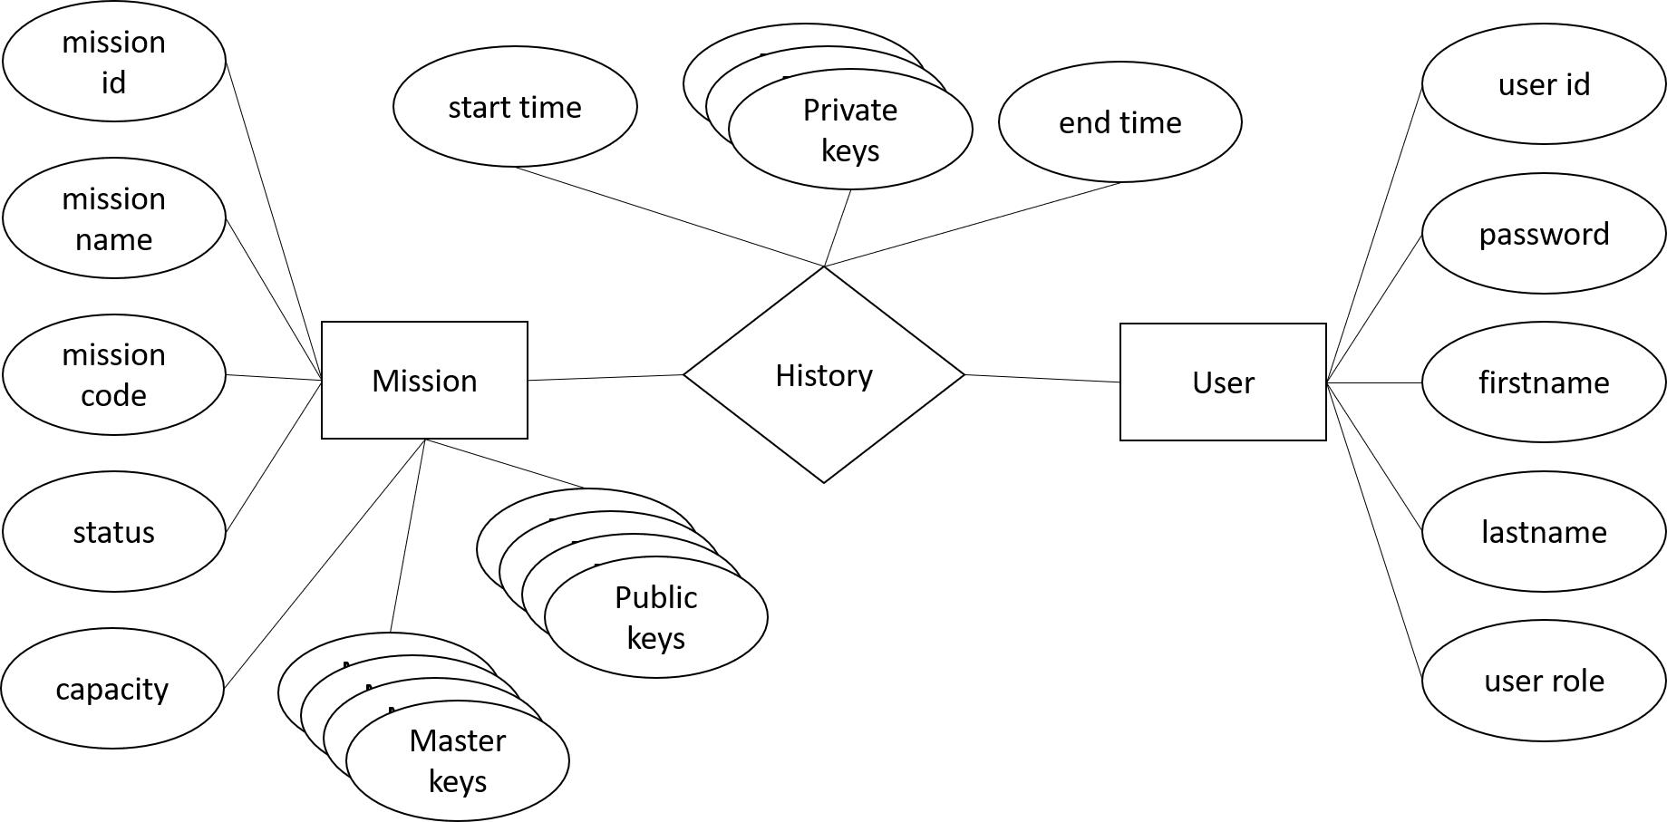
Database structure of central authority

Slide 9
Explanation of the database structure
The database will generate the mission and the user once the mission starts.
When a user tries to setup his keys, the system will first validate the user’s information and the mission information the user provides.
If each information matches the entries of the Mission table and the User table, the central authority will generate the public and private keys of ReVo-ABE for the user and stores the mission-user match information to the History table.

Slide 10
ReVo-ABE implementation
We implement the ReVo-ABE using JAVA and a Java pairing library called JPBC.
The ReVo-ABE has the following classes:
MembershipTree class: It is the base class of the user revocation tree which contains the following members.
Treenodes class; It is the nodes of the membershipTree. It contains left child, right child and parent as its class members.
MasterKey class; It is the object represent the master key of the ReVo-ABE which contains Element g1_alpha and beta.
PrivateKey class; It is the object represent the private key of the ReVo-ABE which contains list of attributes and hashmap of valid attributes and member.

Slide 11
Continue of implementation of ReVo-ABE
The ReVo-ABE has the following classes:
PublicKey class; It is the object represent the public key of the ReVo-ABE which contains membership tree, Element g1, g2, g2_beta, g1_a, and egg_alpha
ReVo-ABE class; It is the object whose instance is hosted by the central authority. It contains all the information for keygen, encrypt and decrypt. It has the node count, the pairing group, the public key object and the private key object.

Slide 12
Conclusion
We have implemented the secure login, mission setup and key generation functionality for the ReVo-ABE. Now the user could login with their public and private keys. We plan to implement the data encryption and decryption in next Month.

Slide 13
Content Caching for DTN network
Problem statement.
Object 1 and solutions.
Object 2 and solutions.
Object 3 and solutions.

Slide 14
Problem Statement
A message needs to be forwarded to a set of nodes who have higher interest similarity with this message. Besides, messages need to be forwarded to the CC also as many as possible.
While forwarding messages, congestion may occur to the nodes with high mobility and contacts.
Different events lead to different topic as trending or important. These need to be identified and quickly dispersed.
Due to limited bandwidth and intermittent connection among the node in a DTN, content transmission from further node causes long-transmission delay which can be handled by efficient cache management.
As nodes also move, their trajectories need to be analyzed in deciding what content to cache in which node.

Slide 15
Objective 1: Priority Content Delivery
Some content may have more priority due to an event and forwarding those content to the CC needs to be fast.
We propose to detect the content with higher priority and transfer them among the nodes as much as possible so that those content will be delivered to the CC and nodes quickly and everyone will be aware of the incident.
However, priority content may become less important after some time, and hence our approach can handle this issue by emphasizing more on content generated in recent time slots than previous time slots.

Slide 16
Trending topic detection
Message generation information is stored in the nodes by discretizing time in several time windows.
The trending topics can be identified by the “TF-IDF” (Term Frequency, Inverse Document Frequency) method by considering the topics of the generated messages in certain number of time windows.
Messages regarding trending topics are generated a lot in a short time span. Hence, we modify the “TF-IDF” by squaring the “TF” value of the topics.
However, messages for an event are generated in certain location. Hence, we consider the Standard Deviation (SD) of the location of the generated messages’ topics to find out how distributively they are being generated.

Slide 17
Trending topic detection formulation
We calculate the modified TF-IDF value of a topic t for a time window as follows:
TF(t)= $\frac{Count(t,{tw}_{cur})}{\sum_{t∈T}{Count(t,{tw}_{cur})}}$
IDF(t)=$\frac{∑t∈T\sum_{tw∈TW}{Count(t,tw)}}{\sum_{tw∈TW}{Count(t,tw)}}$
SD(t) =SD _{∀m ∈ M (t, tw_cur)} Location(m)
Where Count (t, tw) defines the number of times a topic t appeared in a time window tw. T is the set of all topics and TW is the set of all time windows. tw_{cur} is the current time window. M (t, tw_{cur}) is the set of messages containing topic t and generated in tw_{cur}.
Finally, we can calculate the modified TF-IDF as:
TF−IDF _{modified}(t) =TF(t)²∗ log [IDF(t)] / SD(t)
To calculate the priority of a message m, we take the average of all the associated topics’ (m_{t}) modified TF-IDF using the following equation.
Priority(m) = (∑ _{t ∈ m_t} TF−IDF _{modified} (t)) / |m_{t}|
Finally, we detect the trending messages by comparing their priority with the Trending Threshold θ as follows:
Is_Trending (m) =Priority(m) ≥ θ

Slide 18
Objective 2: Providing Content by Interest
Node’s storage, energy, and bandwidth is limited. So, a node cannot store and transmit/receive all the content.
We propose to forward content to a node based on its interest which is defined by its mission.
We measure the similarity of a content message with the interest of a node before forwarding so that it will fulfill the node’s interest.
For increased message delivery, we propose a RL based approach to adjust nodes interests so that they will be able to carry each other messages if frequently connected.

Slide 19
Congestion Handling
Data congestion in the nodes leads to more energy consumption due to transmission and more packet drops due to limited storage which can harm the overall performance of the network.
The congestion state of the nodes can vary based on the contact pattern and connection time with the other nodes.
Hence, we propose to learn the congestion nature of the nodes using RL and act accordingly so that nodes moving to the congested state will receive a reduced amount of data until they receive usual flow of content.

Slide 20
Finding better nodes to forward
Each node calculates the exponential moving average (EMA) of the Congestion Ratio (CR) which is the total transferred data vs total connection time.
The EMA of congestion is calculated based on the past few time intervals.
We consider multiagent Q-learning to forward information to the best node by considering the congestion status of the nodes.
Nodes apply different learning rates for different neighbors while learning based on the number of contact.
The reward r for learning is calculated as 1 / EMA of CR of the receiver node. This means if the receiver node is highly congested it will provide less reward.

Slide 21
Objective 3: Cache Management
Cache nodes can store huge content for other nodes and the content are always changing. This situation cannot be dealt with traditional Q-learning. Hence, we propose Asynchronous Advantage Actor-Critic (A3C) to handle the continuous state-action space.
In stationary scenario, transmission delay is considered as the key parameter while learning cache management. In our scenario, delay depends on the opportunity of nodes’ contact. Hence, transmission delay is measured with the time and hop needed to forward content to a node.
Nodes usually moves in a team for achieving same mission goal. A cache hit is considered when a team member receives the content for his other team member because they are supposed to be in closed vicinity.

Slide 22
Dependency Tree and Parse Tree Generation
Saving and Loading the model locally, saving the captions to database, tree edit distance.
Tree edit Distance.

Slide 23
Saving and loading the model locally
Trained the caption generation model on google collab database.
Saved the model on google drive and then downloaded all those required weights from the drive.
Tested all the code in local machines.

Slide 24
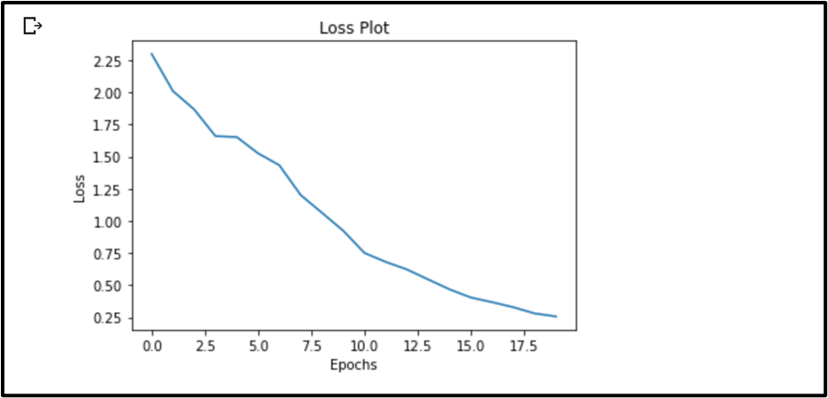
Loss plot after training the model for 20 epochs

Slide 25
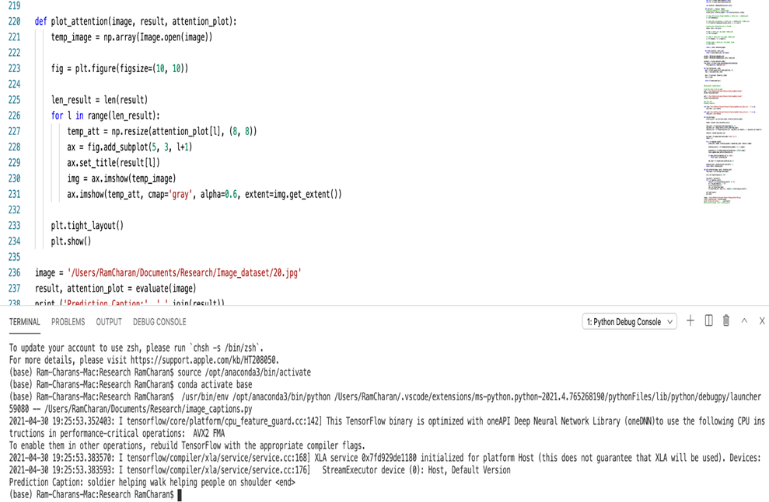
Example of prediction results of caption generation model in local machines

Slide 26
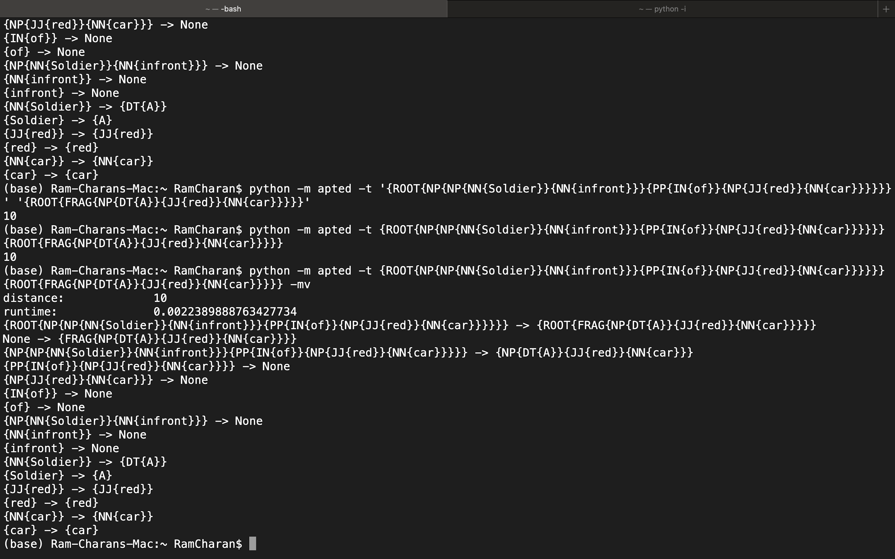
Tree edit distance
It is the minimum cost of transforming the source tree into the destination tree either by inserting, deleting or relabeling the nodes.
Apted Library helps us to compute the tree edit distance using it’s python implementation.
Below is an example to get the tree edit distance.

Slide 27
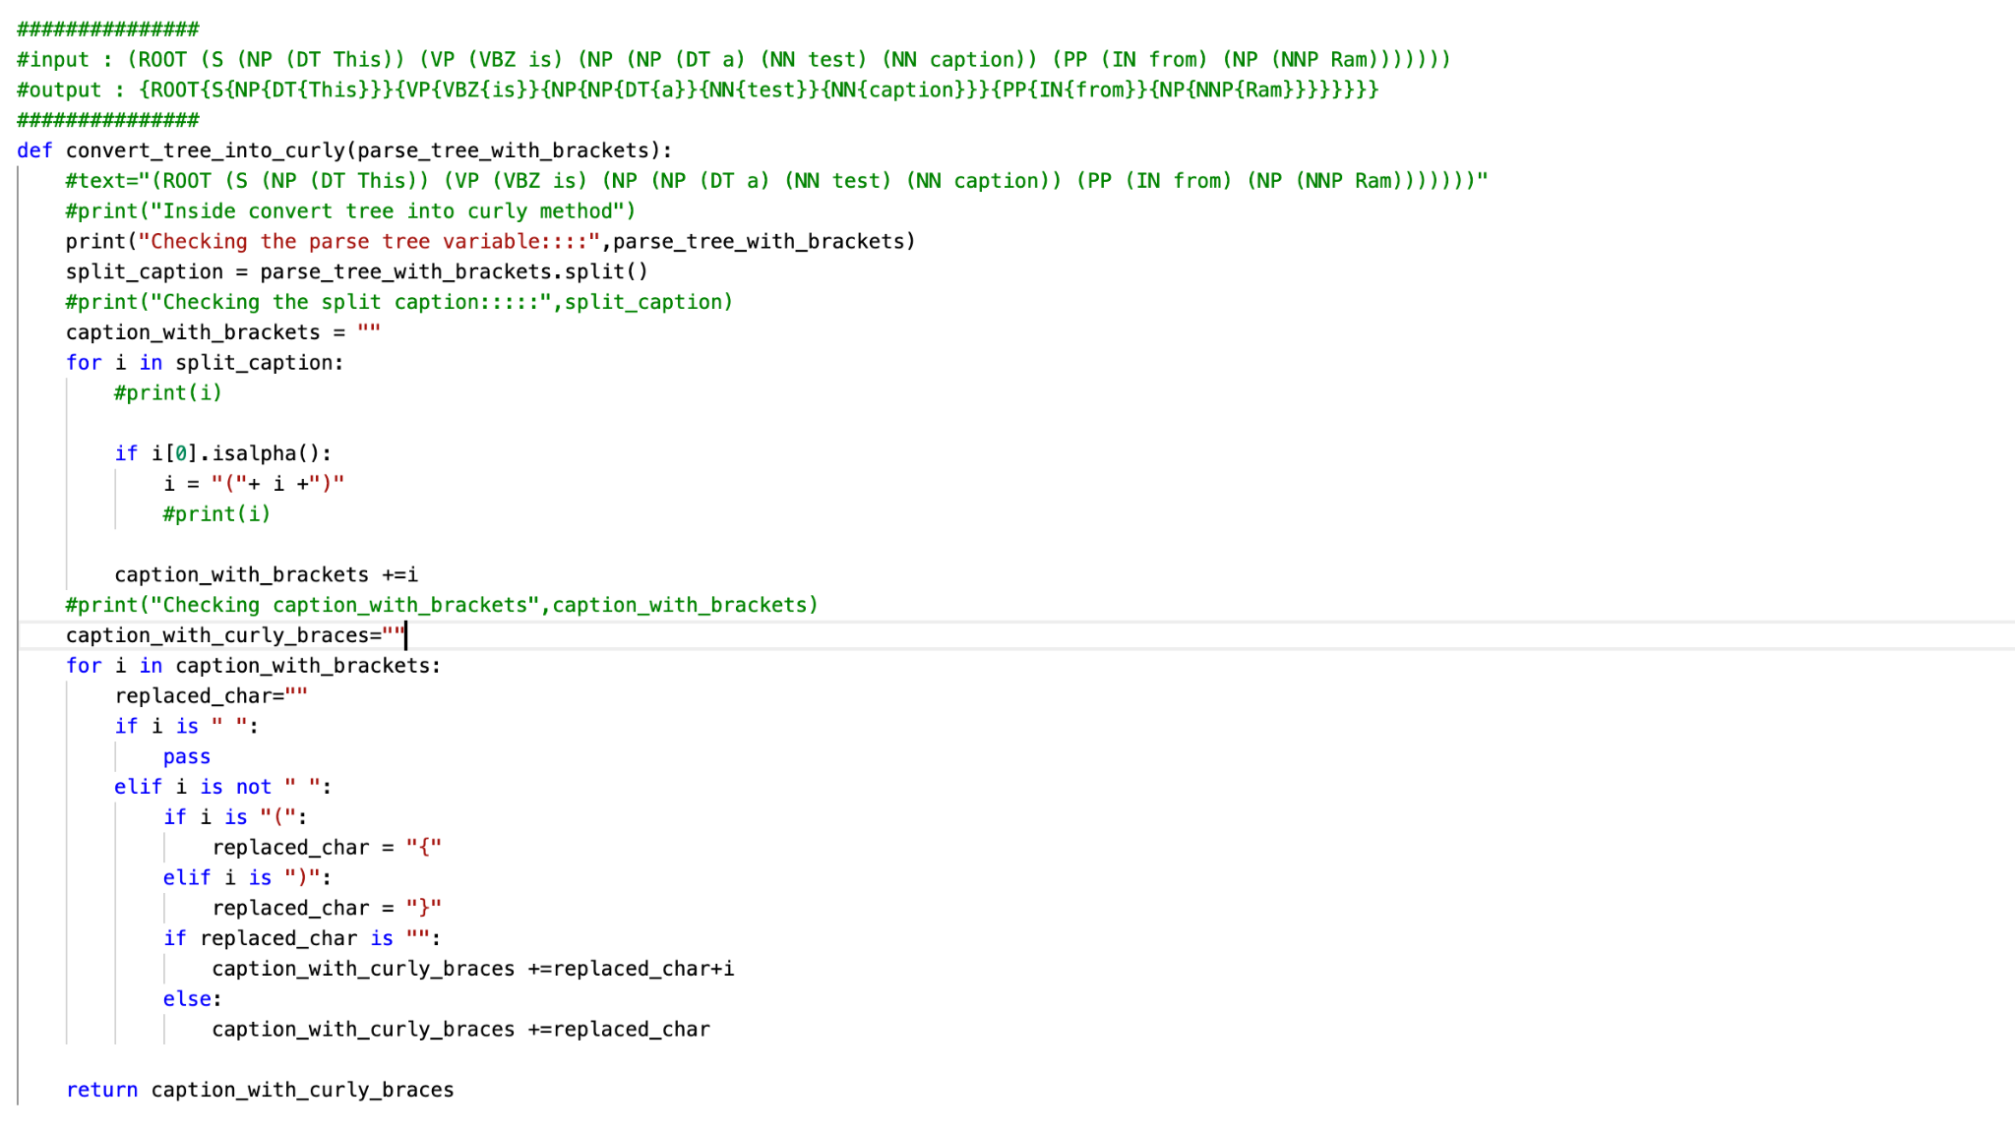
Code to convert the tree to the required format

Slide 28
New results

Slide 29
New results

