Slide 1
Recommendation System for Wedding Registry and Gift suggestion
Presented By - Shudip Datta

Slide 2
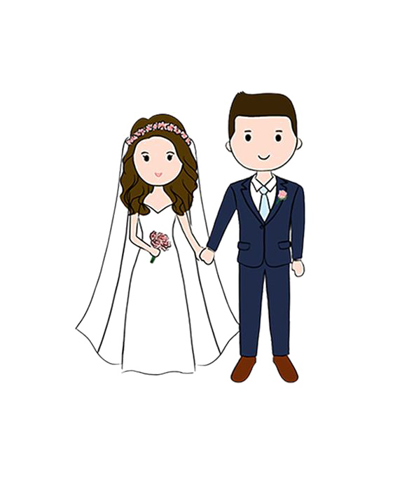

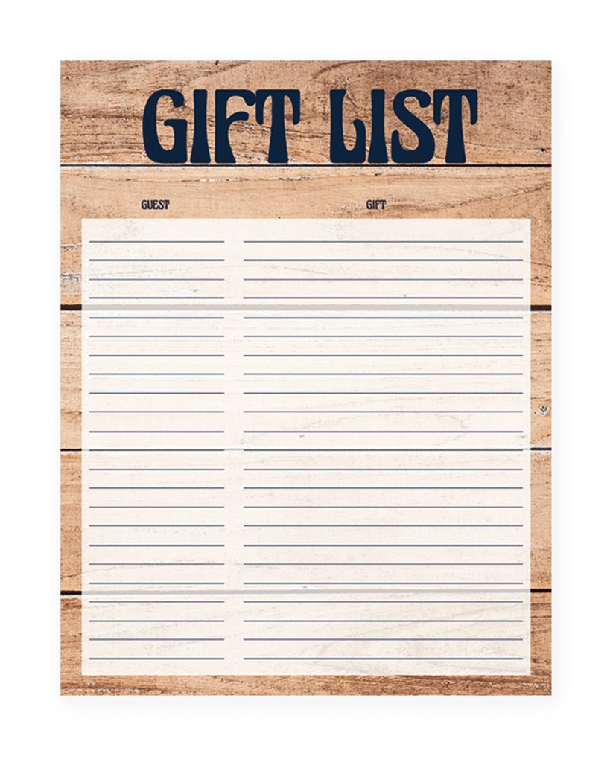
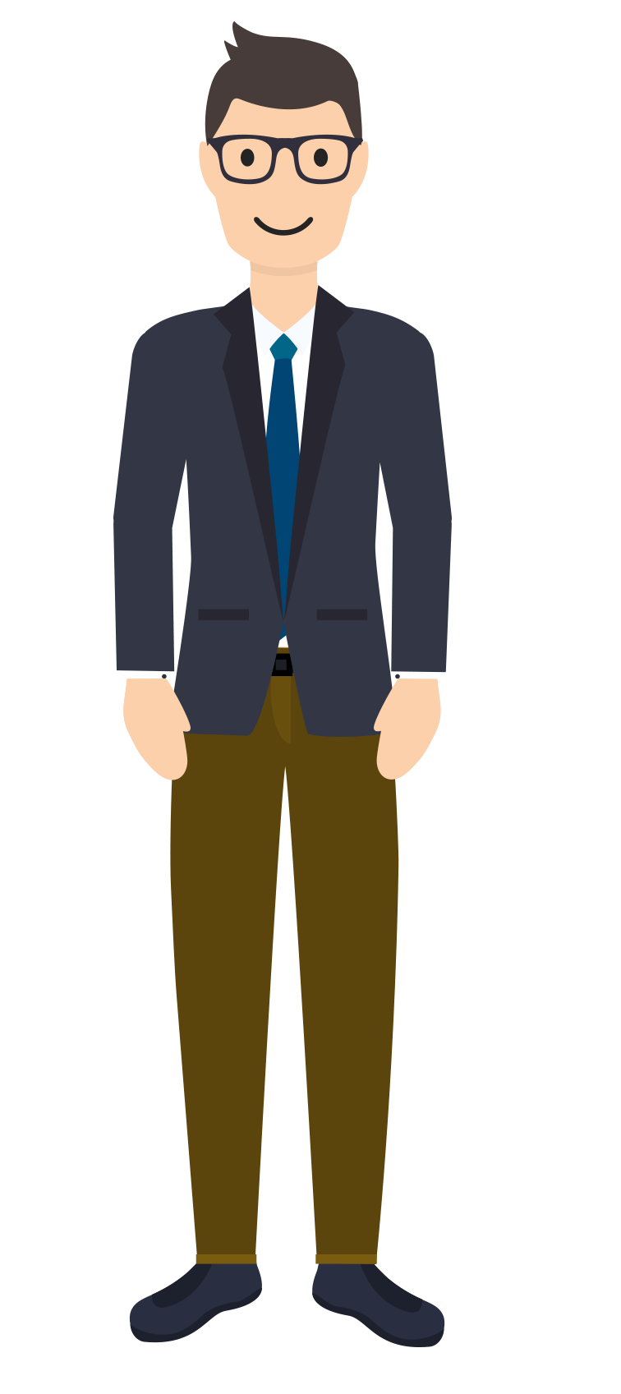

Basic Idea
Similar Couples
Engaged Couple
Wedding Registry for other Married Couple
Registry Recommendation
Gift Recommendation
Wedding Registry
Guests

Slide 3
Project Scenario (B00k Recommendation)
Similar People based on Book Rating History
Book
Recommendation
[User Based
Collaborative
Recommendation]
Engaged Couple
Wedding Registry for other Married Couple
Book Similarity based on Book Rating History
[Content Based
Recommendation]
Wedding Registry
Guests

Slide 4
Dataset
“USER” table include 202 users
2 of them are “COUPLE”,
100 of them are “MARRIED”,
100 of them are “FRIENDS”
“BOOK” table includes total 5056 books
Book ID | Title | Authors | Language | Year
10 | Going Postal | A | eng | 1980
20 | Night Watch | B | fr | 2012
30 | The Shining | C, D | ban | 2019
… | … | … | … | …
User ID | attribute
1 | C
2 | M
3 | F
… | …
User ID | Book ID | Rating
5 | 20 | 5
5 | 30 | 4
15 | 30 | 1
… | … | …
“RATING” table includes
total 38162 ratings

Slide 5
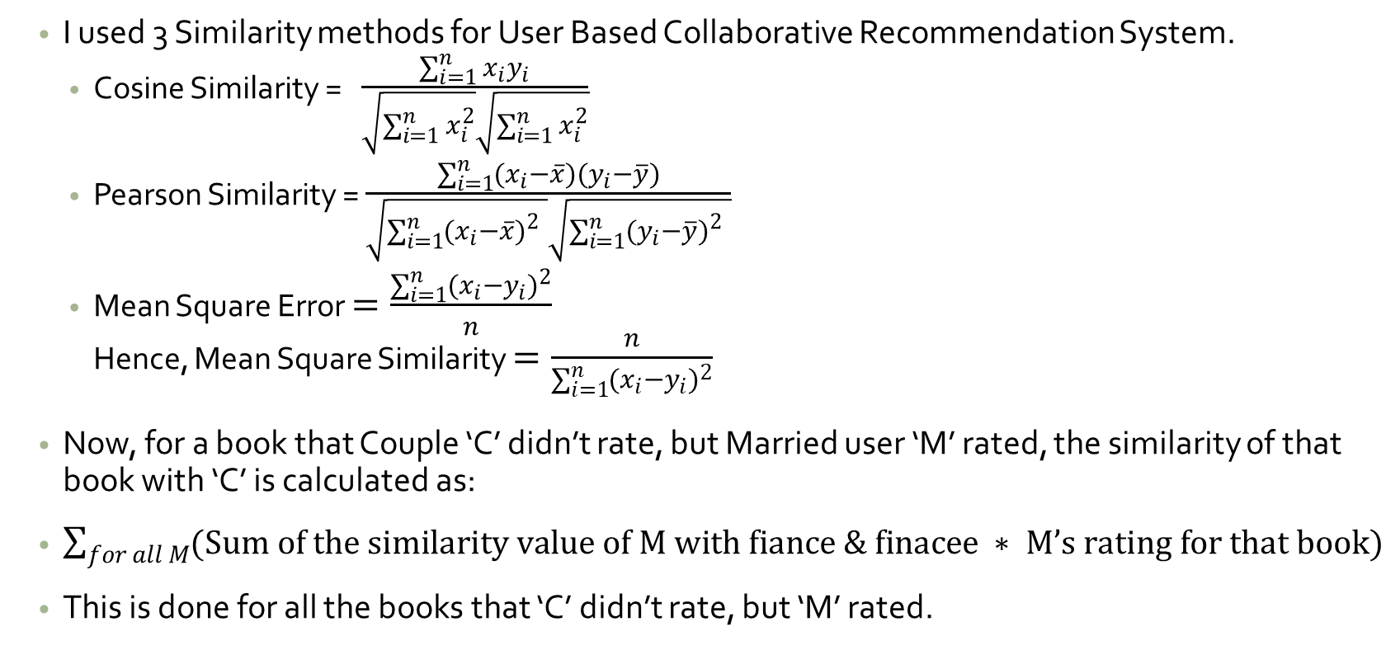
Recommendation for Wedding Registry
I used 3 Similarity methods for User Based Collaborative Recommendation System.
Cosine Similarity = $\frac{\sum_{i=1}^{n}{x_{i}y_{i}}}{\sqrt{\sum_{i=1}^{n}{x_{i}^{2}}}\sqrt{\sum_{i=1}^{n}{x_{i}^{2}}}}$
Pearson Similarity = $\frac{\sum_{i=1}^{n}{{(x}_{i}−\overline{x})(y_{i}−\overline{y})}}{\sqrt{\sum_{i=1}^{n}{{{(x}_{i}−\overline{x})}_{}^{2}}}\sqrt{\sum_{i=1}^{n}{{(y_{i}−\overline{y})}_{}^{2}}}}$
Mean Square Error $=\frac{\sum_{i=1}^{n}{{{(x}_{i}{−y}_{i})}^{2}}}{n}$ Hence, Mean Square Similarity $=\frac{n}{\sum_{i=1}^{n}{{{(x}_{i}{−y}_{i})}^{2}}}$
Now, for a book that Couple ‘C’ didn’t rate, but Married user ‘M’ rated, the similarity of that book with ‘C’ is calculated as:
$\sum_{for all M}{(Sum of the similarity value of M with fiance \& finacee ∗ M’s rating for that book)}$
This is done for all the books that ‘C’ didn’t rate, but ‘M’ rated.

Slide 6
Example
Let’s say after calculating the user similarity based on all the books and rating, we find the following data.
Couple’s Recommendation value for book “B1” is
= (30+40)*5 + (50+20)*4
= 350 + 280
= 630
In this way, 100 most recommended books are put in the registry.
User (Married) | Book ID | Book Rating | Similarity With C1 | Similarity With C2
M1 | B1 | 5 | 30 | 40
M2 | B1 | 4 | 50 | 20

Slide 7
Recommendation for Gift
For content-based recommendation, we need to build user profile and book profile.
Then we can find the similarity of a user with a book.
Process:
Each word, author, language, year of all the books are converted to a numerical value based on their relative frequency, position, rating etc. (TF-IDF). [Example: eng->1.0, 1980->1.2]
For each of these word, author, language, year, the similarity of users with those individual term is calculated. [Example: eng->2.0, 1980->2.2]
Thus, for each book, based on what terms are there, we can find the total similarity of user with that book [Example: if a book has two attributes -> ‘eng’ and ‘1980’, then user similarity will be (2.0+2.2)
Notes:
Relative importance of a word in the whole dataset.

Slide 8
TF-IDF (Term Frequency – Inverse Document Frequency)
Book ID | Title | Authors | Language | Year
10 | Going, Postal | JD Salinger | eng | 1980
20 | Night, Watch | Norton Juster, Jules Feiffer | fr | 2012
30 | The, Shining , Sun | Alan Moore, Dave Gibbons, John Higgins | spa | 2019
Document Frequency (DF) = number of occurrence in the whole document)
Going -> 1
Postal -> 5
JD Salinger -> 10
Eng -> 20
1980 -> 30
Inverse Document Frequency (IDF) = log₁₀ (number of books / DF
Going -> lg(500/1)
Postal -> lg(500/5)
JD Salinger -> lg(500/10)
Eng -> lg(500/20)
1980 -> lg(500/30)
Term Frequency (TF) for a book =1/√total length For, Book ID = 10
Going -> 1 / √2
Postal -> 1 / √2
JD Salinger -> 1 / √1
Eng -> 1 / √1
1980 -> 1 / √1

Slide 9
Creating User Profile
User ID | Book ID | Authors | Rating
1 | 10 | JD Salinger (TF=1 / √1) | 5
1 | 20 | Norton Juster, JD Salinger (TF = 1 / √2) | 4
1 | 30 | Alan Moore, John Higgins, JD Salinger (TF=1 / √3) | 2
User 1 profile for author “JD Salinger” is
1 / √1 * 5 + 1 / √2 * 4 + 1 / √3 * 2
Similarly, build every users profile for every term found in all the books.

Slide 10
User Similarity with Books
User ID | Book ID | Title | Authors | Language | Year
1 | 10 | Going (UP= 4, IDF = lg(500/1)) Postal(UP= 6, IDF = lg(500/5)) | JD Salinger (UP= 9, IDF = lg(500/10)) | eng (UP= 10, IDF=lg (500/20)) | 1980 (UP=5, IDF=lg(500/30))
1 | 20 | Night, Watch | Norton Juster, Jules Feiffer | fr | 2012
1 | 30 | The, Shining , Sun | Alan Moore, Dave Gibbons, John Higgins | spa | 2019
For Book ID 10, User 1’s similarity is
(4*lg(500/1) + 6*lg(500/5)) + (9*lg(500/10)) +(10*lg(500/20)) + (5*lg(500/30))
= [(10.8 + 12) + 15.3 + 14 + 6.1] * 5
If we put different weight (1,2,3,4 for title, authors, language, year respectively)
(10.8 + 12)*1 + 15.3*2 + 14*3 + 6.1*4
In this process, we can find the highest 10 similar books for a user.

Slide 11
Thank You

