Slide 1
Augest Report
Dr. Sanjay Madria

Slide 2
Implementation of Central authority
The front end of the central authority is implemented with React which enable the users to view and request for user and mission modification.
The backend of the central authority is a Restful API built with java servlet and MySQL.

Slide 3

Home page of central authority frontend
Left bar navigate to manage users and missions.
Home page shows total number of users and missions

Slide 4
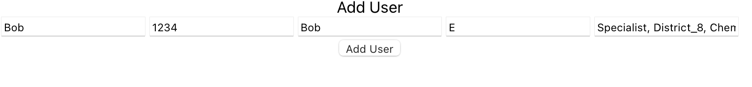
Add user to the server
Use form to add user. The following user information are required:
username
User password
User first name and last name
User attributes. (separate with comma)

Slide 5
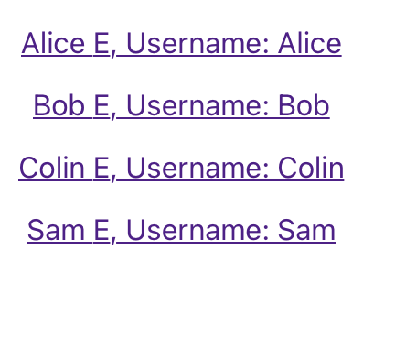
View all the users
The user tab shows all the users in the system.
Click each entry will go the page to modify the user information.

Slide 6
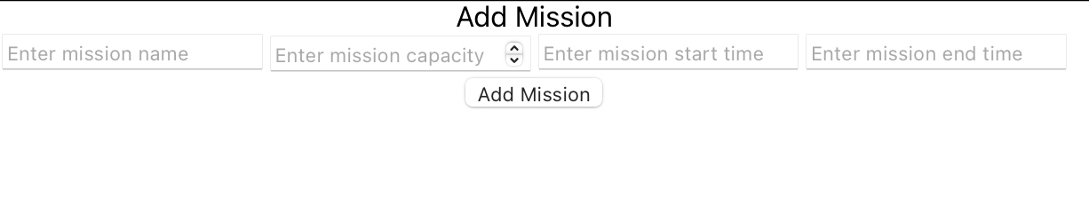
Add missions to the server
Use form to add user. The following user information are required:
Mission name
Mission capacity
Mission start date
Mission end data
The mission code will be generated automatically by the server

Slide 7
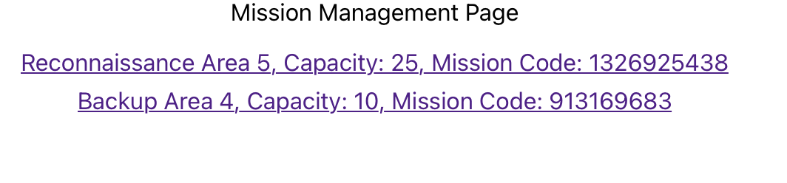
View all the missions
The mission tab shows all the users in the system.
Click each entry will go the page to mange the missions information.

Slide 8
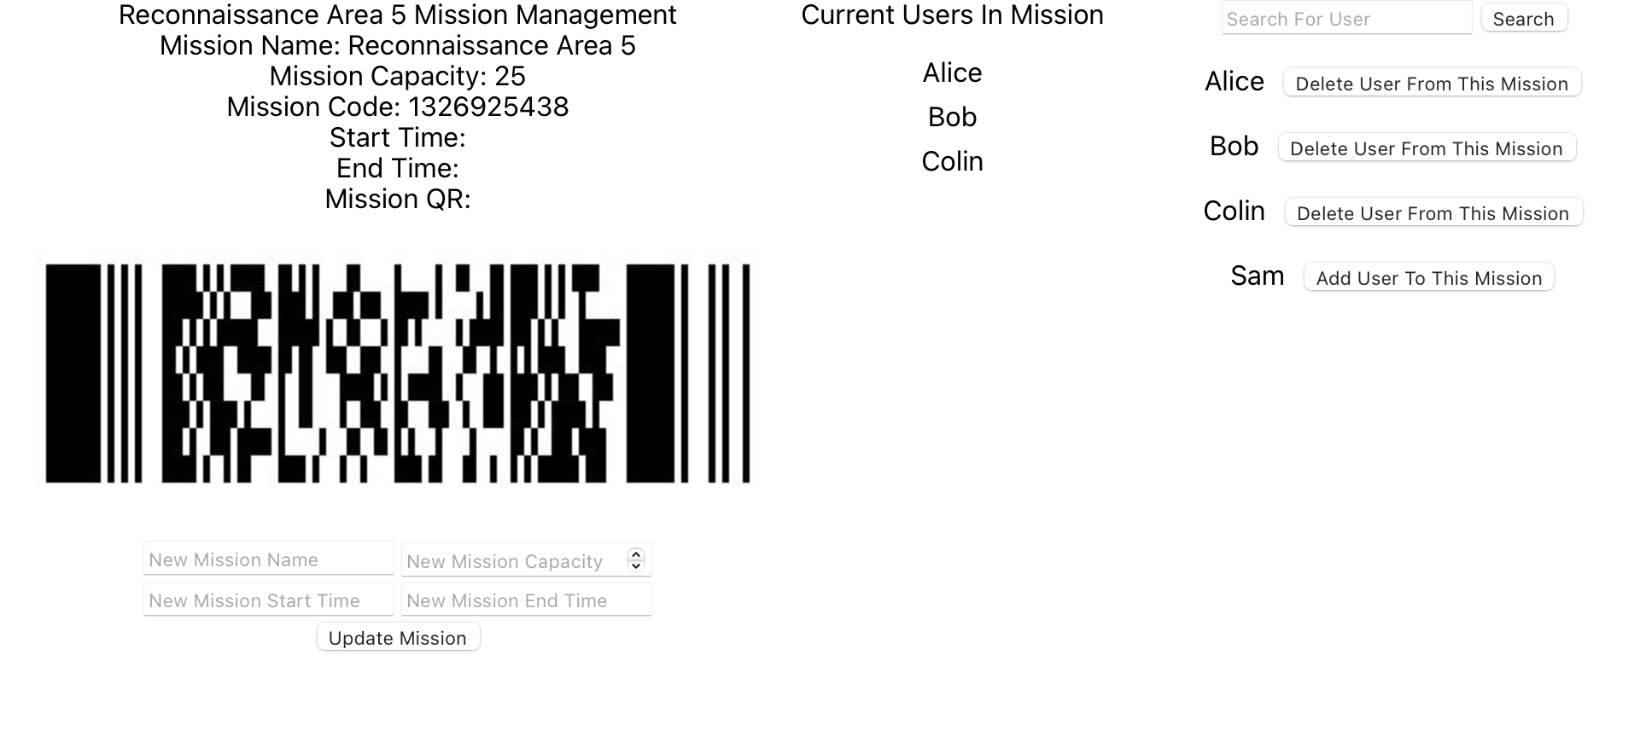
Manage mission in the system
Mission information are shown in the control panel.
Mission code are shown in PDF417 bar code so the user can scan in their android devices.
Manager of the backend could add users to a specific mission by click add or delete buttons on the right.
Middle column shows the current users in the mission.

Slide 9
Backend of the central authority
It is a restful API that takes HTTP request and response the required information as JSON file with HTTP response.
The API is implemented with Java.
The database of the API is MySql.
The databased structure is as discussed in the report of June.

Slide 10
Implemented API
GetUsersOfAMission: Get all the user information as JSON.
AddUser: Add user to the system.
AddMission: Add mission to the system.
AddUserToMission: Add user to a specific mission.
GetMissionCount: Get total mission number in the system.
GetUserCount: Get total user number in the system.
MissionQRCode: Get mission code as the pdf417 bar code.
Missions: Get all mission as JSON object array.

Slide 11
Implemented API
SearchUser: Search a specific User in the system.
UpdateMission: Update a mission (by mission code/mission name).
Bootstrap: Setup and transfer public and private keys as byte array.
(An example request and response of bootstrap is shown in next page)

Slide 12
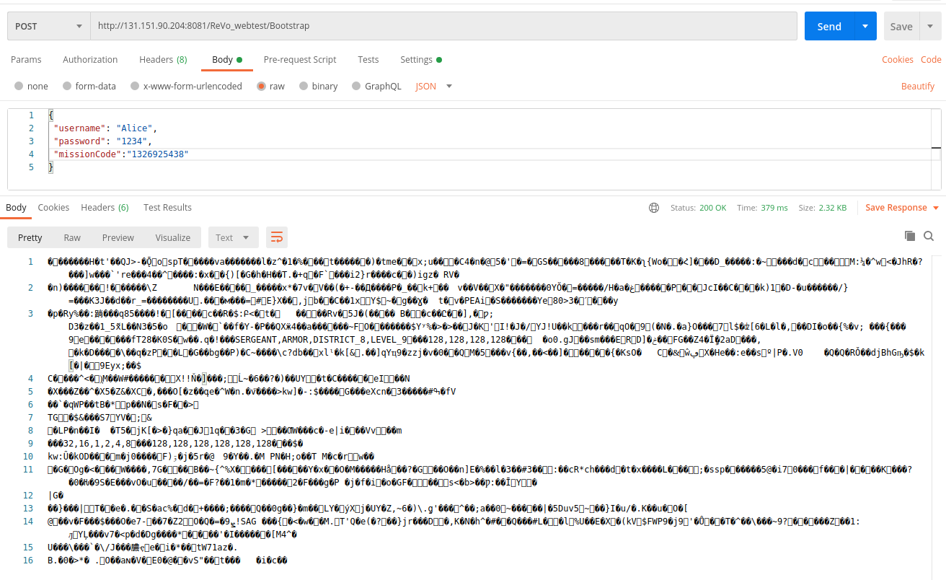
API URL
Request body
Response status
Response body

Slide 13
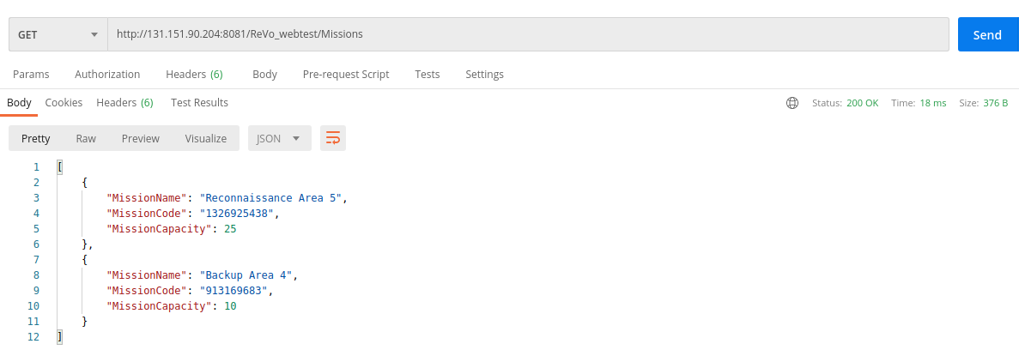
Sample request and output of backend
API URL
Response body
Response status

Slide 14
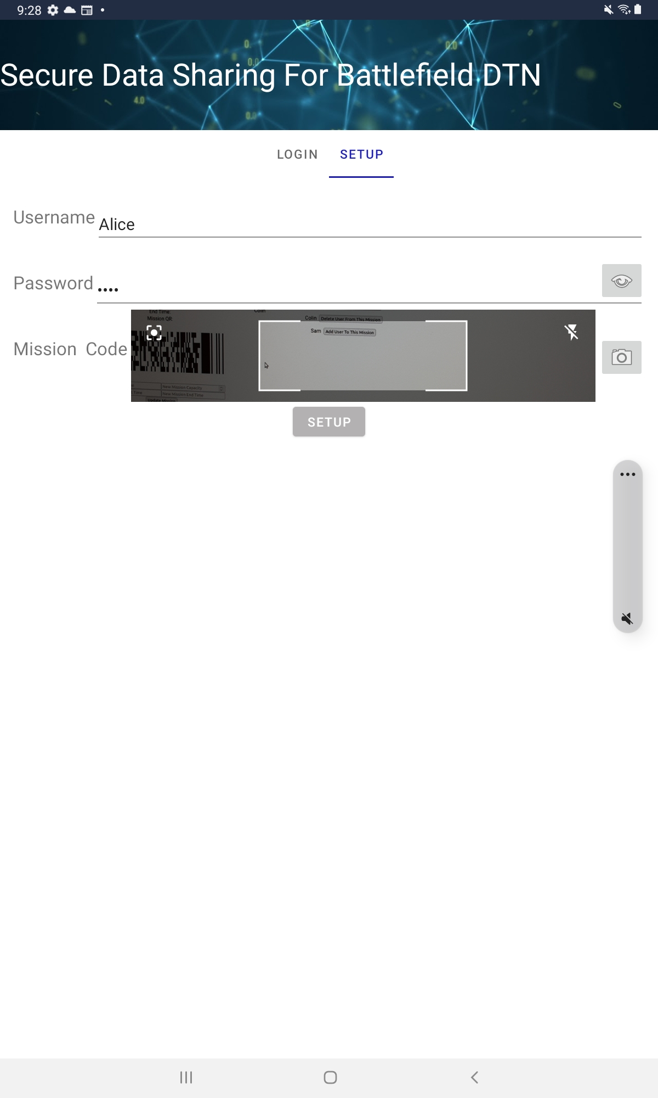
Interaction between android APP and the frontend of the central authority
Android APP could scan the mission code of a mission to setup

Slide 15
Data Preparing for Contact Learning
We prepare the contact data of the nodes by sending sample payloads to each other when any two nodes meet.
This payload records the time when it is sent and received, the id of the sender and the receiver, and few properties of the sender node.
Thus, we can record the time needed to forward data from one node to another nodes. It is because predicting delay of forwarding data to the nodes can help caching appropriate messages with respect to the nodes.

Slide 16
Data Preparation (Details)
Assume node ‘a’ meets node ‘b’ and sends the payload.
The payload will hold the record as <a, b, l_{a}, d_{a} t1, t2, h_{ab}> which means node ‘a’ sent a data to node ‘b’ at the time ‘t1’ and it was received at the time ‘t2’ after ‘h_{ab}’ hops, and the location and direction of node ‘a’ at time t1 were ‘l_{a}’ and ‘d_{a}’ respectively.
Then, assume node ‘b’ meets node ‘c’ at time t3 and the payload from ‘b’ was received to node ‘c’ at time t4.
It will create 2 records: <b, c, l_{b}, d_{b}, t3, t4, h_{bc}> and <a, c, l_{a}, d_{a}, t1, t4, h_{ac}>.

Slide 17
Removing Extra Data
We prepare records of each possible data forwarding information for different pairs of nodes. This information grows exponentially.
However, we control the growth by adopting the following approaches:
A payload may have been received to a node from the same source node via different paths. In that case, we take the record which has the shortest delay and remove the other ones.
If the time difference of sending and receiving a payload is too long (exceeds the ttl of a message) then we remove the record.
If the hop count of a record is too long, then we remove the record.

Slide 18
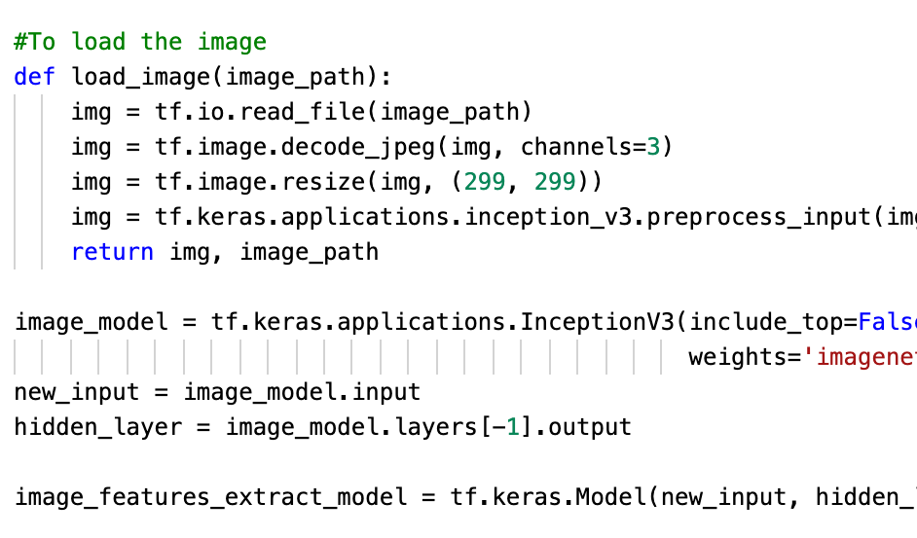
Usage in various parts of the code
Starting from a basic task to load an image and to use its functions to resize and to decode.

Slide 19
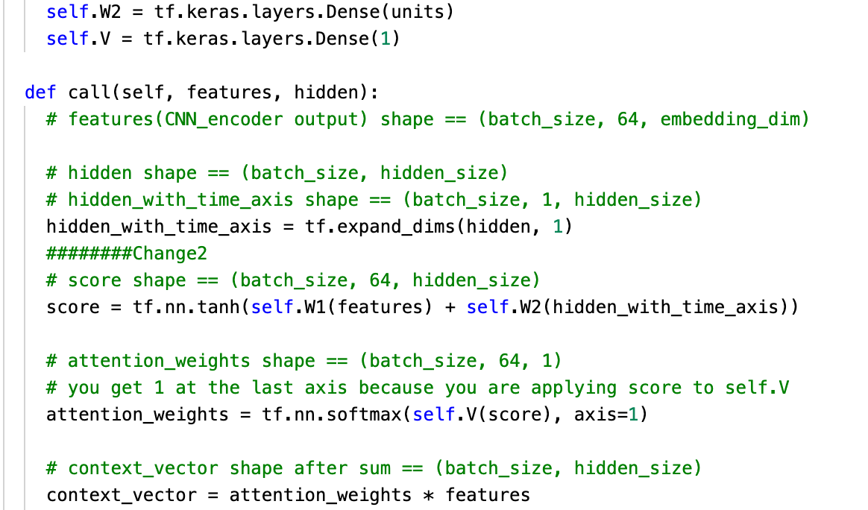
Bahdanau Attention class
It’s in this class where we create the layers of the model, specify the softmax functions, expand dimensions.
It becomes a herculean task doing this in java.

Slide 20
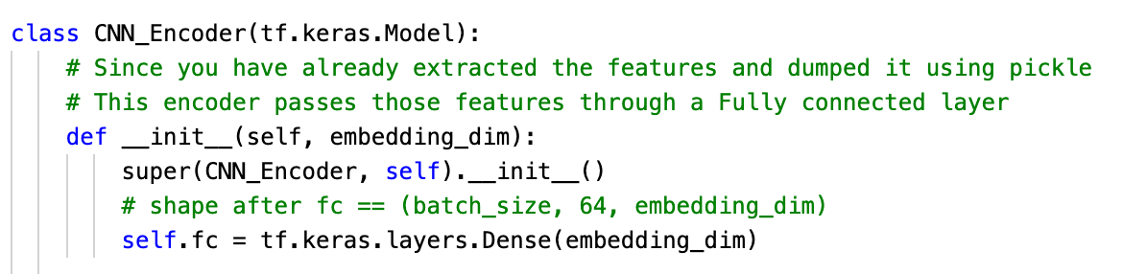
CNN Encoder class
A CNN based encoder-decoder neural network consists of an encoder neural network and decoder neural network in which one or both are convolutional networks.

Slide 21
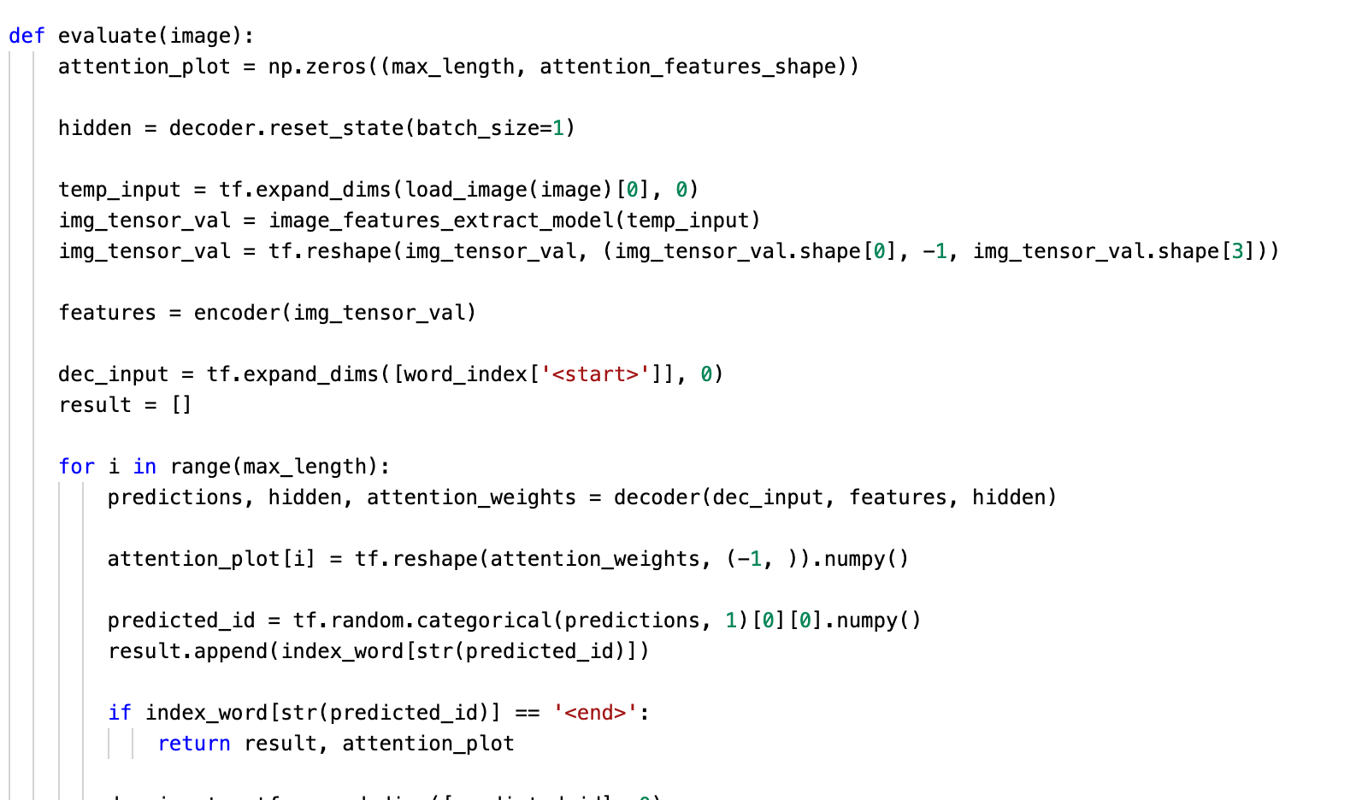
NumPy and TensorFlow
Finally, to evaluate an image like this we use libraries such as NumPy and TensorFlow.
NumPy is the fundamental package for scientific computing in Python. NumPy arrays facilitate advanced mathematical and other types of operations on large numbers of data.
Typically, such operations are executed more efficiently and with less code than is possible using Python's built-in sequences.

Slide 22
Another huge library that needs replacement is sklearn, Scikit-learn is probably the most useful library for machine learning in Python.
The sklearn library contains a lot of efficient tools for machine learning and statistical modelling including classification, regression, clustering and dimensionality reduction.
For this, I am still trying to find a proper equivalent.

Slide 23
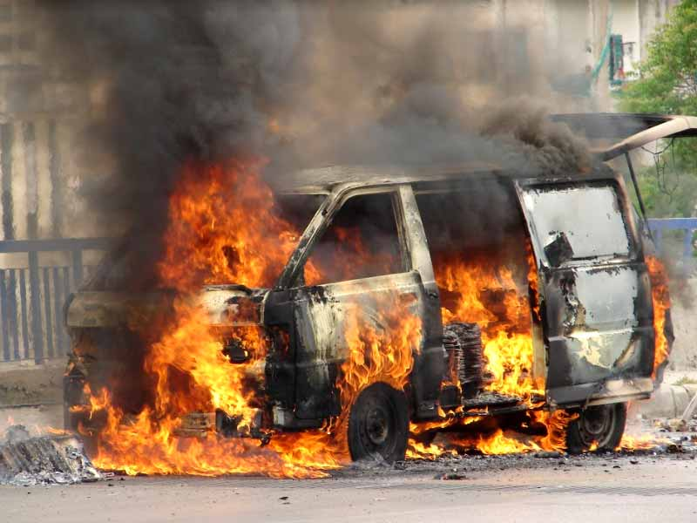


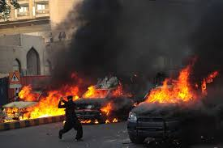
Adding new images to increase the size of the dataset

Slide 24
Future Work
Convert the Python code to Java, eventually to Android.
Find a similarity score based on interesting words.

