Slide 2
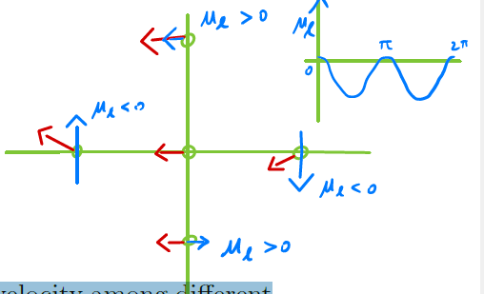
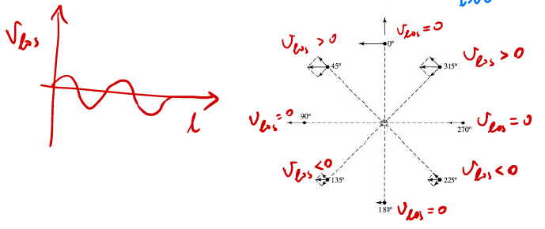





































$$μ_{l}$$
to GC
$$l$$
to GC
$$v_{los}$$
$$0$$
$1$80
$3$60
$$l$$
$$v_{l}>0$$
$$0^{°}$$
$$v_{los}=0$$
$$0^{°}$$
$$v_{l}<0$$
$${315}^{°}$$
$$v_{los}>0$$
$$0$$
$1$80
$3$60
$${315}^{°}$$
$$v_{l}<0$$
$${45}^{°}$$
$${45}^{°}$$
$$v_{los}<0$$
$$v_{l}<0$$
$$v_{los}=0$$
$${270}^{°}$$
$${270}^{°}$$
$${90}^{°}$$
$$v_{l}<0$$
$${90}^{°}$$
$$v_{los}=0$$
$${225}^{°}$$
$${135}^{°}$$
$$v_{l}<0$$
$${225}^{°}$$
$$v_{l}<0$$
$${180}^{°}$$
$${135}^{°}$$
$$v_{los}<0$$
$${180}^{°}$$
$$v_{los}>0$$
$$v_{l}>0$$
$$v_{los}=0$$

Slide 3





$$z$$
$$v_{b}$$
$$v_{b}$$
$$b$$
$$b$$
Sun
$$y$$
$$x$$
to GC

Slide 4
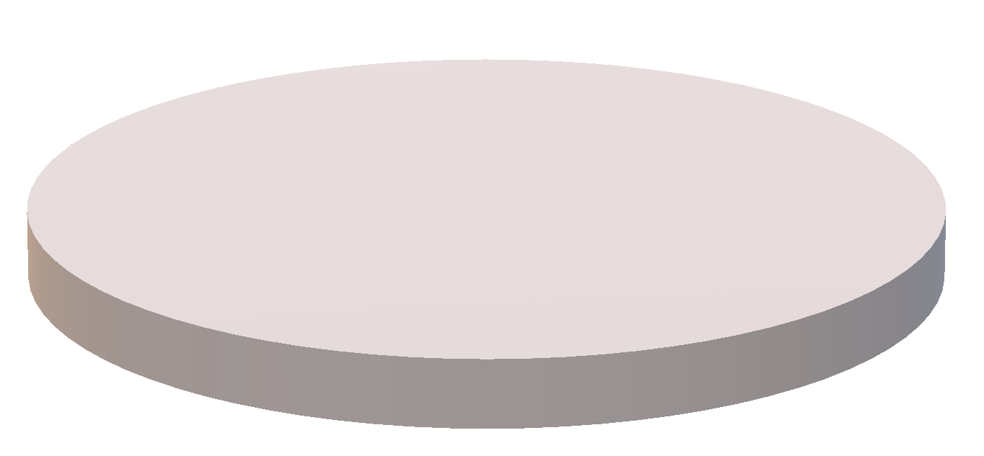



$$d$$
$$b$$
Rotation
GC
$$l$$
Sun

