Slide 1
Operations Research
Lecture 3
Guohua Wan
© Dr. G. Wan

Slide 2
The Simplex Method
An LP problem: The Whitt Window Company
  Three employees, two different kinds of hand-crafted windows: a wood-framed (profit: $60/unit) and an aluminum-framed (profit: $30/unit)
    Doug: makes the wood frames, 6 per day
    Linda: makes the aluminum frames, 4 per day
    Bob: forms and cuts the glass, and 48 square feet of glass per day
    Each wood-framed window: 6 square feet of glass
    Each aluminum-framed window: 8 square feet of glass
  How many windows of each type should be produced per day to maximize profit?

Slide 3
  General LP Problems: Standard Form
  Objective Function:
  Max z =c₁x₁ + c₂x₂ + … + c_{n}x_{n}
  Constraints:
  a₁₁x₁ + a₁₂x₂ + … + a_{1n}x_{n} = b₁
    a₂₁x₁ + a₂₂x₂ + … + a_{2n}x_{n} = b₂
    ...
    a_{m1}x₁ + a_{m2}x₂+ … + a_{mn}x_{n}= b_{m}
    x₁ ≥ 0, x₂ ≥ 0, ..., x_{n} ≥ 0

Slide 4
An simple example of LP
  Max z = 2x₁+ 3x₂ → Max z = 2x₁+3x₂+0x₃+0x₄+0x₅
  s.t. 2x₁+ 3x₂≤ 8 2x₁+ 3x₂+x₃ =8
  4x₁ ≤ 16 4x₁ +x₄ =16
  3x₂≤12 3x₂ +x₅=12
  x₁ ≥ 0, x₂ ≥ 0 x₁ ≥ 0, …, x₅ ≥ 0
Solution method
  m=3, n=5
  Letting some of the variables be zero
  Solving the equations → obtaining a solution
  Optimal?
    Infeasible, unbounded, optimal (unique solution or multiple optimal solutions)

Slide 5
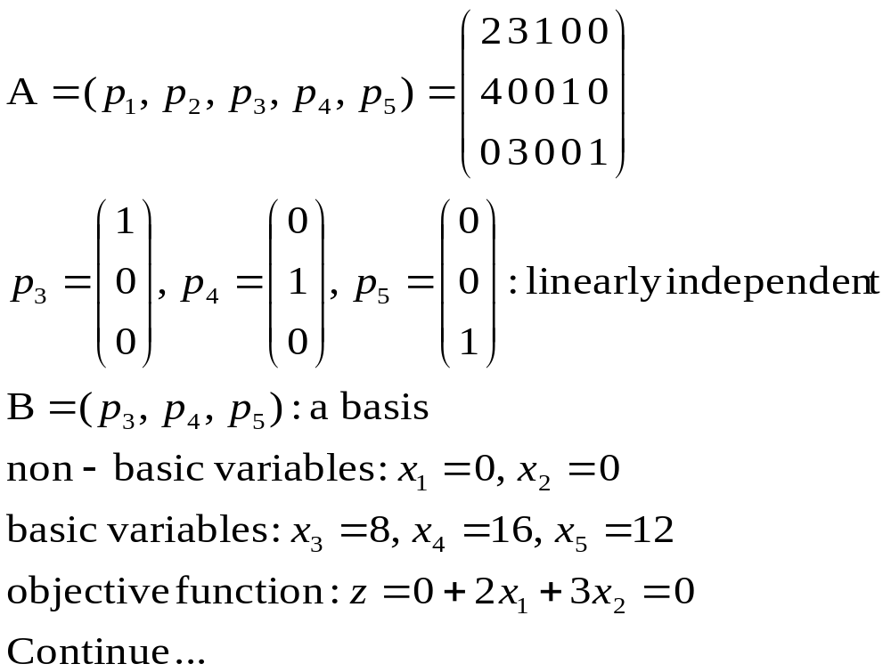

Slide 6
The simplex method 单纯形方法
  A general procedure for solving LP problems
    Initialization 初始化
      Finding the first basic feasible solution
    Optimality test 最优性检验
    Iteration 迭代
      Obtaining another basic feasible solution
      Improving the value of the objective function
      Going to optimality test
  Theoretical foundation?
    Correctness (correct answer to LP problems)
    Convergence (stopping in finite steps) 收敛性

Slide 7
Demonstration of the simplex method
  Solve the LP problem
Min z = | -3x₁ | - 4x₂ | +x₃ | - 2x₄
 | x₁ | + x₂ | +x₃ | + x₄ | ≤25
 | x₁ | +2x₂ | +x₃ | +2x₄ | ≤36
 | x₁ , | x₂ , | x₃ , | x₄ , | ≥0
The standard form
Max z = | 3x₁ | +4x₂ | - x₃ | +2x₄
 | x₁ | + x₂ | +x₃ | + x₄ | +x₅ |  | =25
 | x₁ | +2x₂ | +x₃ | +2x₄ |  | +x₆ | =36
 | x₁ , | x₂ , | x₃ , | x₄ , | x₅ , | x₆ , | ≥0

Slide 8
Simplex Tableau:
z
x₁
x₂
x₃
x₄
x₅
x₆
RHS
z
1
3
4
- 1
2
0
0
0
x₅
0
1
1
1
1
1
0
25
25/1
x₆
0
1
2
1
2
0
1
36
36/2
x₂: entering, x₆: leaving
Simplex Tableau:
z
x₁
x₂
x₃
x₄
x₅
x₆
RHS
z
1
1
0
-3
-2
0
-2
72
x₅
0
½
0
½
0
1
-½
7
7/½
x₂
0
½
1
½
1
0
½
18
18/½
x₁: entering, x₅: leaving

Slide 9
Simplex Tableau:
z
x₁
x₂
x₃
x₄
x₅
x₆
RHS
z
1
0
0
-4
-2
-2
-1
86
x₁
0
1
0
1
0
2
-1
14
x₂
0
0
1
0
1
-1
1
11
Optimal solution:
(x₁, x₂, x₃, x₄, x₅, x₆) = (14, 11, 0, 0, 0, 0)
Max z’=86，thus Min z=-86

Slide 10
Important issues in the simplex method
  Initial solution 初始解
    Observation: A=(I, N)
    Slack variables: Ax ≤ b → Ax + I*x_{s} = b
    Artificial variables: Ax ≥ b → Ax - I*x_{s} + I*x_{s’} = b
  Optimality testing 最优性检验
    Reduced cost coefficients 检验数
      Since Ax=(B, N) (x_{B}, x_{N})^{T} = b → x_{B} = B⁻¹b-B⁻¹Nx_{N},
      and N = (p_{j1} p_{j2}, …, p_{j(n-m)}), thus:
      Z = cx = (c_{B}, c_{N}) (x_{B}, x_{N})^{T} = (c_{B}, c_{N}) (B⁻¹b-B⁻¹Nx_{N}, x_{N})^{T}
      = c_{B}*B⁻¹b + ∑_{j∈N}(c_{j} - c_{B}*B⁻¹p_{j})x_{j} → σ_{j} = c_{j} - c_{B}*p’_{j}
    Optimality test 最优性检验
      σ_{j} ≤ 0 for non-basic variable x_{j}
      Multiple? Infeasible? Unbounded?

Slide 11
  Theorems. 最优性定理
    1. Let x=(b’₁, …, b’_{m}, 0, …, 0)^{T} be a BFS. If σ_{j} ≤ 0 for all the non-basic variables, then x is an optimal solution.
      Proof. No improvement is possible due to σ_{j} ≤ 0.
    2. Let x=(b’₁, …, b’_{m}, 0, …, 0)^{T} be a BFS. If σ_{j} ≤ 0 for all the non-basic variables, and at least one σ_{m+k} = 0 for a non-basic variable, then there are multiple optimal solutions.
      Proof. Let x_{m+k} enter the basis, and pivot to form a new basis. Let x’ be the new solution.
      1). Since σ_{m+k} = 0, we know z=z’. Thus there exist two optimal solutions.
      2). Let y=(x+x’)/2, then y is also an optimal solution.
      Hence, there are multiple optimal solutions.

Slide 12
    3. Let x=(b’₁, …, b’_{m}, 0, …, 0)^{T} be a BFS. If σ_{m+k}>0 and a’_{i, m+k} ≤ 0 for all i =1, …, m, then the objective value of the LP is unbounded.
      Proof. Let x’_{i} = b’_{i} - λa’_{i, m+k}, i∈{1, …, m}
      x’_{m+k} = λ,
      x’_{j} = 0, (i =m+1, …, n, j≠m+k)
      As long as λ>0, then x’ is a feasible solution since σ_{m+k}>0. Let λ→+∞, then z = z₀ + λ*σ_{m+k}→ +∞.
  Transforming of a basis to an adjacent one
    Choice of entering and leaving variables
      Entering variable: let k = arg max{σ_{j}>0}, then x_{k} is the entering variable
        Or arbitrary select a non-basic variable with σ_{j}>0
      Leaving variable:
        Let r = arg min {b’_{i} /a’_{ik} | a’_{ik} >0}, then x_{r} is the leaving variable
      Pivoting: p’_{k} → p’_{r}

Slide 13
  Operations on the tableau: pivoting 转轴运算
    Pivot row, pivot column and pivot number
    Transformation using elementary row operations: p’_{k}→e_{k}
      e_{k} = (0, …, 1, …, 0)^{T}
    Elementary row operations on the table
      Multiplying or dividing a row by a non-zero constant
      Adding or subtracting a multiple of a row to another row
    An example:
 | x₁ | x₂ | x₃ | x₄ | x₅
z | 3 | -1 | 1 | 0 | 0
x₄ | 2 | -1 | 3 | 1 | 0 | 6
x₅ | -2 | 2 | -2 | 0 | 1 | 12

Slide 14
z | 0 | ½ | -7/2 | -3/2 | 0
x₁ | 1 | -½ | 3/2 | ½ | 0 | 3
x₅ | 0 | 1 | 1 | 1 | 1 | 18
z | 0 | 0 | -4 | -2 | - ½
x₁ | 1 | 0 | 2 | 1 | ½ | 12
x₂ | 0 | 1 | 1 | 1 | 1 | 18

Slide 15
The simplex method in tabular form
  Initial simplex tableau (see table)
 | x₁ | x₂ |  | x_{jk} |  | x_{n}
z | c₁ | c₂ | … | c_{jk} | … | c_{n}
x_{j1} | a₁₁ | a₁₂ | … | a_{1,jk} | … | a_{1n} | b₁
x_{j2} | a₂₁ | a₂₂ | … | a_{2, jk} | … | a_{2n} | b₂
… | … |  |  | … |  |  | …
… | … |  |  | … |  |  | …
x_{jm} | a_{m1} | a_{m2} | … | a_{m, jk} | … | a_{mn} | b_{m}
Note: the reduced cost coefficients of basic
variables must be zero 基变量检验数必须为0

Slide 16
Further discussion
  Initial solution 初始解问题
    Big-M method 大M法: introducing some artificial variables
      Constraints
      Ax = b → Ax + x_{s} = b
      Objective function
      z = cx → z = cx - Me^{T}x_{s}
      where e^{T} = (1, 1, …, 1)
      Solving the new problem with the simplex method
    If M is big enough, then the optimal solution remains the same for both problems
      Using the simplex to solve the new problem thus obtain the optimal solution for the original problem

Slide 17
    Two-phase method 二阶段法
      Problem of big-M method
        (1) M: how big is M?
        (2) errors if M is too big
      Artificial variables: x_{s} (total m artificial variables)
        New problem
        Min w = e^{T}x_{s}
        s.t. Ax + x_{s} = b
        x ≥0, x_{s} ≥ 0
      If w = 0, continue with artificial variables w deleted and the original objective function
      If w ≠ 0, then there is no feasible solution of the original problem
    Examples

Slide 18
Radiation Therapy problem
Min z = | 0.4x₁ | +0.5x₂
 | 0.3x₁ | +0.1x₂ | ≤2.7
 | 0.5x₁ | +0.5x₂ | =6
 | 0.6x₁ | +0.4x₂ | ≥6
 | x₁ , | x₂ | ≥0
The standard form
Max z = | -0.4x₁ | -0.5x₂
 | 0.3x₁ | +0.1x₂ | + x₃ |  | =2.7
 | 0.5x₁ | +0.5x₂ |  |  | =6
 | 0.6x₁ | +0.4x₂ |  | - x₅ | =6
 | x₁ , | x₂ , | x₃ , | x₅ , | ≥0

Slide 19
Phase 1 problem
Min z = |  |  |  | x₄ |  | +x₆
 | 0.3x₁ | +0.1x₂ | + x₃ |  |  |  | =27
 | 0.5x₁ | +0.5x₂ |  | + x₄ |  |  | =60
 | 0.6x₁ | +0.4x₂ |  |  | - x₅ | + x₆ | =60
 | x₁ , | x₂ , | x₃ , | x₄ , | x₅ , | x₆ | ≥0
Simplex Tableau:
 | x₁ | x₂ | x₃ | x₄ | x₅ | x₆
z | 0 | 0 | 0 | -1 | 0 | -1 | 0
x₃ | 0.3 | 0.1 | 1 | 0 | 0 | 0 | 2.7
x₄ | 0.5 | 0.5 | 0 | 1 | 0 | 0 | 6
x₆ | 0.6 | 0.4 | 0 | 0 | -1 | 1 | 6

Slide 20
Optimal solution of phase 1:
 | x₁ | x₂ | x₃ | x₄ | x₅ | x₆
z | 0 | 0 | 0 | -1 | 0 | -1 | 0
x₁ | 1 | 0 | 0 | -4 | -5 | 5 | 6
x₃ | 0 | 0 | 1 | 3/5 | 1 | -1 | 0.3
x₂ | 0 | 1 | 0 | 6 | 5 | -5 | 6
Phase 2 problem:
 | x₁ | x₂ | x₃ | x₅
z | -0.4 | -0.5 | 0 | 0 | 0
x₁ | 1 | 0 | 0 | -5 | 6
x₃ | 0 | 0 | 1 | 1 | 0.3
x₂ | 0 | 1 | 0 | 5 | 6
 | x₁ | x₂ | x₃ | x₅
z | 0 | 0 | -0.5 | 0 | 5.25
x₁ | 1 | 0 | 5 | 0 | 7.5
x₅ | 0 | 0 | 1 | 1 | 0.3
x₂ | 0 | 1 | -5 | 0 | 4.5

Slide 21
  Degeneracy 退化
    Definition: some basic variable(s) being zero
      May cause cycling of the simplex method
    Bland rule (1977): elegant but computational unattractive
      Other rules: perturbation method (Charnes, 1952), lexicographic method (Dantzig et al., 1955)
      Only when cycling occurs, take some action
  Reduced (relative) cost coefficients 检验数
    Maximization: σ_{j} = c_{j} - c_{B}*p’_{j}
      σ_{j} ≤ 0 for all variables (basic variables: σ_{j} = 0)
    Minimization: σ_{j} = c_{j} - c_{B}*p’_{j}
      σ_{j} ≥ 0 for all variables (basic variables: σ_{j} = 0)
Computer implementation: introduction
  Excel Solver and Lindo

Slide 22
Summary of the simplex method
  Conversion of general LP to standard form
    Objective function
      min → max
    Constraints
      =; ≤; ≥
    non-negative constraints
      … ≤0; … ≥0; free
  The principle of the simplex method (see figures)
    Basic feasible solution
    Optimality testing
    Pivoting: improving BFS → a new BFS
  Flow chart of the algorithm (see figure)

Slide 23
Objective Function
Constraints
=
Right hand side
Non-singular: Basis
=

Slide 24
Objective Function
Constraints
=
Right hand side
Leaving
Entering
Non-singular: Basis
=

Slide 25
Standard Form
(slack, surplus and
artificial variable)
Calculating σ_{j} for
all non-basic variables
No feasible
solution
Unique optimal
solution
Y
N
Y
Some artificial
variable is a non-zero basic variable
N
all σ_{j}≤0?
σ_{j}=0 for some non-basic variable
Y
For any σ_{j} > 0,
a_{ik} ≤ 0
Y
Unbounded
solution
Multiple optimal
solutions
Let σ_{k}=max{σ_{j}}
Let θ_{r}=min{b_{i}/a_{ik}|a_{ik}>0}
x_{k}: entering, x_{r}: leaving
a_{rk}: pivot number
Pivoting
1. x_{k} →x_{r}
2. a_{rk} → 1, row operations

Slide 26
Summary
The simplex method: a general procedure for solving LP
  Initialization
  Optimality test
  Iteration
    Entering and leaving variables
    Pivoting operations
Some important issues
  Finding initial BFS (basic feasible solution)
    Big-M and two-phase methods
  Degeneracy and the anti-cycling rules

Slide 27

Questions and Discussion

