Slide 1
Wind forecast
By Abdulrhman Abdullah
Data Sciences Bootcamp
SADAIA Academy

Slide 2
Problem
Data
Feature Engineering

Slide 3

Problem

Slide 4

Data

Slide 5
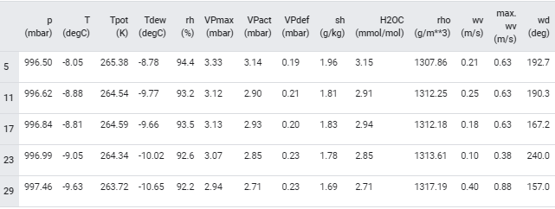
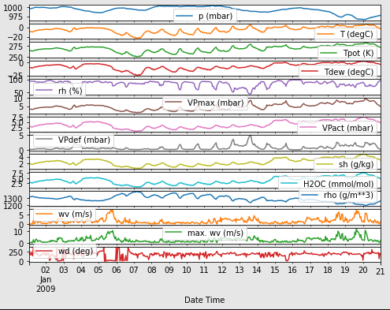
EDA

Slide 6
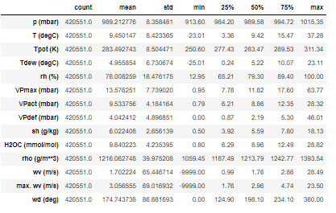

Slide 7
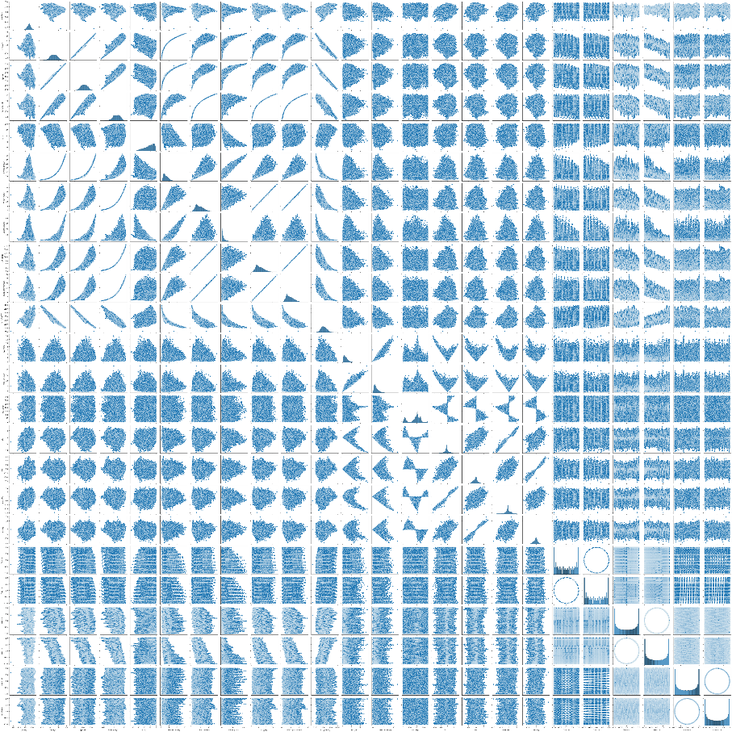

Slide 8
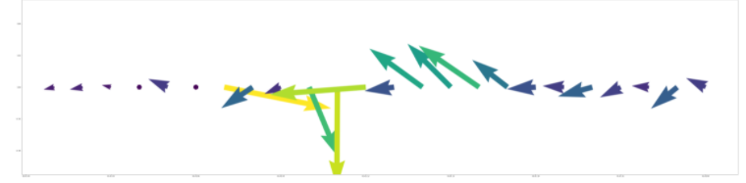
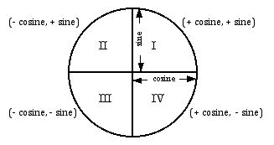
Features Engineering

Slide 9
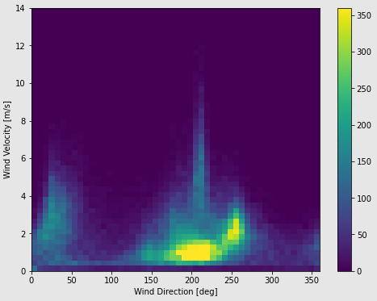
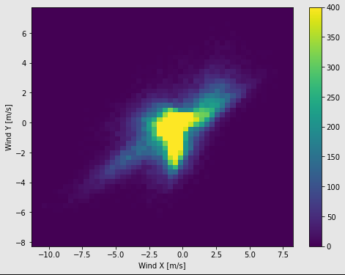
Wind direction

Slide 10
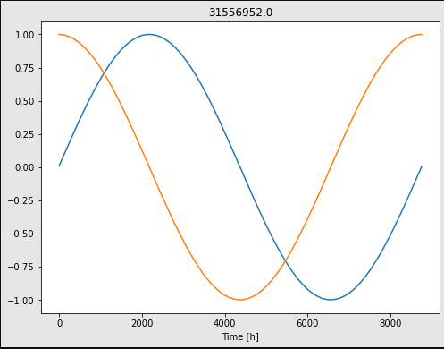
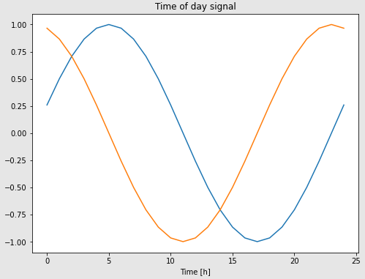
Date
transforms to clear "Time of day" and "Time of year" signals after I convert it to seconds

Slide 11
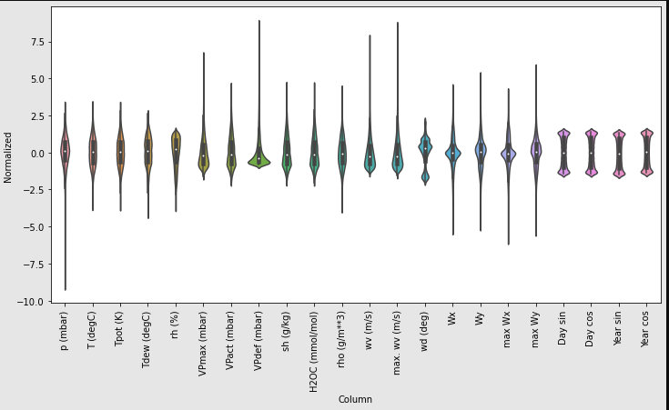
Spilt and normalized Data

Slide 13
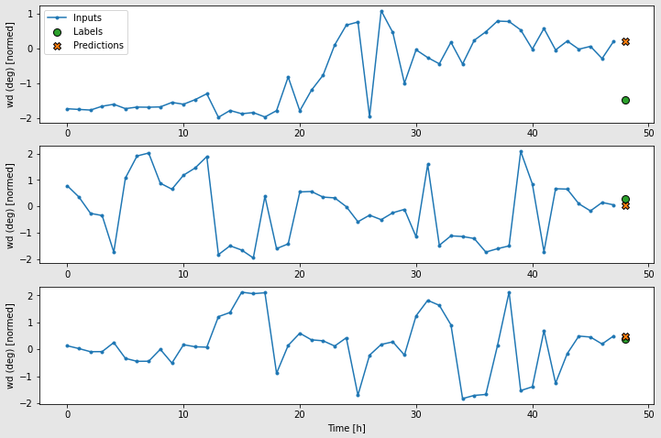
Base Line

Slide 14
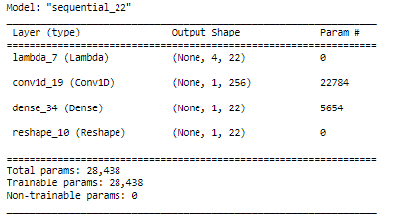
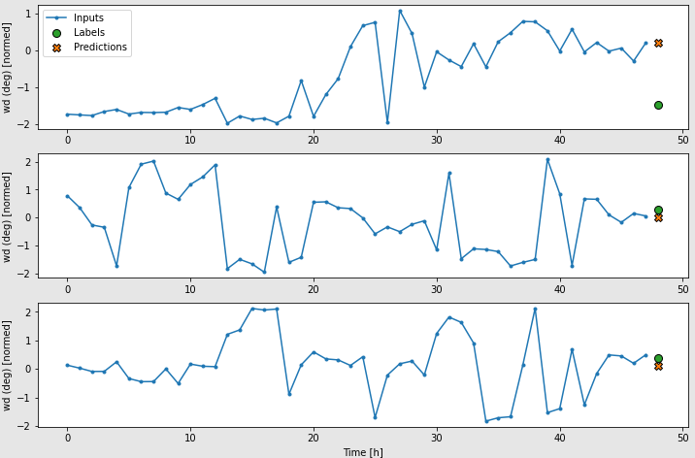
CNN

Slide 15
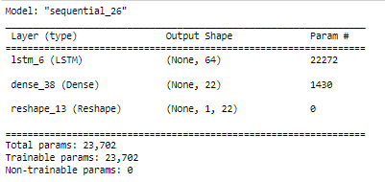

RNN LSTM

Slide 16
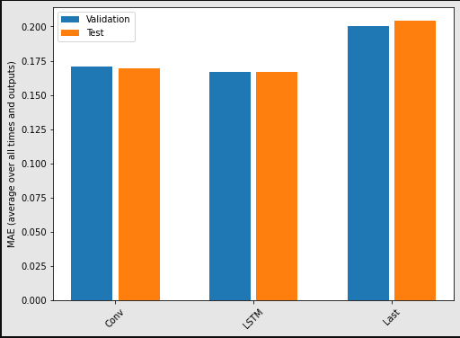

Slide 17
Thank You

Slide 18
Industrial Stack detector
Data
ESA's Sentinel-2 satellites
Characterization of Industrial Smoke Plumes from Remote Sensing Data
Library and tool:
Colab , geopandas, matplotlib, numpy, rasterio, scikitlearn, tensorboard ,torch, torchvision

Slide 19
Model
ResNet-50 binary
architecture as a binary classifier. The architecture is modified to utilize a 12 multi-band channel (all Sentinel-2channels) input vector and results in a scalar logit

Slide 20
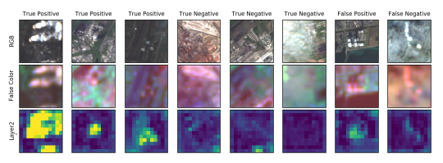
Epoch 100: train loss=0.101, val loss=0.530, train acc=0.959, val acc=0.881

