Slide 1
Wind forecast
By Abdulrhman Abdullah
Data Sciences Bootcamp
SADAIA Academy

Slide 2
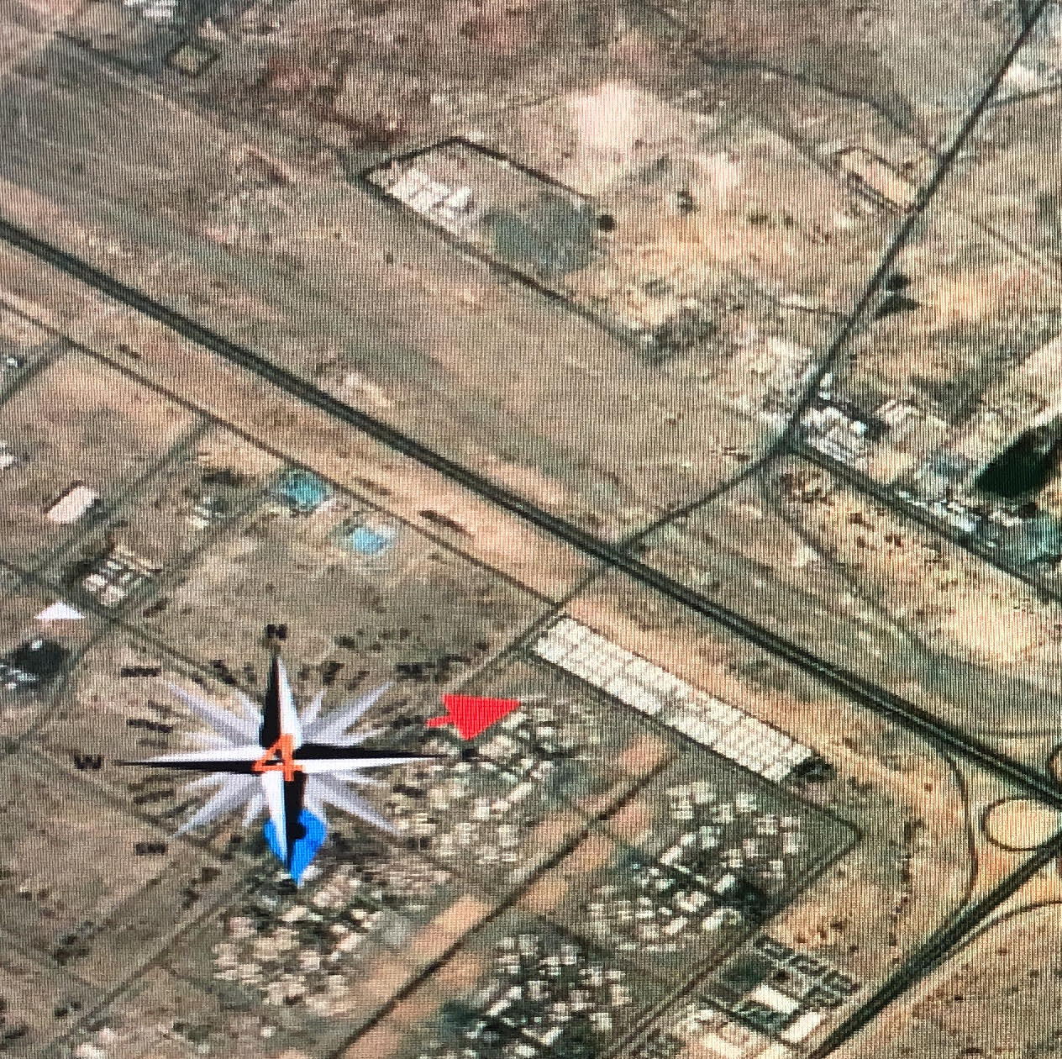

Problem

Slide 3

Data

Slide 4
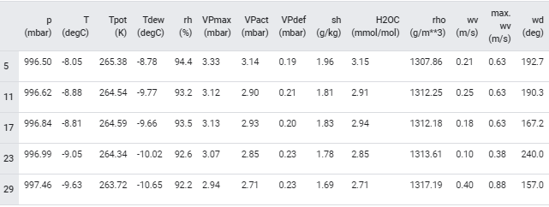
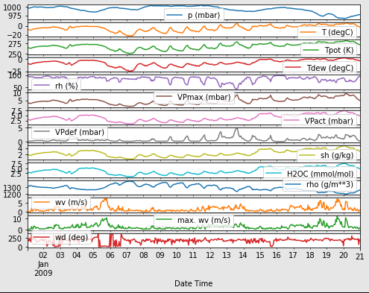
EDA

Slide 5
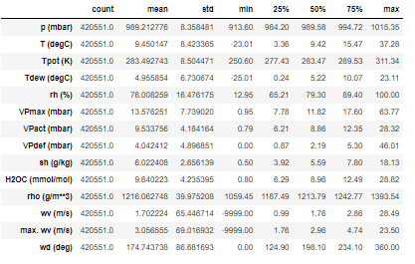

Slide 6
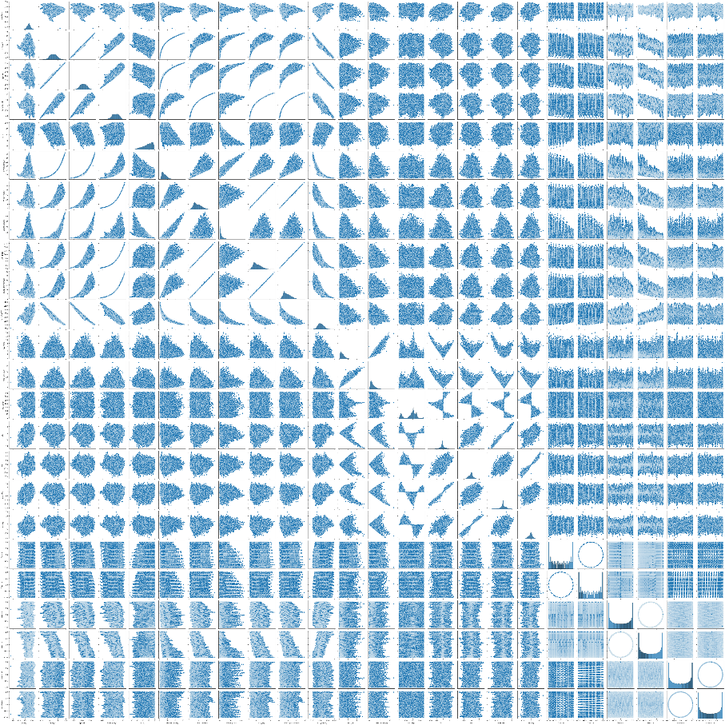

Slide 7
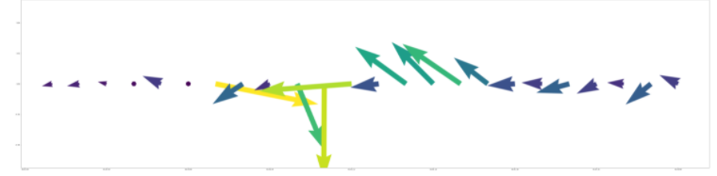
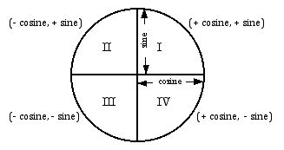
Features Engineering

Slide 8
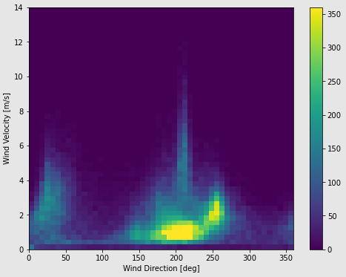
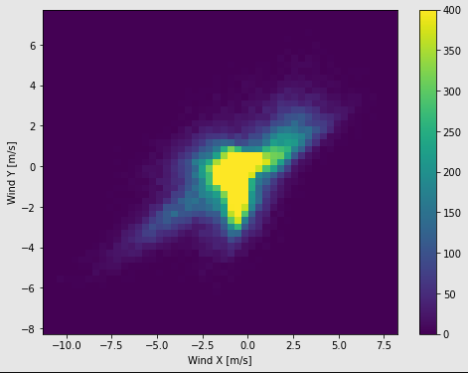
Wind direction

Slide 9
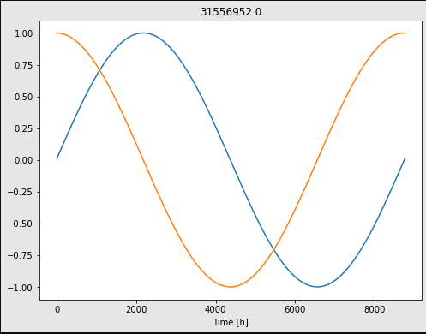
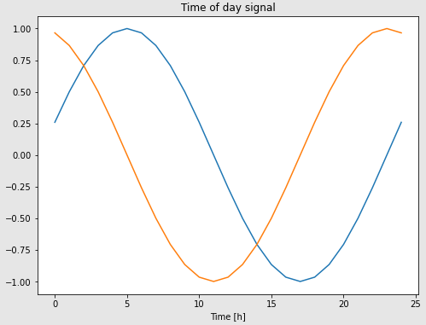
Date
transforms to clear "Time of day" and "Time of year" signals after I convert it to seconds

Slide 10
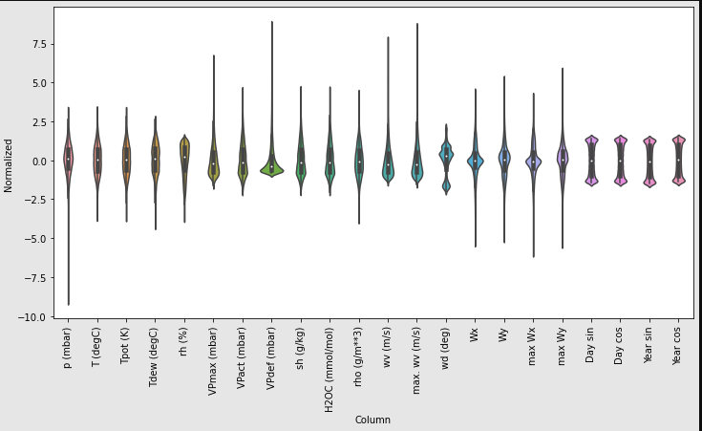
Spilt and normalized Data

Slide 11
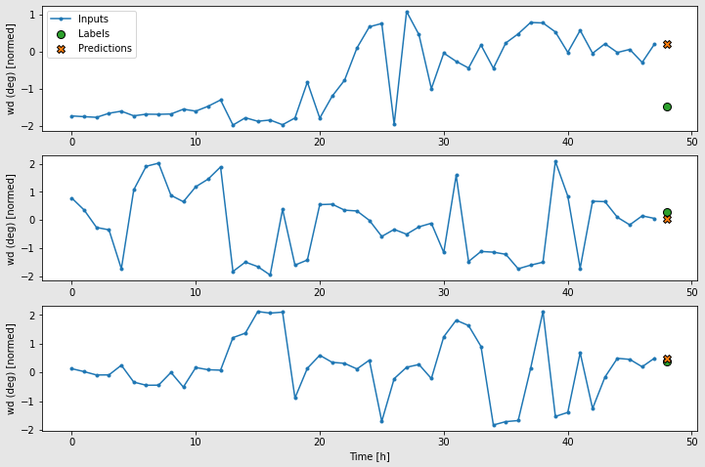
Base Line

Slide 12
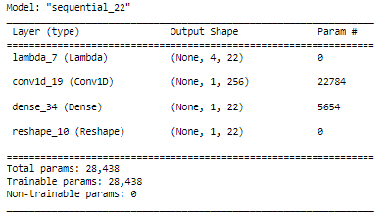
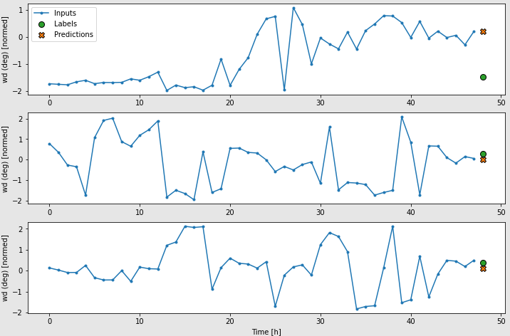
CNN

Slide 13
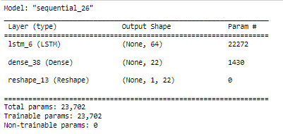

RNN LSTM

Slide 14
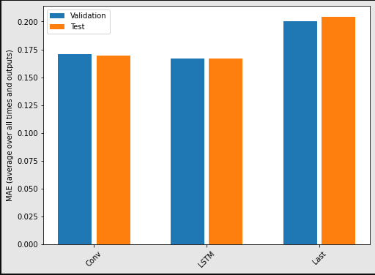

Slide 15
Thank You

Slide 16
Industrial Stack detector
Data
ESA's Sentinel-2 satellites
Characterization of Industrial Smoke Plumes from Remote Sensing Data
Library and tool:
Colab , geopandas, matplotlib, numpy, rasterio, scikitlearn, tensorboard ,torch, torchvision

Slide 17
Model
ResNet-50 binary
architecture as a binary classifier. The architecture is modified to utilize a 12 multi-band channel (all Sentinel-2channels) input vector and results in a scalar logit

Slide 18
