Slide 1
WhiteBoard
A “Chalk” BlackBoard Companion
Andy Zhu
Julian McClellan
Andrew Bonar

Slide 2

Motivation
Create a utility to save course documents to local directory:
Announcements and Notes
Assignments and FIles (Readings, Problem Sets)
Contact Information

Slide 3
Motivation
Expand upon current Chalk functionality:
Predict final grades based on syllabus and performance
Use directory.u.e to report on demographics by major
Gather professor and TA contact information

Slide 4
Chalk: The Update Page

Slide 5
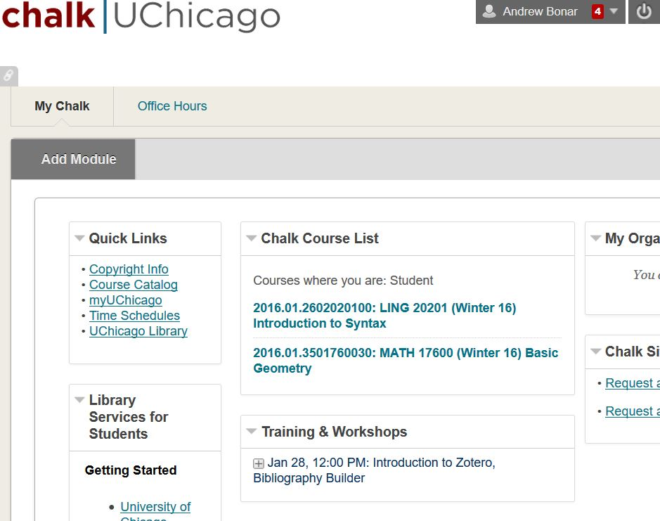

Homepage

Slide 6
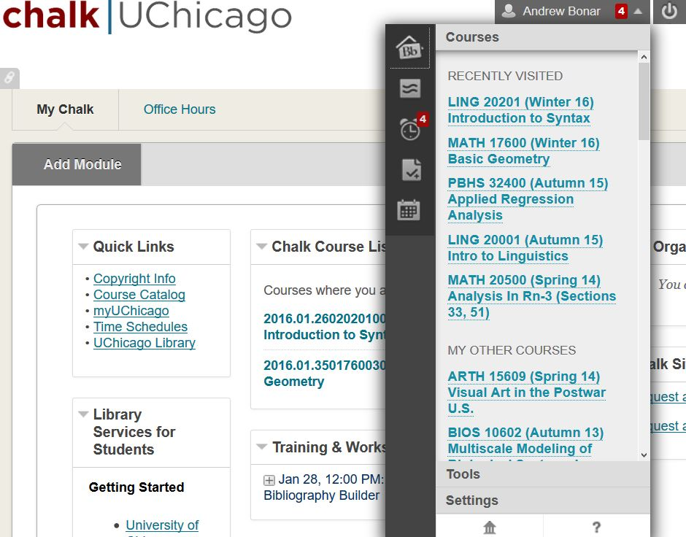
Menu

Slide 7
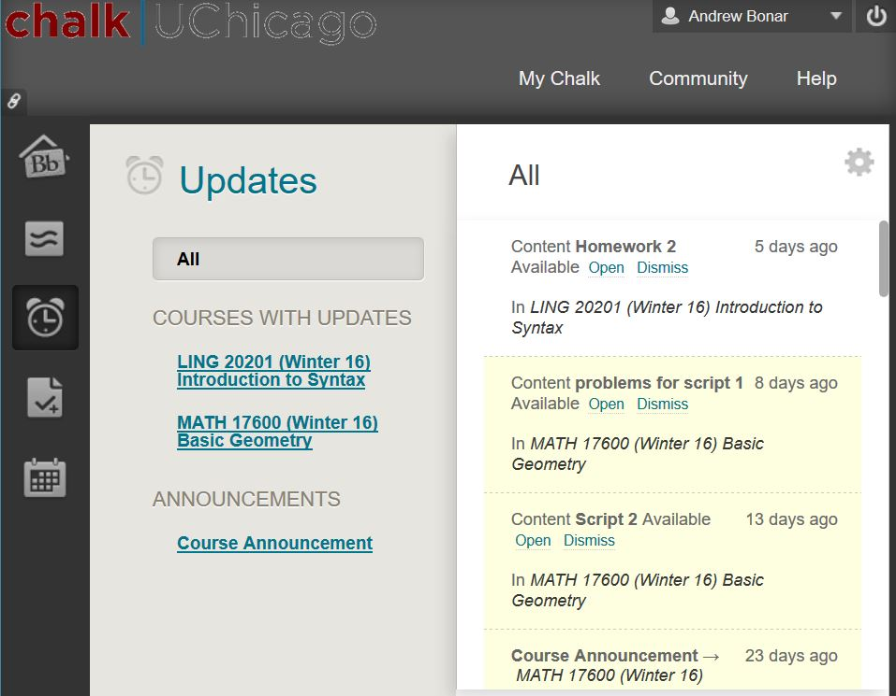
Update Page

Slide 8
Chalk: List of Students

Slide 9
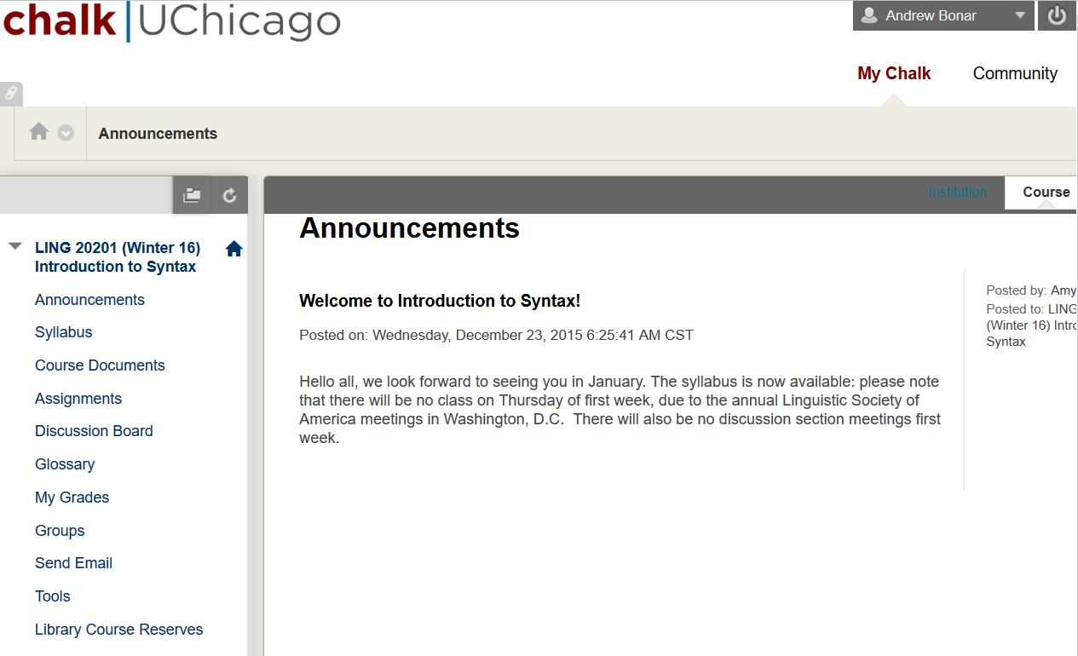
List of Students

Slide 10
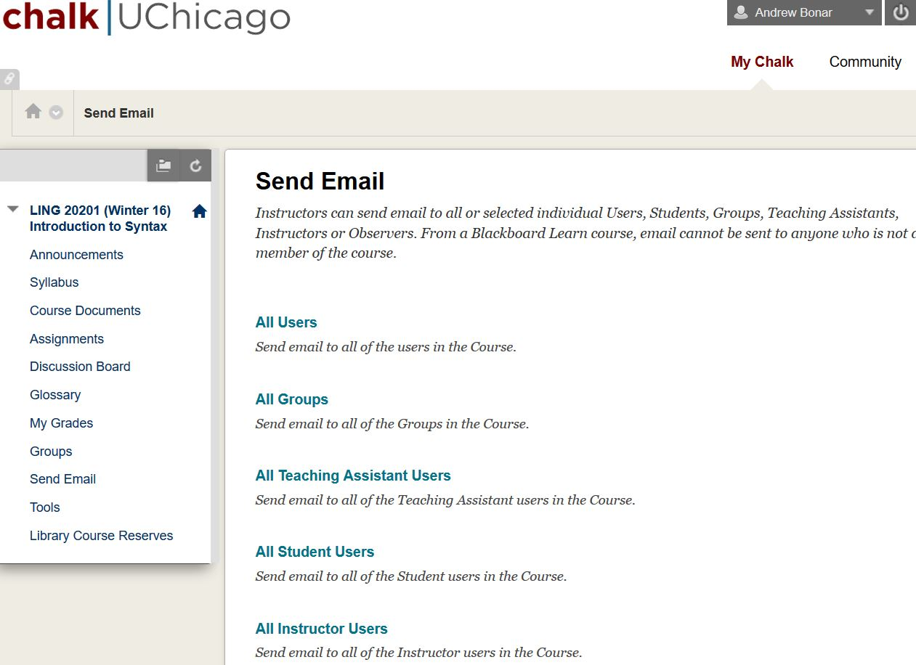
List of Students

Slide 11
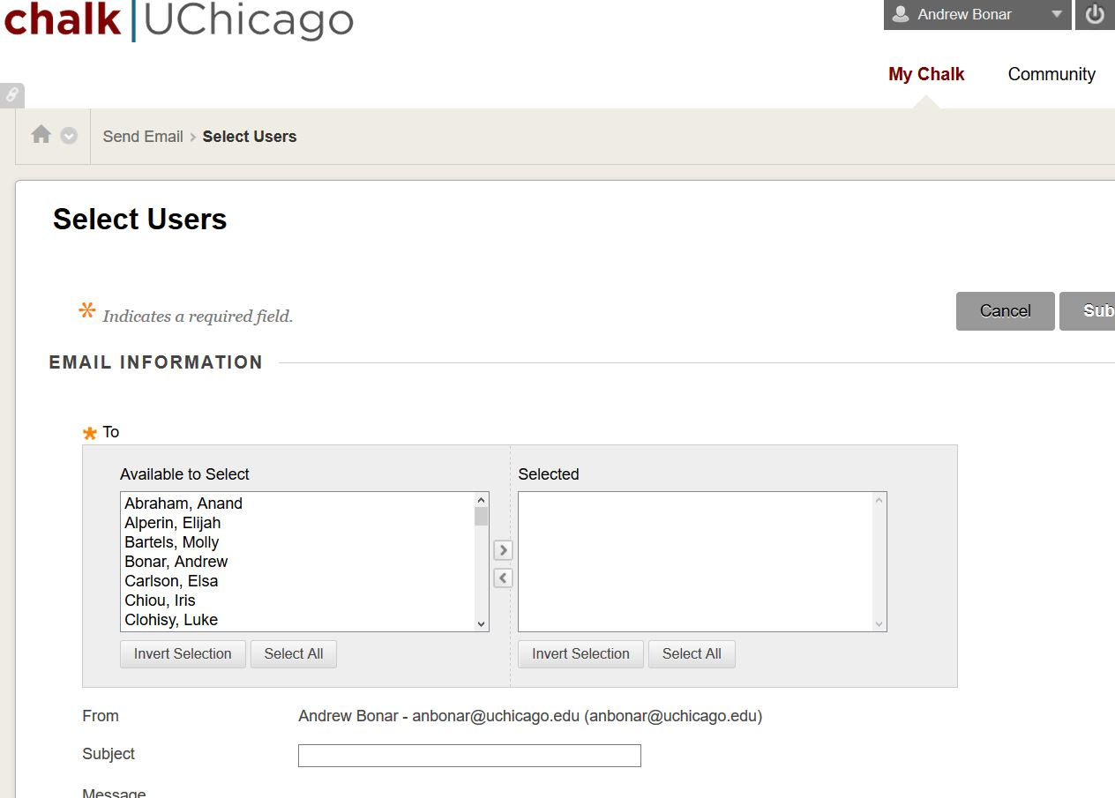
List of Students

Slide 12
Directory: Sample Entry

Slide 13
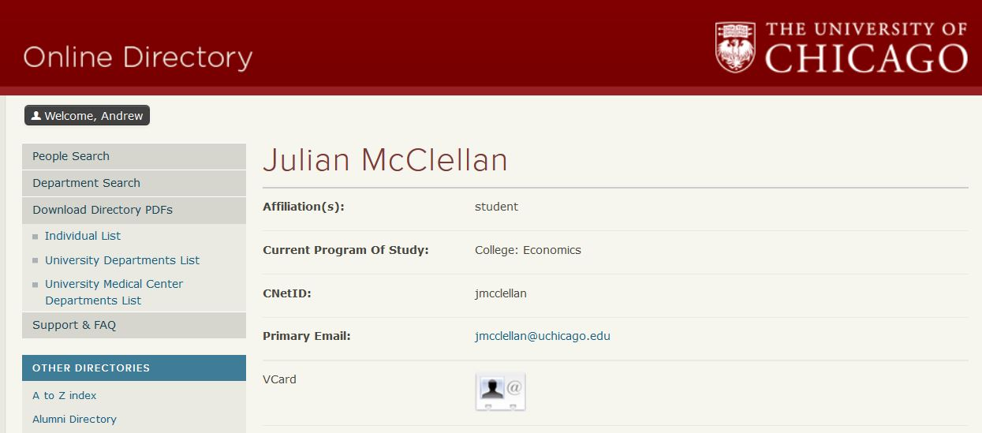
Sample Entry

Slide 14
Tools from outside 122
Django Frontend
CNet ID & Password entry
Function menu: what to update?
Parsing PDFs (pdfminer) - for grade projection using syllabus weights
“Student”, “Instructor” classes to store directory information, pass to plot.ly

Slide 15
Timeline & Responsibilities
Week 5/6 - Chalk Crawler (Andy + Julian), Directory Crawler (Andrew)
Week 7/8- File storage / Download log creation (Andy)
Django Frontend (Julian)
Week 9/10 - PDF Parsing and Grade Projection (Julian + Andrew)
Class demographics and contact information (Andrew)

Slide 16
Questions? Thanks!

