Slide 1
MPCS 53001: Databases
Zach Freeman
Lecture #8

Slide 2

Convo Between Two Cool People
SNL has a new cast member named Luke Null. How does their database handle this? I guess that's why they do "IS NULL"
Imagining his first day:
“Hi, I’m Luke.”
"Last name?"
"Null“
"Okay: SELECT * FROM Performer WHERE last_name IS NULL.... sorry Luke, looks like you're not in our database.“
"No no no - my last name IS Null"
"Yep that's what I searched. You're not there."
Yup there you go... That was so super nerdy.

Slide 3
Reminder
Next class:
THIS Saturday (11/18) and NEXT Tuesday (11/21)
Data warehousing (w/guest speaker Frank Greco from IBM)

Slide 4
Homework
Assignment 8 (project and Gradiance lab)
Get web account set up.
Basic web programming (PHP/HTML with MySQL interactions) – retrieving/displaying data.
Assistance with PHP and web programming will be given during office hours.

Slide 5
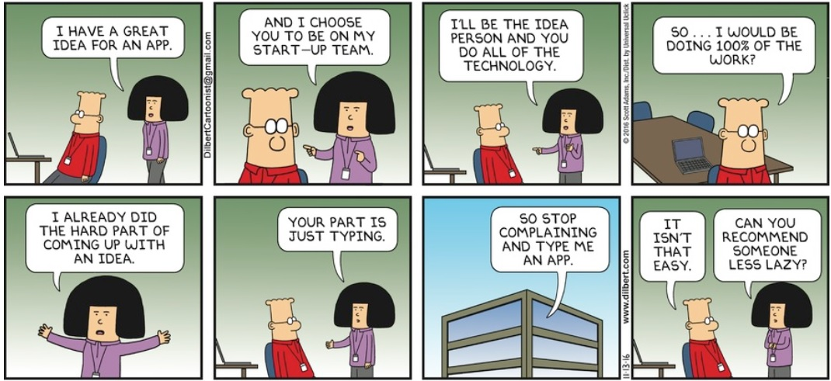
Great App Idea

Slide 6
Overview For Today
Web system architecture
Database connectivity
PHP
SQL Injection

Slide 7
Web System Architecture
Three-tier (or multi-tier) architecture
Presentation tier
Application tier
Data tier

Slide 8
Web System Architecture
Three-tier (or multi-tier) architecture
Client server: presentation and user interaction
Application server: application and business logic
Database server: store the data and communicate with the application server

Slide 9
Three-Tier Architecture
Browser
Presentation (client server)
User inputs and actions
HTML
Application (PHP)
SQL
Relational data
Data (MySQL)

Slide 10
Scalability: Presentation Tier
S1
S2
S3
S4
…
Sn
Application (PHP)
Data (MySQL)

Slide 11
Scalability: Application Tier
S1
S2
S3
S4
…
Sn
A1
A2
…
An
Data (MySQL)

Slide 12
Scalability: Data Tier
S1
S2
S3
S4
…
Sn
A1
A2
…
An
???
Data (MySQL)

Slide 13
Example: Texas Buck Registry
Client server displays info to user and captures clicks and user input.
App server implements actions (creating profile, posting deer, etc.) by issuing query updates to the database server.
Database stores users, deer profiles, counties, etc.

Slide 14
Database Connectivity
Embedded SQL
Language-specific libraries
ADO.NET in C#
JDBC in Java
PHP
mysqli (was mysql til 4.1.3)
PDO (PHP Data Objects)

Slide 15
PHP: Hypertext Preprocessor (PHP)
A scripting language for web development
Server-side language (executed by web server not client server)
Can retrieve data from a database
Can generate a web page dynamically when browser requests it (HTML = static)

Slide 16
PHP formatting
Format:
<? php
… code …
?>
Example:
<? php
echo ‘Hello World!’;
?>

Slide 17
PHP Variables
Variable names must begin with $.
Variables do not need to be declared or typed.
When a variable is assigned a value from a certain class, all class methods become available.

Slide 18
String Values
Double quotes and single quotes have different interpretations in PHP.
Single quotes mean literal string with no processing.
Double quotes mean replace variable names inside the string with their values.

Slide 19

Examples
$race = 'Frank Lloyd Wright 5K';
$raceSentence = 'I ran the $race.';
// value is 'I ran the $race.'
$raceSentence = “I ran the $race.”;
/* value is
'I ran the Frank Lloyd Wright 5K. ' */

Slide 20
PHP Arrays
Numeric and Associative.
Numeric array example:
$popStars = array(“Kesha”, “Beyonce”, “Katy”, “Taylor”)
// indexed 0,1,2 so:
// $popStars[0] is “Kesha”, $popStars[1] is “Beyonce”, etc.

Slide 21
PHP Arrays
Assigning new values to numeric arrays:
$popStars[3] = “Rihanna”;
Assigning new values to the end of arrays:
$popStars[] = “Halsey”;

Slide 22
Associative Arrays
Elements of an associative array $array are pairs x => y, where x is a key string and y is a value.
If x => y is an element of $array, then $array[x] is y.
Example:
$swedishPopStars[‘OG’] = “Robyn”;
$swedishPopStars[‘Hipster’] = “Lykke Li”;
$swedishPopStars[‘CoolGirl’] = “Tove Lo”;
$swedishPopStars[‘WTF’] = “Angie”;

Slide 23
Associative Arrays Example
$mysqlParams = array(
‘host’ => ‘mpcs53001.cs.uchicago.edu’,
‘user’ => ‘zfreeman’,
‘password’ => ‘topSecretAmazingPassword’,
‘database’ => ‘zfreemanDB’);
// $mysqlParams[ ‘user’ ] is ‘zfreeman’
// $ mysqlParams[ ‘database’ ] is ‘zfreemanDB’

Slide 24
Form Values
$_GET
$_POST
$_REQUEST
Setting variables with Form values:
$username = $_REQUEST[‘username’];

Slide 25
MySQL Connection in PHP
MySQL Improved Extension – mysqli
$myConnection = mysqli_connect($host, $username, $password, [$database])
Standard practice is to define the values of the params in anothe file (typically a config file).
Reference with require (or include)

Slide 26
Error Handling in PHP
Error handling is standard. Format for previous connection:
or die(“Could not connect: ” . mysqli_connect_error());
Can use loose error message language for debugging.
Need clear error messages for users.

Slide 27
Selecting Database
If initial connect did not include the database or switching to a different database.
mysqli_select_db($myConnection,$database)
or die(“Could not select database: ” . $database);
If you omit $myConnection, the last open connection will be used.

Slide 28
Queries in PHP
$query = ‘SELECT raceName, runnerName FROM Registrations’;
$result = mysqli_query($query)
or die(“Query $query failed: ” . mysqli_error());
mysqli_query takes a string argument and returns a result or generates an error.

Slide 29
Cursors in PHP
mysqli_fetch_row
mysqli_fetch_assoc
mysqli_fetch_array
When applied to the result of a query they return the next tuple as a numeric array, associative array, or both.
Return false after the last tuple.

Slide 30
Cursor Example
While ($tuple = mysqli_fetch_array($result))
{
echo $tuple[0];
echo $tuple[‘runnerName’];
}

Slide 31
Results recalibration with php
Modify Results, so every race result Rita Jeptoo is listed in gets recalibrated.
$DroppedRunner = trim($_REQUEST[‘runnerToDrop']);
$raceToRecalibrateQuery = “??”;
$result = mysqli_query($raceToRecalibrateQuery)
or die(“Query $query failed: “ .mysqli_error());
while ($tuple = mysqli_fetch_array($result)) {
??
}

Slide 32
Results recalibration with php
Modify Results, so every runner after a dropped runner is moved down a place in the results.
$DroppedRunner = trim($_REQUEST[‘runnerToDrop']);
$raceToRecalibrateQuery = “SELECT DISTINCT race FROM Results WHERE runnerName = $DroppedRunner”;
$result = mysqli_query($raceToRecalibrateQuery)
or die(“Query $query failed: “ .mysqli_error());
while ($tuple = mysqli_fetch_array($result)) {
mysqli_query(CALL RecalibrateAllResultsByRunner($tuple[0], $DroppedRunner))
}

Slide 33
Error Handling in PHP (MySQL)
For SELECT statements that should return values, can check:
if (!$result) {
die(…error handling…)
}
Not useful for CREATE/INSERT/UPDATE/DELETE/DROP

Slide 34
Sessions with PHP
Basic session management: let php handle most of the details.
Start a session with: session_start()
Resume session if already started
Store session data in php defined variable (associative array) $_SESSION
To end session, clear all variables:
Unset($_SESSION[‘<variable>’]);

Slide 35
Session Example
<?php
session_start();
if (!isset($_SESSION[‘username’])) {
print '<a href="/~login.html">Click to Login</a>';
}
else {
…. other stuff …
}
?>

Slide 36
SQL Injection
Hack input to change the query that gets executed.
Usually includes ' followed by the hacker query followed by -- to treat anything after it as comments.
Lesson: user input should not be trusted.

Slide 37

Little Bobby Tables
http://xkcd.com/327/

Slide 38
Bobby Tables Explanation
$newUserQ = 'INSERT INTO Students
VALUES ('$newUserName');
For Bobby, it would evaluate to:
INSERT INTO Students
VALUES ('Robert'); DROP TABLE Students ;--);

Slide 39
Second Example
$result=mysql_query("SELECT * FROM users WHERE username = $_REQUEST['username'] AND password = $_REQUEST['password']");
What if $_REQUEST['username'] = admin' OR 1=1 --
"SELECT * FROM users
WHERE username = 'admin' OR 1=1-- AND password = ''
What’s the result of this query?

Slide 40
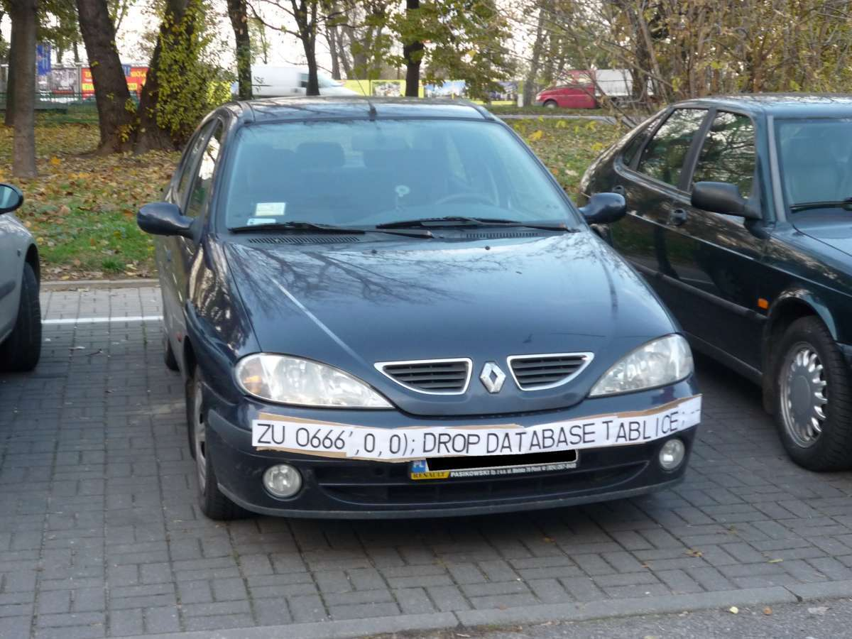

Slide 41
Prepared Statements
$sql = $myConnection->prepare("INSERT INTO Students (firstname, lastname, email) VALUES (:firstname, :lastname, :email)"); $stmt->bindParam(':firstname', $firstname); $stmt->bindParam(':lastname', $lastname); $stmt->bindParam(':email', $email);
$firstname = $_POST['firstname']; $lastname = $_POST['firstname']; $email = $_POST['firstname']; $stmt->execute();

Slide 42
Recap
Web system architecture
Database connectivity
PHP
SQL Injections
Next class -THIS Saturday (11/18) and NEXT Tuesday (11/21):
Data warehousing (w/guest speaker Frank Greco from IBM)

Slide 43
Homework
Assignment 8 (project and Gradiance lab)
Make sure your web account works!
Basic web programming: handle user inputs, generate SQL queries, run them using API (mysqli), collect results, display as HTML.
Assistance with PHP and web programming will be given during normal office hours this week.
Due AFTER Thansgiving

Slide 44

Questions?

