Slide 1



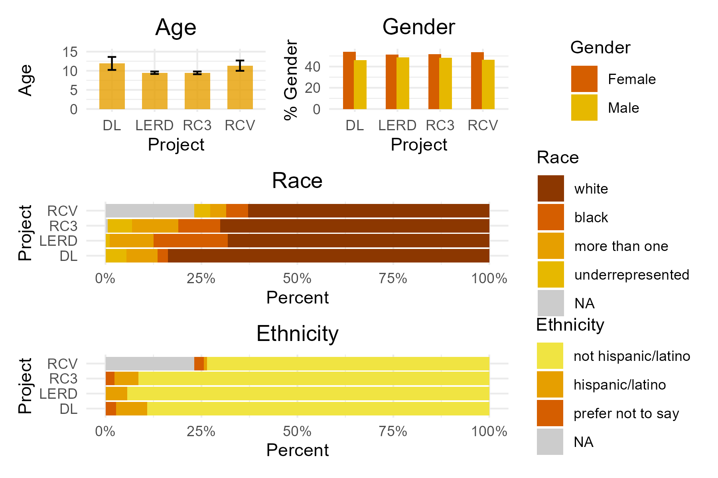
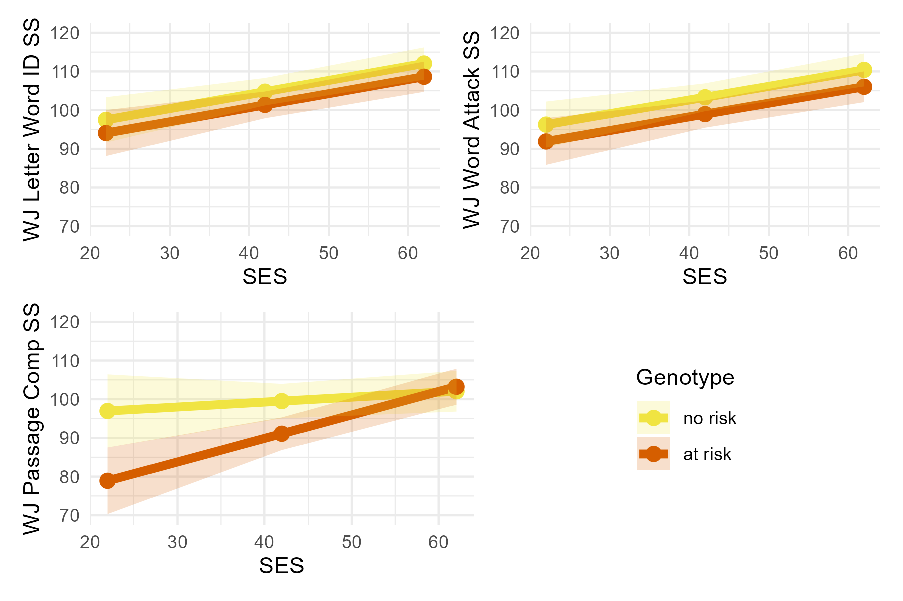
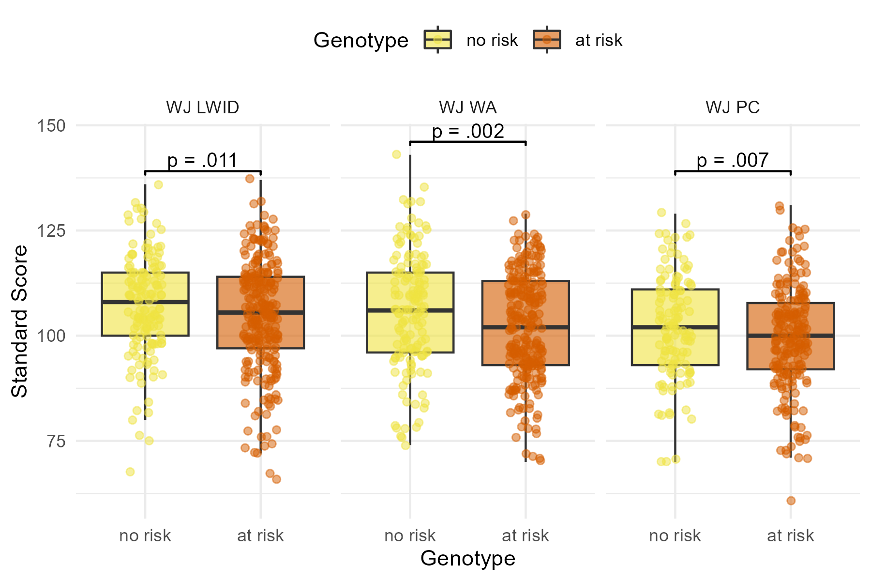
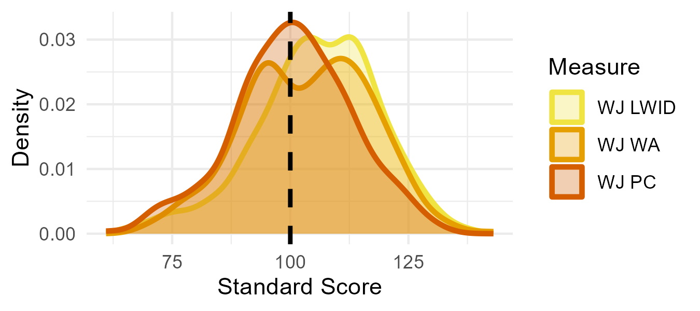

A GRM7 SNP is associated with language decoding in children
Sarah S. Hughes-Berheim¹, Emily Harriot^{1,2}, Chenglin Lou¹, Harrison Parent³, Kellam Schmudde¹, Colleen M. Niswender³ & Laurie E. Cutting^{1,2,4}
¹Peabody College, Vanderbilt University, ²Vanderbilt Brain Institute, ³Department of Pharmacology and Warren Center for Neuroscience Drug Discovery, Vanderbilt University, ⁴Vanderbilt Kennedy Center
INTRODUCTION
RESULTS
Glutamate is the major excitatory neurotransmitter within the CNS, and it is involved in brain development¹
mGlu₇ (metabotropic glutamate receptor 7) modulates glutamate and GABA release and is encoded by the GRM7 gene²
SNPs (single nucleotide polymorphisms) in the GRM7 gene have been associated with ADHD & ASD in humans^{3,4}
In mice, decreasing mGlu₇ expression results in reduced working memory and learning^{1, 5-8}
This suggests SNPs that affect mGlu₇ expression or activity may be related to cognitive outcomes in humans
This study examined whether genotype at rs779710 was associated with reading measures across 4 lab projects
Previous research identified that the C (minor) allele at rs779710 is a risk allele; we hypothesized carrying the C allele would be negatively associated with reading scores
Finally, we tested whether there were any significant genotype by SES interactions
DEMOGRAPHICS OF SAMPLE
RESEARCH QUESTION 2
SES interacted with genotype to affect participant’s PC scores (b = 0.48, p = .02), but not LWID or WA.
C-allele carriers had lower PC scores than T/T homozygotes at low and middle SES, but the same at high SES (Figure 4).
Figure 2. Demographics of Sample (N = 420)
Figure 4. Participant Scores on Reading Measure by SNP Genotype
METHODS
**Note. Underrepresented races included Asian (n = 10), Native American (n = 1), Pacific Islander (n = 1), and prefer not to answer (n = 7).
Participants: 420 children (age M = 10.27, SD = 1.37, 52% female) participated in the study. All were native English speakers with typical IQs (WASI FSIQ > 85).
Behavioral measures: Participants competed the Woodcock Johnson-IV subtests of Letter Word Identification (LWID; real-words), Word Attack (WA; non-words), and Passage Comprehension (PC). Hollingshead Couple Status Score was used as SES.
RESEARCH QUESTION 1
Participants that were T/T homozygous had higher LWID (b = 3.41, p = .011), WA (b = 4.35, p = .002), and PC (b = 28.61, p = .007) than C-allele carriers (Figure 3).
After controlling for age, gender, race, ethnicity and project
CONCLUSION
Having the C allele at rs779710 was associated with lower LWID, WA, and PC scores compared to being T/T homozygous
For PC only, having high SES reduced this genotypic effect
Results suggest having the C allele at rs779710 may disrupt mGlu7 activity, negatively impacting learning
Future investigations into the neural mechanisms that underlie this relationship, including how having the C allele at rs779710 may affect glutamate or GABA release and white matter tract development, are necessary
Figure 3. Participant Scores on Reading Measure by SNP Genotype
Data: Participant genotype was risk-coded with C allele as risk allele (Table 1)
Table 1. Participants (N) per genotype
Risk | Genotype | N
0 (no risk) | T/T homozygous | 149
1 (at risk) | C allele carriers | 271
Figure 1. Density Plot of Participant Scores on Reading Measures
REF & FUNDING
This research was supported by the following grants – R01HD044073, R01HD067254, R21HD087088, R21NS143120, R01MH124671 UL1TR000445, P50HD103537, VUMC Vantage and VU Lacy-Fischer

