Slide 1



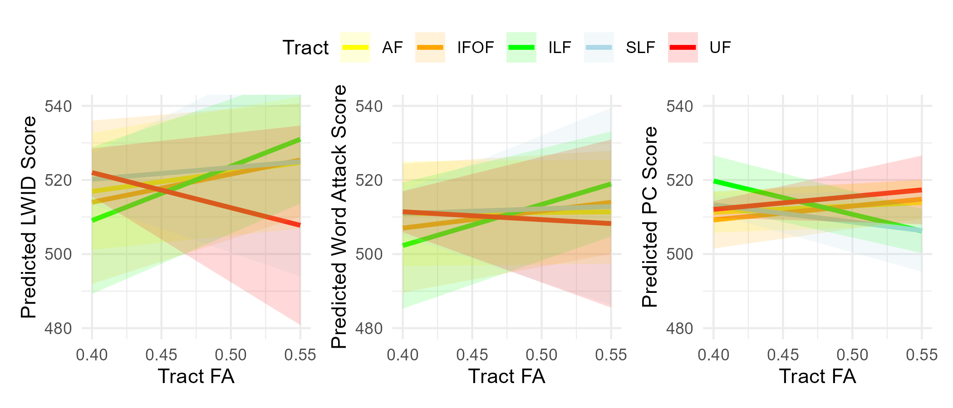
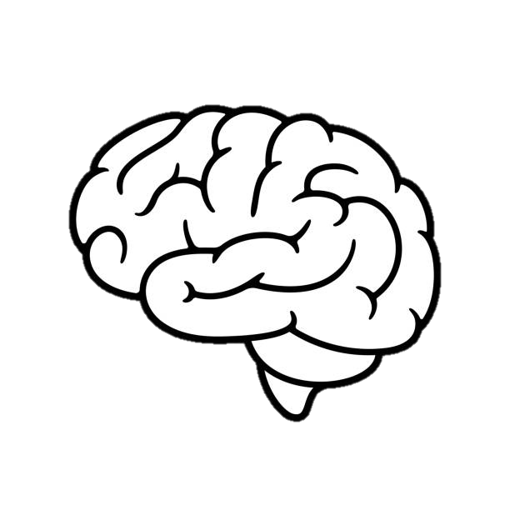
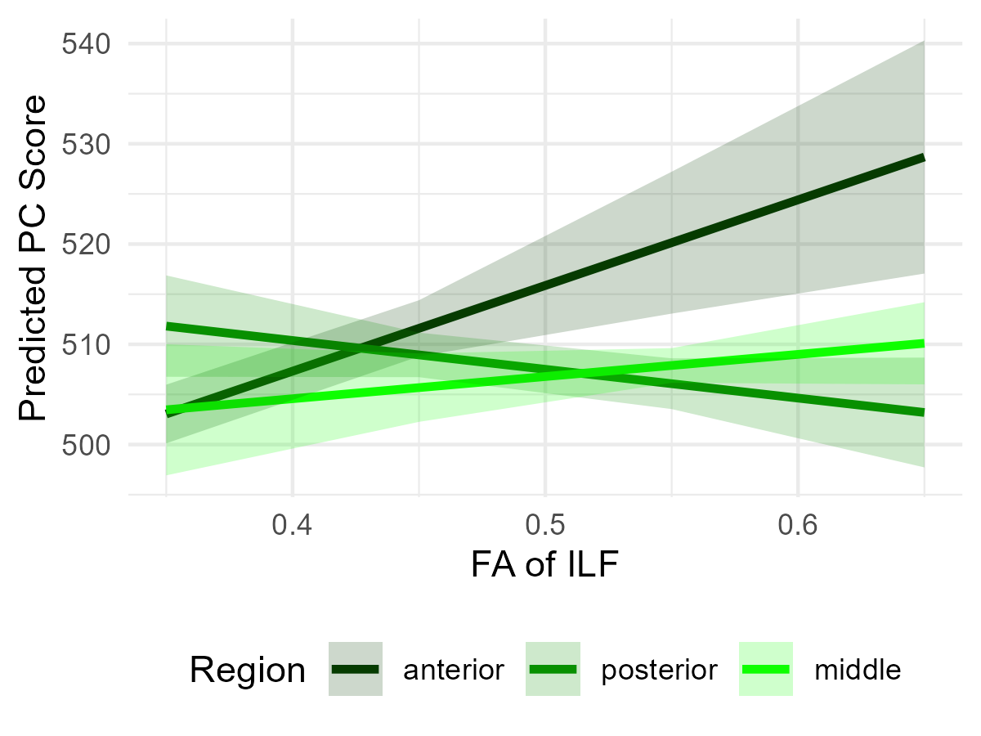

The left inferior longitudinal fasciculus is related to both real word and nonword reading
Sarah S. Hughes-Berheim¹, Emily M. Harriott^{1,2} & Laurie E. Cutting^{1,2,3}
¹Peabody College, Vanderbilt University, ²Vanderbilt Brain Institute, ³Vanderbilt Kennedy Center
INTRODUCTION
RESULTS
RESULTS
White matter (WM) “integrity” of tracts in the reading network may capture individual variability in reading scores separate from that of functional and behavioral data
Several studies have highlighted individual WM tracts with promising results, including the left superior longitudinal (SLF) , inferior longitudinal (ILF), arcuate (AF), uncinate (UF), and inferior frontooccipital fasciculi (IFOF)
However, results are variable across studies, possibly due to testing correlation values of individual tracts with disparate reading scores
We tested whether integrity, or fractional anisotropy (FA), of each of the 5 tracts above was related to reading outcomes after controlling for FA of other tracts, in a sample of middle-aged children
Hypotheses:
Controlling for other reading-related WM tracts,
FA of the left ILF will be related to word reading (LWID)
FA of the left SLF will be related to decoding
FA of the left ILF and SLF will be related to passage comprehension (PC)
Research Question 1: There were NO significant relationships between any WM tract and Word Reading. SES (b = 1.01, p < .001) and age (b = 6.17, p < .001) were significant predictors
Research Question 2 : There were NO significant relationships between any WM tract and Decoding. SES (b = 0.67, p = .004) and age (b = 3.42, p = .006) were significant predictors
Research Question 3: FA of the Left ILF was significantly related to PC (b = -90.17, p = .03). SES (b = 0.21, p = .04), age (b = 1.07; p = .056), LWID (b = 0.46, p < .001), and race (b = -4.66, p = .008) were also significant predictors.
METHODS
EXPLORATORY RESULTS
CONCLUSION
METHODS
Participants: 172 children (age M = 11.65, SD = 1.4). All participants were native English speakers with typical IQs (WASI FSIQ > 85; 58% female).
Behavioral measures: The Woodcock Johnson measures of Letter Word ID (real word reading), Word Attack (nonword reading), and Passage Comprehension were used as measures of reading ability.
MRI: DWI (HARDI) images acquired on a 3T MRI scanner with 32-channel headcoil. Data were processed using QSIPrep (ver0.16.1) and the embedded pyAFQ (ver1.3.2). Visual QA was completed.
Analyses: Analyses were completed in R.
3 GLMs were run to determine whether any of the 5 reading-related WM tracts were related to the outcomes of word reading, decoding, and PC
In all models, we controlled for SES, age, gender, race and ethnicity. For race, Asian (n = 5), Black (n = 20), More than 1 (n = 8), and Prefer not to say (n = 3) were collapsed into “Underrepresented” (n = 36) and compared to White (n = 114)
For the PC model, we controlled Letter Word ID and Word Attack
To explore the relationship between the ILF and PC, we divided the left ILF into thirds and tested whether FA of each region was uniquely associated with PC. Higher FA in posterior sections of ILF compared to anterior ILF was associated with greater PC (b = 114.2, p = .05)
Results indicated only FA of the left ILF was significant related to PC after controlling for FA of other reading-related WM tracts, such that lower FA was related to higher PC
An exploratory analysis indicated this relationship changed based on region of the ILF (higher FA in anterior regions of the ILF is related to greater PC)
Next steps include testing relationships with the vOF tract and using LMERs to account for within-subject differences, which will allow us to determine whether it is global FA or individual tract FA that is important for reading cognition
Preliminary LMER suggests within-subject tract differences in FA do not predict outcomes → suggest a global FA effect
FUNDING
This research was supported by the following grants:
R01HD044073, R01HD067254, R21HD087088, R21NS143120, R01MH124671 UL1TR000445,
R21NS143120, R01 MH124671, P50HD103537

Slide 2
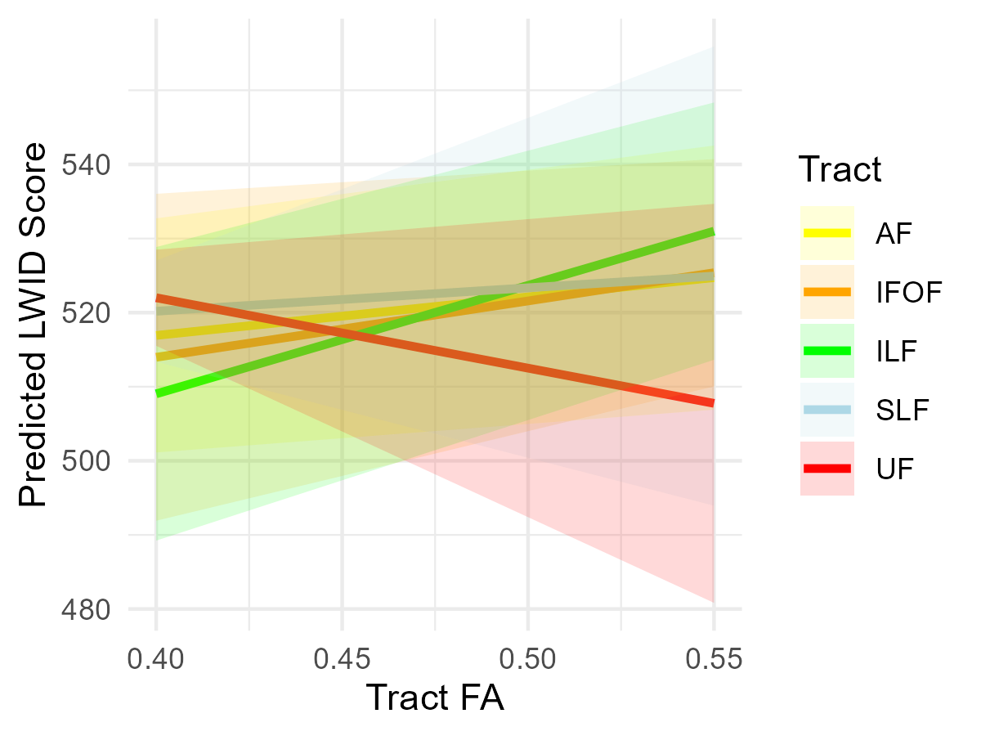
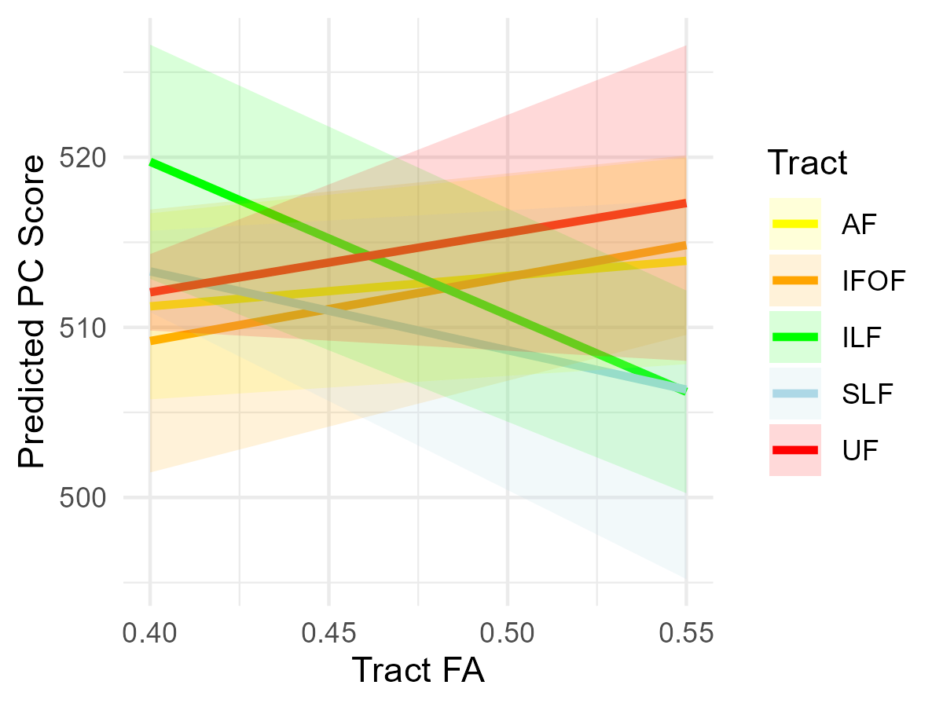
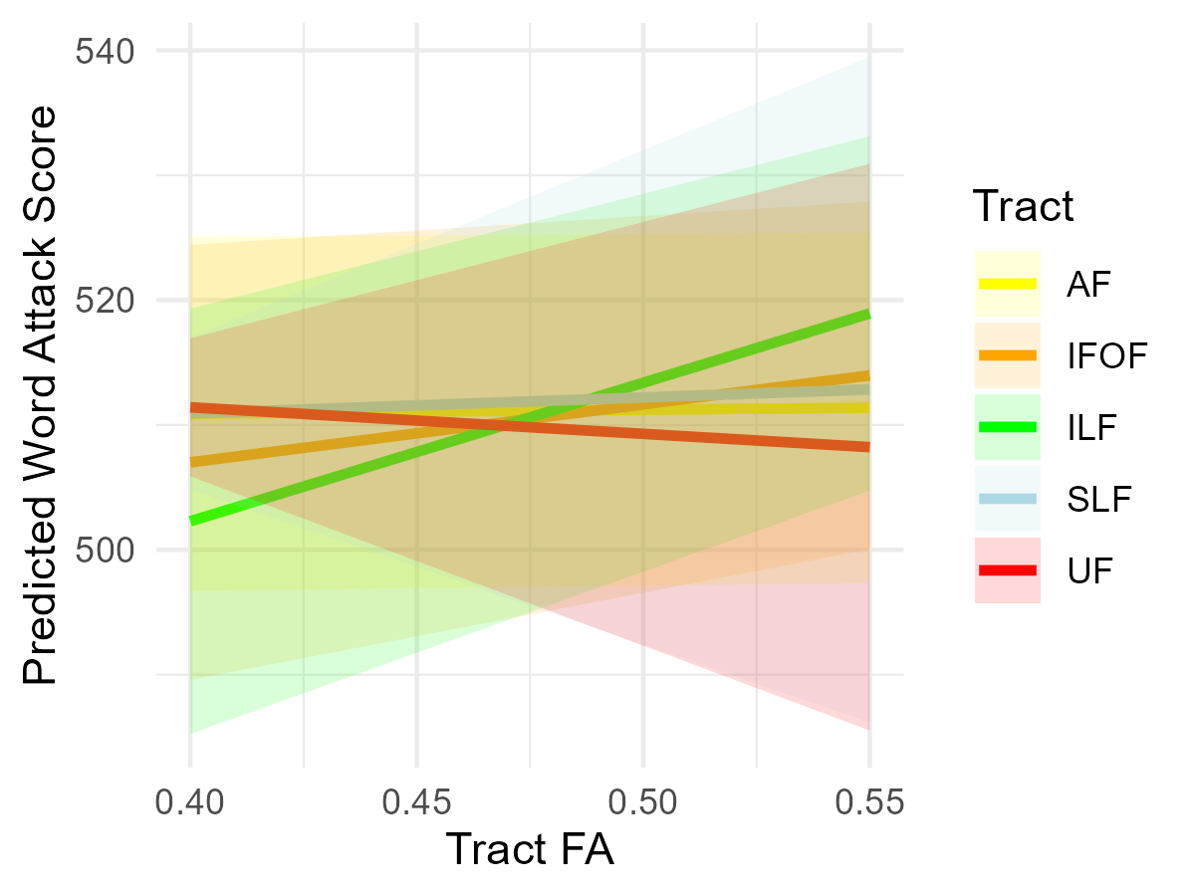
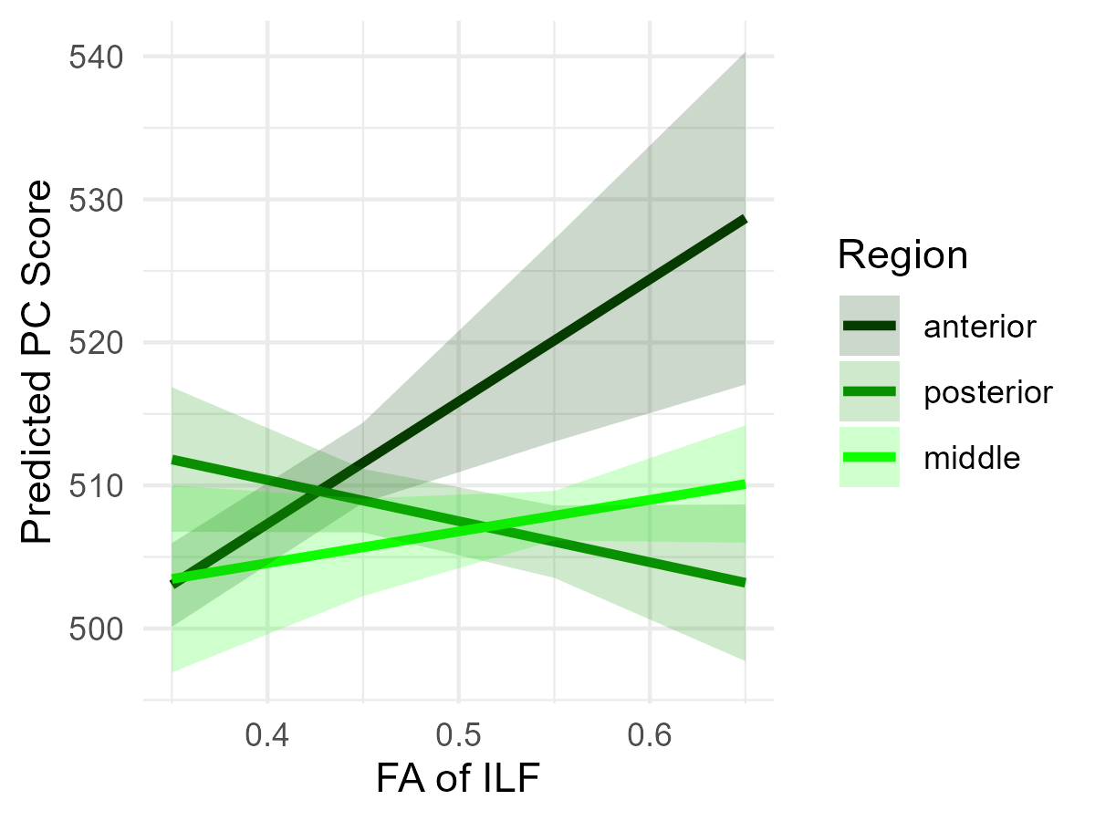
The left inferior longitudinal fasciculus is related to both real word and nonword reading
Sarah S. Hughes-Berheim¹, Emily M. Harriott^{1,2} & Laurie E. Cutting^{1,2,3}
¹Peabody College, Vanderbilt University, ²Vanderbilt Brain Institute, ³Vanderbilt Kennedy Center
INTRODUCTION
RESULTS
RESULTS
RESULTS
White matter (WM) “integrity” of tracts in the reading network may capture individual variability in reading scores separate from functional data
Several studies have highlighted individual WM tracts with promising results, including the left superior longitudinal (SLF) , inferior longitudinal (ILF), arcuate (AF), uncinate (UF), and inferior frontooccipital fasciculi (IFOF)
However, results are variable across studies, possibly due to testing correlation values of individual tracts with disparate reading scores
Research Question 1: There were NO significant relationships between any WM tract and Word Reading. SES (b = 1.01, p < .001) and age (b = 6.17, p < .001) were significant predictors
Research Question 3: FA of the Left ILF was significantly related to PC (b = -90.17, p = .03). SES (b = 0.21, p = .04), age (b = 1.07; p = .056), LWID (b = 0.46, p < .001), and race (b = -4.66, p = .008) were also significant predictors.
We tested whether integrity, or fractional anisotropy (FA), of each of the 5 tracts above was related to reading outcomes after controlling for FA of other tracts, in a sample of middle-aged children
Hypotheses:
Controlling for other reading-related WM tracts,
FA of the left ILF will be related to word reading
FA of the left SLF will be related to decoding
FA of the left ILF and SLF will be related to passage comprehension (PC)
Research Question 2 : There were NO significant relationships between any WM tract and Decoding. SES (b = 0.67, p = .004) and age (b = 3.42, p = .006) were significant predictors
To further explore this relationship, we divided the left ILF into thirds and tested whether FA of each region was uniquely associated with PC.
METHODS
METHODS
Participants: 172 children (age M = 11.65, SD = 1.4). All participants were native English speakers with typical IQs (WASI FSIQ > 85; 58% female).
Behavioral measures: The Woodcock Johnson measures of Letter Word ID (real word reading), Word Attack (nonword reading), and Passage Comprehension were used as measures of reading ability.
MRI: DWI (HARDI) images acquired on a 3T MRI scanner with 32-channel headcoil. Data were processed using QSIPrep (ver0.16.1) and the embedded pyAFQ (ver1.3.2). Visual QA was completed.
Analyses: Analyses were completed in R.
3 GLMs were run to determine whether any of the 5 reading-related WM tracts were related to the outcomes of word reading, decoding, and PC
In all models, we controlled for SES, age, gender, race and ethnicity. For race, Asian (n = 5), Black (n = 20), More than 1 (n = 8), and Prefer not to say (n = 3) were collapsed into “Underrepresented” (n = 36) and compared to White (n = 114)
For the PC model, we controlled Letter Word ID and Word Attack
Include vOF tract
Test for within-subject differences → is it global FA that is related to cognition or do individual tracts within a subject matter
Preliminary LMER suggests within-subject tract differences in FA do not predict outcomes
Suggest a global FA effect
REFERENCES & FUNDING

