Slide 1
Refinements – A new feature of Ruby
Shugo Maeda
2012-10-20T15:00:00 - 2012-10-20T15:45:00

Slide 2
Who am I?
Shugo Maeda
Ruby committer
Director of NaCl
Secretary General of Ruby Association

Slide 3
What's Ruby Association?
Organization dedicated to Ruby's
Development, and
Grant program
Maintenance of the stable version
Promotion
Certification for Ruby programmers
RubyWorld Conference (Nov 8 – Nov 9)
Seminars

Slide 4

I love motorcycles

Slide 5
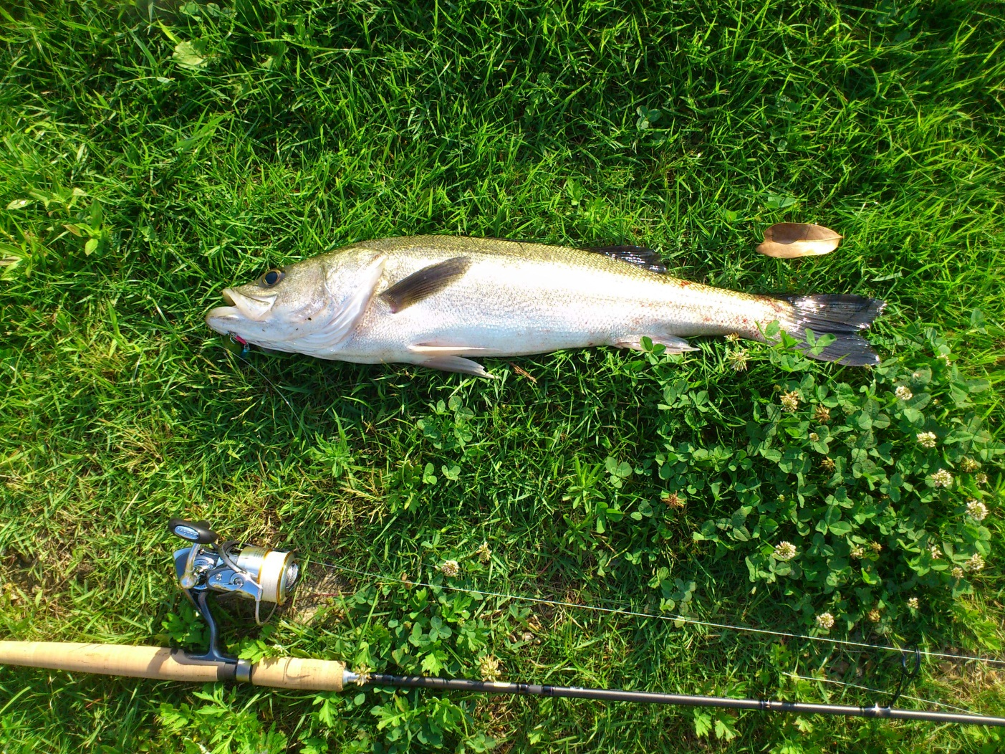
I love fishing

Slide 6
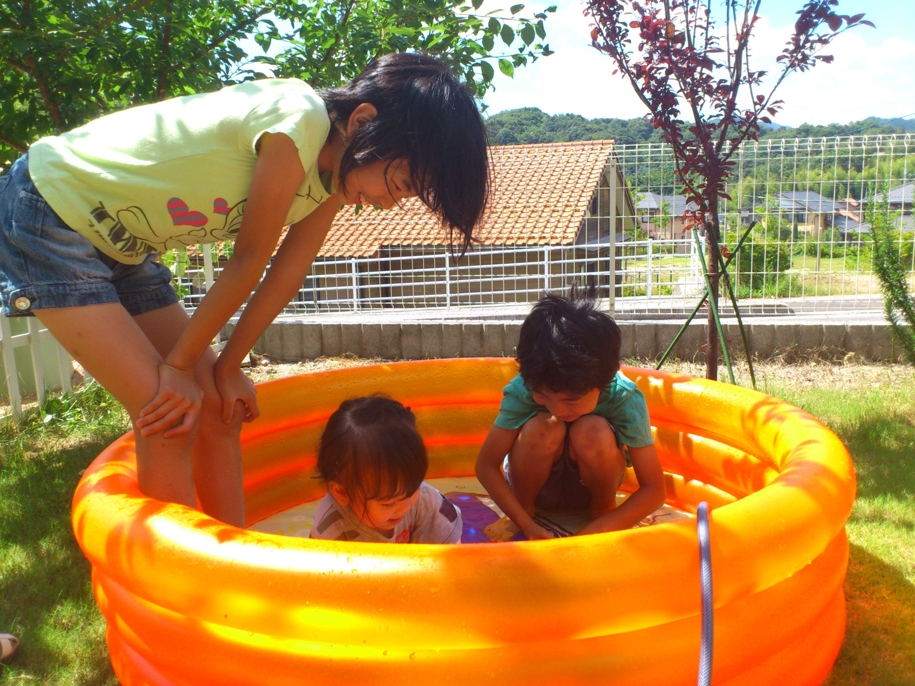
I love my family

Slide 7
Today's topic
Refinements
A new feature to extend classes locally

Slide 8
Background – existing class extensions
Subclassing
Mix-in
Singleton methods
Monkey patching

Slide 9
Subclassing
class Person
attr_accessor :name
end
class Employee < Person
attr_accessor :monthly_salary
end

Slide 10
Ruby's subclassing
Single inheritance
Superclasses aren't affected
Implementation-only inheritance
Violations of LSP

Slide 11
LSP
Liskov Substitution Principle
An instance of a subtype must behave like an instance of the supertype of the subtype
def print_name(person)
puts person.name
end
Person
Employee

Slide 12
An exmaple of LSP violation in Ruby
class Employee < Person
undef name
end
def print_name(person)
puts person.name
end
matz = Employee.new
matz.name = "Yukihiro Matsumoto"
print_name(matz) #=> undefined method

Slide 13
Implementation-only inheritance
Subclassing is not Subtyping
Duck typing
def print_name(person)
puts person.name
end
Person
Employee
need not be a subclass of Person

Slide 14
Mix-in
class; Stream; ... end
module Readable; ... end
class ReadStream < Stream
include Readable
end

Slide 15
Multiple inheritance vs Mix-in
Stream
ReadStream
WriteStream

Slide 16
Thank you!

