Slide 1
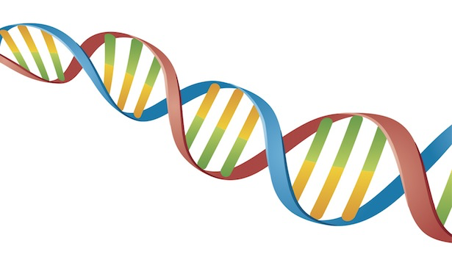
Comparative genomics FuMiSh ORF Predictor
Shuhan Xu, Fuqi Xu, Milda Valiukonytė

Slide 2
Contents
Genomes
Genetic composition analysis
ORF prediction
Evolutionary relationship

Slide 3
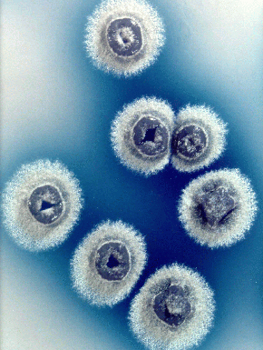
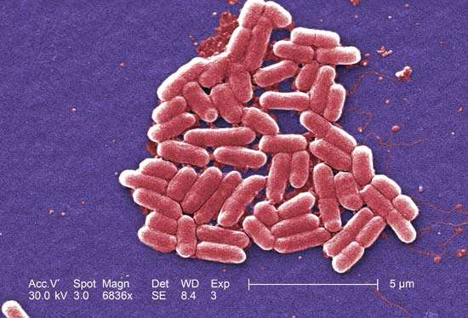
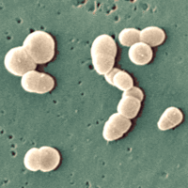
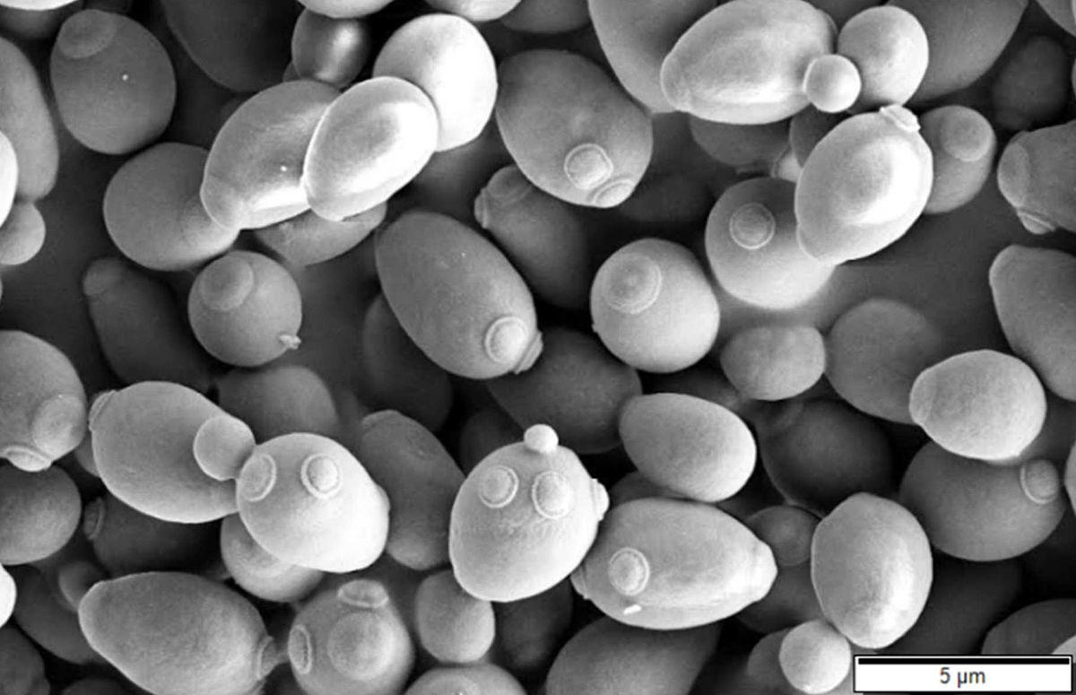
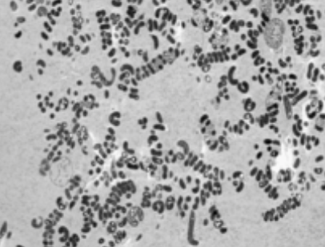
Genomes
Species | Family | Chromosome | Genome length
Escherichia coli | Enterobacteriaceae | All | 5443340
Streptomyces coelicolor | Streptomycetaceae | All | 9054847
Saccharomyces cerevisiae | Saccharomycetaceae | IV | 1531933
Rubrobacter xylanophilus | Rubrobacteraceae | All | 3225748
Spiribacter curvatus | Ectothiorhodospiraceae | All | 1926631
Escherichia coli
Streptomyces coelicolor
Saccharomyces cerevisiae
Rubrobacter xylanophilus
Spiribacter curvatus

Slide 4
Genetic composition analysis

Slide 5
GC content and dinucleotide frequency calculation

Slide 6
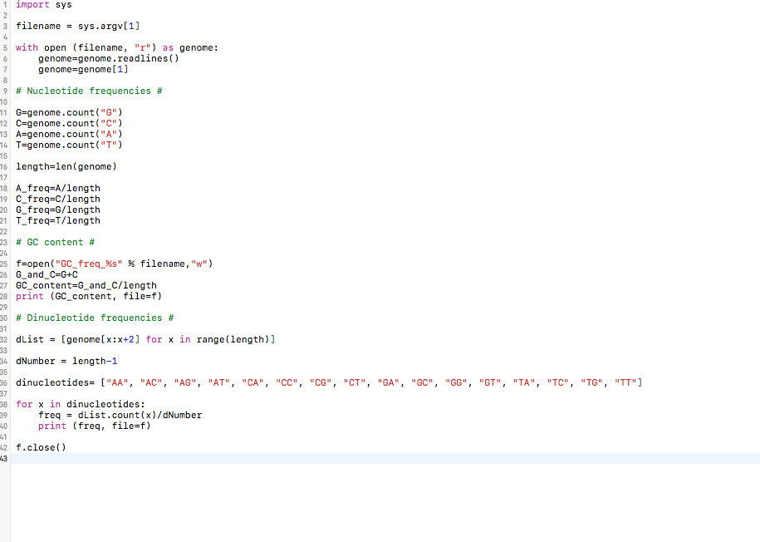
GC content and dinucleotide frequency calculation

Slide 7
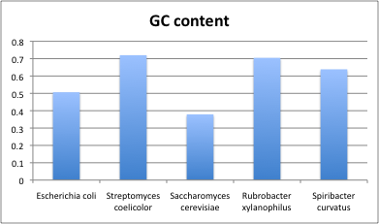
GC content
Notes:
High GC content is related to genome thermostability because of the higher number of hydrogen bonds in this base pair.
Rubrobacter xylanophilus is thermophilic bacteria, first isolated from hot springs in Japan.
Research has also shown that

Slide 8
Nucleotide frequencies

Slide 9
Dinucleotide frequencies
Notes:
greatly variable distribution among species which shows that nucleotide, dinucleotide frequency patterns might be species specific which we can use as signatures to calculate evolutionary dista

Slide 10
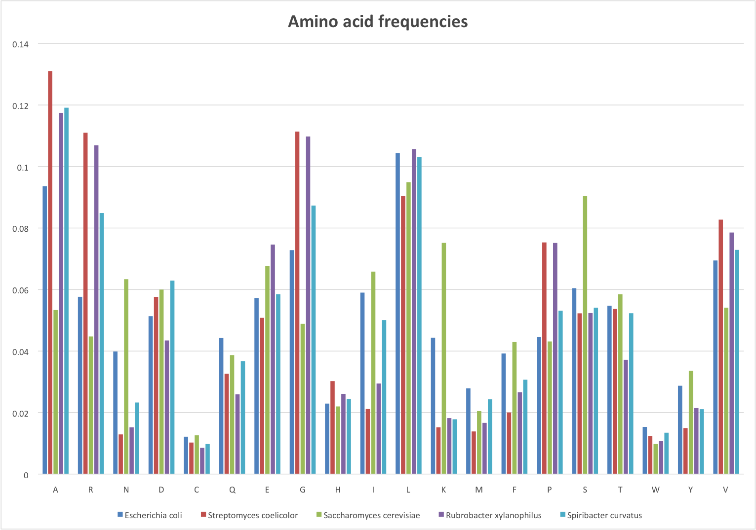
Amino acid frequencies

Slide 11
ORF prediction

Slide 12
Assumptions
ORF begins with a start codon and ends with a stop codon
If more than one ORF share the same stop codon, the longest one is kept
Minimum ORF length of 200 bp for prokaryote and 300 bp for eukaryote
Maximum overlap of 60 bp
Longer ORF is kept if overlap occurs between two ORFs

Slide 13
Comparison with Uniprot proteome
Predicted proteins
Uniprot proteins
BLAST
Predicted proteome
Uniprot proteome
Cross BLAST identifies true positive predictions.
TP: Proteins with E-value <0.001 in both BLAST tests.

Slide 14
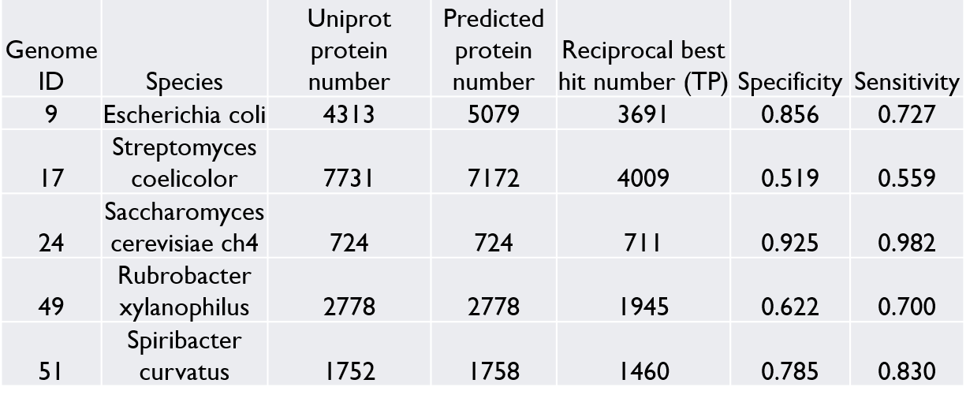
Comparison with Uniprot proteome

Slide 15
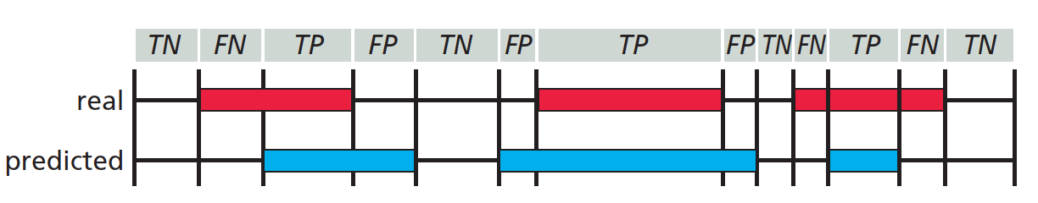
Comparison with Glimmer (“ground truth”)
Use minimum gene length of 110 bp
Use maximum overlap of 50 bp
Analyzed nucleotide level prediction accuracy
For each reading frame, each nucleotide is classified as True Positive (TP), True Negative (TN), False Positive (FP) or False Negative (FN)
Source: Zvelebil and Baum, Understanding Bioinformatics, Figure 9.12

Slide 16
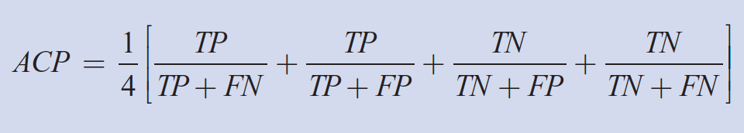
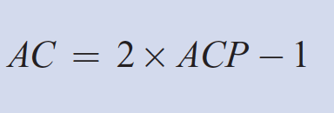
Comparison with Glimmer (“ground truth”)
Sum up all TP, TN, FP and FN for all six reading frames
Sensitivity = TP / ( TP + FN )
Specificity = TP/ ( TP + FP )
Calculate approximate correlation coefficient (AC)
Source: Zvelebil and Baum, Understanding Bioinformatics, Box 10.1

Slide 17
Comparison with Glimmer (“ground truth”)
Genome ID | Species | true ORF | predicted ORF | average true length | average predicted length
9 | Escherichia coli | 5323 | 6329 | 888 | 773
17 | Streptomyces coelicolor | 8548 | 8175 | 939 | 954
24 | Saccharomyces cerevisiae ch4 | 921 | 1604 | 1235 | 782
49 | Rubrobacter xylanophilus | 3375 | 3167 | 879 | 869
51 | Spiribacter curvatus | 1862 | 1955 | 973 | 897

Slide 18
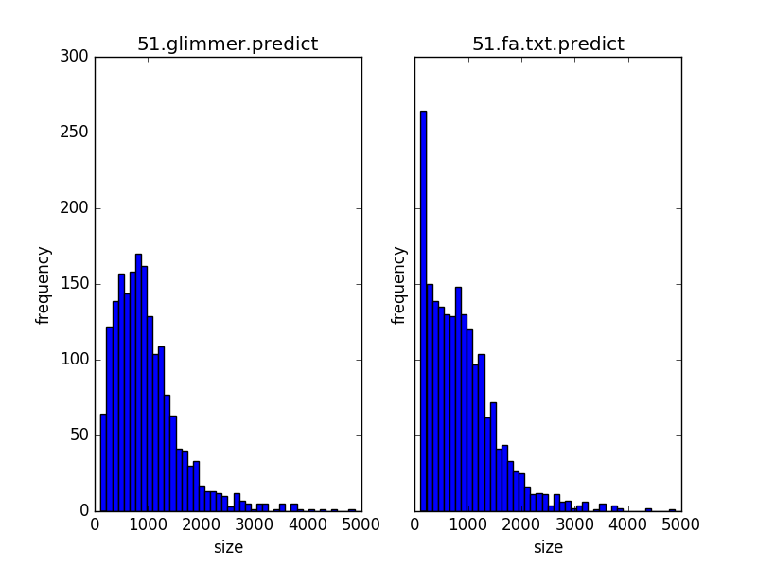
Comparison with Glimmer (“ground truth”)
Average gene length of Spiribacter curvatus
973bp in Glimmer 897bp in FuMiSh

Slide 19
Comparison with Glimmer (“ground truth”)
Genome ID | Species | Sensitivity | Specificity | AC
9 | Escherichia coli | 0.95 | 0.917 | 0.922
17 | Streptomyces coelicolor | 0.59 | 0.61 | 0.529
24 | Saccharomyces cerevisiae ch4 | 0.97 | 0.88 | 0.91
49 | Rubrobacter xylanophilus | 0.623 | 0.671 | 0.586
51 | Spiribacter curvatus | 0.841 | 0.869 | 0.829

Slide 20
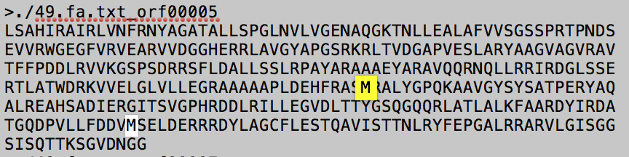
Analysis of comparison with Glimmer

Slide 21
Analysis of comparison with Glimmer
Genome ID | Species | Fraction of GTG and TTG start codons | Fraction of GTG start codons
9 | Escherichia coli | 0.198760098 | 0.13995867
17 | Streptomyces coelicolor | 0.45414132 | 0.407814693
24 | Saccharomyces cerevisiae ch4 | 0.194353963 | 0.10640608
49 | Rubrobacter xylanophilus | 0.56237037 | 0.437925926
51 | Spiribacter curvatus | 0.249194415 | 0.186358754

Slide 22
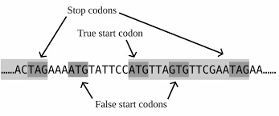
Improvements
Our improvements mainly focus on handling overlapping genes.

Slide 23
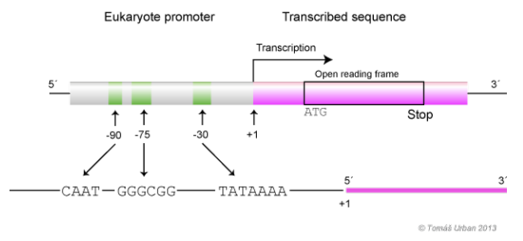
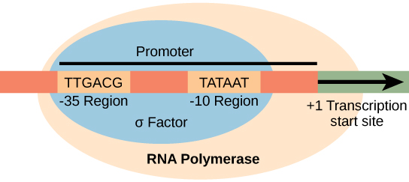
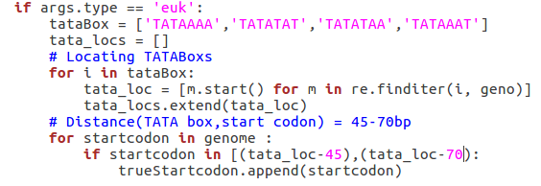
Improvements
Adding promoter information
Pribnow box in prokaryotes
GC box and TATA box in eukaryotes
Distance(TSS,start codon) = 20-40 bp
Distance(TATA box,TSS) = 25-30 bp
So we assume:
Distance(TATA box,start codon) = 45-70bp
1. Mendoza-Vargas, Alfredo, et al. "Genome-wide identification of transcription start sites, promoters and transcription factor binding sites in E. coli
2. Zvelebil, Marketa J., and Jeremy O. Baum. Understanding bioinformatics. Garland Science, 2007.

Slide 24
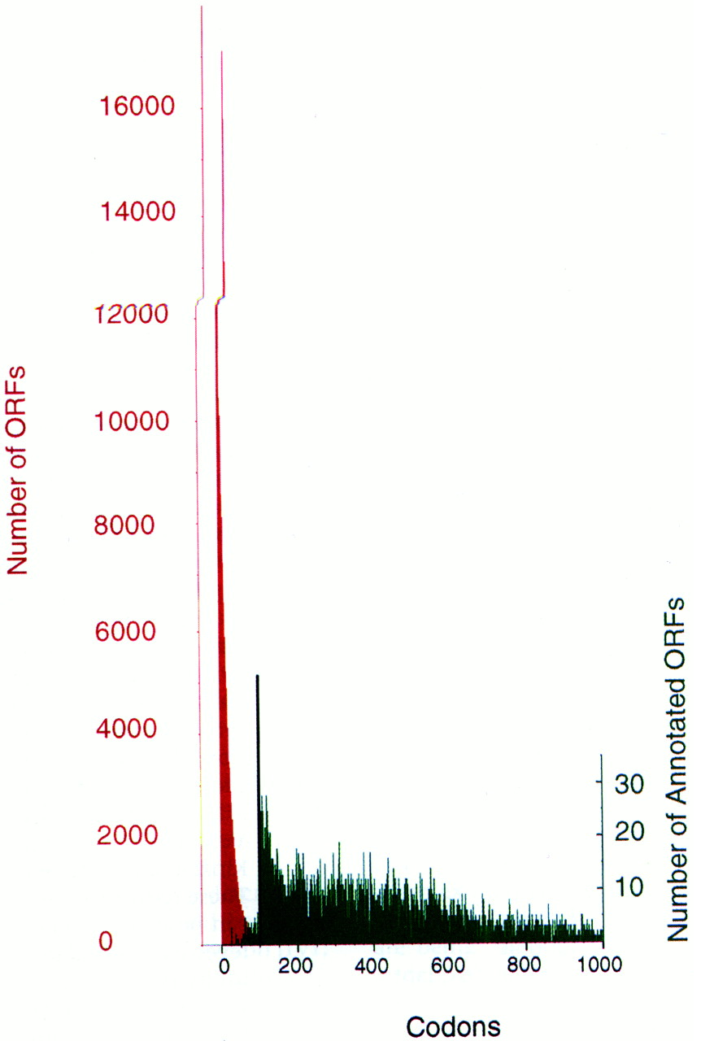
Improvement
It is difficult to assign small ORFs and set the minimum gene length.
In yeast:
In Ecoli:
The average ORF size = 317 amino acids
There are 381 ORFs that are smaller than 100 amino acids.
Blattner, Frederick R., et al. "The complete genome sequence of Escherichia coli K-12." science 277.5331 (1997): 1453-1462.

Slide 25
Improvement
The distribution of gene size helps with the selection of overlapping ORFs.
Start1 Start 2 Stop
ORF1 = 200bp
ORF2 = 800bp
Basrai, Munira A., Philip Hieter, and Jef D. Boeke. "Small open reading frames: beautiful needles in the haystack." Genome research 7.8 (1997)

Slide 26
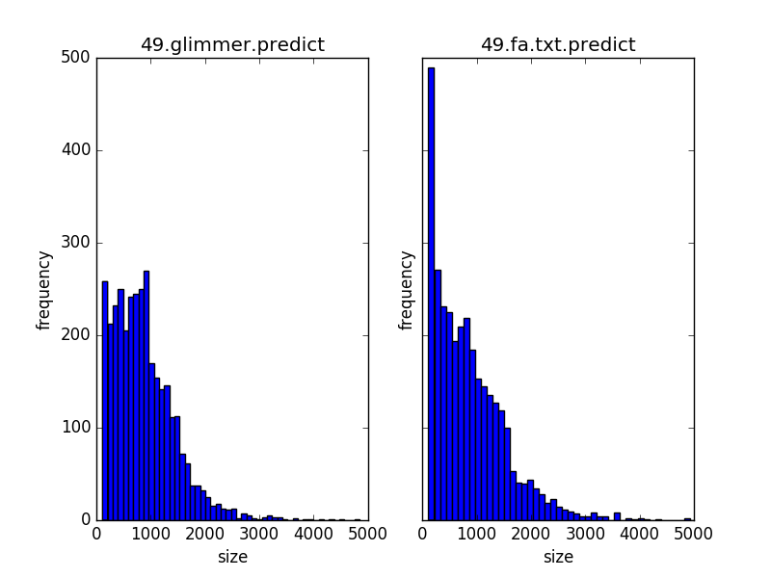
Improvement
We can also use the gene size distribution to test the performance of different predictors statistically, using Chi square test.

Slide 27
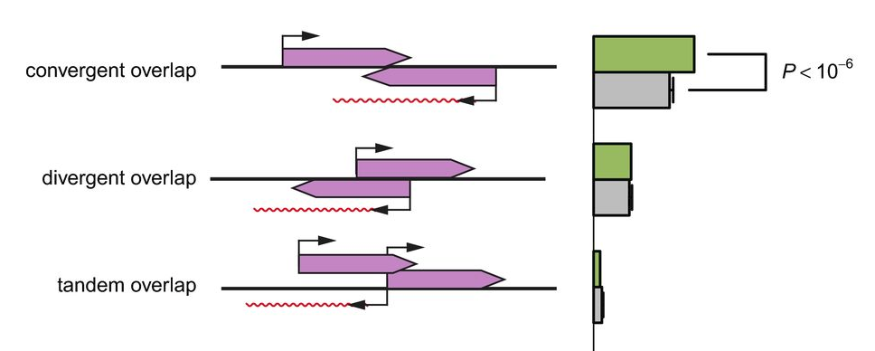
Improvement
Both orientations and lengths should be considered in selecting overlapping ORFs in different reading frames.
A maximal overlap of 60 bp is allowed between two genes on the same strand in FuMiSh.
Clément‐Ziza, Mathieu, et al. "Natural genetic variation impacts expression levels of coding, non‐coding, and antisense transcripts in fission yeast." Molecular systems biology 10.11 (2014): 764.
Hyatt, Doug, et al. "Prodigal: prokaryotic gene recognition and translation initiation site identification." BMC bioinformatics 11.1 (2010): 119.

Slide 28
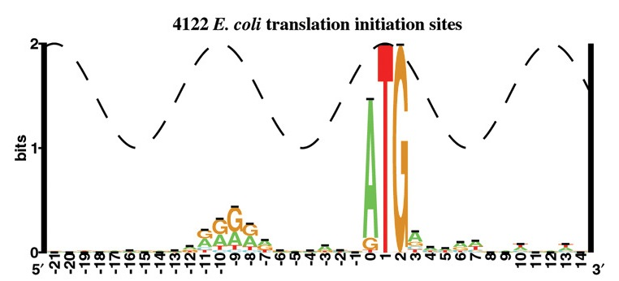
Improvement
Different start codons.
With the increase in GC content,
the ORFs are more likely to start with GTG.

Slide 29
Improvement
Algorithms
Classification, Decision tree, HMM and Neuro Network

Slide 30
Evolutionary relationships

Slide 31
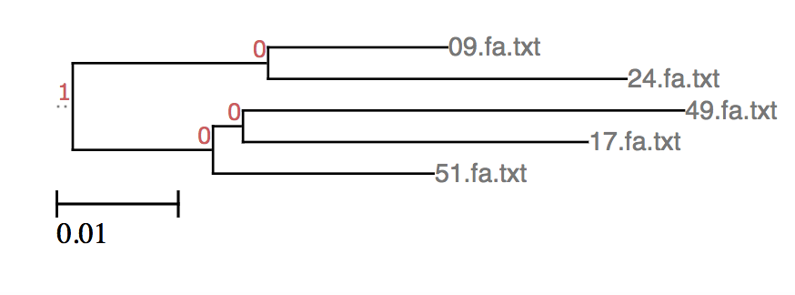
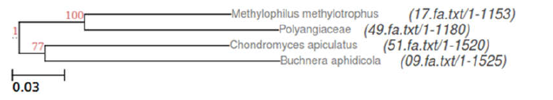
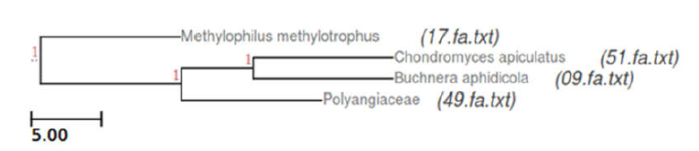
Evolutionary relationship
Tree based on dinucleotide frequencies
Tree based on 16S sequences
Consensus tree based on ten ortholog clusters
Notes:
We constructed phylogenetic tree based on dinucleotide frequencies as they showed the biggest variation across species and in some papers were even referred to as the genomic signature.
We used neighbor joining method because it does not assume constant evolutionary rate.
Constant evolutionary rate dictates that the same number of substitutions will have occurred in each sequence since the time of the last common ancestor.

Slide 32
Thank you!

