Slide 1
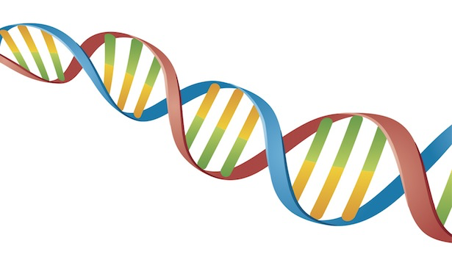
Comparative genomics Final project
Shuhan Xu, Fuqi Xu, Milda Valiukonytė

Slide 2
Contents
Genomes
Genetic composition analysis
ORF prediction
Evolutionary relationship

Slide 3
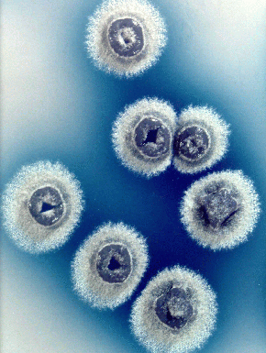
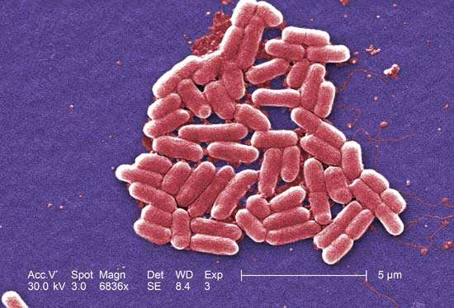
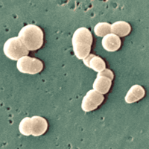
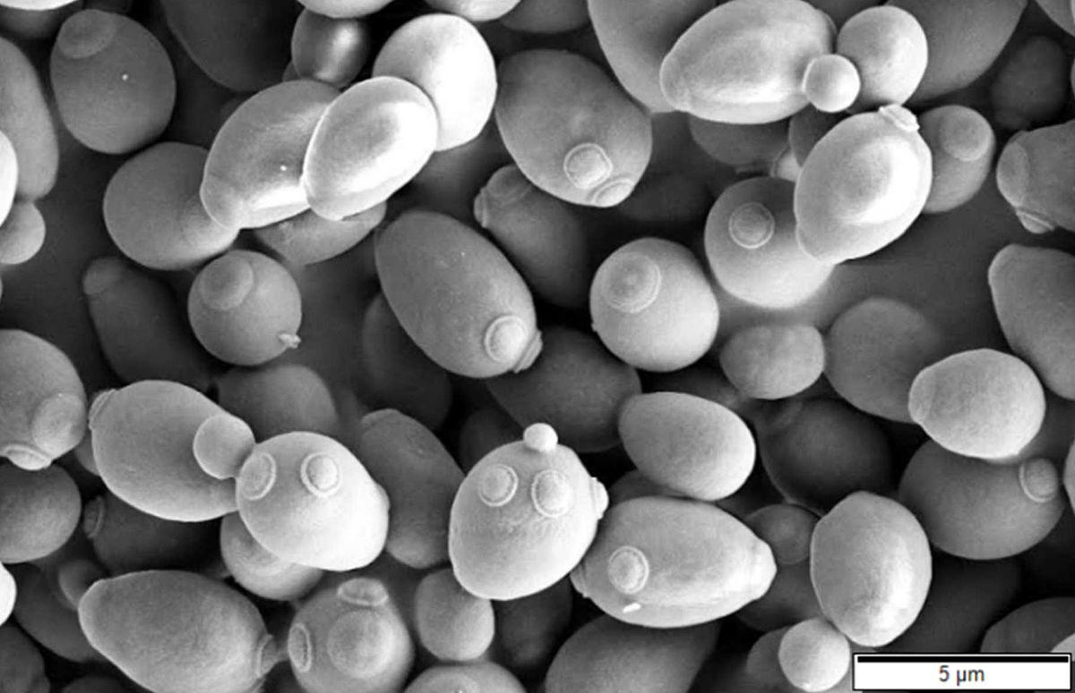
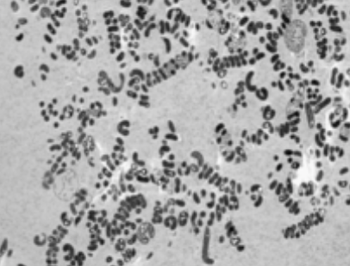
Genomes
Species | Family | Chromosome | Genome length
Escherichia coli | Enterobacteriaceae | All | 5443340
Streptomyces coelicolor | Streptomycetaceae | All | 9054847
Saccharomyces cerevisiae | Saccharomycetaceae | IV | 1531933
Rubrobacter xylanophilus | Rubrobacteraceae | All | 3225748
Spiribacter curvatus | Ectothiorhodospiraceae | All | 1926631
Escherichia coli
Streptomyces coelicolor
Saccharomyces cerevisiae
Rubrobacter xylanophilus
Spiribacter curvatus

Slide 4
Genetic composition analysis

Slide 5
GC content and dinucleotide frequency calculation

Slide 6
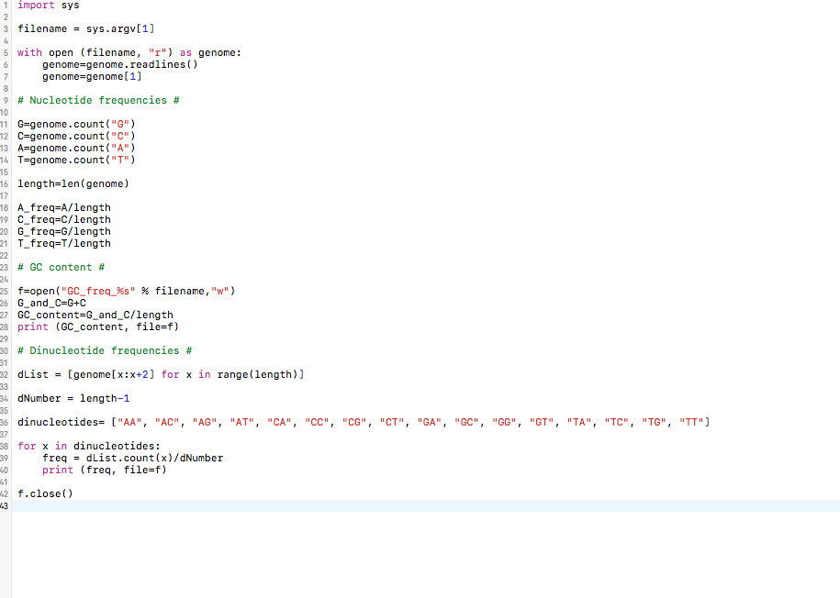
GC content and dinucleotide frequency calculation

Slide 7
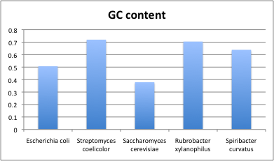
GC content
Notes:
High GC content is related to genome thermostability because of the higher number of hydrogen bonds in this base pair.
Rubrobacter xylanophilus is thermophilic bacteria, first isolated from hot springs in Japan.
Research has also shown that

Slide 8
Nucleotide frequencies

Slide 9
Dinucleotide frequencies
Notes:
greatly variable distribution among species which shows that nucleotide, dinucleotide frequency patterns might be species specific which we can use as signatures to calculate evolutionary dista

Slide 10
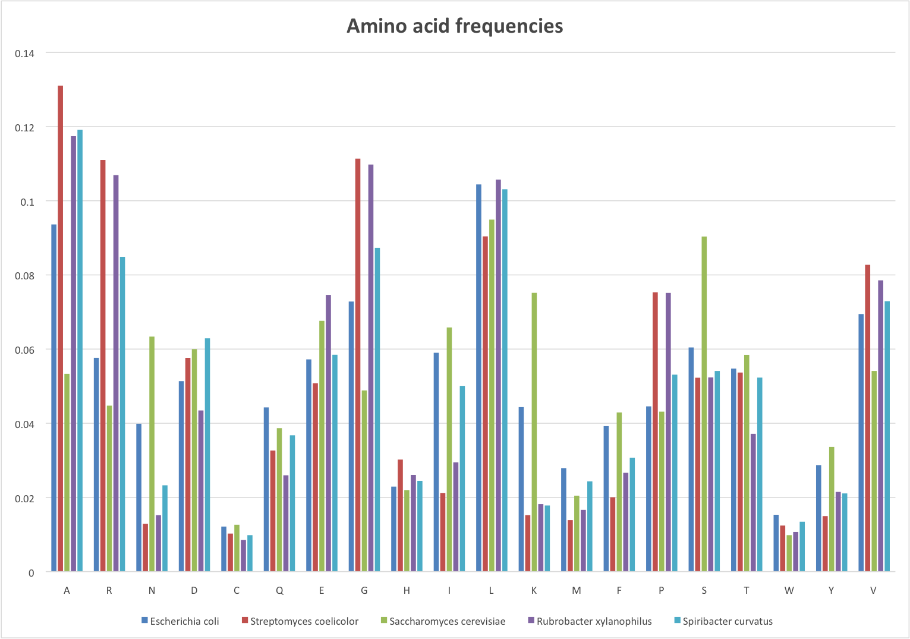
Amino acid frequencies

Slide 11
ORF prediction

Slide 12
Assumptions
ORF begins with a start codon and ends with a stop codon
If more than one ORF share the same stop codon, the longest one is kept
Minimum ORF length of 200 bp for prokaryote and 300 bp for eukaryote
Maximum overlap of 60 bp
Longer ORF is kept if overlap occurs between two ORFs

Slide 13
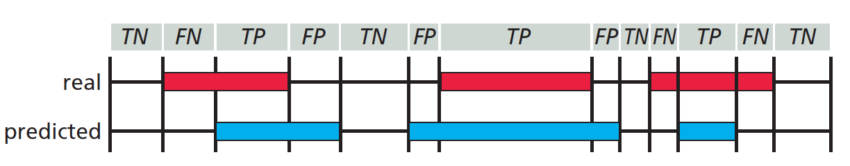
Comparison with Glimmer (“ground truth”)
Use minimum gene length of 110 bp
Use maximum overlap of 50 bp
Analyzed nucleotide level prediction accuracy
For each reading frame, each nucleotide is classified as True Positive (TP), True Negative (TN), False Positive (FP) or False Negative (FN)
Source: Zvelebil and Baum, Understanding Bioinformatics, Figure 9.12

Slide 14
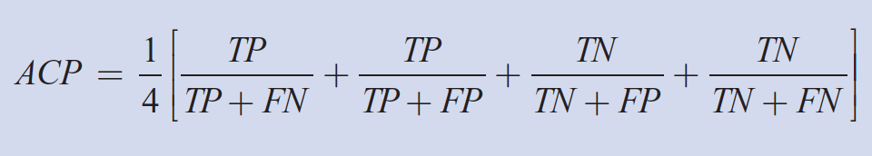
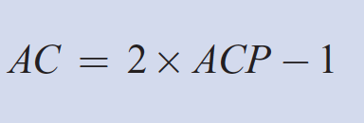
Comparison with Glimmer (“ground truth”)
Sum up all TP, TN, FP and FN for all six reading frames
Sensitivity = TP / ( TP + FN )
Specificity = TP/ ( TP + FP )
Calculate approximate correlation coefficient (AC)
Source: Zvelebil and Baum, Understanding Bioinformatics, Box 10.1

Slide 15
Comparison with Glimmer (“ground truth”)
Genome ID | Species | true ORF | predicted ORF | average true length | average predicted length
9 | Escherichia coli | 5323 | 6329 | 888 | 773
17 | Streptomyces coelicolor | 8548 | 8175 | 939 | 954
24 | Saccharomyces cerevisiae ch4 | 921 | 1604 | 1235 | 782
49 | Rubrobacter xylanophilus | 3375 | 3167 | 879 | 869
51 | Spiribacter curvatus | 1862 | 1955 | 973 | 897

Slide 16
Comparison with Glimmer (“ground truth”)
Genome ID | Species | Sensitivity | Specificity | AC
9 | Escherichia coli | 0.95 | 0.917 | 0.922
17 | Streptomyces coelicolor | 0.59 | 0.61 | 0.529
24 | Saccharomyces cerevisiae ch4 | 0.97 | 0.88 | 0.91
49 | Rubrobacter xylanophilus | 0.623 | 0.671 | 0.586
51 | Spiribacter curvatus | 0.841 | 0.869 | 0.829

Slide 17
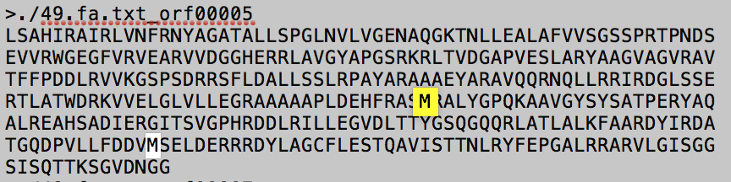
Analysis of comparison with Glimmer

Slide 18
Analysis of comparison with Glimmer
Genome ID | Species | Fraction of GTG and TTG start codons | Fraction of GTG start codons
9 | Escherichia coli | 0.198760098 | 0.13995867
17 | Streptomyces coelicolor | 0.45414132 | 0.407814693
24 | Saccharomyces cerevisiae ch4 | 0.194353963 | 0.10640608
49 | Rubrobacter xylanophilus | 0.56237037 | 0.437925926
51 | Spiribacter curvatus | 0.249194415 | 0.186358754

Slide 19
Evolutionary relationships

Slide 20
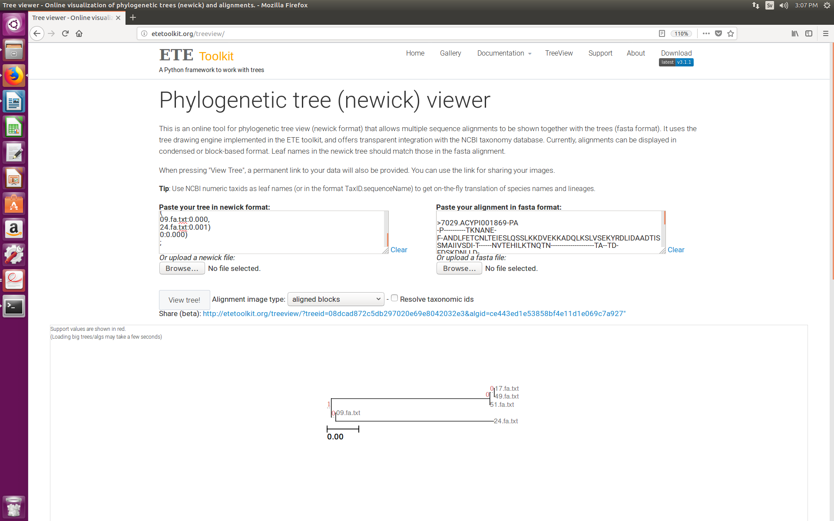
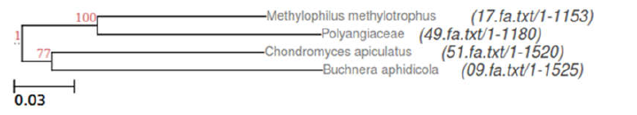
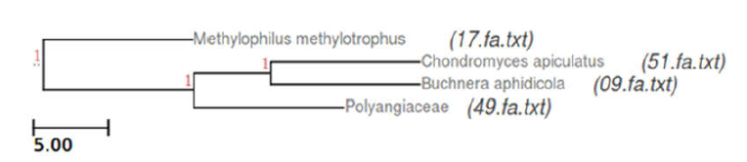
Evolutionary relationship
Tree based on dinucleotide frequencies
Tree based on 16S sequences
Consensus tree based on ten ortholog clusters
Notes:
We constructed phylogenetic tree based on dinucleotide frequencies as they showed the biggest variation across species and in some papers were even referred to as the genomic signature.
We used neighbor joining method because it does not assume constant evolutionary rate.
Constant evolutionary rate dictates that the same number of substitutions will have occurred in each sequence since the time of the last common ancestor.

Slide 21
Thank you!

