Slide 2
Assumptions
ORF begins with a start codon and ends with a stop codon
If more than one ORF share the same stop codon, the longest one is kept
Minimum ORF length of 200 bp for prokaryote and 300 bp for eukaryote
Maximum overlap of 60 bp
Longer ORF is kept if overlap occurs between two ORFs

Slide 3
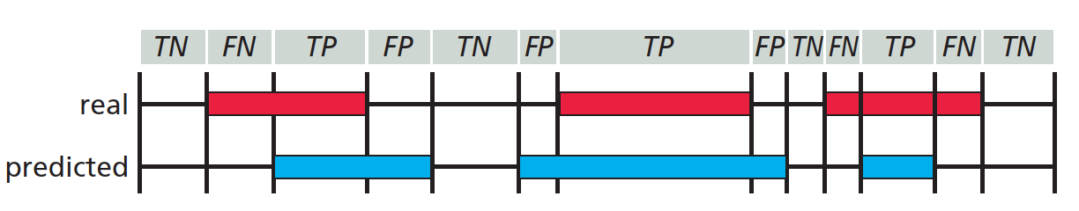
Comparison with Glimmer (“ground truth”)
Use minimum gene length of 110 bp
Use maximum overlap of 50 bp
Analyzed nucleotide level prediction accuracy
For each reading frame, each nucleotide is classified as True Positive (TP), True Negative (TN), False Positive (FP) and False Negative (FN)
Source: Zvelebil and Baum, Understanding Bioinformatics, Figure 9.12

Slide 4
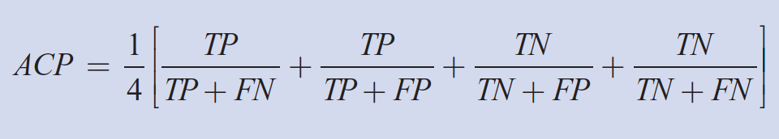
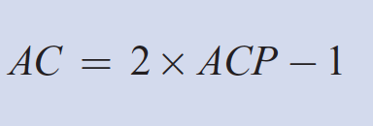
Comparison with Glimmer (“ground truth”)
Sum up all TP, TN, FP and FN for all six reading frames
Sensitivity = TP / ( TP + FN )
Specificity = TP/ ( TP + FP )
Calculate approximate correlation coefficient (AC)
Source: Zvelebil and Baum, Understanding Bioinformatics, Box 10.1

Slide 5
Comparison with Glimmer (“ground truth”)
Genome ID | Species | true ORF | predicted ORF | average true length | average predicted length
9 | Escherichia coli | 5323 | 6329 | 888 | 773
17 | Streptomyces coelicolor | 8548 | 8175 | 939 | 954
24 | Saccharomyces cerevisiae ch4 | 921 | 1604 | 1235 | 782
49 | Rubrobacter xylanophilus | 3375 | 3167 | 879 | 869
51 | Spiribacter curvatus | 1862 | 1955 | 973 | 897

Slide 6
Comparison with Glimmer (“ground truth”)
Genome ID | Species | Sensitivity | Specificity | AC
9 | Escherichia coli | 0.95 | 0.917 | 0.922
17 | Streptomyces coelicolor | 0.59 | 0.61 | 0.529
24 | Saccharomyces cerevisiae ch4 | 0.97 | 0.88 | 0.91
49 | Rubrobacter xylanophilus | 0.623 | 0.671 | 0.586
51 | Spiribacter curvatus | 0.841 | 0.869 | 0.829

Slide 7
Comparison with Glimmer (“ground truth”)
Genome ID | Species | Sensitivity | Specificity | AC
9 | Escherichia coli | 0.95 | 0.917 | 0.922
17 | Streptomyces coelicolor | 0.59 | 0.61 | 0.529
24 | Saccharomyces cerevisiae ch4 | 0.97 | 0.88 | 0.91
49 | Rubrobacter xylanophilus | 0.623 | 0.671 | 0.586
51 | Spiribacter curvatus | 0.841 | 0.869 | 0.829

Slide 8
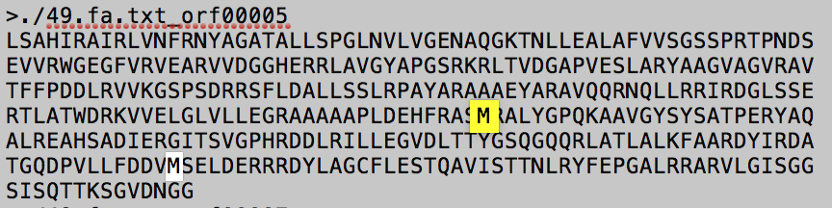
Analysis of comparison with Glimmer

Slide 9
Analysis of comparison with Glimmer
Genome ID | Species | Fraction of GTG and TTG start codons | Fraction of GTG start codons
9 | Escherichia coli | 0.198760098 | 0.13995867
17 | Streptomyces coelicolor | 0.45414132 | 0.407814693
24 | Saccharomyces cerevisiae ch4 | 0.194353963 | 0.10640608
49 | Rubrobacter xylanophilus | 0.56237037 | 0.437925926
51 | Spiribacter curvatus | 0.249194415 | 0.186358754

