Slide 1
Doing a Systems PhD
Steve Hand
SRG Talk - 29th January 2009
University of Cambridge
Computer Laboratory

Slide 2
Systems Research is…
Work in OS, file-systems, databases, networking, language run-times, system security, …
Not a ‘hard’ science
  No ground truth to be discovered
    Get to create the universe!
  Things can be “sort of” right
    Absolutes are rare
Key skill: critical thinking

Slide 3
Critical Thinking - Reading
Read a paper and consider:
  Do I like it? Hate it? (opinion)
  What problem is it trying to solve?
  How does their approach differ from previous ones?
  (how much previous work do I know about – read it! (reference chaining))
  Does it work?
  What could be improved?

Slide 4
Critical Thinking - Writing
Consider a paper (or your thesis) as an argument
  What is the problem?
  If not well known, why is it a problem?
  Why are all previous approaches insufficient (broken / wrong / stupid)?
  What is your approach?
    how does it work?
    how well does it work?
    how does it improve on previous attempts?

Slide 5
PhD Outcomes
Drop out, do something else
Finish, do something else
Finish, join/start a start-up
  Actual PhD work may be important
Finish -> Academic Research
Finish -> (good) Industrial Research
  Last two: academic track record, references, publications important.

Slide 6
Doing a PhD: What’s involved?
Choose an advisor and a research area
Write a research proposal, apply & get accepted
Then do some or all of:
  Build some stuff (e.g. new multimedia FS)
  Measure some stuff (e.g. power use on laptop)
  Evaluate some stuff (e.g. performance of new web server scheduling algorithm)
  Analyze some stuff (e.g. queuing theoretic model of the Internet)
Write a dissertation
Submit and get viva’d – scary!

Slide 7
Choosing an Advisor
How much time do they have?
Is their technical background a good fit?
How do they like to work?
How do they like their students to work?
  Ask their students!
Do they expect you to work on ‘their’ topic (RA for N years)?
Or do they expect you to come up with your own topic?

Slide 8
Choosing a Topic
Don’t have to fix on this on day one!
  Do some stuff, work with others, write some papers, and then choose
  6 – 18 months is fine
How to choose something?
  Read a paper you hate – decide to fix it
  Read a paper you love – join effort
  Discover a problem – aim to solve it
  “Scrabble” – invent something

Slide 9
Risks – Underestimation
Underestimate PhD
  “Bob got a PhD for writing a web server – I’ll write a web server too!”
  (Fail to realize Bob’s PhD was actually about techniques in zero-copy I/O)
  Read nothing but write lots of code
  Zero publications, zero justification
Result:
  Never submit (“don’t like writing”); or
  Submit, sit back confidently, and get blown to shreds in PhD exam

Slide 10
Risks - Overestimation
PhD ~= Nobel prize in Physics
  All existing problems are simple
  All existing solutions are stupid / trivial
  Read everything and dismiss it
  Invent new words or language or logic or ontology just to express the problem
  Cannot explain problem (or solution) to mere mortals – stupid them!
  Zero publications (“Not quite finished yet”)
  Result:
    Never submit (“No one understands me”)
    Submit, sit back smugly, get ripped apart in PhD exam, and blame the idiocy of the world.

Slide 11
Risks – Awaiting Orders
Treat PhD like high school
Ask supervisor what to do
  Don’t understand it
  Don’t agree with it
  But do it anyway
Finish task and wait for next task
  Play TF2 or do consultancy in meantime
Write nothing, read nothing
Repeat until PhD deadline and realize
  You don’t have a thesis; or
  You have a thesis you don’t understand

Slide 12
Risks – Isolation
Come up with plausible topic and reasonable approach / solution
Start work, but don’t make as much progress as you’d like
Oh no! Other people seem to be doing fine!
  Stop coming into department
  Avoid supervisor
  Avoid peers
  Stop showering
  Heroin
  Death

Slide 13
Better Strategies
Work with others from day one
From 1 year in, aim to have a current “draft” of your PhD in your head
Do something every month
  Read + critique a bunch of papers
  Write some code
  Do some measurements
  Write down results, designs, ideas, …
Dual-task if at all possible: left brain / right brain parallelism

Slide 14
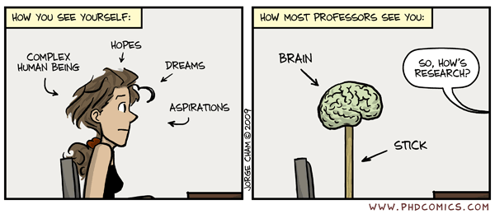
Managing your Supervisor…

Slide 15
Managing your Supervisor (1)
Extreme #1: “The Gauleiter”
  He or she has an idea and/or plan
  Your job is to carry this out
Pros:
  Should be clear what to do
  Can make progress from day 1
Cons:
  Little opportunity for creative thought
  May feel lack of control or ownership
  Potential outcomes: frustration, or apathy
Strategy: read, think & argue

Slide 16
Managing your Supervisor (2)
Extreme #2: “The Don”
  Vaguely interested in everything
  Expects you to come up with an idea, and then go off and do something good (but may not mention this)
Pros:
  Lots of flexibility and options
  Lots of positive feedback from supervisor
Cons:
  Easy to get stuck, or lost
  Feedback may be vague or esoteric (low usefulness)
Strategy:
  Attempt to engage him/her concretely in your work
  Impress with your own erudition / intelligence

Slide 17
Managing your Supervisor (3)
Most supervisors not at extremes, but will have different pros and cons
Key point: it is your responsibility to make your supervisor work for you
  You’re the one who wants to get the PhD
General Strategies:
  Have relatively frequent meetings
  Aim for concrete deliverables (e.g. whiteboard design, or draft paper)
  Educate: be[come] the expert on your topic
  Learn to argue/discuss/explain

Slide 18
Aim to Publish
Writing a thesis with several publications under your belt is a lot easier than doing it from scratch!
  Plus a good way to exercise your possibly atrophied ‘writing muscles’
Work with others:
  E.g. three 3-author papers a year for the same price as one single author paper
Get feedback:
  Reviewers are often smart and dedicated
  And even if they’re not, they’re representative of the research community (i.e. your examiners)

Slide 19
How to Publish (1)
Start by writing down something
  Hard to publish if don’t have a paper :-)
Starting point usually either “stuff I’ve done” or “thing I believe”
  “Stuff I’ve done” – first write a tech report which just describes it
  Add `blank’ related work section
  Retro-fit argument of some sort
  Give to peers / supervisor / others, get feedback, modify, repeat, …
  Submit to appropriate workshop / conference (with proximate deadline)

Slide 20
How to Publish (2)
Or start with an idea / belief
  Write out skeleton argument
  Critique related work
  Work out what you need to actually do to back up your argument, and then
    Sketch out solution in paper, run past peers / supervisor / others, submit position paper
    And/or start to do actual work
      Add details / results etc as you go

Slide 21
In Both Cases: Use Others
Come up with an outline argument
  Run past peers / supervisor / others
  Objectively consider feedback
  Tweak / vastly rework argument
  Repeat until fixpoint
Write a position paper or short paper
  Run past peers / supervisor / others
  Objectively consider feedback
  Tweak / vastly rework paper
  Repeat until deadline

Slide 22
Reasons for Paper Rejection
Paper not clearly written (at a word / sentence / paragraph level)
Paper not clearly written (at a structural / argument level)
Paper clearly written, but:
  argument is weak / false; or
  solution is obvious / incorrect; or
  experiments (or analysis) are poor
PC are biased idiots

Slide 23
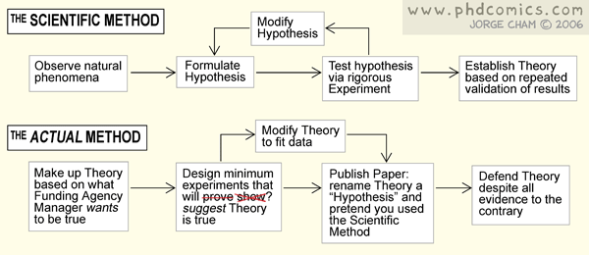
Doing Experiments

Slide 24
Writing up
Need to write a dissertation which supports your PhD thesis
Typically 30-60K words:
  Longest document you’ll have ever written
  Hard to ensure a single “story” throughout
  Core (“meat”) usually 1—3 chapters
    E.g. design, implementation, eval
    E.g. technique1, technique2, technique3
  Produce drafts and get frequent feedback
Expect 6-12 months just for write-up!
Day after submission: best day of your life

Slide 25
Careers after PhD

Slide 26
Summary
Systems Research is (or can be) fun
  Can have “real world” impact, or make a fundamental contribution (or both?)
Keys to success are
  Engage critical thinking – read a lot
  Make everything an argument – use your colleagues and supervisor for feedback
  Be proactive – educate your supervisor
  Publish (or at least submit) papers

Slide 27

Questions?
or why not just chat to me over a beer?

