Slide 1

Application and Comparison of Machine Learning Techniques in Business
DATA SCIENCE MS THESIS DEFENSE BY SHUKHRAT KHUSEYNOV
August 5, 2021, 16:00
https://github.com/shuhrat1998/DATA-SCIENCE-MS-THESIS

Slide 2
introduction
data science & ML; efficiencies and high profits in return; business applications
e-commerce, chatbot applications, banking, healthcare, cyber security, commercial applications
regression analyses, Bayesian methods, random forests, support vector machines
1)churn estimation with a dataset collected from customers of mobile company in the months of 2013 from a real but anonymous source shared on Kaggle.
2)housing price prediction with a real dataset of apartment prices in Moscow, being also used in an online course and shared on Kaggle in 2018.
3)sentiment analysis with a real dataset of women’s e-commerce clothing reviews, being used in another paper and anonymously shared on Kaggle in 2018.

Slide 3
Approach
data normalization (min-max scaler / text preprocessing)
5-fold cross validation
maximizing the metric / minimizing the error
80% training and 20% testing sets
model comparison

Slide 4
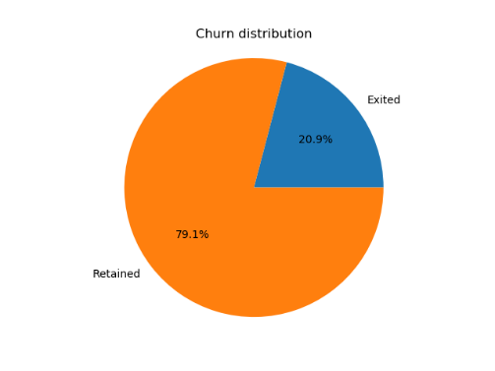
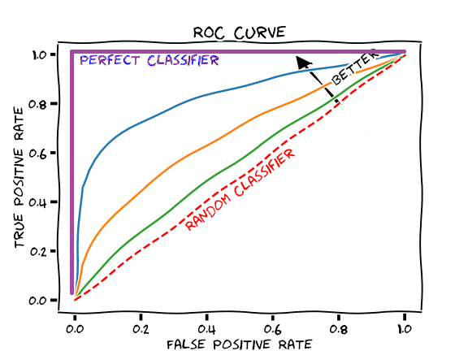
Churn estimation
Accuracy score = (TP+TN) / (TP+FP+TN+FN)
AUROC - area under the Receiver Operating Characteristic (ROC) curve
66469 customers with 66 variables
Source: glassboxmedicine.com
TP rate = TP / (TP+FN)
FP rate = FP / (FP+TN)

Slide 5
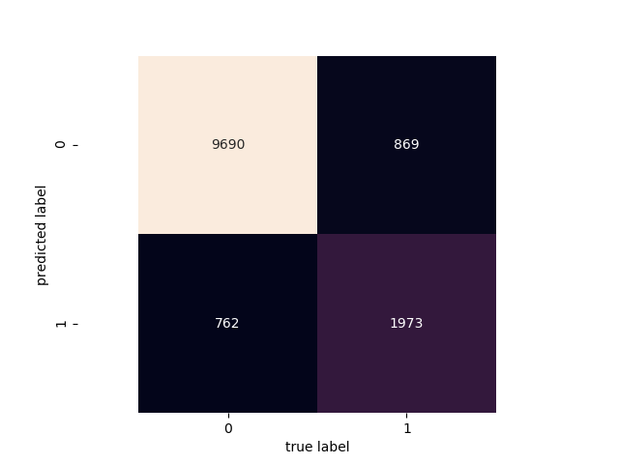
Churn estimation
Model | Metrics
 | accuracy | AUROC
Naïve Bayes | 56.21% | 69.77%
Logistic Regression | 86.45% | 78.18%
K Nearest Neighbors | 87.33% | 79.6%
Random Forest | 86.93% | 78.43%
Support Vector Machines | 86.7% | 77.87%
Neural Networks | 87.21% | 78.97%
XGBoost | 87.73% | 81.07%
-
SAG solver
K = 50
N = 50
C = 10
H = (10, 10)
N = 13
XGBoost’s confusion matrix

Slide 6
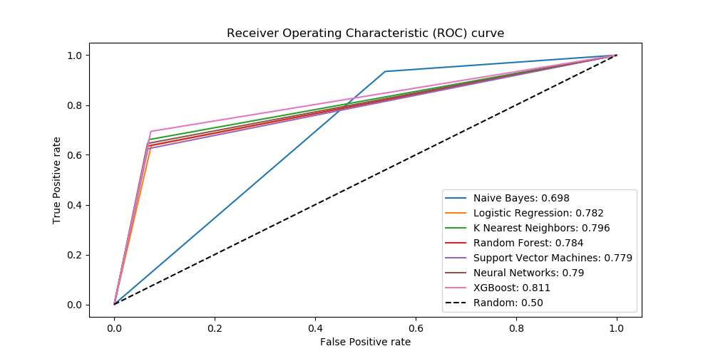
Churn estimation

Slide 7
HOUSING PRICE PREDICTION
The dataset has 2040 entries with apartment prices and few related variables.
Linear regression using OLS method
Gaussian Process regressor with alpha of 1.7 & rational quadratic kernel
K Nearest Neighbors regressor with K of 8
Random Forest regressor with N of 115
Support Vector Machines regression with C of 10000
Neural Networks regressor with (150,150,150,150,150) hidden layers
XGBoost regressor with N of 21
RMSE (Root Mean Square Error)
Correlation coefficient

Slide 8
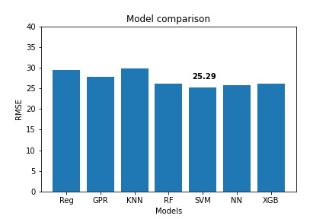
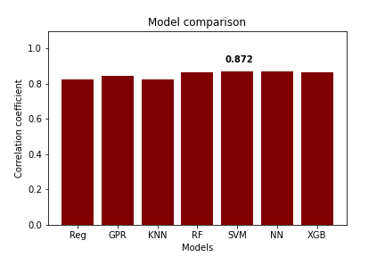
HOUSING PRICE PREDICTION

Slide 9
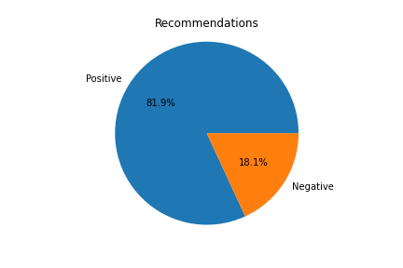
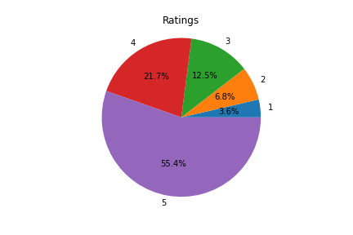
Sentiment analysis
22641 review entries with recommendations & ratings
Accuracy score = (TP+TN) / (TP+FP+TN+FN)
AUROC - area under the Receiver Operating Characteristic (ROC) curve
Macro F1 score – macro averaged F1 score of each class, a combination of precision and recall
F1 score = 2 * Precision * Recall / (Precision + Recall )
Precision = TP / (TP+FP)
Recall or TP rate = TP / (TP+FN)

Slide 10
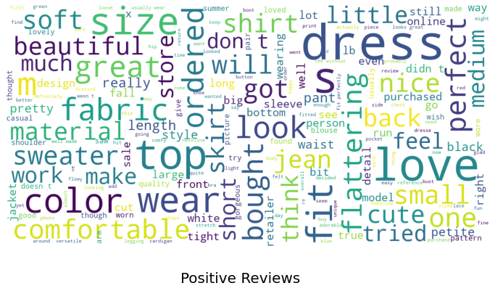
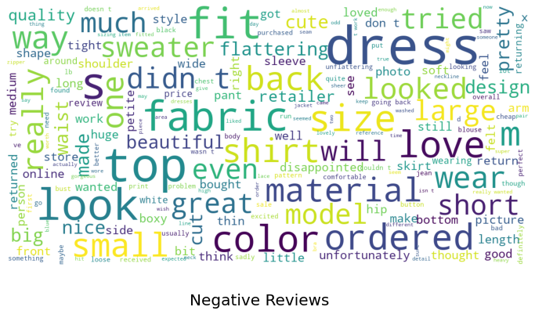
Sentiment analysis
Filtering numbers & special characters; Lowering; Taking out stopwords
Tag clouds according to recommendation labels:
Bag-of-Words (BoW) representation - a simplified matrix with the word counts
Term Frequency – Inverse Document Frequency (TF-IDF) - reflects the relevance of words to a document in a corpus

Slide 11
Sentiment analysis
(binary classification)
Model | BoW |  | TF-IDF
 | accuracy | AUROC | accuracy | AUROC
Naïve Bayes | 45.9% | 55.15% | 45.93% | 55.03%
Logistic Regression | 88.54% | 78.29% | 88.23% | 74.38%
K Nearest Neighbors | 80.95% | 51.49% | 82.69% | 56.13%
Random Forest | 82.65% | 55.66% | 82.73% | 55.89%
Support Vector Machines | 87.99% | 74.88% | 88.7% | 77.87%
Neural Networks | 87.46% | 82.48% | 85.45% | 80.8%
XGBoost | 88.87% | 77.72% | 87.88% | 77.33%
-
-
K = 50
N = 100
C = 100
C = 10000
H = (5,5,5,5,5,5)
H = (7,7,7,7)
N = 1000

Slide 12
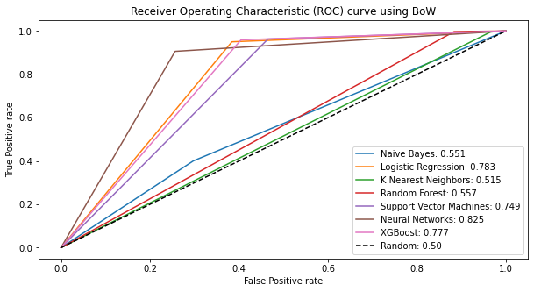
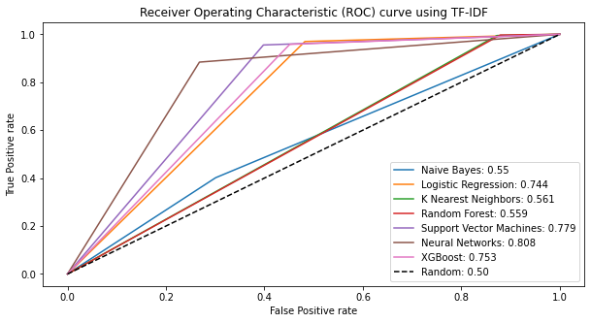
Sentiment analysis
(binary classification)

Slide 13
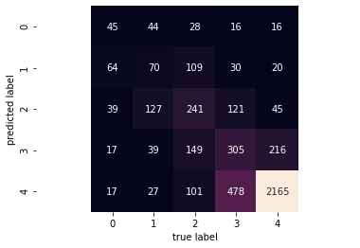
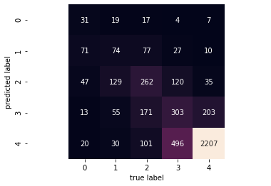
Sentiment analysis
(multiclass classification)
SVM’s confusion matrix using BoW
Model | BoW |  | TF-IDF
 | accuracy | Macro F1 | accuracy | Macro F1
Logistic Regression | 61.54% | 0.42 | 63.66% | 0.39
SVM | 62.4% | 0.42 | 63.52% | 0.42
Neural Networks | 58.8% | 0.40 | 57.52% | 0.39
XGBoost | 62.35% | 0.40 | 61.87% | 0.38
-
C = 1000
C = 10000
H = (100)
SVM’s confusion matrix using TF-IDF
N = 150
In general, the BoW input representation has slightly better performance for multiclass classification, although in the case of SVM classifier, both BoW and TF-IDF have equal macro averaged F1 scores.

Slide 14
BIBLIOGRAPHY
[Chai & Draxler, 2014] Chai, T., & Draxler, R. R. (2014). Root mean square error (RMSE) or mean absolute error (MAE)? Geoscientific Model Development, 7(3), 1247-1250. https://doi.org/10.5194/gmdd-7-1525-2014
[Chen & Guestrin, 2016] Chen, T., & Guestrin, C. (2016). XGBoost: A Scalable Tree Boosting System. In Proceedings of the 22nd ACM SIGKDD International Conference on Knowledge Discovery and Data Mining (pp. 785–794). New York, NY, USA: ACM. https://doi.org/10.1145/2939672.2939785
[Grandini, Bagli, & Visani, 2020] Grandini, M., Bagli, E., & Visani, G. (2020). Metrics for Multi-Class Classification: an Overview. ArXiv, abs/2008.05756. Retrieved from https://arxiv.org/pdf/2008.05756.pdf
[Jeong, 2018] Jeong, T. (2018). Adding Value With Artificial Intelligence. In Building A Smart Partnership For The Fourth Industrial Revolution (pp. 15-21). Atlantic Council. Retrieved from www.jstor.org/stable/resrep20947.5
[Kraus, Feuerriegel, & Oztekin, 2020] Kraus, M., Feuerriegel, S., & Oztekin, A. (2020). Deep learning in business analytics and operations research: Models, applications and managerial implications. European Journal of Operational Research, 281(3), 628-641. https://doi.org/10.1016/j.ejor.2019.09.018
[Manďák & Hančlová, 2019] Manďák, J., & Hančlová, J. (2019). Use of Logistic Regression for Understanding and Prediction of Customer Churn in Telecommunications. Statistika: Statistics and Economy Journal, 99(2), 129-141. Retrieved from https://www.czso.cz/documents/10180/88506448/32019719q2_129_mandak_analyses.pdf
[Pedregosa et al., 2011] Pedregosa, F., Varoquaux, Ga"el, Gramfort, A., Michel, V., Thirion, B., Grisel, O., … others. (2011). Scikit-learn: Machine learning in Python. Journal of Machine Learning Research, 12(Oct), 2825–2830. Retrieved from https://arxiv.org/abs/1201.0490
[Pinnington, 2020] Pinnington, S. (2020). Real Estate Investing (Rep.). Retrieved from https://iqeq.com/sites/default/files/2020-03/IQ-EQ%20Real%20Estate%20Investing%20White%20Paper.pdf
[Puschmann & Powell, 2018] Puschmann, C., & Powell, A. (2018). Turning Words Into Consumer Preferences: How Sentiment Analysis Is Framed in Research and the News Media. Social Media + Society. https://doi.org/10.1177/2056305118797724
[Rao & Bhattacharyya, 2019] Rao, N. T., & Bhattacharyya, D. (2019). Applications of Artificial Intelligence and ML in Business. International Journal of Innovative Technology and Exploring Engineering (IJITEE), 8(7), 2734–2738. Retrieved from https://www.ijitee.org/wp-content/uploads/papers/v8i7/G6392058719.pdf
[Scikit-learn, 1.1.1] Scikit-learn. (2020). 1.1.1. Ordinary Least Squares. Retrieved from https://scikit-learn.org/stable/modules/linear_model.html

Slide 15
BIBLIOGRAPHY
[Scikit-learn, 1.1.11] Scikit-learn. (2020). 1.1.11. Logistic regression. Retrieved from https://scikit-learn.org/stable/modules/linear_model.html
[Scikit-learn, 1.4.1] Scikit-learn. (2020). 1.4.1. Classification. Retrieved from https://scikit-learn.org/stable/modules/svm.html
[Scikit-learn, 1.4.2] Scikit-learn. (2020). 1.4.2. Regression. Retrieved from https://scikit-learn.org/stable/modules/svm.html
[Scikit-learn, 1.6.2] Scikit-learn. (2020). 1.6.2. Nearest Neighbors Classification. Retrieved from https://scikit-learn.org/stable/modules/neighbors.html
[Scikit-learn, 1.6.3] Scikit-learn. (2020). 1.6.3. Nearest Neighbors Regression. Retrieved from https://scikit-learn.org/stable/modules/neighbors.html
[Scikit-learn, 1.7.1] Scikit-learn. (2020). 1.7.1. Gaussian Process Regression (GPR). Retrieved from https://scikit-learn.org/stable/modules/gaussian_process.html
[Scikit-learn, 1.7.5] Scikit-learn. (2020). 1.7.5. Kernels for Gaussian Processes. Retrieved from https://scikit-learn.org/stable/modules/gaussian_process.html
[Scikit-learn, 1.9.1] Scikit-learn. (2020). 1.9.1. Gaussian Naive Bayes. Retrieved from https://scikit-learn.org/stable/modules/naive_bayes.html
[Scikit-learn, 1.11.2.1] Scikit-learn. (2020). 1.11.2.1. Random Forests. Retrieved from https://scikit-learn.org/stable/modules/ensemble.html
[Scikit-learn, 1.17.2] Scikit-learn. (2020). 1.17.2. Classification. Retrieved from https://scikit-learn.org/stable/modules/neural_networks_supervised.html
[Scikit-learn, 1.17.3] Scikit-learn. (2020). 1.17.3. Regression. Retrieved from https://scikit-learn.org/stable/modules/neural_networks_supervised.html
[Siemes, 2016] Siemes, T. (2016). Churn prediction models tested and evaluated in the Dutch indemnity industry (Master’s thesis). Open University of the Netherlands. Retrieved from https://core.ac.uk/download/pdf/80496548.pdf
[Qaiser & Ali, 2018] Qaiser, S., & Ali, R. (2018). Text Mining: Use of TF-IDF to Examine the Relevance of Words to Documents. International Journal of Computer Applications, 181(1). https://www.doi.org/10.5120/ijca2018917395

Slide 16
THANK YOU FOR YOUR ATTENTION!!!

