Slide 1
Images and Result
By Kulboboev Shukhrat

Slide 2
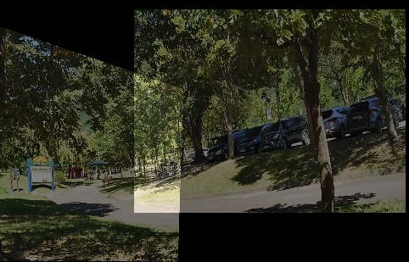
Example1
These two images alignment for RGB camera

Slide 3
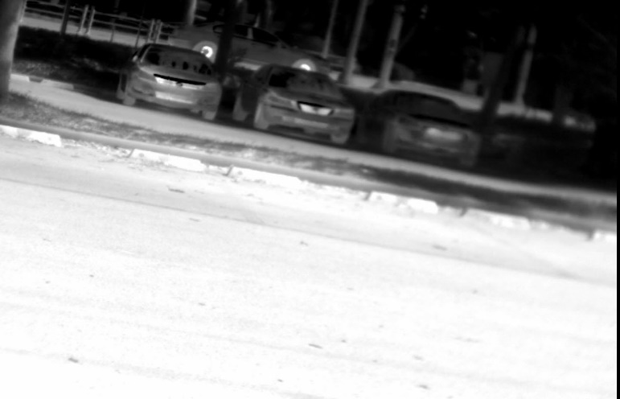
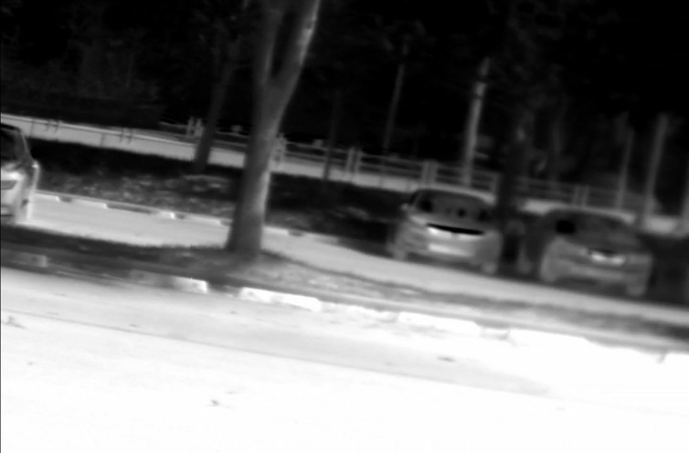
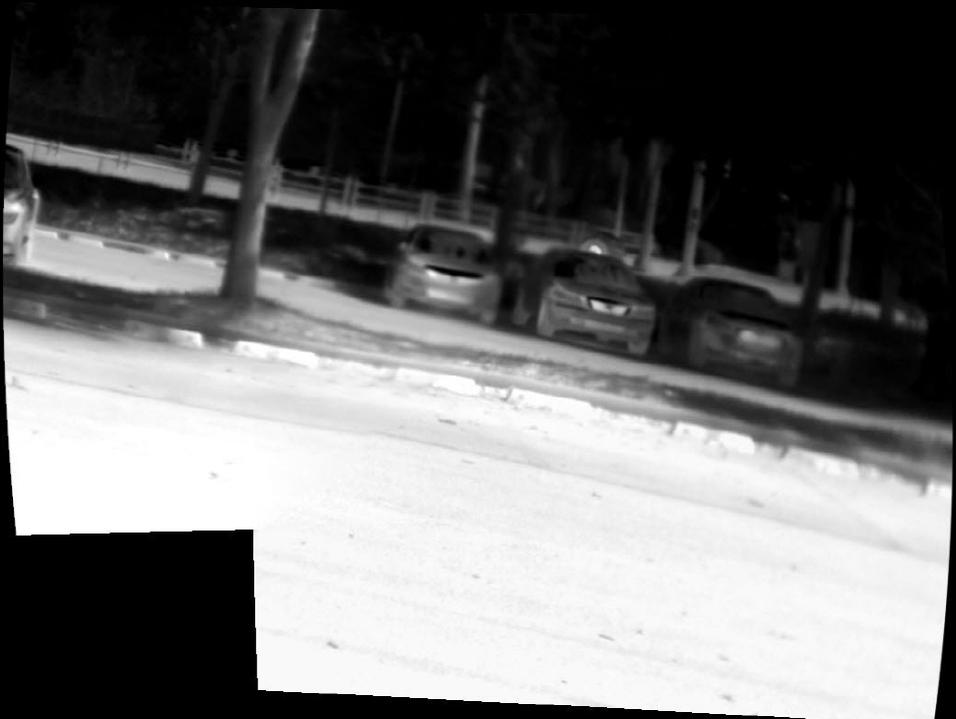
Examples
Two images taken by thermal camera
Two alignment images

