Slide 1
Hubs in Nearest-Neighbor Graphs:
Origins, Applications and Challenges
Miloš Radovanović
Department of Mathematics and Informatics
Faculty of Sciences, University of Novi Sad, Serbia
March 15, 2014
ISM, Tokyo

Slide 2
Thanks
Workshop organizers
Kenji Fukumizu
Institute of Statistical Mathematics, Tokyo, Japan
My coauthors
Mirjana Ivanović
Department of Mathematics and Informatics, Novi Sad, Serbia
Alexandros Nanopoulos
Ingolstadt School of Management, Germany
Nenad Tomašev
ex Jožef Stevan Institute, Ljubljana, Slovenia
Google
March 15, 2014
ISM, Tokyo

Slide 3
Outline
Origins
  Definition, causes, distance concentration, real data, dimensionality reduction, large neighborhoods
Applications
  Approach 1: Getting rid of hubness
  Approach 2: Taking advantage of hubness
Challenges
  Outlier detection, kernels, causes – theory, kNN search, dimensionality reduction, others…
March 15, 2014
ISM, Tokyo

Slide 4
The Hubness Phenomenon
[Radovanović et al. ICML’09, Radovanović et al. JMLR’10]
N_{k}(x), the number of k-occurrences of point x ∈ R^{d}, is the number of times x occurs among k nearest neighbors of all other points in a data set
  N_{k}(x) is the in-degree of node x in the kNN digraph
It was observed that the distribution of N_{k} can become skewed, resulting in hubs – points with high N_{k}
  Music retrieval [Aucouturier & Pachet PR’07]
  Speaker verification (“Doddington zoo”) [Doddington et al. ICSLP’98]
  Fingerprint identification [Hicklin et al. NIST’05]
Cause remained unknown, attributed to the specifics of data or algorithms
March 15, 2014
ISM, Tokyo

Slide 5
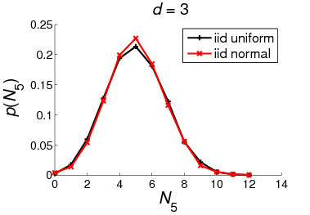
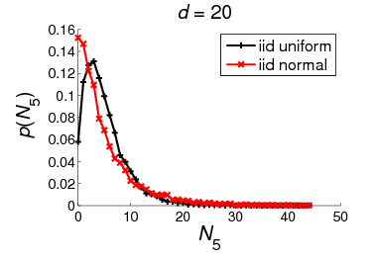
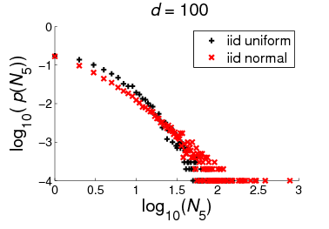
March 15, 2014
ISM, Tokyo

Slide 6
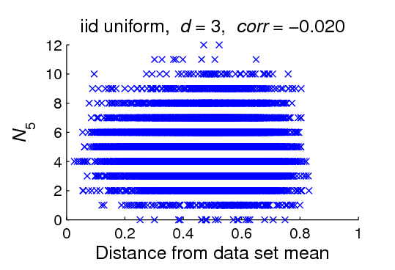
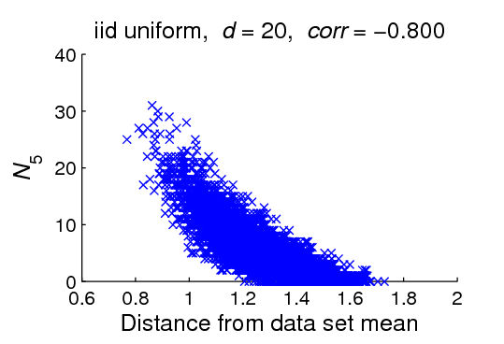
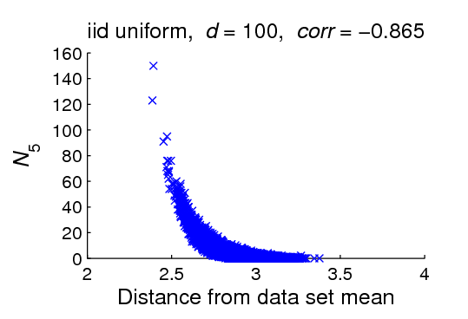
March 15, 2014
ISM, Tokyo

Slide 7
Causes of Hubness
Related phenomenon: concentration of distance / similarity
  High-dimensional data points approximately lie on a sphere centered at any fixed point [Beyer et al. ICDT’99, Aggarwal & Yu SIGMOD’01]
  The distribution of distances to a fixed point always has non-negligible variance [François et al. TKDE’07]
  As the fixed point we observe the data set center
Centrality: points closer to the data set center tend to be closer to all other points (regardless of dimensionality)
Centrality is amplified by high dimensionality
E
Std = √Var
March 15, 2014
ISM, Tokyo

Slide 8
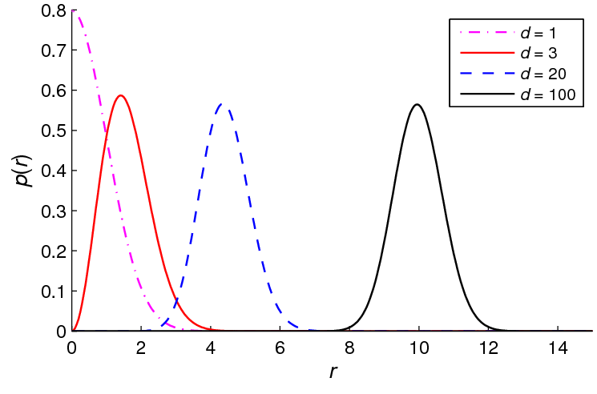
Causes of Hubness
Standard normal distribution of data
Distribution of Euclidean distances of points to data set center (0) = Chi distribution with d degrees of freedom
||X||
March 15, 2014
ISM, Tokyo

Slide 9
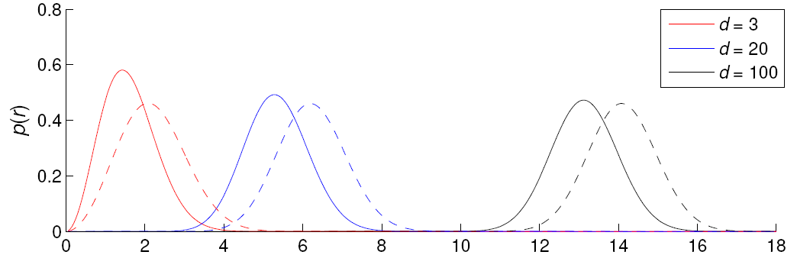
Causes of Hubness
Standard normal distribution of data
Distribution of Euclidean distances of points to:
- Point at expected distance from 0: E(||X||) (dashed lines)
- Point 2 standard deviations closer: E(||X||) – 2·Std(||X||) (full lines)
= Noncentral Chi distribution with d degrees of freedom
March 15, 2014
ISM, Tokyo

Slide 10
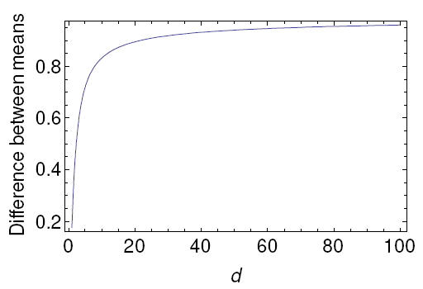
Causes of Hubness
Theorem [Radovanović et al. JMLR’10]: The ascending behavior holds for iid normal data and any two points at distances E + c₁·Std and
E + c₂·Std, for c₁, c₂ ≤ 0, c₁ < c₂
In the above example: c₁ = –2, c₂ = 0
[Suzuki et al. EMNLP’13] discuss similar result for dot-product similarity and more arbitrary data distribution (details in the next talk)
March 15, 2014
ISM, Tokyo

Slide 11
Important to Emphasize
Generally speaking, concentration does not CAUSE hubness
Causation might be possible to derive under certain assumptions
Example settings with(out) concentration and with(out) hubness:
  C+, H+: iid uniform data, Euclidean dist.
  C–, H+: iid uniform data, squared Euclidean dist.
  C+, H–: iid normal data (centered at 0), cosine sim.
  C–, H–: spatial Poisson process data, Euclidean dist.
Two “ingredients” needed for hubness:
  1) High dimensionality
  2) Centrality (existence of centers / borders)
March 15, 2014
ISM, Tokyo

Slide 12
Hubness in Real Data
Important factors for real data
  1) Dependent attributes
  2) Grouping (clustering)
50 data sets
  From well known repositories (UCI, Kent Ridge)
  Euclidean and cosine, as appropriate
Conclusions [Radovanović et al. JMLR’10]:
  1) Hubness depends on intrinsic dimensionality
  2) Hubs are in proximity of cluster centers
March 15, 2014
ISM, Tokyo

Slide 13
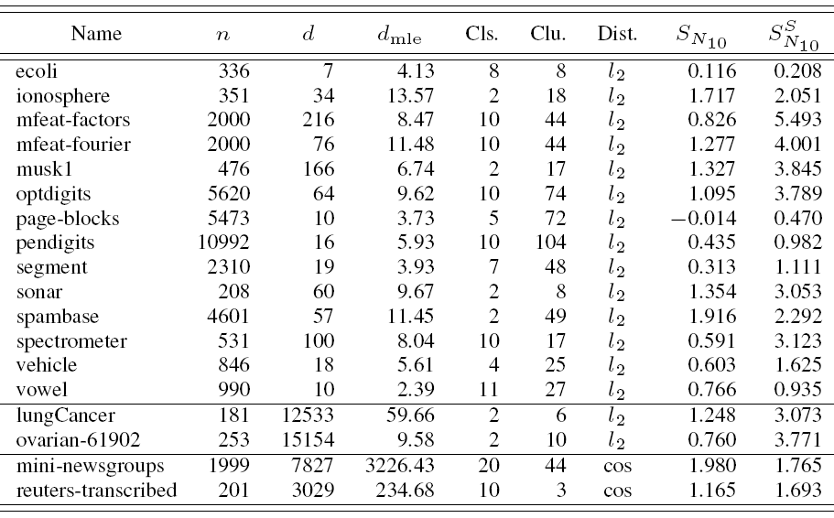
March 15, 2014
ISM, Tokyo

Slide 14
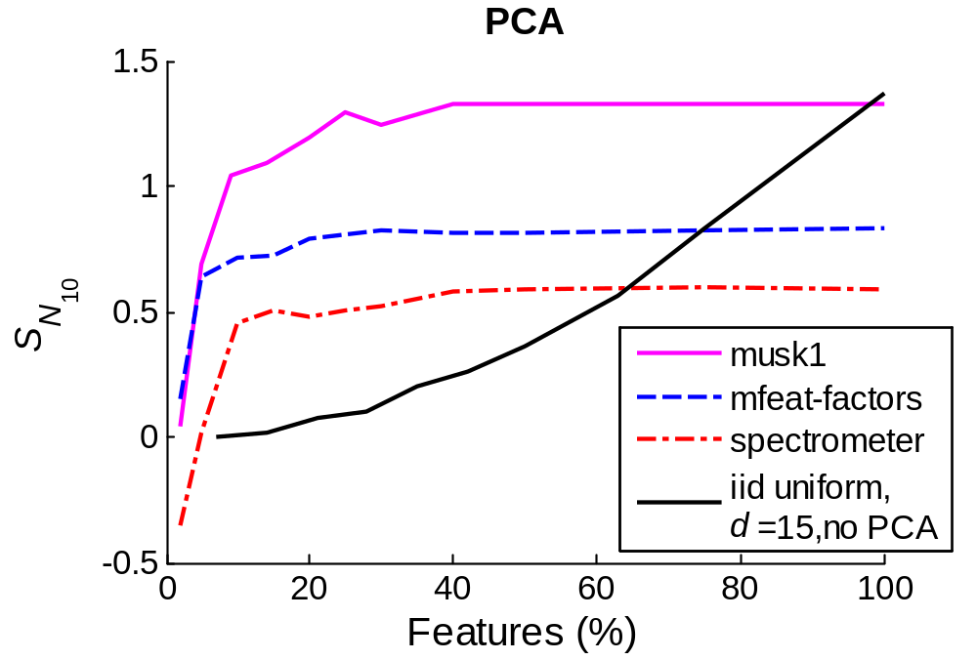
Hubness and Dimensionality Reduction
Intrinsic dimensionality
reached
Similar charts for ICA, SNE, isomap, diffusion maps
March 15, 2014
ISM, Tokyo

Slide 15
Hubness in Real Data
Existence of hubness in real data and dependence on dimensionality verified:
Various UCI, microarray and text data sets [Radovanović et al. JMLR’10]
Collaborative filtering data [Nanopoulos et al. RecSys’09, Knees et al. ICMR’14]
Vector space models for text retrieval [Radovanović et al. SIGIR’10]
Time series data and “elastic” distance measures (DTW) [Radovanović et al. SDM’10]
Content-based music retrieval data [Karydis et al. ISMIR’10, Flexer et al. ISMIR’12]
Doddington zoo in speaker verification [Schnitzer et al. EUSIPCO’13]
Image data with invariant local features (SIFT, SURF, ORB) [Tomašev et al. ICCP’13]
Oceanographic sensor data [Tomašev and Mladenić IS’11]
…
March 15, 2014
ISM, Tokyo

Slide 16
There Are Also Critics
[Low et al. STUDFUZZ’13]
“The Hubness Phenomenon: Fact or Artifact?”
“we challenge the hypothesis that the hubness phenomenon is an effect of the dimensionality of the data set and provide evidence that it is rather a boundary effect or, more generally, an effect of a density gradient”
The “challenge” is easy to overcome by referring to more careful reading of [Radovanović et al. JMLR’10]
Nevertheless, the paper articulates the notion of density gradient (empirically), which could prove valuable
March 15, 2014
ISM, Tokyo

Slide 17
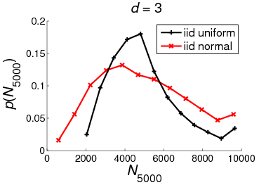
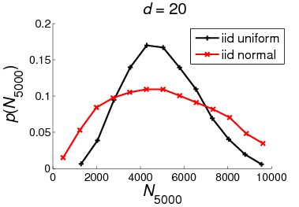
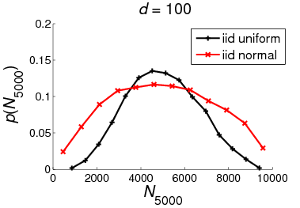
Hubness and Large Neighborhoods
March 15, 2014
ISM, Tokyo

Slide 18
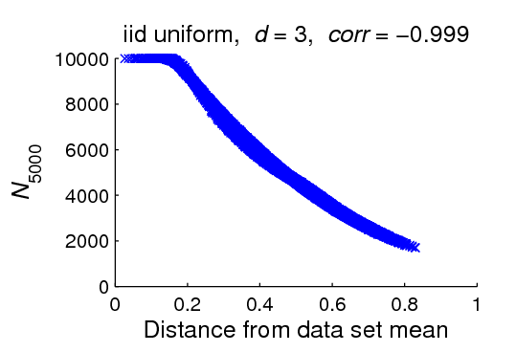
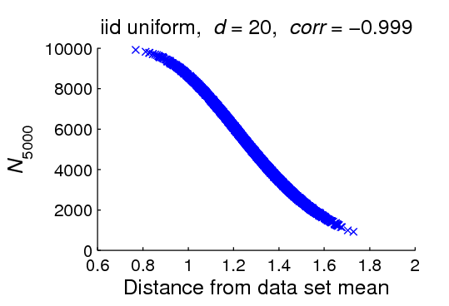
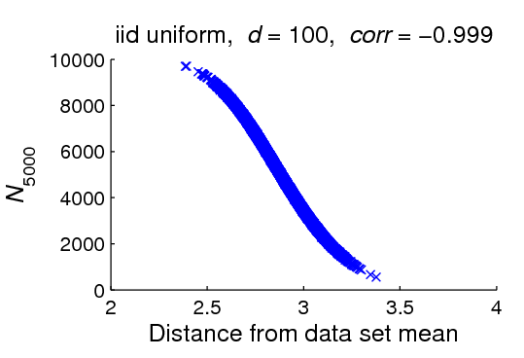
Hubness and Large Neighborhoods
March 15, 2014
ISM, Tokyo

Slide 19
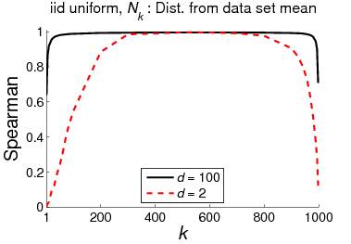
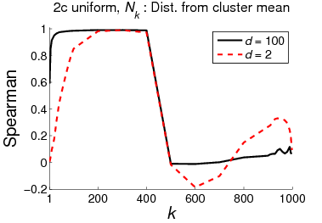
Hubness and Large Neighborhoods
March 15, 2014
ISM, Tokyo

Slide 20
Outline
Origins
  Definition, causes, distance concentration, real data, dimensionality reduction, large neighborhoods
Applications
  Approach 1: Getting rid of hubness
  Approach 2: Taking advantage of hubness
Challenges
  Outlier detection, kernels, causes – theory, kNN search, dimensionality reduction, others…
March 15, 2014
ISM, Tokyo

Slide 21
Approaches to Handling Hubs
Hubness is a problem – let’s get rid of it
Hubness is OK – let’s take advantage of it
Hubness present in many kinds of real data and application domains
We will review research that actively takes hubness into account (in an informed way)
But first…
March 15, 2014
ISM, Tokyo

Slide 22
Hubness and Classification
Based on labels, k-occurrences can be distinguished into:
  “Bad” k-occurrences, BN_{k}(x)
  “Good” k-occurrences, GN_{k}(x)
  N_{k}(x) = BN_{k}(x) + GN_{k}(x)
“Bad” hubs can appear
  How do “bad” hubs originate?
    Observations on real data
March 15, 2014
ISM, Tokyo

Slide 23
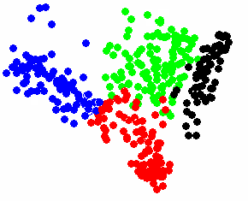
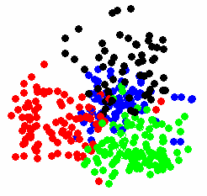
How Do “Bad” Hubs Originate?
The cluster assumption [Chapelle et al. 2006]:
Most pairs of points in a cluster should be of the same class
High
violation
Low
violation
Observations and answers [Radovanović et al. JMLR’10]:
  High dimensionality and skewness of N_{k} do not automatically induce “badness”
  “Bad” hubs originate from a combination of
    1) high (intrinsic) dimensionality
    2) violation of the cluster assumption
March 15, 2014
ISM, Tokyo

Slide 24
In More General Terms
General notion of “error”
  Classification error (accuracy)
  Retrieval error (precision, recall, F-measure)
  Clustering error (within/between cluster distance)
Models make errors, but the responsibility for error is not evenly distributed among data points
Important to distinguish:
  Total amount of (responsibility for) error in the data
    E.g. Σ_{x} BN_{k}(x) / Σ_{x} N_{k}(x)
  Distribution of (responsibility for) error among data points
    E.g. distribution of BN_{k}(x), i.e. its skewness
March 15, 2014
ISM, Tokyo

Slide 25
In More General Terms
Hubness generally does not increase the total amount of error
Hubness skews the distribution of error, so some points will be more responsible for error than others
Approach 1 (getting rid of hubness)
  May reduce (but also increase) total amount of error in the data
  Will make distribution of error more uniform
Approach 2 (taking advantage of hubness)
  Will not change total amount of error in the data
  Will identify points more responsible for error and adjust models accordingly
March 15, 2014
ISM, Tokyo

Slide 26
Outline
Origins
  Definition, causes, distance concentration, real data, dimensionality reduction, large neighborhoods
Applications
  Approach 1: Getting rid of hubness
  Approach 2: Taking advantage of hubness
Challenges
  Outlier detection, kernels, causes – theory, kNN search, dimensionality reduction, others…
March 15, 2014
ISM, Tokyo

Slide 27
Mutual kNN Graphs
[Ozaki et al. CoNLL’11]
Graph-based semi-supervised text classification
  kNN graphs
  Mutual kNN graphs + maximum spanning trees
  b-matching graphs [Jebara et al. ICML’09]
Mutual kNN graphs perform better than kNN graphs (and comparably to b-matching graphs) due to reduced hubness
March 15, 2014
ISM, Tokyo

Slide 28
Centering and Hub Reduction
[Suzuki et al. AAAI’12]
Ranking (IR), multi-class and multi-label kNN classification
Laplacian-based kernels tend to make all points equally similar to the center, thus reducing hubness (compared to plain cosine similarity)
When hubness is reduced, the kernels work well
[Suzuki et al. EMNLP’13]
Text classification
Centering reduces hubness, since it also makes all points equally similar to the center, using dot-product similarity
  I would add, centering reduces centrality (the existence of centers in the data) w.r.t dot-product similarity
For multi-cluster data, weighted centering which moves hubs closer to the center achieves a similar effect
March 15, 2014
ISM, Tokyo

Slide 29
Local and Global Scaling
[Schnitzer et al. JMLR’12]
Content-based music retrieval
Idea: rescale distances from x and y so that distance is small only if x is a close neighbor to y and y is a close neighbor to x
Local scaling: non-iterative contextual dissimilarity measure
LS(d_{x,y}) = d_{x,y} / (μ_{x} μ_{y})^{½}
where μ_{x} (μ_{y}) is the avg. distance from x (y) to its k NNs
Global scaling: mutual proximity
MP(d_{x,y}) = P(X > d_{x,y} ∩ Y > d_{y,x})
where X (Y) follows the distribution of distances from x (y) to all other points
March 15, 2014
ISM, Tokyo
Notes:
μ_{x} = average distance to the k NNs of x

Slide 30
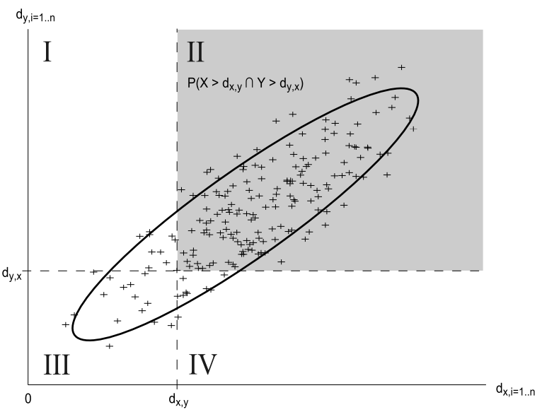
Mutual Proximity Visualized
March 15, 2014
ISM, Tokyo

Slide 31
Properties of LS and MP
Both LS and MP reduce hubness, improving kNN classification accuracy
MP easier to approximate for large data, successfully applied to music retrieval
Methods do not reduce intrinsic dimensionality of data
Hubs/anti-hubs remain as such, but to a lesser degree
Regarding error (“badness”), the methods:
  Reduce badness of hubs
  Introduce badness to anti-hubs
  Badness of regular points stays roughly the same, but less than for both hubs and anti-hubs
LS can benefit from varying neighborhood size based on class labels or clustering [Lagrange et al. ICASSP’12]
MP successfully applied to neighbor-based collaborative filtering [Knees et al. ICMR’14]
  MP improves data point coverage in NN graph
March 15, 2014
ISM, Tokyo

Slide 32
Shared Nearest Neighbors
[Flexer & Schnitzer HDM’13]
Classification
Consider shared neighbor similarity:
SNN(x,y) = |D_{k}(x) ∩ D_{k}(y)| / k
where D_{k}(x) is the set of k NNs of x
Use this measure for computing the kNN graph
SNN reduces hubness, but not as much as LS and MP
SNN can improve kNN classification accuracy, but overall worse than LS and MP
March 15, 2014
ISM, Tokyo

Slide 33
A Case for Hubness Removal
[Schnitzer et al. ECIR’14]
Multimedia retrieval: text, images, music
SNN, and especially LS and MP, in all above domains:
  Reduce hubness
  Improve data point coverage (reachability)
  Improve retrieval precision/recall
March 15, 2014
ISM, Tokyo

Slide 34
Other Ways to Avoid Hubs
[Murdock and Yaeger ECAL’11]
Using clustering to identify species in genetic algorithms
QT clustering algorithm uses ε-neighborhoods, where there is no hubness
[Lajoie et al. Genome Bilogy’12]
Regulatory element discovery from gene expression data
kNN graph between genes is first symmetrized
k neighbors sampled with probability inversely proportional to N_{k}
[Schlüter MSc’11]
Overview and comparison of methods for hub reduction in music retrieval
Methods mostly unaware of the true cause of hubness
March 15, 2014
ISM, Tokyo

Slide 35
Outline
Origins
  Definition, causes, distance concentration, real data, dimensionality reduction, large neighborhoods
Applications
  Approach 1: Getting rid of hubness
  Approach 2: Taking advantage of hubness
Challenges
  Outlier detection, kernels, causes – theory, kNN search, dimensionality reduction, others…
March 15, 2014
ISM, Tokyo

Slide 36
Extending the kNN Classifier
“Bad” hubs provide erroneous class information to many other points
hw-kNN [Radovanović et al. JMLR’10]:
  We introduce standardized “bad” hubness:
h_{B}(x, k) = (BN_{k}(x) – μ_{BNk}) / σ_{BNk}
  During majority voting, the vote of each neighbor x is weighted by
exp(–h_{B}(x, k))
March 15, 2014
ISM, Tokyo

Slide 37
Extending the kNN Classifier
Drawbacks of hw-kNN:
  Does not distinguish between classes when computing “badness” of a point
  Still uses the crisp voting scheme of kNN
Consider class-specific hubness scores N_{k,c}(x):
The number of k-occurrences of x in neighbor sets of class c
  h-FNN, Hubness-based Fuzzy NN [Tomašev et al. MLDM’11, IJMLC]:
  Vote in a fuzzy way by class-specific hubness scores N_{k,c}(x)
  NHBNN, Naïve Hubness Bayesian NN [Tomašev et al. CIKM’11]:
  Compute a class probability distribution based on N_{k,c}(x)
  HIKNN, Hubness Information kNN [Tomašev & Mladenić ComSIS’12]:
  Information-theoretic approach using N_{k,c}(x)
  ANHBNN, Augmented Naïve Hubness Bayesian NN
  [Tomašev & Mladenić ECML’13]:
  Extends NHBNN using the Hidden Naïve Bayes model to take into account hub co-occurrences in NN lists
March 15, 2014
ISM, Tokyo

Slide 38
Why Hub-Based Classifiers Work
[Tomašev & Mladenić, KBS’13]
Data with imbalanced classes
“Bad” hubs from MINORITY classes usually responsible for most error
Favoring minority class data points (standard approach) makes the problem worse
Hubness-based classifiers improve precision on minority classes and recall on majority classes
May be beneficial to combine the hubness-aware voting approaches with the existing class imbalanced kNN classifiers
  Realistically, minority classes need to be favored
  Minority (bad) hubs need to be taken into account
March 15, 2014
ISM, Tokyo

Slide 39
Clustering
[Radovanović et al. JMLR’10]
Distance-based clustering objectives:
  Minimize within-cluster distance
  Maximize between-cluster distance
Skewness of N_{k} affects both objectives
  Outliers do not cluster well because of high within-cluster distance
  Hubs also do not cluster well, but because of low between-cluster distance
March 15, 2014
ISM, Tokyo

Slide 40
Clustering
Silhouette coefficient (SC): For i-th point
  a_{i} = avg. distance to points from its cluster
  (within-cluster distance)
  b_{i} = min. avg. distance to points from other clusters
  (between-cluster distance)
  SC_{i} = (b_{i} – a_{i}) / max(a_{i}, b_{i})
    In range [–1, 1], higher is better
  SC for a set of points is the average of SC_{i} for every point i in the set
March 15, 2014
ISM, Tokyo

Slide 41
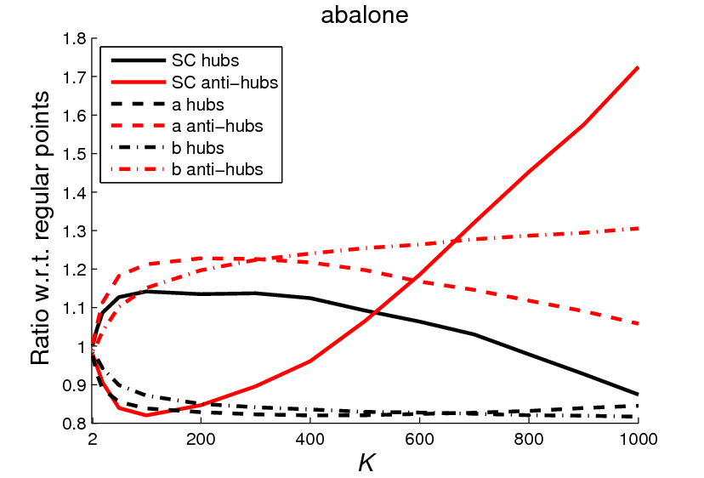
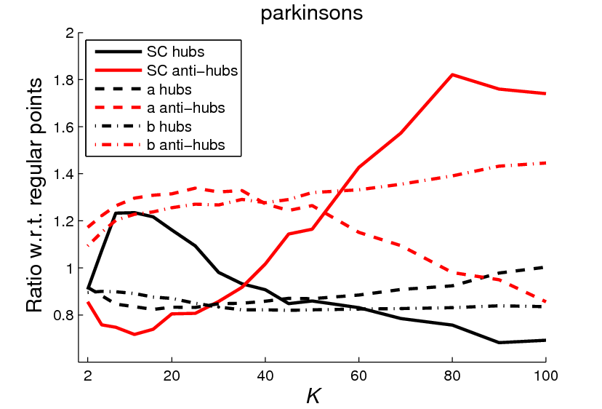
Clustering
[Tomašev et al. submitted]
March 15, 2014
ISM, Tokyo

Slide 42
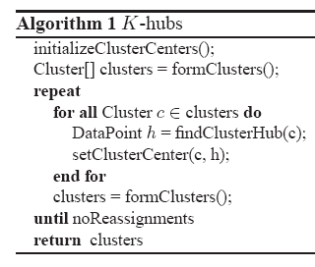
Using Hubs as Cluster Centers
[Tomašev et al. PAKDD’11, TKDE’14]
March 15, 2014
ISM, Tokyo

Slide 43
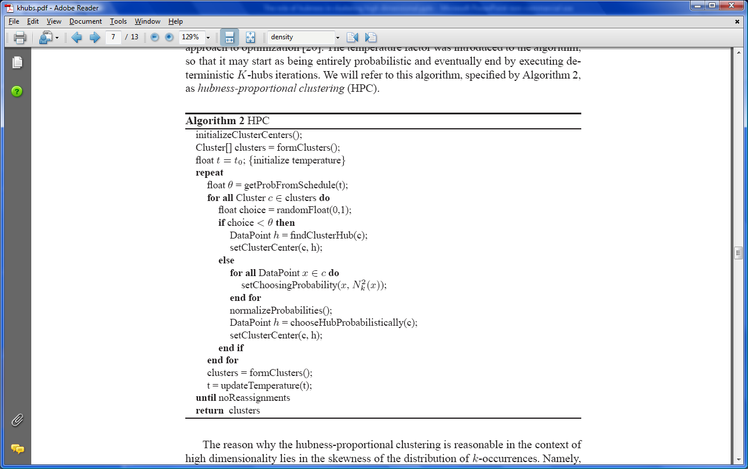
Exploiting the Hubness of Points
March 15, 2014
ISM, Tokyo

Slide 44
Exploiting the Hubness of Points
March 15, 2014
ISM, Tokyo

Slide 45


Exploiting the Hubness of Points
Algorithm 3 HPKM
The same as HPC, except for one line
HPC: HPKM:
“Kernelized” extension of HPKM
[Tomašev et al. submitted]
March 15, 2014
ISM, Tokyo

Slide 46
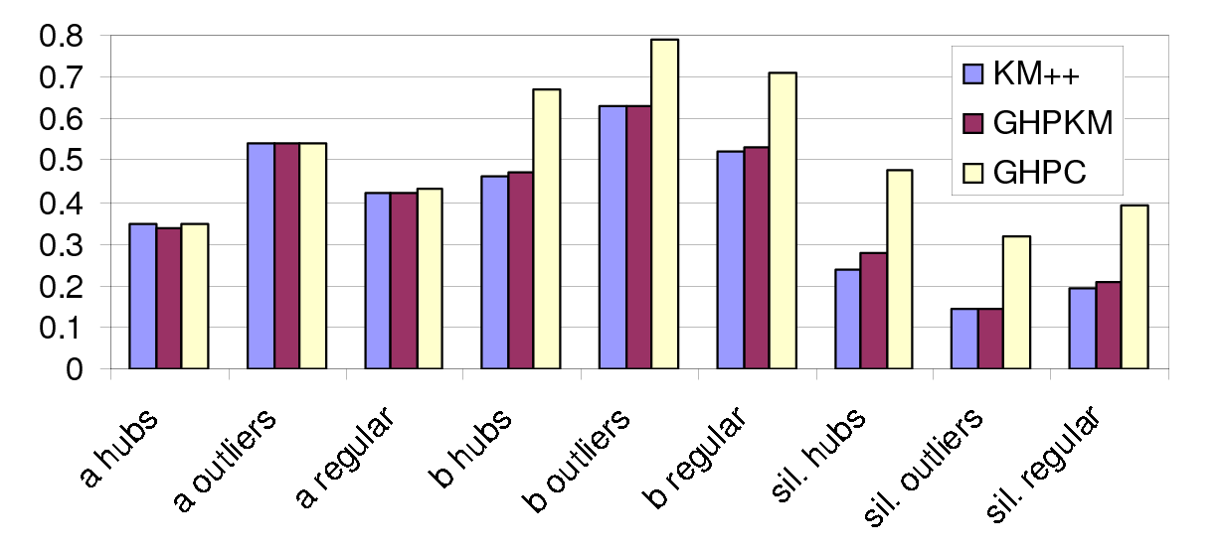
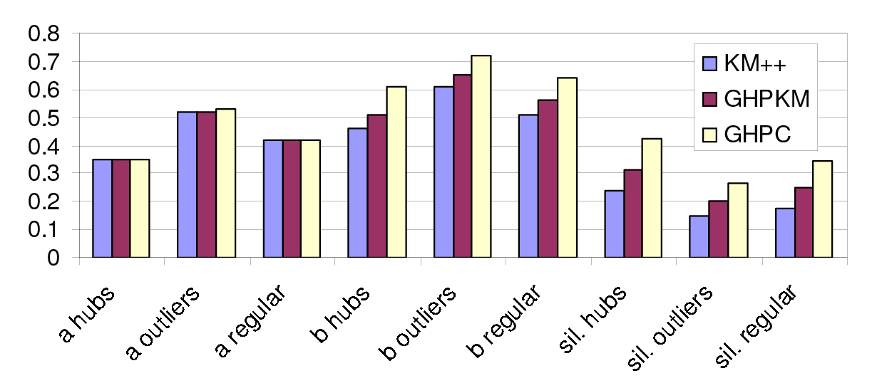
Why Hub-Based Clustering Works
Hub-based clustering more robust to noise
Improves between-cluster distance (b component of SC), especially for hubs
Miss-America, Part 1
Miss-America, Part 2
March 15, 2014
ISM, Tokyo

Slide 47
Instance Selection
[Buza et al. PAKDD’11]
Improve speed and accuracy of 1NN time-series classification
Select a small percentage of instances x based on largest
  GN₁(x)
  GN₁(x) / (N₁(x) + 1)
  GN₁(x) – 2BN₁(x)
The approach using GN₁(x) is optimal in the sense of producing the best 1NN coverage (label-matching) graph
[Lazaridis et al. Signal Processing: Image Communication’13]
Multimodal indexing of multimedia objects (text, 2D image, sketch, video, 3D objects, audio and their combinations)
Select dimensionality of multimodal feature space (20) to maximize hubness while keeping computational cost reasonable
Select reference objects for indexing as strongest hubs
March 15, 2014
ISM, Tokyo

Slide 48
Instance Selection
[Radovanović et al. JMLR’10]
Support vector machine classifier
Bad hubs tend to be good support vectors
[Kouimtzis MSc’11]
Confirm and refine above observation
Observe ratio BN_{k}(x) / GN_{k}(x)
Two selection methods:
  RatioOne: Prefer ratios closest to 1 in absolute value
  BelowOne: Prefer ratios lower than 1
BelowOne performs better than random selection
RatioOne comparable to BelowOne only on larger sample sizes
BelowOne selects instances on the border, but closer to class centers
March 15, 2014
ISM, Tokyo

Slide 49
Local Image Feature Selection
[Wang et al. PR’11]
Improving image-to-class (I2C) distance
Image features extracted locally from each image, and thus have:
  Vector descriptors (that can be compared)
  Associated class information (of the image)
Reduce cost of NN search in testing phase by:
  Removing features with low N_{k}
  Keeping features with high GN_{k} / BN_{k}
March 15, 2014
ISM, Tokyo

Slide 50
Cross-Lingual Document Retrieval
[Tomašev et al. PAKDD’13]
Acquis aligned corpus data (labeled), focus on English and French
Frequent neighbor documents among English texts are usually also frequent neighbors among French texts
Good/bad neighbor documents in English texts are expected to be good/bad neighbor documents in French
Canonical correlation analysis (CCA) is a dimensionality reduction technique similar to PCA, but:
  Assumes the data comes from two views that share some information (such as a bilingual document corpus)
  Instead of looking for linear combinations of features that maximize the variance it looks for a linear combination of feature vectors from the first view and a linear combination from the second view, that are maximally correlated
Introduce instance weights that (de)emphasize (bad) hubs in CCA
Emphasizing hubs gives most improvement in classification and retrieval tasks
March 15, 2014
ISM, Tokyo

Slide 51
Similarity Adjustment
[Radovanović et al. SIGIR’10]
Document retrieval in the vector space model
(TF-IDF + cosine sim., BM25, pivoted cosine)
For document x, query q, we adjust similarity sim(x, q) as follows:
sim_{a}(x, q) = sim(x, q) + sim(x, q) · (GN_{k}(x) – BN_{k}(x)) / N_{k}(x)
[Tomašev et al. ITI’13]
Bug duplicate detection in software bug tracking systems
(TF-IDF + cosine sim. over bug report text)
Similarity adjustment, observing only the past μ occurrences of x:
sim_{a}(x, q) = sim(x, q) + sim(x, q) · GN_{k,μ}(x) / N_{k,μ} (x)
March 15, 2014
ISM, Tokyo

Slide 52
An Approach in Between
[Tomašev & Mladenić, HAIS’12, KAIS]
Image classification
Consider shared neighbor similarity:
SNN(x,y) = |D_{k}(x) ∩ D_{k}(y)| / k
where D_{k}(x) is the set of k NNs of x
Propose a modified measure simhub which
  Increases the influence of rare neighbors
  Reduces the influence of “bad” hubs (considering class-specific hubness N_{k,c}(x) from an information-theoretic perspective)
simhub:
  Reduces total amount of error (badness)
  Reduces hubness
  Bad hubs no longer correlate with hubs (distribution of error is changed)
March 15, 2014
ISM, Tokyo

Slide 53
Outline
Origins
  Definition, causes, distance concentration, real data, dimensionality reduction, large neighborhoods
Applications
  Approach 1: Getting rid of hubness
  Approach 2: Taking advantage of hubness
Challenges
  Outlier detection, kernels, causes – theory, kNN search, dimensionality reduction, others…
March 15, 2014
ISM, Tokyo

Slide 54
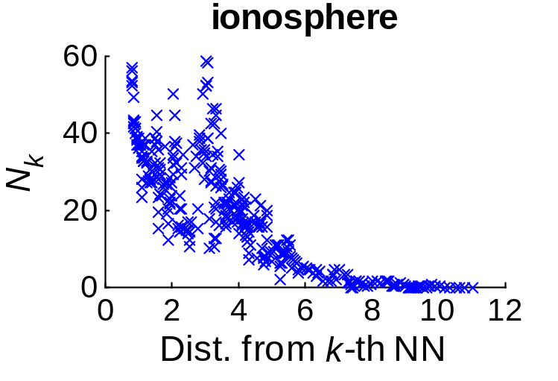
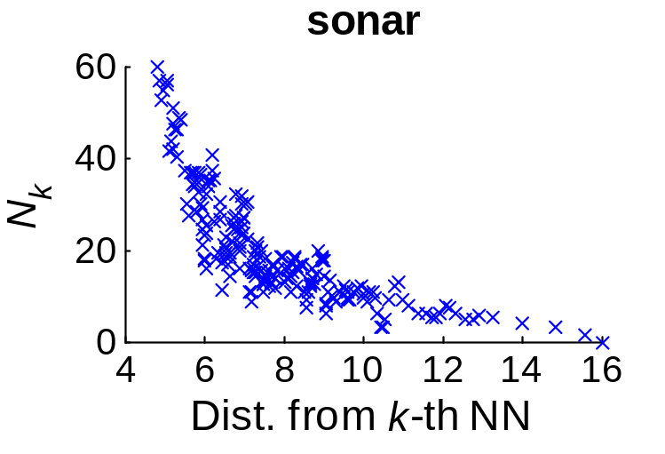
Outlier Detection
[Radovanović et al. JMLR’10]
In high dimensions, points with low N_{k} can be considered distance-based outliers
  They are far away from other points in the data set / their cluster
  High dimensionality contributes to their existence
(k = 20)
March 15, 2014
ISM, Tokyo

Slide 55
Outlier Detection
Challenges [Radovanović et al. submitted]:
For high-dimensional data and low k many points have N_{k} values of 0
Raising k can help, but:
  Cluster boundaries can be crossed, producing meaningless results
  Computational complexity is raised; approximate NN search/indexing methods do not work any more
March 15, 2014
ISM, Tokyo

Slide 56
Kernels
Little is known about the effects of different kernels (and their parameters) on hubness
And vice versa, hubness can be a good vehicle for understanding the effects of kernels on data distributions
For given kernel function K(x,y) and norm distance metric D(x,y) in Hilbert space,
D²(Ψ(x),Ψ(y)) = K(x,x) − 2K(x,y) + K(y,y)
Preliminary investigation in [Tomašev et al. submitted], in the context of kernelized hub-based clustering
Other possible applications: kernelized clustering in general, kernel-kNN classifier, SVMs (with only a start given in [Kouimtzis MSc’11])…
March 15, 2014
ISM, Tokyo

Slide 57
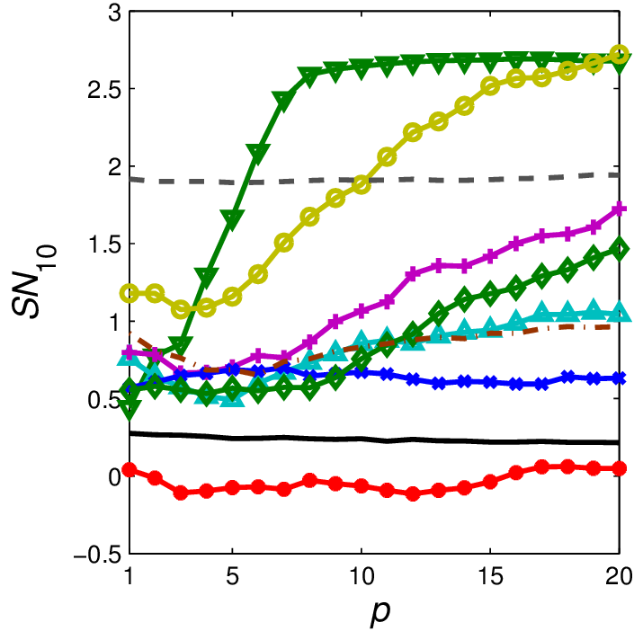
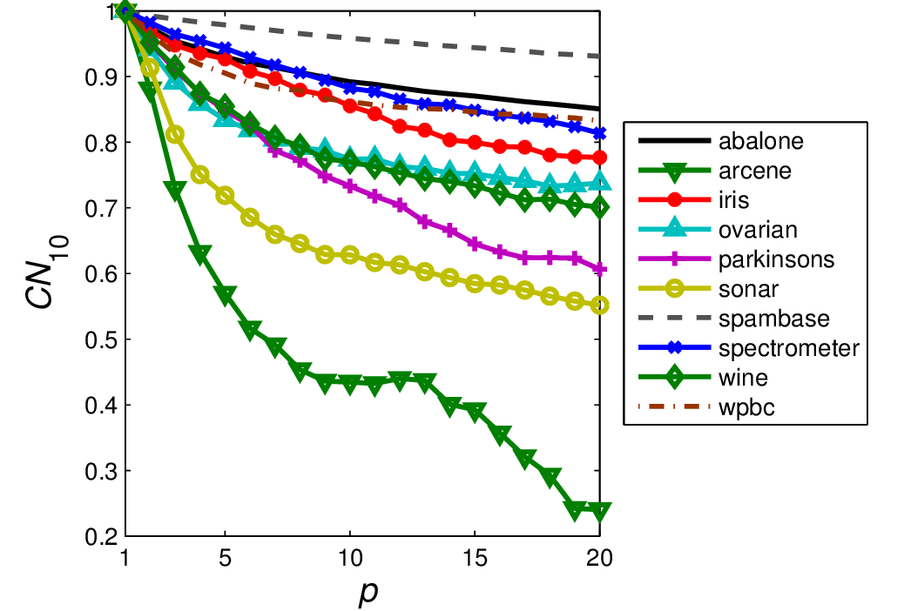
Kernels
[Tomašev et al. submitted]: polynomial kernel K(x,y) = (1 + <x,y>)^{p}
March 15, 2014
ISM, Tokyo

Slide 58
Causes of Hubness: Theory
Theoretical contribution of [Radovanović et al. JMLR’10] only in terms of properties of distances
Good strides made in [Suzuki et al. EMNLP’13] for dot-product similarity
More needs to be done:
  Explain the causes of hubness theoretically for a large class of distances and data distributions
  Characterize the distribution of N_{k} based on the distribution of data, distance measure, number of data points, k
  Explore the effects of different types of normalization
  Understand the difference between kNN and ε-neighborhood graphs
Practical benefits:
  Geometric models of complex networks (mapping graphs to R^{d})
  Intrinsic dimensionality estimation
  …
March 15, 2014
ISM, Tokyo

Slide 59
(Approximate) kNN Search / Indexing
HUGE virtually untouched area, with great practical importance
We did some preliminary experiments, showing that hubness is not severely affected by method from [Chen et al. JMLR’09]
[Lazaridis et al. 2013] used hubness in a specific multimedia context
Need for comprehensive systematic exploration of:
  Interaction between hubness and existing methods
  Construction of new “hubness-aware” methods
Possible need for methods that do not assume k = O(1)
March 15, 2014
ISM, Tokyo

Slide 60
Dimensionality Reduction
Apart from simulations in [Radovanović et al. JMLR’10] and instance weighting for CCA in [Tomašev et al. PAKDD’13], practically nothing done
Many possibilities:
  Improved objective functions for distance-preserving dimensionality reduction (MDS, PCA)
    In order to better preserve kNN graph structure
    Or break the kNN graph in a controlled way
  Improve methods based on geodesic distances (Isomap, etc.)
  …
March 15, 2014
ISM, Tokyo

Slide 61
Other (Possible) Applications
Information retrieval
  Investigation of short queries, large data sets
  Learning to rank
Local image features (SIFT, SURF…)
  Hubness affects formation of codebook representations
  Normalization plays and important role
Protein folding
Suggestions?
March 15, 2014
ISM, Tokyo

Slide 62
References
M. Radovanović et al. Nearest neighbors in high-dimensional data: The emergence and influence of hubs. In Proc. 26th Int. Conf. on Machine Learning (ICML), pages 865–872, 2009.
M. Radovanović et al. Hubs in space: Popular nearest neighbors in high-dimensional data. Journal of Machine Learning Research,11:2487–2531, 2010.
J.-J. Aucouturier and F. Pachet. A scale-free distribution of false positives for a large class of audio similarity measures. Pattern Recognition, 41(1):272–284, 2007.
G. Doddington et al. SHEEP, GOATS, LAMBS and WOLVES: A statistical analysis of speaker performance in the NIST 1998 speaker recognition evaluation. In Proc. 5th Int. Conf. on Spoken Language Processing (ICSLP), 1998. Paper 0608.
A. Hicklin et al. The myth of goats: How many people have ﬁngerprints that are hard to match? Internal Report 7271, National Institute of Standards and Technology (NIST), USA, 2005.
I. Suzuki et al. Centering similarity measures to reduce hubs. In Proc. Conf. on Empirical Methods in Natural Language Processing (EMNLP), pages 613–623, 2013.
K. S. Beyer et al. When is “nearest neighbor” meaningful? In Proc. 7th Int. Conf. on Database Theory (ICDT), pages 217–235, 1999.
C. C. Aggarwal and P. S. Yu. Outlier detection for high dimensional data. In Proc. 27th ACM SIGMOD Int. Conf. on Management of Data, pages 37–46, 2001.
D. François et al. The concentration of fractional distances. IEEE Transactions on Knowledge and Data Engineering, 19(7):873–886, 2007.
March 15, 2014
ISM, Tokyo

Slide 63
A. Nanopoulos et al. How does high dimensionality affect collaborative ﬁltering? In Proc. 3rd ACM Conf. on Recommender Systems (RecSys), pages 293–296, 2009.
P. Knees et al. Improving neighborhood-based collaborative filtering by reducing hubness. Proc. 4th ACM Int. Conf. on Multimedia Retrieval (ICMR), 2014 (to appear)
M. Radovanović et al. On the existence of obstinate results in vector space models. In Proc. 33rd Annual International ACM SIGIR Conference on Research and Development in Information Retrieval, pages 186–193, 2010.
M. Radovanović et al. Time-series classiﬁcation in many intrinsic dimensions. In Proc. 10th SIAM Int. Conf. on Data Mining (SDM), pages 677–688, 2010.
I. Karydis et al. Looking through the “glass ceiling”: A conceptual framework for the problems of spectral similarity. In Proc. 11th International Society for Music Information Retrieval Conference (ISMIR), pages 267–272, 2010.
A. Flexer et al. A MIREX meta-analysis of hubness in audio music similarity. In Proc. 13th International Society for Music Information Retrieval Conference (ISMIR), pages 175–180, 2012.
D. Schnitzer et al. The relation of hubs to the Doddington zoo in speaker verification. In Proc. 21st European Signal Processing Conf. (EUSIPCO), 2013.
N. Tomašev et al. Object recognition in WIKImage data based on local invariant image features. In Proc. 9th Int. Conf. on Intelligent Computer Communication and Processing (ICCP), pages 139–146, 2013.
N. Tomašev and D. Mladenić. Exploring the hubness-related properties of oceanographic sensor data. In Proc. 4th Int. Multiconf. on Information Society (IS), Volume A, pages 149–152, 2011.
T. Low et al. The hubness phenomenon: Fact or artifact? In C. Borgelt et al (eds.): Towards Advanced Data Analysis by Combining Soft Computing and Statistics, pages 267–278, Springer, 2013.
March 15, 2014
ISM, Tokyo

Slide 64
O. Chapelle et al., editors. Semi-Supervised Learning. MIT Press, 2006.
K. Ozaki et al. Using the mutual k-nearest neighbor graphs for semi-supervised classification of natural language data. In Proc. 15th Conf. on Computational Natural Language Learning (CoNLL), pages 154–162, 2011.
T. Jebara et al. Graph construction and b-matching for semi-supervised learning. In Proc. 26th Int. Conf. on Machine Learning (ICML), pages 441–448, 2009.
I. Suzuki et al. Investigating the effectiveness of Laplacian-based kernels in hub reduction. In Proc. 26th AAAI Conf. on Artificial Intelligence, pages 1112–1118, 2012.
D. Schnitzer et al. Local and global scaling reduce hubs in space. Journal of Machine Learning Research 13:2871–2902, 2012.
M. Lagrange et al. Cluster aware normalization for enhancing audio similarity. In Proc. IEEE Int. Conf. on Acoustics, Speech and Signal Processing (ICASSP), 2012.
A. Flexer and D. Schnitzer. Can shared nearest neighbors reduce hubness in high-dimensional spaces? In Proc. 1st International Workshop on High Dimensional Data Mining (HDM), 2013
D. Schnitzer et al. A case for hubness removal in high-dimensional multimedia retrieval. In Proc. 36th European Information Retrieval Conference (ECIR), 2014 (to appear)
J. Murdock and L. S. Yaeger. Identifying species by genetic clustering. In Proc. 20th European Conf. on Artificial Life (ECAL), pages 565–572, 2011.
M. Lajoie et al. Computational discovery of regulatory elements in a continuous expression space. Genome Biology 13(11):R109, 2012.
J. Schlüter. Unsupervised Audio Feature Extraction for Music Similarity Estimation. MSc thesis, Faculty of Informatics, Technical University of Munich, Munich, Germany, 2011.
March 15, 2014
ISM, Tokyo

Slide 65
N. Tomašev et al. Hubness-based fuzzy measures for high-dimensional k-nearest neighbor classification. In Proc. 7th Int. Conf. on Machine Learning and Data Mining (MLDM), pages 16–30, New York, USA, 2011.
N. Tomašev et al. Hubness-based fuzzy measures for high-dimensional k-nearest neighbor classification. International Journal of Machine Learning and Cybernetics, DOI: 10.1007/s13042-012-0137-1 (to appear).
N. Tomašev et al. A probabilistic approach to nearest-neighbor classiﬁcation: Naive hubness Bayesian kNN. In Proc. 20th ACM Int. Conf. on Information and Knowledge Management (CIKM), pages 2173–2176, 2011.
N. Tomašev and D. Mladenić. Hub co-occurrence modeling for robust high-dimensional kNN classiﬁcation. In Proc. 24th European Conf. on Machine Learning (ECML), 2013.
N. Tomašev and D. Mladenić. Class imbalance and the curse of minority hubs. Knowledge-Based Systems, 53:157–172, 2013.
N. Tomašev et al. The role of hubness in clustering high-dimensional data. In Proc. 15th Pacific-Asia Conf. on Knowledge Discovery and Data Mining (PAKDD), Part I, pages 183–195, 2011.
N. Tomašev et al. The role of hubness in clustering high-dimensional data. IEEE Transactions on Knowledge and Data Engineering, 26(3):739–751, 2014.
K. Buza et al. INSIGHT: Efficient and effective instance selection for time-series classification. In Proc. 15th Pacific-Asia Conf. on Knowledge Discovery and Data Mining (PAKDD), Part II, pages 149–160, 2011.
M. Lazaridis et al. Multimedia search and retrieval using multimodal annotation propagation and indexing techniques. Signal Processing: Image Communication, 28(4):351–367, 2013.
March 15, 2014
ISM, Tokyo

Slide 66
G. Kouimtzis. Investigating the Impact of Hubness on SVM Classifiers. MSc thesis, Department of Information & Communication Systems Engineering, University of the Aegean, Karlovassi, Samos, Greece, 2011.
Z. Wang et al. Improved learning of I2C distance and accelerating the neighborhood search for image classification. Pattern Recognition, 44(10–11):2384–2394, 2011.
N. Tomašev et al. The role of hubs in supervised cross-lingual document retrieval. In Proc. 17th Pacific-Asia Conf. on Knowledge Discovery and Data Mining (PAKDD), Part II, pages 185–196, 2013.
N. Tomašev et al. Exploiting hubs for self-adaptive secondary re-ranking in bug report duplicate detection. In Proc. 35th Int. Conf. on Information Technology Interfaces (ITI), 2013.
N. Tomašev and D. Mladenić. Hubness-aware shared neighbor distances for high-dimensional k-nearest neighbor classiﬁcation. In Proc. 7th Int. Conf. on Hybrid Artificial Intelligence Systems (HAIS), Part II, pages 116–127, 2012.
N. Tomašev and D. Mladenić. Hubness-aware shared neighbor distances for high-dimensional k-nearest neighbor classiﬁcation. Knowledge and Information Systems, DOI: 10.1007/s10115-012-0607-5 (to appear).
J. Chen et al. Fast approximate kNN graph construction for high dimensional data via recursive Lanczos bisection. Journal of Machine Learning Research, 10:1989–2012, 2009.
March 15, 2014
ISM, Tokyo

