Slide 1

CFO AI PRO
AI-powered financial decision platform
From Excel data to financial health, bank readiness, forecasts, decision simulation, and executive recommendations.
AMAD Hackathon 2026
Shujaan Almutairi
CFO AI PRO | AMAD Hackathon 2026
1

Slide 2
02
Problem & Solution
المشكلة والحل
The Problem
The Solution
SMEs often keep financial data in Excel, but analysis, financing readiness, and decision simulation are still manual or spread across disconnected tools.
CFO AI PRO unifies the full CFO workflow in one AI-supported platform: upload data, analyze, forecast, simulate, rank decisions, and generate recommendations.
تسريع التحليل المالي
تقييم الجاهزية التمويلية
محاكاة القرار قبل تنفيذه
توصيات قابلة للتفسير
Less manual work
Better decision confidence
Clear evidence for banks and management
Works with demo data or uploaded Excel
CFO AI PRO | AMAD Hackathon 2026
2

Slide 3
03
Who Benefits?
من يستفيد؟
For Business Owners
For Banks
For CFO Teams
Understand profitability, expenses, risk, and next actions without needing a full finance team.
Use readiness indicators and evidence-based explanations before formal credit review.
Run scenarios, compare decisions, and export an executive report for management.
Decision support, not an automated lending decision.
المنصة تدعم القرار، ولا تستبدل المراجعة البشرية أو مستندات البنك.
CFO AI PRO | AMAD Hackathon 2026
3

Slide 4
04
Data & AI Excel Converter
البيانات وتحويل Excel
Sales Data
Expenses Data
Employees Data
Invoices
Customers
Financial Statements
AI Excel Converter
If the uploaded workbook does not match CFO AI's template, the system attempts to detect sheets and columns, preview the mapping, and generate a compatible CFO AI Excel file.
Template Support
A downloadable Excel template is still available when automatic mapping is not confident enough.
revenue / sales / amount -> Sales.Amount
client / customer -> Sales.Customer
CFO AI PRO | AMAD Hackathon 2026
4

Slide 5
05
Project Journey
رحلة المشروع
1
2
3
4
Upload Excel
Validate & Convert
AI Analysis
Financial Health
5
6
7
8
Forecast
Decision Simulator
AI Recommendation
PDF Report
Input -> Analysis -> Decision -> Executive Output
CFO AI PRO | AMAD Hackathon 2026
5

Slide 6
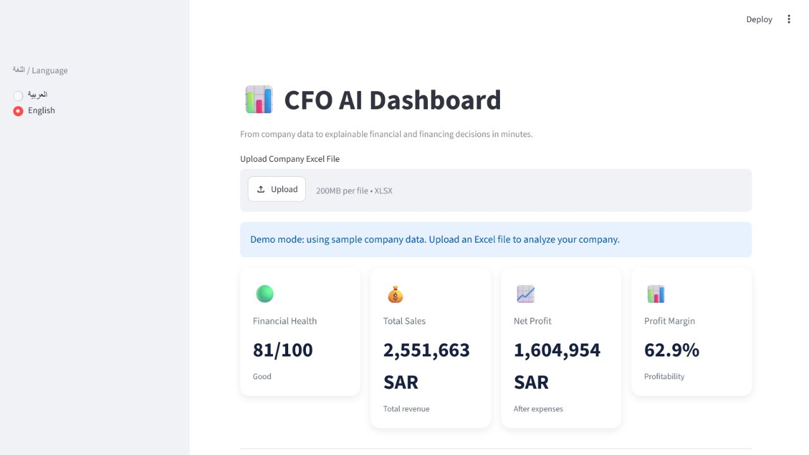
06
Dashboard & Financial Health
لوحة التحليل والصحة المالية
Key indicators: revenue, expenses, net profit, profit margin, financial health.
CFO AI PRO | AMAD Hackathon 2026
6

Slide 7
07
Bank Financing Readiness
الجاهزية التمويلية
Readiness Score
Explainability
Calculates a transparent score and grade using profitability, cost efficiency, collections, and financial stability.
Shows why the company received the score, what may prevent financing, and how to improve readiness.
Why this score?
What blocks financing?
How can the score improve?
Indicative financing limit
لماذا حصلت الشركة على الدرجة؟
ما الذي قد يمنع التمويل؟
كيف يمكن رفع الدرجة؟
حد تمويلي إرشادي
CFO AI PRO | AMAD Hackathon 2026
7

Slide 8
08
CFO AI Agent
الميزة الرئيسية
One-click CFO workflow
What judges should remember
The agent validates the file, reads the analysis, calculates health and readiness, runs forecast, ranks scenarios, creates a recommendation, and answers management questions.
CFO AI PRO is not just a dashboard. It is an AI-supported decision agent for finance teams, SMEs, and banks.
Validate Excel
Analyze Metrics
Forecast
Rank Scenarios
Recommend
Answer Questions
CFO AI PRO | AMAD Hackathon 2026
8

Slide 9
09
Hybrid AI Design
تصميم ذكي وآمن
Verified Financial Engine
Local AI with Ollama
Used for sensitive numeric questions: scores, financing readiness, risks, and decision ranking. It prevents hallucinated numbers.
Used for executive explanations, summaries, communication, and open-ended analysis. Data stays on the presenter's machine during the local demo.
Accurate numbers + private explanation
الأرقام الحساسة من محرك موثوق، والصياغة التنفيذية من ذكاء اصطناعي محلي.
CFO AI PRO | AMAD Hackathon 2026
9

Slide 10
10
Decision Simulator & Ranking
محاكاة وترتيب القرارات
Simulation
Ranking
Test changes before implementation: increase sales, reduce expenses, or hire employees.
Ranks the best scenarios using expected profit, financial health, execution risk, and confidence.
Recommended Action
Expected Impact
Why?
Risks
Management Advice
التوصية
الأثر المتوقع
السبب
المخاطر
نصيحة للإدارة
CFO AI PRO | AMAD Hackathon 2026
10

Slide 11
11
Executive Report & Outputs
المخرجات التنفيذية
Polished PDF Report
GitHub + Live Demo
Generates a clean executive report with health indicators, recommended scenario, impact, management advice, and disclaimer.
The repository includes README, screenshots, presentation files, Excel template, and the Streamlit live application link.
Live Demo: https://dcv7wnj96dqkafa7rb2ukc.streamlit.app
GitHub: https://github.com/shujanAL/CFO-AI-PRO
CFO AI PRO | AMAD Hackathon 2026
11

Slide 12
12
Technology Stack
التقنيات المستخدمة
Python
Streamlit
Pandas
Plotly
SQLite
OpenPyXL
ReportLab
Ollama
qwen2.5:3b
GitHub
VS Code
Architecture
A modular Python app: components for UI, engines for finance logic, utilities for Excel conversion, and report generation for executive output.
CFO AI PRO | AMAD Hackathon 2026
12

Slide 13
13
What Makes CFO AI PRO Different?
ما الذي يميز المشروع؟
Combines financial analytics and AI in one platform
Evaluates bank-financing readiness
Simulates decisions before implementation
Ranks the best options using evidence
Uses Local AI + Verified Financial Engine
Generates executive PDF reports
يجمع التحليل المالي والذكاء الاصطناعي
يقيم الجاهزية التمويلية
يحاكي القرارات قبل التنفيذ
يرتب أفضل الخيارات بالأدلة
يجمع بين ذكاء محلي ومحرك موثوق
ينتج تقريرًا تنفيذيًا
Thank you
Shujaan Almutairi
CFO AI PRO | AMAD Hackathon 2026
13

