Slide 1
Automatic Differentiation
Group 24:
Jessica Wijaya, Shujian Zhu, Malik Wagih, William Palmer

Slide 2
Introduction
Symbolical & Numerical Representation
Symbolical:
costly, hard to compute, closed form solution doesn’t always exist
Numerical:
stability issues, round-off or truncation errors
Solution: Automatic Differentiation
Wide range of applications
Motivates the implementation of our AutoDiff package
Application of Automatic Differentiation:
Root Finder
Methods included in the package:
Newton Method and Gradient Descent

Slide 3
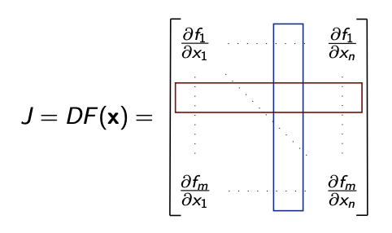
Background: Automatic Differentiation (Forward Mode)
Numerical computation: a combination of elementary operations for which the derivatives are known.
Derivatives of the overall composition can be found by combining the derivatives of elementary operations through the chain rule.
can be considered as the computation of the Jacobian-Vector product.
One sweep of the forward mode can calculate one column vector of the Jacobian
forward mode is very efficient to compute 𝐹:𝑅→𝑅^{𝑚}

Slide 4
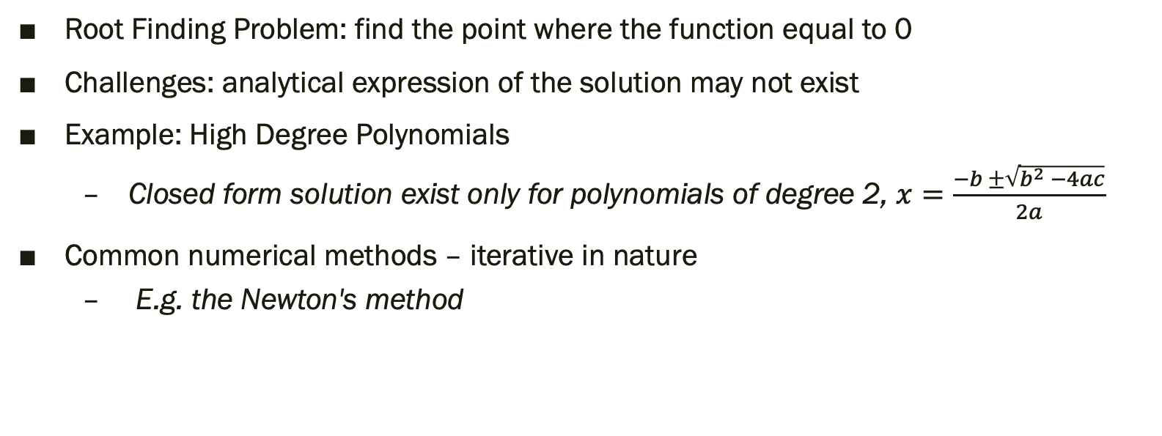
Background: Root Finding Algorithm
Root Finding Problem: find the point where the function equal to 0
Challenges: analytical expression of the solution may not exist
Example: High Degree Polynomials
Closed form solution exist only for polynomials of degree 2, $x=\frac{−b ±\sqrt{b^{2} −4ac}}{2a}$
Common numerical methods – iterative in nature
E.g. the Newton's method

Slide 5
Software Organization
The package has the following directory structure:
README.md
LICENSE.md
setup.py
requirements.txt
test/
_init_.py
test_AutoDiff.py
docs/
documentation.ipynb
milestone1.md
milestone2.ipynb
images/
AutoDiff/
_init_.py
AutoDiff_Class.py
rootfinding.py

Slide 6
How to Install
How to Install: pip install .
Import

Slide 7
How to use
Single variable input function with scalar input values

Slide 8
Example:
𝑓(𝑥)=−𝑥³+2𝑥²+3𝑥+5,
and we are trying to evaluate the value and derivative of at 𝑥=2.
Create and AutoDiff object and passed in the function of interest
Call .val to get the value of the function
Call .der or .derivative('x') to get the value of the derivative

Slide 9
Example:
𝑓(𝑥)=−𝑥³+2𝑥²+3𝑥+5,
and we are trying to evaluate the value and derivative of at 𝑥=2.
Create an AutoDiff object and passed in the function of interest
Call .val to get the value of the function
Call .der or .derivative('x') to get the value of the derivative

Slide 10
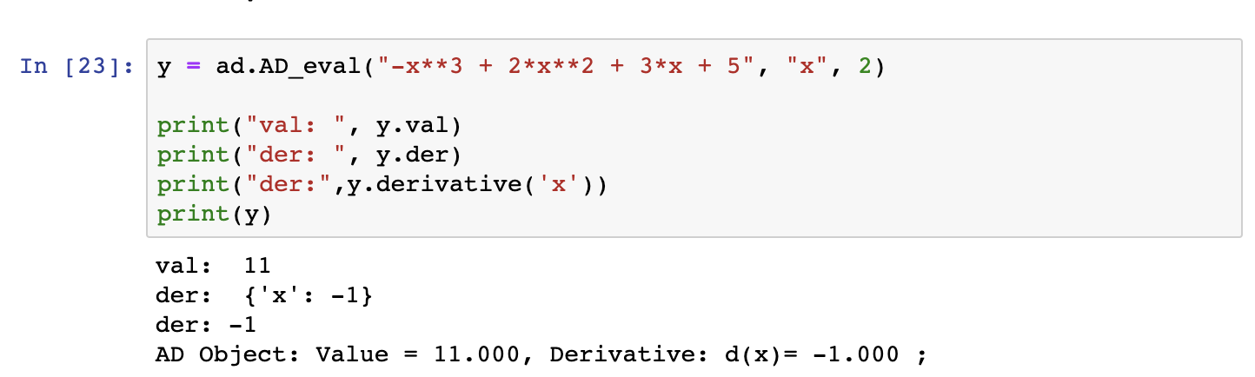
Example:
𝑓(𝑥)=−𝑥³+2𝑥²+3𝑥+5,
and we are trying to evaluate the value and derivative of at 𝑥=2.
Create an AutoDiff object and passed in the function of interest
Call .val to get the value of the function
Call .der or .derivative('x') to get the value of the derivative
AD_eval(function:str, variable_label:str¹, variable_value:float¹)
AD_object(variable_value:float, variable_label:string)

Slide 11
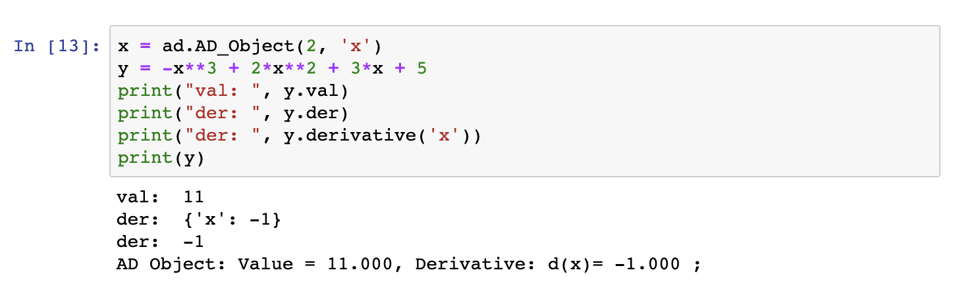
Example:
𝑓(𝑥)=−𝑥³+2𝑥²+3𝑥+5,
and we are trying to evaluate the value and derivative of at 𝑥=2.
Create an AutoDiff object and passed in the function of interest
Call .val to get the value of the function
Call .der or .derivative('x') to get the value of the derivative
AD_eval(function:str, variable_label:str¹, variable_value:float¹)
AD_object(variable_value:float, variable_label:string)

Slide 12
Example:
𝑓(𝑥)=−𝑥³+2𝑥²+3𝑥+5,
and we are trying to evaluate the value and derivative of at 𝑥=2.
Create an AutoDiff object and passed in the function of interest
Call .val to get the value of the function
Call .der or .derivative('x') to get the value of the derivative
AD_eval(function:str, variable_label:str¹, variable_value:float¹)
AD_object(variable_value:float, variable_label:string)

Slide 13
Example:
𝑓(𝑥)=−𝑥³+2𝑥²+3𝑥+5,
and we are trying to evaluate the value and derivative of at 𝑥=2.
Create an AutoDiff object and passed in the function of interest
Call .val to get the value of the function
Call .der or .derivative('x') to get the value of the derivative
AD_eval(function:str, variable_label:str¹, variable_value:float¹)
AD_object(variable_value:float, variable_label:string)

Slide 14
How to use
Multiple variable input function with scalar input values

Slide 15
Example:
𝑓(𝑥)=2𝑥²+2𝑦²
and we are trying to evaluate the value and derivative of at 𝑥=2 and 𝑦=3
Create and AutoDiff object and passed in the function of interest
Call .val to get the value of the function
Call .der or .derivative('x') to get the value of the derivative

Slide 16
Example:
𝑓(𝑥)=2𝑥²+2𝑦²
and we are trying to evaluate the value and derivative of at 𝑥=2 and 𝑦=3
Create an AutoDiff object and passed in the function of interest
Call .val to get the value of the function
Call .der or .derivative('x') to get the value of the derivative

Slide 17
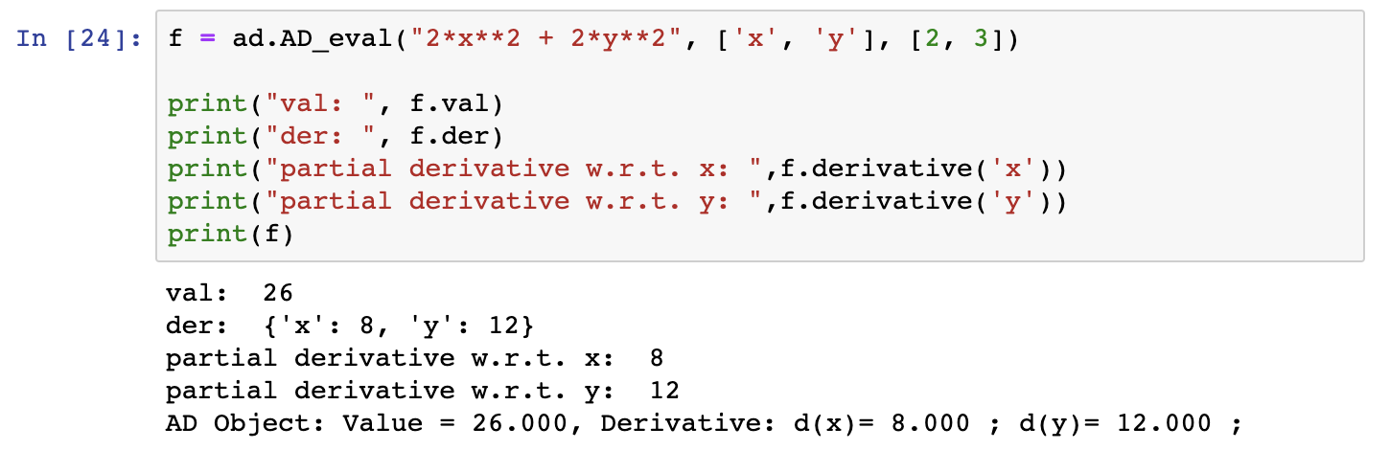
Example:
𝑓(𝑥)=2𝑥²+2𝑦²
and we are trying to evaluate the value and derivative of at 𝑥=2 and 𝑦=3
Create an AutoDiff object and passed in the function of interest
Call .val to get the value of the function
Call .der or .derivative('x') to get the value of the derivative
AD_eval(function:str, variable_label:str¹, variable_value:float¹)
AD_object(variable_value:float, variable_label:string)

Slide 18
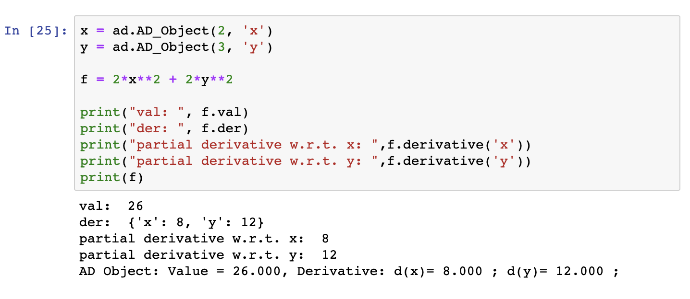
Example:
𝑓(𝑥)=2𝑥²+2𝑦²
and we are trying to evaluate the value and derivative of at 𝑥=2 and 𝑦=3
Create an AutoDiff object and passed in the function of interest
Call .val to get the value of the function
Call .der or .derivative('x') to get the value of the derivative
AD_eval(function:str, variable_label:str¹, variable_value:float¹)
AD_object(variable_value:float, variable_label:string)

Slide 19
Example:
𝑓(𝑥)=2𝑥²+2𝑦²
and we are trying to evaluate the value and derivative of at 𝑥=2 and 𝑦=3
Create an AutoDiff object and passed in the function of interest
Call .val to get the value of the function
Call .der or .derivative('x') to get the value of the derivative
AD_eval(function:str, variable_label:str¹, variable_value:float¹)
AD_object(variable_value:float, variable_label:string)

Slide 20
Example:
𝑓(𝑥)=2𝑥²+2𝑦²
and we are trying to evaluate the value and derivative of at 𝑥=2 and 𝑦=3
Create an AutoDiff object and passed in the function of interest
Call .val to get the value of the function
Call .der or .derivative('x') to get the value of the derivative
AD_eval(function:str, variable_label:str¹, variable_value:float¹)
AD_object(variable_value:float, variable_label:string)

Slide 21
How to use
Multiple variable input function with vector input values

Slide 22
Example:
𝑓(𝑥)=𝑠𝑖𝑛(𝑥)+𝑐𝑜𝑠(𝑦)
and we are trying to evaluate the value and derivative at 𝑥=[1,2,...10] and 𝑦=[11,12,...20]
Create an AutoDiff object using AD_Vector()
Create another variable, say y, as the function of interest, e.g. 𝑦=𝑓(𝑥)
Call .val to get the value of the function
Call .der or .derivative('x') to get the value of the derivative

Slide 23
Example:
𝑓(𝑥)=𝑠𝑖𝑛(𝑥)+𝑐𝑜𝑠(𝑦)
and we are trying to evaluate the value and derivative at 𝑥=[1,2,...10] and 𝑦=[11,12,...20]
Create an AutoDiff object using AD_Vector()
Create another variable, say y, as the function of interest, e.g. 𝑦=𝑓(𝑥)
Call .val to get the value of the function
Call .der or .derivative('x') to get the value of the derivative

Slide 24
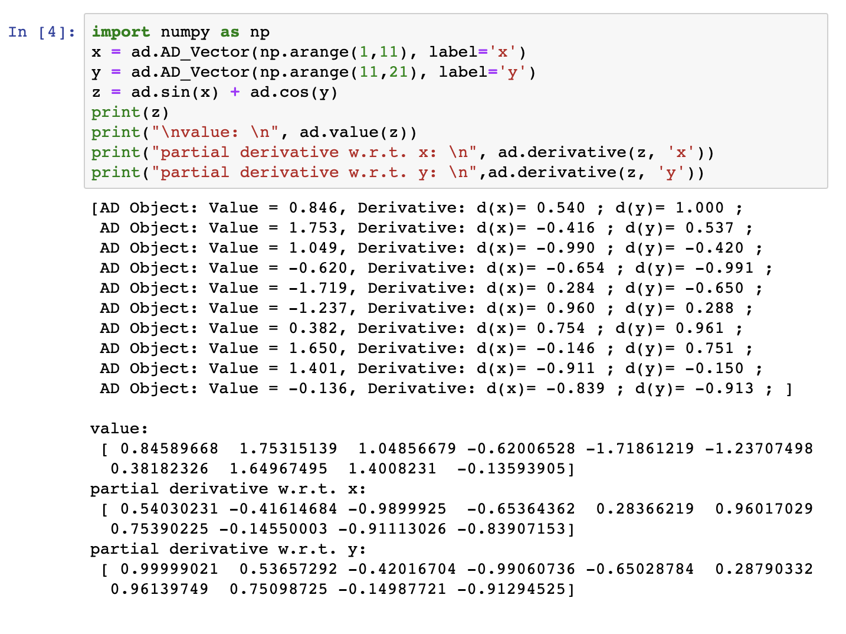
Example:
𝑓(𝑥)=𝑠𝑖𝑛(𝑥)+𝑐𝑜𝑠(𝑦)
and we are trying to evaluate the value and derivative at 𝑥=[1,2,...10] and 𝑦=[11,12,...20]
Create an AutoDiff object using AD_Vector()
Create another variable, say y, as the function of interest, e.g. 𝑦=𝑓(𝑥)
Call .val to get the value of the function
Call .der or .derivative('x') to get the value of the derivative
AD_Vector(values: list, label:string)

Slide 25
Example:
𝑓(𝑥)=𝑠𝑖𝑛(𝑥)+𝑐𝑜𝑠(𝑦)
and we are trying to evaluate the value and derivative at 𝑥=[1,2,...10] and 𝑦=[11,12,...20]
Create an AutoDiff object using AD_Vector()
Create another variable, say y, as the function of interest, e.g. z=𝑓(𝑥)
Call .val to get the value of the function
Call .der or .derivative('x') to get the value of the derivative
AD_Vector(values: list, label:string)

Slide 26
Example:
𝑓(𝑥)=𝑠𝑖𝑛(𝑥)+𝑐𝑜𝑠(𝑦)
and we are trying to evaluate the value and derivative at 𝑥=[1,2,...10] and 𝑦=[11,12,...20]
Create an AutoDiff object using AD_Vector()
Create another variable, say y, as the function of interest, e.g. z=𝑓(𝑥)
Call value(z) to get the value of the function at each point in the vector.
Call derivative(z, 'x') to get the derivative value at each point in the input vector.
AD_Vector(values: list, label:string)

Slide 27
Example:
𝑓(𝑥)=𝑠𝑖𝑛(𝑥)+𝑐𝑜𝑠(𝑦)
and we are trying to evaluate the value and derivative at 𝑥=[1,2,...10] and 𝑦=[11,12,...20]
Create an AutoDiff object using AD_Vector()
Create another variable, say y, as the function of interest, e.g. z=𝑓(𝑥)
Call value(z) to get the value of the function at each point in the vector.
Call derivative(z, 'x') to get the derivative value at each point in the input vector.
AD_Vector(values: list, label:string)

Slide 28
How to use
Vector function

Slide 29

Example:
𝑓(𝑥) = $\left[\begin{matrix}x−2 \\ x^{2}−1\end{matrix}\right]$
and we are trying to evaluate the value and derivative at 𝑥=[1,2,3]
Create an AutoDiff object using AD_Object() (or multiple objects using AD_Vector()
Create a variable for AD_FuncVector() and passed in the list of functions,
Call value(f) to get the function value for each of the function in the vector.
Call derivative(f, 'x') to get the derivative value for each of the function in the vector.

Slide 30
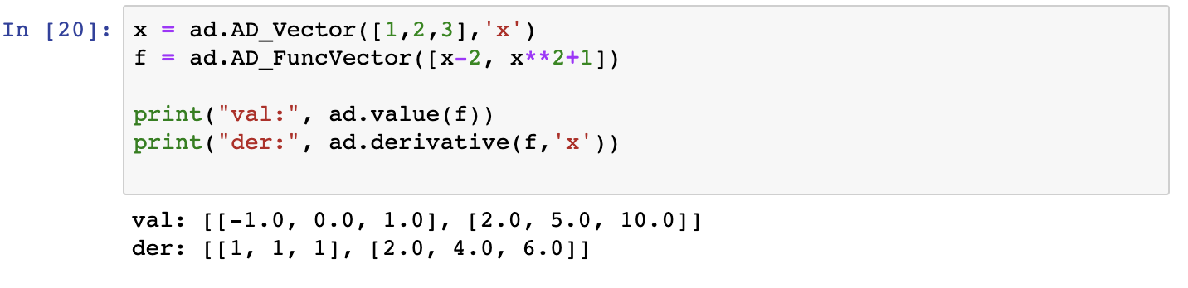
Example:
𝑓(𝑥) = $\left[\begin{matrix}x−2 \\ x^{2}−1\end{matrix}\right]$
and we are trying to evaluate the value and derivative at 𝑥=[1,2,3]
Create an AutoDiff object using AD_Object() (or multiple objects using AD_Vector()
Create a variable for AD_FuncVector() and passed in the list of functions,
Call value(f) to get the function value for each of the function in the vector.
Call derivative(f, 'x') to get the derivative value for each of the function in the vector.

Slide 31

Example:
𝑓(𝑥) = $\left[\begin{matrix}x−2 \\ x^{2}−1\end{matrix}\right]$
and we are trying to evaluate the value and derivative at 𝑥=[1,2,3]
Create an AutoDiff object using AD_Object() (or multiple objects using AD_Vector()
Create a variable for AD_FuncVector() and passed in the list of functions,
Call value(f) to get the function value for each of the function in the vector.
Call derivative(f, 'x') to get the derivative value for each of the function in the vector.

Slide 32

Example:
𝑓(𝑥) = $\left[\begin{matrix}x−2 \\ x^{2}−1\end{matrix}\right]$
and we are trying to evaluate the value and derivative at 𝑥=[1,2,3]
Create an AutoDiff object using AD_Object() (or multiple objects using AD_Vector()
Create a variable for AD_FuncVector() and passed in the list of functions,
Call value(f) to get the function value for each of the function in the vector.
Call derivative(f, 'x') to get the derivative value for each of the function in the vector.

Slide 33

Example:
𝑓(𝑥) = $\left[\begin{matrix}x−2 \\ x^{2}−1\end{matrix}\right]$
and we are trying to evaluate the value and derivative at 𝑥=[1,2,3]
Create an AutoDiff object using AD_Object() (or multiple objects using AD_Vector()
Create a variable for AD_FuncVector() and passed in the list of functions,
Call value(f) to get the function value for each of the function in the vector.
Call derivative(f, 'x') to get the derivative value for each of the function in the vector.

Slide 34
Implementation: Core Classes/Data Structures
AD_Object class: Core Class
Attributes:
Function value (self.val)
Derivative value (self.der)
Variable labels (self.label)
The user will be able to obtain the function value by calling .val
To obtain the derivative value(s), the user can call the class attribute .der or call the class method derivative(AD_Object, variable_label).

Slide 35
Implementation: Core Classes/Data Structures
AD_eval class: the helper class, to provide the user the convenience of implementing automatic differentiation (i.e. passing all the inputs) in a single line of code:
AD_eval(function:str, variable_label:string, variable_value:float)
Attributes:
Function expression (self.f)
Function value (self.val)
Derivative value (self.der)
the AD_Object object(s) initialized for each variable passed by the user
For input function w/ single variables, this will be self.x;
For input function w/ multiple variables, this will be stored in self.vars
When the user creates an instance of the AD_eval class and passes the 3 inputs, this object initialization will
evaluate the function string that the user passed in (using eval function), and
create instance(s) of AD_Object

Slide 36
Implementation: Core Classes/Data Structures
AD_Vector
Not a class on its own. Instead, AD_Vector is a function that will create AD_Object instances for each inputs in the vector.
The function takes in 2 inputs, as shown below:
AD_Vector(variable_value:float, variable_label:string)
This function will then initialize AD_Object’s for each value in the input vector.
Similar as explained before, AD_Object will then evaluate the function value and compute derivative value for these 𝑛 input values.

Slide 37
Implementation: Core Classes/Data Structures
AD_FuncVector
Not a class on its own. Instead, AD_FuncVector is a function that will create AD_Object instances for each inputs in the vector.
The function takes in 1 inputs, the function list, as shown below:
AD_Vector(function:list)
Need to first create an instance of AD_Object (or multiple instances with AD_Vector) and create a function expression using on these instances
This function will then initialize AD_Object’s for each value in the input vector. Then, AD_Object will then evaluate the function value and compute derivative value for these 𝑛 input values.

Slide 38

Basic functions:
addition(+),
subtraction(-),
multiplication(*),
division(/),
negation,
power (can be called by pow() or using **)
Elementary functions:
Trig functions:
sine: sin(x)
cosine: cos(x)
tangent tan(x)
Inverse Trig functions:
arcsine: arcsin(x),
arccosine: arccos(x),
arctangent: arctan(x)
Hyperbolic functions:
sinh: sinh(x)
cosh: cosh(x)
tanh: tanh(x)
logistic function: sigmoid(x, b_0=0, b_1=1)
logarithmic function: log(x)
exponential function: e(x)
square root: sqrt(x)
Comparison functions:
equal (== or __eq__): in addition to the same function value and derivative, the functions have to have the same variable label (e.g. 𝑓(𝑥)=𝑥≠𝑓(𝑤)=𝑤f(x)=x≠f(w)=w)
not equal (!= or __ne__): the opposite of the above condition for equal
greater than (> or __gt__): judged by the function value
less than (< or __lt__): judged by the function value
greater than or equal to (>= or __ge__): judged by the function value
less than or equal to (<= or __le__): judged by the function value

Slide 39
Implementation Details on AutoDiff Operations
Every variable that is passed by the user and is contained in the function given by the user will be initialized as an object instance of AD_Object, and every operation done on this object will create another AD_Object object with an updated function value and derivative.
We overide the dunder functions for basic operations (e.g. _add__, _radd_, _mul_, _rmul_, etc.), as well as for power (_pow_) and negation (_neg_).
For the elementary functions, we implemented the relevant functions as AD_Object's class methods and evaluated the value by using the numpy package.
In addition, we also created additional functions to handle power rule, product rule, and quotientrule, as helper functions to solve more complicated operations for computing the derivative.
Dependencies: numpy library (the only dependency of AutoDiff package)

Slide 40
Extension: root finding

Slide 41
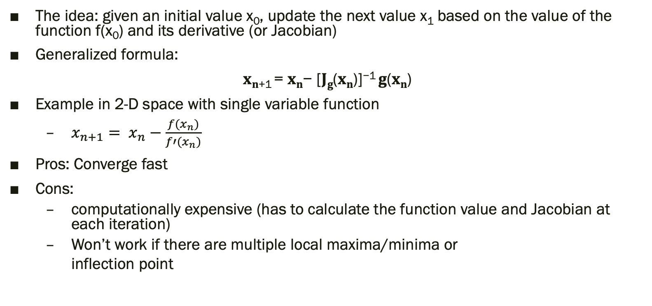
Background: Newton’s Method
The idea: given an initial value x₀, update the next value x₁ based on the value of the function f(x₀) and its derivative (or Jacobian)
Generalized formula:
𝐱_{𝐧+1} = 𝐱_{𝐧}− [𝐉_{𝐠}(𝐱_{𝐧})]⁻¹ 𝐠(𝐱_{𝐧})
Example in 2-D space with single variable function
$x_{n+1}= x_{n}−\frac{f(x_{n})}{f′(x_{n})}$
Pros: Converge fast
Cons:
computationally expensive (has to calculate the function value and Jacobian at each iteration)
Won’t work if there are multiple local maxima/minima or
inflection point

Slide 42
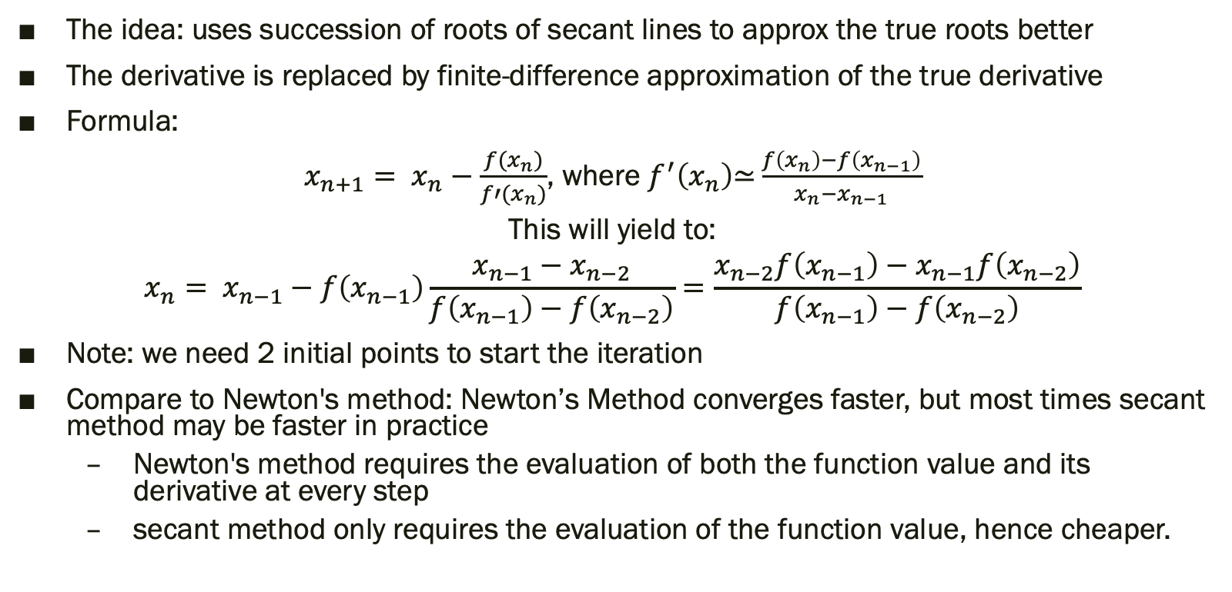
Background: Secant Method
The idea: uses succession of roots of secant lines to approx the true roots better
The derivative is replaced by finite-difference approximation of the true derivative
Formula:
$x_{n+1}= x_{n}−\frac{f(x_{n})}{f′(x_{n})}$, where $f^{′}\left(x_{n}\right)\text{≃}\frac{f\left(x_{n}\right)−f\left(x_{n−1}\right)}{x_{n}−x_{n−1}}$
This will yield to:
$$x_{n}= x_{n−1}−f\left(x_{n−1}\right)\frac{x_{n−1}−x_{n−2}}{f\left(x_{n−1}\right)−f\left(x_{n−2}\right)}=\frac{x_{n−2}f\left(x_{n−1}\right)−x_{n−1}f\left(x_{n−2}\right)}{f\left(x_{n−1}\right)−f\left(x_{n−2}\right)}$$
Note: we need 2 initial points to start the iteration
Compare to Newton's method: Newton’s Method converges faster, but most times secant method may be faster in practice
Newton's method requires the evaluation of both the function value and its derivative at every step
secant method only requires the evaluation of the function value, hence cheaper.

Slide 43
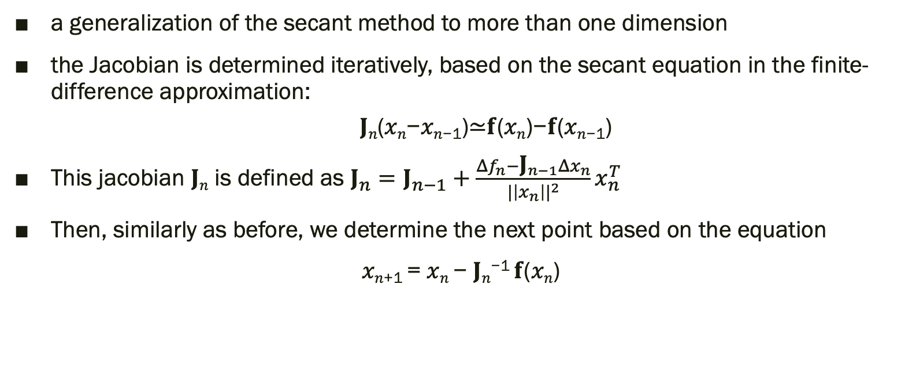
Background: Broyden Method
a generalization of the secant method to more than one dimension
the Jacobian is determined iteratively, based on the secant equation in the finite-difference approximation:
𝐉_{𝑛}(𝑥_{𝑛}−𝑥_{𝑛−1})≃𝐟(𝑥_{𝑛})−𝐟(𝑥_{𝑛−1})
This jacobian 𝐉_{𝑛} is defined as ${\text{J}}_{n}={\text{J}}_{n−1}+\frac{Δf_{n}−{\text{J}}_{n−1}Δx_{n}}{{|\left|x_{n}\right||}^{2}}x_{n}^{T}$
Then, similarly as before, we determine the next point based on the equation
𝑥_{𝑛+1} = 𝑥_{𝑛} − 𝐉_{𝑛}⁻¹ 𝐟(𝑥_{𝑛})

Slide 44
Implementation

Slide 45
Demo

