Slide 1


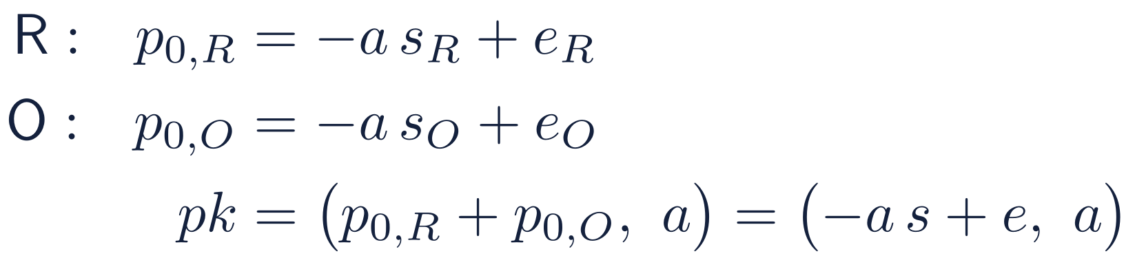
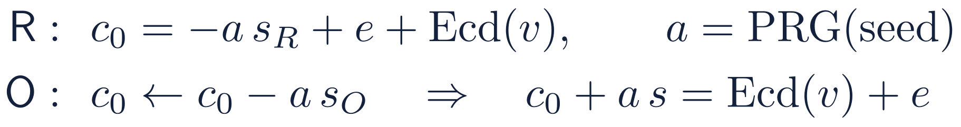
Threshold CKKS: one key, split between R and O
Nobody ever holds s = s_{R} + s_{O}, so neither party can decrypt on its own
CKKS in one box
Joint key generation (setup)
A ciphertext is a pair (c₀, c₁) of polynomials mod q. It packs a vector of N/2 = 8,192 real numbers (N = 2¹⁴), each scaled by Ω and rounded.
From a common random polynomial a, each party draws its own secret share and error, and publishes one polynomial:
Decryption with the secret key s:
What O can do with R's ciphertexts, holding no key:
Rotation keys for slot shifts 2^{i} are made the same way. Each share stays with its owner.
add them
multiply them by its own plaintext columns (x_{O}, y)
rotate slots, to sum a vector into one slot (EvalSum)
Upload under the joint key, at half the size
Depth 2 and no ciphertext × ciphertext products, so no relinearization key. Security rests on Ring-LWE: without s, c₀ looks uniformly random.
R sends c₀ and the short seed of a, not a itself. O's subtraction turns (c₀, a) into a ciphertext under s.
This is standard multiparty CKKS (Mouchet et al., 2021) with two parties and additive key shares. What is specific to us is how the decryption is used: next slide.
Notes:
CKKS encrypts vectors of real numbers: a ciphertext is a pair of polynomials, it holds 8,192 numbers at N = 2^14, and decryption is c0 + c1 s, which gives the encoded vector plus a small error. In our protocol O only adds ciphertexts, multiplies them by its own plaintext columns, and rotates slots to sum vectors, all without any key. The multiplicative depth is 2 and there are no ciphertext-by-ciphertext products, so no relinearization key is needed. The key is generated jointly, following Mouchet et al. 2021: from a common random a, R publishes -a s_R + e_R and O publishes -a s_O + e_O; the sum is a public key for s = s_R + s_O, a key that nobody holds. Rotation keys are made the same way. For the upload, R encrypts with its own share using a symmetric encryption whose random a comes from a seed, so it sends only c0 and the seed. O subtracts a times its share, which converts the ciphertext to the joint key. This is the standard multiparty construction with two parties.

Slide 2
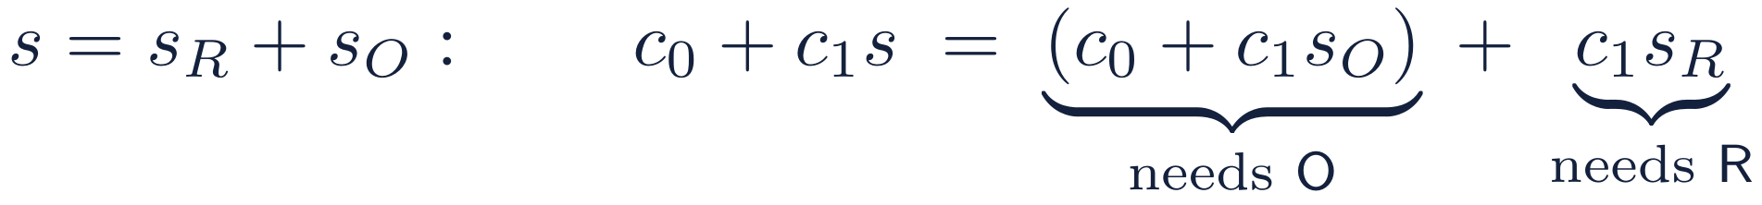
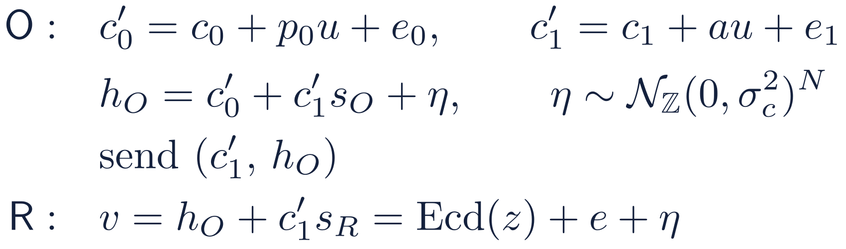
Threshold decryption, with the DP noise built in
O adds its key share and the noise in one step; R finishes the decryption and sees only noisy statistics
Decryption needs both shares:
Our release (phase 4)
1
Fresh u, e₀, e₁ every release
The evaluated c₁ depends on O's plaintext columns; adding au + e₁ makes c₁′ a fresh RLWE sample that looks uniform.
2
Add η inside O's share
η is the DP noise and also drowns the CKKS error e, up to 2⁻⁴⁰. It is fresh too, so two releases cannot be differenced.
3
Never send c₀′
With c₀′, R would get c₁′s_{O} exactly and could solve for s_{O}, since c₁′ is invertible.
O learns nothing. It never receives a decryption share from R, so every ciphertext it holds stays hidden by Ring-LWE.
R learns the noisy statistics. Plus a c₁′ that looks random, so its view can be simulated from the noisy statistics alone: the DP guarantee.
Notes:
Decryption is linear in the key, so it splits: c0 + c1 s_O needs O's share and c1 s_R needs R's. Neither party alone can decrypt. In our release O does three things. It re-randomizes the packed ciphertext with fresh u, e0, e1 under the joint public key: the evaluated c1 is computed from public values and O's plaintext columns, and R chose the random a, so without this step c1 could reveal O's data; after it, c1' is a fresh Ring-LWE sample. Then O computes its share of the decryption and adds the noise eta inside it: eta is the differential-privacy noise on the statistics and also hides the CKKS approximation error statistically. Finally O sends c1' and the noisy share, never c0': with c0', R could compute c1' s_O exactly and recover O's key share. R adds c1' s_R and gets the statistics plus noise. O learns nothing because it never receives a decryption share. R's view can be simulated from the noisy statistics alone, which is what makes the DP guarantee hold for R's whole view.

Slide 3
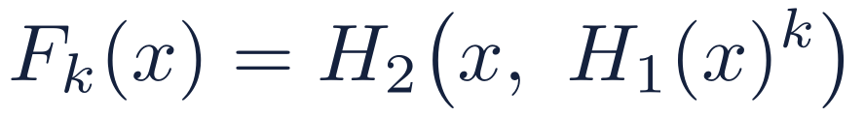

The OPRF: a keyed hash that needs O
R learns F_{k}(id) for its own ids; O never sees the ids, and R never sees the key k
2HashDH (RFC 9497); O's key k is fresh each run
Why it is safe
R
O
O sees α, a uniformly random group element: nothing about the id.
R gets F_{k} only for ids it sends. Without k it cannot compute F_{k} for any other id.
O answers exactly n_{R}^{max} queries per run (R pads with dummies) and logs them against a quota.
A fresh k every run, so F_{k} values from different runs cannot be linked.
α = H₁(id)^{r}, with r random
β = α^{k}
R unblinds: β^{1/r} = H₁(id)^{k}. That gives the item F_{k}(id), used for matching, and the label key F′_{k}(id).
Why we need it: identifiers such as social insurance numbers are a small, guessable space, so a plain hash could be inverted by trying every value. With the OPRF every evaluation needs O, so R cannot test ids offline, and the PSI messages carry no structure. Toy example: R holds 104, 221, 317, pads with dummy 9d1 to n_{R}^{max} = 4, and makes four calls.
Notes:
An oblivious pseudorandom function lets R compute a keyed hash of its identifiers under O's key without O seeing the identifiers and without R learning the key. We use 2HashDH, standardized in RFC 9497: hash the identifier into a group, raise it to the key k, and hash again. R blinds the group element with a random exponent r and sends alpha; O raises it to k; R removes r and applies the outer hash. The output is split into an item part for matching and a key part for opening labels. Alpha is uniformly random, so O learns nothing about the identifier. R only gets values for identifiers it sends, and cannot evaluate the function on anything else without k. R always sends exactly n_R^max queries, padding with dummies, and O logs them against a quota per researcher and project. We need this because identifiers are a small, guessable space: a plain hash could be inverted by brute force. The OPRF makes every membership test an online interaction with O. O draws a fresh key every run.

Slide 4
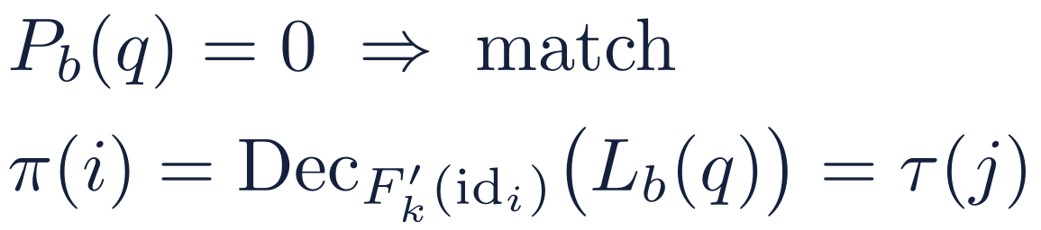
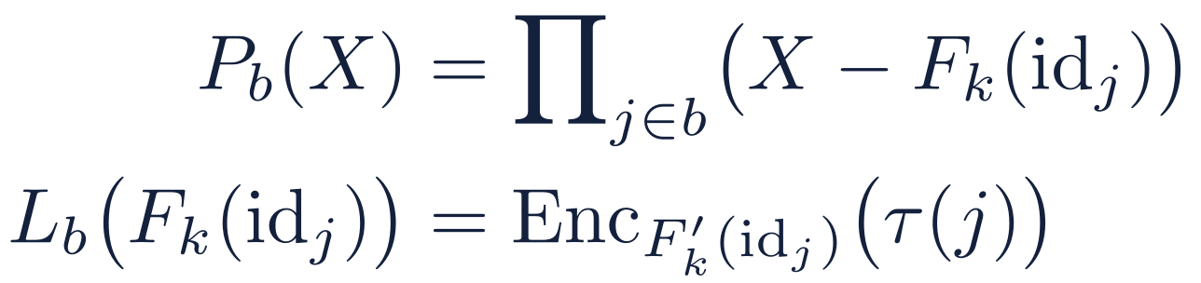
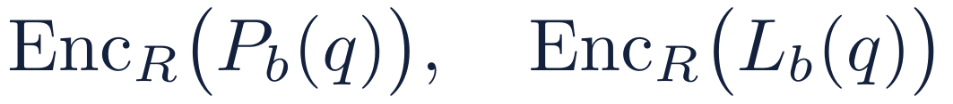
Labeled PSI: who matches, and where
R learns its match set I and positions π(i) = τ(j) in O's shuffled register; O learns only the padded sizes
1
O prepares
2
R asks, O evaluates
3
R decrypts
Pad the register to n̄_{O} with dummies and draw a fresh shuffle τ. Row j becomes the item F_{k}(id_{j}), labeled with its encrypted position. Hash the items into bins; per bin b:
R cuckoo-hashes its items, at most one per bin, encrypts them under its own BFV key, and sends their powers q, q², q⁴, … to keep the depth low. O evaluates every P_{b} and L_{b} under encryption and replies:
No match: P_{b}(q) ≠ 0 and the label value means nothing. The reply reveals nothing else about O's register.
Toy example
What each party learns
O's padded row j | 150 | 7e5 | 221 | 088 | 399 | 104
position τ(j) | 1 | 2 | 3 | 4 | 5 | 6
O: only n_{R}^{max} and n̄_{O}, both public.
R: I and the positions, which are uniformly random because τ is fresh. R needs both: I for its block A, the positions to line up its upload.
7e5 is O's dummy row. R queries 104, 221, 317 and its dummy 9d1: 104 matches with label 6 and 221 with label 3. So I = {104, 221}, π(104) = 6 and π(221) = 3.
Notes:
Labeled private set intersection, following Chen, Laine and Rindal and successors. O pads its register to the public size with dummy rows and draws a fresh secret shuffle tau. Each row becomes an item, its OPRF value, with a label: the row's position in the shuffle, encrypted under the row's label key. O hashes the items into bins and, for each bin, interpolates a membership polynomial whose roots are the items and a label polynomial that maps each item to its encrypted label. R cuckoo-hashes its own items so each bin holds at most one, encrypts them under its own BFV key, and sends powers of them so that O can evaluate high-degree polynomials at low depth. O evaluates both polynomials under encryption and replies. R decrypts: a zero membership value means a match, and then the label value decrypts, under the item's label key, to the row's position. In the toy example, 104 and 221 match with positions 6 and 3. O learns only the padded sizes. R learns the match set and the positions; the positions are uniformly random because the shuffle is fresh. R needs the match set to compute its own block A, and the positions to line up its data with O's rows in the upload.

