Slide 1

Privacy-Preserving Vertical Federated Linear Regression
R
O
When the organization holds the response: protocol, privacy analysis and evaluation
Working draft · September 2026
Notes:
Two-party linear regression between a researcher and a national statistical agency, where the agency holds the outcome. We cover the problem, what we found when reviewing the draft protocol, the revised protocol, and results so far.

Slide 2
1
The problem
Joint regression across data that cannot be pooled
Notes:
Part 1: motivation, data layout, goal and privacy requirements.

Slide 3


Two datasets, one question, no pooling
Researcher R
Organization O (e.g. StatCan)
Smaller cohort with rich domain variables: health, education, surveys
Wants to know whether these predict an administrative outcome
Holds features X_R and identifiers
Population register: tax filings, income, benefits
Holds the outcome y and features X_O
Cannot release records; law and governance bar direct sharing
6–8 weeks
of vetting and approvals today before a researcher can link a cohort to agency records in a Research Data Centre. Neither dataset alone answers the question.
Notes:
The motivating setting: a researcher cohort and an agency register cover overlapping people but different variables. Today, linking them takes weeks of vetting in an RDC.

Slide 4
Same people, different variables
Vertically partitioned data: overlapping rows, disjoint columns
O: register (n_O rows, n_O ≫ n_R)
Goal
R: cohort (n_R rows)
Fit y on [X_R | X_O] over the n matched individuals
Neither party sees the other's raw data
O must not learn which of its records are in R's cohort
The released model must not expose individuals
n
matched
X_R
X_O
y
Notes:
Rows are people, columns are variables. The two tables overlap only on the matched individuals; the register is far larger than the cohort.

Slide 5
What has to be computed
OLS on the matched join needs a Gram matrix that spans both parties
β̂ = (ZᵀZ)⁻¹ Zᵀy, Z = [ X_Rᴵ | X_Oᴵ ]
A
X_Rᵀ X_R
C
X_Rᵀ X_O
c_R
X_Rᵀ y
R alone: exact, never leaves R
O's data, but only on matched rows (needs b)
Cross-party: needs both parties' data
C^{T}
B
X_Oᵀ X_O
c_O
X_Oᵀ y
Only A is purely R's. Everything that touches O's data is computed under R's encryption key and noised by O before R sees it.
ZᵀZ
Zᵀy
Notes:
The Gram matrix splits into blocks. A is the researcher's own; B and c_O are the organization's data restricted to matched rows; C and c_R are genuinely cross-party.

Slide 6




Three guarantees, honest-but-curious parties
Input privacy
Linkage privacy
Output privacy
Each party's view can be simulated from its own input and the agreed output. Neither sees the other's raw data.
O learns nothing about which of its records match R's cohort (only public sizes).
What R receives is differentially private for each matched person's O-side data (x_O, y), with R's features held fixed (replace-one).
Parties follow the protocol but analyse everything they receive. R holds all decryption keys and learns the match set by design; O controls the privacy budget.
Notes:
Threat model: semi-honest. Three guarantees: cryptographic input privacy, linkage privacy for the organization, and differential privacy on what the researcher receives.

Slide 7
Where this work sits
Approach | Where the data sit | Record linkage | Output privacy | Gap for our setting
Central DP regression (AdaSSP, Wang 2018) | One trusted curator holds the joined table | Not needed | DP | Assumes the pooled data exist
VFL with HE (e.g. Yang et al. 2019) | Split across parties | Assumed or separate PSI | Usually none | Model can leak individuals
Private set intersection (Chen–Laine–Rindal) | Split across parties | Yes | Not applicable | Linkage only, no model
This work | Split; never pooled | Labeled PSI, private to O | DP, budget controlled by O | Narrower guarantee: protects O's side; R learns membership
Same statistical engine as AdaSSP (perturb the sufficient statistics, then solve a ridge), delivered without pooling, and with R's own block kept exact.
Notes:
Central DP regression assumes a pooled table; VFL-with-HE work usually lacks output privacy; PSI gives linkage only. We combine private linkage, encrypted aggregation and DP.

Slide 8






2
What we did
Reviewed the draft, found what breaks, and rebuilt it
1. Review
2. Run
3. Attack
4. Redesign
5. Simulate
6. Benchmark
Draft paper and code checked line by line
End-to-end over sockets: plaintext and real OpenFHE
Three privacy reviews plus an independent critique
Revised protocol, TikZ figure, rewritten paper
Accuracy and bias-correction studies
AdaSSP on 29 of Wang's UCI datasets
Notes:
Part 2. The sequence of work: review, running the implementation, adversarial privacy reviews, redesign, simulations, and the AdaSSP benchmark.

Slide 9
Critical finding: the noise did not protect the ciphertext
100%
Why
Fix
The draft added the noise as a plaintext scalar, which changes only c₀
c₁ is a deterministic function of R's own ciphertexts, keys and O's data
R, who holds the key, recomputes c₁ for each candidate dataset and compares
Add a fresh encryption of the noise, which re-randomizes c₁
Switch to the last modulus level, then flood the error term
BFV linkage replies: statistical flooding; CKKS: DP-calibrated flooding
of trials in which R identified the true dataset from O's reply: matched and unmatched records alike (real OpenFHE, 20/20).
73%
the most that ε = 1 differential privacy allows.
Notes:
The most important finding. The DP argument reasoned about the decrypted value, but R holds the key and sees the whole ciphertext. With plaintext-scalar noise, the c1 component is independent of the noise.

Slide 10
Review scorecard
Finding | Severity | Status in the revised protocol
Plaintext-scalar noise leaks through the ciphertext | Critical | Fixed: fresh encryption plus flooding
Calibration step shares raw-data statistics | Critical | Fixed: per-party commitments, public constants only
Add/remove sensitivity vs replace-one adjacency (true ε up to ~2× the claim) | High | Fixed: replace-one Δ, closed form
No privacy ledger across runs | High | Fixed: zCDP ledger at O
PSI reveals O's row order and bin loads | High | Fixed: secret permutation, public padding
Adaptive λ cancels the bias correction | Validity | Fixed: λ set from public inputs
CKKS slot leak; HE parameter security | Checked | Not an issue with OpenFHE
R learns which of its cohort are in the register | By design | Stated in Definition 4
Notes:
Summary of findings across the code review, three privacy reviews and an independent critique, with how the revised protocol handles each.

Slide 11
Contributions
1
Corrected data flow
2
Revised protocol
R's Gram block A is computed locally, is never sent and never noised. The sensitivity loses its B_R⁴ term.
Sanitized replies, replace-one DP, zCDP ledger, per-party calibration, hardened PSI, ridge fixed from public inputs.
3
Theory
4
Evaluation
Finite-noise bias as a conditional expectation, a zero-budget correction, and a closed-form replace-one sensitivity.
End-to-end runs, simulation studies of accuracy and of the correction, and a benchmark against AdaSSP.
Notes:
Four contributions: the corrected data flow, the revised protocol, the theory, and the evaluation.

Slide 12
3
Methodology
The revised protocol, phase by phase
Notes:
Part 3: how the revised protocol works.

Slide 13
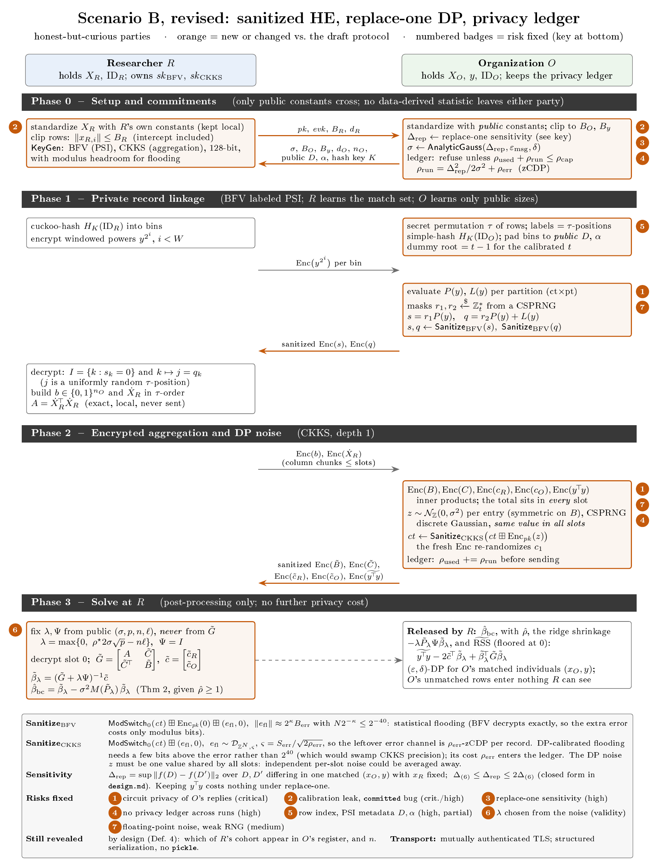
The protocol at a glance
0
Setup and commitments
Only public constants cross
1
Private linkage
BFV labeled PSI; R learns the match set
2
Encrypted aggregation
CKKS, depth 1; DP noise added by O
3
Solve at R
Fixed ridge, bias correction; post-processing
Orange in the figure marks what changed from the draft.
Notes:
Four phases. The figure on the right is the full message flow with the risks each step fixes.

Slide 14
Phases 0–1: commitments and private linkage
0
Setup and commitments
1
Labeled PSI with alignment
R: standardizes with its own constants (kept), clips rows to B_R, generates BFV and CKKS keys
O: standardizes with public constants, clips to B_O and B_y
O computes Δ_rep and σ, and refuses the run if the ledger would exceed its cap
Only public constants cross: no quantiles, clip rates or sample moments
O applies a secret permutation τ, so labels are random positions
Keyed hashing; bins padded to a public degree D and count α
R cuckoo-hashes its IDs and sends encrypted windowed powers
O evaluates membership and label polynomials, masks, and sanitizes
R learns I and the aligned positions; O learns only public sizes
Notes:
Phase 0 exchanges only committed public constants. Phase 1 is labeled PSI in the Chen–Laine–Rindal style, hardened with a secret permutation, public padding and flooded replies.

Slide 15

Phase 2: encrypted aggregation
O multiplies R's encrypted vectors by its own plaintext columns (depth 1)
Enc(B_jk) = Σᵢ Enc(bᵢ) · X_O,ij · X_O,ik
Enc(C_jk) = Σᵢ Enc(Ẋ_R,ij) · X_O,ik
Enc(c_O,k) = Σᵢ Enc(bᵢ) · X_O,ik · yᵢ
Enc(c_R,j) = Σᵢ Enc(Ẋ_R,ij) · yᵢ
A = Ẋ_Rᵀ Ẋ_R stays with R
Exact, never transmitted, never noised.
One noise draw per entry
z is the same in every CKKS slot. Independent noise per slot could be averaged away.
b: selection vector; Ẋ_R: R's features in O's order (zero off the match set)
Each released entry: ct ← Sanitize_CKKS( ct ⊞ Enc_pk(z) ), z ~ discrete Gaussian N_ℤ(0, σ²) from a CSPRNG
Notes:
The four O-dependent blocks are depth-one inner products. The DP noise is a single value per released entry, replicated across slots, added by fresh encryption and then sanitized.

Slide 16


Calibrating the noise, and keeping count
Replace-one sensitivity
σ from the analytic Gaussian
The adjacency replaces one matched person's (x_O, y). The draft used the add/remove bound, which understates Δ.
Smallest σ meeting (ε, δ) for the whole stacked release (Balle–Wang). Discrete Gaussian at the CKKS resolution.
(B_R, B_O, B_y) | Δ_add | Δ_rep | Ratio
(1, 1, 1) | 2.24 | 3.16 | 1.41
(3.16, 3, 3) | 20.6 | 29.4 | 1.43
(√5, √5, 5) | 30.4 | 31.6 | 1.04
Simulation population | 58.2 | 86.2 | 1.48
zCDP ledger at O
ρ_run = Δ²/2σ² + ρ_err. O refuses a run once the cumulative spend would pass its cap. Re-runs, retraining and inference queries all count.
Δ_add ≤ Δ_rep ≤ 2Δ_add. Releasing yᵀy costs nothing under replace-one.
Notes:
The draft's sensitivity bound was for add/remove adjacency; our adjacency is replace-one, which needs up to twice the Δ. The ledger makes re-runs compose under an explicit cap.

Slide 17
Sanitizing O's replies (circuit privacy)
R holds the key, so every reply must reveal nothing beyond its decrypted value
1
Fresh encryption
2
Modulus switch
3
Flood the error
ct ⊞ Enc_pk(z) makes c₁ computationally uniform: it no longer depends on O's data.
Drop to the last level, which scales down the data-dependent error.
BFV: statistical flooding with N·2^−κ ≤ 2^−40. CKKS: DP-calibrated flooding with width ς = S_err / √(2ρ_err).
Why DP-calibrated flooding for CKKS
Open proof obligation
Classical 2⁴⁰ flooding would swamp CKKS precision. A DP-sized flood needs only a few bits above the error; its cost joins the ledger.
An explicit bound on S_err, how much one record can change the ciphertext error, for the exact encoding and key switching.
Notes:
Three sanitization steps. The CKKS flooding is sized as a DP mechanism in the style of Li, Micciancio, Schultz and Sorrell, so it costs a small ledger entry instead of 40 bits of precision.

Slide 18
Phase 3: fixed ridge and zero-budget bias correction
Ridge, fixed before decryption
Theorem (conditional bias)
λ = max{ 0, 2ρ*σ√p − nℓ }, Ψ = I
E[ β̃ | ℰ_η ] − β̂ = σ² M(P) β̂ + O(σ⁴) + O(exp(−p(ηρ−1)²/2))
Release gate
M(P) = (P² + tr(P)P − P diag(P)) Π_O + (P Π_O P + tr(Π_O P) P) Π_R
ρ̂ = λ_min(G̃ + λI) / (2σ√p) ≥ 1
The plain mean does not exist, hence the conditioning on ℰ_η.
Private ridge estimate
β̃_λ = (G̃ + λI)⁻¹ c̃
Why λ must not depend on the noise
Bias-corrected estimate
Chosen from G̃, λ moves with the noise. The correction then removed none of the bias (1.0–1.6× left); with fixed λ it removes 87–98%.
β̂_bc = β̃_λ − σ² M(P̃_λ) β̃_λ
Notes:
R fixes the ridge from public inputs, decrypts, splices in its exact block, solves, and applies the second-order bias correction. The theorem is stated conditionally because the unconditional mean does not exist.

Slide 19



How we evaluate
Simulation population
Monte Carlo
Features on real-world scales (income, age, binary indicators, counts), correlated. Public standardization constants; committed 99.5% bounds; R² ∈ {0.3, 0.5, 0.9}.
n from 100 to 100k matched records; ε ∈ {0.5, 1, 2, 4, 8}, δ = 10⁻⁵; 200 replicates, each with new data and a new DP release.
Metrics
Benchmark
RMSE against the true β (standardized); per-coefficient efficiency ratio; interval coverage; MSE ratio corrected/uncorrected.
29 UCI datasets from Wang's published run, with his preprocessing; AdaSSP as published and under our guarantee; 10-fold test MSE.
Notes:
Simulations use a known population so the true beta, public constants and committed bounds are all data-independent. The benchmark uses Wang's datasets.

Slide 20
4
Results
What we have so far, and what is still to run
Notes:
Part 4: results. Slides marked as placeholders are still to be run.

Slide 21
The cryptographic layer is exact
Draft protocol, run end-to-end over sockets with plaintext and real OpenFHE backends
0
≈10⁻¹⁰
13.8 s
misaligned rows
max |β − β_OLS|
end-to-end on OpenFHE
PSI recovered exactly the true match set in all 6 cohorts, plaintext and OpenFHE
with the noise switched off: encryption adds no error
n_O = 4,000 records, n = 400 matched (plaintext backend: 3.2 s)
All error comes from the DP noise and the ridge it forces. The revised protocol's sanitization has not been implemented in OpenFHE yet (see the placeholder slide).
Notes:
Correctness of linkage and aggregation: exact alignment and 1e-10 agreement with plaintext OLS when noise is off.

Slide 22
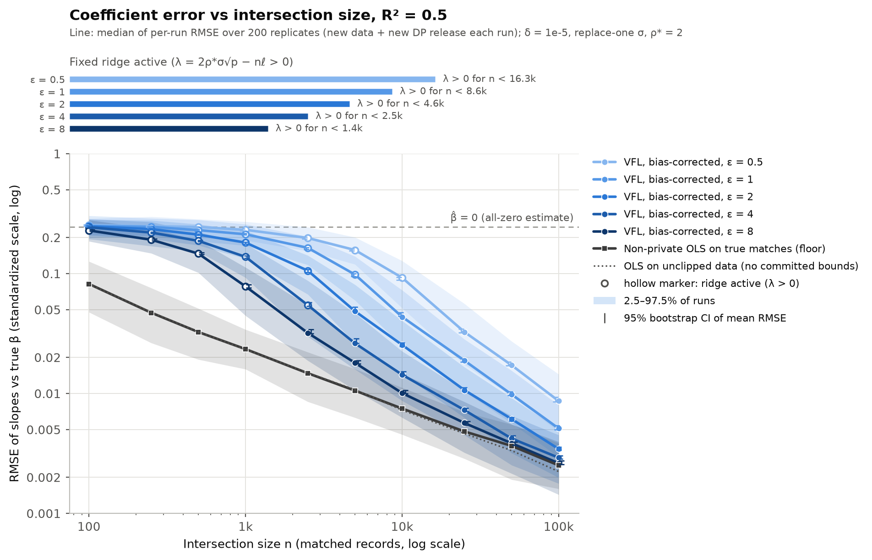
Accuracy against intersection size
Within 2× of non-private OLS at
ε = 8
n ≈ 3.2k
ε = 4
n ≈ 9.4k
ε = 2
n ≈ 34k
ε = 1
n ≈ 105k
Small n: the ridge shrinks β̂ towards 0
Then the DP error falls like 1/n and merges into the OLS floor
Run-to-run spread is about ×2.5–3
Notes:
Median RMSE over 200 runs, with the 2.5–97.5% band across runs and the non-private OLS floor. R-squared 0.5.

Slide 23
Key numbers
Median RMSE of the standardized slopes against the true β (ratio to the OLS floor), R² = 0.5
n | ε = 0.5 | ε = 1 | ε = 2 | ε = 4 | ε = 8 | OLS floor
1,000 | 0.231 (9.9×) | 0.213 (9.1×) | 0.181 (7.7×) | 0.138 (5.9×) | 0.078 (3.3×) | 0.023
10,000 | 0.092 (12×) | 0.044 (5.8×) | 0.025 (3.4×) | 0.014 (1.9×) | 0.010 (1.3×) | 0.0075
100,000 | 0.0087 (3.4×) | 0.0051 (2.0×) | 0.0034 (1.4×) | 0.0029 (1.2×) | 0.0026 (1.0×) | 0.0025
n at which VFL comes within 2× of the OLS floor
R² | ε = 0.5 | ε = 1 | ε = 2 | ε = 4 | ε = 8
0.3 | ≈240k* | 75k | 21k | 7.1k | 1.9k
0.5 | ≈380k* | ≈105k* | 34k | 9.4k | 3.2k
0.9 | >100k | >100k | 66k | 30k | 13k
* extrapolated beyond n = 100k
Notes:
Numbers behind the figure. A stronger signal lowers the OLS floor, but the DP part is set by the committed bounds, so the ratio is largest at high R-squared.

Slide 24
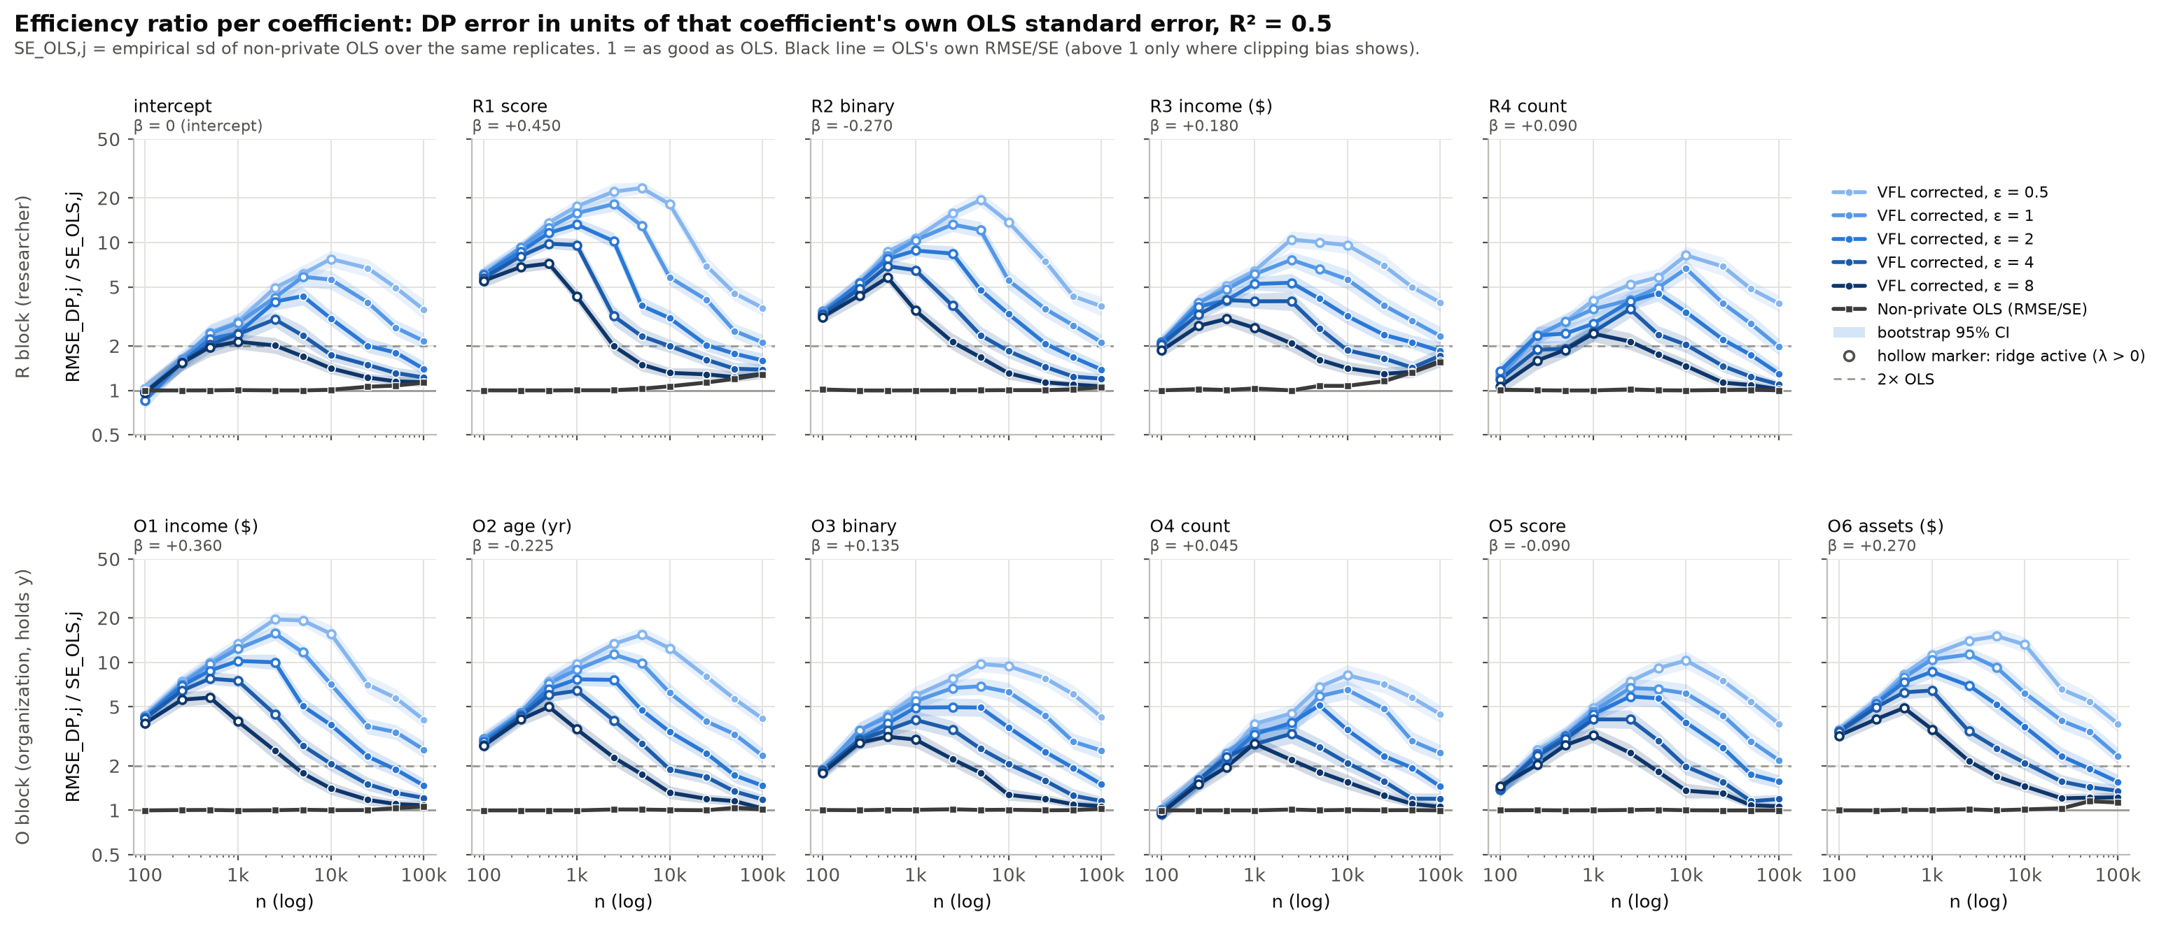
Comparing coefficients on different scales
Raw scale
Efficiency ratio
Result
Coefficients span 5.6 orders of magnitude (≈$0.2 per $ income vs ≈$10k per binary). A pooled raw RMSE is 87% driven by two binary coefficients.
RMSE_DP,j / SE_OLS,j: unit-free. A ratio r means the release is about as accurate as OLS on n/r² records.
Once the ridge is off, DP costs about the same for every coefficient (±15%); O-side coefficients run ~10% higher.
Notes:
Per-coefficient view. Raw RMSE is meaningless across coefficients because of units; the efficiency ratio compares each coefficient against its own sampling error.

Slide 25
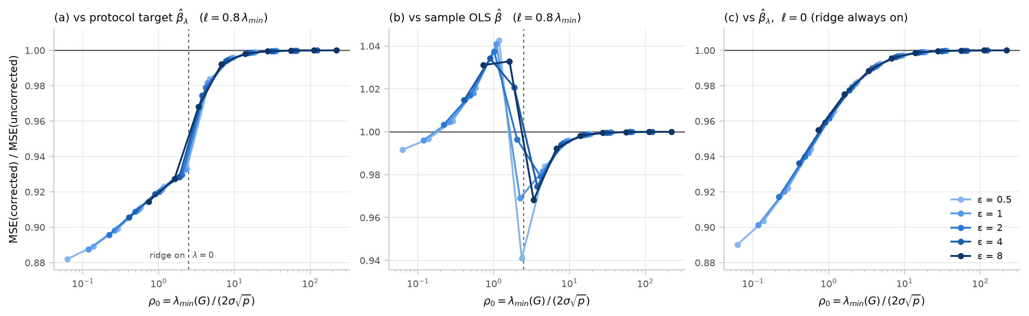
Does the bias correction matter?
−7 to −12%
+0.3 to +4.3%
≥ 130
MSE vs the protocol target when the ridge is on. The correction also shrinks noise; it never raised this MSE (90 settings).
MSE vs OLS under a moderate ridge: the correction restores shrinkage that noise had offset.
averaged releases before the bias alone would matter; one release: at most 0.75% of MSE.
Notes:
Answer to the reviewer: not as a bias correction; the removed bias is tiny. It is still worth applying as a free variance reduction. Rule: apply to every release that passes the gate.

Slide 26
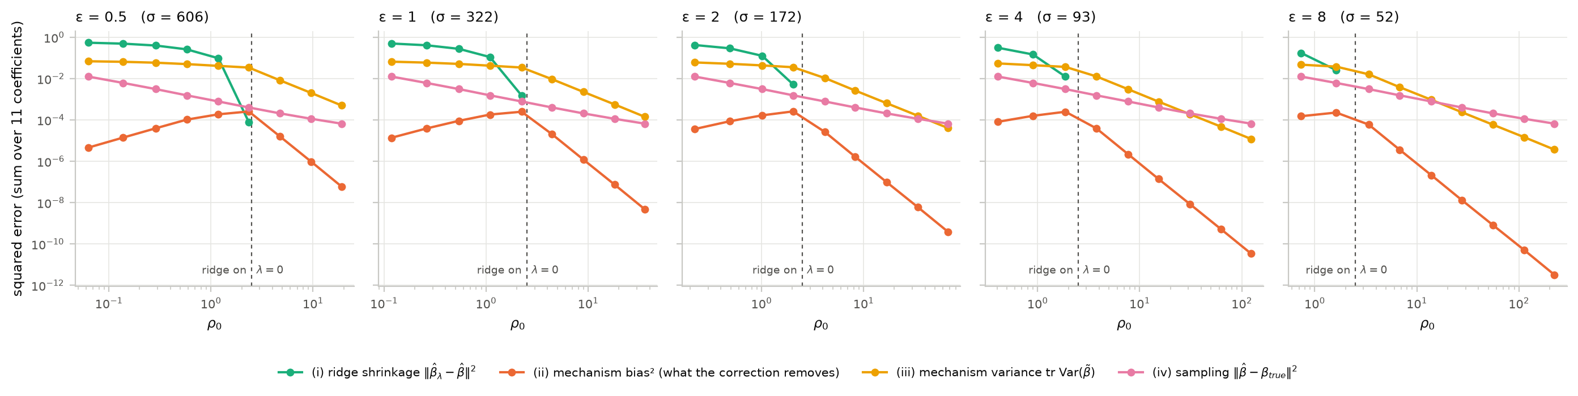
Where the error comes from when σ is large
Error anatomy
Inference
Heavy ridge: 72–90% of the error is shrinkage, 11–31% noise variance
Mechanism bias²: at most 0.75% anywhere
λ = 0: 95% intervals cover 0.94–0.96; SEs within 1–3% of the truth
Ridge on: coverage collapses. Clipping shifts the target at large n (every DP method pays this)
Notes:
When sigma is large, the ridge's shrinkage dominates. Intervals are reliable only when the ridge is off, and at large n clipping to the committed bounds moves the target.

Slide 27
Benchmark against AdaSSP (Wang 2018)
Test MSE at ε = 1, δ = 10⁻⁶, 10-fold CV. Ratio to non-private in brackets; bold = best private method
Dataset | n | d | Non-private | AdaSSP (published) | AdaSSP (matched) | VFL, ours | VFL, uncorrected
housing | 506 | 13 | 0.0396 | 0.0713 (1.80×) | 0.0819 (2.07×) | 0.0779 (1.97×) | 0.0773 (1.95×)
wine | 1,599 | 11 | 0.0201 | 0.0338 (1.68×) | 0.0391 (1.95×) | 0.0370 (1.84×) | 0.0368 (1.83×)
airfoil | 1,503 | 5 | 0.0533 | 0.0579 (1.09×) | 0.0625 (1.17×) | 0.0617 (1.16×) | 0.0616 (1.16×)
concrete | 1,030 | 8 | 0.0444 | 0.0657 (1.48×) | 0.0774 (1.74×) | 0.0751 (1.69×) | 0.0745 (1.68×)
bike | 17,379 | 17 | 0.0279 | 0.0288 (1.03×) | 0.0299 (1.07×) | 0.0295 (1.06×) | 0.0295 (1.06×)
elevators | 16,599 | 18 | 0.00868 | 0.0131 (1.51×) | 0.0154 (1.78×) | 0.0149 (1.71×) | 0.0147 (1.70×)
pol | 15,000 | 26 | 0.135 | 0.140 (1.04×) | 0.146 (1.08×) | 0.144 (1.06×) | 0.143 (1.06×)
kin40k | 40,000 | 8 | 0.0632 | 0.0633 (1.00×) | 0.0633 (1.00×) | 0.0633 (1.00×) | 0.0633 (1.00×)
protein | 45,730 | 9 | 0.119 | 0.120 (1.01×) | 0.120 (1.01×) | 0.120 (1.01×) | 0.120 (1.01×)
Published AdaSSP protects the whole record, a stronger guarantee than ours, and uses Wang's noise constants: at ε = 1 its per-entry noise on XᵀX (11.9) is below ours (13.4), which is still to be checked. Matched = AdaSSP's adaptive λ under our guarantee; idealized, since its λ_min step needs XᵀX in the clear.
Notes:
From reports/adassp/results.csv. Our protocol beats the matched AdaSSP on every dataset here and is within a few percent of published AdaSSP at large n; published AdaSSP is ahead on the small datasets at eps = 1. Our AdaSSP re-implementation reproduces Wang's published MSE (median ratio 1.000 over 29 datasets and 10 values of eps).

Slide 28
Across privacy levels
Test MSE ÷ non-private, three datasets of increasing size; bars: 95% CI of the mean over the 10 folds
Trivial (θ = 0)
AdaSSP (published)
AdaSSP (matched)
VFL, ours
Ours better / worse (of 29) | ε = 0.1 | ε = 1 | ε = 10
vs AdaSSP (published) | 14 / 8 | 6 / 19 | 1 / 21
vs AdaSSP (matched) | 27 / 0 | 27 / 0 | 21 / 3
Bias-corrected vs uncorrected | 14 / 8 | 6 / 19 | 3 / 19
At small ε the fixed ridge wins: AdaSSP spends a third of its budget on λ_min. From ε ≈ 0.5 AdaSSP's adaptive ridge wins (median 4% lower MSE at ε = 1); the gap shrinks as n grows.
Paired over folds, 95% CI; the rest show no significant difference.
Notes:
Native charts from reports/adassp/results.csv; paired verdicts from reports/adassp/all/compare.csv (all 29 datasets of Wang's published run, R = 50 draws per fold; a verdict needs the 95% CI of the paired fold difference to exclude 0). The bias correction changes test MSE by -2.8% to +2.3%: it helps at small eps and slightly hurts at large eps.

Slide 29

Still to run
Cost of the revised protocol in OpenFHE
n_O | d | PSI (s) | Agg. (s) | Traffic (MB) | Flood cost
4,000 | 10 | tbd | tbd | tbd | tbd
32,000 | 10 | tbd | tbd | tbd | tbd
65,536 | 20 | tbd | tbd | tbd | tbd
10⁶ (chunked) | 20 | tbd | tbd | tbd | tbd
Intersection-size sweep on real data
Graphic to be done: test MSE vs matched cohort size n (log) for bike, elevators, pol, kin40k and protein, one panel per dataset, lines for ε ∈ {0.5, 1, 2, 4}; AdaSSP and non-private for reference.
Also pending
Proof of the CKKS error-sensitivity bound S_err
Finite-precision accounting for the discrete Gaussian
Standard errors for the ridge regime
Notes:
Placeholders for results that need new runs: real-data intersection sweeps, and runtime and communication of the revised protocol once implemented in OpenFHE.

Slide 30
Takeaways and next steps
1
The revised protocol closes the critical and high gaps under honest-but-curious parties
Next
Real-data intersection-size sweeps
Check Wang's noise constants; use the joint row bound to tighten our Δ
Implement the revised protocol in OpenFHE and measure its cost
Prove the S_err bound; complete finite-precision accounting
Standard errors; membership-private variant for sensitive registers
2
Accuracy reaches 2× of non-private OLS at n ≈ 3k–100k, depending on ε
3
Against AdaSSP: ahead at small ε, behind at large ε; the gap shrinks as n grows
4
The bias correction is a small effect (under 3% of test MSE); ridge shrinkage dominates when σ is large
Notes:
Four takeaways and five next steps.

