Slide 1
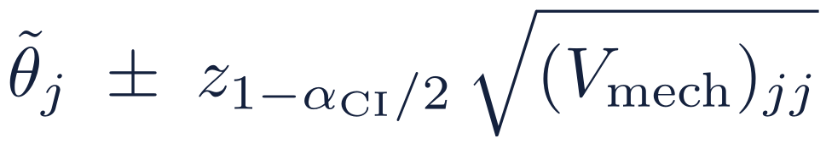
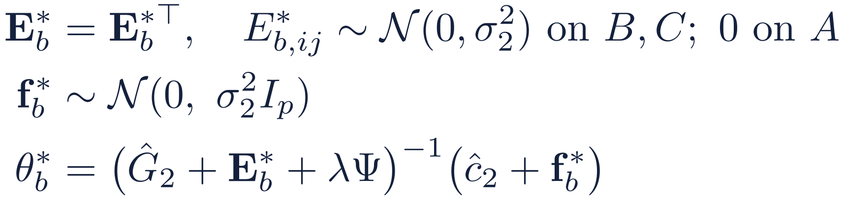
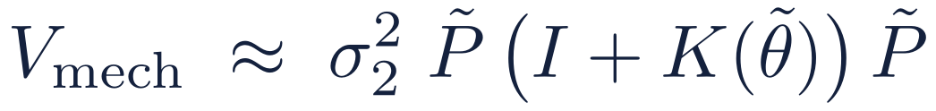
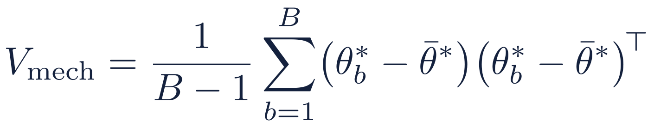
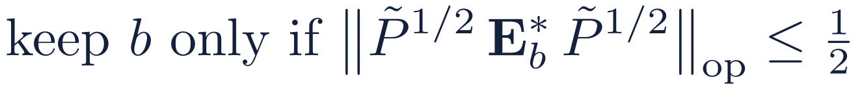
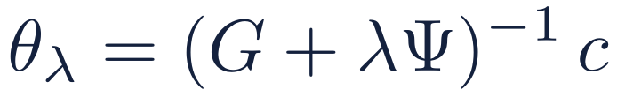
How the Wald interval is computed
V_{mech}, the covariance due to the DP noise, by parametric bootstrap at R: free post-processing
1
Simulate the noise
2
What it estimates
3
The interval
For b = 1, …, B, around R's own release:
First order in the noise:
α_{CI} = α − α_{L} − α_{U} = 0.045, so z = 2.005 (nominal 95.5%)
Target
χ_{ij} = 0 if i and j are both in R's block A (never noised), else 1.
I: noise f on ĉ₂. K(θ): noise E on Ĝ₂, times θ.
R can use this closed form instead of the bootstrap: same first-order guarantee, no Monte Carlo error.
Without this truncation the bootstrap mean and covariance do not exist. Use antithetic pairs (E*_{b}, f*_{b}) and (−E*_{b}, −f*_{b}).
a fixed function of the data, so only the noise enters: no sampling variance.
First order: relative error O(1/ϑ₀) + O(B^{−1/2}). In simulation V_{mech} is within 2% of the true noise s.d., and the intervals cover 0.944–0.962 (target 0.955). The interval for β adds sampling variance, V = V_{mech} + s̃² P̃ Ĝ₂ P̃, and is widened for the ridge bias.
Notes:
How R computes the Wald interval for the ridge target. Step 1: R knows the noise distribution exactly, so it simulates fresh noise around its own stage-2 release: symmetric noise on the B and C entries (none on its exact block A) and noise on c-hat, solves the ridge each time, and takes the sample covariance of the draws. Draws where the simulated noise is too large relative to the ridged matrix are discarded; without this truncation the bootstrap moments do not exist. Step 2: to first order the estimate's error is P (f - E theta), so the bootstrap estimates sigma_2^2 P (I + K(theta)) P, where I comes from the noise on c and K(theta) from the noise on G times the coefficients. R may use this closed form directly. Step 3: the interval is the estimate plus or minus z times the square root of the diagonal of V_mech, with z = 2.005 because 0.005 of the error budget goes to the two auxiliary bounds. It targets theta_lambda, a fixed function of the data, so only the mechanism noise matters. The interval for beta adds the sampling variance and is widened for the ridge bias.

