Slide 1

Regression across a register and a cohort, without pooling
R
O
Privacy-preserving vertical federated linear regression: motivation, protocol and results
October 2026
Notes:
An introduction for people meeting this material for the first time. A researcher and a national statistical agency want to fit a linear regression on the people they have in common, where the agency holds the outcome. Neither may share its records. We build the protocol up from three standard tools (differential privacy, homomorphic encryption and private set intersection), state what it guarantees, show how to choose its parameters, and look at the results so far.

Slide 2
What we will cover
1
2
3
The problem
Building blocks
The protocol
Why join a research cohort to an agency register, and what must stay private
Differential privacy, homomorphic encryption, private set intersection
Six phases, from setup to confidence intervals
4
5
6
Guarantees
Choosing parameters
Results
What each party learns, and what is proven
Two settings; from a budget to noise, ridge and sample size
Simulation, real data, encrypted runs and other baselines
Notes:
Six parts. The building blocks are short primers: enough to follow the protocol, not a full course. The protocol and its guarantees are the core. Part 5 introduces the two evaluation settings of the protocol, I for inference and P for prediction, and shows how the pieces trade off. Part 6 gives the results of the current version: simulation, real data, the encrypted runs of the full implementation, and the comparisons with central DP and other baselines.

Slide 3
1
The problem
Joint regression across data that cannot be pooled
Notes:
Part 1: the setting, the data layout, what has to be computed, and the privacy requirements.

Slide 4


Two datasets, one question, no pooling
Researcher R
Organization O (e.g. StatCan)
Smaller cohort with rich domain variables: health, education, surveys
Wants to know whether these predict an administrative outcome
Holds features X_{R} and identifiers
Population register: tax filings, income, benefits
Holds the outcome y and features X_{O}
Cannot release records; law and governance bar direct sharing
6–8 weeks
of vetting and approvals today before a researcher can link a cohort to agency records in a Research Data Centre. Neither dataset alone answers the question.
Notes:
The motivating setting. A researcher's cohort and an agency's register cover overlapping people but different variables. Today, linking them means weeks of vetting and work inside a secure Research Data Centre. The goal is a protocol that answers the regression question directly, without either side handing over records.

Slide 5
Same people, different variables
Vertically partitioned data: overlapping rows, disjoint columns
O: register (n_{O} rows, n_{O} ≫ n_{R})
Goal
R: cohort (n_{R} rows)
Fit y on [X_{R} | X_{O}] over the n matched people
Neither party sees the other's records
O must not learn who is in R's cohort
The released model must not expose any individual
n
matched
X_{R}
X_{O}
y
Notes:
Rows are people, columns are variables. The two tables overlap only on the matched people, and the register is far larger than the cohort. This layout is called vertical partitioning: the parties hold different columns for the same rows. The regression we want uses R's columns and O's columns together, on the matched rows only.

Slide 6
What has to be computed
Least squares needs only a few sums over the matched rows, and those sums span both parties
A^{I}
X_{R}^{I⊤} X_{R}^{I}
C^{I}
X_{R}^{I⊤} X_{O}^{I}
c_{R}^{I}
X_{R}^{I⊤} y^{I}
R's rows in I only: R computes it exactly, and it never leaves R
O's rows π(I) only, as is (y^{T}y)^{I}: depends on which rows match, not on how they pair
C^{I⊤}
B^{I}
X_{O}^{I⊤} X_{O}^{I}
c_{O}^{I}
X_{O}^{I⊤} y^{I}
Cross-party: pairs R's row i with O's row π(i), so it depends on the bijection π
I = the cohort members found in O's register. π = the bijection from I to O's matching rows; X_{O}^{I} and y^{I} list O's rows π(i) in the order of I. Everything that touches O's data is computed under encryption and released to R only with noise. From here on we drop the superscript I.
G^{I} = Z^{T}Z
c^{I} = Z^{T}y^{I}
Notes:
Ordinary least squares needs the Gram matrix G = ZᵀZ and the vector c = Zᵀy over the matched rows. These are sufficient statistics: once you have them, you never need the rows again. Every block is a sum over the matched set I, which is why each carries a superscript I. They differ in what they need to know about the matching. A^I uses only R's rows in I, so R computes it exactly and it never leaves R. B^I, c_O^I and the sum of squares (yᵀy)^I use only O's matched rows π(I): they depend on which rows match but not on how R's and O's rows pair up. C^I and c_R^I multiply R's row i by O's row π(i), so they depend on the bijection π itself; this is why the linkage step must give R the position of every match, not just the match set. The protocol computes all O-dependent sums under encryption and releases them to R only after adding noise. On later slides the superscript I is dropped.

Slide 7




Three requirements
Input privacy
Cohort privacy
Output privacy
O learns nothing about R's features. Its whole view can be simulated from public sizes.
O learns nothing about who is in R's cohort, not even its exact size.
Everything R receives is differentially private for each person's O-side data (x_{O}, y).
Honest-but-curious parties. Both follow the protocol but analyse everything they receive. R and O each hold a share of the decryption key. By design, R learns which members of its cohort are in the register.
Notes:
The three requirements. Input privacy protects R's data from O; cohort privacy protects the fact of who R is studying; output privacy protects the people in O's register from R, the analyst. The threat model is honest-but-curious, also called semi-honest: nobody deviates from the protocol, but everyone tries to learn from what they see. A researcher who deliberately deviated could break output privacy; covering that needs extra machinery, discussed at the end. One thing is disclosed by design: R learns which of its own cohort members appear in the register.

Slide 8
Where this work sits
Approach | Where the data sit | Record linkage | Output privacy | Gap for this setting
Central DP regression (e.g. AdaSSP) | One trusted curator holds the joined table | Not needed | Differential privacy | Assumes the pooled data exist
Federated learning with encryption | Split across parties | Assumed, or a separate step | Usually none | The model can leak individuals
Private set intersection | Split across parties | Yes | Not applicable | Linkage only, no model
This protocol | Split, never pooled | Labeled PSI: O learns nothing | DP on all R receives; budget enforced by O | Protects O's side; R learns which of its cohort match
Each ingredient has a precedent: DP noise at collective decryption (UnLynx, Drynx, SPINDLE, FAMHE; Kluczniak–Santato for the cryptographic half) and noisy sufficient statistics for vertical regression (Xu–Yuan–Wu; Krichene et al.). What is new is the combination: one decryption share whose noise is both the zCDP noise and the CKKS flooding, R’s block exact, a ridge independent of the estimation noise, and a ledger for adaptive runs.
Notes:
Central DP regression, such as AdaSSP by Wang (2018), assumes one curator already holds the joined table. Federated learning with homomorphic encryption keeps data split but usually releases an unprotected model. Private set intersection only does the linkage. We do not claim the ingredients. DP noise attached to a collective decryption appears in UnLynx, Drynx, SPINDLE and FAMHE, and Kluczniak and Santato add DP noise to partial decryptions as a defence for threshold approximate HE, which is the cryptographic half of our release. Noisy sufficient statistics for vertically partitioned linear regression go back to Xu, Yuan and Wu, and Krichene et al. add noise only to the statistics that involve private features, which is the shape of our guarantee. What is new is the combination: PSI-linked threshold CKKS, a single decryption share whose exactly sampled discrete Gaussian is at once the zCDP noise and the worst-case flooding noise, R's block kept exact, a two-stage ridge independent of the estimation noise, and a per-register ledger that composes adaptive runs. The guarantee is narrower than central DP in one respect: it protects O's side of each record, and R learns which of its cohort members match.

Slide 9
2
Building blocks
Differential privacy, homomorphic encryption, private set intersection
Notes:
Part 2: three short primers, enough to follow the protocol.

Slide 10
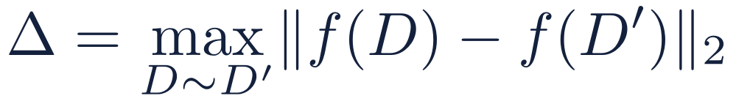
Differential privacy in one slide
A release is private if no single person's data changes it by much
D and D′ differ in one person's O-side data (x_{O}, y): replace-one adjacency
ε caps how much one person can shift the odds of any outcome (a factor e^{ε})
δ is a small slack; take δ ≤ 1/(10N) for a register of N people
Post-processing is free: anything computed from a DP release stays DP
The Gaussian mechanism
The two curves are shifted by the sensitivity Δ. The wider the noise relative to Δ, the harder it is to tell them apart.
Notes:
Differential privacy is a property of a randomized release M. For any two neighbouring datasets D and D', and any set of outcomes S, the probability of S changes by at most a factor e^epsilon, plus a small slack delta. Here neighbours differ in one person's O-side data, with R's features held fixed: replace-one adjacency. The Gaussian mechanism adds normal noise to a statistic f. Its scale is the sensitivity Delta, the most f can move between neighbours, times a multiplier s that depends only on (epsilon, delta). Two properties we use constantly: post-processing cannot weaken the guarantee, and costs of several releases add up (next slides).

Slide 11


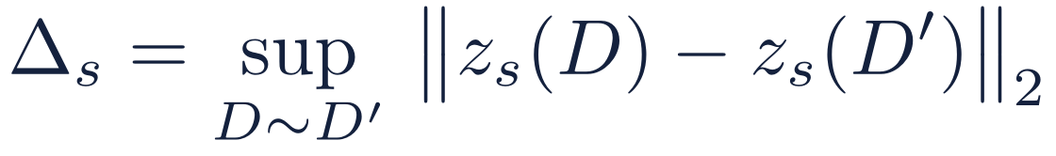
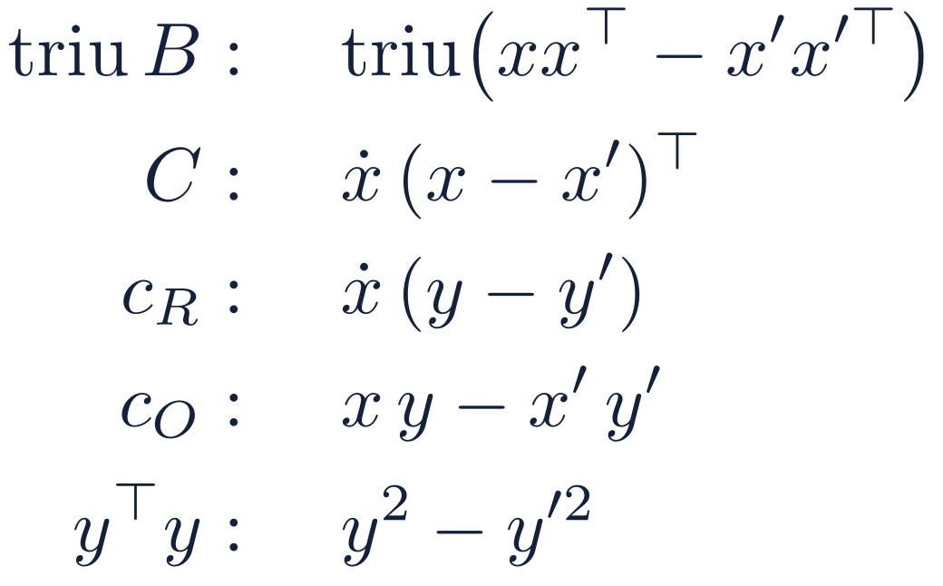
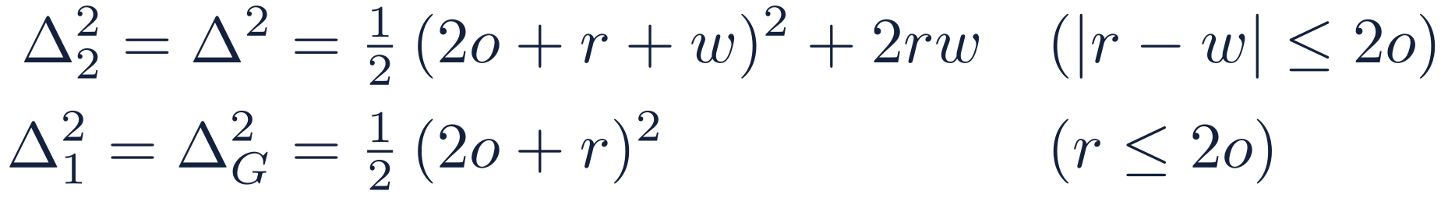
Δ_{s}: how far one person can move a release
DP protects the people in O's register from R, the only party that sees decrypted output
Who is protected
The sensitivity Δ_{s}
Neighbours D ∼ D′: one matched person's (x_{O}, y) is replaced by any other value within the bounds. Their R row ẋ and the match set I stay fixed.
With ẋ fixed and x = x_{O}, a replacement (x, y) → (x′, y′) moves:
R already knows ẋ and I (the linkage reveals I by design: outside DP).
O sees only ciphertexts (encryption, not DP).
Every entry gets the same noise, so the squared changes add up over the blocks of a release. Stage 1 has only the first two blocks, so Δ_{G} < Δ. Only the upper triangle of the symmetric B is released, so each off-diagonal change counts once.
What release s contains
s | Stage | Entries released
1 | stage 1 | triu B, C
2 | stage 2 | triu B, C, c_{R}, c_{O}, y^{T}y
Maximizing over the bounds, with (r, o, w) = (B_{R}², B_{O}², B_{y}²):
A = Ẋ^{T}Ẋ is never released: R computes it itself, and it is the same in both neighbours.
Clipping is what makes Δ finite, and Δ does not depend on n: more records make the signal bigger, not the noise. Upper triangle of B
triu B is upper triangle of B (including diagonal). Note that B is symmetric.
Notes:
Differential privacy here protects the people in O's register, and the adversary is R, because R is the only party that ever sees a decrypted output. O only sees ciphertexts, so encryption protects O's view. Two datasets are neighbours if one matched person's O-side features and outcome are replaced by any other values inside the clipping bounds, with that person's R row and the match set fixed. R already knows both; the match set is revealed by the linkage by design and is outside the DP guarantee. The protocol makes two releases: stage 1 with the upper triangle of B and C, and stage 2 with everything. A is never released because R computes it. The sensitivity Delta_s is the largest change one person can make to the whole vector of release s, in l2 norm. Replacing x and y moves each block as shown; since every entry gets noise of the same size, the squared changes add up. Maximizing over the bounds gives the closed forms. In the toy example Delta is root 38 and Delta_G is root 24.5; both were checked by brute-force maximization. Delta depends only on the bounds, not on n.

Slide 12
How much one person can move the statistics
The sensitivity Δ sets the noise; it follows from public clipping bounds
Every row is clipped to public bounds: ‖x_{R}‖ ≤ B_{R} (with the intercept), ‖x_{O}‖ ≤ B_{O} and |y| ≤ B_{y}. Replacing one person's (x_{O}, y) changes B, C, c_{R}, c_{O} and y^{T}y by at most Δ:
$$Δ^{2}=\frac{1}{2}{\left(2O+R+W\right)}^{2}+2RW, \left(R,O,W\right)=\left(B_{R}^{2},B_{O}^{2},B_{W}^{2}\right)$$
Bounds (B_{R}, B_{O}, B_{y}) | Δ | Comment
(1, 1, 1) | 3.16 | unit bounds
(0.71, 0.71, 1) | 2.03 | one unit row bound split between the parties
(5.59, 6.24, 2.89) | 86.2 | simulation population (standardized income, age, counts)
A = X_{R}^{T} X_{R} is computed exactly by R and never released, so it adds nothing to Δ
y^{T}y is free when B_{y}² ≤ 2(B_{R}² + B_{O}²); otherwise it gets its own budget
Δ grows with the squared bounds: tight bounds matter most
Bounds are chosen from public reference data before any data are seen; values beyond them are clipped.
Notes:
The released vector is (triu B, C, c_R, c_O, yT y). Replacing one person's O-side data, with R's row fixed, moves it by at most Delta in the l2 norm. With R, O, Y the squared bounds, the usual case has the closed form on the slide; it is the exact supremum when O has at least two features. Three practical consequences. Keeping A out of the release removes R's fourth-power term, which is why A stays exact at R. yT y adds nothing when B_y^2 <= 2(B_R^2 + B_O^2), which covers all our settings; otherwise it is released separately. And since Delta scales with the squares of the bounds, choosing tight bounds is the most powerful lever on accuracy. Splitting one row bound between the parties, B_R^2 = B_O^2 = 1/2, gives Delta = 2.03 instead of 3.16.

Slide 13
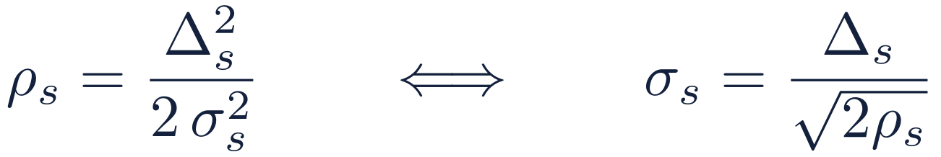


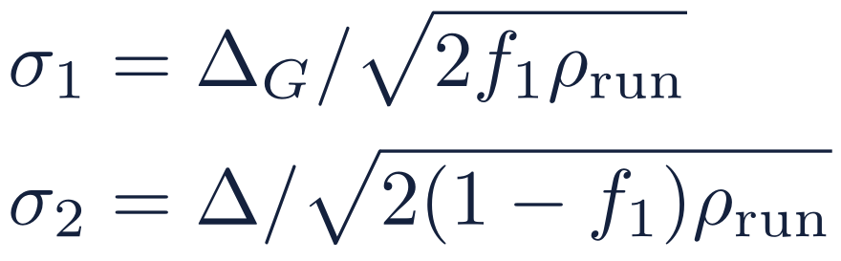
σ_{s} and ρ_{s}: one equation ties them to Δ_{s}
Δ_{s} is fixed by the bounds and ρ_{s} by the budget, so the noise σ_{s} follows
Δ_{s} sensitivity: how far one person can move release s
ρ_{s} zCDP cost: the share of the budget release s spends
σ_{s} noise s.d. added to every entry of release s
Why the equation holds
From the run's (ε, δ) to the noise
R sees ẑ_{s} = z_{s} + N(0, σ_{s}² I): independent noise with the same s.d. on every entry. For neighbours D ∼ D′ and any order a > 1, the Rényi divergence is
1
Convert (ε, δ) to a zCDP budget
Tight conversion: ρ_{run} = 0.01497 at ε = 1, δ = 10⁻⁹.
2
Split it between the two stages
ρ-zCDP means this is at most aρ for every a > 1, so release s costs exactly ρ_{s} = Δ_{s}²/(2σ_{s}²). Costs add: ρ_{run} = ρ₁ + ρ₂. They add across runs too, and O's ledger caps the total.
3
Set the noise
I and P: σ₁ ≈ 1.55σ₂ here. The 25% share raises σ₂ by 15% (previous: 10%, +5%).
Toy example (previous setting, f₁ = 0.1; ε = 1, δ = 10⁻⁹): Δ_{G} = 4.95, σ₁ = 90.45; Δ = 6.16, σ₂ = 37.55. Everything after the releases (λ, the gate, θ̃, V_{mech}, the intervals) uses only ẑ₁, ẑ₂, A and public numbers: free post-processing.
Notes:
The three quantities are tied by one equation: rho_s equals Delta_s squared over two sigma_s squared. Delta_s comes from the clipping bounds and rho_s from the privacy budget, so sigma_s follows. Why: R sees each released entry plus independent Gaussian noise of the same standard deviation. The Renyi divergence of order a between the two Gaussians for neighbouring datasets is a times the squared change over two sigma squared, which is at most a times Delta squared over two sigma squared. That is exactly the definition of rho-zCDP with rho equal to Delta squared over two sigma squared. zCDP costs add, across the two stages and across runs; O keeps a ledger and refuses to decrypt past the cap. To set the noise: convert the run's epsilon and delta to a zCDP budget rho_run with the tight conversion of Canonne, Kamath and Steinke, which allows about 27 percent more rho than the simple bound. Split it between the stages. The stage-1 share f_1 is a parameter of the protocol, not a constant: both evaluation settings, I and P, use f_1 = 0.25, and the previous setting used 0.1. On the simulation population f_1 = 0.25 gives sigma_1 about 1.55 times sigma_2; stage 1 only has to give a lower bound for the ridge, and its share raises sigma_2 by about 15 percent over a single release (5 percent at f_1 = 0.1). The toy example on the slide keeps its own numbers, which use the previous setting. Everything computed afterwards is post-processing and costs nothing more.

Slide 14
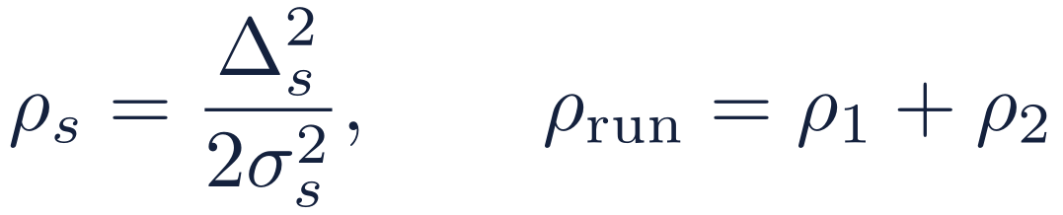

Budgets add up, and O keeps the books
Zero-concentrated DP (zCDP) makes the accounting simple
One run = two releases
Stage 2: all statistics, 75%
Stage 1: B and C only, 25% of ρ in settings I and P (previous: 10%), used to choose the ridge
Each release s costs ρ_{s}; the costs of a run add up
The run's total converts to (ε, δ); the protocol uses the tight conversion, and the formula above is a close, simple bound
Doubling ε roughly halves the noise σ
Ledger at O
One ledger per base register, shared by all researchers. A run’s full cost is charged atomically at admission, never refunded. Adaptive runs pass a privacy filter; smudging is accounted in hockey-stick divergence (share ξ_{L}). No decryption without O’s share.
Notes:
zCDP measures privacy loss with a single number rho. A Gaussian release with sensitivity Delta and noise sigma costs Delta^2 / (2 sigma^2), and the costs of several releases simply add. At the end, the total converts to an (epsilon, delta) statement; the protocol uses the tight conversion of Canonne, Kamath and Steinke, and the simple bound on the slide is within a few tens of percent of it. A protocol run makes two releases: a small one used only to choose the ridge, a quarter of the budget in settings I and P and a tenth in the previous setting, and the main one. O keeps one ledger per base register, shared across researchers, because an individual can appear in many cohorts. The ledger charges a run's full cost, for all its planned releases, atomically when the run is admitted, and never refunds it, so concurrent runs cannot jointly pass the cap. Runs chosen after seeing earlier results go through a privacy filter. The smudging of the encryption error is accounted in hockey-stick divergence, with a small reserved share xi_L of the cap, so the ledger does not raise the flooding parameter. Composition across runs is proved for a colluding, adaptive coalition of researchers. Because R cannot decrypt anything without O's key share, O can enforce the cap simply by refusing.

Slide 15
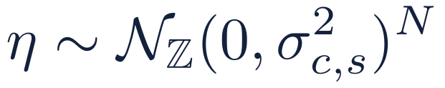
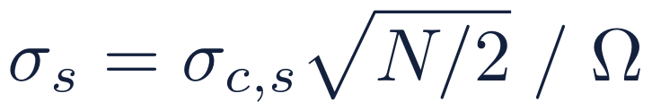
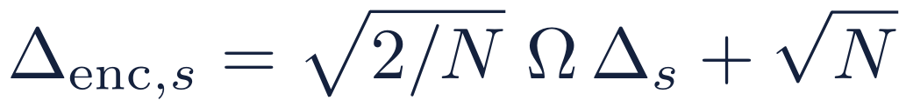
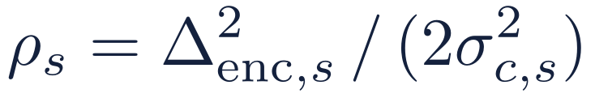


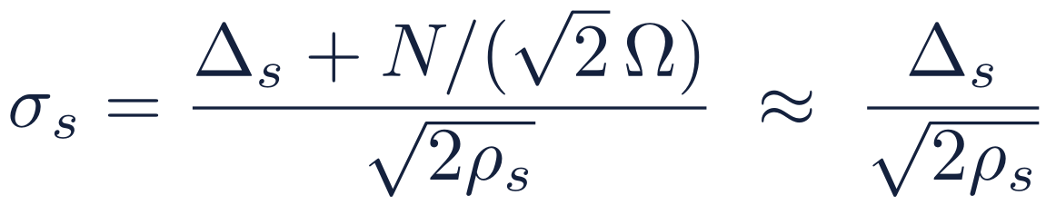
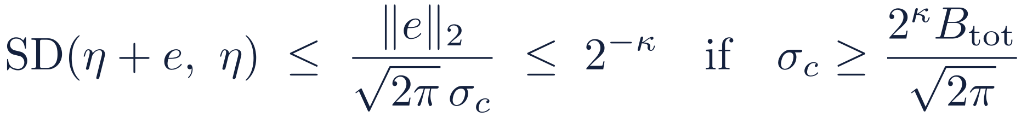
Where the noise actually lives
O adds integer noise η to the ciphertext's coefficients; R decodes it as Gaussian noise on each entry
1
Statistic in the slots
2
Coefficients: O adds η
3
What R decodes
Release s is a vector z_{s} with one entry per slot. One person moves it by at most Δ_{s} in ℓ2.
encode
decode
×Ω, τ⁻¹
÷Ω, τ
Noise with s.d. σ_{s} on every released entry: the picture of the previous slide.
exact for the discrete Gaussian
Why the slot picture is enough
η also hides the CKKS error
e depends on the data and O’s key share, so it is hidden (κ = 40–46, from ε, δ). As σ_{c,s} = σ_{s}·Ω_{f}·√(2/N), O raises Ω_{f} until:
With N = 2¹⁴ and Ω_{f} = 2^{61.8}–2^{71.9} the extra term is below 10⁻¹⁰. Exact integer sampling of the discrete Gaussian makes the guarantee exact.
Price: δ_{DP} = δ_{run} − (1 + e^{ε})·n_{rel}(δ_{B} + 2^{−κ} + …).
How the σ’s drive the statistics: σ₁ sets the radius r₁ = q·σ₁ (exact quantile: q = 7.42 in I, 4.44 in P, at p = 11) and so λ; σ₂ sets the ridge target 2ϑ*σ₂√p, the gate and V_{mech} ∝ σ₂². Records needed for a given coefficient accuracy grow like σ₂² ∝ Δ²/ρ.
Notes:
The slot picture is how to think about it, but O does not add Gaussian noise to the slots. The statistic is encoded: scaled by the final scale Omega_f and mapped through the inverse canonical embedding, which shrinks l2 norms by root 2 over N. So in the coefficient domain the sensitivity is root 2 over N times Omega_f times Delta_s, plus small terms. O adds an integer vector eta, each coefficient a discrete Gaussian with standard deviation sigma_c,s, and the cost is exactly Delta_enc squared over two sigma_c squared. When R decodes, the noise on each slot has standard deviation sigma_c times root N over 2, divided by Omega_f, so the slot picture holds up to a relative term below 1e-10 at the evaluation settings. The same eta also hides the CKKS error, which depends on the data and on O's key share: by the smudging lemma the error is hidden up to 2 to the minus kappa if sigma_c is at least 2 to the kappa times the worst-case error bound over root 2 pi, and at least 2 to the 42. kappa is no longer a constant: Calibrate derives it from epsilon and delta, 40, 40, 40, 41 and 46 for epsilon 0.5 to 8 at delta 1e-9, so that the slack takes at most a tenth of delta. Since sigma_s is fixed by the budget, O meets the flooding condition by raising the scale: Omega_f is between 2^61.8 and 2^71.9 at the evaluation settings, about 2^62.6 at epsilon = 1 under setting I. The cost is a small deduction from delta. Finally, sigma_1 drives the ridge choice through the radius r_1, which settings I and P take from an exact Monte Carlo quantile, and sigma_2 drives the gate and the confidence intervals; the records needed for coefficient accuracy grow like sigma_2 squared, so like Delta squared over rho.

Slide 16

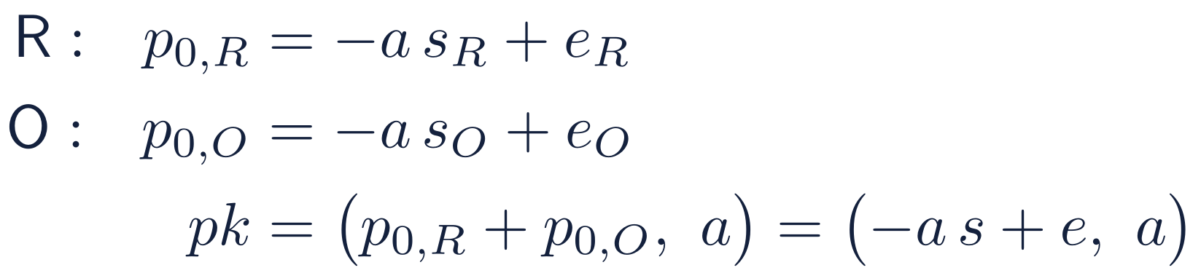
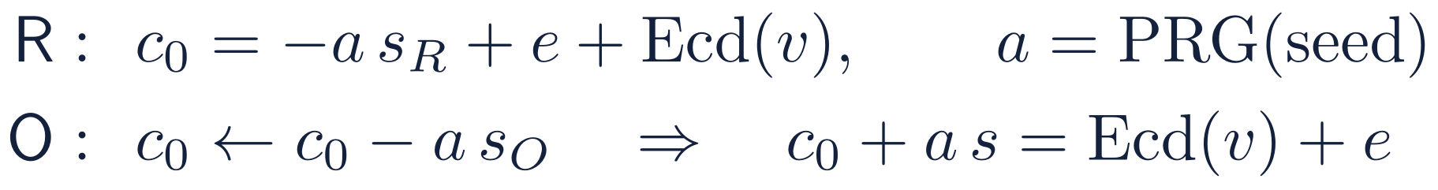
Threshold CKKS: one key, split between R and O
Nobody ever holds s = s_{R} + s_{O}, so neither party can decrypt on its own
CKKS in one box
Joint key generation (setup)
A ciphertext is a pair (c₀, c₁) of polynomials mod q. It packs a vector of N/2 = 8,192 real numbers (N = 2¹⁴), each scaled by Ω and rounded.
From a common random polynomial a, each party draws its own secret share and error, and publishes one polynomial:
Decryption with the secret key s:
What O can do with R's ciphertexts, holding no key:
Rotation keys for slot shifts 2^{i} are made the same way. Each share stays with its owner.
add them
multiply them by its own plaintext columns (x_{O}, y)
rotate slots, to sum a vector into one slot (EvalSum)
Upload under the joint key, at half the size
Depth 2 and no ciphertext × ciphertext products, so no relinearization key. Security rests on Ring-LWE: without s, c₀ looks uniformly random.
R sends c₀ and the short seed of a, not a itself. O's subtraction turns (c₀, a) into a ciphertext under s.
This is standard multiparty CKKS (Mouchet et al., 2021) with two parties and additive key shares. What is specific to us is how the decryption is used: next slide.
Notes:
CKKS encrypts vectors of real numbers: a ciphertext is a pair of polynomials, it holds 8,192 numbers at N = 2^14, and decryption is c0 + c1 s, which gives the encoded vector plus a small error. In our protocol O only adds ciphertexts, multiplies them by its own plaintext columns, and rotates slots to sum vectors, all without any key. The multiplicative depth is 2 and there are no ciphertext-by-ciphertext products, so no relinearization key is needed. The key is generated jointly, following Mouchet et al. 2021: from a common random a, R publishes -a s_R + e_R and O publishes -a s_O + e_O; the sum is a public key for s = s_R + s_O, a key that nobody holds. Rotation keys are made the same way. For the upload, R encrypts with its own share using a symmetric encryption whose random a comes from a seed, so it sends only c0 and the seed. O subtracts a times its share, which converts the ciphertext to the joint key. This is the standard multiparty construction with two parties.

Slide 17
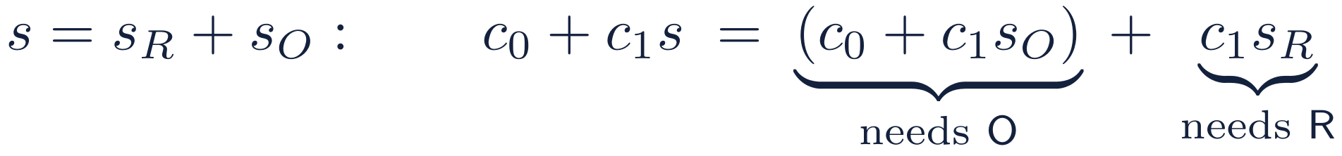
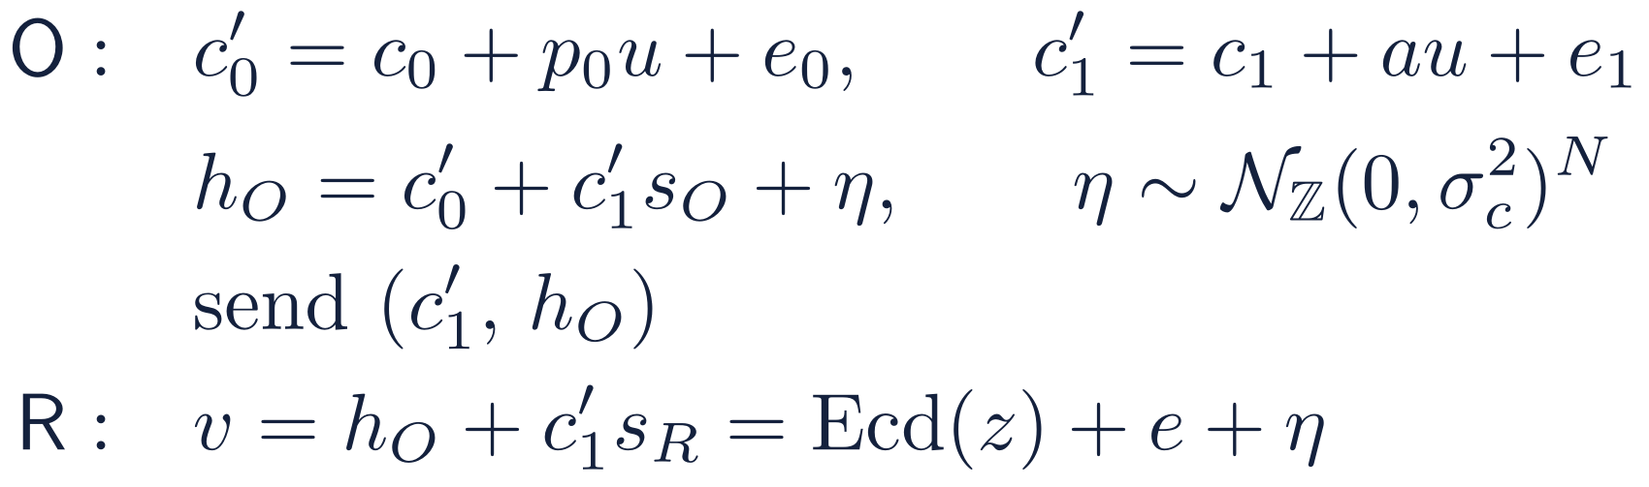
Threshold decryption, with the DP noise built in
O adds its key share and the noise in one step; R finishes the decryption and sees only noisy statistics
Decryption needs both shares:
Our release (phase 4)
1
Fresh u, e₀, e₁ every release
The evaluated c₁ depends on O's plaintext columns; adding au + e₁ makes c₁′ a fresh RLWE sample that looks uniform.
2
Add η inside O's share
η is the DP noise and also drowns the CKKS error e, up to 2^{−κ} (κ = 40–46). It is fresh too, so two releases cannot be differenced.
3
Never send c₀′
The proof needs it: without c₀′, u and e₁ appear only in c₁′, which then looks uniform. With it, R would get c₁′s_{O} + η: O’s key share masked only by η.
O’s view reveals nothing. It never receives R’s decryption share. Scope: R’s decrypted v_{s} must never leave R, and anything R discloses later is noiseless to O.
R learns the noisy statistics. Plus a c₁′ that looks random, so its view can be simulated from the noisy statistics alone: the DP guarantee (if R samples its errors honestly).
Notes:
Decryption is linear in the key, so it splits: c0 + c1 s_O needs O's share and c1 s_R needs R's. Neither party alone can decrypt. In our release O does three things. It re-randomizes the packed ciphertext with fresh u, e0, e1 under the joint public key: the evaluated c1 is computed from public values and O's plaintext columns, and R chose the random a, so without this step c1 could reveal O's data; after it, c1' is a fresh Ring-LWE sample. Then O computes its share of the decryption and adds the noise eta inside it: eta is the differential-privacy noise on the statistics and also floods the CKKS approximation error, up to 2 to the minus kappa. Finally O sends c1' and the noisy share, never c0'. Because eta is inside the share, c0' would not give R the exact product c1' s_O; it would give c1' s_O plus eta, O's key share hidden only by the DP noise. Withholding c0' matters because the privacy proof needs it: with c0' withheld, the randomness u and e1 appear only in c1', which can then be replaced by a uniform element. R adds c1' s_R and gets the statistics plus noise. Two scoping points. O learns nothing from its view of the protocol, because it never receives a decryption share from R; but O knows eta, so anything R later discloses is noiseless to O, and R's decrypted value v_s must never leave R, since with O's share it would reveal R's key. And R's view can be simulated from the noisy statistics alone, which is what makes the DP guarantee hold for R's whole view, provided R samples its own encryption errors honestly.

Slide 18
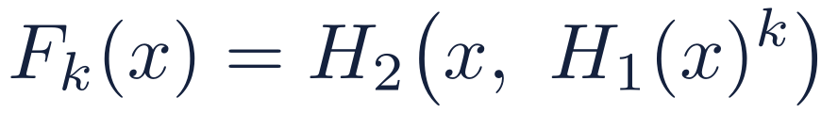
The OPRF: a keyed hash that needs O
R learns F_{k}(id) for its own ids; O never sees the ids, and R never sees the key k
2HashDH (RFC 9497); O's key k is fresh each run
Why it is safe
R
O
O sees α, a uniformly random group element: nothing about the id.
R gets F_{k} only for ids it sends. Without k it cannot compute F_{k} for any other id.
O answers exactly n_{R}^{max} queries per run (R pads with dummies) and logs them against a quota.
A fresh k every run, so F_{k} values from different runs cannot be linked.
α = H₁(id)^{r}, with r random
β = α^{k}
R unblinds: β^{1/r} = H₁(id)^{k}. That gives the item F_{k}(id), used for matching, and the label key F′_{k}(id).
Why we need it: identifiers such as social insurance numbers are a small, guessable space, so a plain hash could be inverted by trying every value. With the OPRF every evaluation needs O, so R cannot test ids offline, and the PSI messages carry no structure. Toy example: R holds 104, 221, 317, pads with dummy 9d1 to n_{R}^{max} = 4, and makes four calls.
Notes:
An oblivious pseudorandom function lets R compute a keyed hash of its identifiers under O's key without O seeing the identifiers and without R learning the key. We use 2HashDH, specified in RFC 9497 (an Informational RFC): hash the identifier into a group, raise it to the key k, and hash again. R blinds the group element with a random exponent r and sends alpha; O raises it to k; R removes r and applies the outer hash. The output is split into an item part for matching and a key part for opening labels. Alpha is uniformly random, so O learns nothing about the identifier. R only gets values for identifiers it sends, and cannot evaluate the function on anything else without k. R always sends exactly n_R^max queries, padding with dummies, and O logs them against a quota per researcher and project. We need this because identifiers are a small, guessable space: a plain hash could be inverted by brute force. The OPRF makes every membership test an online interaction with O. O draws a fresh key every run. 3

Slide 19
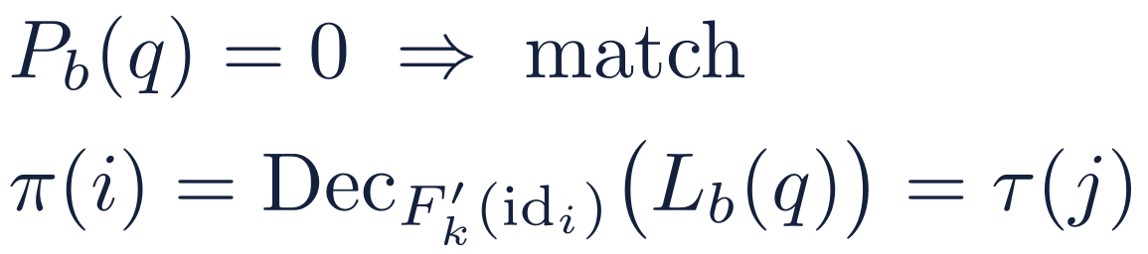
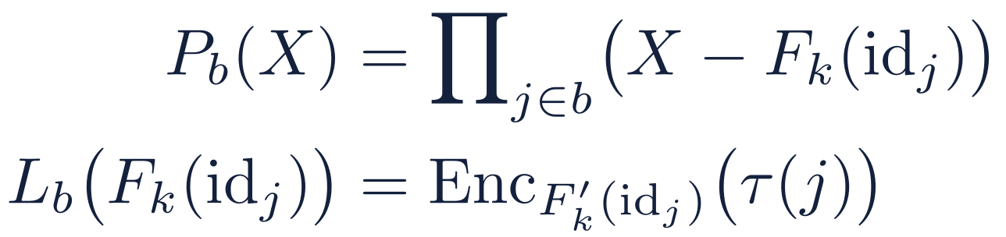
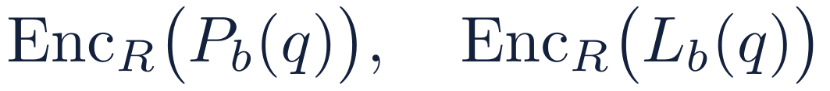
Labeled PSI: who matches, and where
R learns its match set I and positions π(i) = τ(j) in O's shuffled register; O learns only the padded sizes
1
O prepares
2
R asks, O evaluates
3
R decrypts
Pad the register to n̄_{O} with dummies and draw a fresh shuffle τ. Row j becomes the item F_{k}(id_{j}), labeled with its encrypted position. Hash the items into bins; per bin b:
R cuckoo-hashes its items, at most one per bin, encrypts them under its own BFV key, and sends their powers q, q², q⁴, … to keep the depth low. O evaluates every P_{b} and L_{b} under encryption and replies:
No match: P_{b}(q) ≠ 0 and the label value means nothing. The reply reveals nothing else about O's register.
Toy example
What each party learns
O's padded row j | 150 | 7e5 | 221 | 088 | 399 | 104
position τ(j) | 1 | 2 | 3 | 4 | 5 | 6
O: only n_{R}^{max} and n̄_{O}, both public.
R: I and the positions, which are uniformly random because τ is fresh. R needs both: I for its block A, the positions to line up its upload.
7e5 is O's dummy row. R queries 104, 221, 317 and its dummy 9d1: 104 matches with label 6 and 221 with label 3. So I = {104, 221}, π(104) = 6 and π(221) = 3.
Notes:
Labeled private set intersection, following Chen, Laine and Rindal and successors. O pads its register to the public size with dummy rows and draws a fresh secret shuffle tau. Each row becomes an item, its OPRF value, with a label: the row's position in the shuffle, encrypted under the row's label key. O hashes the items into bins and, for each bin, interpolates a membership polynomial whose roots are the items and a label polynomial that maps each item to its encrypted label. R cuckoo-hashes its own items so each bin holds at most one, encrypts them under its own BFV key, and sends powers of them so that O can evaluate high-degree polynomials at low depth. O evaluates both polynomials under encryption and replies. R decrypts: a zero membership value means a match, and then the label value decrypts, under the item's label key, to the row's position. In the toy example, 104 and 221 match with positions 6 and 3. O learns only the padded sizes. R learns the match set and the positions; the positions are uniformly random because the shuffle is fresh. R needs the match set to compute its own block A, and the positions to line up its data with O's rows in the upload.

Slide 20
3
The protocol
Six phases, from setup to confidence intervals
Notes:
Part 3: the protocol phase by phase. Blue is R, orange is O.

Slide 21
The protocol at a glance
What each party does, and what crosses the wire
0
1
2
3
4
5
R
Agree public parameters; key share s_{R}
Learns matches and positions; computes A
Encrypts its features in O's row order
Adds its share; decodes noisy statistics
Ridge from release 1; estimate and intervals from release 2
setup and key shares
OPRF and PSI
encrypted vectors
(c₁′, h_{O})
Bounds → Δ, σ, Ω; ledger check; key share s_{O}
Answers PSI over its padded register
Converts them to the joint key
Computes B, C, c_{R}, c_{O}, y^{T}y under encryption
Re-randomizes; adds noise in its decryption share
O
Setup
Link
Upload
Aggregate
Release ×2
Solve
O never receives a decryption share from R; R never receives the part of a ciphertext that would expose O's key share.
Notes:
The whole protocol in one picture. Phase 0: both parties agree public parameters and generate a split key. Phase 1: private linkage; R learns which of its cohort members match and where they sit in O's shuffled register, and computes its own block A. Phase 2: R uploads its features, encrypted, in O's row order. Phase 3: O computes the needed sums under encryption. Phase 4: O releases them in two rounds, adding noise inside its share of the decryption. Phase 5: R chooses the ridge from the first release, then computes the estimate and confidence intervals from the second. The next slides take each phase in turn.

Slide 22
Phase 0: setup
Everything that sets the noise is public and fixed before any data are touched
R + O
Agreed in public
O
Derived by O
Study scope Φ, on public attributes only (province, birth-year band)
Caps: cohort n_{R}^{max}; register padded to n̄_{O} with dummy rows
Clipping bounds B_{R} (with the intercept), B_{O}, B_{y}, from public reference data
Budget (ε, δ) and the statistical setting: I (f₁ = 0.25, ϑ* = 2.5, exact r₁, intervals) or P (f₁ = 0.25, ϑ* = 1.5, α_{L} = 0.75, no intervals)
Sensitivities Δ and Δ_{G} from the bounds
Flooding κ, noise σ₁, σ₂ and scale Ω_{f} (Calibrate)
Ledger: admit and charge the full cost, or refuse
A fresh secret shuffle τ of its rows and a fresh OPRF key
R + O
Split key generation
Joint public key, secret s = s_{R} + s_{O}, and rotation keys only. Neither party can decrypt alone.
Notes:
Phase 0. The parties agree on everything that determines the noise before touching data: a study scope defined on public attributes, a cap on the cohort size, the padded register size, clipping bounds from public reference data, the privacy budget, and the statistical setting. The protocol is stated for an abstract parameter vector; the concrete values are evaluation settings. We evaluate two named settings of the same protocol: I, for inference, with f_1 = 0.25, validity target 2.5, an exact Monte Carlo radius and intervals; and P, for prediction, with f_1 = 0.25, target 1.5, alpha_L = 0.75 and no intervals. From these O derives the sensitivities, the flooding parameter kappa, the noise scales and the CKKS scale, and admits the run against its ledger, charging the full cost at once. O draws a fresh secret shuffle of its rows and a fresh OPRF key for this run. Finally the parties run threshold key generation: one joint public key whose secret key is split between them.

Slide 23
Phase 1: link
Labeled PSI tells R which cohort members are in the register, and where
R
Pad the cohort identifiers with random dummies to exactly n_{R}^{max}
After phase 1
R + O
OPRF: R gets F_{k}(id) for each padded id; O evaluates exactly n_{R}^{max} calls
R knows I and the positions τ(j) of its matches
R has A exactly; it never leaves R
O knows only n_{R}^{max} and n̄_{O}
The positions are uniformly random, because τ is fresh every run
R
Cuckoo-hash the hashed ids; send encrypted queries under R's own key
O
Evaluate membership and label polynomials over its padded register; reply
R
Decrypt: match set I, and positions π(i) = τ(j) in O's shuffled order
R
Compute its own block A = Σ_{i∈I} ẋ_{i} ẋ_{i}^{T} exactly, locally
Notes:
Phase 1 in detail. R pads its identifier list to the public cap, so O learns nothing from the count. The OPRF gives R a keyed hash of each identifier. R cuckoo-hashes these and sends encrypted queries, encrypted under R's own BFV key, so O cannot read them. O evaluates membership and label polynomials and replies. R decrypts: it learns which identifiers match and, for each, its position in O's shuffled register. R then computes its own block A exactly. O has learned only the public sizes.

Slide 24
Phase 2: upload
R lines its data up with O's rows, encrypts them, and sends them over
R
Vectors over all n̄_{O} positions
Why this hides everything from O
Selection b: 1 at a matched position, 0 elsewhere
Features ẋ_{j}: R's clipped feature j (and the intercept) at matched positions, 0 elsewhere
In O's shuffled order, so O can multiply them by its own columns position by position
O sees only ciphertexts, which look random without R's key share. Matched and unmatched positions are indistinguishable, so O cannot tell who is in the cohort.
R encrypts with its own share and a short seed (half the upload); O folds in its share to convert to the joint key.
Notes:
Phase 2. R builds vectors as long as O's padded register, in O's shuffled order: a selection vector with a 1 at each matched position, and one vector per feature with R's clipped value at matched positions and zeros elsewhere. The first feature is the intercept. R encrypts each vector with its own key share, sending only c0 and a short seed from which the random a can be regenerated; this halves the upload. O subtracts a times its own share, which turns the ciphertext into one under the joint key. To O, all of this looks random, so matched and unmatched positions cannot be told apart.

Slide 25
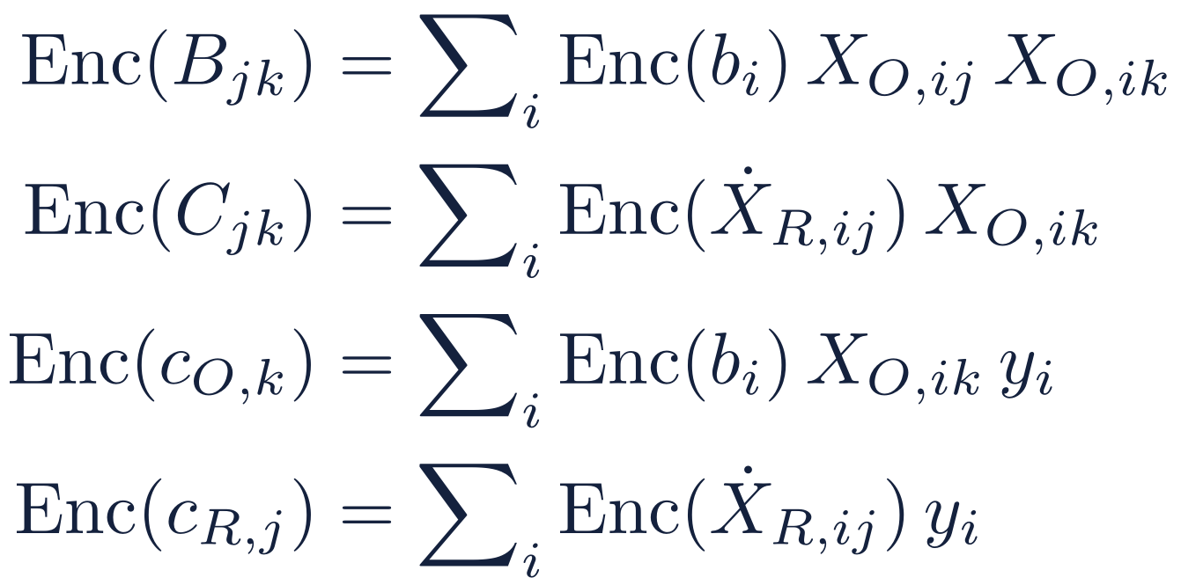


Phase 3: aggregate
O multiplies R's encrypted vectors by its own plaintext columns and sums
Sum chunks, then EvalSum
A register longer than one ciphertext is split into chunks; slot sums use rotations.
Pack: one entry per slot
Every released number sits alone in its own slot of a packed ciphertext.
Two packed ciphertexts
b: selection vector; ẋ_{R}: R's features in O's order (zero off the match set)
M₁ holds only B and C (for stage 1); M₂ holds every entry (stage 2).
Unmatched positions contribute zero, because b and ẋ_{R} are zero there. The result is the matched-row statistics, still encrypted. Multiplicative depth is 2.
Notes:
Phase 3. Each O-dependent statistic is an inner product between one of R's encrypted vectors and one of O's plaintext columns, summed over positions. Multiplying by the selection vector restricts O's data to the matched rows. O first sums the chunk products, then does one EvalSum per entry to collect the total into a slot. It then packs the entries so that each sits alone in its own slot: M1 holds only B and C, for the first release, and M2 holds everything, for the second. Keeping them separate means the first release can only depend on B and C.

Slide 26
Phase 4: the release
O adds the privacy noise inside its own share of the decryption
c₀′ never leaves O
Needed by the proof: c₁′ then looks uniform. With it, R would get c₁′s_{O} + η.
η does two jobs
The DP noise on the statistics; it also floods every encryption error (to 2^{−κ}, κ = 40–46).
Fresh every time
New u, e₀, e₁ and η for each release; the ledger was charged at admission.
What R ends up with: the statistics plus discrete-Gaussian noise of the planned size, and a c₁′ that looks random. R's view can be simulated from the noisy statistics alone, which is exactly the DP guarantee.
Notes:
Phase 4, the core of the protocol. O first re-randomizes the packed ciphertext with fresh randomness u, e0, e1, using the joint public key (p0, a). It then computes its share of the decryption, c0' + c1' s_O, and adds noise eta drawn from an exact discrete Gaussian on the integers. It sends c1' and this noisy share h_O, but never c0'. R adds c1' s_R and gets the encoded statistic, plus the encryption error e, plus eta. Two points matter. Because c0' is not sent, the re-randomization coins appear only in c1', which is what lets the proof treat c1' as uniform; with c0', R would learn c1' s_O plus eta, O's key share hidden only by the DP noise. And eta is chosen wide enough to give the planned DP noise on the statistic and also to drown the encryption error statistically, up to 2 to the minus kappa, with kappa derived from epsilon and delta; that second job is what fixes the CKKS scale. Fresh randomness every release stops R from differencing two releases. The ledger is not charged here: the run's full cost was charged when it was admitted.

Slide 27
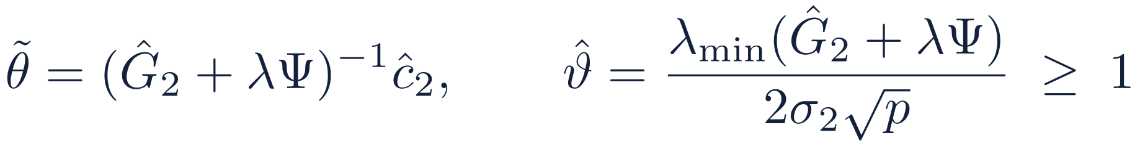
Two releases: pick the ridge, then estimate
The ridge must not depend on the noise in the release it is applied to
Stage 1 (25%)
Ĝ₁ = A ⊕ noisy B, C
Choose (λ, Ψ)
Stage 2 (75%)
Release of B and C only, noise σ₁
R adds its exact block A; finds a lower bound on λ_{min}(G)
Ridge just large enough that ϑ ≥ ϑ* (I: 2.5, P: 1.5); Ψ ridges only O’s block if that suffices
All statistics, noise σ₂; gate ϑ̂ ≥ 1
Because (λ, Ψ) comes from stage 1 and A only, it is independent of the stage-2 noise, which keeps the error analysis and the intervals valid. ϑ measures how far the noisy Gram matrix is from singular. q is an exact Monte Carlo quantile of the stage-1 noise: 7.42 (I) or 4.44 (P) at p = 11; the previous setting’s union bound gave 11.53.
Notes:
The noisy Gram matrix can be badly conditioned, or even singular, when n is small relative to the noise, so the protocol adds a ridge. Choosing the ridge from the same noisy release would make it depend on the noise and break the error analysis. So the protocol spends a share f_1 of the budget, a quarter in settings I and P, on a first release of B and C only. R combines it with its exact A, computes a lower confidence bound on the smallest eigenvalue, and picks the smallest ridge that makes the validity ratio theta at least its target: 2.5 under setting I, 1.5 under setting P. The radius r_1 of that lower bound is sigma_1 times an exact Monte Carlo quantile of the largest eigenvalue of the stage-1 noise, computed offline from public quantities; it is about a third smaller than the union bound the previous setting used, which is why the ridge now switches off sooner. Psi says where the ridge goes: only on O's block if that is enough, otherwise on everything. The main release then uses the remaining three quarters, a gate refuses to report if the matrix still looks too close to singular, and the estimate is the ridge solution on the second release.

Slide 28
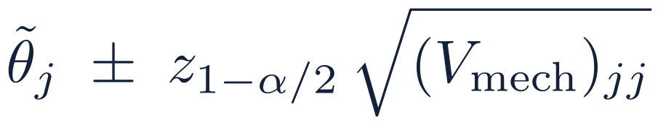
Phase 5: estimates and intervals
Everything here is post-processing at R: it costs no extra privacy budget
Two targets
Interval for θ_{λ} (Wald)
θ_{λ} is what the protocol estimates directly (the ridge target on the clipped data); β is the coefficient of the working linear model on the clipped data.
Covers the protocol’s own target at the nominal level. Setting I only: setting P reports no intervals.
Parametric bootstrap of the noise
R knows the noise distribution exactly, so it simulates many fresh noise draws around its release
This gives the mechanism's covariance V_{mech}, and corrects the residual sum of squares for the noise
Add the usual sampling variance to get the total V
Interval for β (bias-aware)
Widened for the worst-case ridge bias (Armstrong, Kolesár and Kwon); needs a bound on ‖β‖.
Notes:
R now has a noisy release and a known noise distribution, so everything else is post-processing and costs no privacy. There are two targets. theta_lambda is the ridge solution on the true clipped statistics, which is what the protocol estimates without bias at first order. beta is the coefficient of the working linear model for the clipped data, with conditionally independent, homoskedastic errors; its sample analogue is the least-squares fit G inverse c. The ridge pulls the estimate away from beta by a bias that is bounded but not zero. A parametric bootstrap simulates fresh noise around the release to estimate the mechanism's covariance and to correct the residual sum of squares. The Wald interval targets theta_lambda. The bias-aware interval for beta widens the Wald interval to cover the worst-case ridge bias, which needs a bound on the norm of beta, either public or derived privately from stage 1. Both intervals belong to setting I; setting P gives up the intervals for a smaller ridge. An optional bias correction exists; it is off, because its effect is small.

Slide 29
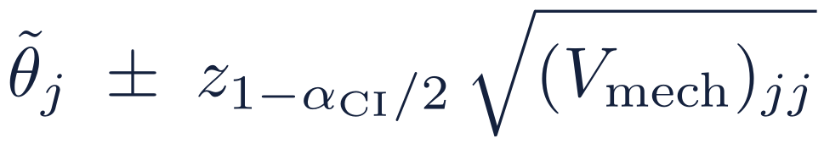
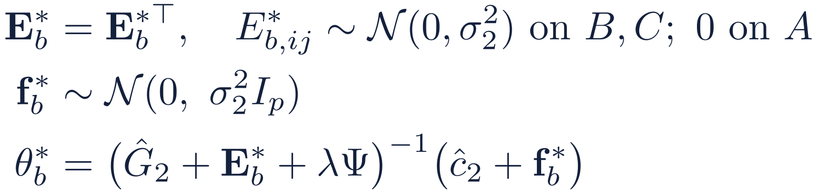
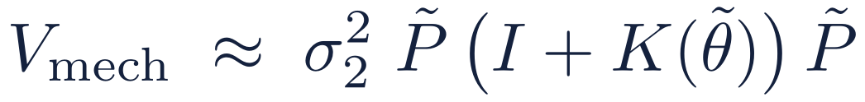
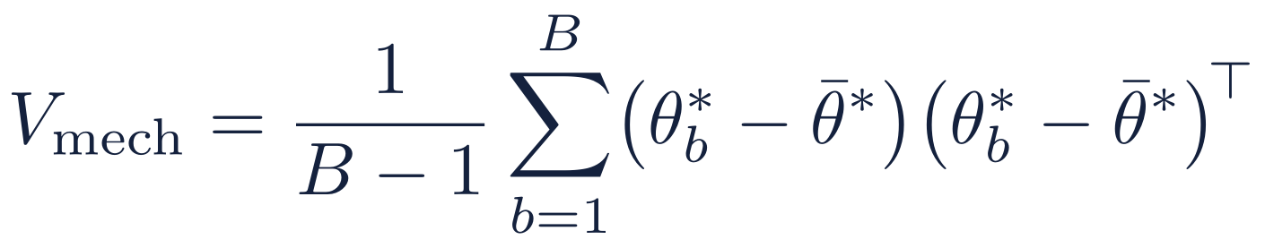
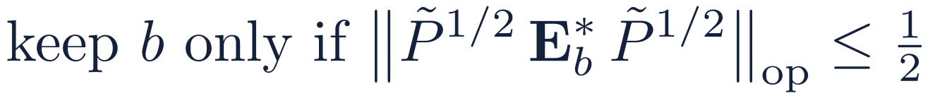
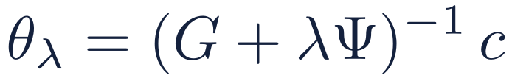
How the Wald interval is computed
V_{mech}, the covariance due to the DP noise, by parametric bootstrap at R: free post-processing
1
Simulate the noise
2
What it estimates
3
The interval
For b = 1, …, B, around R's own release:
First order in the noise:
α_{CI} = α − α_{L} − α_{U} = 0.045, so z = 2.005 (nominal 95.5%)
Target
χ_{ij} = 0 if i and j are both in R's block A (never noised), else 1.
I: noise f on ĉ₂. K(θ): noise E on Ĝ₂, times θ.
R can use this closed form instead of the bootstrap: same first-order guarantee, no Monte Carlo error.
Without this truncation the bootstrap mean and covariance do not exist. Use antithetic pairs (E*_{b}, f*_{b}) and (−E*_{b}, −f*_{b}).
a fixed function of the data, so only the noise enters: no sampling variance.
First order: relative error O(1/ϑ₀) + O(B^{−1/2}). Under setting I the intervals cover 0.945–0.966 in all 70 synthetic cells and 0.945–0.964 in 48 real-data cells (target 0.955). The interval for β adds sampling variance, V = V_{mech} + s̃² P̃ Ĝ₂ P̃, and is widened for the ridge bias.
Notes:
How R computes the Wald interval for the ridge target. Step 1: R knows the noise distribution exactly, so it simulates fresh noise around its own stage-2 release: symmetric noise on the B and C entries (none on its exact block A) and noise on c-hat, solves the ridge each time, and takes the sample covariance of the draws. Draws where the simulated noise is too large relative to the ridged matrix are discarded; without this truncation the bootstrap moments do not exist. Step 2: to first order the estimate's error is P (f - E theta), so the bootstrap estimates sigma_2^2 P (I + K(theta)) P, where I comes from the noise on c and K(theta) from the noise on G times the coefficients. R may use this closed form directly. Step 3: the interval is the estimate plus or minus z times the square root of the diagonal of V_mech, with z = 2.005 because 0.005 of the error budget goes to the two auxiliary bounds. It targets theta_lambda, a fixed function of the data, so only the mechanism noise matters. Under setting I it covers 0.945 to 0.966 in all 70 cells of the synthetic study, with the ridge on or off, and 0.945 to 0.964 in 48 cells of real data with the noise of a real budget. The interval for beta adds the sampling variance and is widened for the ridge bias. 1

Slide 30
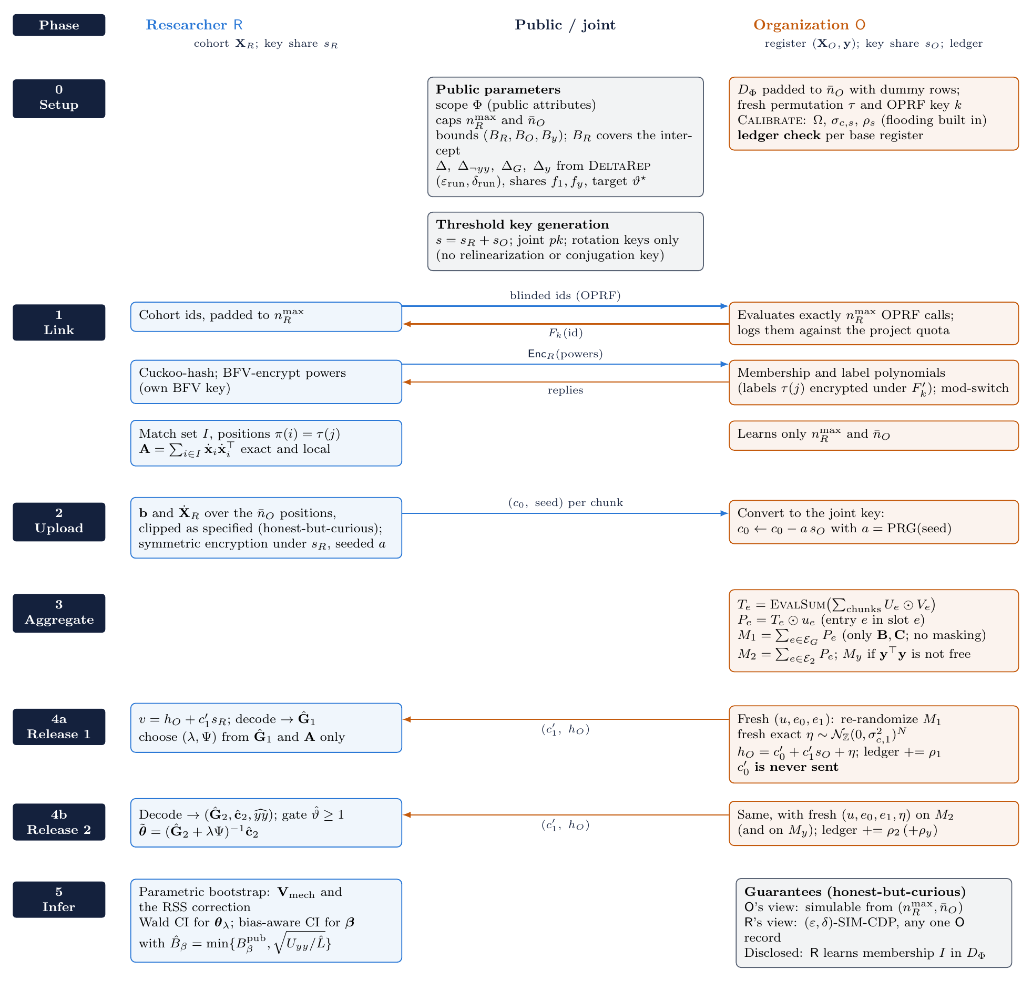
The whole protocol on one page
Blue arrows: R to O. Orange arrows: O to R.
Notes:
A reference figure with every message of the protocol. Rows are phases, the left column is R, the right column is O, and the middle column holds public or joint objects. Use it as a map when reading the specification.

Slide 31
4
Guarantees
What each party learns, and what is proven
Notes:
Part 4: the guarantees, the status of their proofs, and one consequence for the encryption parameters.

Slide 32
What each party learns
Against honest-but-curious parties
 | Learns | Does not learn | Why
O | The public sizes n_{R}^{max} and n̄_{O} | R's features, who is in the cohort, or which of its rows match | Ring-LWE in R’s key share; OPRF and PSI security; O never receives R’s decryption share or v_{s}. O’s view only: what R discloses is noiseless to O
R | Its own data; which of its cohort match, and where; the DP-noised statistics | Anything about one person’s O-side data beyond (ε, δ)-DP; nothing else about O’s register (G4) | Noise in O’s share; view simulated from the noisy statistics (SIM-CDP). G4: random-oracle model, CDH; PSI-noise layer in the textbook BFV model
Assumed
Not covered
Honest-but-curious parties; R samples its encryption errors honestly
Ring-LWE; CDH (OPRF); private, authenticated channels
Across runs: an honest ledger; colluding, adaptive researchers stay (ε_{L}, δ_{L})-DP
A deviating researcher (skips clipping, inflates errors): needs zero-knowledge proofs
Hiding match status from R: circuit-PSI, at a higher sensitivity
Results R publishes, as seen by O (O knows the noise)
Notes:
The guarantees in one table, with their scope. O's view of the protocol can be simulated from public sizes, so it learns nothing else; that covers O's view only. O knows the noise eta, so anything R later discloses is noiseless to O, and R's decrypted value v_s must never leave R, because together with O's share it would reveal R's key. R's view can be simulated from the noisy statistics alone; formally, R's view is (epsilon, delta)-SIM-CDP, a computational version of differential privacy. That needs R to sample its encryption and key-share errors honestly, since inflated errors would push a data-dependent term past the flooding bound. Across runs, the joint view of all researchers on a base register, colluding and choosing runs adaptively, is (epsilon_L, delta_L)-DP under O's ledger. G4, that R learns nothing about O's register beyond its matches and their positions, is proved in the random-oracle model under the computational Diffie-Hellman assumption; its second layer, the flooding of the PSI replies, is proved in the textbook BFV model, and whether OpenFHE's RNS BFV meets that model is still open. Out of scope: a deviating researcher, who could break output privacy without zero-knowledge proofs that its uploads are well formed; hiding match status, possible with circuit-PSI at a higher sensitivity; and protection of R's published results from O.

Slide 33
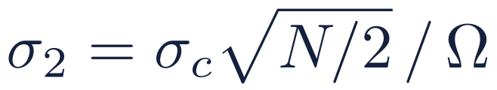
Why the CKKS scale has to be large
Hiding the encryption error statistically costs about 40 extra bits
ε | κ | log₂ Ω_{f}
0.5 | 40 | 61.8
1 | 40 | 62.75
2 | 40 | 63.7
4 | 41 | 65.6–65.7
8 | 46 | 71.6–71.9
The privacy budget fixes the noise σ₂ seen in the statistics. So the scale Ω_{f} must be large enough that η is also 2^{κ} times the error, and σ_{c} ≥ 2⁴²:
2^{17.8}–2^{18.8}
Example: setting I, ε = 1, δ = 10⁻⁹, simulation bounds (σ₂ = 575); B_{tot} = 2^{26.6} is proven for OpenFHE’s key switching.
measured error in OpenFHE 1.5.1, 7.8–8.7 bits below the proven worst case B_{tot} = 2^{26.6}. O calibrates from the bound, never from the observed error; OpenFHE’s noise estimation is not used.
Fixed parameters: N = 2¹⁴, chain [60, 59, 59, 59] + P [60, 60] bits, log QP = 357 < 438 (128-bit limit). κ is derived from (ε, δ); q₀ needs at most 98 of its 119 bits.
Notes:
One concrete consequence of the proofs, now with the parameters fixed. The noise eta must be 2 to the kappa times the worst-case encryption error to hide it statistically (the smudging lemma), and at least 2 to the 42. But the noise the analyst sees in the statistics, sigma_2, is fixed by the privacy budget, and it equals sigma_c sqrt(N/2) / Omega_f. So the final scale has to grow until both hold. The worst-case bound for OpenFHE's key switching is proven: B_tot is about 2^26.6, a bit above the 2^25.3 of centred key switching, because OpenFHE's base conversion returns uncentred digits. kappa is derived from epsilon and delta: 40, 40, 40, 41 and 46 for epsilon 0.5 to 8 at delta 1e-9, which gives final scales from 2^61.8 to 2^71.9, the same from 4k to 1M register rows within 0.4 bits (the table is for the previous setting; setting I is about 0.13 bits lower). The chain is four primes of 60, 59, 59 and 59 bits plus two 60-bit special primes, log QP = 357, below the 128-bit limit of 438 for N = 2^14; q0 needs at most 98 of its 119 bits. The measured error of the implementation is 2^17.8 to 2^18.8, 7.8 to 8.7 bits below the bound, but O must calibrate from the worst-case bound: an estimate from the actual ciphertexts would depend on the data and could leak through the noise level, and OpenFHE's noise-estimation modes are not used.

Slide 34
5
Choosing parameters
From a privacy budget to noise, ridge and the sample size needed
Notes:
Part 5: how to go from a privacy budget to concrete noise levels, the ridge, and the number of matched records needed. All numbers here are for the full protocol.

Slide 35


Two settings of the same protocol
Setting I (inference)
Setting P (prediction)
Exact radius r₁ = 7.42σ₁ (p = 11), f₁ = 0.25, ϑ* = 2.5, α_{L} = α_{U} = 0.0025
Keeps the interval guarantee: Wald for θλ, bias-aware for β
Chosen to minimize coefficient error over 70 synthetic cells; ridge off 35% sooner than the previous setting
Synthetic, ε = 1: σ₁ = 892, σ₂ = 575, n_{off} = 27.0k
Both keep the gate ϑ̂ ≥ 1; the previous setting (f₁ = 0.1, union bound) stays as a reference
Exact radius at α_{L} = 0.75 (r₁ = 4.44σ₁), f₁ = 0.25, ϑ* = 1.5, no intervals
Tuned for test error only; same noise and same privacy guarantee as I
Chosen over 140 cells, standardized and block-normalized, with the gate refusing at most 1% of releases
Replaces P₀ (ϑ* = 0.5), whose gate refused most block-normalized releases on real data
Notes:
The protocol is stated for an abstract parameter vector, and every theorem holds for any admissible choice. The numbers we evaluate are evaluation settings, and there are two named settings of the same protocol. They differ only in statistical parameters, so the noise, which depends only on epsilon, delta and f_1, and the privacy guarantee are identical; both keep the gate. Setting I, for inference, keeps the interval guarantee. It sizes the stage-1 radius by an exact Monte Carlo quantile instead of a union bound, uses a quarter of the budget for stage 1 and the validity target 2.5. It was chosen on the synthetic population alone by a rule written down in advance, minimizing coefficient error over 70 cells, and it switches the ridge off 35 percent sooner than the previous setting with f_1 = 0.1. Setting P, for prediction, gives up the intervals for a smaller ridge: target 1.5, and a radius at the 25 percent quantile. Its first version, P_0 with target 0.5, was also chosen on standardized synthetic data, but on block-normalized real data its gate refused most releases. The lesson was to select on both standardized and block-normalized populations and to require the gate to refuse at most 1 percent of releases; that second pre-registered rule picked the current P.

Slide 36
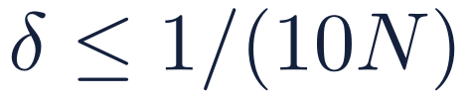
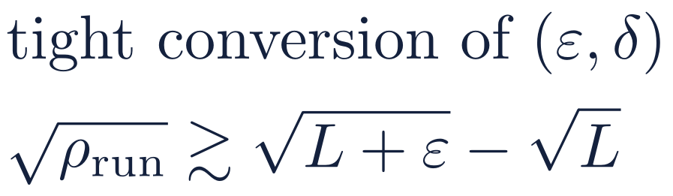
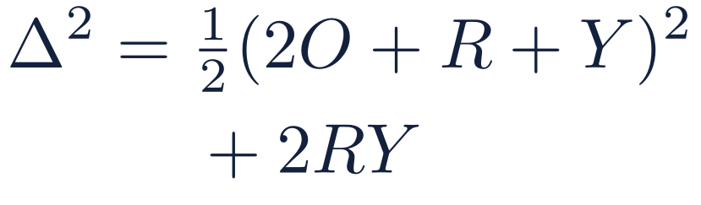
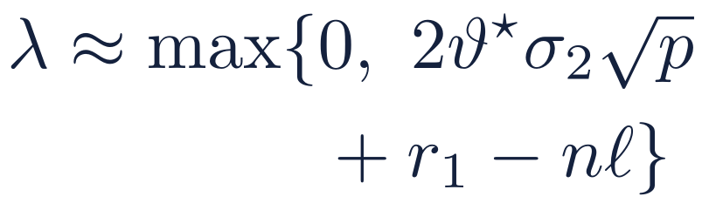
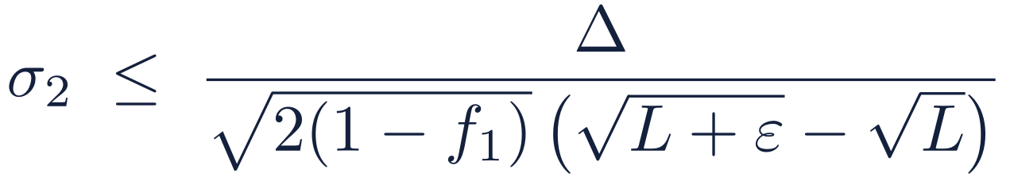
From ε to σ and λ
Every input is public and fixed before any data are seen
1
δ
2
Budget
3
Δ
4
σ
5
λ
N = people O protects. Smaller δ costs little (next slide)
L = ln(1/δ). Two releases share ρ_{run}
(R, O, Y) = squared bounds; Δ_{G}: B and C only
f₁ = stage-1 share: 0.25 in I and P (previous: 0.1)
Planning value; ℓ = λ_{min}(G)/n from reference data, else 0; r₁ = q·σ₁
σ₂ / Δ δ \ ε | 0.1 | 0.25 | 0.5 | 1 | 2 | 4 | 8
δ = 10⁻⁶ | 41.6 | 17.6 | 9.15 | 4.78 | 2.51 | 1.34 | 0.727
δ = 10⁻⁸ | 51.6 | 21.4 | 11 | 5.68 | 2.95 | 1.55 | 0.825
δ = 10⁻⁹ | 56 | 23.1 | 11.9 | 6.09 | 3.15 | 1.64 | 0.871
Planning formula
Simple zCDP bound: overstates σ₂ by 6–33%. Table at f₁ = 0.1; ×1.095 at f₁ = 0.25 (I, P).
Notes:
The calibration chain, from experiments/calibration_protocol.py (reports/calibration/protocol.md). Pick delta from the number of people protected. Convert (epsilon, delta) to a zCDP budget with the tight conversion. Compute the sensitivities from the bounds. Split the budget between the two releases with the stage-1 share f_1, which gives the two noise scales; f_1 is 0.25 in both evaluation settings, I and P, and was 0.1 in the previous setting. The ridge at run time comes from stage 1; for planning, approximate the smallest eigenvalue of G by n times ell, where ell comes from public reference data, or 0 if none exists, and take r_1 as the exact quantile times sigma_1. The table gives sigma_2 per unit of sensitivity at f_1 = 0.1; for example at epsilon = 1 and delta = 1e-9 it is about 6 times Delta. Since sigma_2 scales like one over root (1 - f_1), the values are 1.095 times larger at settings I and P. The planning formula uses the simple conversion and is conservative.

Slide 37
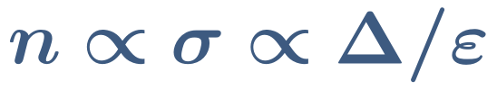
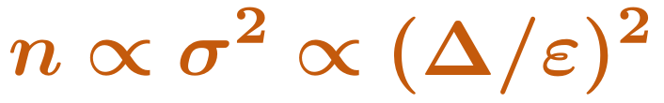
From σ to the matched records
Two scaling laws, exact at first order: one pilot figure carries over to any ε
Prediction
Coefficients
The ridge scales with σ, so the excess test error depends on n only through n / σ. Doubling ε roughly halves the records.
Once the ridge is off, DP error / sampling error ≈ σ²(1+‖β‖²) tr(Σ⁻²) / (n s² tr(Σ⁻¹)). Doubling ε cuts the records by about 3.5×.
Target | Setting | Measured at base ε | Transfer (× σ₂ or × σ₂²) | Observed (v3.1)
Prediction within 10% | protein, I, ε = 2 (from ε = 1) | 8.2k | 4.2k | 4.1k
Prediction within 10% | protein, I, ε = 4 (from ε = 1) | 8.2k | 2.2k | 2.1k
Prediction within 10% | protein, P, ε = 2 (from ε = 1) | 5.0k | 2.6k | 2.5k
Prediction within 10% | protein, P, ε = 8 (from ε = 1) | 5.0k | 715 | 599
Coefficients within 2× OLS | synthetic, I, ε = 4 (from ε = 2) | 88k | 24k | 27k
Coefficients within 2× OLS | synthetic, I, ε = 8 (from ε = 2) | 88k | 6.8k | 8.0k
Checked on v3.1 (δ = 10⁻⁹): prediction on protein with block normalization, coefficients on the synthetic population (R² = 0.5). Transfer = base count × the ratio of σ₂ (or σ₂²) from Calibrate. The laws break down for ill-conditioned designs, at high R² where clipping bias dominates, and at small n.
Notes:
Two rules of thumb to translate a noise level into a sample size. For prediction, the excess test error depends on n only through n divided by sigma, so the records needed scale with sigma. For coefficients, once the ridge is off, the DP error relative to the sampling error scales with sigma squared over n, so the records needed scale with sigma squared. In practice: measure the records needed once, at one epsilon, on a pilot or public data, and transfer. The table checks both laws against the current mechanism. For prediction we take the real-data sweep on protein, with block normalization, under settings I and P: from 8.2k records at epsilon 1, the law predicts 4.2k at epsilon 2 and 2.2k at epsilon 4, against 4.1k and 2.1k observed; under P it predicts 2.6k and 715 against 2.5k and 599. For coefficients we take the synthetic population under setting I: from 88k at epsilon 2, the law predicts 24k and 6.8k at epsilon 4 and 8, against 27k and 8.0k observed, so doubling epsilon cut the records by about 3.3 times. The transfer is conservative for prediction and slightly optimistic for coefficients, and it is least accurate at small n.

Slide 38
What each choice costs
Reference: δ = 10⁻⁹, previous setting (f₁ = 0.1, ϑ* = 2.5), tight bounds, one run per budget
Change | σ₂ | Records for prediction | Records for coefficients
Bounds 2× closer to the data (no extra clipping) | × 0.25 | × 0.25 | × 0.06
Split one unit row bound between the parties | × 0.64 | × 0.64 | × 0.41
Double ε | × 0.51–0.53 | × 0.51–0.53 | × 0.26–0.28
δ from 10⁻⁶ to 10⁻⁹ | × 1.20–1.32 | × 1.20–1.32 | × 1.44–1.73
Setting I instead of previous (exact r₁, f₁ = 0.25) | × 1.095 | × 0.67 | × 1.09–1.13
Setting P instead of I (ϑ* = 1.5, no intervals) | × 1.00 | × 0.68–0.75 | × 1.00
One budget shared by 5 runs (zCDP) | × 2.24 | × 2.24 | × 5.00
One budget shared by 5 runs (naive split of ε, δ) | × 4.81–4.97 | × 4.81–4.97 | × 23.10–24.70
Worked example: simulation population, δ = 10⁻⁹, settings I and P (same σ; Δ = 86.2, Δ_{G} = 77.2, p = 11)
ε | ρ_{run} | σ₁ | σ₂ | r₁ (I) | Ridge off from n: I | P | previous setting
0.5 | 0.0040 | 1737 | 1119 | 12,878 | 53k | 31k | 81k
1 | 0.0150 | 892 | 575 | 6,617 | 27k | 16.2k | 42k
2 | 0.0561 | 461 | 297 | 3,419 | 13.9k | 8.4k | 22k
4 | 0.2062 | 240 | 155 | 1,783 | 7.3k | 4.4k | 11.2k
8 | 0.7320 | 128 | 82 | 946 | 3.9k | 2.3k | 6.0k
Notes:
The knobs and what they buy. Tighter bounds are by far the most powerful: twice as close cuts sigma by 4 and the records needed for coefficients by 16. Splitting one row bound between the parties cuts sigma by about a third. Doubling epsilon roughly halves sigma; going from delta = 1e-6 to 1e-9 costs 20-32%. Sharing one budget over several runs is much cheaper with zCDP than with a naive split. Two rows compare the settings; they replace the old stage-1-share row. Setting I against the previous setting: the larger stage-1 share raises sigma_2 by 9.5 percent, but the exact radius cuts the ridge, so prediction needs about a third fewer records, while coefficients within twice the non-private error come 9 to 13 percent later once the ridge is off. Setting P against I: the same noise, a smaller ridge, and about 25 to 32 percent fewer records for prediction, with no intervals. The worked example uses settings I and P, which share sigma_1 and sigma_2 because both use f_1 = 0.25. The ridge switches off at 3.9k to 53k matched records under I and 2.3k to 31k under P, against 6.0k to 81k at the previous setting: I is 35 percent sooner.

Slide 39
6
Results
Accuracy in simulation and on real data
Notes:
Part 6: results. Read the setup slide first: it says exactly what the experiments simulate.

Slide 40


How we evaluated
Simulation population
Real data
Comparisons
Features on real-world scales (income, age, indicators, counts), correlated; 99.5% bounds. R² ∈ {0.3, 0.5, 0.9}; n from 100 to 100k; 200 cohorts per n; δ = 10⁻⁹.
29 UCI datasets from Wang’s AdaSSP study; 10-fold CV. Each party normalizes its own block of every row, with bounds from a public reference split. δ = 10⁻⁶ against AdaSSP, 10⁻⁹ elsewhere.
Non-private least squares (the floor); predicting zero; AdaSSP on the joined table; full-record SSP, Ferrando–Wang–Sheldon intervals and TukeyEM.
What the experiments run
A plaintext simulation of the exact v3.1 mechanism (two releases, ridge from stage 1, gate, bootstrap intervals), validated by 450 encrypted OpenFHE runs.
Settings I and P, chosen on synthetic data by pre-registered rules; the previous setting (f₁ = 0.1) as a reference.
Bias correction off. The earlier caveats (one release, a ridge from a known eigenvalue, the correction applied) no longer apply.
Notes:
The evaluation has a simulation part, where the true coefficients are known, and a real-data part on 29 datasets from Wang's AdaSSP study. Every result is for the current protocol: a plaintext simulation of the exact v3.1 mechanism, with both releases, the stage-1 ridge, the gate and the bootstrap intervals, and the full OpenFHE implementation, whose 450 encrypted runs reproduce that simulation. Two named settings of the same protocol are evaluated, I for inference and P for prediction, both chosen on synthetic data by rules written down in advance; the previous setting is kept as a reference. delta is 1e-9 except in the comparison with AdaSSP, which uses Wang's 1e-6. On real data each party preprocesses its own columns: it normalizes its own block of every row, with constants and bounds from a public reference split, because no party can normalize whole rows in the vertical setting. The bias correction is off. The caveats of the earlier experiments, a single release, a ridge from a known eigenvalue and the correction applied, no longer apply.

Slide 41
The full protocol runs on OpenFHE
All six phases on OpenFHE 1.5.1, R and O as separate processes with message transcripts; 80 tests
0
2^{17.8–18.8}
22–43 s
misaligned rows
measured encryption error
per run, one core
PSI recovered exactly the true match set and alignment; A was exact in every encrypted run
7.8–8.7 bits below the proven worst case B_{tot} = 2^{26.6} that sets the scale
1k–64k register rows; O’s CPU about 260 s at 1M rows (76 s on 4 cores), extrapolated
Cost per run, measured at n̄_{O} = 65,536 (one core)
Measured to 64k rows
Step | Communication | O's computation | Rounds
Link | n_{R}^{max} OPRF calls; PSI (27 MB) | Preprocessing linear in n̄_{O}; per-query evaluation (15.3 s) | 2–3
Upload | (d_{R} + 2)·m half-size ciphertexts (24 MB) | (d_{R} + 2)·m key conversions (0.3 s) | 1
Aggregate | None | |ℰ|·m products; |ℰ|·log₂(N/2) rotations (19.8 s; 5.4 s on 4 threads) | 0
Release (×2) | Two ring elements each (1 MB in all) | Re-randomize, partial decryption, N exact samples (0.6 s) | 1 each
m = ⌈n̄_{O}/(N/2)⌉ chunks; |ℰ| = released entries. Key generation adds 20 MB. Traffic 73 MB at 65,536 rows; 88–422 MB extrapolated to 100k–1M.
Notes:
The full protocol is now implemented. Every phase runs on OpenFHE 1.5.1, with R and O as separate processes that exchange explicit messages over a socket and log a transcript: the RFC 9497 OPRF, labeled PSI with flooded replies, threshold key generation, the seeded upload and key conversion, the aggregation circuit, and the release with exact discrete-Gaussian noise inside O's share. A small C++ layer gives the polynomial-level access the release needs; 80 tests pass. Linkage recovers exactly the right matches and alignment, A is exact, and with the noise switched off by a test-only flag the statistics match their plaintext values to 1e-11 relative. The parameters are fixed: N = 2^14, a chain of 60, 59, 59 and 59 bits plus two 60-bit special primes, log QP = 357, kappa derived from epsilon and delta. The measured encryption error is 2^17.8 to 2^18.8, 7.8 to 8.7 bits below the proven worst case B_tot = 2^26.6, from which O calibrates. A full run took 22 to 43 seconds on one core for registers of 1k to 64k rows; the table gives the measured split at 65,536 rows. A cost model built from microbenchmarks extrapolates O's CPU time to about 260 seconds at 1M rows, 76 seconds on four cores, with 88 to 422 MB of traffic from 100k to 1M rows. Nothing has been run above 64k rows yet. O's work is linear in the padded register, which is why the study scope matters.

Slide 42
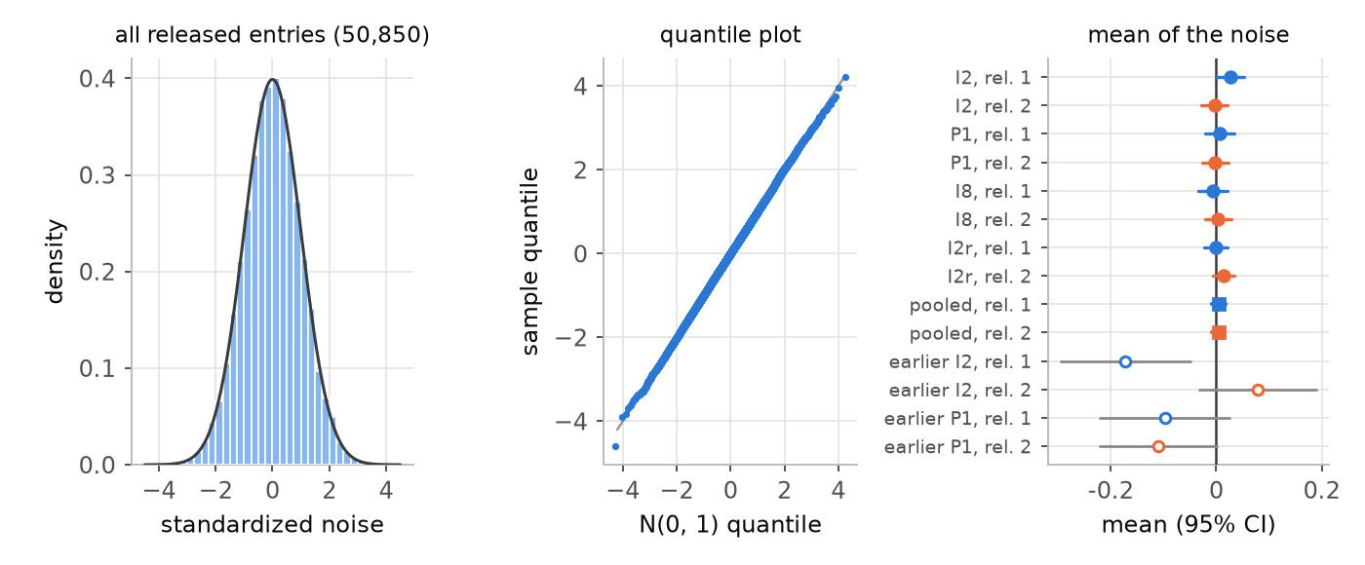
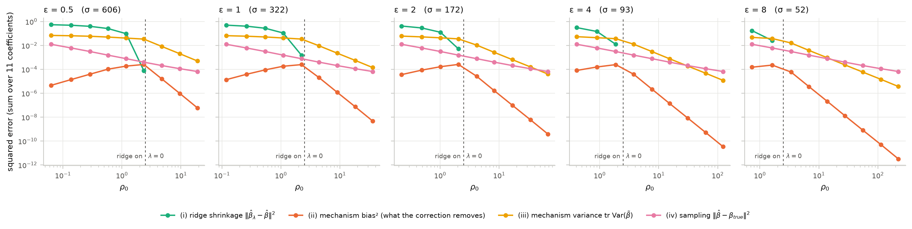
Faithful under encryption
450 OpenFHE runs, n = 10,000 matched in a 16,384-row register: I at ε = 2 (250), P at ε = 1 (100), I at ε = 8 (100)
No release refused; A exact; λ and estimates rebuilt from the recorded noise to 10⁻¹¹
λ in the simulated 95% range in 95/100, 144/150, 92/100, 100/100 runs
What was run
What it shows
The decrypted noise has its calibrated law: mean +0.006 and +0.004 (s.e. 0.007, 0.006), s.d. 0.995 and 1.006, KS p = 0.13 and 0.48
Wald coverage 0.954 with the ridge on and 0.958 with it off: encryption changes only the noise draw
Notes:
The encrypted runs check that the implementation does what the plaintext simulation assumes. We ran the full OpenFHE protocol 450 times on one synthetic dataset: 10,000 matched records in a register of 12,000 rows padded to 16,384. Setting I at epsilon 2 and setting P at epsilon 1 have the ridge on; setting I at epsilon 8 has it off. Because the first 100 runs of I at epsilon 2 came out slightly low, 150 more followed with fresh seeds. No release was refused and A was exact. Feeding each run's decrypted releases, rebuilt from the recorded noise, to the plaintext solver reproduced its ridge, estimate and half-widths to 1e-11, so an encrypted run differs from a plaintext one only through its noise. The ridge and the coefficients fell inside the simulated 95 percent ranges about as often as they should. The figure shows the raw decrypted noise standardized by the calibrated sigma: the histogram and quantile plot match the normal law, the mean is zero within its standard error for every configuration and release, and the slightly negative means of the earlier five-run checks, shown hollow, are not reproduced. Pooled, the stage-1 noise has mean +0.006 and s.d. 0.995, the stage-2 noise +0.004 and 1.006, with Kolmogorov-Smirnov p-values 0.13 and 0.48. The Wald interval covered 0.954 with the ridge on, over 250 runs, and 0.958 with it off.

Slide 43
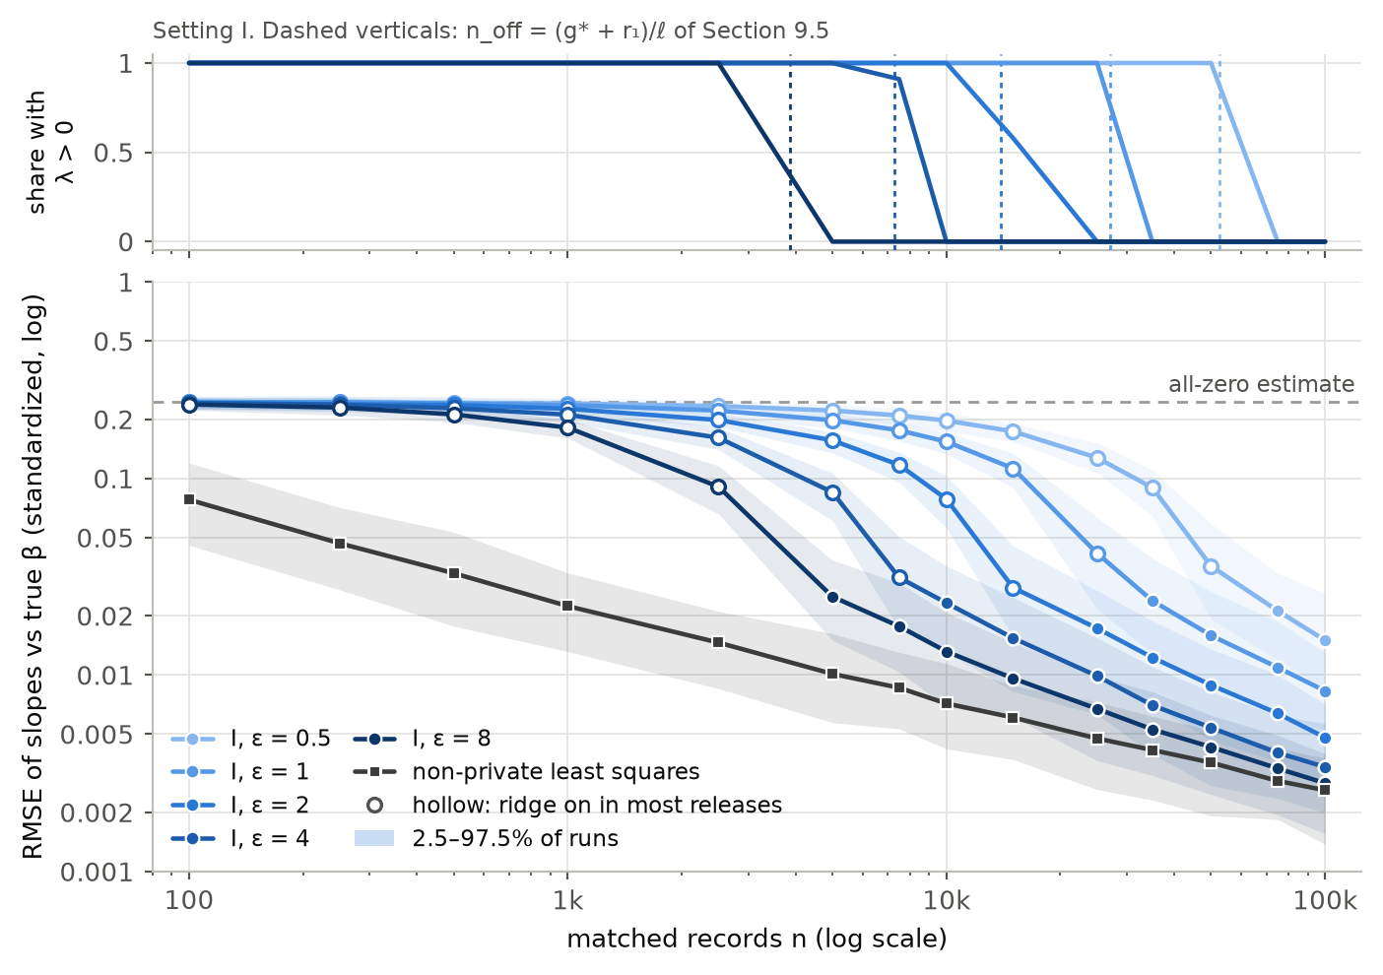
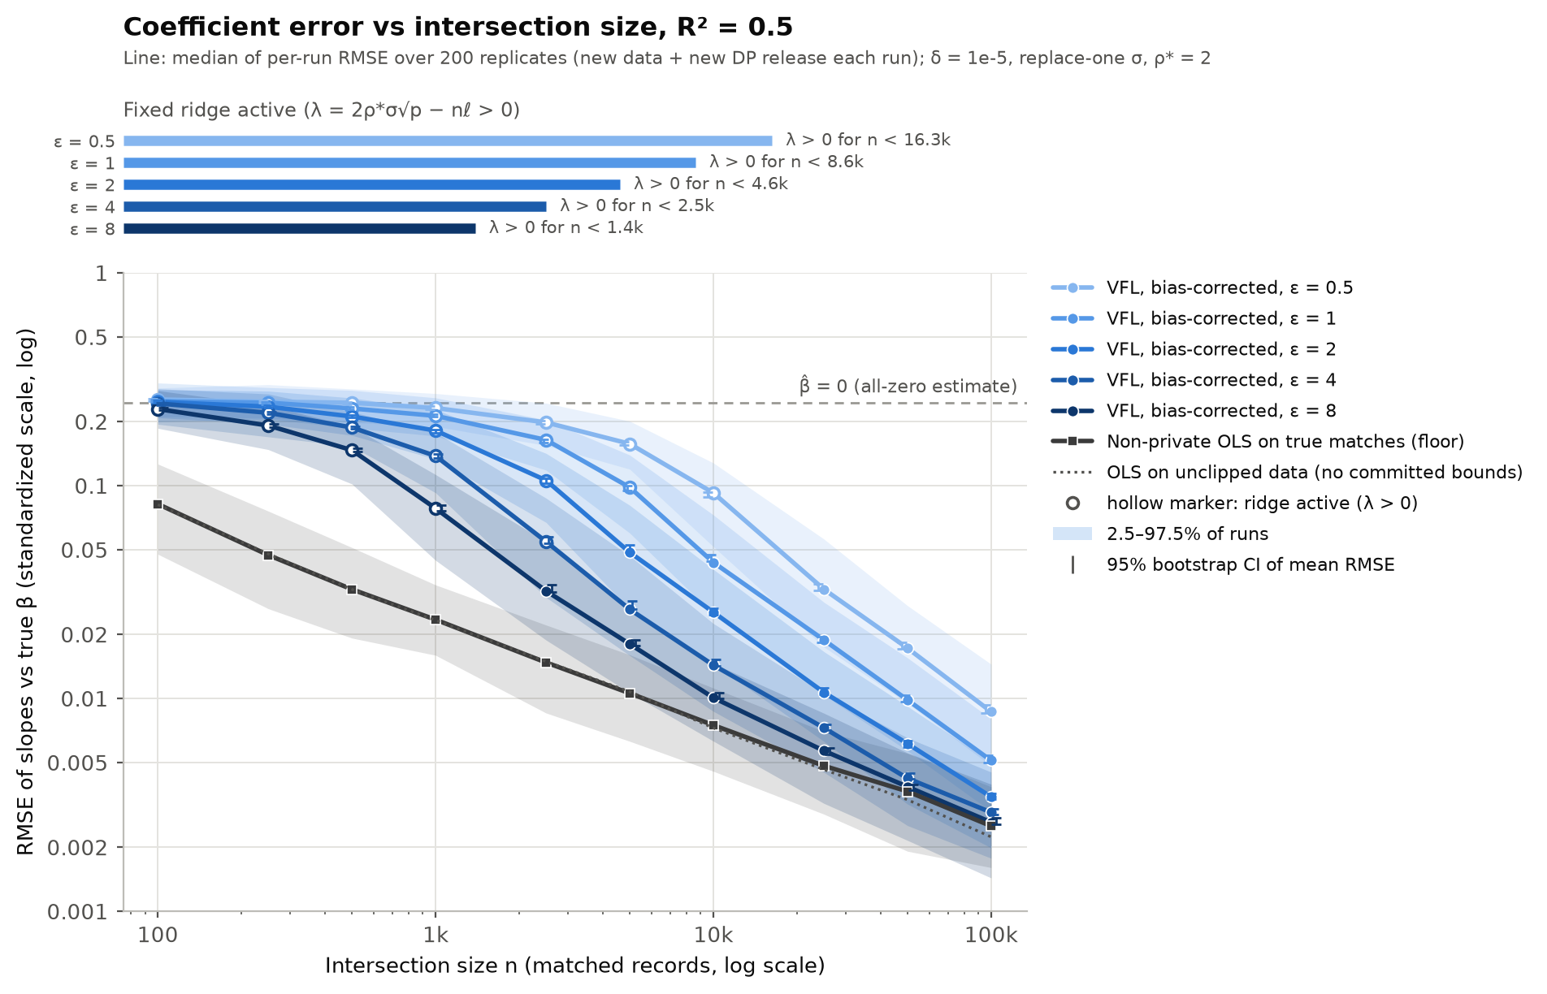
Accuracy against intersection size
Simulation, R² = 0.5, setting I, δ = 10⁻⁹, 200 cohorts per n
Within 2× of non-private least squares at
ε = 8
n ≈ 8.0k
ε = 4
n ≈ 27k
ε = 2
n ≈ 88k
ε = 1
n > 100k
Small n: the ridge pulls the estimate towards 0
Ridge off at n_{off} = 3.9k–53k, 35% sooner than before
Prediction within 10% much earlier: 20k (I), 13.7k (P) at ε = 1
Notes:
Root mean squared error of the standardized slopes against the true coefficients, setting I, over 200 cohorts per n, each with new data and a fresh pair of releases, against the non-private floor. The top panel shows the share of releases in which the stage-1 ridge is on. At small n the ridge dominates and the estimate is pulled towards zero, the dashed line. The ridge switches off at 3.9k matched records for epsilon 8 up to 53k for epsilon 0.5, 35 percent sooner than at the previous setting. Once it is off, the DP error falls like 1/n, faster than the sampling error's 1/sqrt(n), and the curves merge into the floor. The coefficients come within twice the non-private error at 8.0k, 27k and 88k records for epsilon 8, 4 and 2, and not within 100k at epsilon 1. Prediction is much more forgiving: test error within 10 percent of non-private needs 20k records under setting I and 13.7k under setting P at epsilon 1.

Slide 44
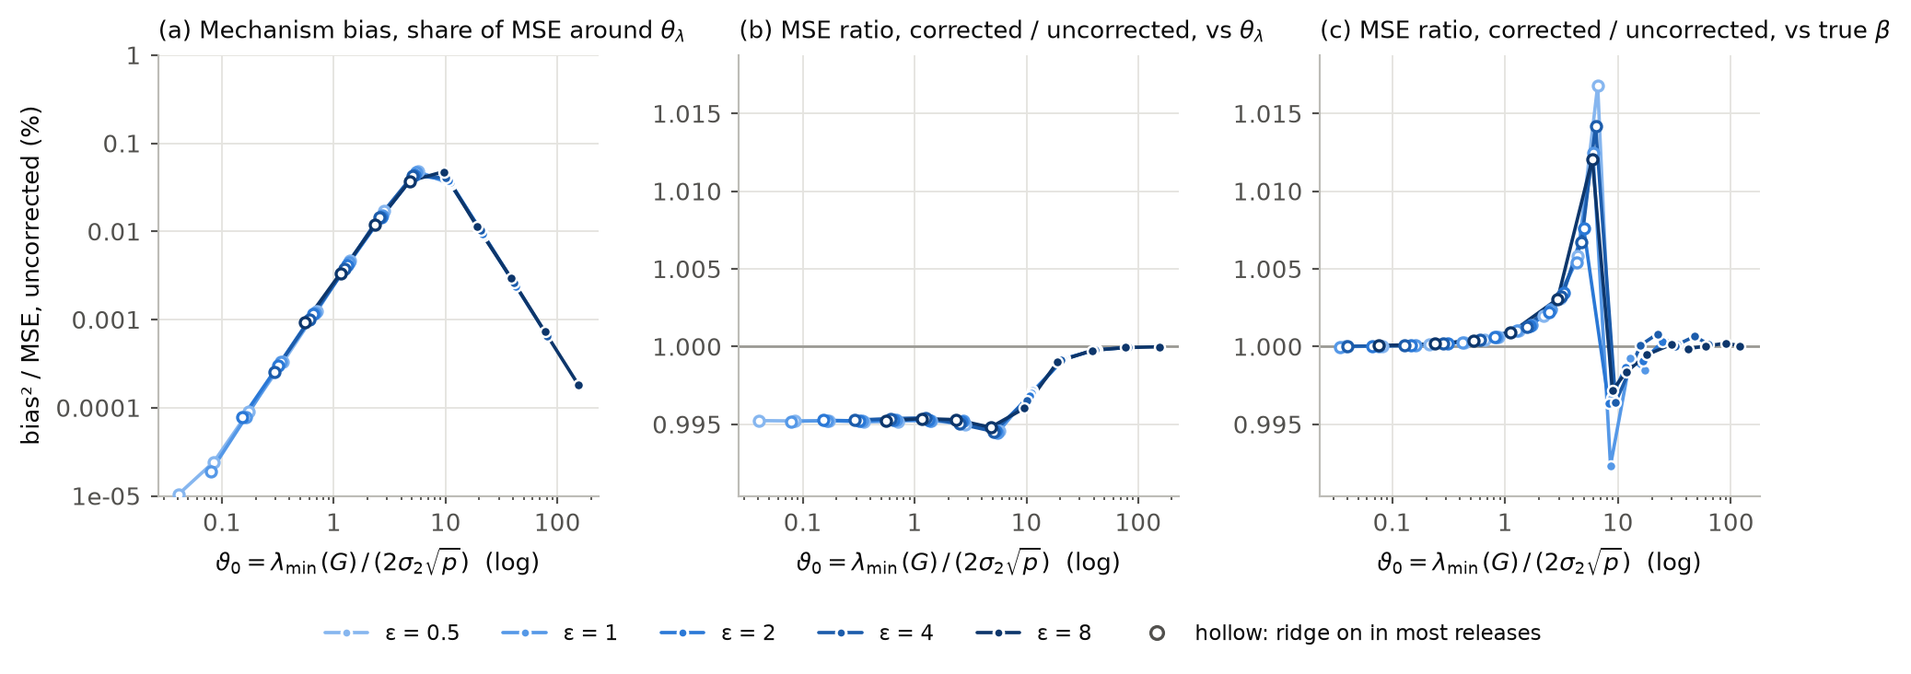
Where the error comes from when σ is large
ϑ₀ = λ_{min}(G) / (2σ₂√p)
Mechanism bias under I: ≤ 0.19% of the MSE around θ_{λ} (cell average; 0.24% worst case)
The optional correction gains only 1.4–1.7%: it stays off
At large n, clipping shifts the target slightly (any DP method pays this)
Error anatomy
So what?
The ridge, not the noise, limits accuracy at small n: tighter bounds and more matched records help most
ϑ₀ compares the weakest part of the signal with the size of the noise, and it grows like n/σ, roughly n·ε. Figure: v3.1 at the previous setting.
Notes:
The figure is the bias study under v3.1 at the previous setting, plotted against the validity ratio theta_0 = lambda_min(G) / (2 sigma_2 root p): left to right means more data relative to noise. Panel (a): the bias that the noise itself causes, through inverting a noisy matrix, as a share of the mean squared error; it peaks near the switch-off of the ridge and is below 0.05 percent there. Under setting I, which holds the validity ratio near 5 instead of 8 to 9, it is larger but still negligible: at most 0.19 percent of the mean squared error around theta_lambda, averaged over a cell, and 0.24 percent in the worst single case. Panels (b) and (c): the optional correction changes the mean squared error by a fraction of a percent; under setting I it gains 1.4 to 1.7 percent with the ridge on, mostly a variance reduction, so it stays off. With the ridge on, the error against least squares is mostly deterministic shrinkage. The practical message: at small n, accuracy is limited by the ridge, so tighter bounds and more matched records are what help.

Slide 45
Intervals that hold up
Setting I, δ = 10⁻⁹: simulation of the exact mechanism, real data with calibrated noise, and encrypted runs
Check | Size | Ridge | Wald interval for θ_{λ} (target 0.955) | Bias-aware interval for β (target ≥ 0.95)
Synthetic population | 70 cells × 200 releases | on in 43 cells, off in 27 | 0.945–0.966 in every cell | 0.930–0.964 with the ridge off; unbounded while it is on
Repeats, previous setting | 10,000 releases each | off (synthetic); on (protein) | ε = 8: 0.9554; protein: 0.9548–0.9577 | —
Real data, calibrated noise | 48 cells × 1,000 releases | on in 40 cells, off in 8 | 0.945–0.964; protein 0.952–0.963 | not checkable on a fixed cohort
Encrypted runs (OpenFHE) | 250 and 100 runs | on (ε = 2) / off (ε = 8) | 0.954 / 0.958 | —
Reading the table
For contrast
Pooled over coefficients and releases; target 0.955
Wald hits its target with or without the ridge, plaintext or encrypted
The β interval is valid, informative only once the ridge is off
A naive Wald interval read as an interval for β covered only 9–85% while the ridge was on (41 cells). Ferrando–Wang–Sheldon intervals are finite there, but cover θ_{λ} only 0.57–0.86. Naming the target matters.
Notes:
Coverage of the two intervals under setting I. On the synthetic population, 70 cells of n and epsilon with 200 releases each, the Wald interval for theta_lambda covers 0.945 to 0.966 in every cell, with the ridge on or off. The bias-aware interval for beta covers the true slopes 0.930 to 0.964 once the ridge is off; while it is on, the private bound on the norm of beta is usually zero and the interval is unbounded. The two borderline cells of the earlier encrypted checks were repeated with 10,000 plaintext releases each: 0.9554 on the synthetic data at epsilon 8 and 0.9548 to 0.9577 on protein, so they are on target. On five real datasets, with fixed cohorts and the noise of a real budget, the Wald interval covers 0.945 to 0.964 over 48 cells, and 0.952 to 0.963 on protein. In the encrypted runs it covers 0.954 with the ridge on and 0.958 with it off. For contrast, a naive Wald interval around a ridge estimate, read as an interval for beta, covers only 9 to 85 percent while the ridge is on: the ridge bias is not small. The lesson is to be explicit about which target an interval is for.

Slide 46
Real data against central DP
Test MSE ÷ own non-private MSE at ε = 1, δ = 10⁻⁶, 10-fold cross-validation; v3.1 with block normalization
Dataset | n | d | Predict zero | AdaSSP (published) | v3.1 I | v3.1 P
housing | 506 | 13 | 2.81× | 1.83× | 2.44× | 2.28×
wine | 1,599 | 11 | 2.83× | 1.75× | 1.87× | 1.73×
airfoil | 1,503 | 5 | 1.94× | 1.10× | 1.43× | 1.27×
concrete | 1,030 | 8 | 2.87× | 1.53× | 2.56× | 2.26×
bike | 17,379 | 17 | 3.85× | 1.04× | 1.38× | 1.22×
elevators | 16,599 | 18 | 4.21× | 1.56× | 1.13× | 1.10×
pol | 15,000 | 26 | 2.56× | 1.04× | 1.53× | 1.38×
kin40k | 40,000 | 8 | 1.00× | 1.00× | 1.00× | 1.00×
protein | 45,730 | 9 | 1.40× | 1.01× | 1.02× | 1.01×
1.0× = as good as each method’s own non-private fit; lower is better; bold = lowest private ratio.
AdaSSP needs the joined table and protects the whole record, but its guarantee is only nominally stronger: under our replace-one adjacency its published constants give ε up to 28% above nominal. Elevators: block normalization’s own non-private fit is 2.6× worse, so AdaSSP still wins in absolute MSE. Predict zero: ÷ Wang’s non-private fit.
Notes:
Nine of the 29 datasets, at epsilon = 1 and delta = 1e-6. Each number is test MSE divided by the method's own non-private MSE, so 1.00 means no loss. Predicting zero is the floor any useful method must beat. AdaSSP, with Wang's published algorithm and preprocessing, needs all the data pooled with one curator, so it is not available in our setting, but it shows what a central method achieves. v3.1 uses block normalization, where each party normalizes its own block of every row, the preprocessing a vertical deployment can actually use, under setting I and setting P. AdaSSP's guarantee covers the whole record, so it looks stronger, but only nominally: its published constants are calibrated for add-or-remove adjacency, and under our replace-one adjacency they give an epsilon up to 28 percent above the nominal one, at epsilon 8; recalibrating it exactly would raise its test error by a median 2 to 3 percent. The earlier claim that AdaSSP is more private at the same nominal epsilon is withdrawn. Setting P is better than setting I almost everywhere, and AdaSSP is ahead on most datasets. Elevators is the exception in this ratio, because block normalization makes its own non-private fit much worse; in absolute test error AdaSSP still wins there.

Slide 47
Across privacy levels
Test MSE ÷ own non-private MSE, three datasets of increasing size, δ = 10⁻⁶; bars: 95% CI over folds
v3.1, setting I
AdaSSP (published)
v3.1, setting P
29 datasets, vs AdaSSP | ε = 0.5 | ε = 1 | ε = 8
P: better / worse | 6 / 19 | 5 / 20 | 3 / 15
I: better / worse | 6 / 19 | 5 / 20 | 1 / 21
Median gap (%), P / I | +10 / +15 | +14 / +25 | +4 / +11
AdaSSP on the joined table is ahead on most datasets; the gap shrinks with ε. The cause is the stage-1 ridge, 1.8× (P) and 2.8× (I) AdaSSP’s under the same guarantee, sized for valid intervals; v3.1’s stage-2 noise is lower.
Better / worse: paired over folds, 95% CI, absolute test MSE; the rest are ties.
Notes:
Native charts from reports/v31_P2/adassp_benchmark_P2.json; verdicts over all 29 datasets from the same file. Each curve is test MSE relative to the method's own non-private fit, as epsilon goes from 0.5 to 8, for AdaSSP with Wang's published constants and for v3.1 with block normalization under settings I and P. On housing, the smallest, AdaSSP is clearly ahead. On elevators the v3.1 ratio is lower, but only because block normalization makes its own non-private fit worse; in absolute error AdaSSP still wins. On protein, with 45k rows, the curves nearly coincide. Over the 29 datasets v3.1 is worse than AdaSSP on 19 to 20 at epsilon up to 1, under either setting; the median gap at epsilon 1 is 14 percent under P and 25 percent under I, and at epsilon 8 it is 4 and 11 percent. The cause is the stage-1 ridge, 1.8 times AdaSSP's under P and 2.8 times under I at the same guarantee: it is sized to certify the validity ratio, which the intervals need and which AdaSSP does not provide. v3.1's stage-2 noise is in fact lower than AdaSSP's under the same guarantee.

Slide 48
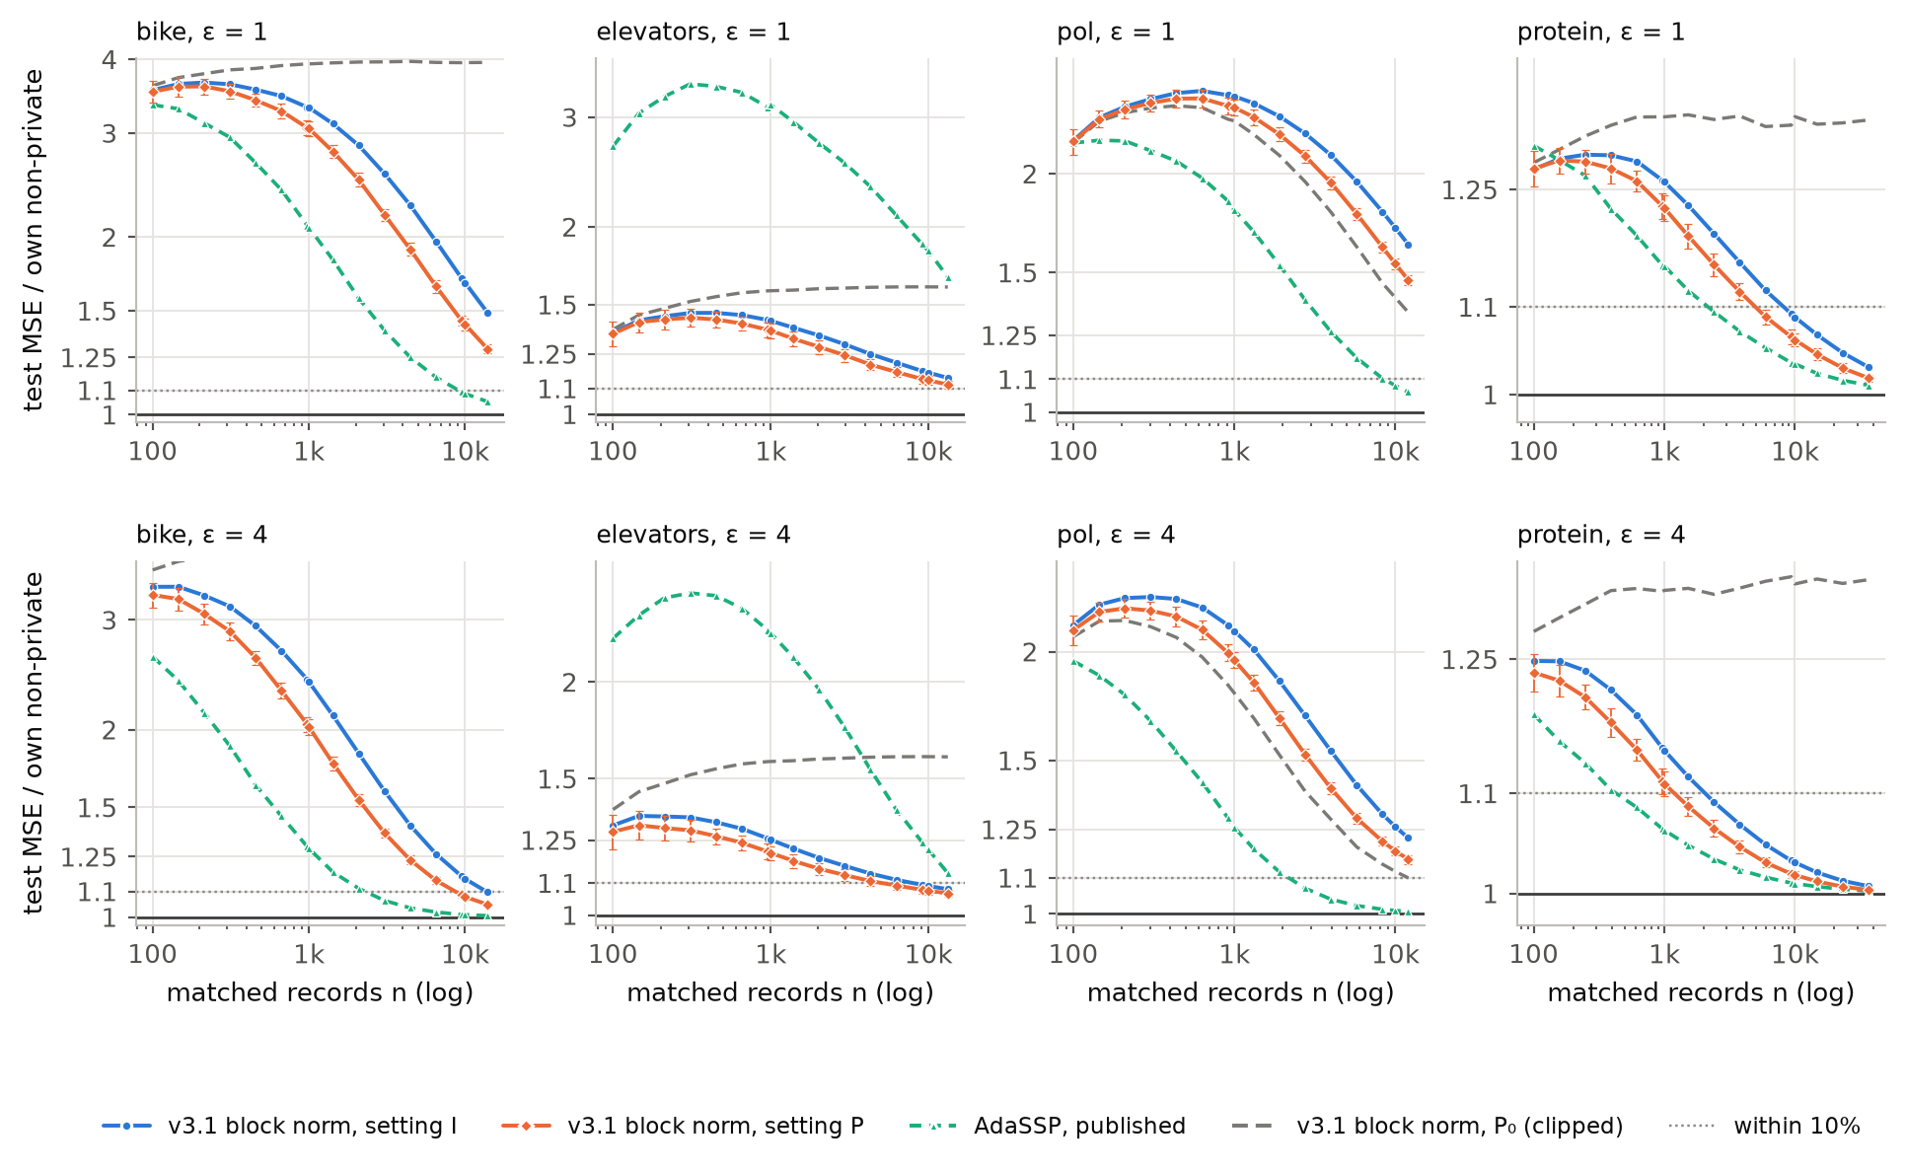
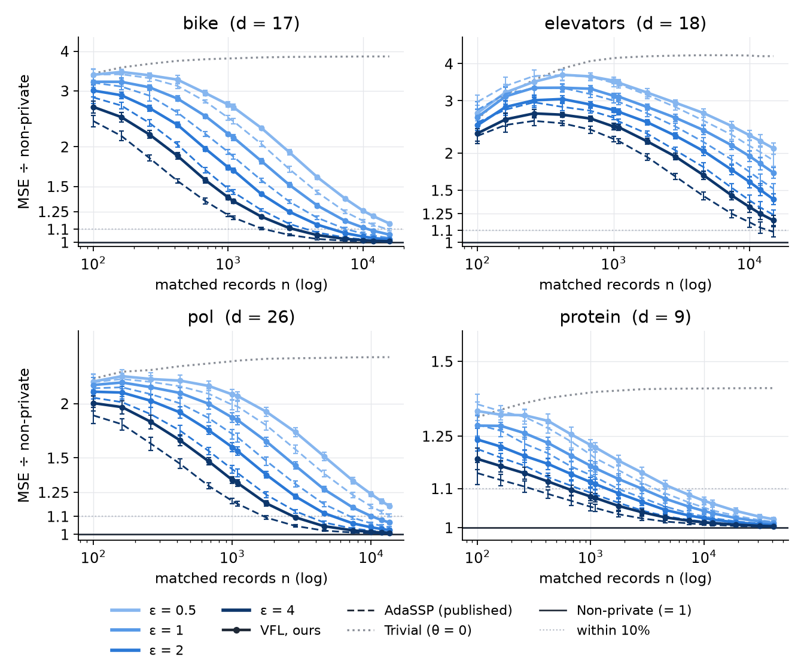
How many matched records on real data?
Test MSE ÷ own non-private MSE at the same n; nested training subsets; block normalization; δ = 10⁻⁹
Matched records to come within 10% of own non-private
v3.1 P / v3.1 I / (AdaSSP, published)
 | ε = 1 | ε = 2 | ε = 4 | ε = 8
bike | >13.9k >13.9k (9.1k) | >13.9k >13.9k (4.5k) | 8.6k 13.6k (2.3k) | 4.5k 7.3k (1.2k)
elevators | >13.3k >13.3k (>13.3k) | 9.5k >13.3k (>13.3k) | 5.1k 8.0k (>13.3k) | 2.5k 4.1k (8.8k)
pol | >12.0k >12.0k (8.5k) | >12.0k >12.0k (4.3k) | >12.0k >12.0k (2.2k) | 10.5k >12.0k (1.0k)
protein | 5.0k 8.2k (2.2k) | 2.5k 4.1k (992) | 1.2k 2.1k (427) | 599 985 (166)
Doubling ε roughly halves the records (protein, P: 5.0k → 2.5k → 1.2k → 599)
On protein P needs 2.3–3.6× and I 3.7–5.9× the records of AdaSSP
Elevators reaches 10% of its own (worse) non-private fit before AdaSSP
Notes:
The real-data counterpart of the simulation curves, under v3.1 with block normalization at delta = 1e-9. For four datasets with many rows we took nested subsets of the training folds as the matched set and measured test error relative to each method's own non-private fit. The table gives the number of matched records needed to come within 10 percent: setting P, setting I, and in brackets AdaSSP on the joined table. On protein, P needs 5.0k records at epsilon 1 and I needs 8.2k, against 2.2k for AdaSSP; doubling epsilon roughly halves each count, as the scaling law predicts. P needs 2.3 to 3.6 times AdaSSP's records on protein and I 3.7 to 5.9 times. Bike and pol do not get within 10 percent at the sizes available except at large epsilon. Elevators gets there before AdaSSP, but against its own non-private fit, which block normalization makes worse. 'Within 10%' is not equally hard on every dataset: on protein, predicting zero is already only 1.4 times worse than non-private.

Slide 49
Other baselines
Full-record SSP
FWS intervals
TukeyEM
Noise on R’s block A too, the protocol otherwise unchanged: test MSE about 1% higher on the 29 datasets, 7–18% more records on the synthetic population, about 1.16× the run time.
Ferrando–Wang–Sheldon bootstrap on our stage-2 release: covers θ_{λ} only 0.57–0.86 while the ridge is on. For β it equals our interval once the ridge is off, and stays finite where ours is unbounded.
Least squares on subsets, chosen by the exponential mechanism; needs no bounds. It releases nothing on 25 of 29 datasets at ε ≤ 2, and is worse than v3.1 (P) on 24–25.
What they tell us
Keeping A exact is a modest accuracy gain, and spends no budget or circuit work on statistics R already holds.
Dropping the bounds does not help at these sizes.
For β while the ridge is on, a bootstrap without the ridge helps from ϑ₀ ≈ 1, about a quarter of n_{off}; below that only θ_{λ} has a useful interval.
Notes:
Three more baselines bound the cost of the design choices. Full-record SSP noises R's own block as well, with the protocol otherwise unchanged; that is what a protocol that treats the whole record as private would do. It raises test error by a median of about 1 percent on the 29 datasets, needs 7 to 18 percent more records on the standardized synthetic population, and costs about 1.16 times the run time. The parametric bootstrap of Ferrando, Wang and Sheldon, run on our stage-2 release, targets beta, not the ridge target: it covers theta_lambda only 57 to 86 percent of the time while the ridge is on. Once the ridge is off it gives the same interval for beta as our bias-aware interval, and while the ridge is on it stays finite and covers where ours is unbounded, from about theta_0 = 1, roughly a quarter of the switch-off size. TukeyEM, which fits least squares on disjoint subsets and needs no bounds, fails its stability test and releases nothing on 25 of the 29 datasets at epsilon up to 2.

Slide 50
Limits and open items
By design
Still to do
Honest-but-curious parties only; a deviating researcher needs zero-knowledge input proofs
R learns which of its cohort are in the register
Exact-identifier linkage; linear models; model-based variance
O's work grows with the padded register, so the scope Φ matters
Runs at 100k–1M register rows; the PSI item length needs about 59 bits at 1M
Redesign the stage-1 rule so the ridge does not overshoot: it is the gap to AdaSSP
Open proofs: the fixed-run admission rule under adaptive requests; β intervals when clipping makes errors heteroskedastic; the PSI noise bound for OpenFHE’s RNS BFV; its error sampler, checked only numerically
Author decisions still pending (e.g. a noise-ratio-dependent P, publishing precision)
Notes:
Limits by design: the guarantee assumes both parties follow the protocol; R learns match status; linkage is on exact identifiers; the model is linear with a model-based variance; and O's cost is linear in its padded register. Much of the earlier to-do list is done: the full protocol is implemented and benchmarked on OpenFHE, the experiments were rerun under its exact two-release rule, the parameter sets are fixed, and the real-data comparison uses preprocessing each party can do on its own. Still open: runs at 100k to 1M register rows, which so far exist only as an extrapolated cost model, and for which the PSI items must be lengthened to about 59 bits to keep false matches below 2 to the minus 40; a stage-1 rule whose ridge does not overshoot, since the ridge is what separates v3.1 from AdaSSP; a few proofs, namely the rule for runs fixed in advance when requests are in fact adaptive, the interval for beta when clipping makes the errors heteroskedastic, the bound on the PSI evaluation noise for OpenFHE's RNS BFV, and the subgaussianity of OpenFHE's error sampler, which is checked only numerically; and several decisions for the authors.

Slide 51
Summary
1
A researcher and an agency can fit a joint regression without pooling: linkage by labeled PSI, sums under split-key encryption, DP noise added inside O's decryption share
2
O’s view reveals only public sizes; R gets (ε, δ)-DP statistics, composed across runs by O’s ledger. Proven for honest-but-curious parties and implemented end to end on OpenFHE
3
Valid intervals for the ridge target (0.945–0.966 in simulation). Protein comes within 10% of non-private at 5.0k (P) and 8.2k (I) matched records for ε = 1
4
Trails central DP on the joined table by a median 14% (P) / 25% (I) at ε = 1, because its ridge is sized for valid intervals
Notes:
Four things to remember. The protocol combines three standard tools so that a researcher and an agency can fit a regression without pooling. Its guarantees are proven for honest-but-curious parties, with a ledger that composes runs, and the whole protocol now runs on OpenFHE. Its intervals for the ridge target hold their level in simulation, on real data and under encryption, and prediction on protein comes within 10 percent of non-private at 5.0k matched records under setting P and 8.2k under setting I at epsilon 1. Against central DP on the joined table it trails by a median 14 percent under P and 25 percent under I at epsilon 1, because its stage-1 ridge is sized to make the intervals valid; that ridge is the main open design question.

