Slide 1
BCPR280 Assignment 2
Zhong Wei

Slide 2
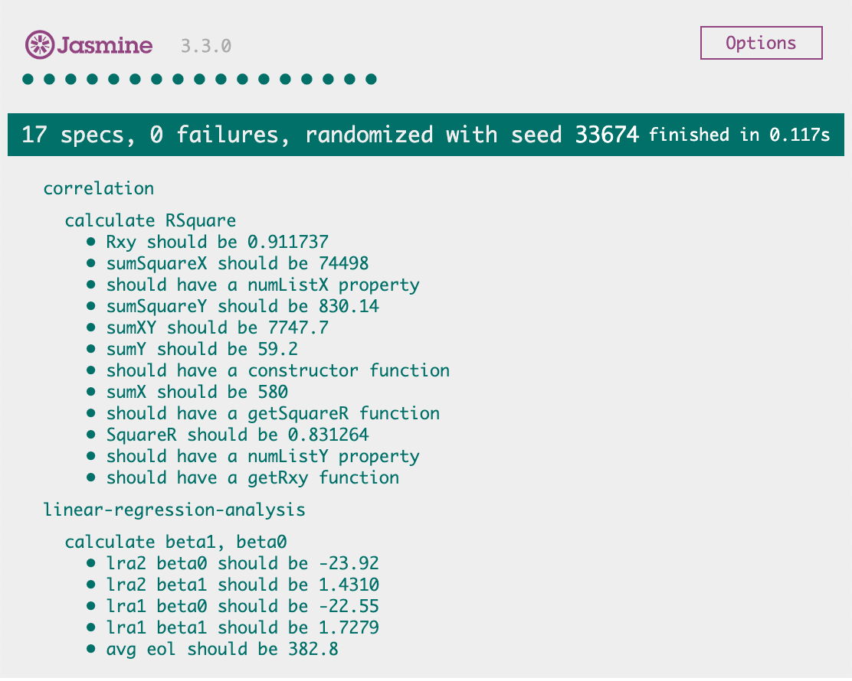
Task 1 & Task 2 & Task 9

Slide 3
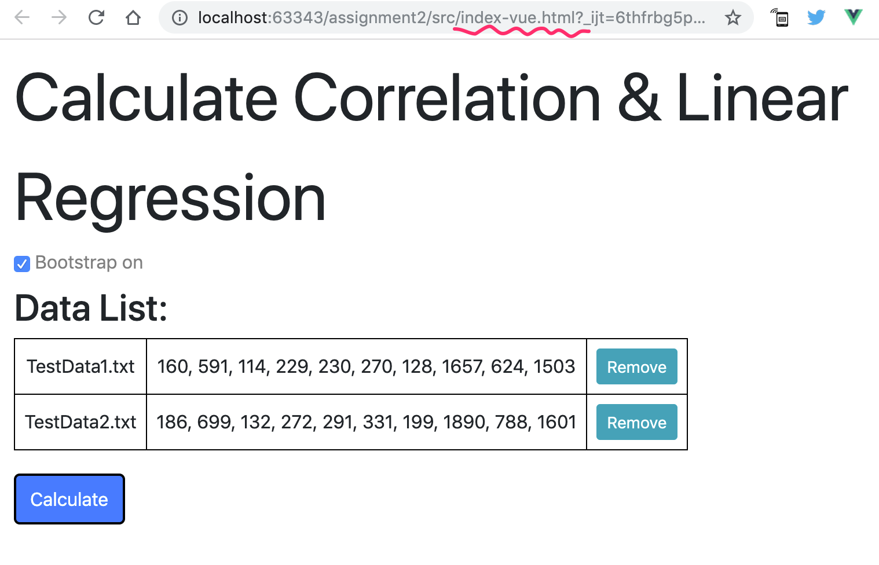
Task 3 Vue.js interface

Slide 4
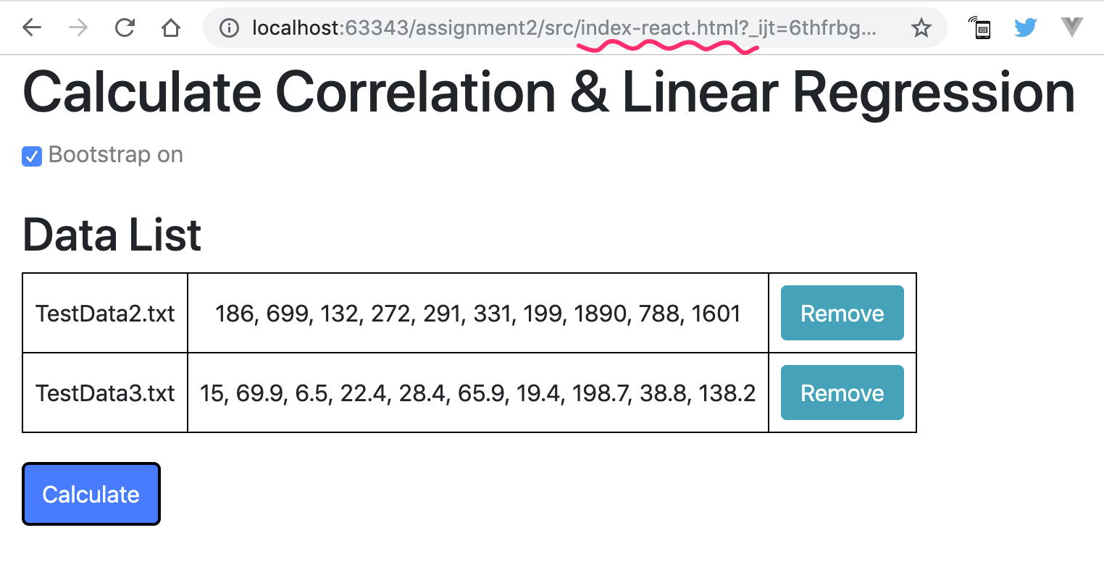
Task 4 React.js Interface

Slide 5

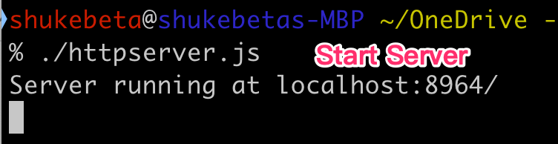

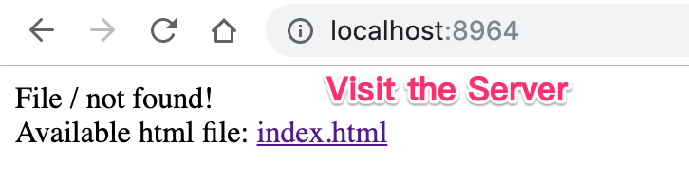

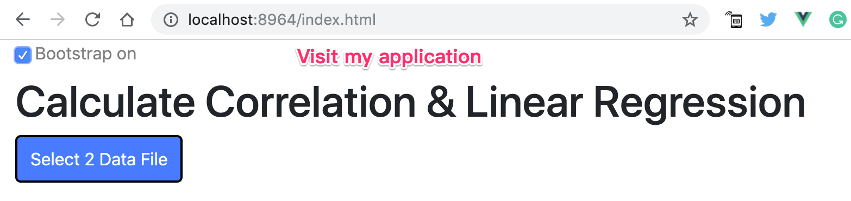
Task 5 Node.JS Interface – HTTP SERVER

Slide 6

Task 6 Enhance UI with BootStrap 4
Layout: <div id="app" class="container-fluid">
Title: <h1 class="display-4"><small>Calculate Correlation & Linear Regression</small></h1>
Table: <table class="table-hover">
Label: <label class="text-black-50">
Button: <button class="btn btn-primary" type="button">Calculate</button>

Slide 7
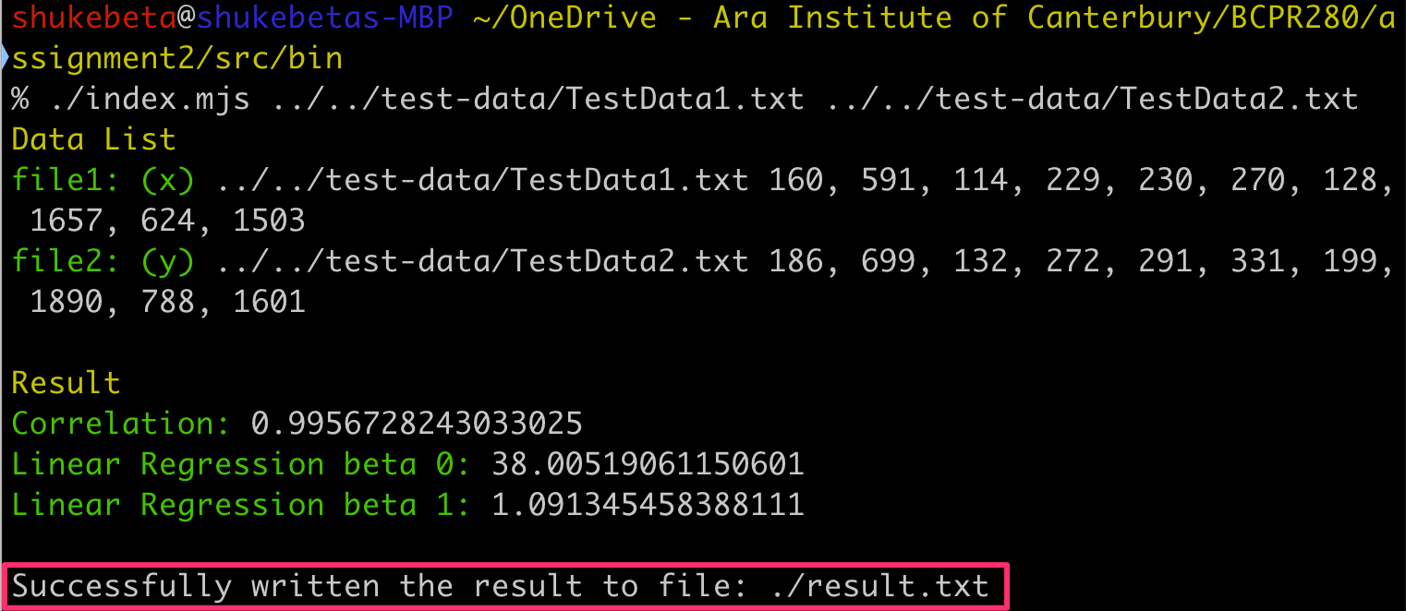
Task 7 Command Line Application

Slide 8
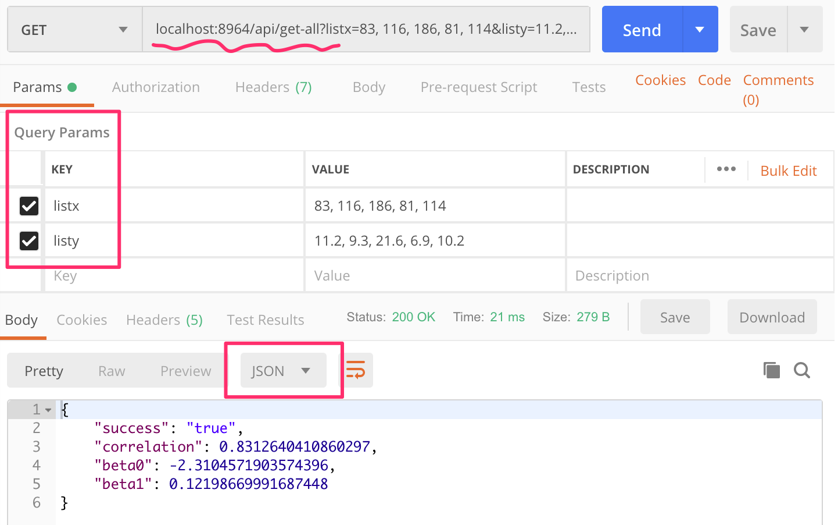
Task 8 Restful API

