Slide 1

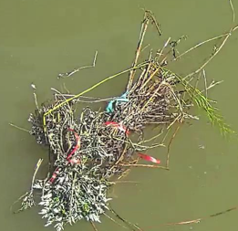
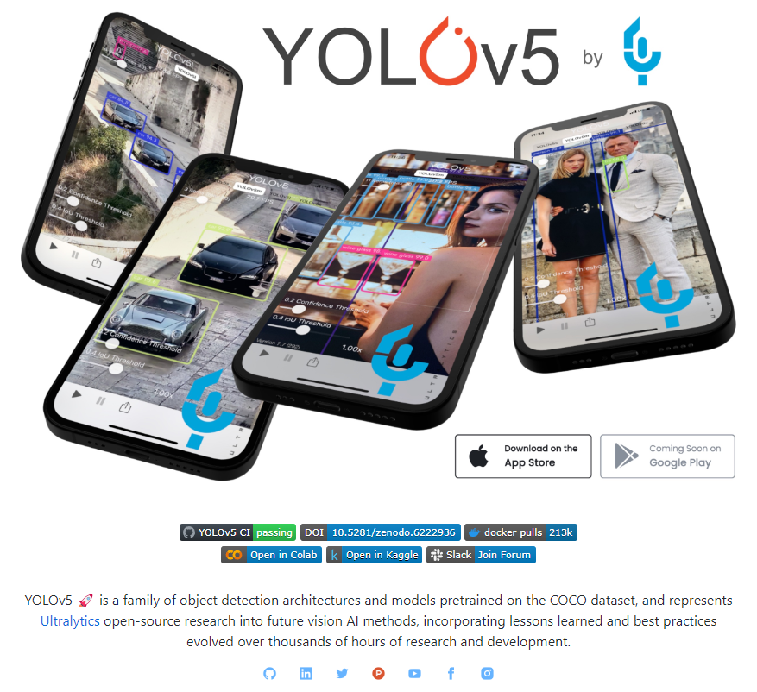
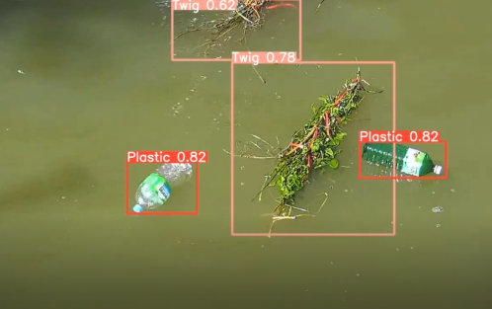
학습 모델 – YOLOv5
2 class training
1. plastic
2. twig
pre-trained model
Yolov5 training
result

Slide 2
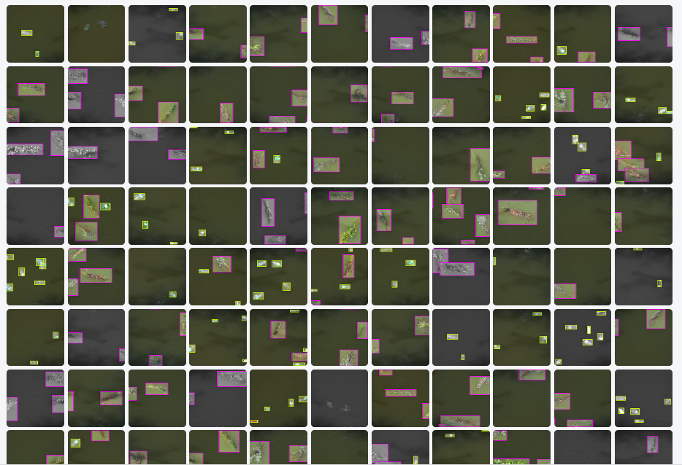
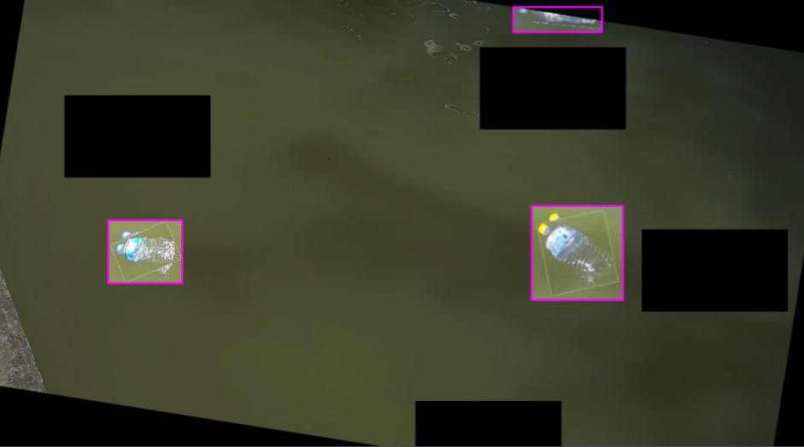
Dataset
218 labeled train images
Augmentation – Cutmix, Rotation

Slide 3
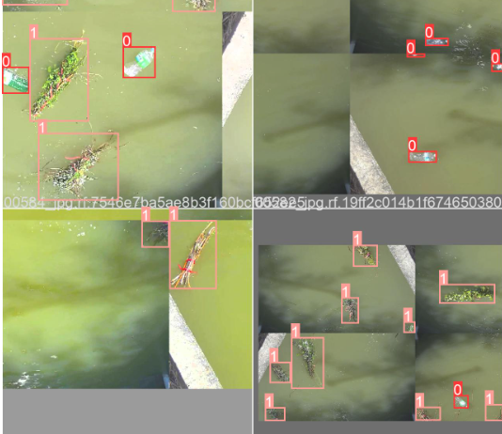
Dataset
218 labeled train images
Augmentation – Mosaic

Slide 4
Results
Original
Inferenced

Slide 5
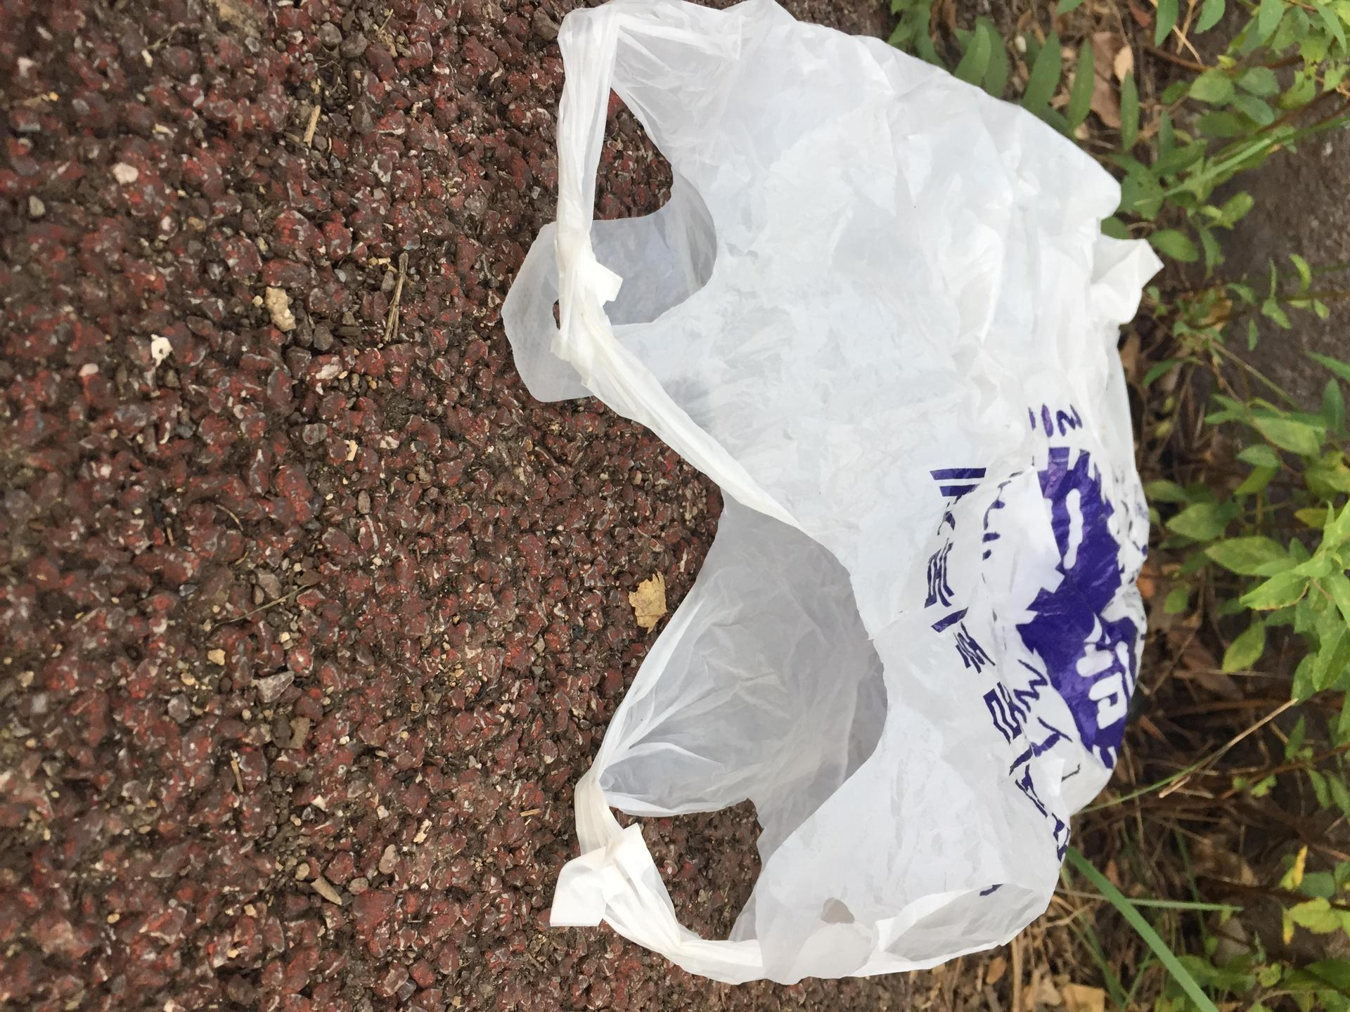
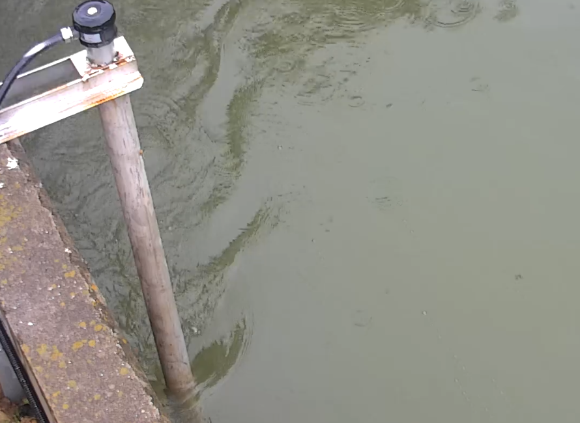
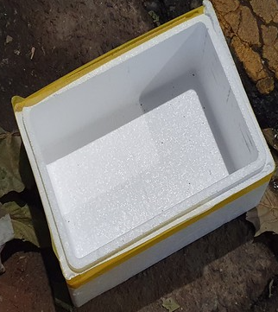
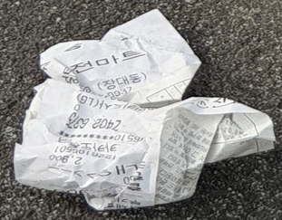
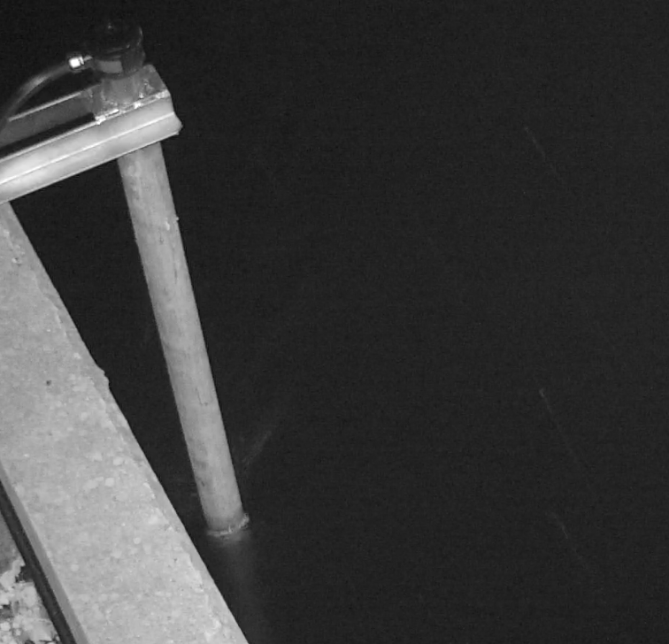
Future plan
Multi class training
Model generalization
1. plastic
2. twig
3. vinyl
비오는날
4. styrofoam
5. paper
어떤 환경에서도 잘 동작하는 모델 구현
….
야간

