Slide 1
ANALYTICS PORTFOLIO
BANKING RISK ANALYTICS,
BUILT END TO END
From raw banking records to a reviewable lending story.

Slide 2
THE PROJECT
THE PROJECT TURNS A RAW BANKING DATASET INTO A REVIEWABLE LENDING STORY
Data quality checks, feature engineering, SQL analysis, and Power BI decision support help an analyst compare exposure, risk mix, and customer financial strength.

Slide 3
The portfolio is large enough to demand structure
3,000
₹1.77 B
88.06%
3,000
unique Client IDs
total bank loans
loan-to-deposit ratio
customers

Slide 4
Four layers move the project from raw records to decisions
Layer | Role in the workflow
Python | Inspect, clean, transform, and explore the data
MySQL | Create a repeatable analytical layer
Power BI | Expose portfolio and customer views
Analyst review | Compare risk, exposure, and coverage before lending decisions
4

Slide 5
Trust starts with data quality, not dashboard polish
Validation. Zero missing values and zero exact duplicate rows.
Key design choice. Client ID is unique across all 3,000 records, so it serves as the customer-level business key for Power BI drill-through and SQL lookups.
Semantic caution. Deposit and account fields may overlap, so combined balances remain project-defined metrics.

Slide 6
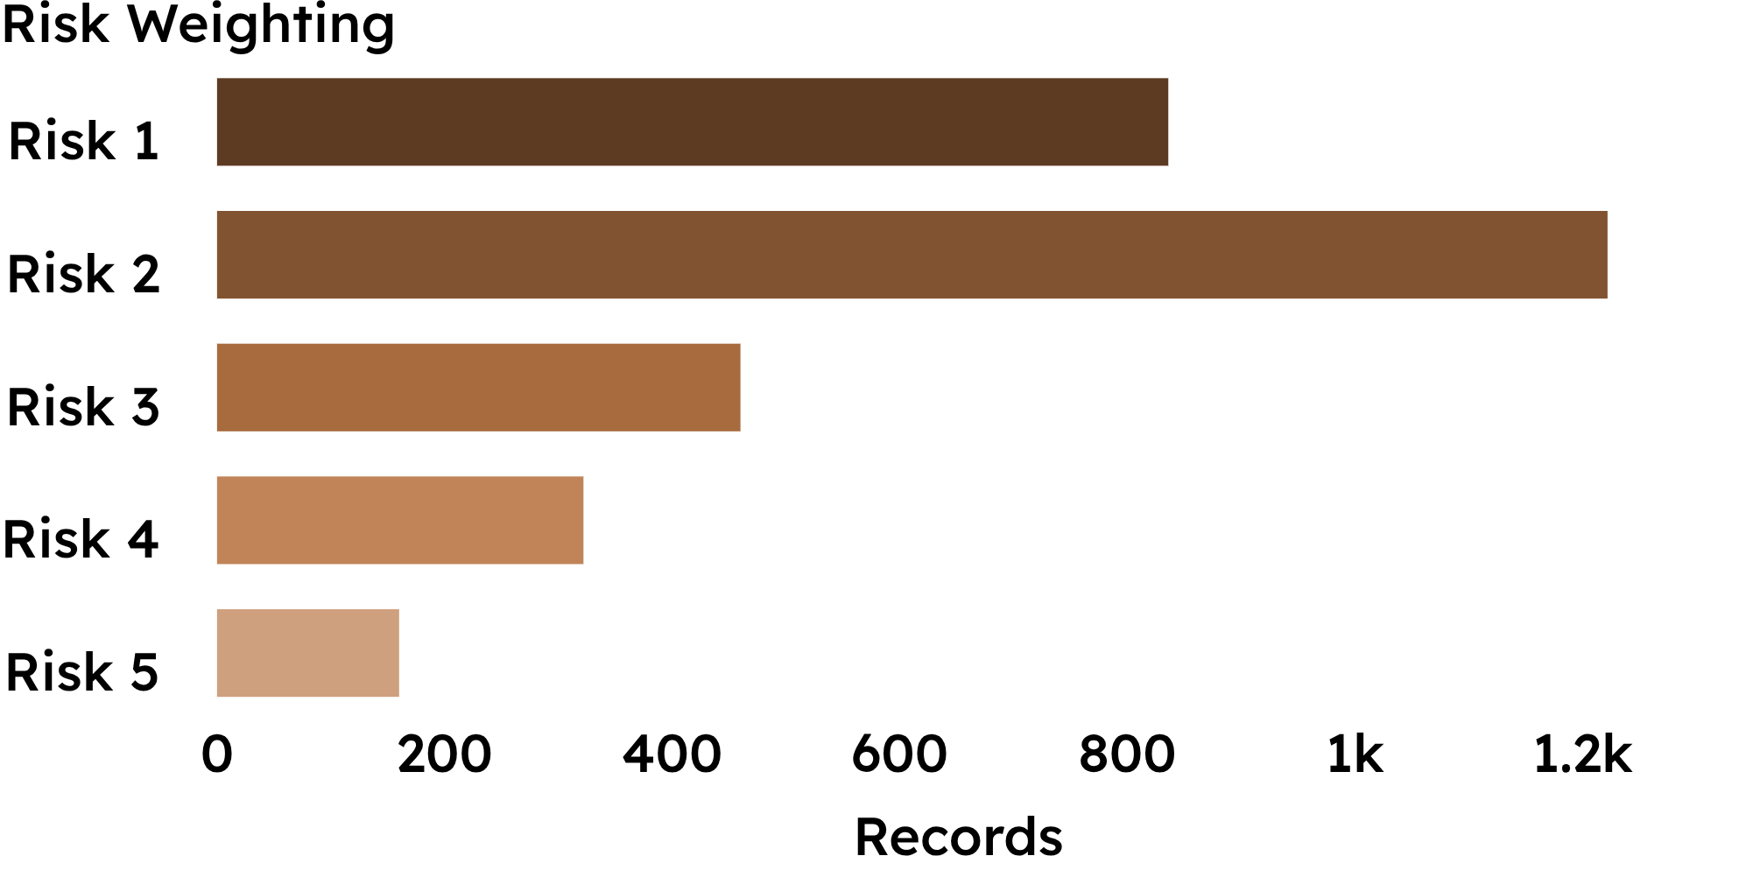
Risk Weighting 2 is the center of gravity, while 16.07% enters the monitoring segment
Risk 2
1,222 records · 40.7%
Risk 1: 836 · 27.9%
Risk 3: 460 · 15.3%
Risk 4–5: 482 records
Monitoring segment: 16.07% of the dataset

Slide 7
PORTFOLIO VIEW
₹2.60 B
₹2.01 B
Exposure is manageable at portfolio level, but business lending dominates
total business lending
total bank deposits
₹429.31 M
₹1.77 B
Deposits exceed loans at portfolio level, while the business-lending book remains the largest exposure.
Risk 4–5 loan exposure
total bank loans
88.06% loan-to-deposit ratio means deposits exceed loans at portfolio level.

Slide 8
Branch 2 deserves attention; Branch 4 carries the highest leverage
One row per unique customer
Branch | Customers | Deposits | Loans | L/D | Risk 4–5
Branch 1 | 660 | ₹425.49 M | ₹380.88 M | 89.52% | 16.1%
Branch 2 | 495 | ₹328.97 M | ₹278.60 M | 84.69% | 18.0%
Branch 3 | 1,352 | ₹925.40 M | ₹814.22 M | 87.99% | 15.1%
Branch 4 | 493 | ₹334.82 M | ₹300.47 M | 89.74% | 16.8%
Branch 3 is largest by customer count. Branch 2 has the highest Risk 4–5 share. Branch 4 has the highest loan-to-deposit ratio.

Slide 9
Customer 360 turns portfolio metrics into a review path
Exposure
Profile
Bank loans, business lending, credit-card balance, and customer credit exposure
Selected customer, age, income, loyalty, and branch
Action
Coverage
Priority Review, Monitor, Opportunity, or Standard Monitoring
Customer loan-to-deposit ratio and deposit strength
These rules support analyst review; they do not automate credit approval.

Slide 10
BOUNDARY CONDITIONS
THE MOST CREDIBLE INSIGHT IS THE BOUNDARY OF THE MODEL
This is descriptive risk analytics, not predictive credit-risk modeling, because the dataset has no default, delinquency, or loss outcome.
Risk Weighting definitions are not documented in the source dataset.
Dashboard thresholds are analytical rules created for the project, not formal policy.

