Slide 1


Note: pls open this file in Microsoft power point
Team : Data Dominators
BCA 1st year | vsics
Problem statement
Rural Women Entrepreneurship Support
Download source code
Download user manual
*Both buttons above contain hyperlinks for downloading the respective files

Slide 2

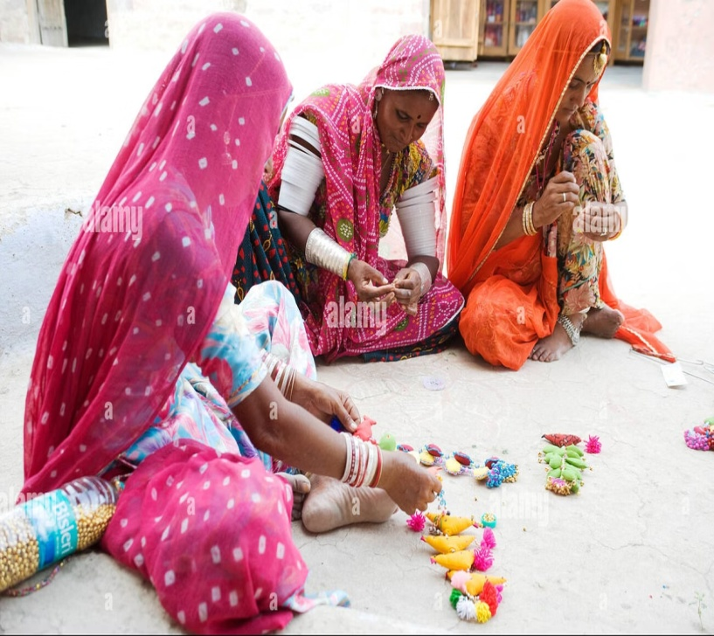

EmpowerHer: Bridging Skills & Opportunities for Rural Women Entrepreneurs
"We believe every rural woman with a skill deserves
a chance to earn, learn, and grow. EmpowerHer is our way of turning that belief into reality. ”
Meet our team
Rishabh shukla
Team leader, backend dev and data scientist
Aarav shukla
Frontend Developer & UI/UX Designer
Rishabh Verma
AI/ML Developer
Sakshi Yadav
Presentation & Documentation
Priyanshi Dixit
Data Analyst & Researcher

Slide 3

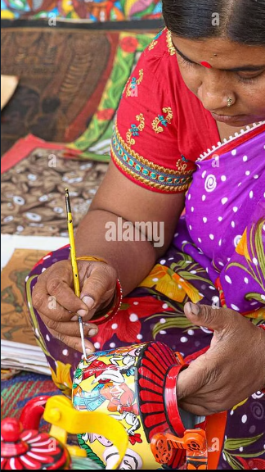
The Challenge: Unlocking the Potential of Rural Women
In villages across India, countless women possess remarkable skills—from weaving and embroidery to food processing and handicrafts. Yet, many struggle to earn a sustainable income because they lack critical resource
Mentorship
Lack of guidance to navigate their entrepreneurial
journey effectively
Access to Markets
Limited platforms where their products are valued and can reach wider audiences
Mentorship
Lack of guidance to navigate their entrepreneurial journey effectively
These barriers not only limit personal growth but also restrict community development. Empowering rural women is not just a social mission it is a key driver for economic upliftment.

Slide 4



`
Our Solution: A Comprehensive Digital Platform
Skill Development
Financial Literacy
Marketplace
To bridge the gap between talent and opportunity, we propose a comprehensive digital platform designed specifically for rural women. Our platform is more than a marketplace—it is a holistic ecosystem that nurtures skills, provides mentorship, and ensures financial empowerment
Mentorship & Skill Development
Personalized guidance from experienced entrepreneurs and skill trainers to help women start and scale businesses.
Financial Literacy & Support
Step-by-step modules covering loans, savings, and government schemes, empowering women to make informed financial decisions.
Mentorship & Skill Development
Personalized guidance from experienced entrepreneurs and skill trainers to help women start and scale businesses.

Slide 5



Platform Features That
Empower
Networking & Peer Support
Community forums and chat features to encourage knowledge sharing, collaboration, and motivation
Mobile & Low-Bandwidth
Accessibility
Optimized for smartphones and low internet connectivity to ensure inclusivity across rural areas.
Optimized for smartphones and low internet connectivity to ensure inclusivity across rural areas.

Slide 6
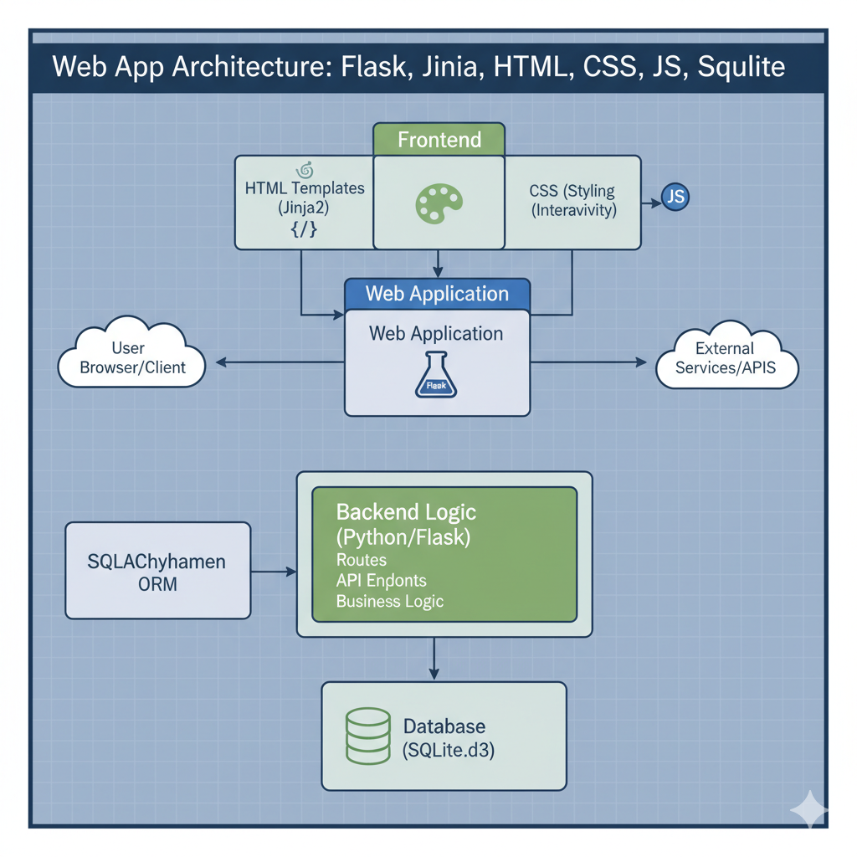
System Architecture
Technology Stack:
Frontend: HTML, CSS, Jinja Templates
Backend: Flask + SQLite
Modules: Auth, Recommendations, Product,
Requests, Knowledge Hub(video, blogs),
govt. schemes
Database: Users, Products, Requests, Blogs,
Videos, Schemes
Why This Stack?
Lightweight
Efficient and fast performance
Scalable
Ready to grow with demand
Beginner-Friendly
Easy to maintain and develop
Fast Development
Quick deployment and iteration

Slide 7
User Workflow: Simple & Intuitive
01
02
Landing Page
Users select their role (Entrepreneur, Mentor, or Buyer)
Signup/Login
Create account and access
Personalized dashboard
03
04
View Recommendations
AI-powered suggestions for role
(Entrepreneur, Mentor, or Buyer)
Send Requests
Connect with mentors or buyers through
secure request system
05
06
Approval & Access
Once approved, access contact details and
begin collaboration
Explore Resources
Browse marketplace, blogs, videos, and
government schemes

Slide 8
Key Platform Features
Role-Based
Dashboard
Each user sees content specific to their role and needs
Smart
Recommendations
AI/Rule-based suggestions for role(Entrepreneur, Mentor, or Buyer
Secure
Requests
Mentors approve requests before contact info is shared
Marketplace
List of products with ease
Knowledge Hub
Blogs, videos, and government schemes for guidance
Multilingual Support
Google Translate for regional language accessibility

Slide 9
Future Enhancements
Our platform is designed to evolve and scale with emerging technologies and user needs. Here's what's on the horizon:
AI-Based Matchmaking
Enhanced recommendations using
machine learning algorithms
1
Direct Chat Feature
Real-time messaging between
users for instant communication
2
Payment Gateway
Integrated marketplace
Transactions for seamless buying
3
Mobile Application
Flutter/React Native
app for enhanced accessibility
4
API Integration
Third-party integration and business
analytics capabilities
5
6
Gamification
Badges and leaderboards to boost
engagement
Direct Buy System
Direct buy and cart system like flipkart
or amazon
7

Slide 10

Impact & Usefulness
EmpowerHer bridges critical gaps by connecting entrepreneurs, mentors, and buyers in a supportive digital ecosystem. Our platform supports early-stage startups to grow faster while providing essential learning resources and government scheme information.
By encouraging digital entrepreneurship in both rural and urban areas, we promote collaboration and networking that drives startup success and community development.
3
Key User Roles
Entrepreneurs, Mentors, Buyers
100%
Digital Inclusion
Accessible across all regions
Empowering rural women is not just a social mission—it is a key driver for economic upliftment and community transformation.

