Slide 1
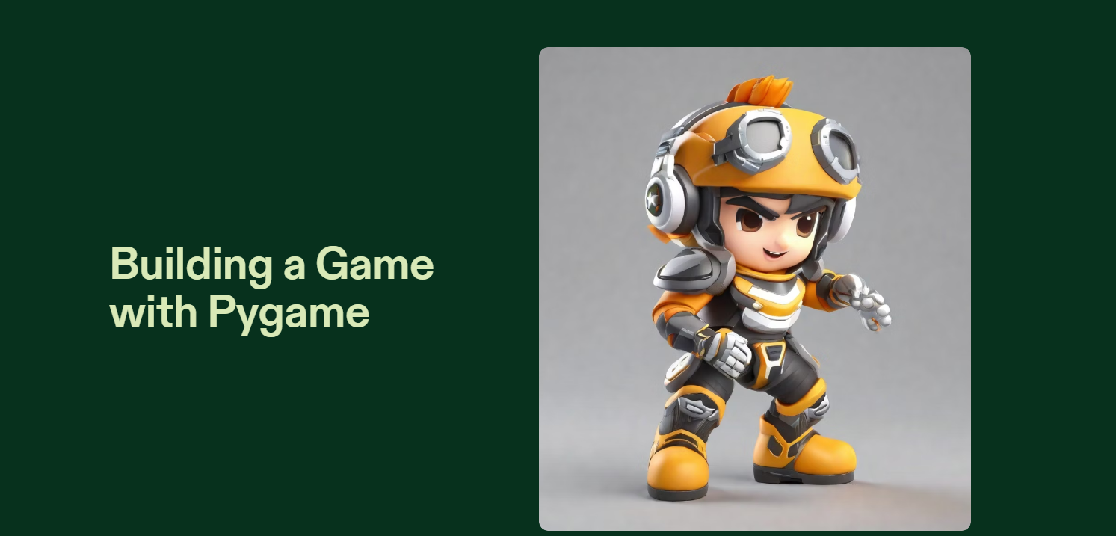

By,
Shambhavi Shukla
21ERWCS073

Slide 2
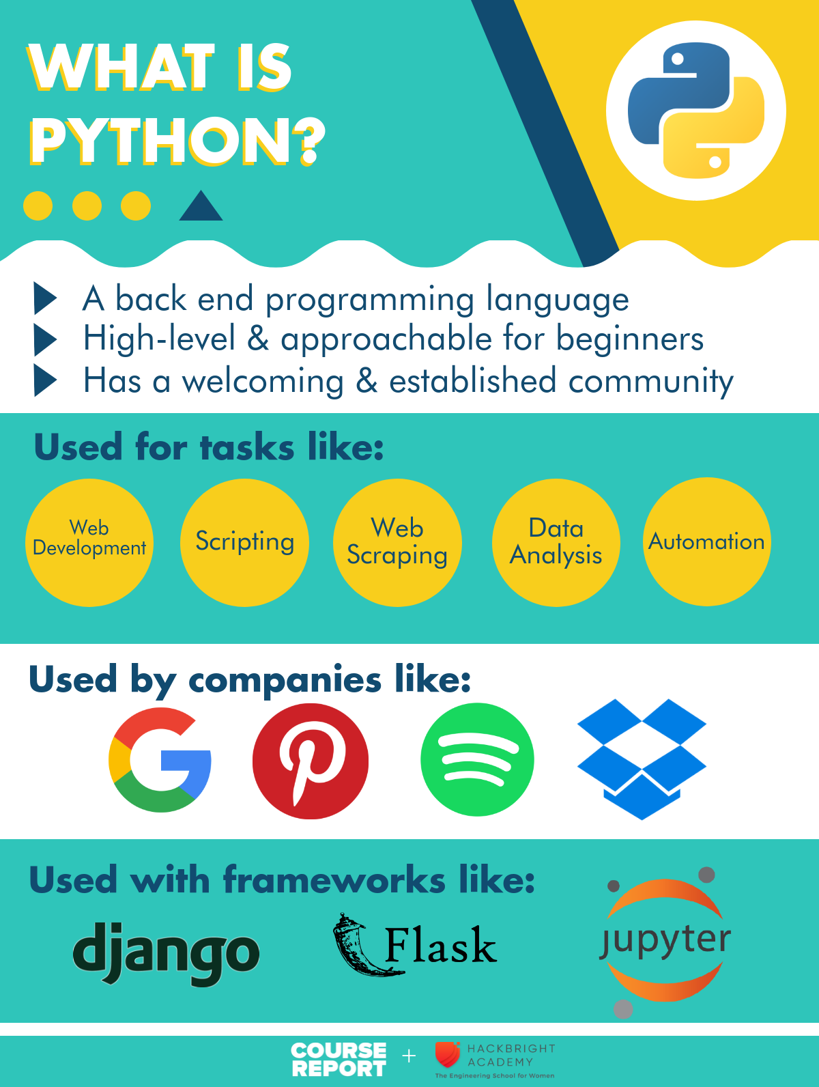

Slide 3
simple graphical Battleship game using Pygames
The Battleship game implemented in this code allows you to click on cells in the grid to guess the location of the hidden battleship. The goal is to find the battleship by guessing the correct row and column.

Slide 4
Library and modules used
library
modules
Pygames
Random(Predefined library in the Python)
Sys(a built-in module that provides access to system-specific parameters and functions.)
Os(it grants access to functions specific to the operating system (OS) your code is running on.)

Slide 5
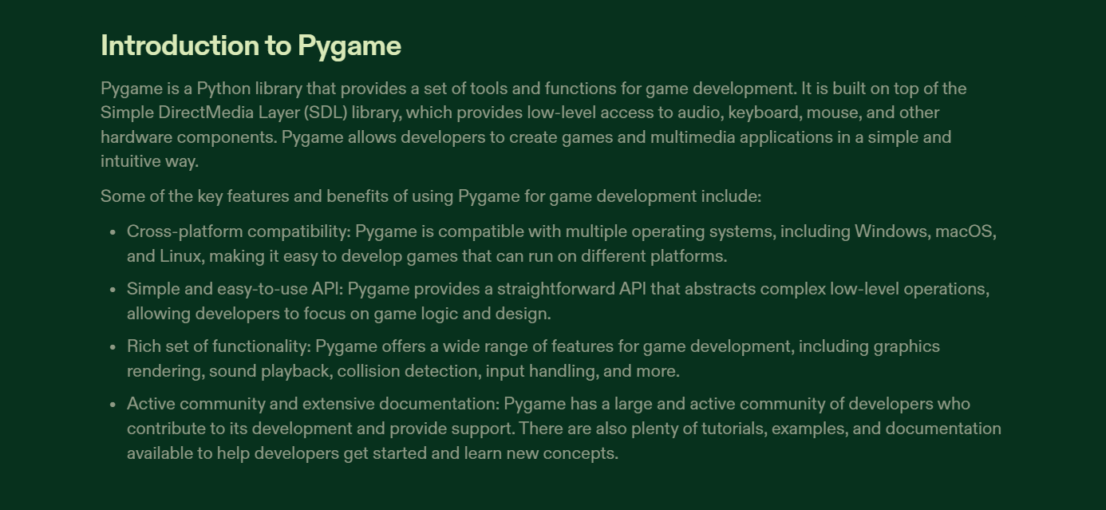

Slide 6
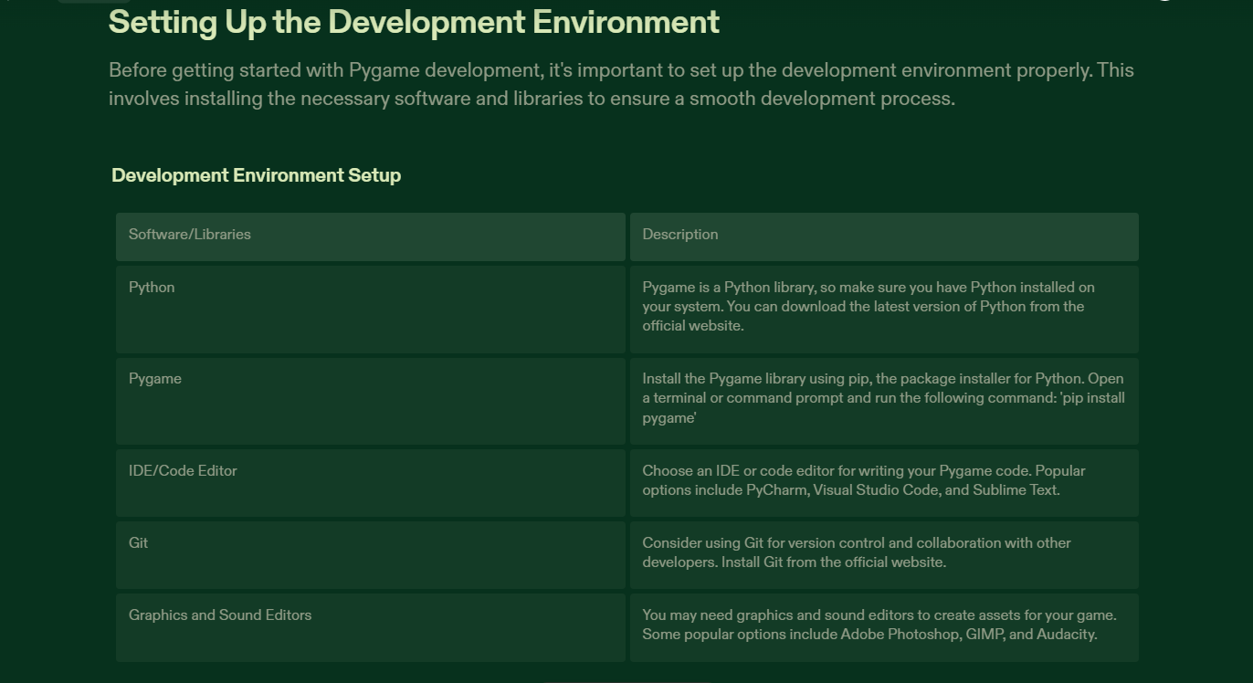

Slide 7
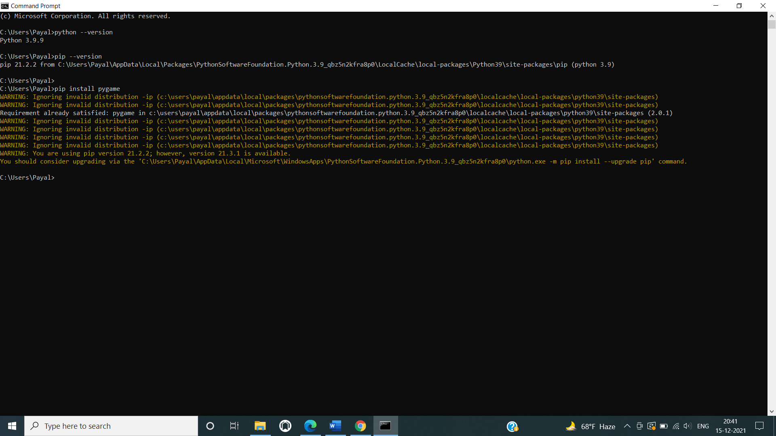
Installation of pygamas library

Slide 8
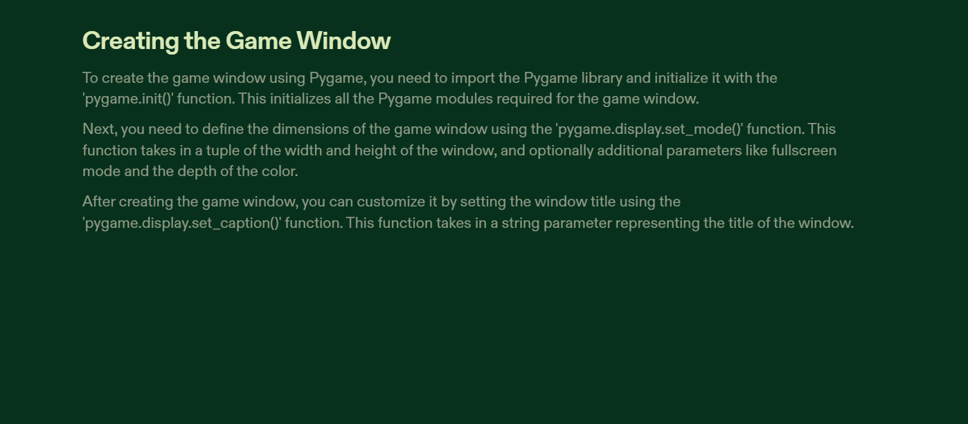

Slide 9
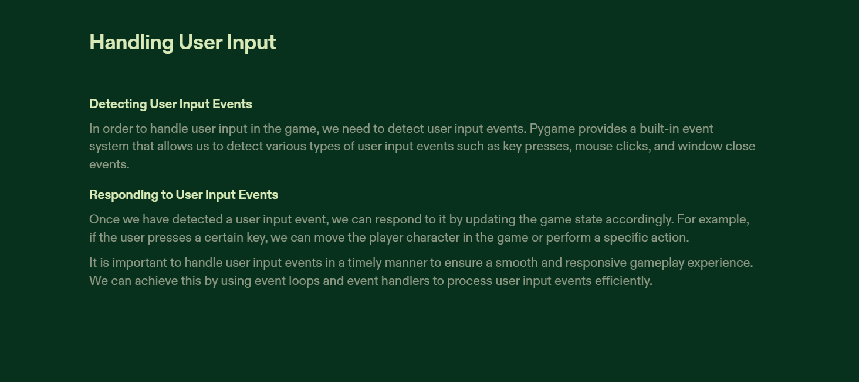

Slide 10
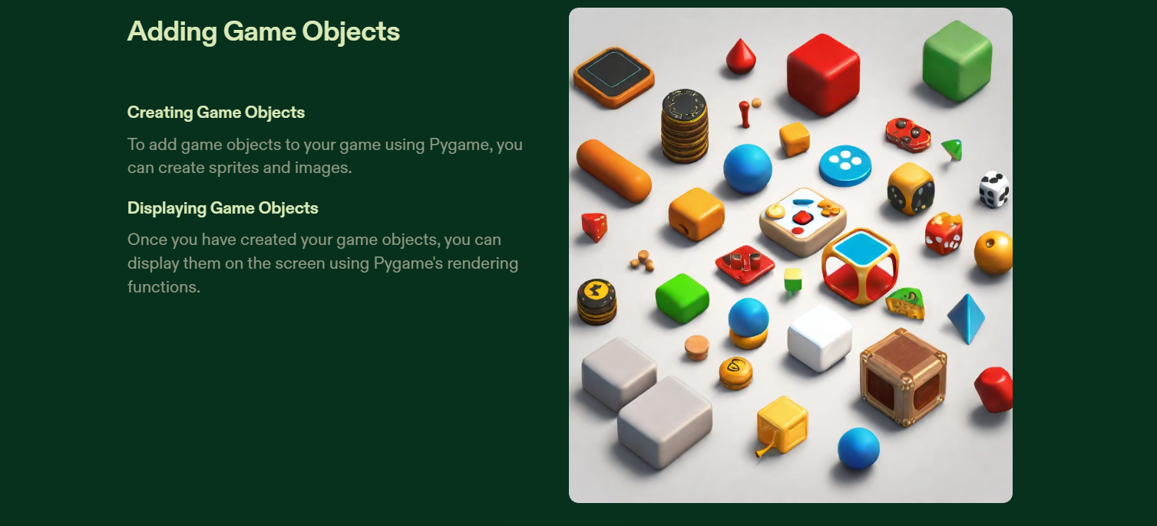

Slide 11
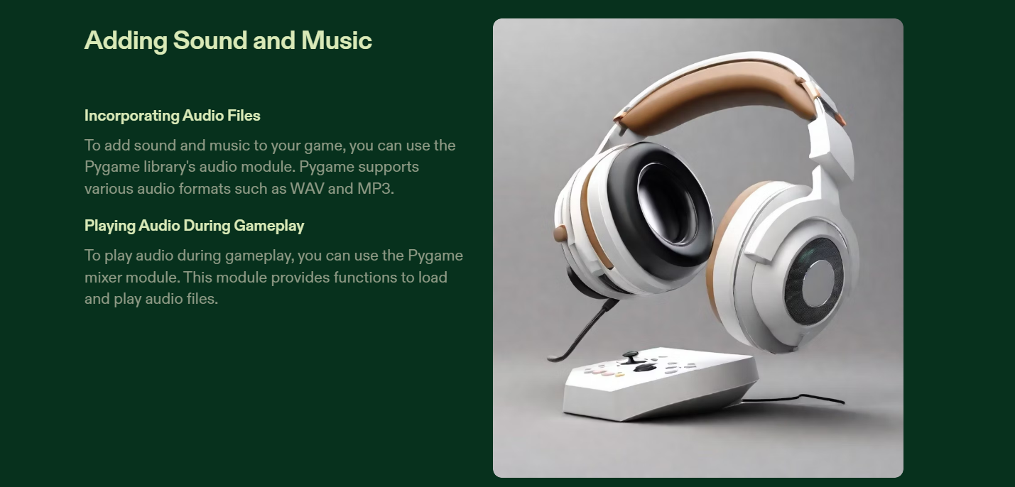

Slide 12
Gameplay:
Initialization: The game starts by creating a grid of cells, where each cell represents a potential location for the battleship. The size of the grid is set to 5x5 by default.
• Guessing the Battleship Location: You, as the player, interact with the game by clicking on the cells in the grid. Your clicks represent your guesses for the battleship's location. When you click on a cell, the game will evaluate your guess.
• Evaluation of Guesses: After each click, the game evaluates whether your guess corresponds to the actual location of the battleship. If your guess matches the battleship's location, you win the game. If your guess is incorrect, the game marks the cell as a "miss" and indicates that you didn't hit the battleship.
• Winning the Game: If you successfully guess the exact row and column where the battleship is located, the game will display a message saying "Congratulations! You sunk my battleship!" This indicates that you've won the game. After this message is shown, the game will pause for a brief moment before closing.
• Continuing the Game: If your guess is incorrect, the game will mark the cell as a miss ("X") and allow you to continue guessing. The game loop will keep running until you either guess the battleship's location correctly or choose to quit the game by closing the window.

Slide 13
How to Play:
Run the code to start the game window.
The game window will display a grid of cells representing the potential battleship locations along with the time limit.
Click on the cells to guess the battleship's location. The game will evaluate your guesses and update the display accordingly.
Keep guessing until you find the battleship within the time limit.
If you find the battle ship within the time limit then it displays the “Congratulations, You sunk my battleship”
Else it display message ”Time is up, you lose”.

Slide 14
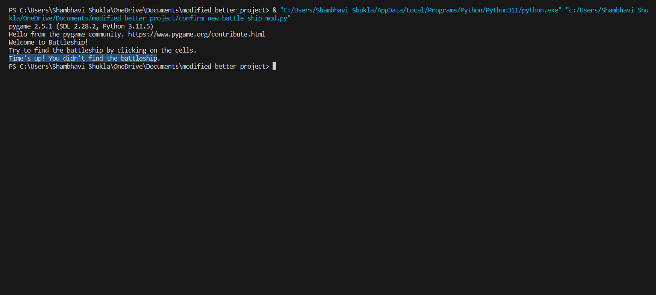
Output of loosing the game

Slide 15
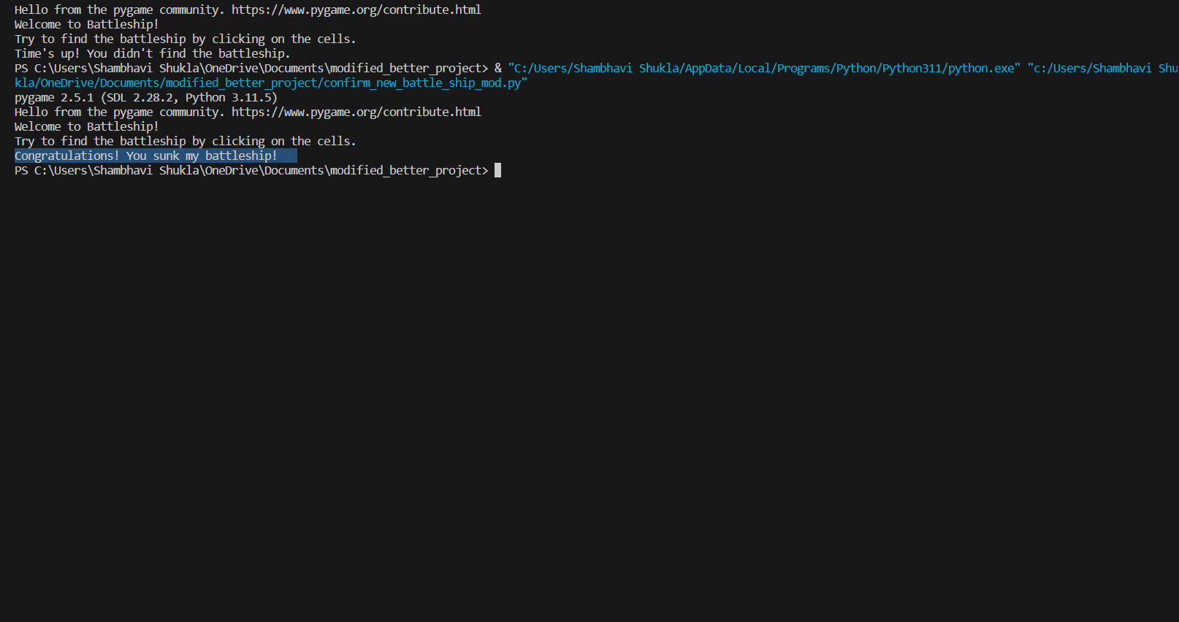
Output of finding the ship

Slide 16
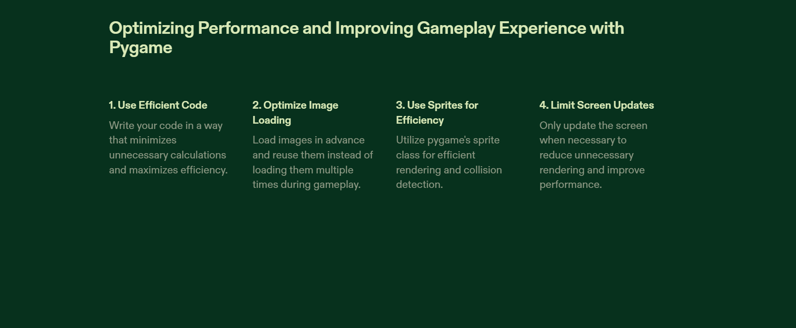

Slide 17
Conclusion
The simple graphical version of the Battleship game provides an engaging and visual way to play the classic guessing game. While this version might lack some of the complexities and features found in more advanced implementations, it offers a straightforward and accessible gameplay experience. Here are a few key takeaways and conclusions from this simple graphical version:
Simplicity
• Interaction
• Strategy and Logic
• Entertainment
• Accessibility • Building Block
• Customization Potential
• Learning Opportunity

Slide 18


