Slide 1
Show and Tell: A Neural Image Caption Generator
​Khrystyna Semkiv, Priya Shukla, Raghu Shantharam
Communication and Information Technologies

Slide 2
Contents
Introduction
Motivation
Related works
Architecture
Datasets
Evaluation Metrics and Results
Conclusion
Further Improvements

Slide 3
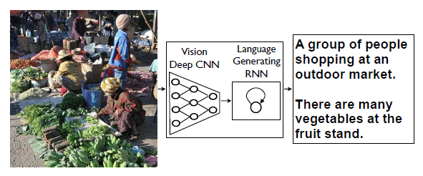
Introduction
The model used here is called Neural Image Caption (NIC)
Consists of a CNN and RNN
CNN is the encoder
RNN is the decoder that produces the final description

Slide 4
Motivation
Helps visually impaired people better understand the image
Reduced amount of wasted time
Simplify the working process

Slide 5
Related works
R. Gerber and H.-H. Nagel. Knowledge representation for the generation of quantified natural language descriptions of vehicle traffic in image sequences. In ICIP. IEEE, 1996.
G. Kulkarni, V. Premraj, S. Dhar, S. Li, Y. Choi, A. C. Berg, and T. L. Berg. Baby talk: Understanding and generating simple image descriptions. In CVPR, 2011.
R. Socher, A. Karpathy, Q. V. Le, C. Manning, and A. Y. Ng. Grounded compositional semantics for finding and describing images with sentences, 2014.
K. Cho, B. van Merrienboer, C. Gulcehre, F. Bougares, H. Schwenk, and Y. Bengio. Learning phrase representations using RNN encoder-decoder for statistical machine translation, 2014.
R. Kiros, R. Salakhutdinov, and R. S. Zemel. Unifying visual-semantic embeddings with multimodal neural language models, 2014 .
J. Mao, W. Xu, Y. Yang, J. Wang, and A. Yuille. Explain images with multimodal recurrent neural networks, 2014.

Slide 6
Related works
R. Gerber and H.-H. Nagel. Knowledge representation for the generation of quantified natural language descriptions of vehicle traffic in image sequences. In ICIP. IEEE, 1996.
G. Kulkarni, V. Premraj, S. Dhar, S. Li, Y. Choi, A. C. Berg, and T. L. Berg. Baby talk: Understanding and generating simple image descriptions. In CVPR, 2011.
R. Socher, A. Karpathy, Q. V. Le, C. Manning, and A. Y. Ng. Grounded compositional semantics for finding and describing images with sentences, 2014.
K. Cho, B. van Merrienboer, C. Gulcehre, F. Bougares, H. Schwenk, and Y. Bengio. Learning phrase representations using RNN encoder-decoder for statistical machine translation, 2014.
R. Kiros, R. Salakhutdinov, and R. S. Zemel. Unifying visual-semantic embeddings with multimodal neural language models, 2014 .
J. Mao, W. Xu, Y. Yang, J. Wang, and A. Yuille. Explain images with multimodal recurrent neural networks, 2014.

Slide 7
Related works
R. Gerber and H.-H. Nagel. Knowledge representation for the generation of quantified natural language descriptions of vehicle traffic in image sequences. In ICIP. IEEE, 1996.
G. Kulkarni, V. Premraj, S. Dhar, S. Li, Y. Choi, A. C. Berg, and T. L. Berg. Baby talk: Understanding and generating simple image descriptions. In CVPR, 2011.
R. Socher, A. Karpathy, Q. V. Le, C. Manning, and A. Y. Ng. Grounded compositional semantics for finding and describing images with sentences, 2014.
K. Cho, B. van Merrienboer, C. Gulcehre, F. Bougares, H. Schwenk, and Y. Bengio. Learning phrase representations using RNN encoder-decoder for statistical machine translation, 2014.
R. Kiros, R. Salakhutdinov, and R. S. Zemel. Unifying visual-semantic embeddings with multimodal neural language models, 2014 .
J. Mao, W. Xu, Y. Yang, J. Wang, and A. Yuille. Explain images with multimodal recurrent neural networks, 2014.

Slide 8
Related works
R. Gerber and H.-H. Nagel. Knowledge representation for the generation of quantified natural language descriptions of vehicle traffic in image sequences. In ICIP. IEEE, 1996.
G. Kulkarni, V. Premraj, S. Dhar, S. Li, Y. Choi, A. C. Berg, and T. L. Berg. Baby talk: Understanding and generating simple image descriptions. In CVPR, 2011.
R. Socher, A. Karpathy, Q. V. Le, C. Manning, and A. Y. Ng. Grounded compositional semantics for finding and describing images with sentences, 2014.
K. Cho, B. van Merrienboer, C. Gulcehre, F. Bougares, H. Schwenk, and Y. Bengio. Learning phrase representations using RNN encoder-decoder for statistical machine translation, 2014.
R. Kiros, R. Salakhutdinov, and R. S. Zemel. Unifying visual-semantic embeddings with multimodal neural language models, 2014 .
J. Mao, W. Xu, Y. Yang, J. Wang, and A. Yuille. Explain images with multimodal recurrent neural networks, 2014.

Slide 9
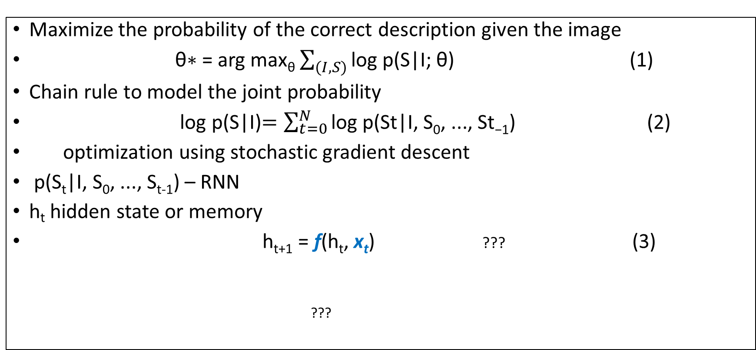
Architecture: Encoder
Maximize the probability of the correct description given the image
θ∗ = arg max_{θ} $\sum_{(I,S)}{\text{log} \text{p}\text{(}\text{S}\text{|}\text{I}\text{; }\text{θ}\text{)}}$ (1)
Chain rule to model the joint probability
log p(S|I)$=\sum_{t=0}^{N}{\text{log} \text{p}\text{(}\text{St}\text{|}\text{I}\text{, }\text{S}\text{0}\text{, ..., }\text{St}\text{−1}}$) (2)
optimization using stochastic gradient descent
p(S_{t}|I, S₀, ..., S_{t-1}) – RNN
h_{t} hidden state or memory
h_{t+1} = f(h_{t}, x_{t}) ??? (3)
???

Slide 10
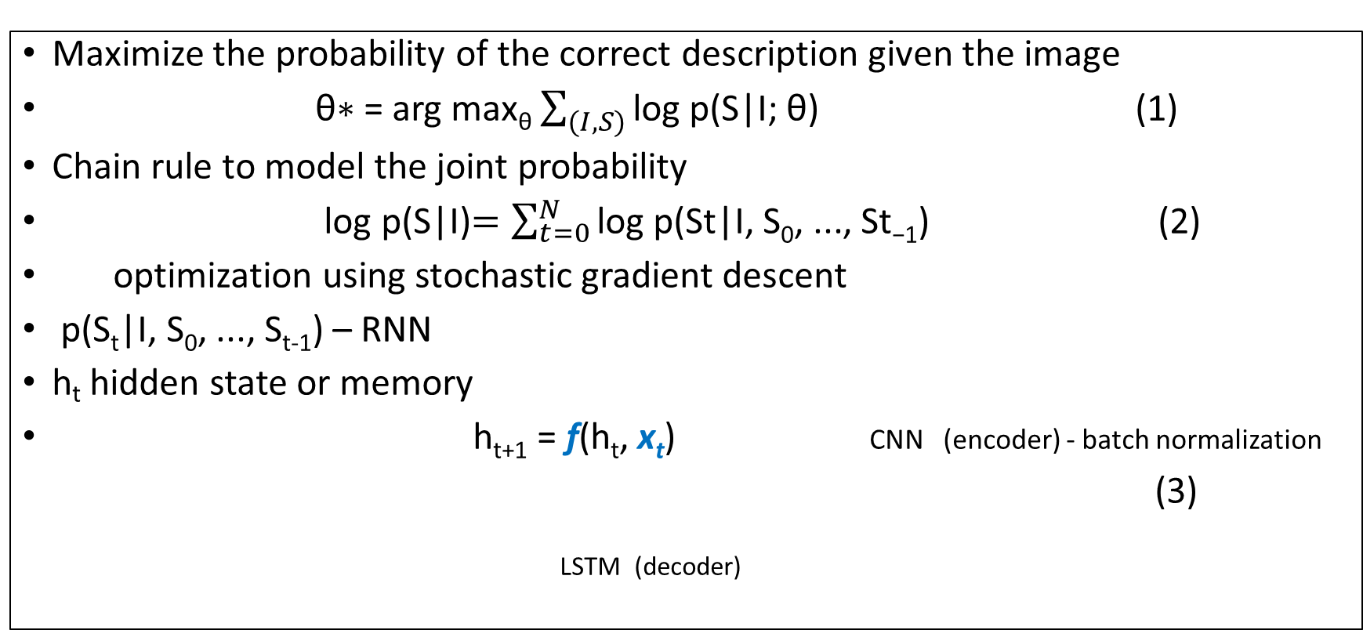
Architecture: Encoder
Maximize the probability of the correct description given the image
θ∗ = arg max_{θ} $\sum_{(I,S)}{\text{log} \text{p}\text{(}\text{S}\text{|}\text{I}\text{; }\text{θ}\text{)}}$ (1)
Chain rule to model the joint probability
log p(S|I)$=\sum_{t=0}^{N}{\text{log} \text{p}\text{(}\text{St}\text{|}\text{I}\text{, }\text{S}\text{0}\text{, ..., }\text{St}\text{−1}}$) (2)
optimization using stochastic gradient descent
p(S_{t}|I, S₀, ..., S_{t-1}) – RNN
h_{t} hidden state or memory
h_{t+1} = f(h_{t}, x_{t}) CNN (encoder) - batch normalization
(3)
LSTM (decoder)

Slide 11
Architecture: Decoder
i_{t} = σ(W_{xt}x_{t} + W_{im}m_{t−1}) (4)
f_{t} = σ(W_{fx}x_{t} + W_{fm}m_{t−1}) (5)
o_{t} = σ(W_{ox}x_{t} + W_{om}m_{t−1}) (6)
c_{t} = f_{t} ꙩ c_{t−1} + i_{t} ꙩ h(W_{cx}x_{t} + W_{cm}m_{t−1}) (7)
m_{t} = o_{t} ꙩ c_{t} (8)
p_{t+1} = Softmax(m_{t}) (9)
ꙩ represents multiplication with gate value
W matrices are trained parameters
LSTM(Long term short memory)

Slide 12
Architecture
x₋₁ = CNN(I) (10)
x_{t} = W_{e}S_{t}, t ∈ {0 . . . N − 1} (11)
p_{t+1} = LSTM(xt), t ∈ {0 . . . N − 1} (12)

Slide 13
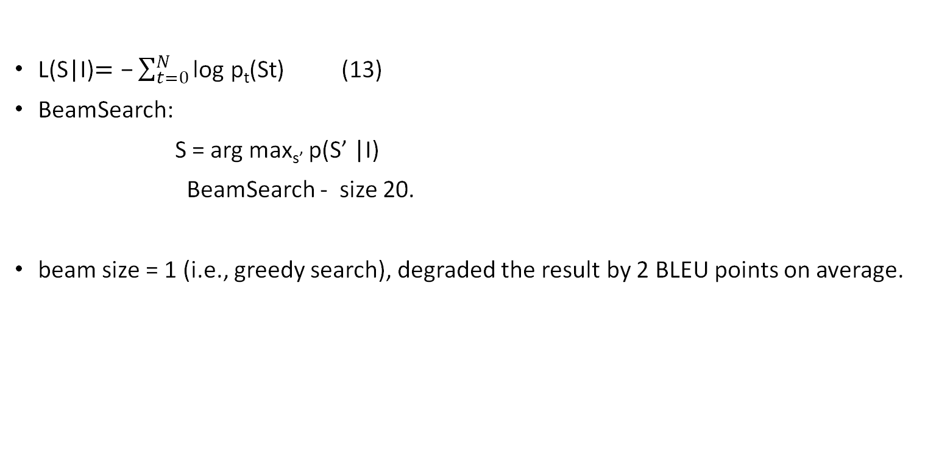
Architecture
L(S|I)$=\text{−}\sum_{t=0}^{N}{\text{log} \text{p}\text{t}\text{(}\text{St}}$) (13)
BeamSearch:
S = arg max_{s’} p(S’ |I)
BeamSearch - size 20.
beam size = 1 (i.e., greedy search), degraded the result by 2 BLEU points on average.

Slide 14
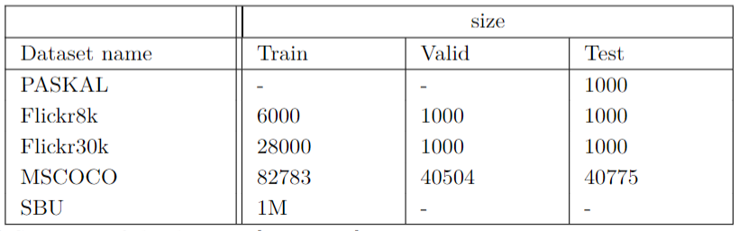
Datasets
Descriptions are in English;
There are 5 descriptions to every image in all datasets except SBU (1 description);
SBU dataset is the only one that has captions (labels) as the ground truth, but not the sentences generated by the human;

Slide 15
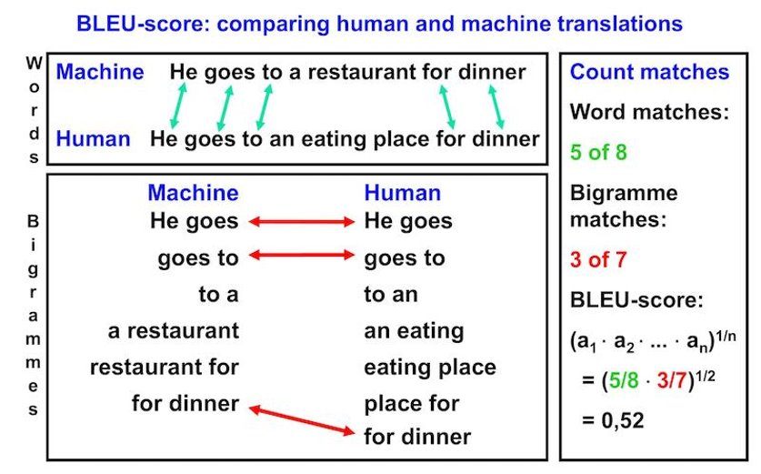
Metrics: BLEU
Advantages:
Easy to understand;
Inexpensive method;
Can be used with more than one ground-truth;
Does not depend on the language;
Disadvantages:
Does not take in account intelligibility of grammatical correctness;

Slide 16
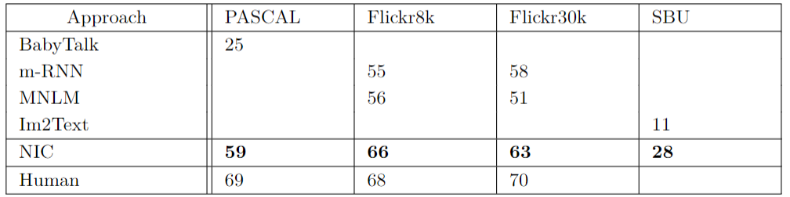
Results: BLEU

Slide 17
Metrics: Ranking
Proxy task of ranking a set of available descriptions .
Known ranking metrics like recall@k.
recall@k(high is good), med r(low is good)
Unsatisfactory :
-the number of possible sentences grows exponentially with the size of the dictionary
-the likelihood that a predefined sentence will fit a new image will go down
Computational complexity

Slide 18
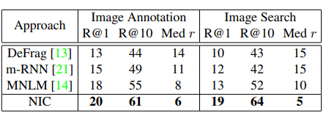
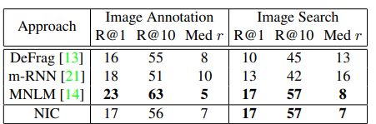
Result: Ranking
Recall@k and median rank on Flickr8k
Recall@k and median rank on Flickr30k.

Slide 19
Metrics: Human Evaluation
Most reliable, but also a time-consuming experiment.
Amazon Mechanical Turk experiment was set up.
Image description was rated by 2 raters.
Percentage of the agreement was approximately 65%.
We can involve more raters to improve efficiency.

Slide 20
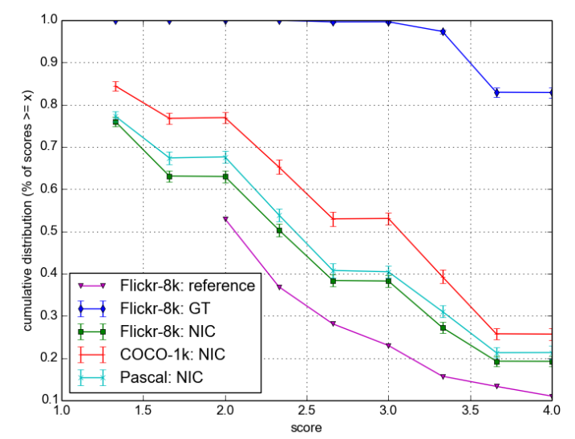
Results: Human Evaluation
NIC predictions compared with reference and GT.

Slide 21
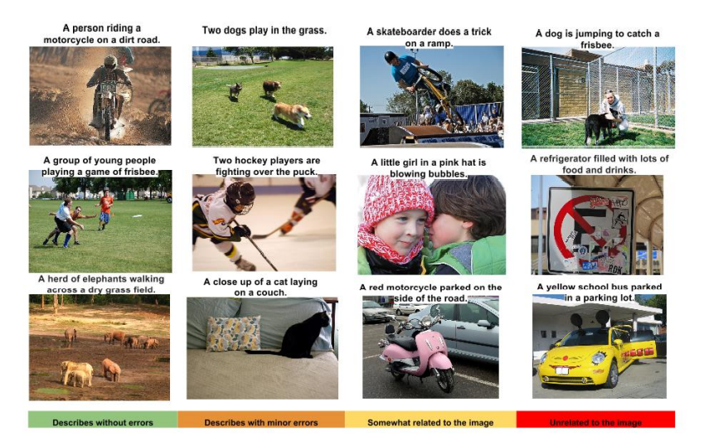
Evaluation results by human rating

Slide 22
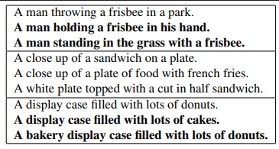
Generation Diversity Discussion
Sentences generated are novel, diverse, and precise.
Table shows the N-best list extracted using the NIC model.
Top 15 generated sentences were analyzed.

Slide 23
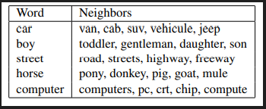
Analysis of Embeddings
An image can be described better using word embeddings.
Word embedding vectors are used.
Independent of the size of the dictionary.
Can be trained along with the dictionary.
Additional subset of words can be added for a better description.

Slide 24
Conclusion
NIC is used to generate a reasonable description in English.
NIC consists of a CNN that encodes the image and an RNN that generates the sentence.
NIC is more accurate and performs better than other techniques.
Performance is said to increase with larger data sets.

Slide 25
Further Improvements
Using our own dataset;
Since we use smaller dataset we can change hyperparameters and try different regularization techniques such as augmentation;
Borrow approach of LSTM part from another papers;
Novel descriptions can be added into vocabulary of reference sentences;
Convert the text description into speech;
Human Evaluation can be done with more people (7-10);
Check how the model works using unsupervised data;

Slide 26

Questions

