Slide 1
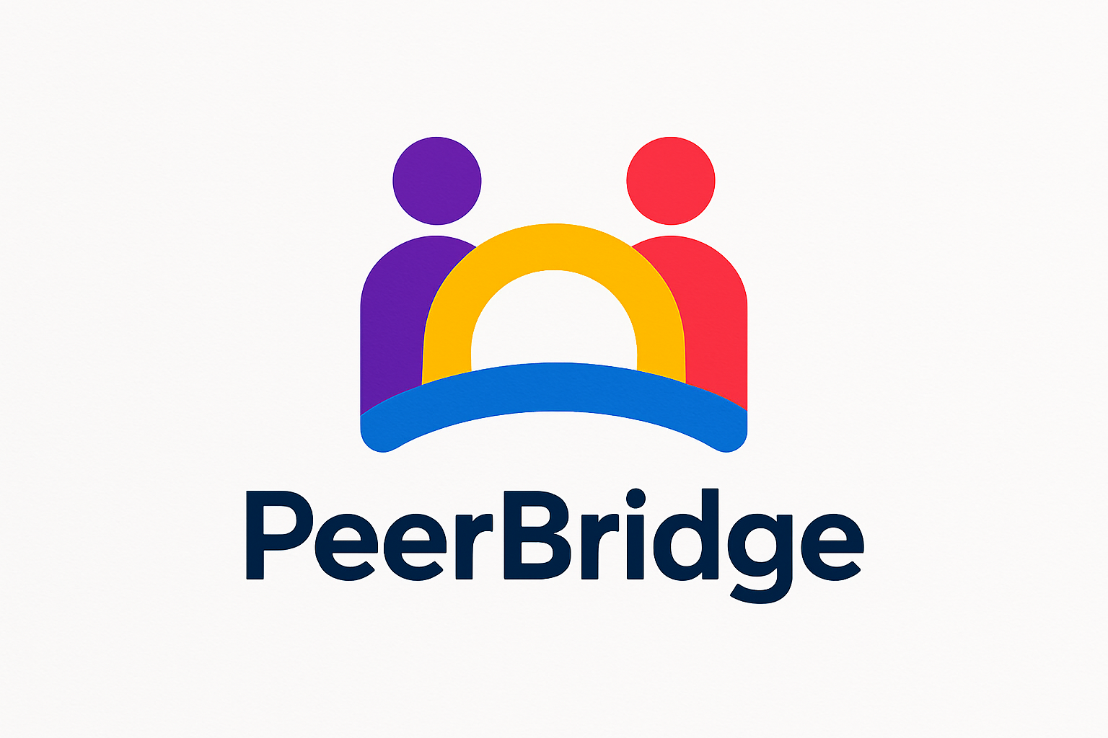
Team : NeuraNexus Project: PeerBridge

Slide 2
Theme: Education and Learning
Problem: In college, it’s not always easy to get help when you’re stuck. Group chats are messy, forums are slow, and sometimes you just need someone from your own stream or semester who actually gets what you’re struggling with. But finding the right person—someone who’s available, willing to help, and knows the subject—is harder than it should be. And without any system to keep things fair, people either get ignored or spammed.

Slide 3
Solution: PeerBridge is a platform built to fix that. It connects students with each other based on stream, semester, subjects, and even preferred language. You can see who’s online, ask for help, or offer support through one-on-one video calls. And to keep things fair, there’s a credit system: help someone, earn credits; spam or ignore, lose them. It’s like having a smart filter for your academic network—so you’re always matched with the right peers. Plus, there’s gamification: badges, leaderboards, and rewards to keep things fun and motivating. PeerBridge isn’t just about solving doubts—it’s about building a culture of collaboration, discipline, and growth across campuses. And it fits right into India’s vision for digital learning and skill development.

Slide 4
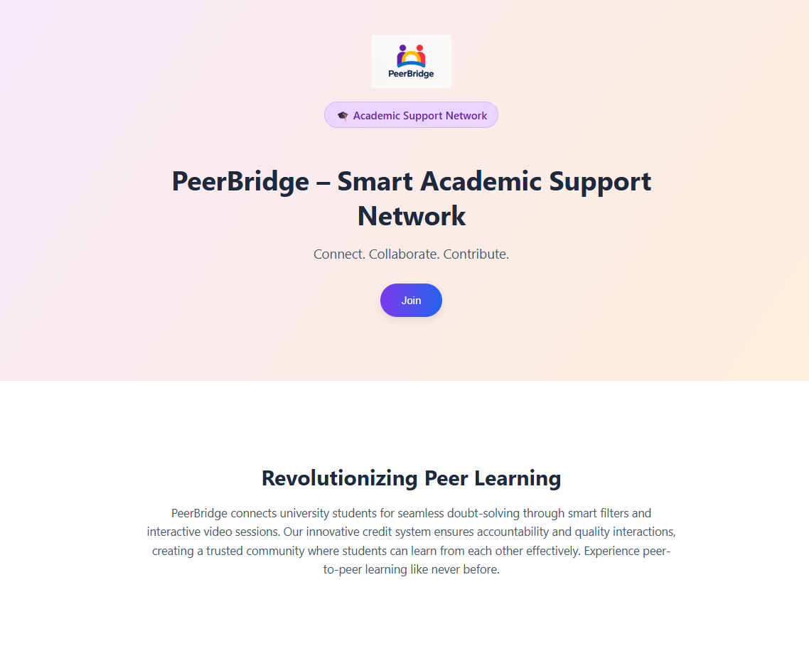
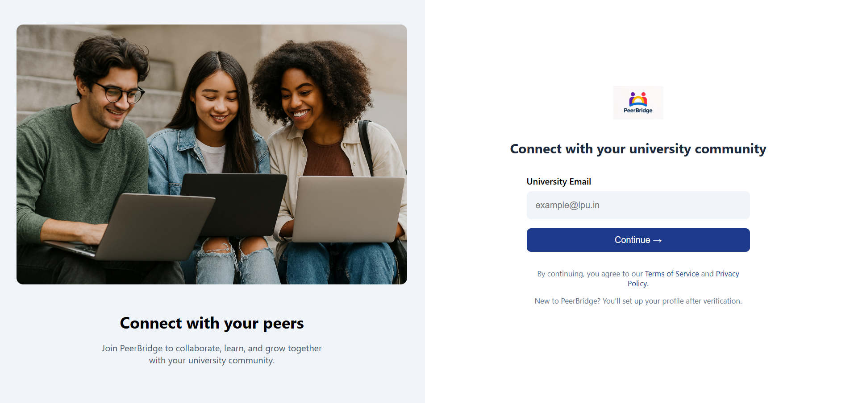
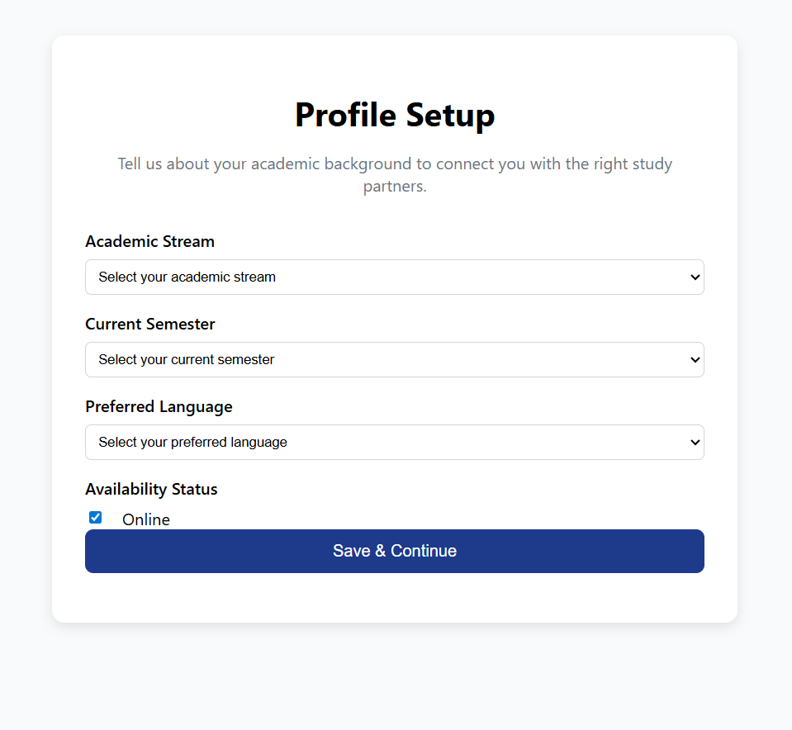
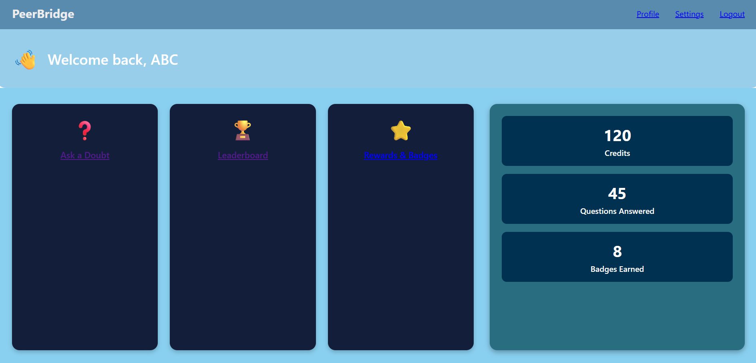
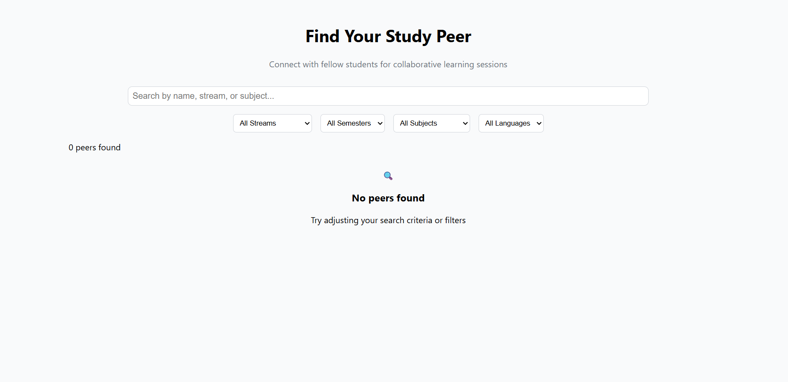
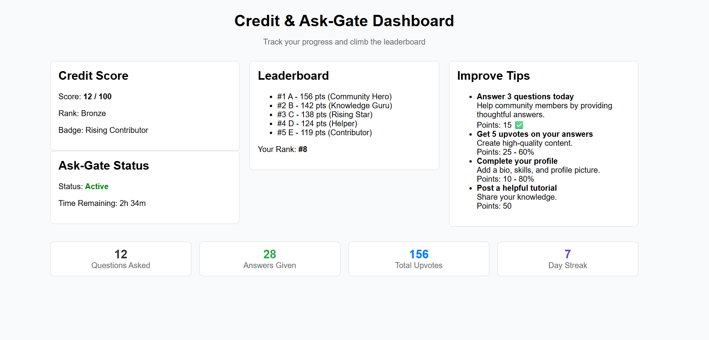

Slide 5
Pitch: In today’s fast-paced academic world, students crave more than just lectures—they seek connection, collaboration, and community. PeerBridge is the solution: a student-driven platform that transforms how university peers interact, learn, and grow together. Built for students, by students, PeerBridge bridges the gap between isolated study and collaborative success. Whether you're looking to join a project team, get peer feedback, or earn credits through meaningful contributions, PeerBridge makes it seamless. Why PeerBridge? Because learning thrives in community. PeerBridge empowers students to teach, learn, and build together—unlocking real-world impact through peer-to-peer collaboration. From hackathons to homework help, PeerBridge is your launchpad for academic synergy.

Slide 6
Built with: HTML/CSS/JS frontend GitHub repo: shukla7721/peerbridge_mvp: Smart academic support network for peer learning and collaboration.
Team – Amar Mani Shukla, Amit Kumar, Arvind Kumar

