Slide 1

UIET CSJMUNIVERSITY,KANPUR
COMPUTER SCIENCE & ENGINEERING DEPARTMENT
CONNECTING THE DOTS BETWEEN NEWS ARTICLES
Guide :
Dr. Renu Jain
Presents :
SAURABH SHUKLA
CSJMA16001390053
1

Slide 2
INDEX :
FIB PROBLEM 3
WHAT IS OUR PROBLEM? 6
APPROACH 12
WORK FLOW 13
WHAT MAKES THE STORY GOOD? 15
WHY DID I SELECT THIS TOPIC? 17
CHAIN COMPUTATION 20
DIJKSTRA’S ALGORITHM 30
RESULTS 32
FUTURE WORK 33
REFERENCES 34
2

Slide 3
FIB(FILL IN BLANKS) PROBLEM :
Given a sentence with a blank.
We need to fill this blank with an apropriate word.
For example:
1.In this COVID-19 pandemic , to be safe we should wash our hands ……………
a) frequently
b) after 2 hour
c) after 1 day
d) shouldn’t wash
3
SAURABH SHUKLA(CSE,053)

Slide 4
CONT.
For example:
2.I enjoyed ………… the film but I didn’t like the ending.
a) some of
b) most of
c) most
d) some
For example:
3.I have no horse ………… I can lend you.
a) who
b) that
c) whose
d) which
4
SAURABH SHUKLA(CSE,053)

Slide 5
CONT.
Can we say ? :
After filling the most suitable word ,A meanigful sentences can be formed.
A wrong selection of word can differ the meaning of sentences.
5
SAURABH SHUKLA(CSE,053)

Slide 6
OUR PROBLEM :
SOURCE
?
TARGET
6

Slide 7
CONT.
Similarly we can say :
Like FIB problem we have to fill these blanks/question mark with the articles.
so that the story or the news article make sense when we will read.
Here question mark can be filled with these given(below) articles.
A1 ,A2 ,A3 ,…………………… ,An
Note :
articles can be type of sports,politics, entertainment.
7

Slide 8
CONT.
So our aim is to develop a coherent chain linking the source and target documents into a meaningful story
SOURCE
Ai
Aj
TARGET
Here Ai,Aj are intermediate articles.
8
SAURABH SHUKLA(CSE,053)

Slide 9
CONT.
For example :
1.it can discover the hidden chain between JNU FEE HIKE PROTEST and CAA,NRC,NPR protest.
2. it can discover the chain between Jessica lal murder case and Nitish katara murder case.
Latest exapmle:
3.It can discover the chain between COVID-19 pandemic and economic crisis(impact).
9
SAURABH SHUKLA(CSE,053)

Slide 10
EXAMPLE :
Art_x
?
Art_y
u,v,w
Linking articles index :
x,u,v,w,y
Link Topics :
Art_x_ COVID-19 pandemic
Art_u_Lockdown in india
Art_v_demand decreases
Art_w_manufacturing closed due to lockdown
Art_y_economy crisis(impact)
10

Slide 11
EXAMPLE :
Art_123
?
Art_111
103,105,113,
Linking articles index :
123,103,105,113,111
Link Topics :
Art_123_68% turnout in Gujarat Phase-I
Art_103_Gujarat final phase poll tomorrow
Art_105_Development won in Gujarat
Art_113_BJP victory celebrated
Art_111_Modi elected leader of Gujarat BJP
11

Slide 12
Our approach :
INPUT :
PICK TWO ARTICLES
(START,TARGET)
OUTPUT :
BRIDGE THE GAP
With a smooth chain of article
Finally our game plan is to find out a good chain/a relevant chain
12

Slide 13
Work flow :
STEP I : Chain Computation:
For a similarity measure between documents we use the Bhattacharya’s distance.
After generation of chain we will have to do its evaluation
Bhattacharyya’s Distance
DB = - ln (BC(p,q))
where BC(p,q) = x € X Σ (p(x).q(x))^{1/2} is the Bhattacharyya coefficient
source:http://en.wikipedia.org/wiki/Bhattacharyya_distance
13

Slide 14
CONT.
We evaluate the characteristics of a good chain by its coherence
We have different methods to find the coherence of a chain.
STEP 2 : Chain Evaluation :
Now that we have a chain, we evaluate our results using coherence of the output chain as a parameter.
• Coherence1(d1, …,dn) = i=1…n-1min Σw 1(w € di ∩ di+1)
This is straight from the below mentioned paper of Dafna Shahaf.
Source(ref) : Dafna Shahaf and Prof. Carlos Guestrin : Connecting the dots between news articles. ACM SIGKDD Conference on Knowledge Discovery and Data Mining (KDD) 2010
Finally, we compare different combinations of weight-assignment methods and shortest path algorithms to see which combination gives us a better coherence.
14

Slide 15
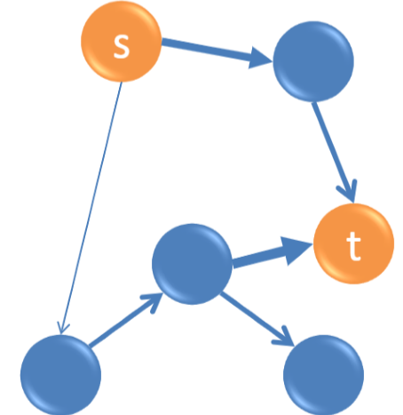
WHAT MAKES THE STORY GOOD?
A good chain makes the story good.
What is a good chain?
A good chain should have these attributes
Every transition is strong
No jitteriness(back - and - forth)
Short(5-6 articles)
15
Source:google images

Slide 16
CONT.
Art_x
?
Art_y
u,v,w
Linking articles index :
x,u,v,w,y
Link Topics :
Art_x_ COVID-19 pandemic
Art_u_Lockdown in india
Art_v_demand decreases
Art_w_manufacturing closed due to lockdown
Art_y_economy crisis(impact)
16

Slide 17
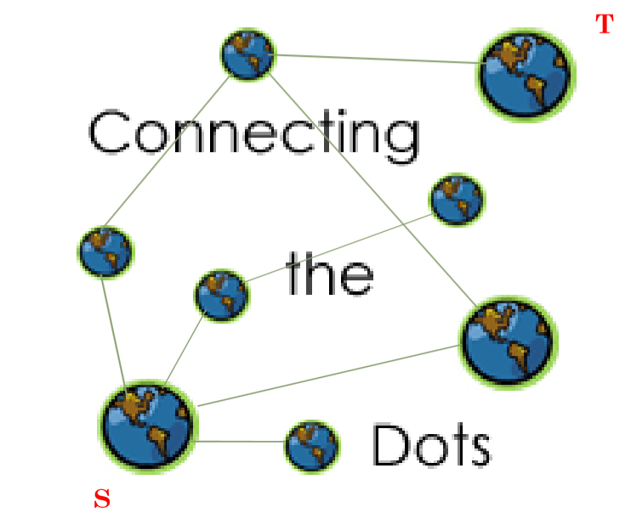
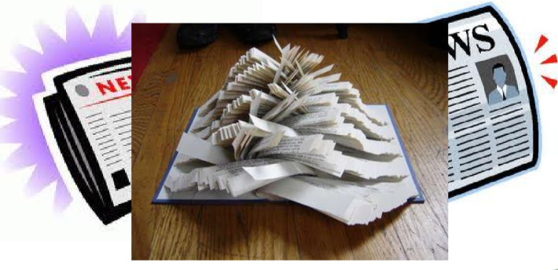
Why did I select this topic? :
CONNECTING THE DOTS BETWEEN NEWS ARTICLES
Source:google images
17

Slide 18
CONT.
Why did I select this topic :
Getting information off the internet is like taking a drink from a fire hydrant.
-Mitchell Kapor
News browsing is one of the primary uses of the internet
Information Overload is everywhere so these days we are facing this problem.
The problem is for entire sectors, from scientists to intelligence analysts and web use
18

Slide 19
CONT.
all of whom are constantly struggling to keep up with the larger and larger amounts of content published everyday.
With this much data, it is often easy to miss the big picture
Tackling information overload
Navigate between topics
Searching for relevant news is difficult
So This project will help to give you basic idea to tackle above problems.
We have problems of :
19

Slide 20
WORK FLOW(CHAIN COMPUTATION) :
NEWS ARTICLE FROM THE HINDU
SPLIT INTO WORDS
STEMMING
BHATTACHARYA’S DISTANCE
FREQUENCY COUNTING
REMOVE STOP WORDS
DIJKSTRA’S ALGORITHM
20

Slide 21
Example :
NEWS ARTICLE FROM THE HINDU
osama bin laden, leader of terror outfit al- qaeda and alleged mastermind of the 9/11 attacks in new york city, was killed in pakistan in a special forces operation by the united states, u.s. president barack obama announced on sunday night.
In a statement issued shortly after 11.30 p.m., mr. obama confirmed that osama, high on the list of u.s. authorities most wanted men, had been killed after a “fire-fight” in abbottabad, a military cantonment town not far from islamabad. Len=100
21

Slide 22
CONT.
NEWS ARTICLE FROM THE HINDU
SPLIT INTO WORDS
['', 'osama', 'bin', 'laden', '', 'leader', 'of', 'terror', 'outfit', 'al-', 'qaeda', 'and', 'alleged', 'mastermind', 'of', 'the', '9/11', 'attacks', 'in', 'new', 'york', 'city', '', 'was', 'killed', 'in', 'pakistan', 'in', 'a', 'special', 'forces', 'operation', 'by', 'the', 'united', 'states', '', 'u', 's', '', 'president', 'barack', 'obama', 'announced', 'on', 'sunday', 'night', '', '', 'in', 'a', 'statement', 'issued', 'shortly', 'after', '11', '30', 'p', 'm', '', '', 'mr', '', 'obama', 'confirmed', 'that', 'osama', '', 'high', 'on', 'the', 'list', 'of', 'u', 's', '', 'authorities', '', 'most', 'wanted', 'men', '', 'had', 'been', 'killed', 'after', 'a', '“fire-fight”', 'in', 'abbottabad', '', 'a', 'military', 'cantonment', 'town', 'not', 'far', 'from', 'islamabad', '']
Len=100
22

Slide 23
CONT.
NEWS ARTICLE FROM THE HINDU
SPLIT INTO WORDS
STEMMING
['', 'osama', 'bin', 'laden', '', 'leader', 'of', 'terror', 'outfit', 'al-', 'qaeda', 'and', 'alleg', 'mastermind', 'of', 'the', '9/11', 'attack', 'in', 'new', 'york', 'citi', '', 'wa', 'kill', 'in', 'pakistan', 'in', 'a', 'special', 'forc', 'oper', 'by', 'the', 'unit', 'state', '', 'u', 's', '', 'presid', 'barack', 'obama', 'announc', 'on', 'sunday', 'night', '', '', 'in', 'a', 'statement', 'issu', 'shortli', 'after', '11', '30', 'p', 'm', '', '', 'mr', '', 'obama', 'confirm', 'that', 'osama', '', 'high', 'on', 'the', 'list', 'of', 'u', 's', '', 'author', '', 'most', 'want', 'men', '', 'had', 'been', 'kill', 'after', 'a', '“fire-fight”', 'in', 'abbottabad', '', 'a', 'militari', 'canton', 'town', 'not', 'far', 'from', 'islamabad', '']
Len=44
23

Slide 24
CONT.
NEWS ARTICLE FROM THE HINDU
SPLIT INTO WORDS
STEMMING
REMOVE STOP WORDS
['osama', 'bin', 'laden', 'leader', 'terror', 'outfit', 'al-', 'qaeda', 'alleg', 'mastermind', '9/11', 'attack', 'york', 'citi', 'wa', 'kill', 'pakistan', 'special', 'forc', 'oper', 'unit', 'presid', 'barack', 'obama', 'announc', 'sunday', 'night', 'statement', 'issu', 'shortli', '11', '30', 'obama', 'confirm', 'osama', 'list', 'author', 'kill', '“fire-fight”', 'abbottabad', 'militari', 'canton', 'town', 'islamabad']
Len=44
24

Slide 25
CONT.
NEWS ARTICLE FROM THE HINDU
SPLIT INTO WORDS
STEMMING
FREQUENCY COUNTING
REMOVE STOP WORDS
[['bin', 1], ['laden', 1], ['leader', 1], ['terror', 1], ['outfit', 1], ['al-', 1], ['qaeda', 1], ['alleg', 1], ['mastermind', 1], ['9/11', 1], ['attack', 1], ['york', 1], ['citi', 1], ['wa', 1], ['pakistan', 1], ['special', 1], ['forc', 1], ['oper', 1], ['unit', 1], ['presid', 1], ['barack', 1], ['announc', 1], ['sunday', 1], ['night', 1], ['statement', 1], ['issu', 1], ['shortli', 1], ['11', 1], ['30', 1], ['confirm', 1], ['list', 1], ['author', 1], ['“fire-fight”', 1], ['abbottabad', 1], ['militari', 1], ['canton', 1], ['town', 1], ['islamabad', 1], ['osama', 2], ['kill', 2], ['obama', 2]]
Len=44
25

Slide 26
CONT.
NEWS ARTICLE FROM THE HINDU
SPLIT INTO WORDS
STEMMING
BHATTACHARYA’S DISTANCE
FREQUENCY COUNTING
REMOVE STOP WORDS
Bhattacharyya’s Distance
DB = - ln (BC(p,q))
where BC(p,q) = x € X Σ (p(x).q(x))^{1/2} is the Bhattacharyya coefficient
source:http://en.wikipedia.org/wiki/Bhattacharyya_distance
26

Slide 27
CONT.
Bhattacharyya’s Distance
DB = - ln (BC(p,q))
where BC(p,q) = x € X Σ (p(x).q(x))^{1/2} is the Bhattacharyya coefficient
We have used x as the common words between the two articles.
p(x) is the number of occurrences of x in document p divided by total number of words in document p.
q(x) is used similarly for document q.
Bhattacharya’s distance is closer to 0 for more similar articles
farther than 0 for dissimilar articles due to the –ve logarithm taken of the Bhattacharya’s coefficient.
27

Slide 28
CONT.
NEWS ARTICLE FROM THE HINDU
SPLIT INTO WORDS
STEMMING
BHATTACHARYA’S DISTANCE
FREQUENCY COUNTING
REMOVE STOP WORDS
DIJKSTRA’S ALGORITHM
28

Slide 29
DISTANCE
DISTANCE
MATRIX
DIJKSTRA’S ALGORITHM
A
B
C
D
E
A
0 | 6 | 0 | 1 | 0
6 | 0 | 5 | 2 | 2
0 | 5 | 0 | 0 | 5
1 | 2 | 0 | 0 | 1
0 | 2 | 5 | 1 | 0
B
C
D
E
29

Slide 30
DIJKSTRA’S ALGORITHM
A
B
C
D
E
VERTEX | SHORTEST DISTANCE FROM A | PREVIOUS VERTEX
A | 0
B | 3 | D
C | 7 | E
D | 1 | A
E | 2 | D
6
A
A
B
5
0 | 6 | 0 | 1 | 0
6 | 0 | 5 | 2 | 2
0 | 5 | 0 | 0 | 5
1 | 2 | 0 | 0 | 1
0 | 2 | 5 | 1 | 0
B
1
2
C
C
2
5
D
D
E
E
1

Slide 31
NOTE:
Here we can use CosineSimilarity also as a weight instead of distance as a weight.
With cosine similarity as weight we can use same algorithm Dijkstra,A* for chain computation
Then we can compare the both results
31

Slide 32
Results :
Results on the same source and target article for different combination of methods.
Weight Algorithm Chain(linking articles index)
Bhatt. Dist Dijkstra 345-343-330-349-342
Bhatt. Dist A* -------------------------------
CosineSimilarity Dijkstra -------------------------------
CosineSimilarity A* -------------------------------
32

Slide 33
Future Work
We used here news articles .we can use different articles other than news articles may help in important scientific discoveries.
With millions of articles are being produced daily worldwide, this process needs to be implemented onto a large scale.
33

Slide 34
References:
[1] Dafna Shahaf and Prof. Carlos Guestrin : Connecting the dots between news articles. ACM SIGKDD Conference on Knowledge Discovery and Data Mining (KDD) 2010.
[2] http://en.wikipedia.org/wiki/Bhattacharyya_distance
[3] Dafna Shahaf , Prof. Carlos Guestrin and Eric Horvitz : Trains of thought-Generating information maps. International World Wide Web Conference (WWW), 2012.
34

Slide 35
In this COVID-19 pandemic,
STAY AT HOME,STAY SAFE,STAY HAPPY.
Thank You!
35

