Slide 1
MPMC PROJECT
Highway Vehicle Speed Detector

Slide 2
AGENDA
Introduction​
Component Required
​Circuit Diagram
Code Explanation
​Conclusion

Slide 3
INTRODUCTION
Introducing a breakthrough in highway safety: the Highway Vehicle Speed Checker Circuit powered by the versatile 8051 Microcontroller. This project focuses on an innovative system designed to monitor and regulate vehicle speeds effectively. By employing advanced sensors and harnessing the precision of the 8051 Microcontroller, this circuit ensures accurate speed detection. Join us as we explore the components, operational principles, and the pivotal role this technology plays in enforcing speed limits. Witness how this project contributes significantly to enhancing road safety by controlling vehicle speeds on highways

Slide 4
COMPONENTS REQUIRED
8051 Microcontroller
IR Sensors
LCD Display
Potentiometer
Jumper Wires
Breadboard
Voltage Supply

Slide 5
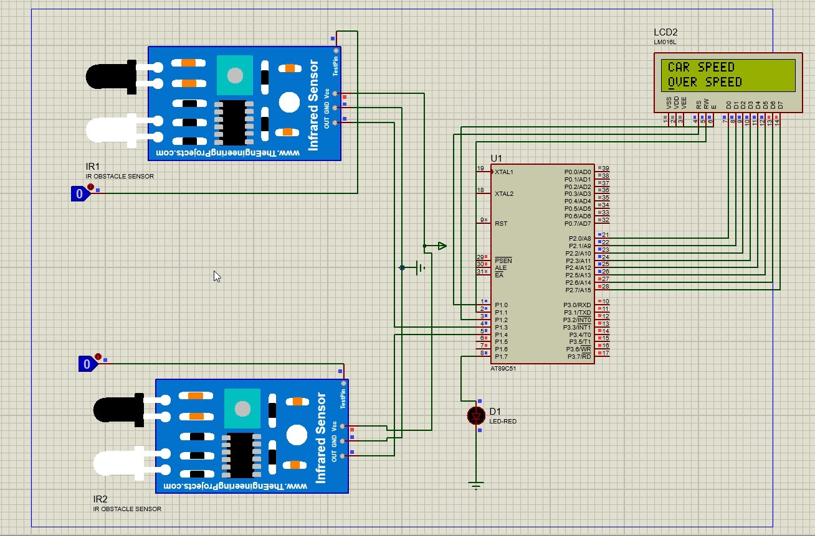
CIRCUIT DIAGRAM

Slide 6
SPEED HAS NEVER KILLED ANYONE. SUDDENLY BECOMING STATIONARY, THAT'S WHAT GETS YOU.
“
,,
Jeremy Clarkson

Slide 7
AREA OF FOCUS
Applications
Road Safety Enhancement
Traffic Management
Data Collection and Analysis

Slide 8
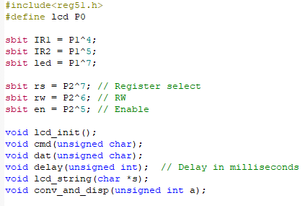

EMBEDDED C CODE
CODE EXPLANATION

Slide 9

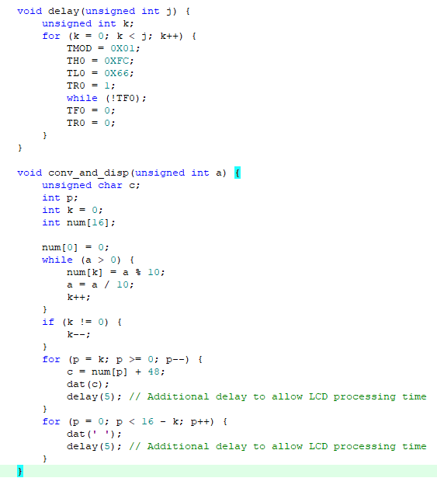
EMBEDDED C CODE
CODE EXPLANATION

Slide 10
SUMMARY
The Highway Vehicle Speed Detector utilizing the 8051 microcontroller successfully delivers an efficient system for monitoring vehicle speeds. By integrating sensor data and microcontroller processing, it accurately measures vehicle speeds, offering a cost-effective solution for traffic management and safety enforcement on highways. This project showcases the potential of microcontroller technology in real-time speed detection applications, contributing to enhanced road safety and traffic regulation.

Slide 11
THANK YOU
Alkesh Shukla (S20210020252)

