Slide 1

CODE ARENA
Automated Lab-Test Evaluation Platform
Eliminating manual bias from computer-based examinations
PROJECT TEAM
TS
Tejveer Singh
AS
Akashdeep Singh
UID: 24BCA10210
UID: 24BCA10222
AR
Aditya Rangta
DG
Danish Gupta
UID: 24BCA10158
UID: 24BCA10138
BCA | Teacher : Mr. Arvinder Singh | Chandigarh University

Slide 2



The Problem: Manual Checking
In most computer-based lab tests, a teacher walks around and manually inspects each student's screen under severe time pressure. This process directly shapes learning outcomes:
THE RESULT
ZERO
Time-Consuming
One examiner cannot thoroughly test every student's code within a short lab period.
marks — even when the task was completed correctly
Human Error & Bias
Quick visual checks miss working logic, leading to inconsistent, subjective grading.
This directly discourages honest effort and erodes trust in the evaluation process.
No Transparency
Students get a mark with no test-case breakdown or way to verify how it was decided.

Slide 3
A Real Lab-Test Scenario
This project began with a second-semester lab test experienced firsthand by our team — a clear example of how manual checking breaks down under real classroom conditions.
1
The Test Begins
2
The Rush to Check
Students start coding tasks on individual systems during a fixed, limited lab period.
With one teacher and many systems, each submission gets only a few seconds of attention.
3
Correct Work Overlooked
4
Unfair Zero Marks
Working programs are glanced over quickly; subtle correct logic is missed in the rush.
Despite completing the task, several students — including me— received zero.

Slide 4










Our Solution: Code Arena
A secure web platform for running the exam — students code in a monitored editor, and every submission is ready for the teacher to review.
FOR TEACHERS
FOR STUDENTS
Create and validate a secure exam room with a custom time limit
Enter a 6-digit code to join the exact room
Monitor tab-switches and copy-paste attempts in real time during the exam
Write and run code in a live editor for the actual test
Add or paste questions into the room, visible instantly to students
Instant compile-and-run feedback while solving each problem
Review, grade, and download every student’s file — individually or as one zip — whenever you want
No stress about grading logic — just write real, working code

Slide 5
THE WORKFLOW
How Code Arena Works
From a secure room to a graded review — a simple flow for teachers and students alike.

Slide 6
The Basic Workflow
From room creation to results — a simple four-step flow, shared by every teacher and student session.
1
Room Created & Secured
2
Student Joins Securely
Teacher sets up a secure exam room with a custom time limit and adds the questions.
Student enters the 6-digit code to access the exact room and its editor.
3
Live Coding, Monitored
4
Auto-Submit & Handover
Student writes and runs code on one page; tab-switches and copy-paste attempts are logged in real time.
When time is up, work is auto-submitted and every file lands with the teacher, ready to review.

Slide 7





Teacher Workflow
Behind the Examiner Portal — from room setup to reviewing every submission.
TEACHER WORKFLOW
Create & Validate Rooms
Set up a secure exam room with a custom time limit in a few clicks.
Add Questions
Paste or write problems into the room, visible instantly to students.
Monitor for Integrity
Tab-switches and copy-paste attempts during the exam are logged and visible in real time.
Review & Download
After auto-submission, preview any student's file, or download all files for a room in one zip.

Slide 8





Student Workflow
A Single, Focused Page — everything a student needs, from code to submission.
STUDENT WORKFLOW
Enter the Room Code
Type the 6-digit code shared by the teacher to join instantly.
View Question & Editor Together
The problem statement and code editor sit on one page — no tab-switching needed.
Write, Run & Test
Compile and run code with immediate feedback as you work.
Auto-Submit at Time-Up
When the teacher's timer ends, your latest code is submitted automatically — no manual step needed.

Slide 9
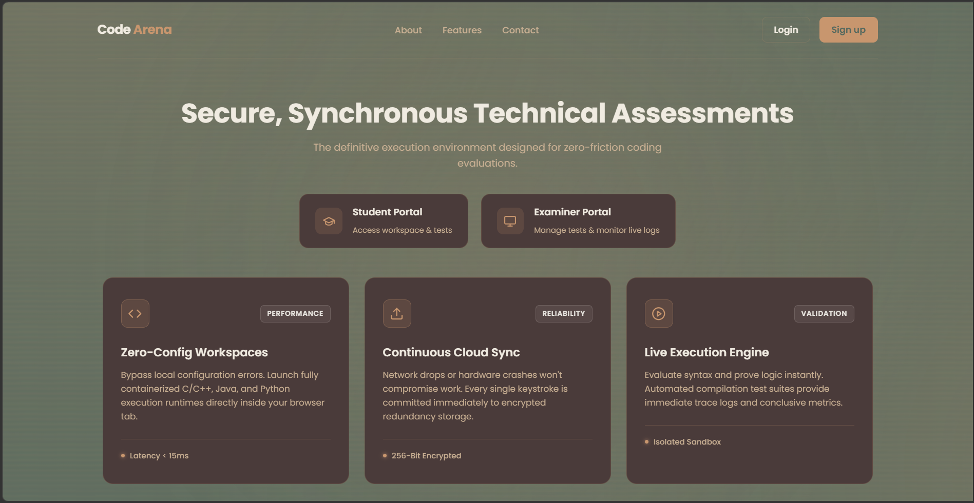

See It Live: Landing Page
A first look at the Code Arena landing page.
Insert Landing Page Screenshot Here
Replace this placeholder with Insert → Picture, then delete this note.

Slide 10


Project Overview
Code Arena is a web-based platform built for academic lab tests. It replaces the rushed, walk-around checking of a live exam with a secure digital room — recording every submission and every integrity flag so the teacher can review and grade properly, without the time pressure.
OBJECTIVES
TECH STACK
Eliminate manual bias from lab-test evaluation
Next.js — Frontend
Give every student a secure, distraction-free coding environment
Node.js — Backend API
Give students instant, actionable feedback
PostgreSQL — Database
Redis — Caching & Queues
Scale smoothly to large classrooms and batches
Socket.io — Live Exam Rooms
Judge0 — Code Execution Engine
Landing page and examiner portal already built — backend architecture in active development.

Slide 11

THANK YOU
For your time and attention — questions & discussion welcome.
Tejveer Singh · Akashdeep Singh · Aditya Rangta · Danish Gupta
BCA | Teacher : Mr. Arvinder Singh | Chandigarh University

